Slide 1
BITS PILANI | WILP | M.Tech Cloud Computing | CCZG628T Dissertation
−30%
A Cost-Aware Adaptive Retrieval:
A Partially Observable Markov
Decision Process Framework
for Agentic RAG on AWS
cost vs fixed 3-hop
= F1
0.668 vs 0.668
350/350
M. B. Sri Pranavya (ID 2024MT03517)
Supervisor: R. Thulasi Priya, Ford Motor Private Limited, Chennai
Additional Examiner: Dr. M. J. Balachandran
Faculty Mentor: SaiKishor Jangiti
live AWS checks
Final Semester Viva | November 2026

Slide 2
Agenda
What this presentation covers
01
Problem and objectives
07
Results and statistics
02
Literature and positioning
08
Ablation, sensitivity, adaptivity
03
POMDP formulation
09
Live validation evidence
04
System architecture on AWS
10
SoK comparison, limitations
05
Safeguards and engineering
11
Conclusions and future work
06
Experimental setup
A Cost-Aware Adaptive Retrieval: POMDP Framework for Agentic RAG on AWS | M. B. Sri Pranavya | 2024MT03517
2

Slide 3
Problem and Objectives
01 PROBLEM
Fixed-depth retrieval pays for evidence it may not need
THE PROBLEM
OBJECTIVES
▸ RAG grounds an LLM in retrieved passages, but most pipelines retrieve a fixed k times.
▸ Easy questions overpay; hard ones may be under-served.
▸ Agentic RAG lets the model decide, but through prompting, with no principled cost/quality trade-off.
▸ No explicit belief about whether the evidence is already sufficient.
▸ Cost, latency and stopping are rarely evaluated rigorously (SoK 2026).
▸ Formulate retrieval control as a POMDP: belief, typed actions, observations, cost-aware reward.
▸ Implement on real AWS services; measure real token cost, hops and latency.
▸ Compare against 12 other strategies, same conditions, with paired bootstrap tests.
▸ Isolate the cause of any saving by ablation.
▸ Report limits honestly.
A Cost-Aware Adaptive Retrieval: POMDP Framework for Agentic RAG on AWS | M. B. Sri Pranavya | 2024MT03517
3

Slide 4
Related Work and Positioning
02 LITERATURE
All baselines are implemented on one common interface
Method | Core idea | Cost / stopping handled by
Self-RAG [2] | Model critiques its own retrieval and output | Learned reflection tokens; no explicit cost
Adaptive-RAG [3] | Route question by estimated complexity | Classifier picks 1 of 3 pipelines
CRAG [4] | Evaluate retrieval quality, correct if poor | Corrective loop; no budget
FLARE [5] | Retrieve when generation is uncertain | Confidence threshold
HyDE [6] | Embed a hypothetical answer for retrieval | None (query rewriting)
Step-Back [7] | Abstract the question first | None (query rewriting)
RAG-Fusion [8] | Multi-query + reciprocal rank fusion | None (more retrieval)
POMDP (this work) | Belief over evidence sufficiency + expected utility | Explicit cost, latency, redundancy in reward
SoK on agentic RAG [9] formalises a finite-horizon POMDP and lists open problems (cost-aware orchestration, stopping, stable retrieval, evaluation, security) but has no implementation or results. This work builds and measures it.
A Cost-Aware Adaptive Retrieval: POMDP Framework for Agentic RAG on AWS | M. B. Sri Pranavya | 2024MT03517
4

Slide 5
POMDP Formulation
03 FORMULATION
Mapped one-to-one to code in backend/app/core/pomdp/
STATE
BELIEF
s_t = (q, b_t, h_t, c_t)
b_t over {sufficient, insufficient}
query, belief, history, cost counter
linear-pool update (retrieval), Bayes update (LLM judge)
ACTIONS
OBSERVATION
retrieve(source) | reformulate | validate | stop
o_t = (rel, cov, conf, lat)
typed + validated; RETRIEVE must carry a source
relevance, entity coverage, confidence, latency
REWARD
R = ΔQuality − λ1·Cost − λ2·Latency − λ3·Redundancy (finite horizon, γ = 1)
Policy: choose a = argmax E[U(a)] under the current belief, with STOP always a candidate. POMDP-VI (value iteration) and quality-only (λ = 0) variants are provided for comparison.
Every weight is a named configuration constant, so each can be ablated.
A Cost-Aware Adaptive Retrieval: POMDP Framework for Agentic RAG on AWS | M. B. Sri Pranavya | 2024MT03517
5

Slide 6
Controller Flowchart
03 FORMULATION
One episode: observe, update belief, pick the best-utility action, stop when it wins
Safeguards
hop cap, $ cap, stale, gain
retrieve(source)
Question q
+ budget
Belief b_t
evidence sufficiency
Policy
argmax E[U(a)]
reformulate
STOP wins
Loop repeats until STOP
is the best action or a
safeguard forces it.
update belief
STOP
answer + trace
validate
Observation
(rel, cov, conf, lat)
OpenSearch kNN +
Bedrock (environment)
A Cost-Aware Adaptive Retrieval: POMDP Framework for Agentic RAG on AWS | M. B. Sri Pranavya | 2024MT03517
6

Slide 7
Belief Update and Stopping Logic
03 FORMULATION
Why the controller stops early on easy questions and spends on hard ones
Retrieve k=4 passages
Score relevance
+ coverage
Down-weight
duplicates
Linear-pool belief update
Belief high / gain low?
uncertain
Validate with LLM judge
(Bayes update)
no
yes
Next hop: retrieve or reformulate
STOP: answer + trace
Hard stops regardless of utility: MAX_HOPS cap | EPISODE_BUDGET_USD | MIN_MARGINAL_GAIN + LOW_GAIN_PATIENCE | STALE_PATIENCE (no new docs)
At the hop cap, STOP is the only legal action, which guarantees a finite horizon.
A Cost-Aware Adaptive Retrieval: POMDP Framework for Agentic RAG on AWS | M. B. Sri Pranavya | 2024MT03517
7

Slide 8
System Architecture on AWS
04 ARCHITECTURE
Every service sits behind a Protocol with a live and a mock implementation
CloudWatch metrics
Bedrock: Claude Haiku 4.5
LLM, judge, rewrite
FastAPI controller
POMDP + 12 baselines
safeguards, LLM cache
Bedrock: Titan Embeddings v2
256-d, normalised
React UI
chat, trace, dashboard
Amazon Cognito
JWT / JWKS (RS256)
OpenSearch kNN
index hp-test (800 to ~2,000)
Region: ap-southeast-2
Auth: JWT on every non-health endpoint
Rate limiting: per-user and per-IP (slowapi)
Local mode: USE_LOCAL_MOCKS switches all
services to NumPy / SQLite / filesystem
Terraform IaC
VPC, IAM, data, auth
DynamoDB (episodes)
S3 (report objects)
A Cost-Aware Adaptive Retrieval: POMDP Framework for Agentic RAG on AWS | M. B. Sri Pranavya | 2024MT03517
8

Slide 9
Runtime Safeguards
05 ENGINEERING
Eight tested limits applied identically to every strategy
Safeguard | Purpose
MAX_HOPS hard cap | Finite horizon; STOP only at cap
Confidence threshold stop | Stop when belief is high enough
EPISODE_BUDGET_USD | Per-query spending ceiling
MIN_MARGINAL_GAIN + LOW_GAIN_PATIENCE | Stop when extra hops add little
STALE_PATIENCE | Stop after N hops with no new docs
Duplicate-document accounting | Redundancy penalised, no belief inflation
Timeout and retries | Bound latency of slow sources
MAX_BUDGET_USD + LLM cache | Global kill switch; repeat calls free
−18%
spend on out-of-index queries (STALE N=1)
8 / 8
out-of-index questions refused
3.75→3.0
POMDP hops, out-of-index
In-index cost and hops unchanged. Validation n=30 plus 8 out-of-index probes.
A Cost-Aware Adaptive Retrieval: POMDP Framework for Agentic RAG on AWS | M. B. Sri Pranavya | 2024MT03517
9

Slide 10
Engineering, Security and Quality
05 ENGINEERING
Beyond the algorithm: what makes it deployable
Area | Implemented
Authentication | JWT on all endpoints; HS256 local, Cognito RS256 + JWKS; no client-supplied user id trusted
Prompt-injection defence | Retrieved text sanitised, instruction-like patterns defanged, per-request random data fence
Persistence | PERSIST_EPISODES: each episode to DynamoDB, best-effort, never fails the request
Infrastructure as code | Terraform modules; least-privilege IAM; encryption at rest (S3, DynamoDB, OpenSearch)
Testing | ~256 test functions in 28 files; Vitest coverage; Playwright E2E; SonarQube; pip-audit, npm audit in CI
Cost control | Real Bedrock token metering; $ budget kill switch; on-disk LLM cache
UI | Chat with reasoning trace; 13-strategy comparison dashboard with CSV export
ML component | NumPy query-difficulty and cost predictor with tests
A Cost-Aware Adaptive Retrieval: POMDP Framework for Agentic RAG on AWS | M. B. Sri Pranavya | 2024MT03517
10

Slide 11
Experimental Setup and Protocol
06 SETUP
Same models, index, k and prompts for every strategy
Item | Configuration
LLM | Claude Haiku 4.5 (Bedrock Converse)
Embeddings | Titan v2, 256-d, normalised
Vector index | OpenSearch kNN, dense only
Retrieval | k = 4 per hop
Datasets | HotpotQA (n=80, n=200), MS MARCO (n=60)
Index size | 800 passages (~2,000 for n=200)
Split | Seeded 70/15/15 (seed 13)
Pricing | $0.001/1K in, $0.005/1K out tokens
Protocol requirement | What was done
No test-set tuning | Weight tuned on validation only
Statistics | Paired bootstrap, 95% CI
Cost + quality | Pareto frontier, $ per F1
Metrics | F1, EM, P, R, $, tokens, hops, latency
Honest record | Failed first run kept
Strategies (13): POMDP, POMDP-VI, POMDP-Quality, Fixed-1/2/3, Self-RAG, Adaptive-RAG, CRAG, FLARE, RAG-Fusion, Step-Back, HyDE.
Cost weight chosen as the cheapest value within 0.02 F1 of the best on validation.
A Cost-Aware Adaptive Retrieval: POMDP Framework for Agentic RAG on AWS | M. B. Sri Pranavya | 2024MT03517
11

Slide 12
Results: HotpotQA (n = 80, live AWS)
07 RESULTS
Same F1 as Fixed-3 at lower cost, fewer hops, half the latency
Strategy | F1 | Cost ($/query) | Hops | Latency (ms)
POMDP | 0.668 | $0.00243 | 2.08 | 5,222
Step-Back | 0.677 | $0.00252 | 3.00 | 6,820
HyDE | 0.666 | $0.00245 | 3.73 | 7,291
FLARE | 0.642 | $0.00297 | 3.98 | 10,370
Self-RAG | 0.667 | $0.00302 | 4.08 | 10,555
Adaptive-RAG | 0.622 | $0.00328 | 2.77 | 9,605
Fixed (3 hops) | 0.668 | $0.00348 | 3.00 | 10,416
CRAG | 0.657 | $0.00352 | 5.01 | 15,377
RAG-Fusion | 0.701 | $0.00396 | 6.00 | 17,343
POMDP-VI | 0.675 | $0.00528 | 4.78 | 16,688
$0.00243
POMDP cost/query vs $0.00348 Fixed
2.08 hops
vs 3.00 fixed (−31%)
5.2 s
latency vs 10.4 s fixed (−50%)
RAG-Fusion has the highest F1 (0.701) but costs 63% more. POMDP-VI is the most expensive: a more elaborate policy did not help.
A Cost-Aware Adaptive Retrieval: POMDP Framework for Agentic RAG on AWS | M. B. Sri Pranavya | 2024MT03517
12

Slide 13
Cost vs Quality Frontier
07 RESULTS
Each point is a strategy; the POMDP sits in the cheapest group at equal F1
A Cost-Aware Adaptive Retrieval: POMDP Framework for Agentic RAG on AWS | M. B. Sri Pranavya | 2024MT03517
13

Slide 14
Statistical Significance (paired bootstrap, n = 80)
07 RESULTS
POMDP minus strategy; negative cost = POMDP cheaper
Compared with | Cost difference ($/query) | Hops | F1 difference
Fixed (3 hops) | −$0.00104 | −0.93 | −0.000 n.s.
POMDP-VI | −$0.00284 | −2.70 | −0.008 n.s.
CRAG | −$0.00108 | −2.94 | +0.010 n.s.
FLARE | −$0.00054 | −1.90 | +0.026 n.s.
RAG-Fusion | −$0.00153 | −3.93 | −0.034 n.s.
Self-RAG | −$0.00060 | lower | n.s.
Adaptive-RAG | −$0.00087 | lower | +0.045 (significant)
Step-Back, HyDE | n.s. | − | n.s.
7 of 9
strategies significantly costlier than POMDP
0
significant F1 losses
+0.045
F1 gain over Adaptive-RAG
n.s. = not statistically significant (the 95% interval includes zero). Step-Back and HyDE are equally cheap.
A Cost-Aware Adaptive Retrieval: POMDP Framework for Agentic RAG on AWS | M. B. Sri Pranavya | 2024MT03517
14

Slide 15
Confirmation: n = 200 and MS MARCO
07 RESULTS
Result holds on a larger sample and a second, single-hop dataset
Run | Strategy | F1 | Cost | Hops
HotpotQA n=200 | POMDP | 0.692 | $0.00248 | 2.12
 | Fixed-3 | 0.710 | $0.00344 | 3.00
 | Fixed-2 | 0.686 | $0.00237 | 2.00
MS MARCO n=60 | POMDP | 0.323 | $0.00107 | 1.02
 | Fixed-3 | 0.334 | $0.00290 | 3.00
 | Fixed-2 | 0.336 | $0.00200 | 2.00
 | Self-RAG | 0.338 | $0.00191 | 2.57
 | Adaptive-RAG | 0.330 | $0.00120 | 1.07
−28%
−63%
n=200: F1 is 0.018 below Fixed-3, interval includes zero, so a small loss cannot be excluded. Fixed-2 is as cheap, so the saving comes from choosing a smaller depth on its own.
cost vs Fixed-3, n=200
cost vs Fixed-3, MS MARCO
A Cost-Aware Adaptive Retrieval: POMDP Framework for Agentic RAG on AWS | M. B. Sri Pranavya | 2024MT03517
15

Slide 16
Ablation: the Cost Term Causes the Saving
08 ANALYSIS
Same controller with cost, latency and redundancy weights set to zero
Dataset | Variant | F1 | Cost | Hops
HotpotQA | Cost-aware | 0.651 | $0.00245 | 2.1
HotpotQA | Quality-only | 0.667 | $0.00388 | 4.4
MS MARCO | Cost-aware | 0.325 | $0.00107 | 1.01
MS MARCO | Quality-only | 0.338 | $0.00264 | 3.33
−$0.00143
−$0.00158
cost, HotpotQA (significant)
cost, MS MARCO (significant)
F1 differences (−0.016, −0.014) are not significant. Removing the cost terms raises cost and hops with no reliable quality gain, so the cost-aware reward is the cause of the saving.
A Cost-Aware Adaptive Retrieval: POMDP Framework for Agentic RAG on AWS | M. B. Sri Pranavya | 2024MT03517
16

Slide 17
Cost Sensitivity and Adaptivity Audit
08 ANALYSIS
The saving depends on retrieval being priced; depth adapts between datasets
Configuration | Hop distribution | Mean | corr(hops,F1)
HotpotQA, weight 40 | 2 hops: 77, 4: 3 | 2.08 | +0.12
HotpotQA, weight 60 | 1 hop: 67, 2: 13 | 1.16 | −0.07
HotpotQA, weight 20 (run 1) | 2 to 6 hops | 3.73 | −0.30
MS MARCO, weight 60 | 1 hop: 59, 2: 1 | 1.02 | +0.14
Self-RAG, HotpotQA | 2: 32, 4: 13, 6: 35 | 4.08 | −0.33
Adaptive-RAG, HotpotQA | 1: 26, 3: 37, 5: 17 | 2.77 | +0.11
Reading: with free retrieval the saving is negligible (0.46%); it grows with the price of search APIs or managed vector queries.
At the tuned weight the POMDP uses 2 hops on 96% of HotpotQA queries: adaptive by design, near-fixed in this configuration. Depth does adapt across datasets (about 2 vs 1 hop).
Infra: one t3.small.search node is about $1/day; whole live API campaign about $0.07.
A Cost-Aware Adaptive Retrieval: POMDP Framework for Agentic RAG on AWS | M. B. Sri Pranavya | 2024MT03517
17

Slide 18
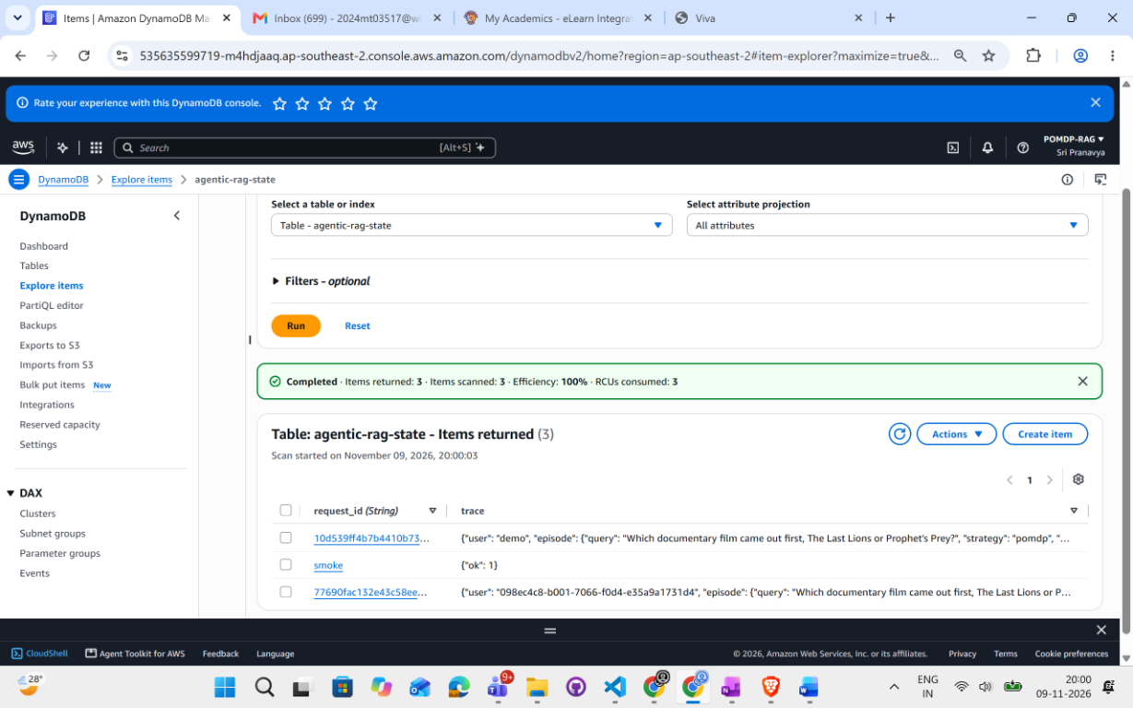
Live Validation on AWS
09 EVIDENCE
Everything measured on real Bedrock and OpenSearch, not mocks
350 / 350
13
5.0 min
200/401/401
live checks passed
strategies via /compare in 54 s
Playwright UI test, passed
Cognito valid/missing/tampered
Check | Result
6 questions x 13 strategies + batch eval | 0 failed, 0 warnings
Each response | Real tokens, $ cost, trace, passages
Out-of-index question | 'Insufficient evidence.'
DynamoDB persistence | Episode written and read back
S3 report object | Written and read back
Cognito-authenticated query | 'The Last Lions', 2 hops, $0.002392
A Cost-Aware Adaptive Retrieval: POMDP Framework for Agentic RAG on AWS | M. B. Sri Pranavya | 2024MT03517
18

Slide 19
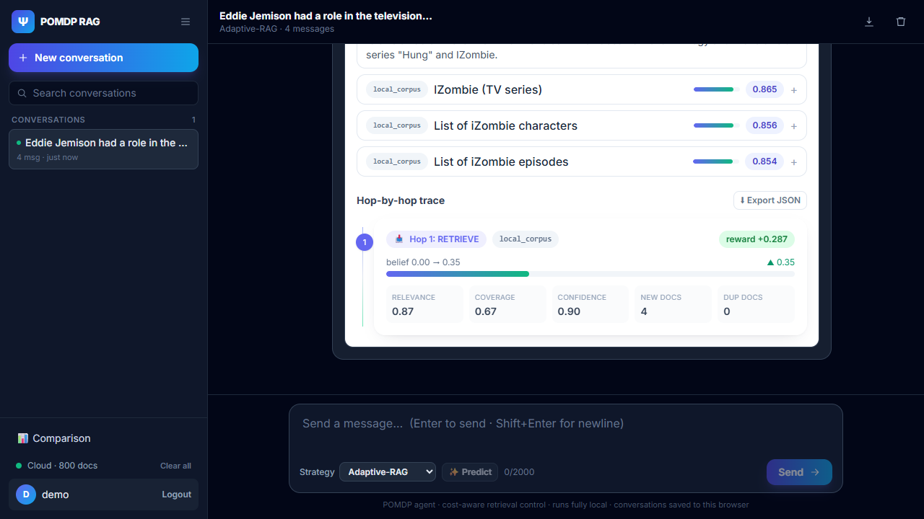
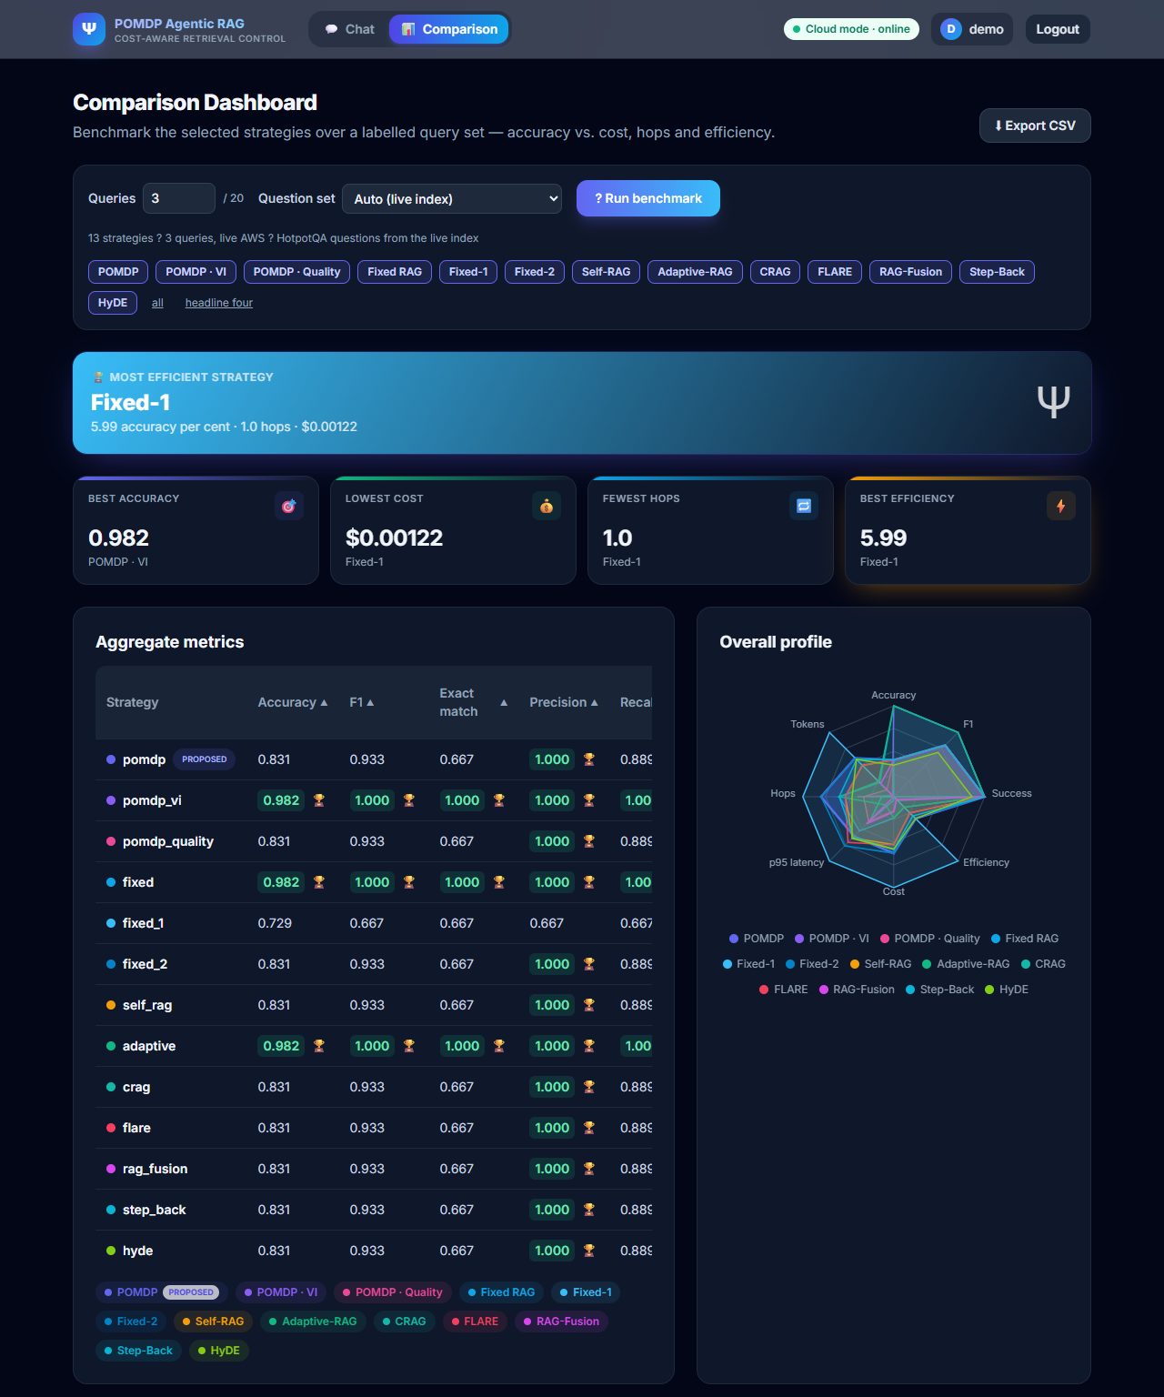
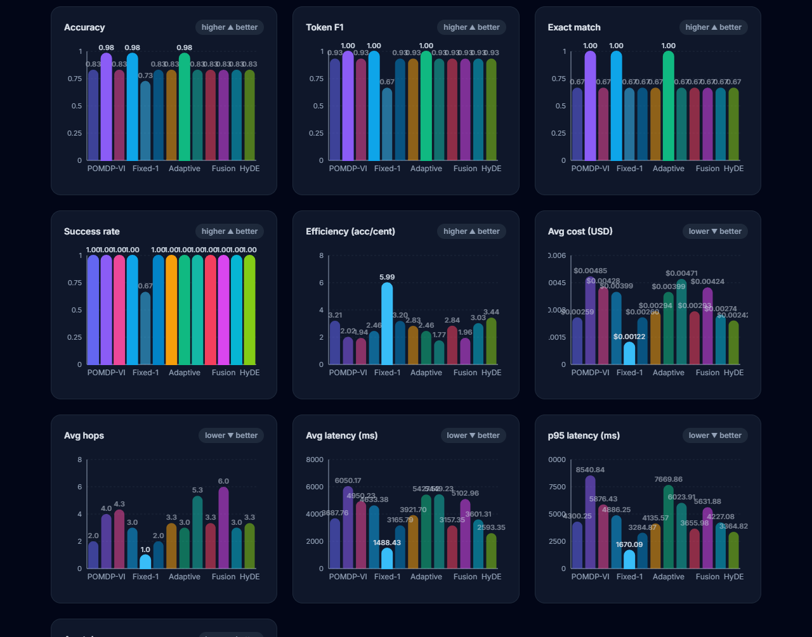
Application and Dashboard Evidence
09 EVIDENCE
Left: per-hop reasoning trace and per-metric charts. Right: aggregate metrics and radar profile (13 strategies, live AWS)
A Cost-Aware Adaptive Retrieval: POMDP Framework for Agentic RAG on AWS | M. B. Sri Pranavya | 2024MT03517
19

Slide 20
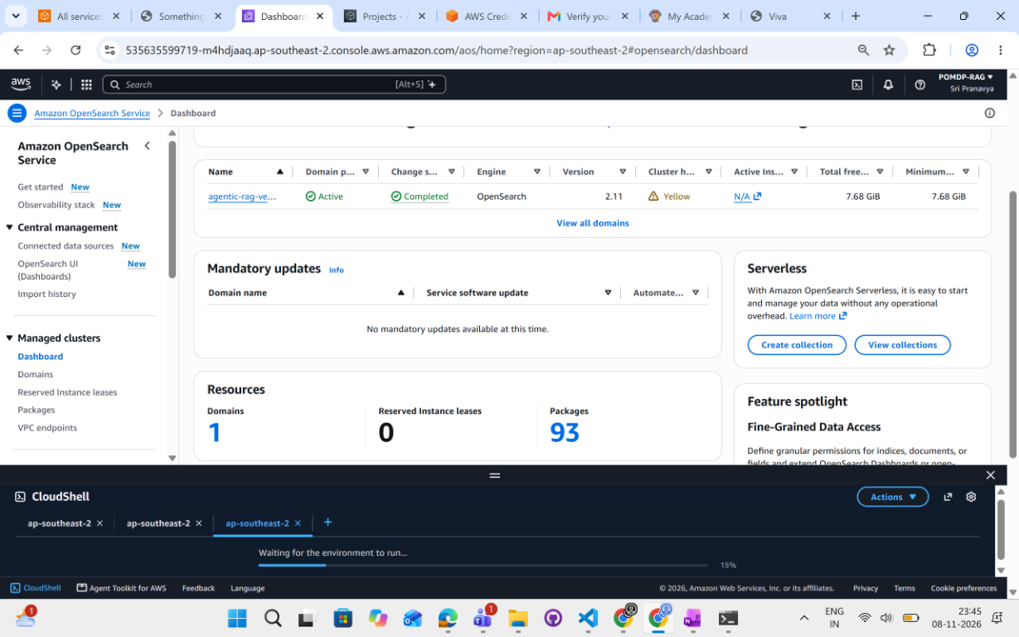
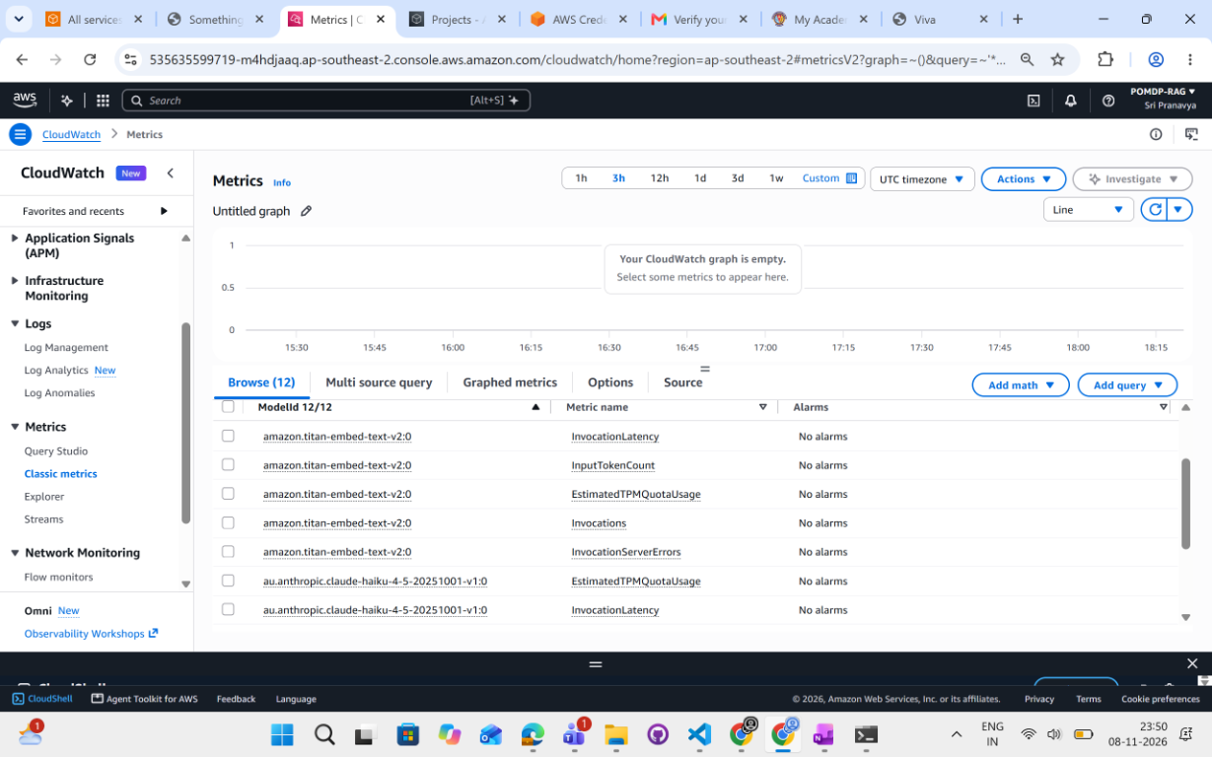
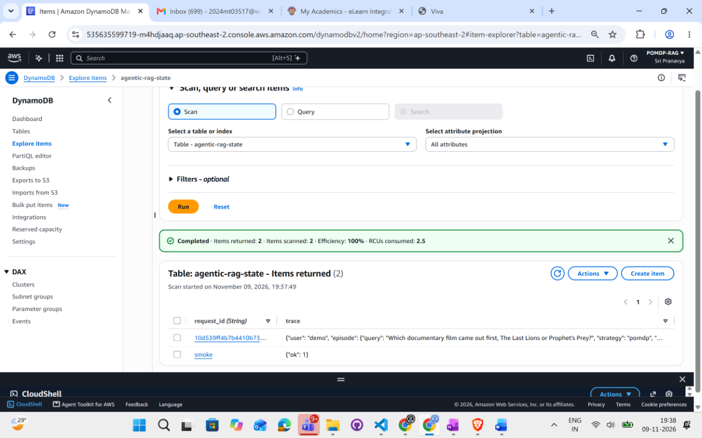
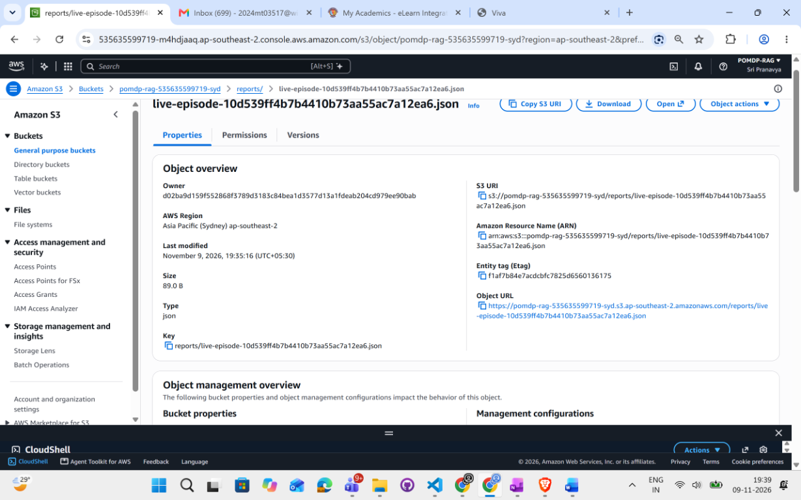
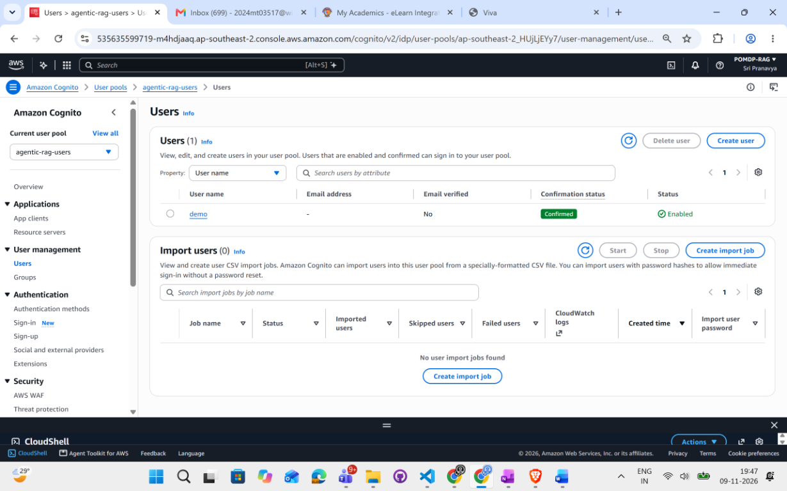
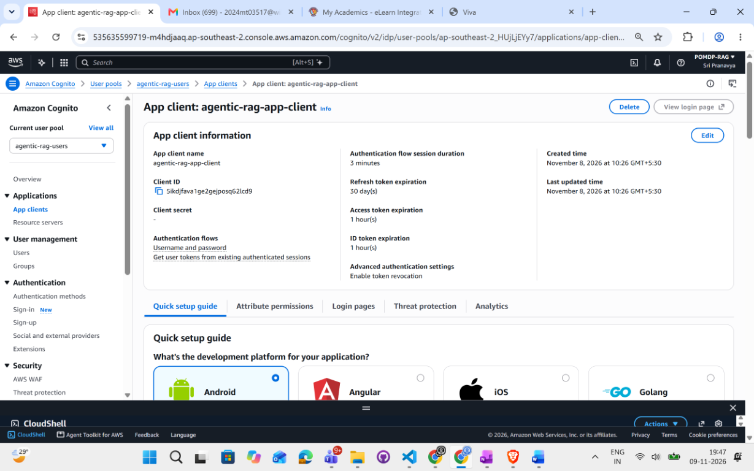
AWS Console Proof
09 EVIDENCE
Resources created and used by the application
A Cost-Aware Adaptive Retrieval: POMDP Framework for Agentic RAG on AWS | M. B. Sri Pranavya | 2024MT03517
20

Slide 21
Comparison with the SoK Paper
10 POSITIONING
From survey and roadmap to a measured system
Dimension | SoK paper | This work
Nature | Survey and roadmap | Implemented, deployed, measured
Experimental results | None | HotpotQA n=80/200, MS MARCO n=60, ablation, live AWS
Action space | Abstract, open-ended | 4 typed action kinds, 3 sources, validated
Belief | Memory as stand-in | Explicit, Bayes-style updates, shown in UI
Cost model | Single λ x cost | Separate cost, latency, redundancy; real Bedrock prices
Stopping | Open problem | Expected-utility stop + hop, budget, confidence caps
Baselines | Described | 12 baselines on one interface
Statistics | Calls for rigour | Paired bootstrap, Pareto frontier, validation-only tuning
Cost saving | Not measured | 28 to 30% (HotpotQA), ~63% (MS MARCO)
Safety / security | Listed as risks | 8 safeguards, 8/8 refusals, JWT/Cognito, injection fencing
A Cost-Aware Adaptive Retrieval: POMDP Framework for Agentic RAG on AWS | M. B. Sri Pranavya | 2024MT03517
21

Slide 22
Conclusions and Future Work
11 CLOSE
CONCLUSIONS
FUTURE WORK
▸ A POMDP controller with a cost-aware reward matched fixed 3-hop F1 at 28 to 30% lower cost on HotpotQA and ~63% lower on MS MARCO.
▸ Ablation shows the cost term, not the belief alone, causes the saving, on two datasets.
▸ End-to-end on AWS: measured cost, 350 live checks, persistent authenticated episodes.
▸ Not a quality gain: a cost and latency gain at equal quality.
▸ Run Natural Questions and FEVER on a larger, varied index.
▸ Learn the policy from logged episodes; test per-query depth adaptation.
▸ Add Progress Rate, Effective Information Rate, ECE and injection-attack experiments.
▸ Deploy on Lambda or Fargate; add hybrid BM25.
▸ Delete billable AWS resources after the evaluation.
A Cost-Aware Adaptive Retrieval: POMDP Framework for Agentic RAG on AWS | M. B. Sri Pranavya | 2024MT03517
23

Slide 23
References
11 CLOSE
[1] Lewis et al., Retrieval-Augmented Generation for Knowledge-Intensive NLP Tasks, NeurIPS 2020
[2] Asai et al., Self-RAG, ICLR 2024
[3] Jeong et al., Adaptive-RAG, NAACL 2024
[4] Yan et al., Corrective Retrieval Augmented Generation, arXiv:2401.15884
[5] Jiang et al., Active Retrieval Augmented Generation (FLARE), EMNLP 2023
[6] Gao et al., Precise Zero-Shot Dense Retrieval without Relevance Labels (HyDE), ACL 2023
[7] Zheng et al., Take a Step Back, ICLR 2024
[8] Rackauckas, RAG-Fusion, arXiv:2402.03367
[9] Systematisation of knowledge on agentic RAG, arXiv:2603.07379, 2026
[10] Yang et al., HotpotQA, EMNLP 2018
[11] Nguyen et al., MS MARCO, CoCo@NIPS 2016
[12] Kaelbling, Littman, Cassandra, Planning and acting in partially observable stochastic domains, AI 101, 1998
Code and evidence: https://github.com/Sripranavya/2024mt03517-Cost-Aware-Adaptive-Retrieval-Application
Thank you | Questions?
A Cost-Aware Adaptive Retrieval: POMDP Framework for Agentic RAG on AWS | M. B. Sri Pranavya | 2024MT03517
24

