Slide 1
Executive Sales Performance Dashboard Sales & Profit Analysis using Tableau
Task 4: Dashboard Design
Date:17-02-2026
Presented by: Siddirala Sripriya

Slide 2
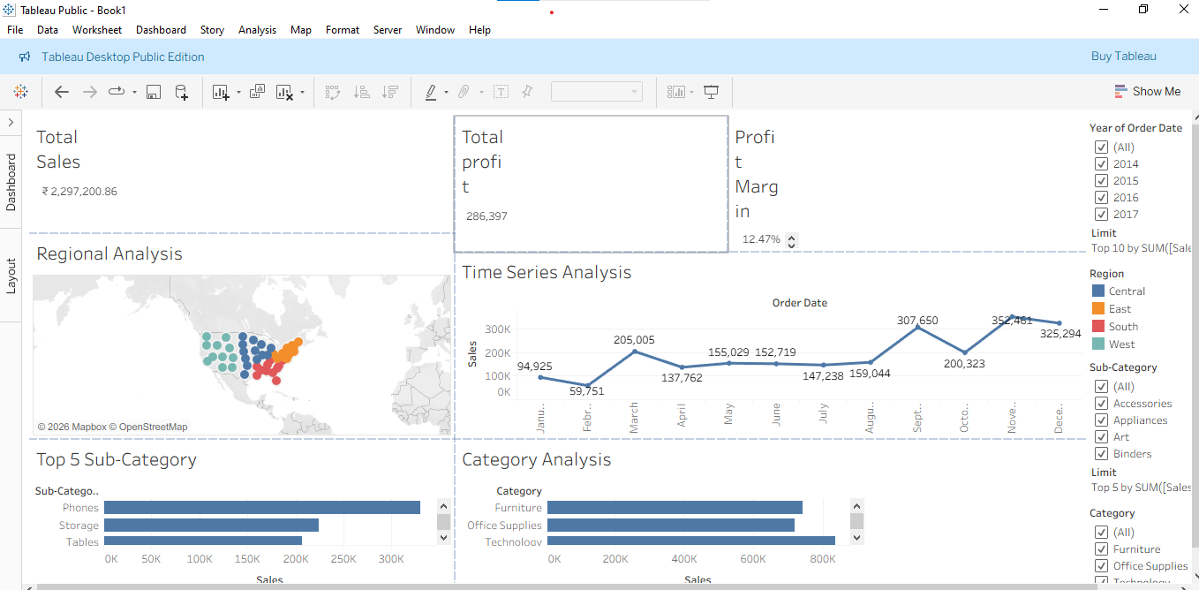

Slide 3
Project Overview
Objective
Design an interactive dashboard for business stakeholders.
Dataset: Superstore Sales dataset (Kaggle source)
Tools Used: Tableau

Slide 4
Key Metrics and KPIs
.Total Sales: ₹ 22,97,201 • Total Profit: ₹ 2,86,397 • Profit Margin: 12.46%
The business generated ₹22.9L in revenue with a healthy profit margin of 12.46%

Slide 5
Time-Series Analysis
• Monthly Sales Trend (2014–2017) • Highest growth month showed 243% increase • Some months showed decline (e.g., -37%)

Slide 6
Regional Analysis
Sales by Region: • West: Highest performing region • East: Strong performance • Central & South: Moderate performance
West region contributes the highest revenue.

Slide 7
Category Performance
Sales by Category: • Technology: Highest sales contributor • Furniture: Moderate sales • Office Supplies: Stable performance
Technology category drives maximum revenue.

Slide 8
Interactive Filters
Filters included: • Year (2014–2017) • Region • Category • Segment
Users can dynamically analyze performance by selecting specific criteria.

Slide 9
Business Insights
• Strong revenue generation with 12.46% profitability • Technology & West region are key drivers • Growth fluctuates month-to-month • Some regions/categories need improvement

Slide 10
THANK YOU

