Slide 1
Irrigation System for Agriculture

Slide 2
Introduction:
This Project proposed an embedded System and Verilog for automatic irrigation for field Which has a wireless sensor network for real time to control irrigation system.
This System support the field both plain and slope area and therefore its avoids the water overflow at slope area which save the plant and water.
This irrigation system updates solenoid value for specified location of mist emitters automatically according to the set point of temperature, humidity and soil moisture.

Slide 3
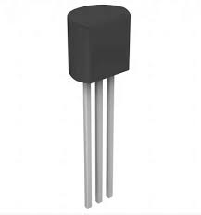
In India, observed in the warm and humid conditions at a temperature range of 10–35 °C [10]. The upper temperature limit will normally be around 31–35 °C.
So.it is very hard for famer to maintain his crop according to the season.
The national average yield of Indian cardamom is only 149 kg/ha as against 300 kg/ha in Guatemala One of the main reasons for the increased yield in Guatemala is the well-distributed rainfall.
lm35 temperature sensor
So cardamom plant needs proper irrigation for the growth of the plant and also for the yield.

Slide 4
COMPONENTS DESCRIPTION :
Temperature Sensor:
The LM35 series are precision integrated-circuit temperature sensor. The LM35 is rated to operate over a −55° to +150°C temperature range. This sensor senses the field temperature
The proposed system maintains the temperature range between 240C to 35 0C. This value manually is changed according to the seasonal temperature using the manual mode.

Slide 5
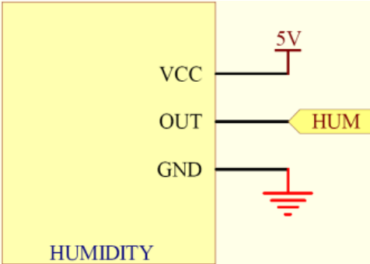
Humidity Sensor
SY-HS-220 Humidity sensor used in this system detects the cardamom field humidity. The SY-HS-220 is rated to operate over 0-60.C temperature range and operating humidity range over 30-90%RH. This sensor senses the field humidity and is connected to microcontroller

Slide 6
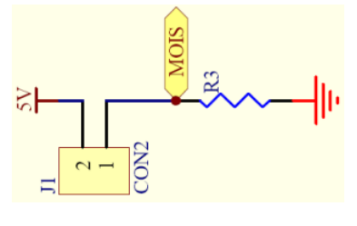
Moisture Sensor
Grid-like resistance-type sensor senses the moisture on vegetation from 0% (dry) to 100% (wet).
Soil moisture sensors measure the water content in the soil and can used to estimate the amount of store water in the soli

Slide 7
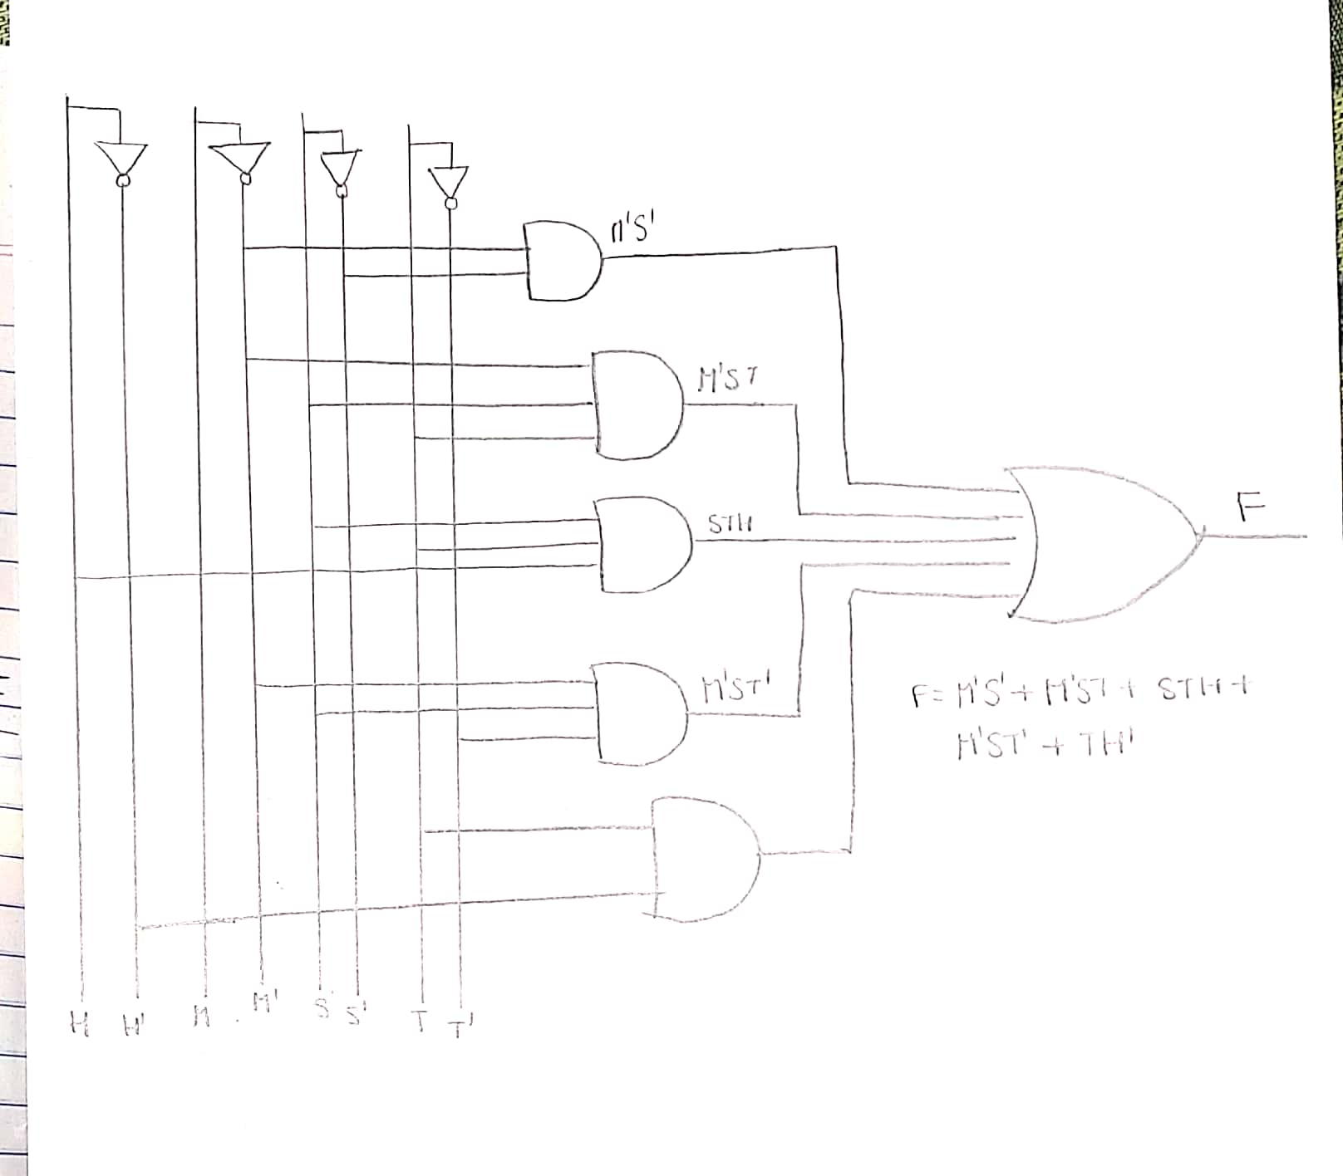
Design and implementation:
For the given question we design the function F(H,S,T,M).
F(H,S,T,M)=M'S' + M'ST + STH + M'ST' + TH'

Slide 8
Temperature (T) | Season (S) | Moisture (M) | Humidity (H) | Output (F)
0 | 0 | 0 | 0 | 1
0 | 0 | 0 | 1 | 1
0 | 0 | 1 | 0 | 0
0 | 0 | 1 | 1 | 0
0 | 1 | 0 | 0 | 1
0 | 1 | 0 | 1 | 1
0 | 1 | 1 | 0 | 0
0 | 1 | 1 | 1 | 0
1 | 0 | 0 | 0 | 1
1 | 0 | 0 | 1 | 1
1 | 0 | 1 | 0 | 1
1 | 0 | 1 | 1 | 0
1 | 1 | 0 | 0 | 1
1 | 1 | 0 | 1 | 1
1 | 1 | 1 | 0 | 1
1 | 1 | 1 | 1 | 1

Slide 9
Start
Initialization of Set Points for Humidity, Moisture, Temperature ,Season
M=0
T=1 and M=0 and S=1
T=1 and H=1 and S=1
T=0 and M=0 and S=1
T=1 and M=0
OR OPERATOR
F(H,S,T,M)

Slide 10
CONCLUSION:
By the help of this system farmer can leave the tension of watering the crop time to time and no need of man power to check water availability.

