Slide 1



“DETECTION OF DRIVER’S DROWSINESS USING CONVOLUTIONAL NEURAL NETWORK EMBEDDED WITH IOT”
PROJECT MEMBERS:
RAGAVI R – 19ITR068
SRIRAAM J – 19ITR095
THANISH KUMAR P – 19ITL113
PROJECT GUIDE:
Mrs.P.Vanitha, M.E.,
Assistant Professor
Department of Information Technology

Slide 2
Objective(s)
Create an application to detect the drowsiness of the drivers using CNN embedded with IoT.
Classify the driver’s eye status.
Intimate the driver to wakeup via Alarm, IoT devices.
Initiate the Emergency Call Service if required.

Slide 3
Introduction
Long distance driving with monotonous driving conditions often leads to drowsiness and mental fatigue in the driver.
Sleep deprivation is another cause which leads to drowsiness and fatigue, which may result in road accidents.
Hence, it is necessary to monitor the drowsiness of the driver and alert the drivers when required.

Slide 4
Literature review
S.No | PAPER | AUTHOR | YEAR | ALGORITHM / TECHNIQUE | REMARKS
1 | A Smartphone Based Drowsiness Level Detection and Warning System for Automotive Drivers | Anirban Dasgupta, Daleef Rahman, Aurobinda Routray | 2019 | SVM Algorithm, Convolution Operation | We have proposed a three-stage verification system to address the driver fatigue issue. The measures are PERCLOS, VUR, and a reaction test response of the driver on the smartphone screen.
2 | IoT-Based Smart Alert System for Drowsy Driver Detection | Anil Kumar Biswal, Debabrata Singh, Binod Kumar Pattanayak, Debabrata Samanta , | 2021 | ESP8266,CNN | The existing techniques are based on psychological or vehicle based approach to detect drowsiness of drivers and also, the severity of collision is separately measured, but such technique is highly intruding as well as fully turns on the physical environment.
3 | Real-Time Driver-Drowsiness Detection System Using Facial Features | WANGHUA DENG & RUOXUE WU | 2019 | CNN | We design a new algorithm and propose the MC-KCF algorithm to track the driver's face using CNN and TCNN to improve the original KCF algorithm. We define the facial regions of detection based on facial key points. Moreover, we introduce a new evaluation method for drowsiness based on the states of the eyes and mouth.

Slide 5
Literature review
S.No | PAPER | AUTHOR | YEAR | ALGORITHM / TECHNIQUE | REMARKS
4 | Deep CNN models-based ensemble approach to driver drowsiness | Mohit Dua,Shakshi,Ritu Singla,Saumya Raj,Arti Jangra | 2020 | SVM, CNN | Earlier proposed approaches focused on very few features like eye blinking, facial expressions, etc., as a result of which the predictions and accuracy were not completely up to the mark. The model suggested in this experimentation considers new features as well, such as head movements and hand gestures, thereby gives the most promising results.
5 | Real-time Driver Drowsiness Detection for Android Application Using Deep Neural Networks Techniques | Rateb Jabbara, Khalifa Al-Khalifa, Mohamed Kharbeche, Wael Alhajyaseen, | 2018 | CNN | Hence, it can be integrated into advanced driver-assistance systems, the Driver drowsiness detection system, and mobile applications. However, there is still space for the performance improvement. The further work will focus on detecting the distraction and yawning of the driver.
6 | Driver Drowsiness Detection System Using CNN Approach Based on Image Processing | Mr. Nitin B Raut, Praveen Raja M, Kishor V, Prathap M | 2021 | CNN | As a result, for both experienced and specific drivers,a system for assessing driver fatigue that informs the drivingr when the key susceptibility negative consequences occur would help to minimise accidents by preventing and decreasing rest situations.

Slide 6
Literature review
S.No | PAPER | AUTHOR | YEAR | ALGORITHM / TECHNIQUE | REMARKS
7 | Real-time Driver Drowsiness Detection using Deep Learning | Md. Tanvir Ahammed Dipu, Syeda Sumbul Hossain, Yeasir Arafat, Fatama Binta Rafiq | 2021 | SVM, CNN | The key goal is to ensure that a lightweight approach is applied in integrated devices while maintaining and achieving high efficiency. In the trained model, we only use 250 low-light images. The main improvement done in the future is adding more low-light photos to work well in low-light conditions.
8 | Real-Time Driver Drowsiness Detection System Using Eye Aspect Ratio and Eye Closure Ratio | Sukrit Mehta, Sharad Dadhich, Sahil Gumber, Arpita Jadhav Bhatt | 2019 | SVM | The face of the driver has been detected by capturing facial landmarks and warning is given to the driver to avoid real time crashes. Non-intrusive methods have been preferred over intrusive methods to prevent the driver from being distracted due to the sensors attached on his body. The proposed approach uses Eye Aspect Ratio and Eye Closure Ratio with adaptive thresholding to detect driver’s drowsiness in real-time.
9 | Deep convolutional network based real time fatigue detection and drowsiness alertness system | Vijay Prakash Sharma , Jitendra Singh Yadav, Vivek Sharma | 2022 | CNN | We go over the features, advantages, and algorithms of a prototype system for detecting driver fatigue. It is divided into four sections: the process of getting things started and getting ready using eye-tracking technology to conduct research detection of the early warning signs the fourth stage of the alertness system in order to determine whether or not a driver is fatigued, we look at non-intrusive outside signals.

Slide 7
Problem Description
Driver distraction happens when something or someone diverts attention from the task of driving. Driver drowsiness, in contrast to driver distraction, lacks a cause and is instead characterized by a gradual loss of focus on the road and traffic demands. However, both driver fatigue and distraction might result in a reduction in driving performance.

Slide 8
Proposed Methodology
End
NO
Target detection algorithm
Face detection
(Person)
Image Dataset
Extract region proposals
Compute CNN features
Classify region
From microphone
Is drowsy?
YES
YES
Eye, mouth & dead position detection
Find VUR
Find PERCLOS
Eye state classification
NO
NO
YES
Is drowsy?
Did the driver touch?
YES
NO
Ask for touch
Intimation

Slide 9
Software/Tools
IoT COMPONENTS:
Arduino UNO.
Buzzer.
LCD Display 16x2.
LED.
Bread board.
Jumper wires.
SOFTWARE REQUIREMENTS:
Operating System : Windows 10 Programming.
Language : Python 3.7.
IDE : Visual Studio Code and Arduino IDE.

Slide 10
Description of Each Phase
Build and train the model using CNN:
The convolutional neural network algorithm is used for image classification.
models.Sequential()
model.add() – Conv2D, Maxpooling2D, Flatten, Dense
model.fit()
Target detection algorithm:
Target detection falls under the more general categories of image processing and image interpretation. Recognizing a target, such as a human face and eyes, from a series of photographs is required (often in the optical or infrared spectral regions).

Slide 11
Description of Each Phase
PERCLOS:
The PERCLOS method is statistic of drowsiness based on eye closure rates of the driver. It has been acknowledged as a key indicator of drowsiness. The percentage of time when the eyelids covered at least 80% of the pupil is known as PERCLOS. Ec and Eo are terms that indicate the closed and open eye’s count during certain interval. If the P value is higher, then it indicates higher levels of drowsiness, and vice versa.
P = (Ec/(Ec+Eo))*100%
VUR:
VUR is voiced-to-unvoiced ratio. It is measured based on sound data fetched by the microphone of
the device. It is asked to tell the “Active” command, if the driver saying the right command then the warning will
be turned off.

Slide 12
Description of Each Phase
INTIMATION
Once the system detecting drowsiness of the driver then it starts to give the warnings.
Alarm
1. Alarm audio will be played.
Via IoT Devices
1.Message will be displayed in the LCD board.
2.Buzzer & LED will be turned on.
Emergency Call Service (Twilio)

Slide 13
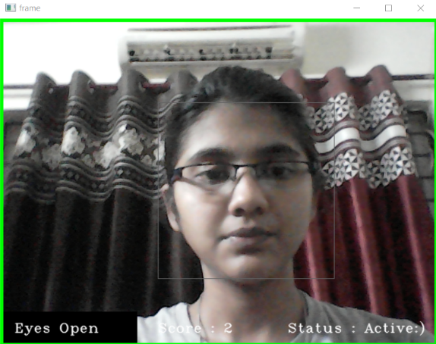
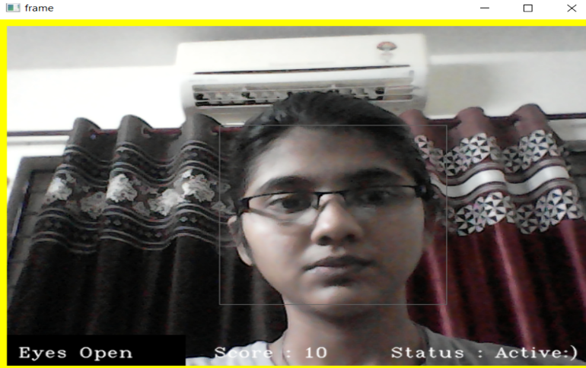
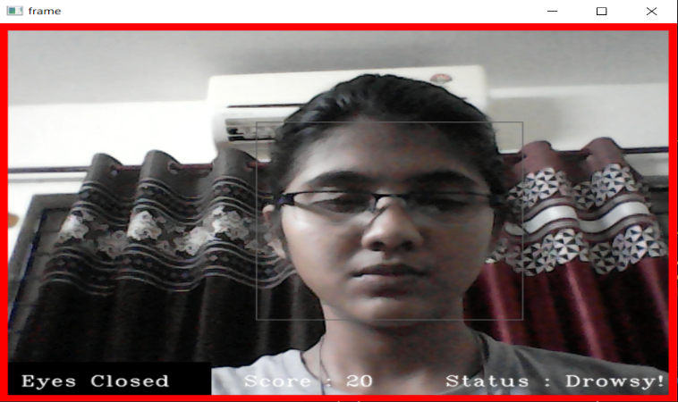
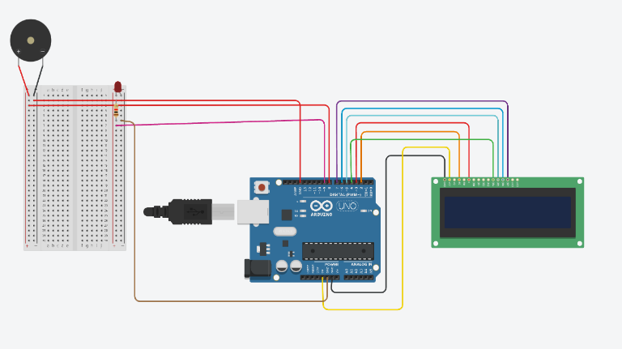
Demo Screenshots
Green frame represents the active stage
Yellow frame represents the active stage
Red frame represents the drowsy stage
Circuit Diagram

Slide 14
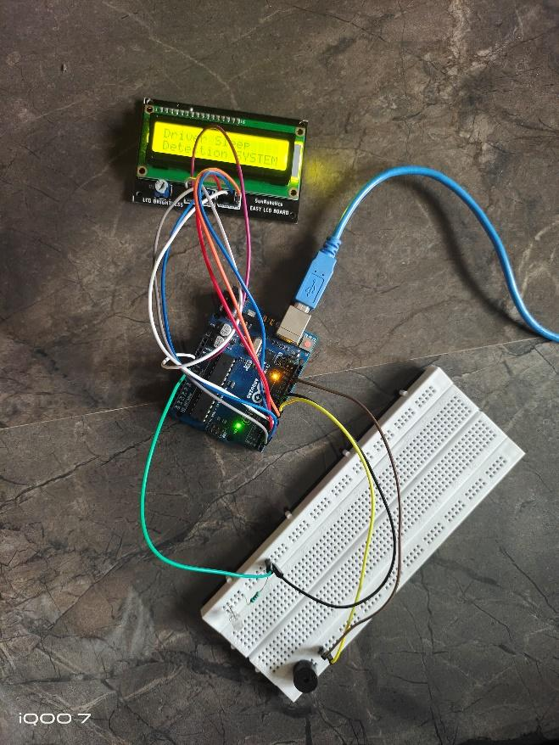

Demo Screenshots
Physical Circuit
Emergency Call

Slide 15
Result
The drowsiness is calculated through CNN Algorithm and it helps to classify the drowsiness of driver and embedded IoT system helps to wakeup the drivers. The accuracy of this drowsiness system is 94.78%.
Sample’s Drive Link :
https://drive.google.com/drive/folders/1PTkoP5rdyIGKRjacccMzP4JazEn107Z-?usp=sharing
S.No | Under Good Lighting Condition | Under Bad Lighting Condition | Wearing Specs
1 | 95% (out of 20 samples) | 30% (out of 20 samples) | 45% (out of 10 samples)

Slide 16
Conclusion
This method generally combines two different systems in one integrated system. The proposed system is used to construct a no intruding technique for measuring drowsiness of the driver with 3 stage verification.
The camera and Arduino UNO board are the essential parts of this system. They are used to persistently record facial landmarks that are localized using facial landmark points and then to compute PERCLOS.
Furthermore, if the estimated PERCLOS value exceeds the threshold range, the eyes remain open and the system's state remains unchanged.
The system also urgently alerts using a buzzer and contacts the authority (owner) if the PERCLOS value deviates from the threshold range to provide the driver with additional supportive alertness.

Slide 17
Future Work
The future development in this project can be inclusion of GPS system with crash sensors which can be used if the vehicle has been crashed in some area and the exact GPS location can be sent to the owners or their family members in case of emergency.
The crash sensor which is installed in the car will help us to detect the accidents and intimate to their respective owners or their family members. And also we can improve the camera which can function even in dark nights which will be helpful for detection of drowsiness even in dark.

Slide 18
References
[1] Dasgupta, A., Rahman, D. and Routray, A, A smartphone-based drowsiness detection and warning system for automotive drivers. IEEE transactions on intelligent transportation systems, 20(11), pp.4045-4054, 2018.
[2] Biswal, A.K., Singh, D., Pattanayak, B.K., Samanta, D. and Yang, M.H, IoT-based smart alert system for drowsy driver detection. Wireless communications and mobile computing, 2021.
[3] Deng, W. and Wu, R, Real-time driver-drowsiness detection system using facial features. Ieee Access, 7, pp.118727-118738, 2019.
[4] Dua, M., Singla, R., Raj, S. and Jangra, A, Deep CNN models-based ensemble approach to driver drowsiness detection. Neural Computing and Applications, 33(8), pp.3155-3168, 2021.
[5] Jabbar, R., Al-Khalifa, K., Kharbeche, M., Alhajyaseen, W., Jafari, M. and Jiang, S, Real-time driver drowsiness detection for android application using deep neural networks techniques. Procedia computer science, 130, pp.400-407, 2018.

Slide 19
References
[6] Raut, M.N.B., Praveen Raja, M., Kishor, V. and Prathap, M. Driver Drowsiness Detection System Using CNN Approach Based on Image Processing. Annals of the Romanian Society for Cell Biology, pp.5501-5508, 2021.
[7] Dipu, M.T.A., Hossain, S.S., Arafat, Y. and Rafiq, F.B, Real-time Driver Drowsiness Detection using Deep Learning. International Journal of Advanced Computer Science and Applications, 12(7), 2021.
[8] Mehta, S., Dadhich, S., Gumber, S. and Jadhav Bhatt, A, February. Real-time driver drowsiness detection system using eye aspect ratio and eye closure ratio. In Proceedings of international conference on sustainable computing in science, technology and management (SUSCOM), Amity University Rajasthan, Jaipur-India, 2019.
[9] Sharma, V.P., Yadav, J.S. and Sharma, Vs, Deep convolutional network based real time fatigue detection and drowsiness alertness system. International Journal of Electrical and Computer Engineering (IJECE), 12(5), pp.5493-5500, 2022.

Slide 20
Thank You

