Slide 1
MACHINE LEARNING / PROJECT PRESENTATION
Customer Segmentation
Using K-Means Clustering
Understand Customers. Discover Patterns. Make Smarter Decisions.
Customer segmentation is the process of grouping customers based on similar characteristics and spending behaviour. This project uses the K-Means clustering algorithm to identify customer groups based on annual income and spending score, helping businesses understand customer patterns and make better marketing decisions.
PYTHON
UNSUPERVISED ML
K = 3
DATA → CLUSTER → INSIGHT
CUSTOMER SEGMENTATION / K-MEANS CLUSTERING
01

Slide 2
01 / OVERVIEW
From customer data to business insight
A compact, explainable clustering workflow built around two customer attributes.
THE QUESTION
THE METHOD
THE OUTPUT
Can customers be grouped by similar income and spending behaviour?
Standardize the selected features, then apply K-Means clustering.
Three illustrative customer segments, shown through plots and centroids.
PROJECT SNAPSHOT
200
synthetic customer profiles
2
clustering features
3
target clusters
6
supplied visual outputs
CUSTOMER SEGMENTATION / K-MEANS CLUSTERING
02

Slide 3
02 / BUSINESS CONTEXT
Why segment customers?
A single average customer profile can hide important differences in behaviour.
ONE-SIZE-FITS-ALL
HIDDEN PATTERNS
BETTER DECISIONS
The same offer may not appeal equally to every customer.
Income and spending can reveal groups with different needs.
Segments can inform tailored campaigns and customer engagement.
Project aim
Demonstrate how unsupervised learning can turn two simple customer attributes into interpretable groups.
CUSTOMER SEGMENTATION / K-MEANS CLUSTERING
03

Slide 4
03 / OBJECTIVES
What this project sets out to do
The objectives follow the supplied report and implementation.
Understand customer segmentation and unsupervised learning
EXPECTED LEARNING
Prepare and explore a customer dataset
Practice Python-based data preparation, model building, visualization and basic interpretation of cluster results.
Scale income and spending features before clustering
Use the Elbow Method to guide the choice of K
Visualize groups and interpret their profiles
The analysis helps demonstrate how machine learning can support targeted marketing, improve customer understanding, and enable more informed business decisions.
Scope
Demonstration dataset, not a validated production model.
CUSTOMER SEGMENTATION / K-MEANS CLUSTERING
04

Slide 5
04 / TECHNOLOGY STACK
The tools behind the workflow
Each library has a specific role in the analysis pipeline.
Python
NumPy
Pandas
Core implementation
Synthetic data and numeric operations
Tabular data handling
Scikit-learn
Matplotlib
Seaborn
Scaling and K-Means model
Charts and plotting
Statistical visualizations
Programming Language: Python is used to implement the customer segmentation process.
Libraries: NumPy and Pandas handle data processing, while Matplotlib and Seaborn visualise customer patterns.
Machine Learning: Scikit-learn provides StandardScaler and the K-Means clustering algorithm to group customers based on their features.
CUSTOMER SEGMENTATION / K-MEANS CLUSTERING
05

Slide 6
05 / DATASET
A reproducible synthetic dataset
The code generates 200 simulated customer records for demonstration.
CUSTOMER ID
ANNUAL INCOME
SPENDING SCORE
Generated income values, clipped to a plausible range and represented in thousands of dollars.
Generated score from 1 to 100 to represent spending behaviour.
Sequential identifier for each generated record.
Synthetic profile pattern used in the code
50
lower income
100
middle income
50
higher income
higher spending
middle spending
lower spending
CUSTOMER SEGMENTATION / K-MEANS CLUSTERING
06

Slide 7
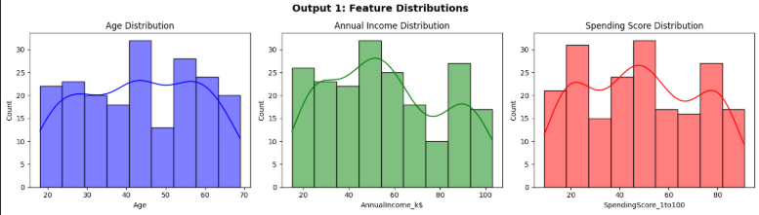
06 / EXPLORE THE DATA
First look: feature distributions
The supplied histograms summarize age, annual income and spending score.
AGE
Generated between 18 and 69 years.
INCOME
Concentrated around the three synthetic profile bands.
SPENDING
Values are clipped to a 1–100 range.
CUSTOMER SEGMENTATION / K-MEANS CLUSTERING
07

Slide 8
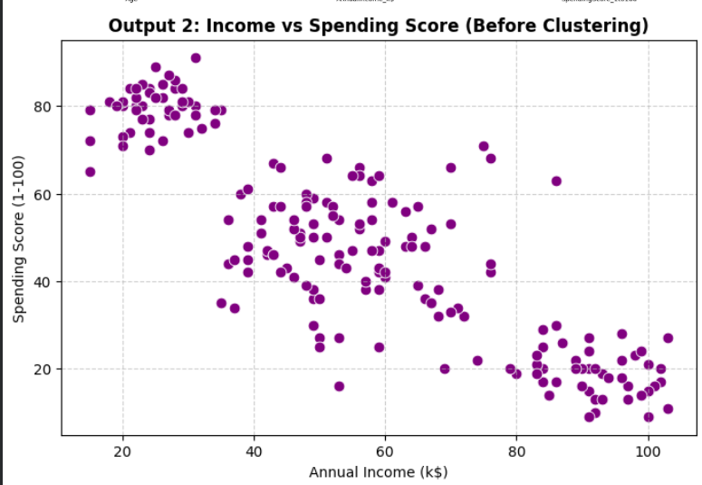
07 / RELATIONSHIP
Income vs. spending before clustering
The raw scatter plot shows three broad patterns embedded in the simulated data.
LOWER INCOME
A high-spending group appears in the upper-left area.
MID-RANGE
A broader group sits around moderate income and spending.
HIGHER INCOME
Lower spending scores appear toward the lower-right.
CUSTOMER SEGMENTATION / K-MEANS CLUSTERING
08

Slide 9
08 / METHOD
How K-Means forms groups
The algorithm iteratively assigns points to the nearest centroid and updates each centroid.
01
02
03
04
05
Select features
Scale features
Choose K
Fit K-Means
Interpret
Annual income + spending score
StandardScaler puts features on a comparable scale
Elbow curve helps inspect candidate cluster counts
Assign points and update centroid locations
Compare group positions and average profiles
Important: scaling is applied to the selected clustering features; the reported charts show income and spending for interpretation.
CUSTOMER SEGMENTATION / K-MEANS CLUSTERING
09

Slide 10
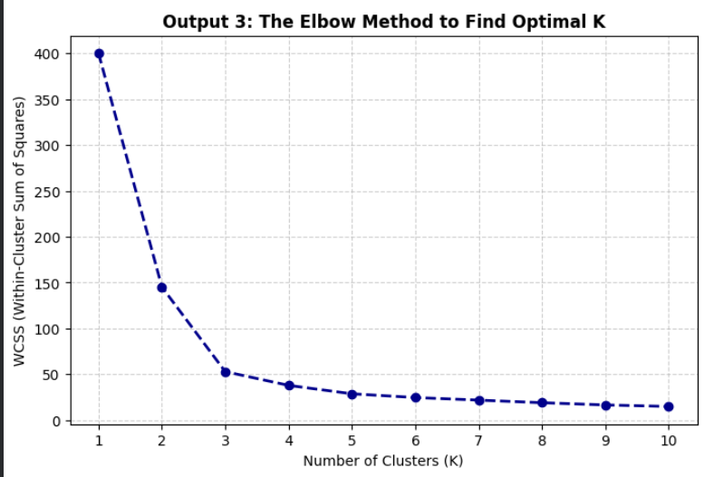
09 / SELECT K
The Elbow Method
The supplied curve drops sharply at first, then begins to flatten around K = 3.
WHAT IS WCSS?
Within-cluster sum of squares measures how tightly points sit around their assigned centroids.
WHY K = 3?
The elbow is used as a practical visual guide for a compact, interpretable three-group solution.
Heuristic choice, not proof of the only correct K.
CUSTOMER SEGMENTATION / K-MEANS CLUSTERING
10

Slide 11
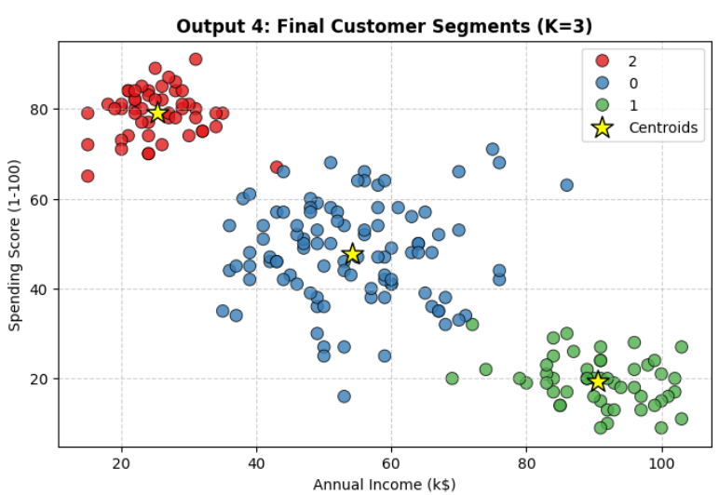
10 / RESULTS
Three clusters in two dimensions
The final supplied 2D plot displays the customer groups and centroid markers.
CLUSTER A
Lower income · higher spending
CLUSTER B
Middle income · moderate spending
CLUSTER C
Higher income · lower spending
CUSTOMER SEGMENTATION / K-MEANS CLUSTERING
11

Slide 12
11 / INTERPRETATION
From clusters to customer profiles
These labels are descriptive interpretations of the synthetic data, not universal customer types.
High-spending / lower-income
May respond to value, affordability and frequent small offers.
01
Balanced / middle-range
May respond to broad, everyday offers and balanced product choices.
02
Low-spending / higher-income
May respond to relevance, premium value and trust-building.
03
CUSTOMER SEGMENTATION / K-MEANS CLUSTERING
12

Slide 13
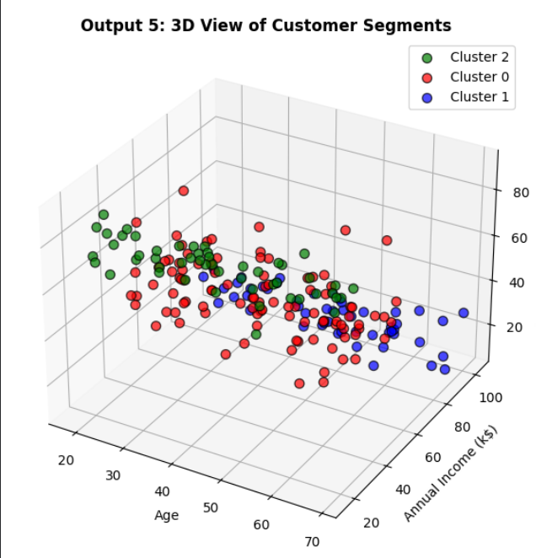
12 / VISUAL ANALYSIS
A 3D view adds age as context
The supplied 3D plot shows age alongside income and spending score.
TWO FEATURES DRIVE CLUSTERING
The project selects income and spending score for the clustering step.
AGE IS CONTEXT
Age is included in the generated dataset and shown in the 3D visualization.
A visualization does not mean age was used to fit K-Means.
CUSTOMER SEGMENTATION / K-MEANS CLUSTERING
13

Slide 14
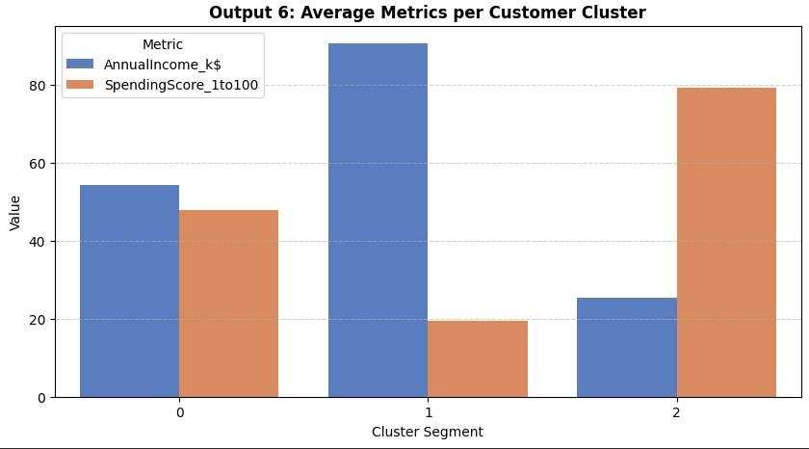
13 / COMPARE GROUPS
Average values by cluster
The supplied bar chart compares mean income and spending score across the displayed cluster IDs.
READ THE SHAPE
One group has higher income and lower spending; another has lower income and higher spending.
WHY IT MATTERS
Cluster averages make group differences easier to communicate than individual data points alone.
Cluster IDs are arbitrary labels; the number itself has no ranking.
CUSTOMER SEGMENTATION / K-MEANS CLUSTERING
14

Slide 15
14 / NEW-CUSTOMER USE CASE
How a new profile can be assigned
The report describes a simple example prediction for a customer with income 85k and spending score 15.
INPUT PROFILE
MODEL STEP
OUTPUT
Income: 85k
Scale with the same fitted scaler, then assign to the nearest learned centroid.
Cluster ID
+ profile
Spending: 15
Note: the supplied source describes this workflow, but the exported report does not provide a clearly readable verified cluster ID for this example.
CUSTOMER SEGMENTATION / K-MEANS CLUSTERING
15

Slide 16
15 / BUSINESS RELEVANCE
Where segmentation can help
Potential uses suggested by the report; outcomes would need real-data testing.
PERSONALIZED CAMPAIGNS
CUSTOMER RETENTION
RESOURCE PLANNING
Tailor messages and offers to different customer profiles.
Plan engagement strategies for groups with different spending patterns.
Prioritize campaign effort and compare group-level responses.
Use the clusters as a starting hypothesis—not as a substitute for customer research, privacy safeguards or business validation.
CUSTOMER SEGMENTATION / K-MEANS CLUSTERING
16

Slide 17
16 / EVALUATION
What the project can—and cannot—claim
The report explicitly identifies limits that matter before real-world use.
LIMITATIONS
NEXT STEPS
• Synthetic rather than real customer data
• Only two features used for clustering
• K-Means is sensitive to initialization and outliers
• No real-world validation is reported
• Test on a representative real dataset
• Add relevant customer features carefully
• Compare with other clustering methods
• Evaluate silhouette / Davies–Bouldin scores
• Build a dashboard only after validation
Technical accuracy note: the supplied code should be checked before demonstration—its cluster column uses fit_transform rather than fit_predict, which returns distances rather than discrete cluster labels.
CUSTOMER SEGMENTATION / K-MEANS CLUSTERING
17

Slide 18
17 / CONCLUSION
A simple model. A useful starting point.
K-Means demonstrates how customer profiles can be grouped by income and spending patterns.
01
Explore
02
Cluster
03
Interpret
Key takeaway: the value lies not only in forming groups, but in validating what those groups mean.
THANK YOU • QUESTIONS & DISCUSSION
CUSTOMER SEGMENTATION / K-MEANS CLUSTERING
18

