Slide 1
Generative Modeling for Inclusive Facial Image Creation
Course: CPS584 Advanced Intelligent Systems and Deep Learning
Team:
Sriraj Guptha Batchu
Vinitha Uppunuru

Slide 2
Introduction
This project explores the use of generative modeling to create facial images representing diverse ethnic groups, including Indian, Oriental, and European. By applying advanced diffusion models, it aims to blend features from different groups while maintaining realistic details. The focus is on promoting inclusivity in image generation by combining technical methods like U-Net architecture and class conditioning.
This approach highlights the potential of deep learning in addressing diversity and representation challenges.

Slide 3
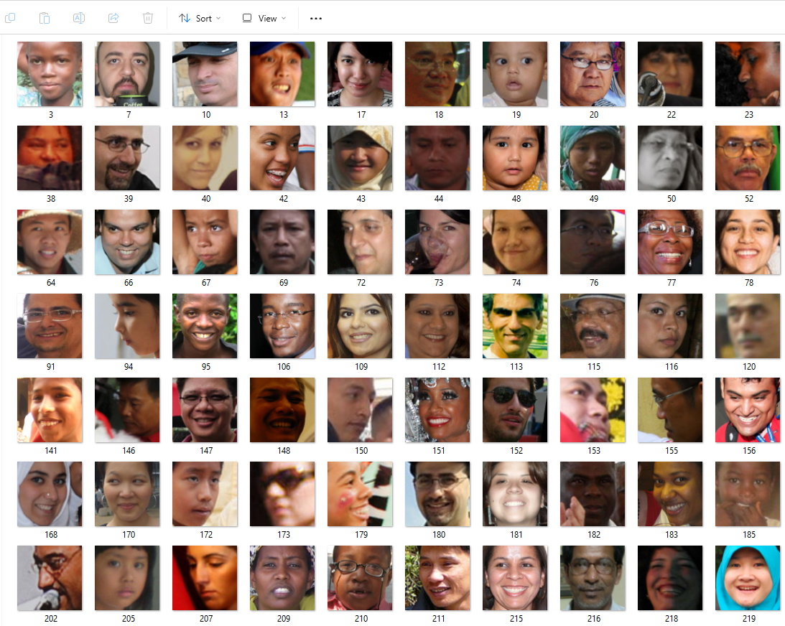
Dataset Preparation
1. Dataset: FairFace Dataset with more than 600 images per ethnic group.
2. Preprocessing: Resized to 28x28 pixels, normalized, and augmented (flipping, rotation).
3. Class Conditioning: Labels for ethnic groups to guide image generation.

Slide 4
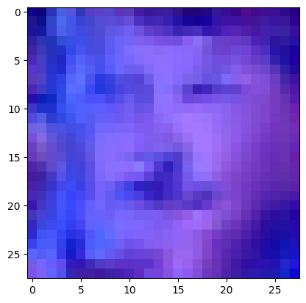
Model Architecture
U-Net Structure:
Down Blocks: Perform feature extraction using ResNet and attention mechanisms.
Up Blocks: They are responsible for reconstructing the final output image
Class Embeddings:
Additional channels are used to encode ethnic group information as input to the model.
Simulates noise removal, facilitating image generation through iterative refinement.

Slide 5
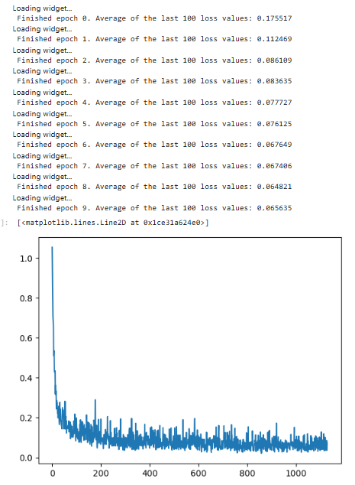
Training Process
Optimizer: The Adam optimizer is used with a learning rate of 5e-4
Loss Function: Mean Squared Error (MSE) is employed to measure the difference between the predicted and actual noise.
Training Duration: The model is trained for 10 epochs to ensure convergence.

Slide 6
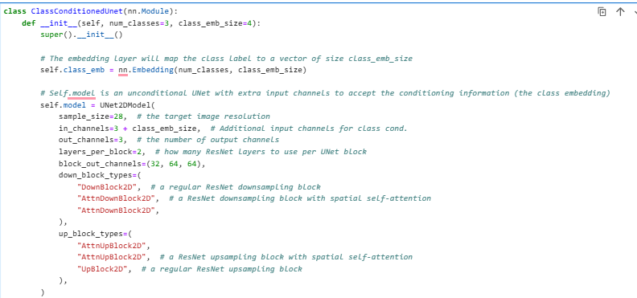
Code Snippet - Class Conditioned U-Net
Class Embedding:
Transforms class labels (e.g., ethnic groups) into dense vector representations of size class_emb_size. These embeddings serve as conditioning inputs for the U-Net model.
Modified U-Net:
Incorporates additional input channels to process both image data and class embeddings.
Employs ResNet blocks with attention mechanisms for efficient feature extraction and image generation.

Slide 7
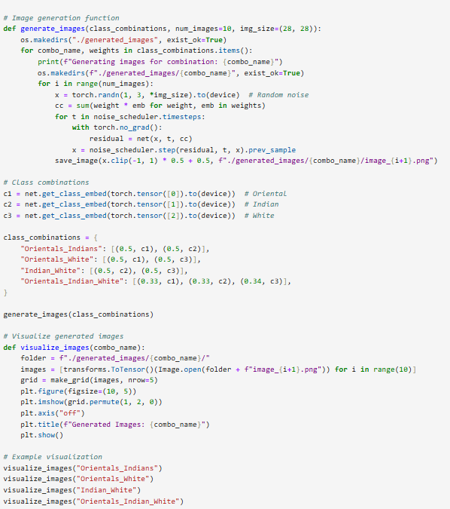
Image Generation Process
1. Class Conditioning: Class embeddings blended for ethnic combinations.
2. Noise Scheduler: DDPMScheduler modeled the denoising steps.
3. Outputs: Generated images for blends like Indian + Oriental + European
Indian + Oriental
Oriental + European
Indian + European.
4. Visualization: Grid layouts to showcase results.

Slide 8
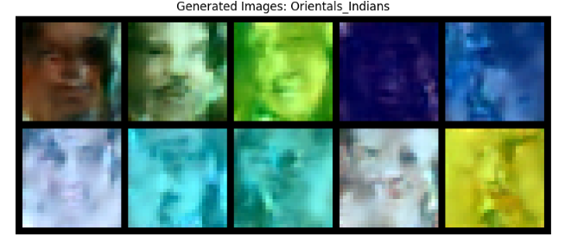
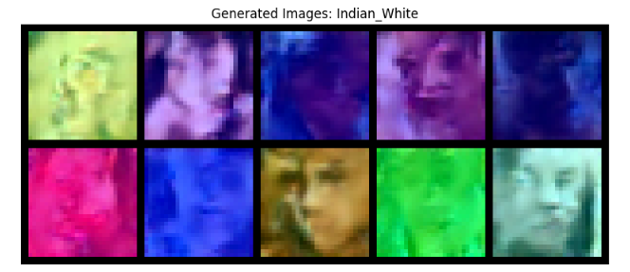
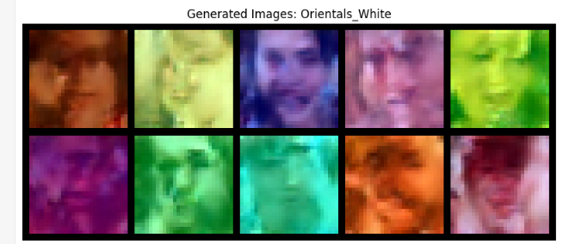
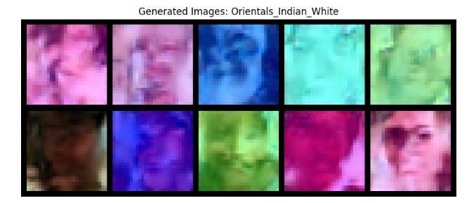
Results

Slide 9
Challenges and Solutions
1. Low Resolution: 28x28 pixels limited detail; memory constraints necessitated compromise.
2. Training Time: Long epochs due to complex architectures; cosine scheduler mitigated time.
3. Limited Experimentation: Resource constraints limited hyperparameter tuning.

Slide 10
Conclusion
1. Achievements:
- Generated diverse, realistic images.
2. Limitations:
- Resource and resolution constraints.
3. Future Scope:
- Improve resolution and diversity.
- Optimize training with better hardware.

