Slide 1
Teradata Installation
Class 1 – 11/4/2018

Slide 2
Installation Steps
Prerequisites: Since the VM is 64 bit, your CPU must support 64-bit
Installation Steps for Windows
Step 1 − Download the required VM version from the link, https://downloads.teradata.com/download/database/teradata-express-for-vmware-player
Step 2 − Extract the file and specify the target folder.
Step 3 − Download the VMWare Workstation player
https://my.vmware.com/en/web/vmware/free#desktop_end_user_computing/vmware_workstation_player/15_0
Step 4 − Once the download is complete, install the software.

Slide 3
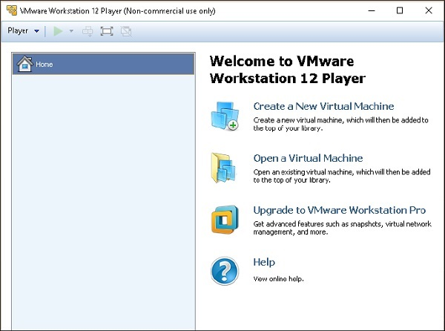
Installation Steps
Step 5 − After the installation is complete, run the VMWARE client.
Step 6 − Select 'Open a Virtual Machine'. Navigate through the extracted Teradata VMWare folder and select the file with extension .vmdk.

Slide 4
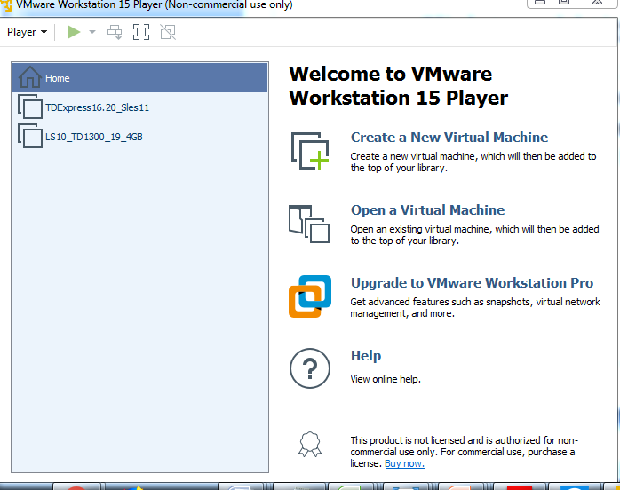
Installation Steps
Step 7 − Teradata VMWare is added to the VMWare client. Select the added Teradata VMware and click ‘Play Virtual Machine’.

Slide 5
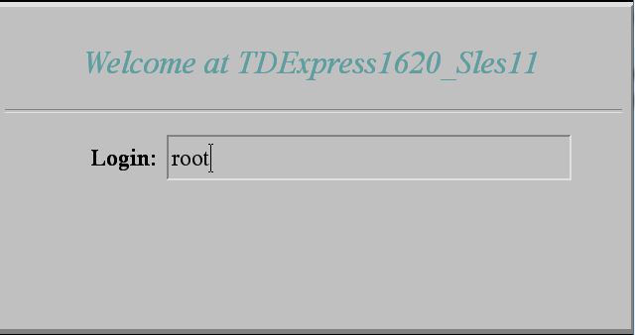
Installation Steps
Step 8 − If you get a popup on software updates, you can select ‘Remind Me Later’.
Step 9 − Enter the user name as root, press tab and enter password as root and again press Enter.

Slide 6
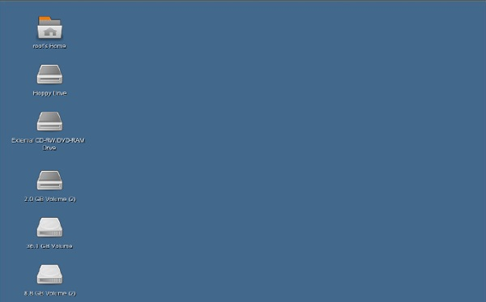
Installation Steps
Step 10 − Once the following screen appears on the desktop, double-click on ‘root’s home’. Then double-click on ‘Genome’s Terminal’. This will open the Shell.

Slide 7
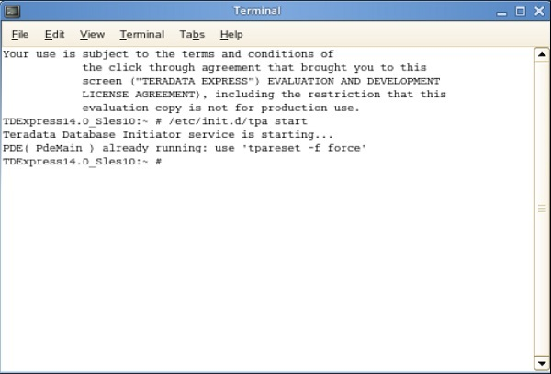
Installation Steps
Step 11 − From the following shell, enter the command /etc/init.d/tpa start. This will start the Teradata server.

Slide 8
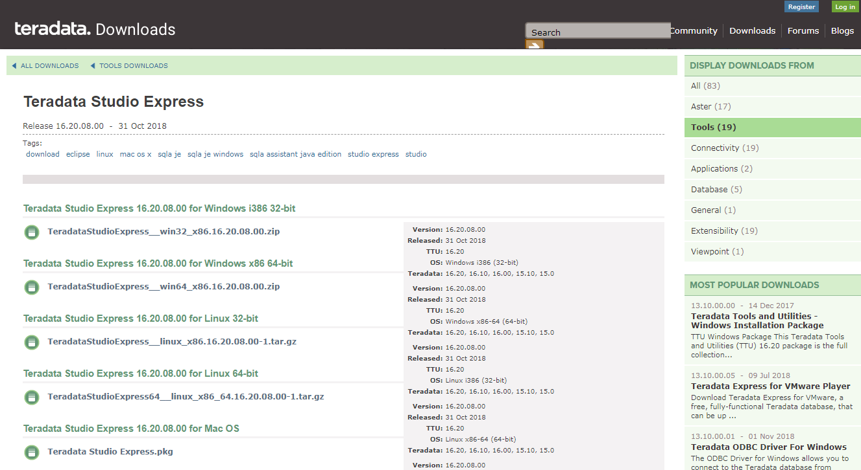
Installation Steps
Step 12 − Download the TD Express https://downloads.teradata.com/download/tools/teradata-studio-express . Download TeradataStudioExpress__win32_x86.16.20.08.00.zip

Slide 10
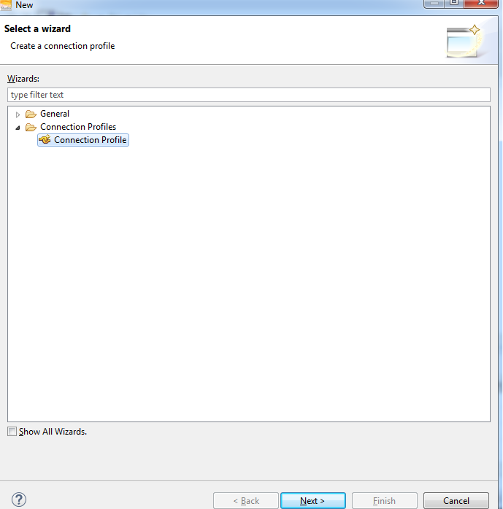
Installation Steps
Step 12: Go to the Start Programs – Teradata Express – connection

Slide 11
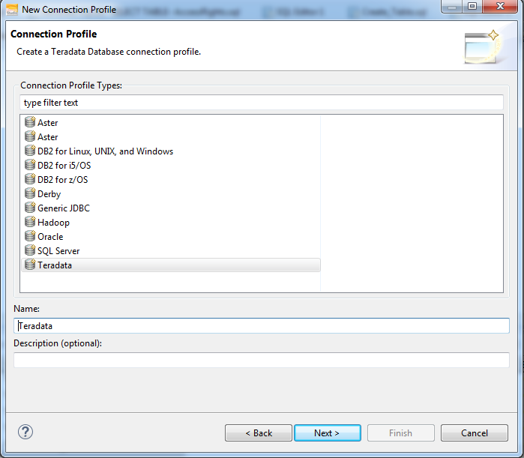
Installation Steps
Step 13: Choose Teradata and Name: Teradata then, click Next

Slide 12
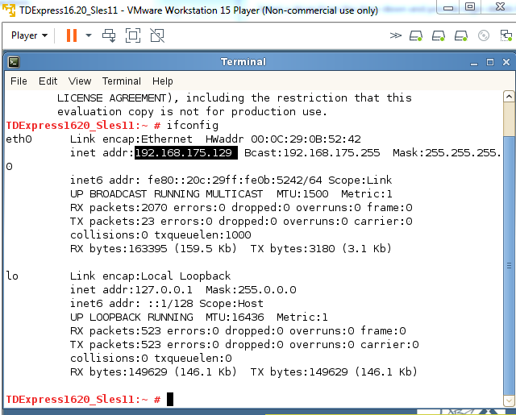
Installation Steps
Step 14: Go to VMWare – Gnome Terminal and type ifconfig you will get the IP Address

Slide 13
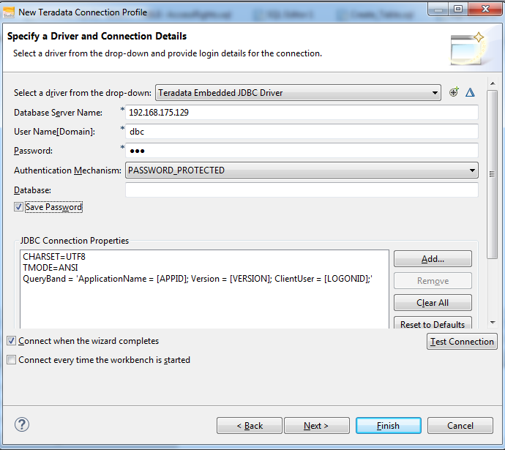
Installation Steps
Step 15: Database Servername: your IP address, Username:dbc, Password dbc then click on Test Connection

Slide 14
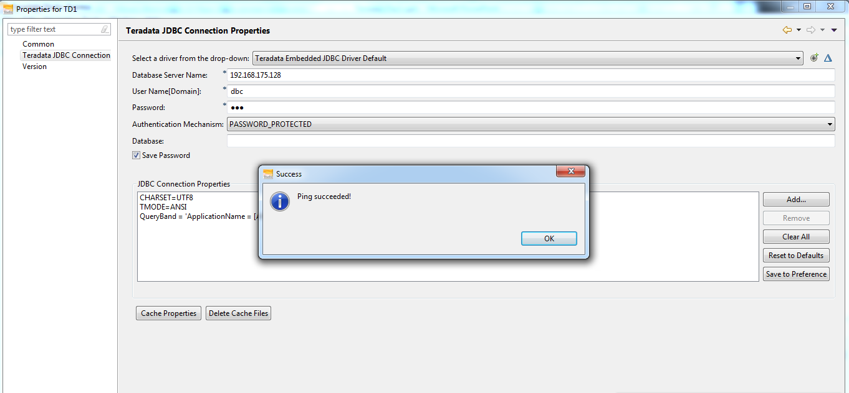
Installation Steps
Step 16: The following popup should be appeared then, Teradata connection to Database is successful

Slide 15
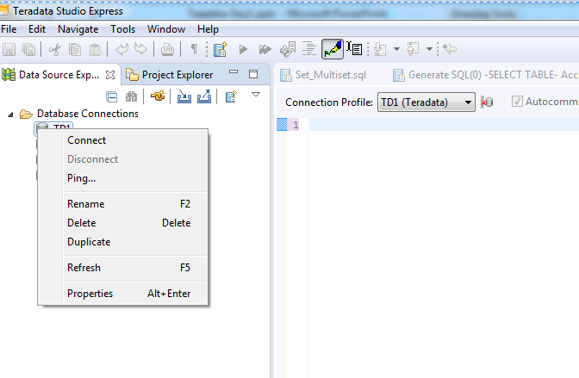
Installation Steps
Step 17: Click on OK then, Go to Database connections Right Click on TD1 then connect

Slide 16
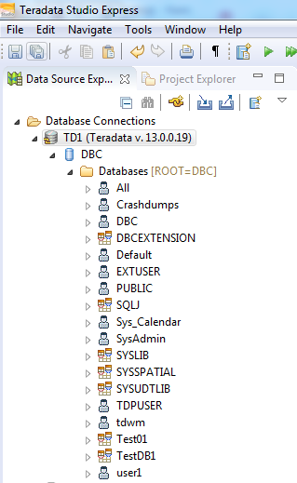
Installation Steps
Step 19: Double Click on TD1 then, you can see the following Databases

Slide 17
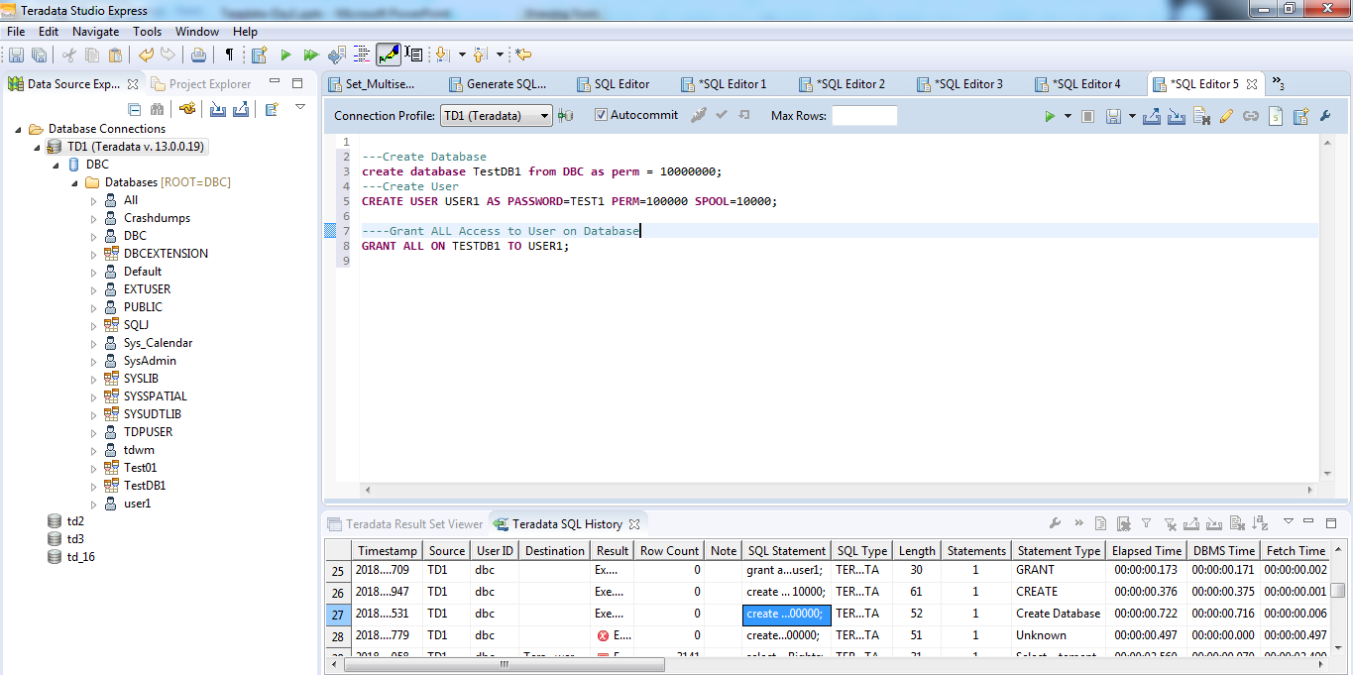
Installation Steps
Step 20: To Create new database, user and grant access write the script on right side:

Slide 18
Syntax
Create Database Syntax:
CREATE DATABASE TESTDB1 FROM DBC AS PERM = 100000000;
Create User Syntax:
CREATE USER USER1 AS PASSWORD=TEST1 PERM=100000 SPOOL=10000;
Grant Access to the user on Database
GRANT ALL ON TESTDB1 TO USER1;
Now you all set to rock on Teradata SQL Platform !!!!

