Slide 1
SYLLOGISM

Slide 2
Syllogism is an important section on logical reasoning and hence its comprehension needs more than normal attention. It is a very interesting topic where the logical thinking and the decision making skills are highly tested.
The term syllogism means inference or conclusion drawn from the statements. The question of syllogism can be solved with the help of venn diagrams.

Slide 3
In syllogism, a statement of certain relation between two or more terms is analogous to a sentence is grammar.
The proposition consists of three parts, namely subject, predicate and copula.
Subject: The subject is about which something is said.
Predicate: The predicate is the part of the proposition denoting which is affirmed or denied about the subject.
Copula: The copula is that part of the proposition which denotes the relation between the subject and the predicate.

Slide 4
Example:
Consider the proposition ‘Man is intelligent’.
Here the information is given about the man.
So ‘Man’ is the subject.
‘Intelligent’ is the quality affirmed for this subject. So it is the predicate.
‘Is’ denotes the relation between the subject and the predicate. So, it is the copula.

Slide 5
Structure of the Question
Syllogism questions always starts with the directions to answer.
In each question we could find two segments i.e., statements and conclusions.
Always consider the information provided in the statements is true.
Check whether the conclusions follow the statements and answer as per the direction.

Slide 6
Reap to Remember
Four possible forms of statements or conclusions:
1. All A is B.
2. Some A is B.
3. Some A are not B.
4. No A is B.
Applying the Venn diagram method will be very easy to solve any question. Go through the following basic representations of the statements.

Slide 7
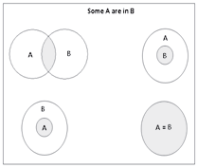
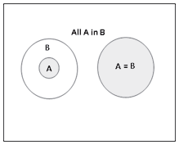
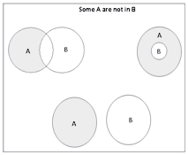
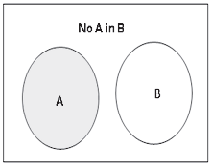
Possible Diagrams:

Slide 8
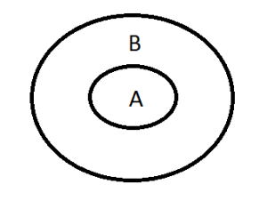
CONCEPT 1 – All A is B
The Diagram is,
The Possible conclusions are,
All A is B.
Some A is B.
Some B is A.

Slide 9
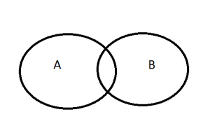
CONCEPT 2 - Some A is B.
The Diagram for Some A is B is
The possible conclusions are,
1) Some A is B
2) Some B is A

Slide 10
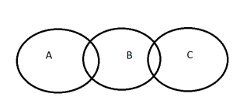
CONCEPT 3 – Some A is B and Some B is C
The Diagram is,
Now the Possible Conclusions are,
Between A and B Between B and C
Some A is B Some B is C
Some B is A Some C is B
There is no DIRECT CONNECTION between A and C. So it is not possible to derive any conclusion between A and C.

Slide 11
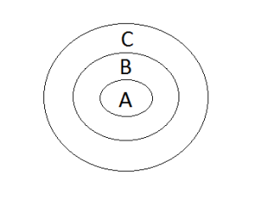
CONCEPT 4 – All A is B and All B is C
The Conclusions are,
Between A and B Between B and C Between A and C
All A is B. All B is C. All A is C.
Some A is B. Some B is C. Some A is C.
Some B is A. Some C is B. Some C is A.

Slide 12
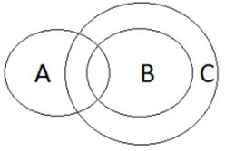
Concept 5 – Some A is B, All B is C.
The possible conclusions are,
Between A and B Between B and C Between A and C
Some A is B All B is C Some A is C
Some B is A Some B is C Some C is A
Some C is B

Slide 13
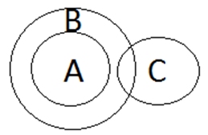
Concept 6 – All A is B and Some B is C
The possible conclusions are,
Between A and B Between B and C
All A is B Some B is C
Some A is B Some C is B
Some B is A
There is no DIRECT CONNECTION between A and C. So it is not possible to derive any conclusion between A and C.

Slide 14
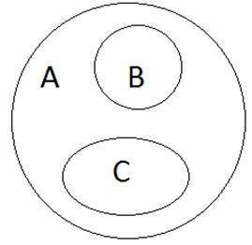
Concept 7 – All B is A and All C is A
The Possible Conclusions are,
Between A and B Between A and C
All B is A All C is A
Some B is A Some C is A
Some A is B Some A is C
There is no DIRECT CONNECTION between B and C. So it is not possible to derive any conclusion between B and C.

Slide 15
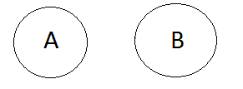
Concept 8 – No A is B
The Possible Conclusions are,
No A is B
No B is A
Some A is not B
Some B is not A

Slide 16
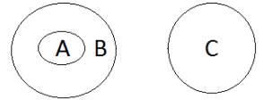
Concept 9 – All A is B and No B is C
The Possible Conclusions are,
Between A and B Between B and C Between A and C
All A is B No B is C No A is C
Some A is B No C is B Some A is Not C
Some B is A Some B is not C
Some C is not B

Slide 17
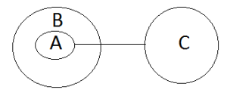
Concept 10 – All A is B and No A is C
The Possible Conclusions are,
Between A and B Between A and C Between B and C
All A is B No A is C Some B is not C
Some A is B No C is A
Some B is A Some A is not C
Some C is not A

Slide 18
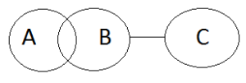
Concept 11 – Some A is B; No B is C
The Possible Conclusions are,
Between A and B Between B and C Between A and C
Some A is B No B is C Some A is not C
Some B is A No C is B
Some B is not C
Some C is not B

Slide 19
Concept 11 – Some A is B; No B is C
The Possible Conclusions are,
Between A and B Between B and C Between A and C
Some A is B No B is C Some A is not C
Some B is A No C is B
Some B is not C
Some C is not B

Slide 20
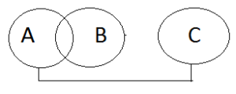
Concept 12 – Some A is B; No A is C
The Possible Conclusions are,
Between A and B Between A and C Between B and C
Some A is B No A is C Some B is not C
Some B is A No C is A
Some A is not C
Some C is not A

Slide 21
Practice questions:
Directions for Q1 to Q8:
In each question below are two statements followed by conclusions numbered 1 and 2. Read all the conclusions and then decide which of the given conclusions logically follows from the statements.
Give answer:
• (A) if only (1) conclusion follows
• (B) if only (2) conclusion follows
• (C) if either (1) or (2) follows
• (D) if neither (1) nor (2) follows and
• (E) if both (1) and (2) follow.

Slide 22
1. Statements:
No file is an elephant.
All elephants are caps.
Conclusions:
I. Some caps are elephants.
II. Some files are caps.
Ans: A
2. Statements:
Some books are birds.
Some birds are fingers.
Conclusions:
I. Some fingers are books.
II . Some fingers are birds.
Ans: B

Slide 23
3. Statements:
All books are shrubs.
All trees are shrubs.
Conclusions:
I . Some shrubs are books.
II . Some shrubs are trees.
Ans: E
4. Statements:
All nails are ears.
Some ears are eyes.
Conclusions:
I . All ears are nails.
II . Some eyes are nails.
Ans: D

Slide 24
5. Statements:
Some apartments have electricity.
Some boats have electricity.
Conclusions:
A. Some apartments have boats
B. Some boats have apartments
C. All boats have apartments
D. None of the above
Ans: D

Slide 25
6. Statements:
Some AB is CD.
No CD is EF.
Conclusions:
A. Some AB is No EF
B. Some EF is AB
C. Some AB is EF
D. None of the above
Ans: A

Slide 26
7. Statements:
No *** are ###.
Some ^^^^ are ###.
Conclusions:
A. Some ^^^^ are ***
B. Some *** are no ^^^^
C. Some ^^^^ are no ***
D. None of the above
Ans:

Slide 27
8. Statements:
Some cars are four-wheelers.
All cars are tricycles.
Conclusions:
A. No tricycles are four-wheelers
B. All four-wheelers are tricycles
C. Some tricycles are four-wheelers
D. None of the above
Ans: C

Slide 28
9. Statements:
All smart are dumb.
Some bad are smart.
Conclusions:
A. All dumb are bad.
B. Some dumb are bad.
C. No bad are dumb.
D.none.
Ans: B

Slide 29
10. Statements:
All cities have houses.
All lands have cities.
Conclusions:
A. All houses have lands
B. All lands have houses
C. Not all houses have lands
D. None of the above
Ans: B and C

Slide 30
11. Statements :
All kitchens have closets.
All closets have shelves.
Conclusions:
A. Some kitchens have not shelves
B. All shelves have kitchens
C. All kitchens have shelves
D. None of the above
Ans: C

Slide 31
12. Statements :
All ambulances are life savers.
No ambulances are bumper cars.
Conclusions:
A. No life savers are bumper cars
B. No bumper cars are life savers
C. Some life savers are not bumper cars
D. None of the above
Ans: C

Slide 32
13. Statements:
All dogs are brown.
All pit bulls are brown.
Conclusions:
A. Some pit bulls are dogs
B. Some pit bulls are not dogs
C. All pit bulls are dogs
D. None of the above
Ans: D

Slide 33
14. Statements:
Some books are no reference books.
All books are encyclopedias.
Conclusions:
A. Some reference books are not encyclopedias
B. No reference books are encyclopedias
C. All reference books are encyclopedias
D. None of the above
Ans: A

Slide 34
15. Statements:
Some vans are cars.
Some cars are roads.
Conclusions:
I. Some roads are vans.
II . Some cars are vans.
III. No van is road.
IV. Some roads are cars.
(a) Only II and III follow
(b) Only I and IV follow
(c) Only II and IV follow
(d) None of these
Ans: C

Slide 35
16. Statements:
All outlaws are meek.
Some meek (men) are clever.
All clever (men) are foolish.
Conclusions:
I. Some foolish (men) are outlaws.
II. No foolish (man) is outlaw.
III. Some meek (men) are foolish.
IV. All clever (men) are meek
(a) None of these
(b) Only I or II follows
(c) Only III and IV follow
(d) Only I or II and III follow
Ans: D

Slide 36
17. Statements:
Some papers are balls.
Ball is not spherical.
Conclusions:
I . Some papers are spherical.
II. Some balls are spherical.
III . Some papers are not spherical.
IV . Some balls are papers.
(a) Only III follows
(b) Only IV follows
(c) Either III or IV follows
(d) Only III and IV follow
Ans: D

Slide 37
18. Statements:
Some fowls are insects.
All fowls are butterflies.
All insects are snakes.
Conclusions:
I. Some snakes are fowls.
II. Some butterflies are insects.
III. Some snakes are butterflies.
IV. Some insects are fowls.
(a) All follow
(b) Only IV follows
(c) Either I or III follows
(d) None of these
Ans: A

Slide 38
19. Statements:
All men are women.
All women are crazy.
Conclusions:
I. All men are crazy.
II. All the crazy are men.
III. Some of the crazy are men.
IV. Some of the crazy are women.
(a) None of the conclusions follow
(b) All the conclusions follow
(c) Only I, III & IV follow
(d) Only II & III follow
Ans: C

Slide 39
20. Statements:
All chairs are tables.
Some tables are sofa sets.
Conclusions:
I. Some sofa sets are chairs
II. All sofa sets are chairs.
III. Some chairs are sofa sets.
IV. All chairs are sofa sets.
(a) All the conclusions follow
(b) Only I & II follow
(c) None of the conclusions follow
(d) Only II & III follow
Ans: c

Slide 40
21. Statements:
Some books are benches.
No bench is a table.
Conclusions:
I. Some books are tables.
II. Some benches are books.
III. All benches are books.
IV. Some tables are books.
(a) Only I follows
(b) Only II follows
(c) Only II & IV follow
(d) None of the conclusions follow
Ans: B

Slide 41
22. Statements:
Some donkeys are elephants.
Some elephants are cats.
Conclusions:
I. Some cats are donkeys.
II. Some donkeys are cats.
III. Some elephants are donkeys.
IV. Some cats are elephants.
(a) None of the conclusions follow
(b) Only III & IV follow
(c) All the conclusions follow
(d) Only I, II & IV follow
Ans: B

Slide 42
23. Statements:
1. Some singers are rockers
2. All rockers are westerners
Conclusions:
I. Some rockers are singers
II. Some westerners are rockers
III. Some singers are westerners
IV. Some singers are not westerners
a) I,II and III follow
b) I,II and IV follow
c) II, III and IV follow
d) I,III and IV follow
e) All follow
Ans: A

Slide 43
24. Statements:
1. All cats are bulls
2. Some bulls are dogs
Conclusions:
I. All bulls are cats
II. Some cats are dogs
III. No cats are dogs
IV. Some bulls are cats
a) Only IV follows
b) Only III follows
c) Only II follows
d) Only IV and II follow
e) IV and either II or III follow
Ans: E

Slide 44
25. Statements:
1. All pigs are elephants
2. No pigs are bakers
Conclusions:
I. Some bakers are not pigs
II. Some pigs are not bakers
III. Some elephants are not bakers
IV. Some bakers are not elephants
a) I, II and III follow
b) I, II and IV follow
c) I, III and IV follow
d) II, III and IV follow
e) All follow
Ans: A

Slide 45
Directions for Q26 and Q27:
Each question contains six statements followed by four sets of combinations of three.
Choose the set in which the combinations are logically related such that the third statement is the conclusion drawn from the preceding two statements.

Slide 46
26.
A. All roses have thorns.
B. All roses have nectar.
C. All plants with nectar have thorns.
D. All shrubs have roses.
E. All shrubs have nectar.
F. Some roses have thorns.
BEF
ABC
BDE
ACF
Ans: C

Slide 47
27.
A. Some buildings are not skyscrapers.
B. Some skyscrapers are not buildings.
C. No structure is a sky scrapper.
D. All skyscrapers are structures.
E. Some skyscrapers are buildings.
F. Some structures are not buildings.
ACE
BDF
FDA
ACF
Ans: B

Slide 48
28. If “Some kings are soldiers,
no soldier is revolutionary”, which
of the following conclusions is logical?
(a) Some soldiers are not revolutionary.
(b) All revolutionaries are soldiers.
(c) All soldiers are kings.
(d) None of these
Ans: D

Slide 49
Directions for Q29 and Q30:
Each question has a set of four statements. Each statement has three segments. Choose the alternative where the third segment in the statement can be logically deduced using both the preceding two, but not just from one of them.

Slide 50
29.
A. No cowboys laugh. Some who laugh are sphinxes. Some sphinxes are not cowboys.
B. All ghosts are florescent. Some ghosts do not sing. Some singers are not florescent.
C. Cricketers indulge in swearing. Those who swear are hanged. Some who are hanged are not cricketers.
D. Some crazy people are pianists. All crazy people are whistlers. Some whistlers are pianists.
A and B
C only
A and D
D only
Ans: C

Slide 51
30.
A. Dinosaurs are prehistoric creatures. Water-buffaloes are not dinosaurs. Water-buffaloes are not prehistoric creatures.
B. All politicians are frank. No frank people are crocodiles. No crocodiles are politicians.
C. No diamond is quartz. No opal is quartz. Diamonds are opals.
D. All monkeys like bananas. Some GI Joes like bananas. Some GI Joes are monkeys.
C only
B only
A and D
B and C
Ans: B

Slide 52


