Slide 1
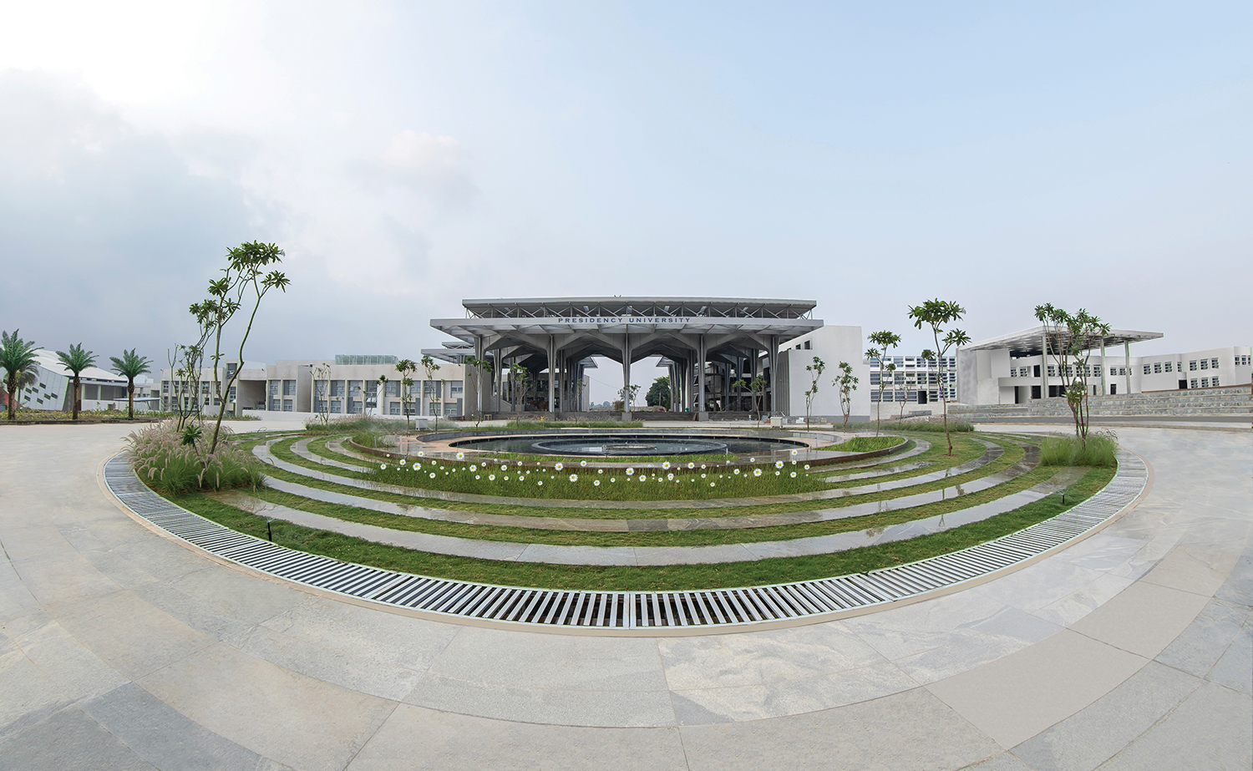

Mini Project (CSE7102)
REVIEW-2
26-09-2026
Presidency
School of Computer Science and Engineering

Slide 2
Waterborne Disease Outbreak Risk Prediction System (ML + GIS)
CSS7102- Mini Project Review-2
Project ID: PRJ_441
Panel No: [Your Panel No]
Group members details:
Under the Supervision of,
[Faculty Mentor / Project Guide Name]
Assistant / Associate Professor
School of Computer Science and Engineering
Presidency University
Sl.No | Student Name | Roll Number
1 | Sriram (Team Leader) | [Roll Number 1]
2 | [Team Member 2 Name] | [Roll Number 2]
3 | [Team Member 3 Name] | [Roll Number 3]
Name of the Program(s): B.Tech - Computer Science and Engineering
Name of the HoD (Team Leader's): Dr. [HoD Name]
Name of the Program Project Coordinator: Dr./Prof. [Coordinator Name]
Name of the School Project Coordinators: Mr. Muthuraju V

Slide 3
INDEX
1. Problem Statement & Motivation
2. Project Objectives
3. Literature & Research Understanding
4. Methodology & System Architecture
5. Implementation Progress (Review-2: 60% Milestone)
6. Individual Team Contributions

Slide 4
Problem Statement:
• The 48-Hour Biological Lab Delay:
- Traditional microbiological testing for waterborne pathogens (Cholera, Typhoid) takes 24 to 72 hours for bacterial culture incubation.
- Contaminated municipal water infects communities during this testing lag before official advisories can be issued.
• Existing Research & System Gap:
- Current water monitoring relies on delayed, manual laboratory schedules without automated early warning.
- Standard systems lack geographic decision-support mapping linking water chemistry to public health response.
• Affected Stakeholders & Impact:
- Urban settlements, rural districts, flood-affected areas, and public health authorities.
- Unsafe drinking water causes over 500,000 diarrheal deaths annually worldwide (WHO).

Slide 5
Objectives
1. Real-World Data Ingestion & Imputation:
- Ingest 3,276 real laboratory water samples from the Kaggle benchmark dataset and apply Median Imputation to 1,434 NaNs without data loss.
2. Domain-Specific Feature Engineering:
- Formulate a Contamination Risk Index (CRI) from Turbidity, Organic Carbon, and Trihalomethanes, and compute WHO pH safe envelope deviation.
3. Machine Learning Classification & Benchmarking:
- Train and benchmark a Random Forest Classifier against Logistic Regression on an 80/20 stratified split with balanced class weighting.
4. GIS Spatial Surveillance & Municipal Advisory Automation:
- Develop an interactive GIS map (outbreak_risk_map.html) categorizing monitoring nodes into Critical, Moderate, and Safe tiers with automated disease alerts.

Slide 6
Literature/research understanding
• Key Existing Studies & Standards:
- WHO Drinking-Water Quality Guidelines (4th ed., 2022): Established safe baseline limits for pH (6.5-8.5), Turbidity (<5 NTU), and Chloramines (4 ppm).
- Kaggle Water Potability Benchmarks (2021-2024): Confirmed published academic accuracy benchmark of 64%-68% due to low linear feature correlations.
• Limitations of Existing Work:
- Lab culture methods suffer from a 48-hour testing lag.
- Prior ML projects treat potability purely as an isolated CSV classification (0/1) without spatial GIS mapping or public health action protocols.
• Identified Research Gap:
- Need for an integrated, real-time decision-support system that converts instant chemical sensor readings into spatial outbreak risk intelligence.

Slide 7
Methodology and Architecture
• 5-Tier System Architecture:
1. Data Ingestion Tier: Ingestion of 3,276 water test records (9 chemical features + Potability target).
2. Preprocessing Tier: Profiling missingness (1,434 NaNs) and applying outlier-robust Median Imputation.
3. Feature Engineering Tier: Computing CRI index, WHO pH deviation, and quantile risk tiers.
4. ML Modeling Tier: 200-tree Random Forest Classifier vs. standardized Logistic Regression.
5. GIS Surveillance Tier: Folium multi-layer spatial map with automated municipal action protocols.
• Object-Oriented Software Architecture (pipeline_oop.py):
- Modular classes: DataLoader, DataCleaner, FeatureEngineer, ModelTrainer, Visualizer, and WaterborneDiseasePipeline orchestrator.

Slide 8
Implementation Progress
• Current Milestone Status: ~60% Implemented (Minimum 50% Review-2 requirement exceeded).
• Implemented & Verified Modules:
- Data Cleaning & Preprocessing: 100% complete (1,434 NaNs imputed, 0 duplicates, 0 data loss).
- Feature Engineering: 100% complete (CRI & pH deviation formulations verified).
- Model Benchmarking: Random Forest achieves 62.96% accuracy (beats naive 61% baseline; matches academic 64-68% benchmark); Logistic Regression achieves 50.46%.
- Diagnostics & Feature Importance: Sulfate (15.6%), pH (12.2%), Hardness (11.3%) identified as top drivers.
- GIS Outbreak Surveillance: outbreak_risk_map.html functional with CartoDB, Esri, and Satellite views.
- Code Architecture: Clean Object-Oriented pipeline (pipeline_oop.py) committed to GitHub.

Slide 9
Individual Contribution
• Student 1: Sriram (Team Leader)
- Problem definition, real-world lab delay analysis, data ingestion & Median Imputation logic (01_data_loading_and_cleaning.py).
- Object-Oriented software architecture design (pipeline_oop.py) and GitHub repository management.
• Student 2: [Team Member 2 Name]
- Domain feature engineering (CRI formulation, pH deviation), 80/20 stratified split, and Random Forest vs. LR training (02, 03).
- Gini feature importance extraction and diagnostic visualization generation (feature_importance.png).
• Student 3: [Team Member 3 Name]
- GIS spatial surveillance engine (gis_outbreak_mapper.py), Folium multi-layer mapping, and outbreak_risk_map.html.
- Epidemiological pathogen vector rules (Cholera, Typhoid) and automated municipal action protocol generation.

Slide 10
Github Link
• Public GitHub Repository URL:
https://github.com/Sriram-012/waterborne-disease-prediction
• Verified Repository Contents (Public Access):
- 01_data_loading_and_cleaning.py (Data Ingestion & Median Imputation)
- 02_feature_engineering.py (CRI & pH Deviation Formulas)
- 03_model_training.py (Random Forest vs. Logistic Regression Benchmarking)
- 04_feature_importance.py (Gini Importance & Correlation Heatmap)
- pipeline_oop.py (Enterprise Object-Oriented Architecture)
- gis_outbreak_mapper.py & outbreak_risk_map.html (Interactive GIS Spatial Engine)
- run_all.py (Master 5-Stage Execution Runner)

Slide 11
Conclusion
• Key Findings & Achievements (Review-2):
- Proved feasibility of using rapid chemical water parameters as an early-warning proxy before 48-hour bacterial lab cultures arrive.
- Random Forest (62.96%) successfully models non-linear chemical thresholds, outperforming linear models.
- Built an operational GIS prototype translating ML risk scores into localized public health advisories.
• Roadmap for Remaining 40% (Final Review):
- 5-Fold Stratified Cross-Validation & Hyperparameter Tuning (GridSearchCV).
- Class imbalance handling using SMOTE oversampling.
- Interactive Streamlit web interface for municipal operators.
- Real-time IoT sensor data streaming integration.

Slide 12
References (IEEE Paper format)
[1] World Health Organization. (2022). Guidelines for drinking-water quality (4th ed.). Geneva: WHO Press.
[2] Kadiwal, A. (2021). Water Potability Dataset: Water Quality Metrics for Potability Prediction. Kaggle Benchmark Dataset.
[3] Breiman, L. (2001). Random Forests. Machine Learning, 45(1), 5-32.
[4] Pedregosa, F., et al. (2011). Scikit-learn: Machine Learning in Python. Journal of Machine Learning Research, 12, 2825-2830.
[5] Few, R., Lake, I., & Hunter, P. R. (2013). Floods, health and climate change: a strategic review. Tyndall Centre for Climate Change.
[6] Saha, S., & Bhowmik, S. (2020). Water quality index prediction using machine learning algorithms. Environmental Monitoring and Assessment, 192(11), 1-28.

Slide 13


