Slide 1
AEROVISION
Real-Time Flight Intelligence & Accessible Airport Portal
Presented by:
Sriram Bhaskara
USN - 1CR25CS187
Suhaas S Reddy
USN - 1CR25CS188
Ratan Ojha
USN - 1CR25EC167
Rechitha V
USN - 1CR25EC168
Mini Project Presentation | Semester 4

Slide 2
PROBLEM STATEMENT
The Challenges of Modern Air Travel
01 | Fragmented Flight Updates
Passengers struggle with delayed or out-of-sync flight tracking data scattered across different airline systems and boards.
02 | No Road Traffic Predictability
Existing navigation maps show static travel times that fail to account for Bengaluru's severe peak-hour traffic gridlocks on the way to BLR Airport.
03 | Terminal Congestion Blindspots
Travelers face unpredictable security and check-in queue lengths, causing stress and poor time management inside terminal halls.
04 | Inaccessible Assistance Booking
Elderly or disabled passengers endure slow manual paperwork and verification barriers when requesting buggy or wheelchair services.

Slide 3
OUR SOLUTION
AeroVision — A Unified Flight-Driven Intelligence & Navigation App
Live FIDS & Space Radar
An integrated departures/arrivals board coupled with a moving aircraft tracking map that visualizes approaches and departures relative to airport coordinates.
Indoor Pathfinding Navigation
Interactive SVG maps of Terminal 1 and Terminal 2 mapping gates, restaurants, and baggage belts with built-in route planning for passengers.
Flight-Driven Crowd Analytics
Estimates terminal check-in, security, and immigration queue wait-times dynamically based on real-time flight density and passenger load equations.
Assist & Travel Planner
Features browser-based Aadhaar OCR checking to auto-approve senior assistance, and OSRM route calculations using time-of-day traffic multipliers.

Slide 4
TECHNOLOGY STACK
Frontend Stack
• React.js 18 (Component-based architecture)
• Vite (Next-generation frontend toolchain)
• Tailwind CSS (Adaptive design tokens)
• Leaflet.js (Interactive airspace radar)
• Axios (JWT authorization interceptors)
• Tesseract.js (Client-side image OCR)
Backend & DB
• Node.js (Server runtime engine)
• Express.js (REST API endpoint router)
• SQL.js (SQLite-compatible backend DB)
• Socket.IO (WebSocket push event engine)
• node-fetch (External API connection client)
• Helmet & Compression (Security & speed)
External APIs & Feeds
• AeroDataBox API (Schedules & gates)
• OpenWeather API (Airfield METAR weather)
• OpenRouteService (Travel planning geocode)
• OSRM Project (Keyless driving routing)
• Nominatim (Alternative geocoding feed)
• Hugging Face Inference (AI chat completions)

Slide 5
HOW IT WORKS
01 | Flight Search & FIDS
User logs in, enters a flight number. The backend queries AeroDataBox API (or local mock DB) to retrieve schedules, gate numbers, and terminal routes.
02 | Travel Route Plan
The user inputs their location. OSRM computes the driving distance and the backend applies IST-based traffic multipliers for a realistic commute duration.
03 | Queue Wait Estimation
The crowd engine calculates check-in, security, and immigration density levels based on flight counts and passenger loads in a 3-hour window.
04 | Mobility OCR Booking
The user uploads an Aadhaar card. Client-side Tesseract.js extracts the DOB, verifies senior status, and auto-approves wheelchair/buggy booking.

Slide 6
KEY FEATURES
Live Flight Board
Real-time departures and arrivals with dynamic gate, terminal, and status updates, supported by live cron refreshes.
Airspace Radar Map
Interactive map plotting moving flights. Real-time trajectory rendering based on active flight windows (90 mins).
Interactive SVG Terminal
Detailed indoor terminal layout showing gates, lounges, restrooms, and shops with route drawing pathfinding.
Zone Queue Congestion
Real-time queue wait-time calculations for check-in and security driven by passenger volumes and delays.
Traffic Travel Planner
GPS-based route mapping with automatic peak/off-peak travel time adjustments matching Bangalore traffic hours.
AI Chatbot Assistant
Context-aware AI assistant answering passenger queries about gates, airport services, and airport directions.

Slide 7
CHALLENGES & SOLUTIONS
⚠️ CHALLENGE
✔️ SOLUTION
Database Concurrency Crashes
SQL.js wrapper threw errors on `.catch` calls when executing queries.
Converted the query method to `async` to wrap row outputs in promises, resolving crashes.
Routing API Key Restrictions
TomTom API keys got revoked, blocking geocoding and travel route planning.
Replaced TomTom with OpenRouteService, and integrated keyless OSRM/Nominatim fallbacks.
Vite CSS Tailwind Purging
Babel JSX compile error broke Hot Module Reloading, causing unstyled components.
Fixed raw unicode character syntax in NotificationPanel, cleared Vite cache, and rebuilt CSS.
Radar Plane Clustering
Simulated planes clustered in static circles right on top of the airport.
Created a rolling 90-minute time-window filter for active flights, dispersing planes along vectors.
Inaccurate Commute Times
Default OSRM route durations ignored Bengaluru's extreme street gridlocks.
Implemented dynamic time-of-day traffic multipliers in IST (e.g. 1.95x during peak office hours).

Slide 8
FUTURE ENHANCEMENTS
AI Computer Vision Queue Monitoring
Integrate airport CCTV cameras with AI object-detection models (like YOLO) to scan video feeds and count the exact number of people in lines, providing 100% accurate queue wait-times.
Indoor Turn-by-Turn GPS (Beacons)
Deploy Bluetooth Low Energy (BLE) beacons inside the terminal to enable real-time, blue-dot turn-by-turn navigation guiding passengers from check-in directly to boarding gates.
DigiYatra / Biometric Integration
Incorporate facial recognition API endpoints to let passengers authenticate their identity and verify mobility assistance bookings instantly via a quick face scan.
Predictive Baggage Tracking (RFID)
Utilize IoT RFID luggage tracking to display a live baggage status panel on the passenger dashboard showing exactly where their luggage is (loading, unloading, or carousel).

Slide 9
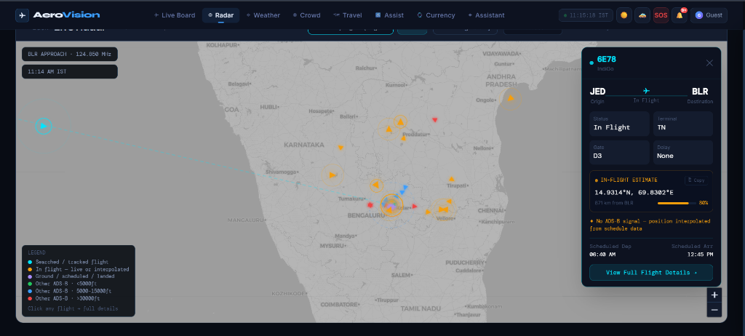

Slide 10
CONCLUSION
AeroVision
“A production-ready aviation intelligence web application for Kempegowda International Airport (BLR), Bengaluru, integrating live flight boards, terminal pathfinding, passenger crowd density analytics, and smart accessibility booking.”
[ Accessibility-First Design ] · [ Verified API Resilience ] · [ Dynamic Operation Modeling ]
Thank You!
Questions & Feedback Welcome

