Slide 1

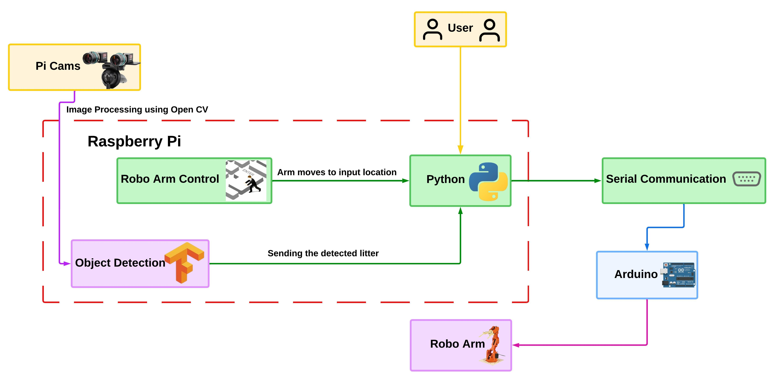

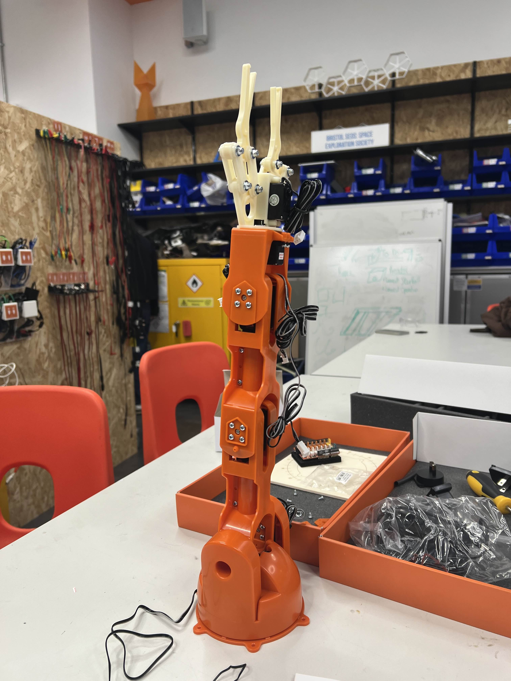
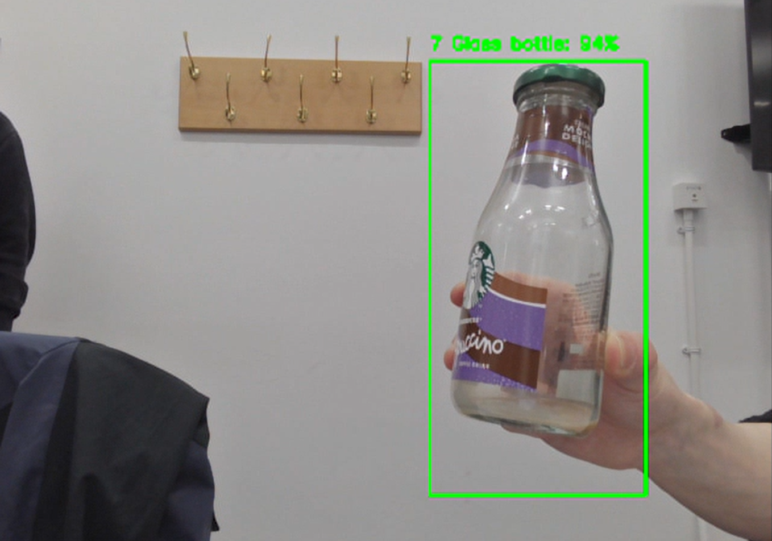
Litter Recognition
An Autonomous System to Collect and Identify Litter…
TEAM: Ryan, Jack, Hanzhong, Sriram, Jude
CLIENT: Ben Scott-Robinson
CLIENT BRIEF
Goals:
As a Client, I would like a proof-of concept autonomous that can identify and dispose of 6 key types of litter...
To optimize the currently inefficient process of highway litter collection.
  Currently lanes must be closed to allow costly trucks with hand pickers to collect the trash.
  This is expensive and leaves litter that can harm and kill animals
Create a proof-of-concept autonomous system that can identify and pick up different types of litter.
How it works?
Our project consists of an Arduino Braccio robotic arm and two C270 Logitech webcams. Our project runs on a system connected to these pieces of hardware and, using a TFLite detection model, detects litter in the video feed sent back by the webcams. If litter has been detected in the video feed, the distance of the litter from the arm is calculated. This distanced is then used to decide a 3D vector that is sent to the arm so that it can pick up and dispose of the litter.
Features:
Real-time litter detection trained on the TACO dataset with thousands of annotated images.
Autonomous system to pick up and dispose of litter.
Debug interface allowing users to monitor how the robot moves.
Interface modes, allowing the user to choose how much functionality they wish from the robot.
Our Architecture
Robotics
Real-Time Litter Detection
Software Engineering Project Celebration: https://www.bristol.ac.uk/science-engineering/ilo/industry/software-projects/

