Slide 2

FOOD BRIDGE - Bridging The Gap Between Food Sources And People In Need
By
Sriram V (2231MCA0011)
Guide Name: Dr. Geetha P (Associate Professor, IST)

Slide 3
Abstract
--abstract--

Slide 4
Objectives and Scope of the Project
--Content--

Slide 5
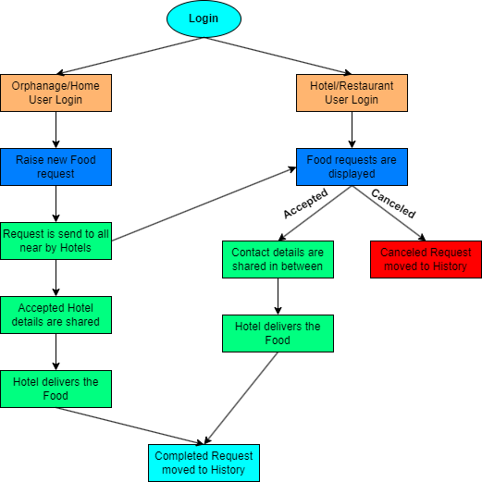
Block Diagram

Slide 6
Block Diagram
Login
Orphanage/Home User Login
Hotels/Restaurant User Login
Raise new Food request
Food Requests are displayed
Accepted
Cancelled
Request is sent to all nearby Hotels
Contact details are shared
Cancelled request moved to History
Accepted Hotel’s details are shared
Hotel delivers the Food
Hotel delivers the Food
Completed
Completed request moved to History

Slide 7
Algorithm / Technique Proposed or Solution methodology
--content--

Slide 8
Hardware Requirements

Slide 9
Software Requirements
Front-End Framework: Angular 17, Ionic
Development Environment: Visual Studio Code
Database Management: Firestore
Hosting: Firestore
Login Management: Firestore

Slide 10
UML Diagram
User details
user_name
contact_number
organization_type
organization_name
user_address
Request
request_id
user_name
contact_number
organization_name
user_address
food_count

Slide 11
Work done so far
Have created Basic design and pages
Created Login function
Navigations between the pages are done
Request creation for Orphanage/Home users is done

Slide 12
Work to be done
To create the Request module for Hotel/Orphanage user
To create the Request Accept and Cancel process for Hotel/Orphanage
To finish the Contact sharing between users
To make Request not visible to other hotels when a request is Accepted by a hotel
To make Request still visible to other hotels when one hotel cancelled the request

Slide 13
Thank You

Slide 15
Title of the Project: FOOD BRIDGE - Bridging The Gap Between Food Sources And People In Need
Problem Definition / Abstract
Related Work / Existing System
Objectives and Scope of the proposal
Block Diagram
Algorithm / Technique Proposed or Solution methodology
Analysis and Design
Hardware:
Software:
UML Diagram and ER diagram
Database Table design

Slide 16
8. Work Plan
9. Work done so far
10. Work to be done
11. Time schedule
12. Reference

