Slide 1

Gokaraju Rangaraju Institute of Engineering and Technology
(Autonomous) Department of Information Technology
A Mini Project on
Development Of A Subject Based Document Classification Model Using Natural Language Processing
Guide
Dr. N. Rajasekhar
Professor
Team Members
(21241A12H9) Punith Kumaran BS
(21241A12K1) V. Sriram Varma
(21241A12E3) E. Clement

Slide 2
Contents
Abstract
Aim and Scope
UML diagrams
System Architecture
Algorithms Used
Project Implementation and execution
Results

Slide 3
Abstract
This project explores an innovative approach to document classification by leveraging advanced natural language processing (NLP) techniques and machine learning algorithms. The primary objective is to develop a robust system that can automatically classify and organize large collections of documents based on their content. The core of the system employs sentence transformers for high-quality sentence embeddings, enhancing the contextual understanding of textual data. Utilizing the k-Nearest Neighbors (k-NN) algorithm, the project aims to achieve precise classification by identifying and grouping similar documents.
To streamline the document organization process, the project integrates several powerful NLP libraries including spaCy, NLTK, and RAKE. spaCy is employed for its efficient tokenization, named entity recognition (NER), and dependency parsing capabilities. NLTK (Natural Language Toolkit) is utilized for additional text preprocessing tasks such as stop-word removal, stemming, and lexical analysis. RAKE (Rapid Automatic Keyword Extraction) is incorporated to extract key phrases and significant terms that contribute to the document's thematic representation.

Slide 4
The project is implemented in Python, ensuring a versatile and scalable solution. The integration of these libraries within the Python ecosystem allows for a seamless workflow, from raw text processing to feature extraction and ultimately to document classification. By combining the strengths of sentence transformers, k-NN, and advanced NLP techniques, this project aims to deliver an effective and efficient document classification system capable of handling diverse and extensive document repositories. The system's performance and accuracy are evaluated through comprehensive testing on various datasets, demonstrating its potential for practical applications in fields such as information retrieval, content management, and digital archiving.

Slide 5
Aim
To develop a machine learning model/software that is capable of reading, classifying, and organizing documents in storage efficiently.
Scope
Helps large firms organise large volumes of document creations effectively and makes accessing them easier.

Slide 6
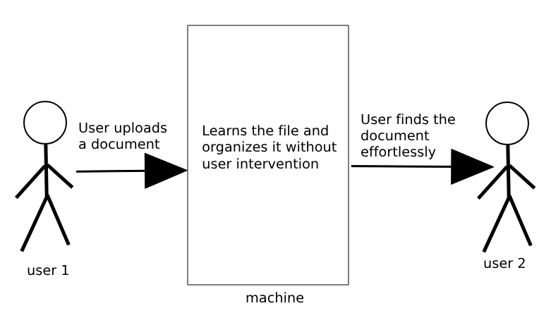
UML Diagrams
Use case Diagram

Slide 7
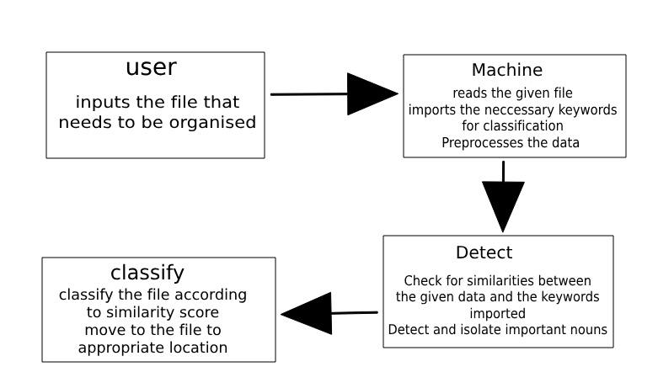
Class Diagram

Slide 8
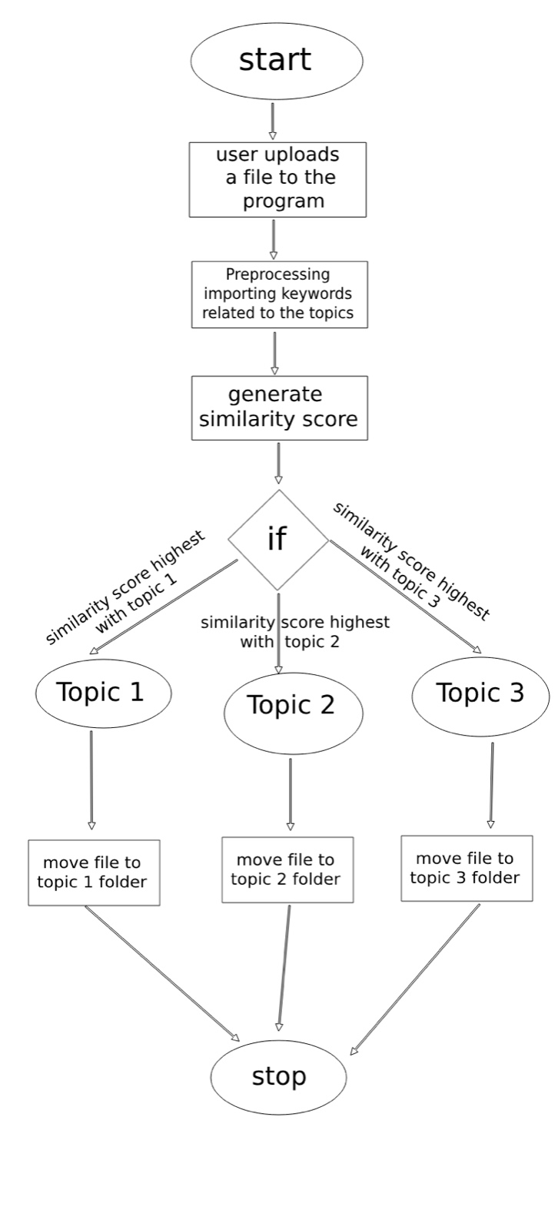
Activity Diagram

Slide 9
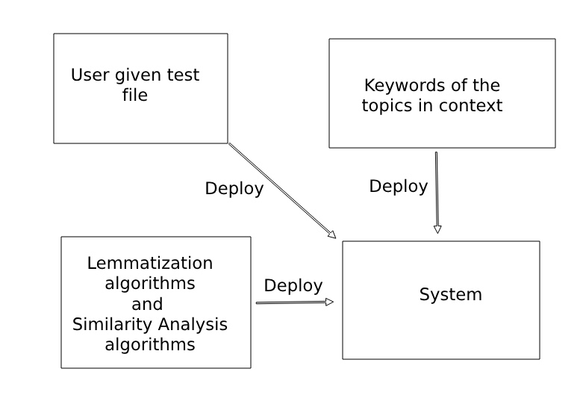
Deployment Diagram

Slide 10
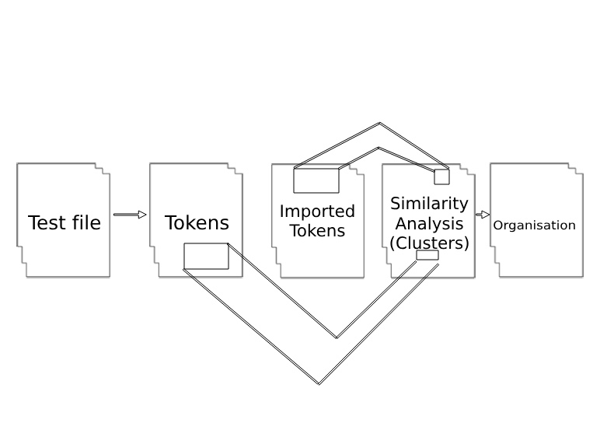
System Architecture

Slide 11
Algorithms used
Cosine Similarity Algorithm: The spacy’s similarity() function that is used to extract the similarity scores between the given file and topics uses the cosine values of the token vectors to generate a similarity score.
Lookup Tables: SpaCy uses large, pre-compiled lookup tables that map word forms to their lemmas. These tables are built from linguistic resources and contain common words and their lemmatized forms.
Word Scoring: The RAKE function uses a word scoring algorithm according to frequency and importance to rank the keywords.
Named Entity Recognition (NER): in spaCy is a process where the model identifies and categorizes entities in a text. Entities are real-world objects such as persons, organizations, locations, dates, and

Slide 12
more.
KNN: is a simple, non-parametric algorithm used for classification and regression. It classifies data points based on the closest training examples in the feature space, using distance metrics like Euclidean distance. The "k" in KNN specifies the number of nearest neighbors to consider.
Part-of-Speech (POS) tagging: is the process of assigning parts of speech to each word in a text, such as nouns, verbs, adjectives, etc. It helps in understanding the grammatical structure of a sentence. Tools like spaCy and NLTK provide pre-trained models for automatic POS tagging, facilitating various NLP tasks.

Slide 13
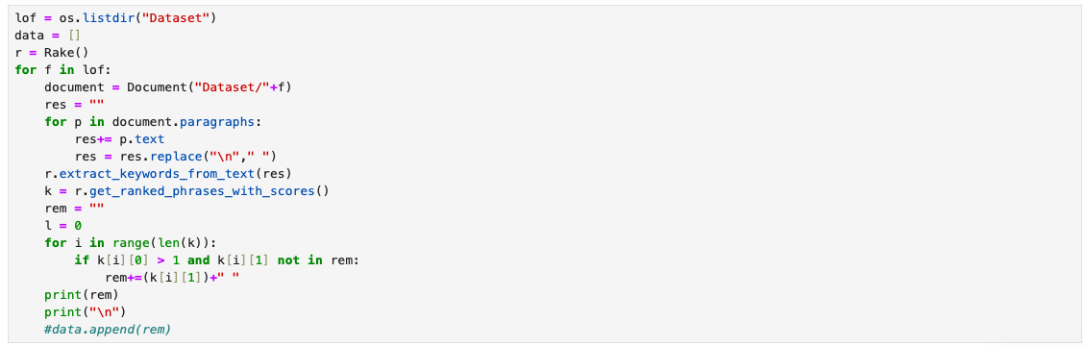
Project Implementation and Execution
Extraction of keywords from dataset

Slide 14
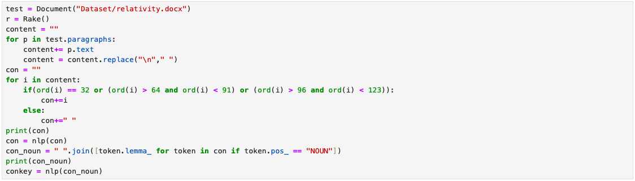
[Fig – 30] - Preprocessing of file data
[Fig – 30] - Finding similarity between the topics and given file
[Fig – 30] - Example of the returned scores of similarity

Slide 15
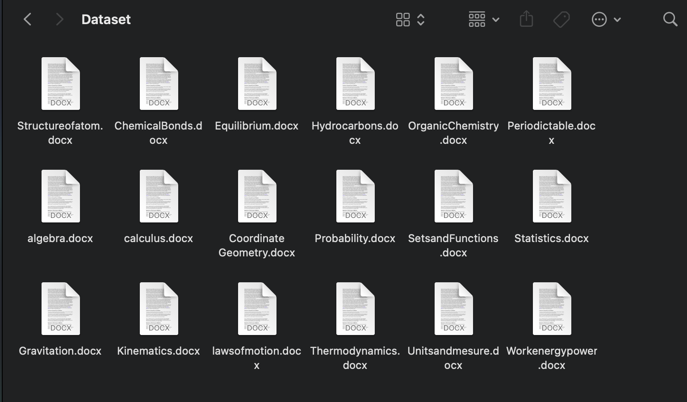
Results
Before: All the documents are cluttered and unorganised.

Slide 16
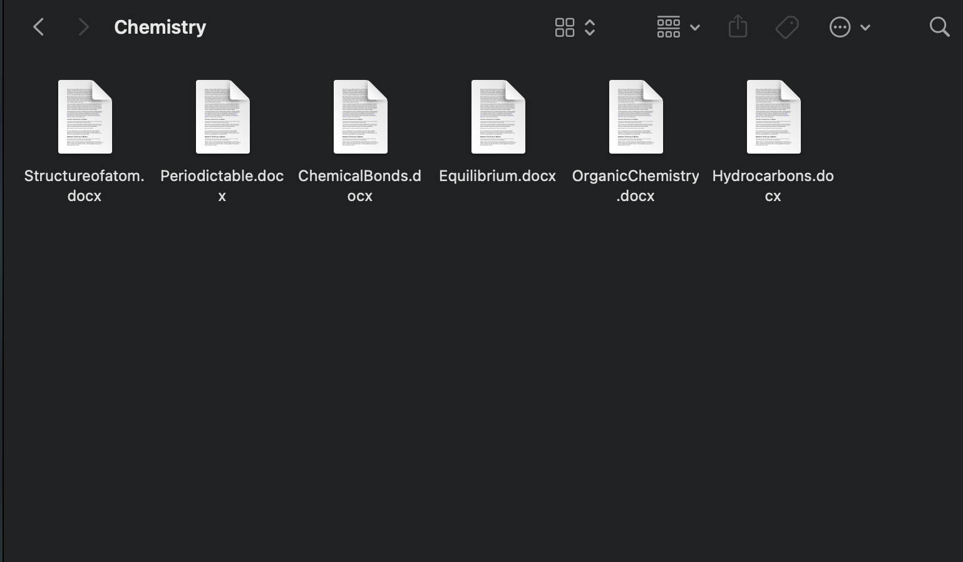
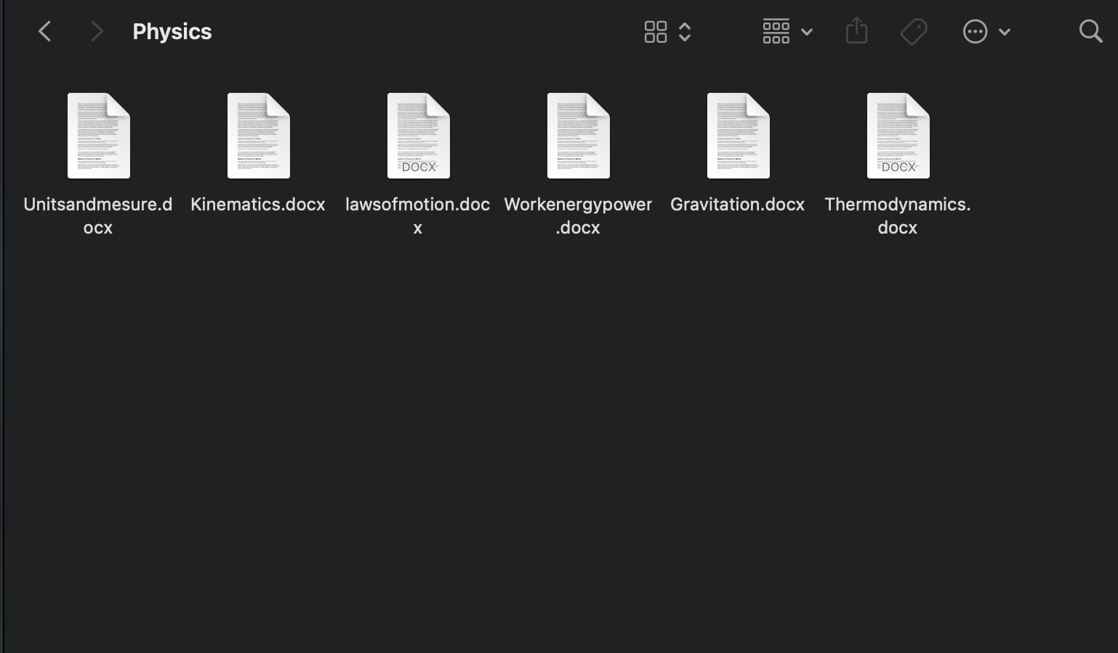
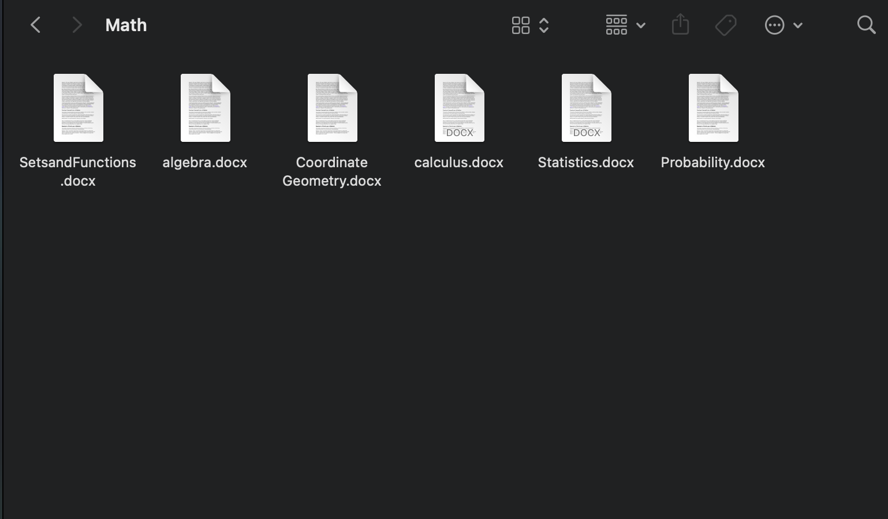
After: All the files are organised automatically in their appropriate folders.

Slide 17
Thank You!

