Slide 1

EXPLORATORY DATA ANALYSIS (EDA)
ON
AMCAT DATASET
Sriram Dhurjati
6th October2024

Slide 2


ABOUT ME
BACKGROUND :
My name is Sriram Dhurjati. I completed my graduation in Electrical and Electronics Engineering from NBKR Institute of Science and Technology. Currently, I am pursuing a course in Data Analytics at Innomatics Research Labs, where I am enhancing my skills to gain insights from data and apply analytical techniques to real-world scenarios.
INTEREST IN DATASCIENCE :
I'm deeply interested in harnessing data to reveal hidden trends, tackle challenging issues, and drive evidence-based decision-making.
The process of transforming raw data into meaningful insights that can guide strategies and actions truly captivates me.
Data is becoming increasingly important in decision-making across all industries.
My areas of concentration includes Data Science and it is a fascinating field due to the rapid growth of technology.
WORK EXPERIENCE : I Effectively Completed a 4-month Web Development Internship at SlashMark, Facilitated by AICTE, from February 1, 2024, to May 1, 2024.
: www.linkedin.com/in/sriram-dhurjati-14091b169 https://github.com/Sriram-dhurjati

Slide 3
PROJECT OBJECTIVE
The primary objective of this exploratory data analysis (EDA) project is to gain insights into the relationships between different variables and to uncover patterns or trends within the dataset. By conducting a thorough analysis, we aim to extract valuable information that can aid in understanding the factors influencing salary, employment outcomes, and overall employability of individuals who have taken the AMCAT assessment.
Through visualizations, statistical summaries, and correlation analyses, we seek to answer pertinent questions such as :
What is the distribution of salaries among the candidates?
Are there any significant differences in salaries based on gender, educational qualifications, or specialization?
How do personality traits correlate with employability metrics such as domain-specific scores and overall performance?
Are there any discernible patterns in the data regarding job cities, college tiers, or graduation years that could impact employability?

Slide 4
DATA SUMMARY
To Summarize the Working of the Data Analysis we conducted:
INTRODUCTION: We began by importing the dataset and outlining the objective of our analysis, which was to explore factors influencing the earnings of fresh graduates in specific job roles.
DATA EXPLORATION: We explored the dataset by examining its structure, dimensions, and summary statistics. This step helped us understand the nature of the data and identify potential variables of interest.
UNIVARIATE ANALYSIS: We conducted univariate analysis to understand the distribution of individual variables. This involved visualizing probability density functions, histograms, boxplots, and countplots to identify outliers and understand the frequency distribution of both numerical and categorical variables.
BIVARIATE ANALYSIS: We then proceeded to explore relationships between variables. This involved analyzing scatter plots, box plots, bar plots, and other visualizations to identify patterns and correlations between numerical and categorical variables.
RESEARCH QUESTIONS: We addressed specific research questions related to the earnings of fresh graduates and potential relationships between gender and specialization preferences.

Slide 5
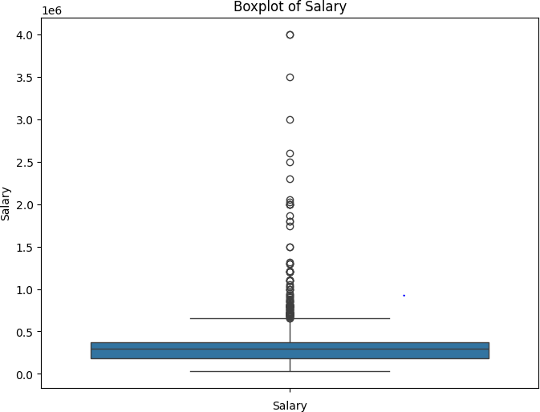
UNIVARIATE ANALYSIS
The graph represents a box plot of average salary, with salary on the y axis and years of experience on the x-axis. Here are some of the key observations I can make:
Median salary: The horizontal line in the middle of each box represents
the median salary for each group of experience. It appears that the
experienced group.
Distribution of salaries: The boxes show the interquartile range (IQR),
which represents the middle 50% of salaries in each group. The boxes
get wider as experience increases, indicating that there is more
variability in salaries for more experienced workers.
Outliers: The whiskers extend from the top and bottom of the boxes to
show any outliers in the data. There are a few outliers in the data,
particularly for the less experienced groups.
This boxplot only shows the average salary for each group of experience It does not tell us anything about the individual salaries of workers, or about the factors that
influence salary such as education, job title, or location.

Slide 6
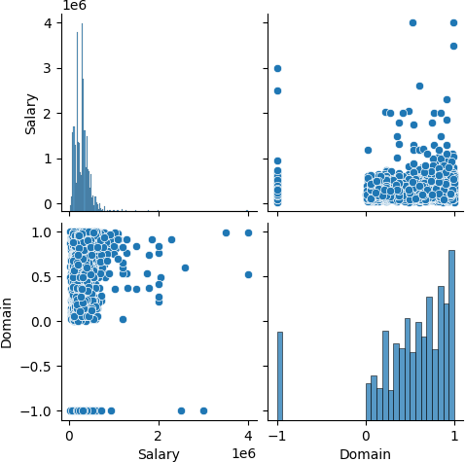
BIVARIATE ANALYSIS
Top left corner: The top left corner of the "Salary" vs. "Domain
" scatter plot shows a dense concentration of points, indicating
many individuals with low salaries and low domain values.
This might represent entry-level positions or less specialized
roles.
Top right corner: The top right corner shows fewer points,
suggesting that there are fewer individuals with both high salaries
and high domain values. This could be due to the limited number
of highly specialized and high-paying positions available.
Diagonal trend: The diagonal trend in the "Salary" vs. "Domain“
scatter plot reinforces the positive correlation between the two
variables. As domain values increase, salary values also tend to
increase.

Slide 7
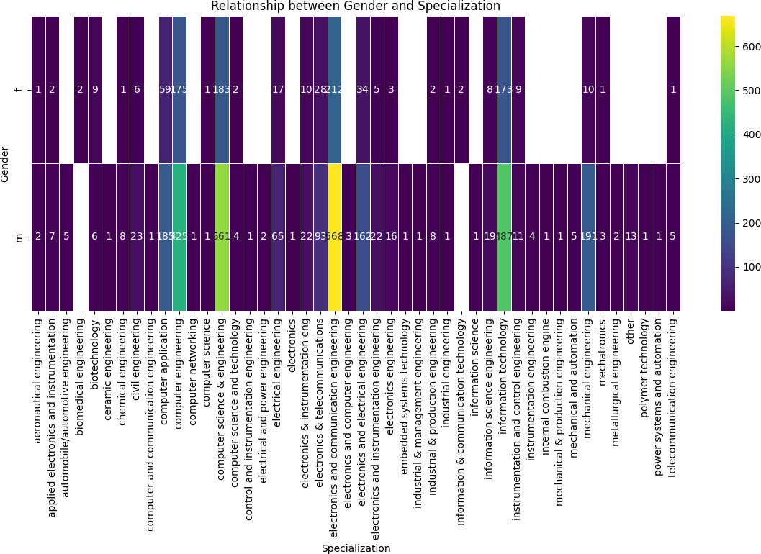
RESEARCH QUESTION
Times of India article dated Jan 18, 2019 states that “After doing your Computer Science Engineering if you take up jobs as a Programming Analyst, Software Engineer, Hardware Engineer and Associate Engineer you can earn up to 2.5-3 lakhs as a fresh graduate.” Test this claim with the data given to you. Is there a relationship between gender and specialization? (i.e. Does the preference of Specialisation depend on the Gender?)

Slide 8
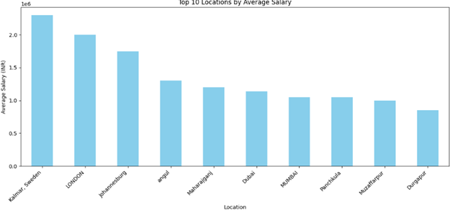
BONUS
Earnings After Graduation:
While the average salary for specified job roles among fresh Computer Science Engineering graduates falls within the range mentioned in the Times of India article, further investigation into factors such as location, industry, and company size could provide insights into variations in earnings.
Research Question:
What factors contribute to variations in earnings among fresh graduates in the specified job roles?

Slide 9
INFERENCE SOLUTION
The top 10 cities with the highest average salaries in the df1 DataFrame.
The cities are listed on the x-axis, with the city with the highest average salary on the left and the city with the lowest average salary on the right.
The average salary for each city is represented by a blue bar.
The height of the bar indicates the magnitude of the average salary.
The y-axis shows the average salary in INR.
Based on the graph:
We can see which cities have the highest average salaries in the data.
This information could be useful for people who are considering moving to a new city for work or who are interested in learning more about salary trends across different locations.

Slide 10
CHALLENGES WORKING ON EDA PROJECT
Data Quality:
One of the primary challenges was dealing with data quality issues such as missing values, inconsistencies, and outliers. Cleaning and preprocessing the data to ensure its accuracy and reliability required careful attention and thorough validation techniques.
Complexity of Analysis: Analyzing the relationships between various factors influencing earnings among fresh graduates involved complex statistical and analytical techniques. Understanding the underlying patterns and trends in the data required expertise in data analysis and interpretation.
Interdisciplinary Knowledge: The project required interdisciplinary knowledge spanning fields such as statistics, economics, and sociology. Integrating insights from multiple disciplines to draw meaningful conclusions posed a challenge, necessitating collaboration and consultation with domain experts.
Data Visualization: Effectively communicating the findings through data visualization was another challenge. Choosing the right visualization techniques to convey complex information in a clear and concise manner required creativity and design skills.

Slide 11
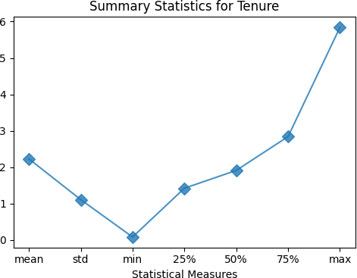
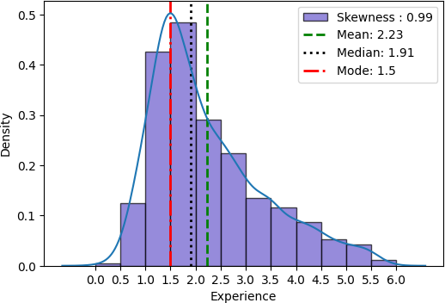
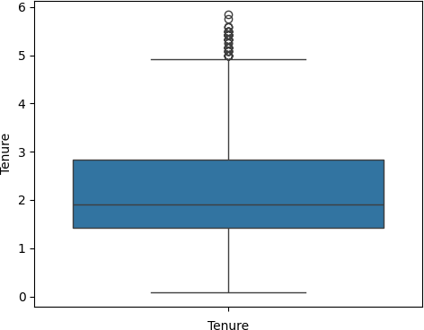
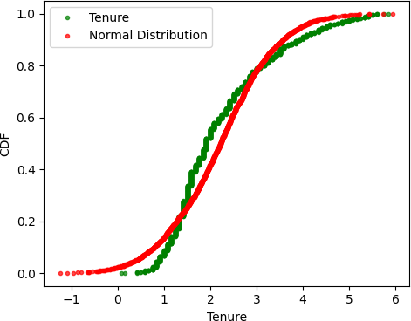

Slide 12
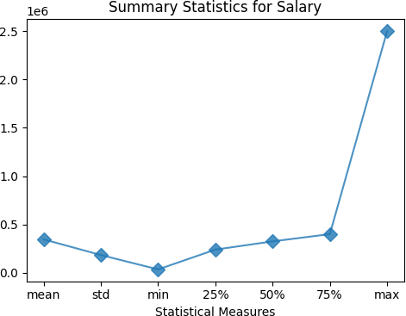
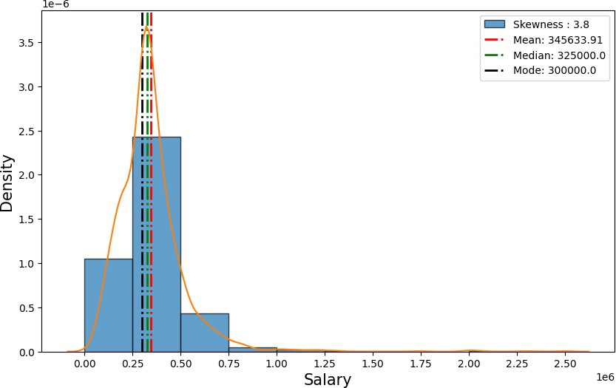
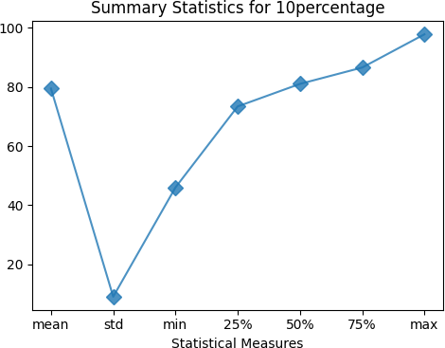
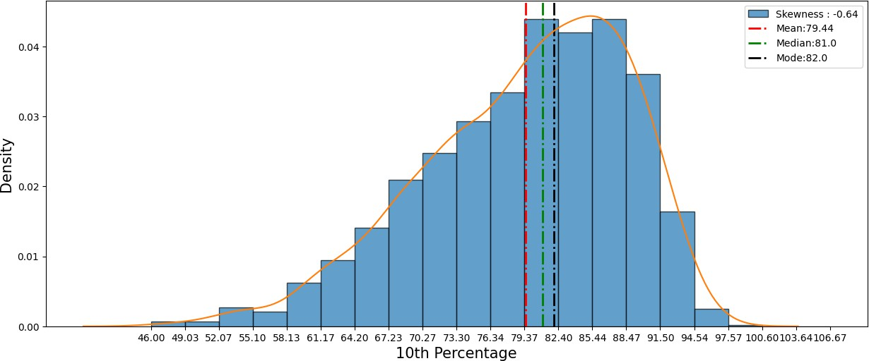

Slide 13
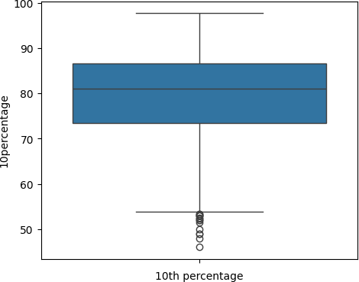
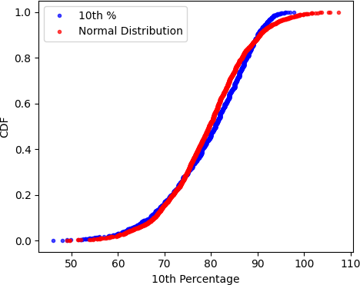

Slide 14
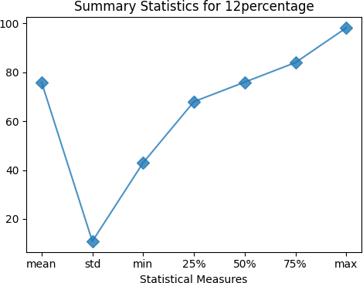
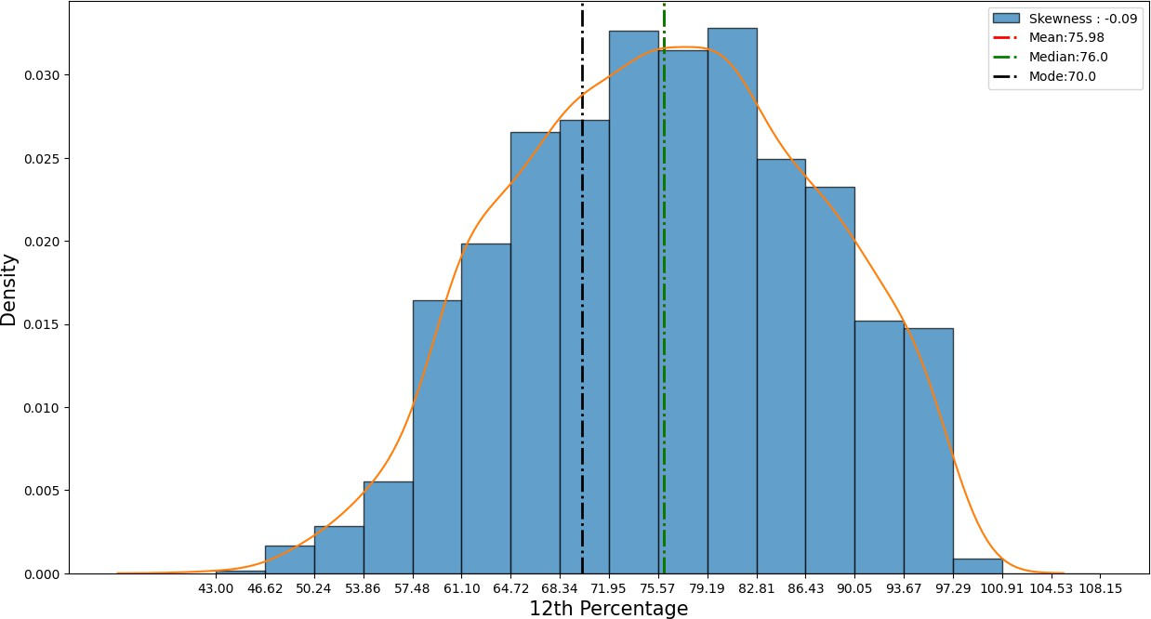
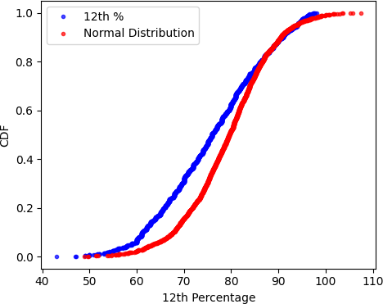
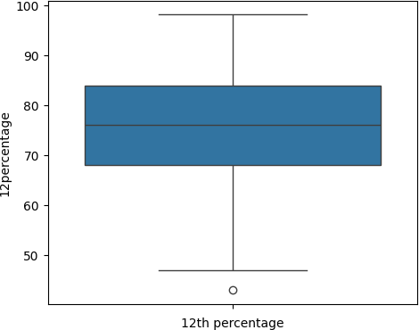

Slide 15
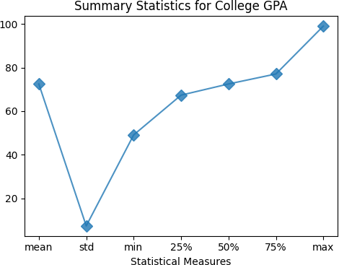
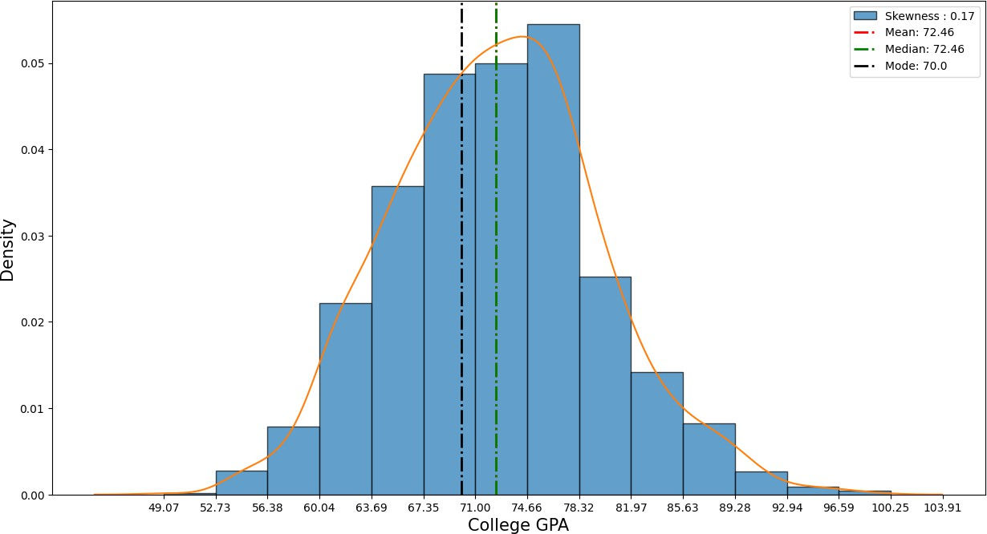
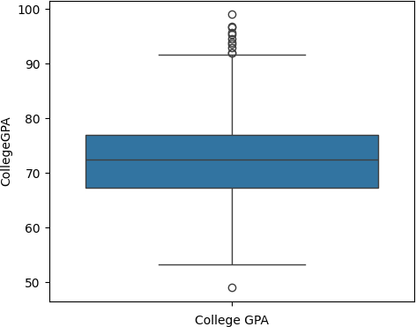
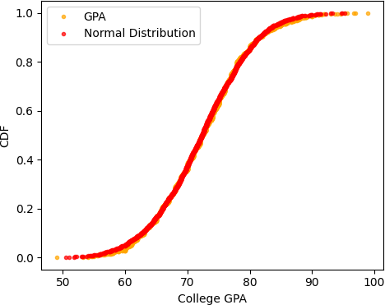

Slide 16
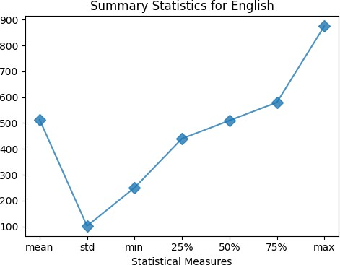
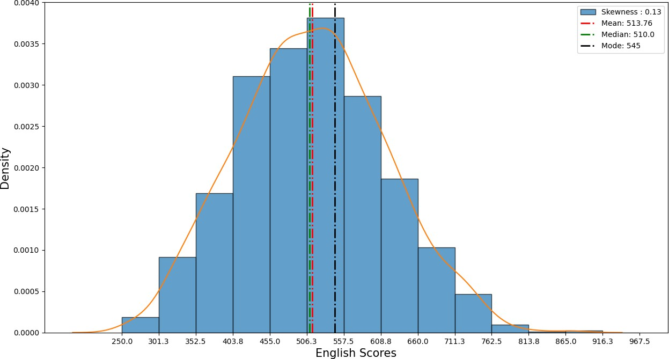
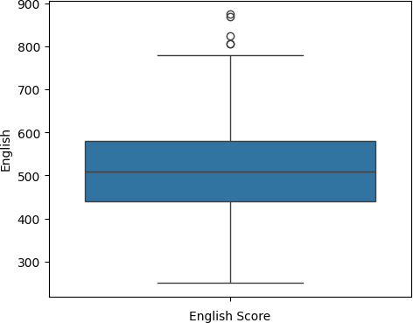
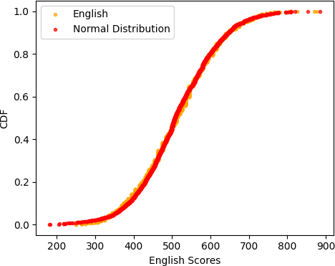

Slide 17
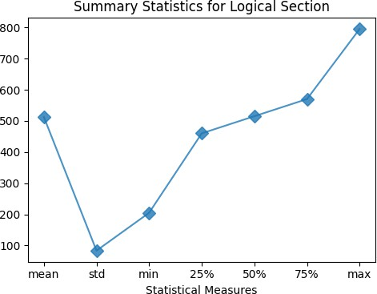
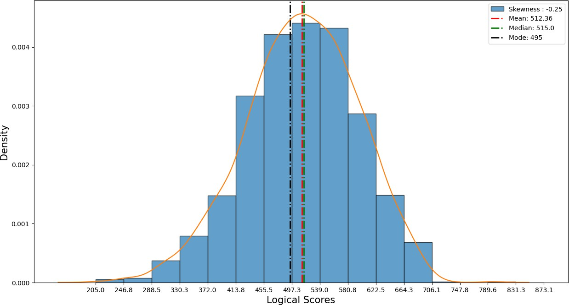
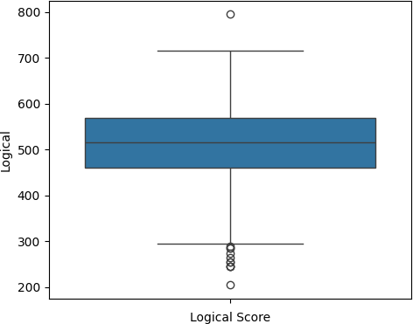
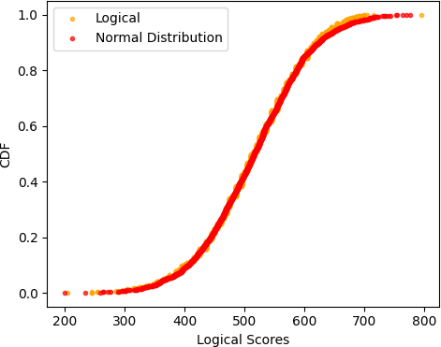

Slide 18
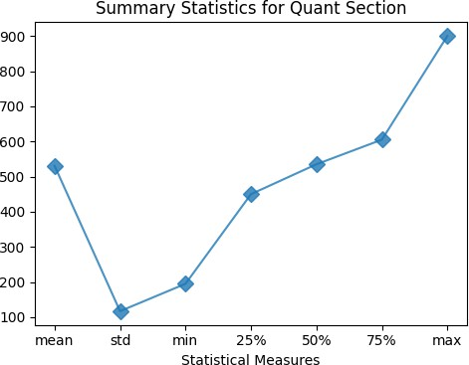
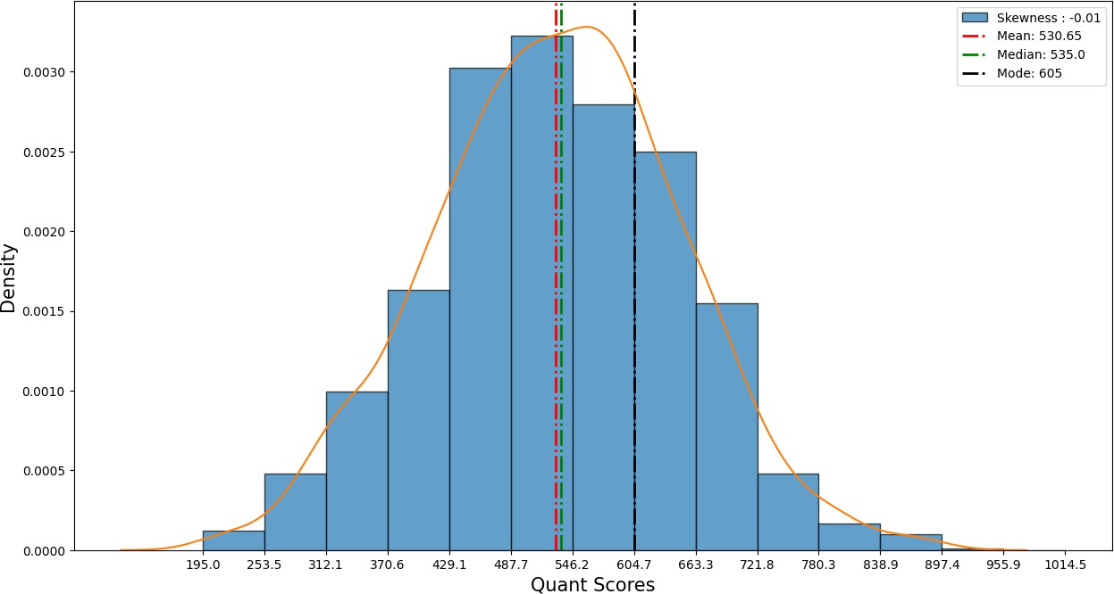
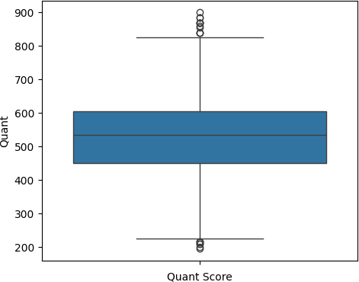
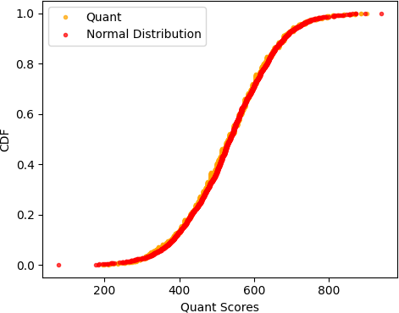

Slide 19
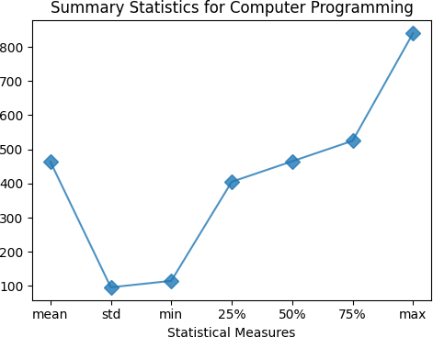
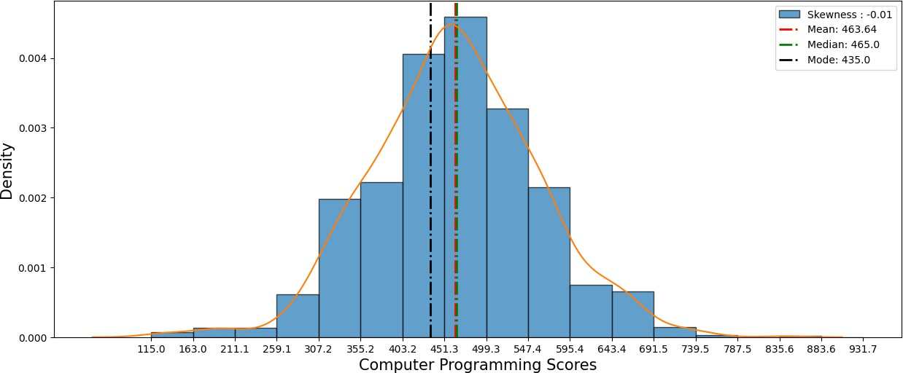
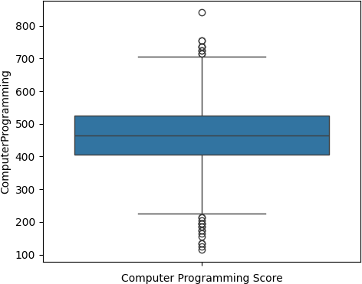
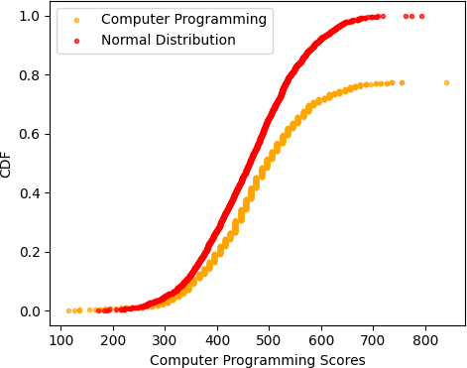

Slide 20
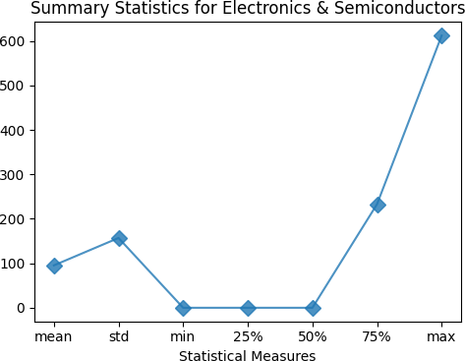
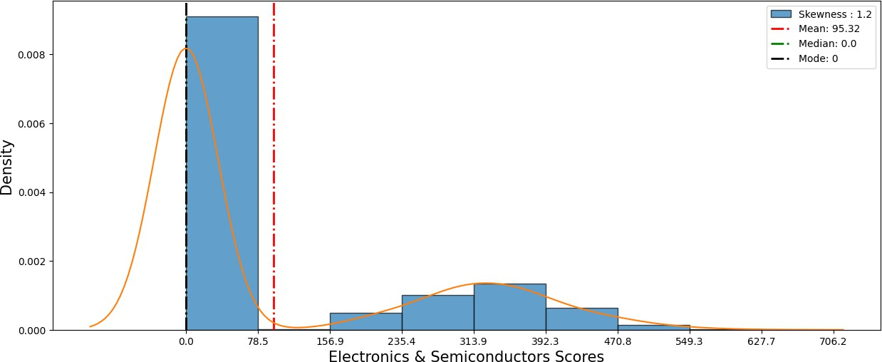
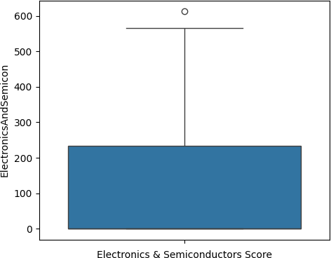
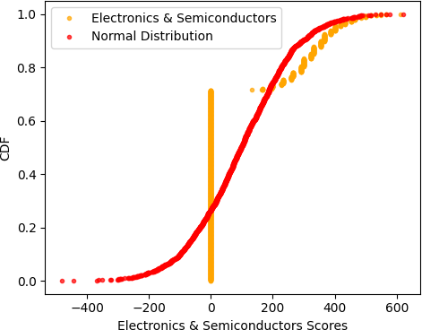

Slide 21
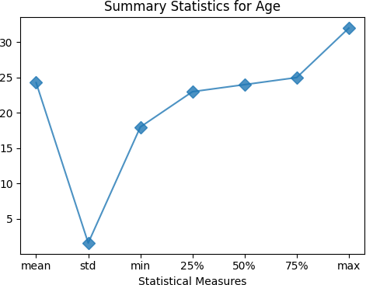
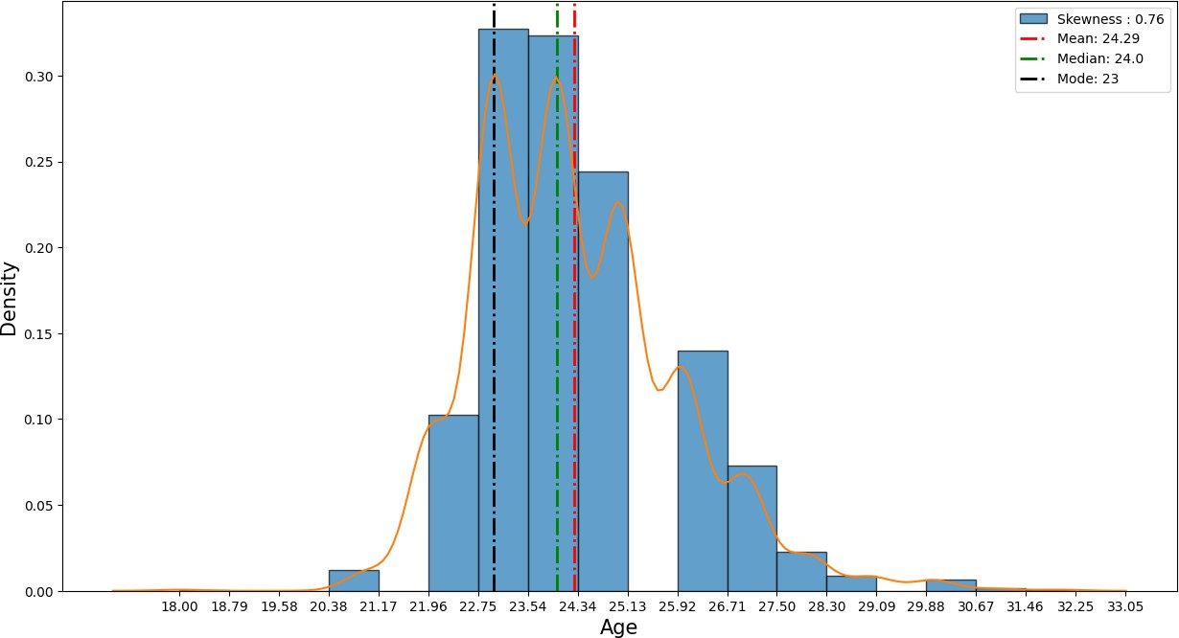
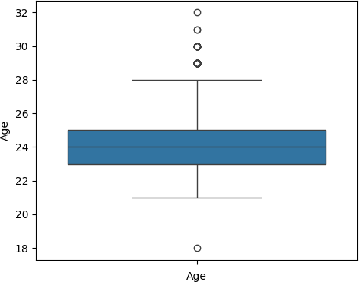
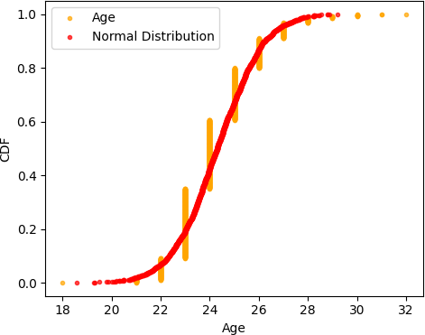

Slide 22
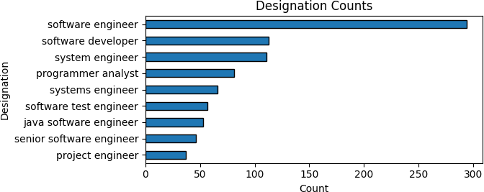
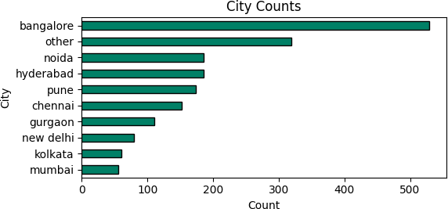
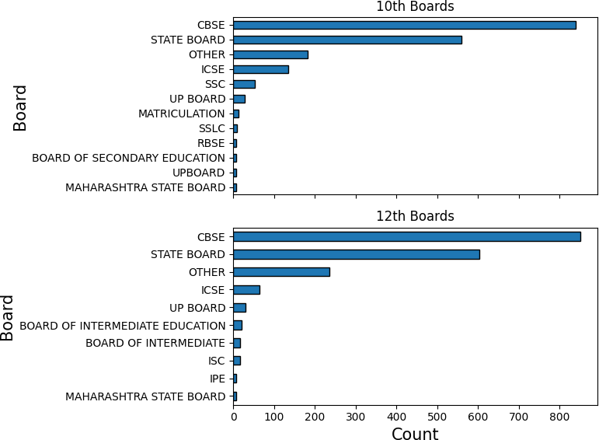
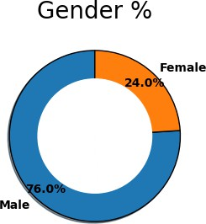
[]:

Slide 23





Slide 24



Slide 25





Slide 26




Slide 27





Slide 28




Slide 29





Slide 30
CONCLUSION
In conclusion, we summarized our findings and highlighted key insights from the analysis. We also discussed potential implications of our results and suggested areas for further investigation or research. Overall our analysis provided valuable insights into factors influencing earnings among fresh graduates in specific job roles.
Variation in Earnings: Our analysis revealed significant variations in earnings among fresh graduates, with factors such as specialization, location, and company size playing crucial roles in determining salary levels.
Impact of Specialization: The choice of specialization appears to have a substantial impact on earnings potential. Specializations in high-demand fields such as Computer Science and Engineering tend to command higher salaries compared to other disciplines.
Geographical Influence: Location emerged as a significant factor influencing earnings, with graduates working in certain cities or regions earning higher salaries on average. This suggests that economic factors and cost of living variations contribute to salary discrepancies.

Slide 31

THANK YOU

