Slide 1



Indian-Sign-Language
Revolutionizing ISL with AI

Slide 2






VISION
To empower the Deaf community in India by promoting Indian Sign Language as a recognized, inclusive, and accessible medium of communication, education, and expression — fostering equality, dignity, and full participation in society.

Slide 3




PROBLEM
Problem 1
Lack of Accessible Communication for the Deaf Community
Problem 2
Limited Educational Resources in ISL

Slide 4
PROBLEM
Problem 3
Underrepresentation and Marginalization
Problem 4
No Official Recognition,
Lack of Interpreter Services

Slide 5
THE UTOPIA
Solution 1
So, An AI model has been trained from my part to help promoting ASL

Slide 6

HOW LEARNIFY WORKS
1. Turn your camera on
2. Sign infront of the camera and there you go
3. Track & Learn:
- Adaptive feedback
- Smart progress analytics

Slide 7
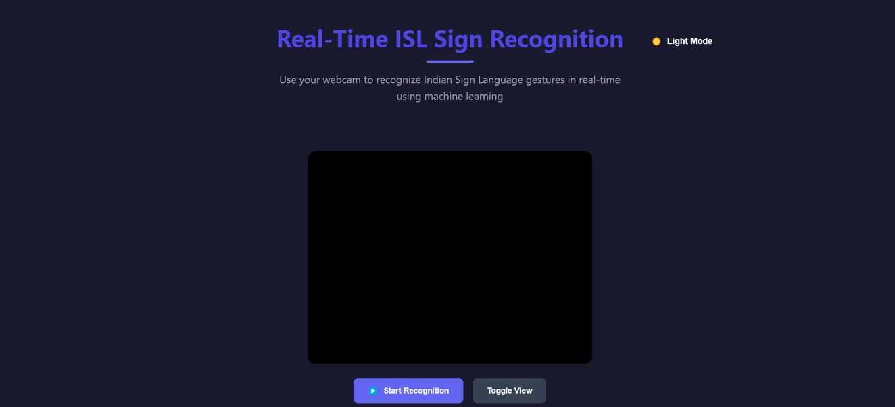
Product

Slide 8


Hyperparameters (get_params):
bootstrap: True
ccp_alpha: 0.0
class_weight: None
criterion: gini
max_depth: None
max_features: sqrt
max_leaf_nodes: None
max_samples: None
min_impurity_decrease: 0.0
min_samples_leaf: 1
min_samples_split: 2
min_weight_fraction_leaf: 0.0
monotonic_cst: None
n_estimators: 100
n_jobs: None
oob_score: False
random_state: 42
verbose: 0
warm_start: False
Hyper parameters

Slide 9
Accuracy
R2 score:0.96
MSE score:0.96 too(approx)

Slide 10
Result
Able to build a random classifier to accuractely detect indian sign language and build a model on it with r2 score being 0.96 and mse being close to 0.96.D

Slide 11
Future Enhancement
Positioning
Will need to make this separately for coding,will need to make this deployable and make this an extension for google meet or any other meeting app to make interviews easier

Slide 12


Sriram Naveen
E23CSEU0873
The Team

Slide 13
Thank You

