Slide 1
Music file upload

Slide 2
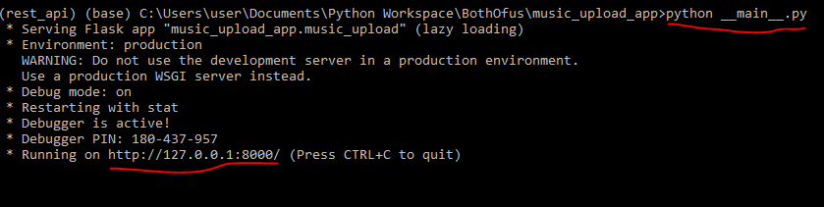
Steps
Clone the code base from github
Step 1
Step 2

Slide 3
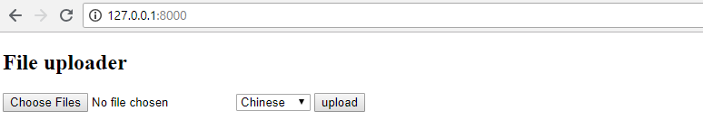
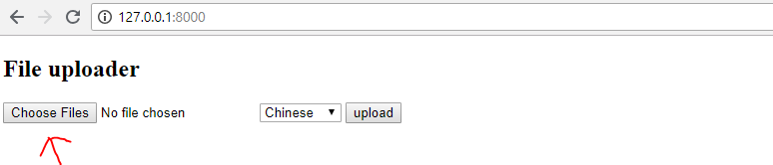
Steps
Step 3
Step 4

Slide 4
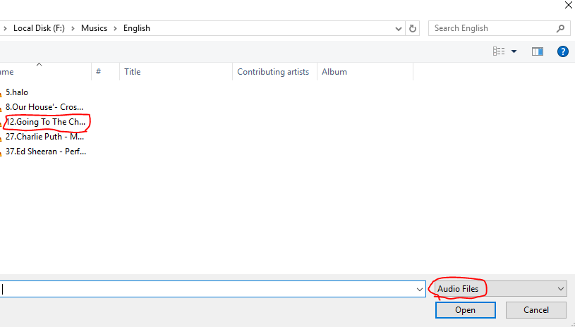
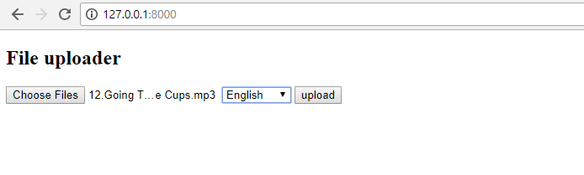
Steps
Step 5
Step 6

Slide 5
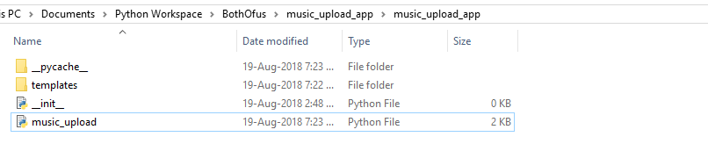
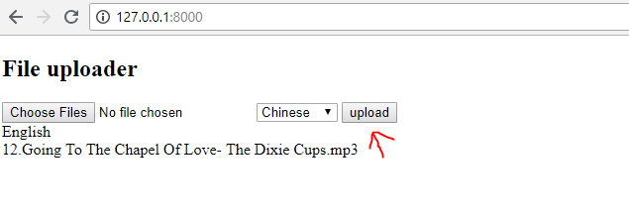
Steps
Step 7 – Before clicking upload
Step 8

Slide 6
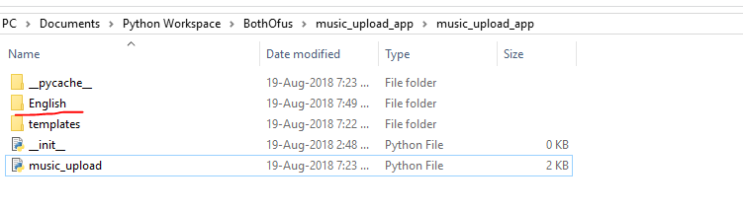
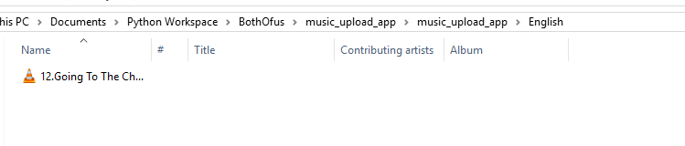
Steps
Step 9 – After clicking upload
Step 10 – File saved in the respective directory

