Slide 1


SMART INDIA HACKATHON 2024
Problem Statement ID – SIH1607
Problem Statement Title- A smart AI based solution for traffic management on routes with heavy traffic from different directions, with real-time monitoring and adaptation of traffic light timings.
Theme- Smart Automation
PS Category- Software
Team ID- 26118
Team Name- InnoMinds007

Slide 2
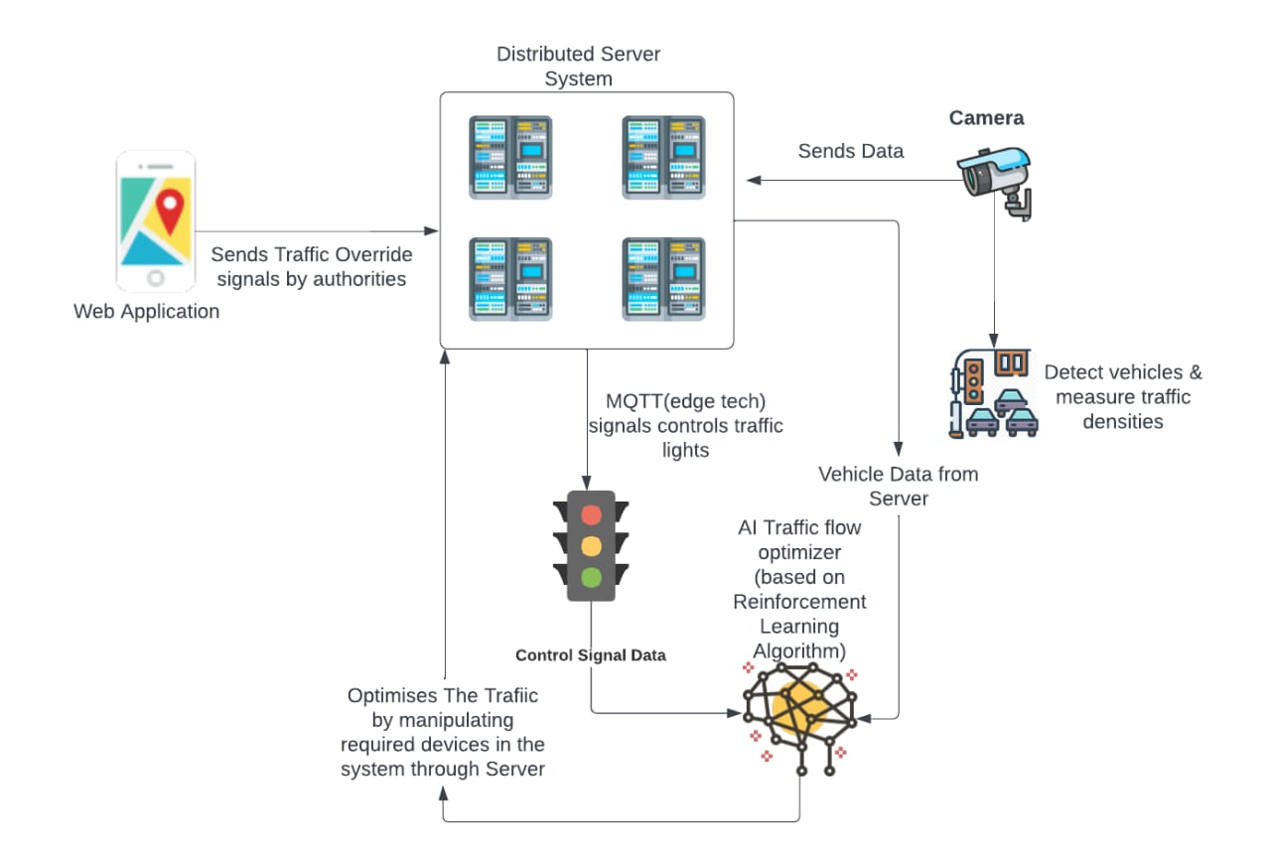
InnoMinds007
Distributed Edge Enhanced AI Traffic Flow Optimizer With Low Latency
Proposed AI Solution
AI for Traffic Flow : AI reduces wait times and minimizes congestion dynamically
Edge Technology : Machines make real-time decisions without central systems.
Emergency Vehicle Detection : An AI detects ambulances via camera. Server uses MQTT through AWS IoT. Video feed processed through AWS Video Kinesis.
Clustered Signals : Signals within 350 meters operate as a synchronized cluster.
Distributed Server System : Multiple servers manage clusters, not one centralized server.
Resynchronization After Disruption : AI resyncs traffic lights after emergency disruptions.
Police Manual Control: Police can use the app to manually control the traffic lights.
Public Alerts : App gives real-time roadblocks and traffic updates.
How It Addresses the Problem
Optimized Traffic Flow : Reduces congestion, waiting times.
Emergency Response : Quick detection ensure ambulance priority.
Synchronized Signals : Clustering prevents traffic bottlenecks.
Rapid Resynchronization : AI quickly restores normal traffic flow.
Manual Control : Police manage lights during emergencies.
Public Notifications : Real-time updates guide drivers.
Unique Value Proposition :
Edge Technology Decision Making : Local systems decide without relying on a central server.
Finding position of emergency vehicles using Radio Frequency: Detect ambulance signals to determine position using Radio Frequency.
Distributed Server Architecture : A cluster of servers oversees multiple signal clusters so reduced latency.
Cloud Integration : Traffic data analyzed in real-time for continuous improvement.
Mobile App for Police : Police can control the traffic during critical events.
Real-Time Public Alerts : Drivers receive updates to avoid blocked routes.
@SIH Idea submission- Template
2

Slide 3
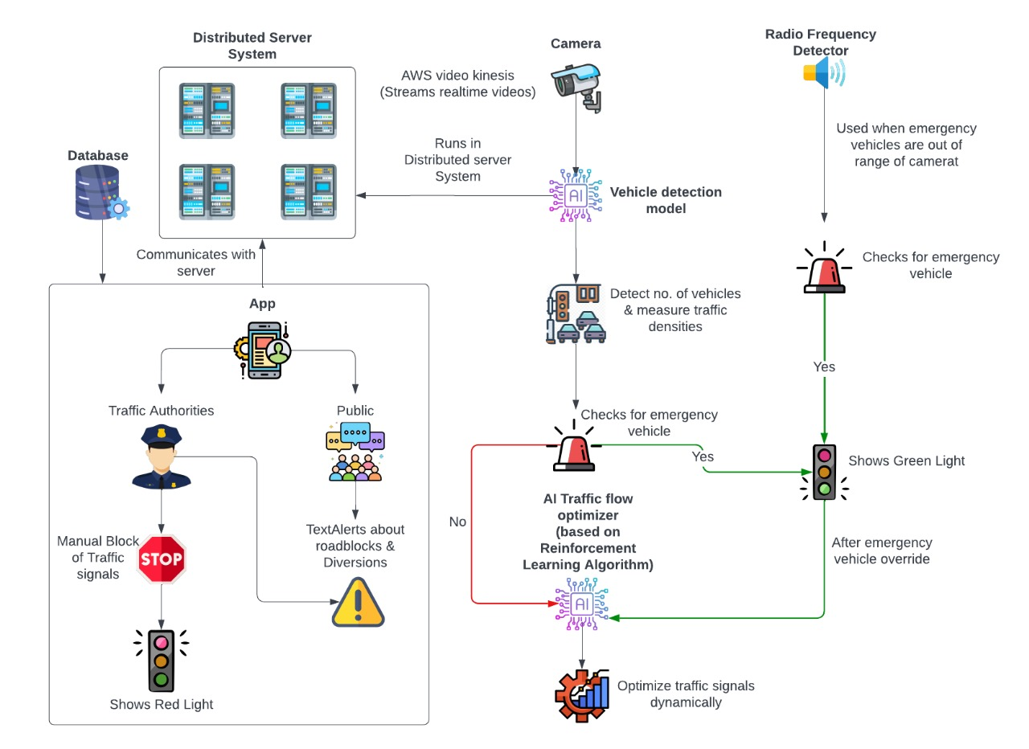


InnoMinds007
TECHNICAL APPROACH
Tech Stack
Jetson (Server):
Runs AI Vehicle detection and AI traffic flow optimizers models.
Vehicle Detection AI Model:
Detects vehicles and measures traffic density.
AI Traffic flow Optimizer:
Reinforcement Learning algorithms and deep learning is used to develop it.
Optimizes traffic flow to reduce waiting time and resynchronizes signals
React & MUI:
Builds a responsive, user-friendly front-end for traffic control.
Firebase:
Securely stores user data in database.
AWS IoT Core:
Facilitates MQTT communication between server, traffic lights, and mobile devices.
AWS Kinesis Video Streams:
Streams live video data to the server in real time.
AWS Load Balancer:
Provides backup servers for seamless operation.
ESP32:
Controls traffic lights based on AI-driven decisions.
Radio Frequency Detector:
It detect sirens of emergency vehicles which is installed at traffic light intersections.
Revenue Streams:
SaaS product for both public and authorities
Prototype Video -
Click Here
Web Application -
Credential :-
Username – sih
Password - 123
Click Here
@SIH Idea submission- Template
3

Slide 4
FEASIBILITY AND VIABILITY
InnoMinds007
Feasibility of the Idea
Potential Challenges and Risks
Strategies for Overcoming Challenges
Edge Technology: Initial cost for devices like NVIDIA Jetson is high, but long-term operational costs are low due to decentralized processing.
Google Maps API: A cost-effective solution for real-time traffic data (density, roadblocks, diversions), reducing the need for expensive custom sensor infrastructure.
Reinforcement Learning (RL) for Traffic Control: High initial resource demands for model training, but once deployed, it becomes highly efficient and adaptive, reducing ongoing costs.
Distributed Server System: Reduces the load on a central server, improving system reliability and scalability, which lowers long-term maintenance and upgrade costs.
AWS Cloud Infrastructure: Its scalable, pay-as-you-go model makes it cost-effective and feasible for large-scale implementations.
Latency: Video Processing by the AI models may take some time.
Model Performance: Customization is required to adapt AI models to local traffic patterns.
Camera: If an ambulance is outside the camera's view, the system won’t detect it, risking delays in giving priority to emergency vehicles.
Network Reliability:Potential disruptions in cloud services or network connectivity could affect real-time decision-making and communication between devices.
Initial Training Time:Reinforcement learning models require extensive data and training time before they can function effectively.
Reduced Latency: Fine-tuned AI models are deployed on edge devices like Jetson and ESP32 to minimize processing delays and improve response time.
Model Optimization : Reinforcement learning AI continuously adapts to changing traffic patterns by training on real-time data, improving accuracy and performance.
Radio Frequency Detectors: Radio frequency-based detectors are used to detect ambulance signals and determine the ambulance's position when it's outside the camera range.
Network Redundancy:Implement backup systems, like AWS Load Balancer and distributed servers, to ensure continuous operation during network or cloud service interruptions.
Pre-Deployment Training:RL models undergo extensive training during the initial deployment phase, so they are optimized and require minimal ongoing adjustments.

Slide 5
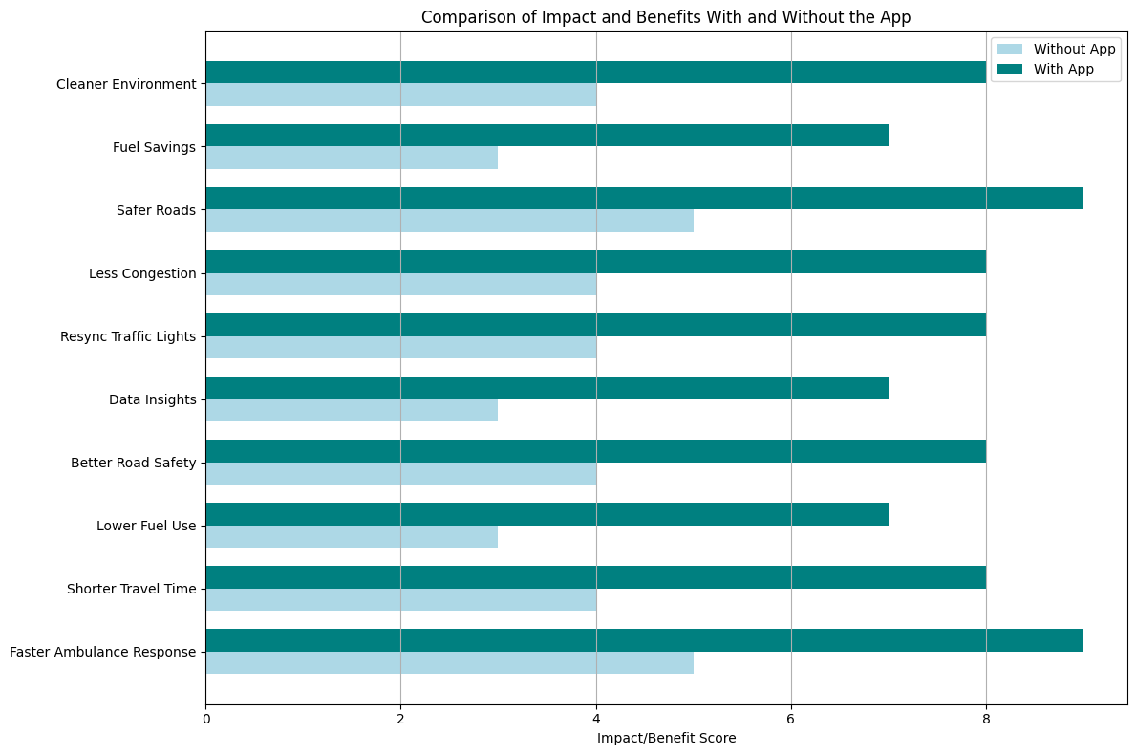
IMPACT AND BENEFITS
InnoMinds007
Potential Impact on the Target Audience:-
Drivers: Reduced waiting times by up to 20%, leading to smoother commutes and fewer delays—saving drivers an average of 15-30 minutes daily.
Emergency Services: Faster response times with priority-based signal control, reducing ambulance delays by 70%.
City Authorities: Improved traffic management, reducing road incidents. Authorities can dynamically block routes during emergencies, enhancing control.
Public Safety: Fewer accidents and better emergency control, reducing traffic-related through real-time updates and manual overrides.
Benefits of the Solution:
Social:
Reduced traffic stress and faster commutes save commuters up to 30 minutes per day.
Real-time notifications improve drivers' experience by avoiding congested areas, reducing delays by 35%.
Economic:
Reduced fuel consumption and vehicle operating costs through optimized traffic flow.
City governments saves on traffic management costs by minimizing manual control.
Increased productivity, as people spend less time in traffic, boost their efficiency for daily commuters.
Environmental:
Lower carbon emissions, reducing CO2 output by up to 12% ,contributing to a cleaner urban environment.
More efficient traffic flow reduces pollution, helping cities meet sustainability goals with up to 10% improvement in air quality.
Technological Advancement:
Cities adopting AI-driven technologies can position themselves as smart city leaders, potentially increasing investment.
AI resynchronizes traffic lights within few cycles after emergency disruptions, restoring signal sync quickly.
Authorities can dynamically block routes and paths during unexpected events, enhancing traffic control
Note : These numbers are predicted in the simulated environment using our AI models.
5

Slide 6
RESEARCH AND REFERENCES
InnoMinds007
Prototype Web Application
Prototype Video
Application GitHub Repository
Innominds Research Paper
Traffic Light Control System for Emergency Vehicle Using Radio Frequency Documentation
Documentation of AWS Video Kinesis
Documentation of MQTT
IIIT Paper for Traffic Clustering
Synchronised_Traffic_Light _Demo

