Slide 1
Intern Report
Sriram Gugulothu

Slide 2
Natural Language Processing
Natural Language Processing (NLP) is a specialized area within artificial intelligence (AI) and computer science that focuses on the interaction between computers and human language. It enables machines to understand, interpret, and generate human language in a way that is both meaningful and useful.
Application:-
Text classification – Grammarly.
Voice assistants – Siri , Google assistants.
Text summarization.
Named Entity Recognition

Slide 3
Basics of NLP
Tokenization – It is the process of splitting the text into smaller meaningful units called Tokens. Tokens can be words or sub words or group of few words.
Stemming – Simplifying the words to their basic form is called stemming. It is a method of text processing that eliminates the prefixes and suffixes from words which transforms them to their root words. E.g. – Working is simplified to work.
Lemmatization – Unlike Stemming, it uses vocabulary and morphological analysis to convert a word to its base form called lemma. E.g – better – good.
Parts of Speech Tagging – Giving each word a grammatic category, Noun, Pronoun, verb etc..
Text Vectorization – Process of converting the text data into numerical vectors. Since Machine Learning or Deep Learning model only deals with numbers it is crucial to represent them in the form of numerical vectors. Good vectorization → King – men + woman = queen

Slide 4
Basics of NLP
Sentimental Analysis – The process of classifying whether a block of text is positive, negative or neutral. E.g - Customers feedback, Classify the movie rating.
Named Entity Recognition – A technique in NLP that focuses on identifying and classifying entities. Named entities refers to real world objects such as Persons, Organization, Date etc. NER primary goal is to add structure and meaning to textual data by identifying and classifying named entities. Efficient Search, News classification and Customer support are few of its applications.

Slide 5
Recurrent Neural Network

Slide 6
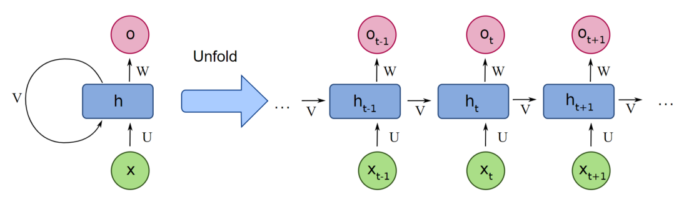
Recurrent Neural Network

Slide 7
Recurrent Neural Network
It is the Sequence-to-sequence neural network.
As animation shows, tokens are processed in sequence manner (one per timestamp).
At each time stamp the current RNN cell is fed by previous state and current input. Primary goal of passing previous states is to maintain the context and carry information from previous time steps through the sequence.
RNN suffers from short term memory, caused by vanishing gradients problem.
If RNN has more steps then it is most likely to suffer from vanishing gradients.

Slide 8
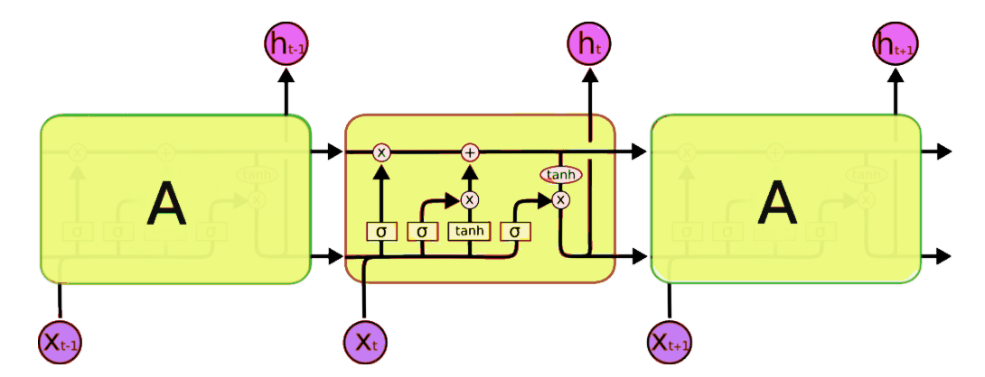
Long Short Term Memory

Slide 9
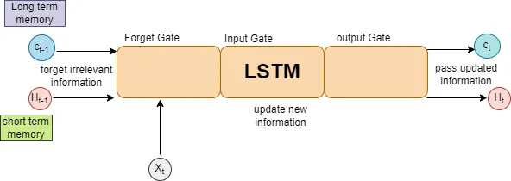
Long Short Term Memory

Slide 10
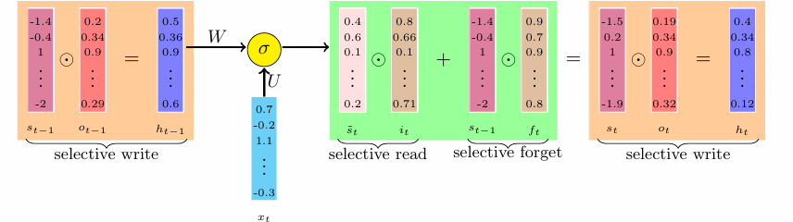
Long Short Term Memory

Slide 11
LSTM
It is also Sequence-to-sequence neural network.
LSTM is similar to RNN, but additionally it has few Gates to tackle the vanishing gradient problem.
Forget Gate (Selective Forget) – Gate is responsible for which data from previous state of the network to be remembered.
Input Gate (Selective Read) - Gate is responsible for what new information should be added to the cell state based on the current input and previous hidden state
Output Gate (Selective Write) – Gate is responsible for what information from the cell state should be the output as the final hidden state of the LSTM cell.

Slide 12
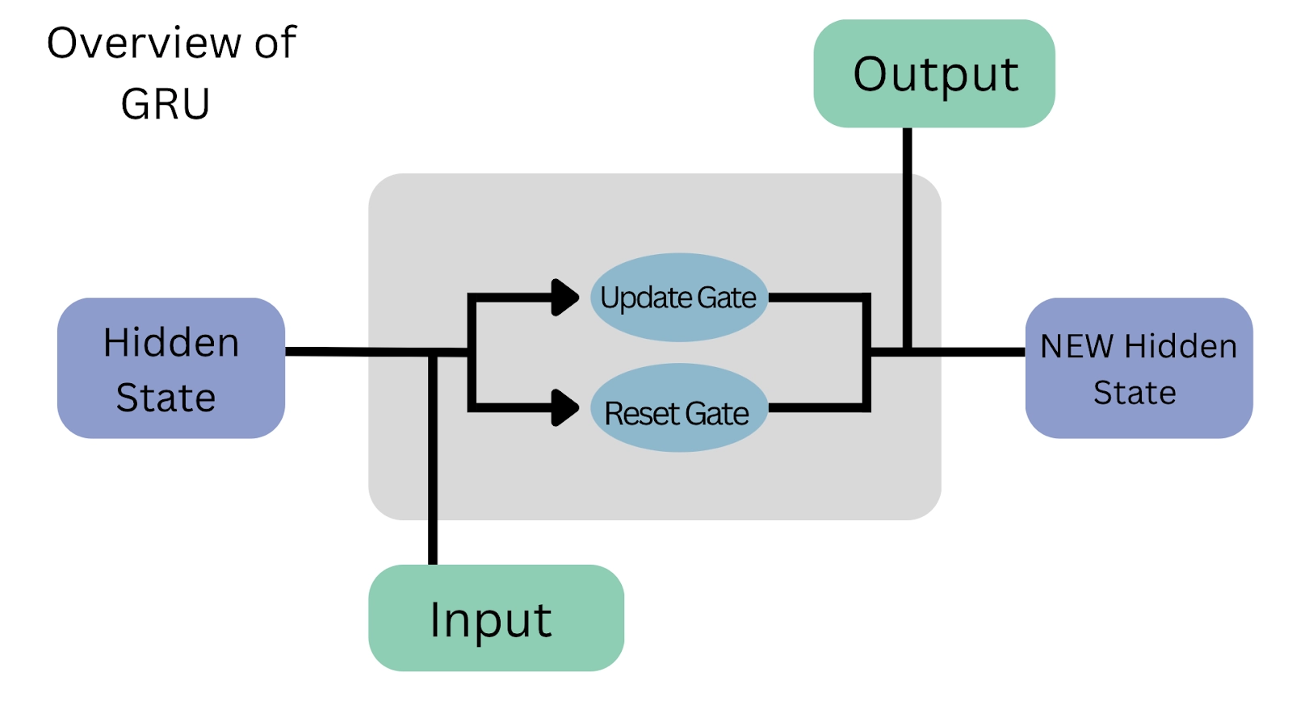
GRU

Slide 13
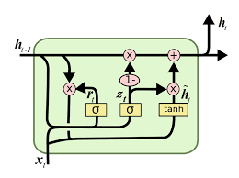
GRU

Slide 14
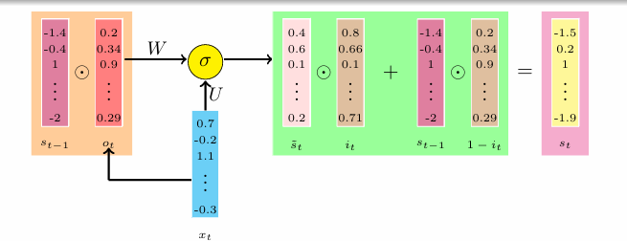
GRU

Slide 15
Gated Recurrent Unit
It is also Sequence-to-sequence neural network.
It is one of the variant of LSTM
Forgot gate and Input gate from LSTM are merged to one gate in GRU.
There are two gates in GRU-
Update Gate – It is responsible for what information is to be sent for the next time step. It resembles the LSTM output gate.
Reset Gate – It decides how much of past memory should be forgotten by keeping required amount of current input. It is comparable to how much the Input Gate and Forget Gate work together in LSTM.

Slide 16
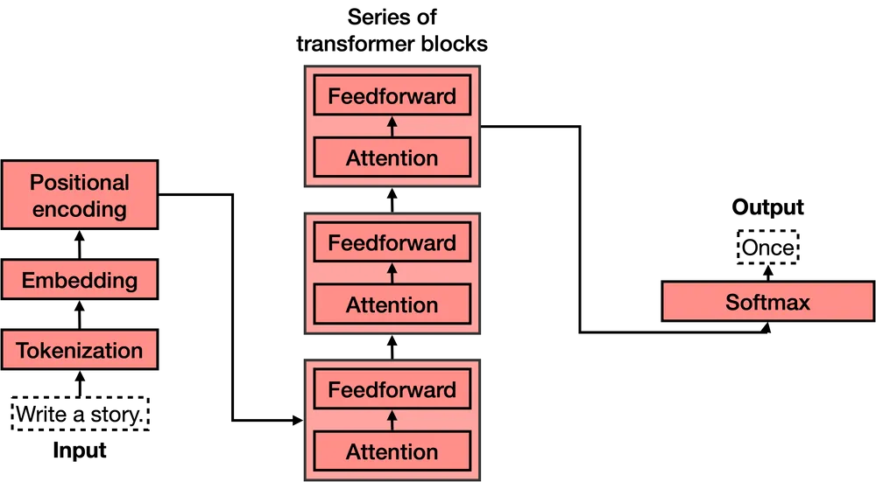
Transformers

Slide 17
Transformers
It is also parallel neural network.
Unlike RNN, all tokens are processes simultaneously.
Tokenization – Splitting the text to meaningful words or sub words called tokens
Embedding – Transforming the text tokens to numerical vectors ensuring words with close similarity are near to each other in n – dimensional space. Contextual information should be maintained.
Positional Encoding – Adding a sequence of predefined vectors to the embedding vectors. Since transformers process the tokens parallelly, positional encoding is helpful in knowing the position of token in sentence.
Transformer block (many) – A transformer is a concatenation of many transformer blocks. Each one of these is composed by an attention component followed fully connected layer. Attention component is helpful in learning the attention parameters, which means how much each token is dependent on other tokens in the sentence.
Soft Max Layer – Here probability comes into play to decide which is chosen to be the output. Cross – Entropy loss is used for categorical output while MSE for continues output.

Slide 18
BERT
Bidirectional Encoder Representations from Transformers
BERT was specially trained on Wikipedia (~2.5B words) and Google’s BooksCorpus (~800M words).
Masked Language Model – It enables bidirectional learning from text by masking a word in a sentence. It forces BERT to use the words on both directions to predict the masked word.
Next Sentence Predication – It is used to help BERT learn about relationship between sentences by predicting if a given sentence follows the previous sentence or not.
BERT is trained on both MLM and NSP at the same time.
For each token BERT outputs the word embedding of with defined size, ( default = 512). It captures the contextual meaning within the sentence.

Slide 19
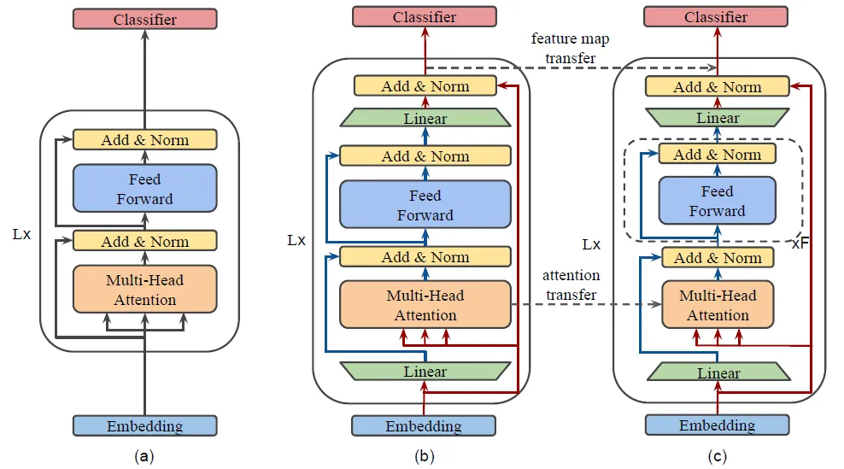
Transformers

Slide 20
MobileBERT
Proposed for compressing and accelerating the BERT model.
mobileBERT is thin version of BERTLarge
Inverted-bottleneck – This refers to a specific architectural design used in neural networks. An inverted bottleneck layer starts with a wider set of channels and narrows down (Bottleneck) and then expands again. This design helps in reducing the computation cost while maintaining model performance.
Teacher model – BERTLarge with inverted-bottleneck layer is trained first. This specially designed model serves as a ‘teacher’ because it learns the task with high accuracy and robustness.
After training BERTLarge knowledge transfer is done to MobileBERT.
Parameter transfer is performed.
Block sizes are comparably small to BERTLarge.
Layer normalization is replaced with linear transformation. ReLU replaces GELU
MBERT is trained in such a way that self-attention behaviour of IB-BERT are as closely as related. Feature map of each layer should be as close as possible.
MBERT achieves an overall GLUE score of 77.7 which is only 0.6 lower than BERTBASE, while 4.3 smaller and 5.5 faster than BERTBASE.

Slide 21
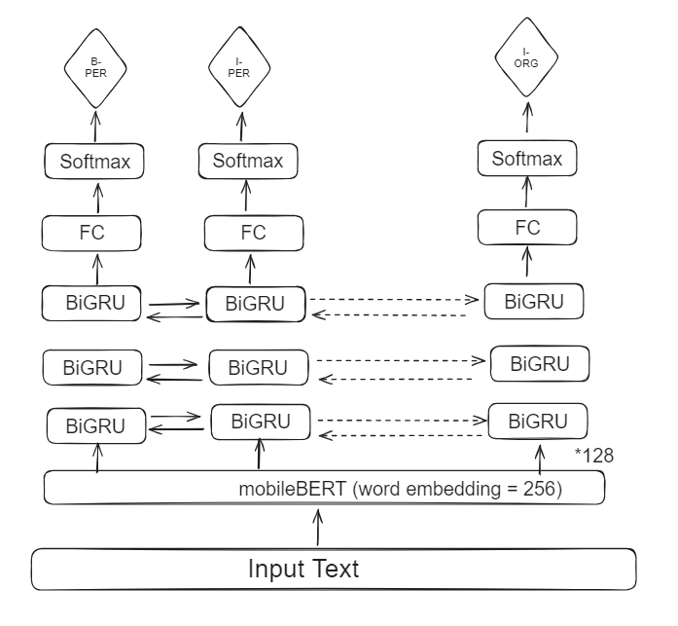
Alternative to mobileGliner Model

Slide 22
Data Loading
Datasets
Collected several named entity datasets
multiNerdDatasets, wikiNeuralDatasets and contantinWernerDatasets
These datasets contains the data in several European languages along with Japanese. Slight alteration is perform in such a way that it helps in better training of model.
Input text is loaded batch wise after converting each word in text to mobilBERT tokens. Dataset class is used for this task.
Hugging face dataset object is used for soother loading of data into workspace.

Slide 23
Training and Testing
Each tokenized input is sent to mobileBERT pretrained mode. Each token transformed to embedded vectors.
Sequentially, each embedded vectors are passed through the 3 layered BiGRUs.
Output of last layer BiGRUs are passed to a fully connected component with 41 neurons, as there are 41 entities.
Cross entropy is used for loss calculation after performing softmax.
Backpropagation is performed for every batch after making previously calculated gradient to zero.
After each epoch, along with training accuracy and loss, F1, Precision, Recall scores are also calculated.
After each epoch testing accuracy and loss, along with F1, Precision, Recall scores are also calculated for Test data.

Slide 24
Loss,Optimizer and Util functions
Cross entropy loss is used for training.
Adam optimizer is used.
Tqdm library is used to show the epoch progress.
Along with accuracy and loss calculations, Precision, Recall, and F1 scores are used.
Added gradient clipping to tackle gradient explosion issue. Observed this with larger learning rates.
Checkpoint logging performed.

Slide 25
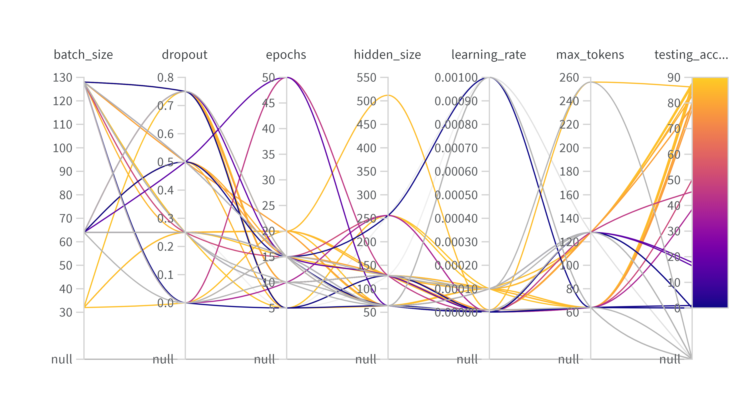
Observations

Slide 26
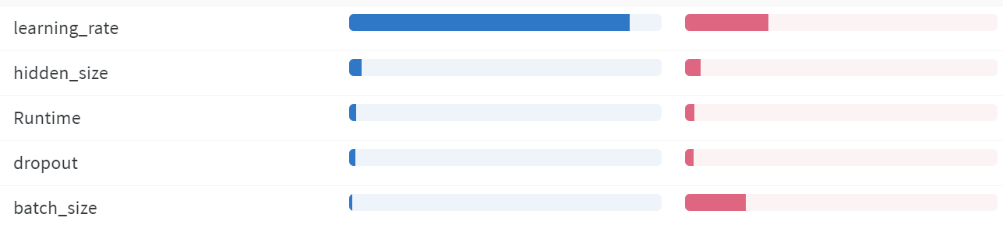
Blue line indicates importance and Red line indicates correlation with accuracy.

