Slide 1

CHAI-TIME
POS
System
Chai Time POS is a web-based Point of Sale system designed to manage café operations such as billing, order management, and sales monitoring through an interactive digital interface.
Guided By
Mrs. V. Devi Nandhini AP/AI&DS
https://chai-time.netlify.app/
01

Slide 2
DOMAIN &
TECHNOLOGIES
TOOLS & TECHNOLOGIES USED
HTML
CSS
Markup structure
Styling & layout
Domain
JavaScript
Firebase Auth
Web Development
App logic & interactivity
User authentication
Technology Domain
Firebase Realtime DB
Chart.js
Cloud-Based POS System
Cloud database & sync
Sales data visualization
Application Area
Retail & Café Management Systems
jsPDF
SheetJS
PDF bill generation
Excel report export
02

Slide 3
ABSTRACT
KEY HIGHLIGHTS
System Type
Web-based Cloud POS
Chai Time POS System
Domain
Café & Retail Management
01
A web-based POS system designed to digitize and streamline café operations including billing, order management, and real-time business monitoring.
Backend
Firebase Auth + Realtime Database
Analytics
Chart.js — sales, cashier performance
02
Provides dual interfaces: a Cashier Interface for order processing & bill generation, and an Owner Portal for analytics, shift management, and reports.
Reports
PDF (jsPDF) & Excel (SheetJS) export
03
Built with HTML, CSS, JavaScript + Firebase (Auth & Realtime DB) for secure cloud-based data storage and live sync. Libraries: Chart.js, jsPDF, SheetJS.
Payments
Cash + UPI with QR code support
User Roles
Cashier Interface + Owner Portal
This system improves operational efficiency, reduces manual errors, and provides owners with real-time business insights.
03

Slide 4
OBJECTIVE
THE MAIN OBJECTIVES OF THIS PROJECT ARE:
01
Develop a web-based POS system for café management.
02
Simplify billing and order processing for cashiers.
03
Provide real-time sales monitoring for café owners.
04
Implement secure authentication and data storage using Firebase.
05
Create a user-friendly and responsive interface for all devices.
06
Generate reports and analytics to support business decision making.
04

Slide 5
LITERATURE SURVEY · PAPER 01 / 03
Transforming SME Operations with Real-time Mobile POS and Firebase Integration
Azhari & Sutarman · IJSTEM, Vol. 4(4), pp. 108–135 · 2024 · CC BY 4.0 Open Access
What the Paper Studies
Connection to Your Project
Citation Info
Develops a mobile POS for SMEs using React Native + Firebase Realtime DB.
Role-based access: staff (cashier) & admin (owner) — same as Chai Time.
Low-stock alerts, inventory sync, and usability testing for a café-type SME.
SUS score > 80 — validated high user satisfaction.
Your system uses the same Firebase Realtime DB backend.
Dual-role login (Cashier / Owner) mirrors the role model in this paper.
Raw materials tracking parallels their inventory management module.
Validates Firebase for real-time POS in SME café environments.
[1] F. N. Azhari and Sutarman, IJSTEM, vol. 4, no. 4, pp. 108–135, 2024.
DOI: 10.53378/ijstem.353134
Publisher: IIARI, Philippines
Use in: Introduction + Lit Review + Tech Stack
05

Slide 6
LITERATURE SURVEY · PAPER 02 / 03
Seiton: A Mobile Inventory Management System for Micro, Small and Medium-sized Enterprise
Margate, Ravina, Pido & Young · IEEE ICETAS 2020 · IEEE Xplore Indexed · DOI: 10.1109/ICETAS51660.2020.9484183
What the Paper Studies
Connection to Your Project
Citation Info
Builds a mobile inventory app for a 'Family Milk Tea' café SME in the Philippines.
Solves stockout, overstocking, and manual Excel-based sales recording problems.
System handles stock tracking, purchase orders, and sales reporting.
Tested with real café users; measurable improvement in inventory accuracy.
Same target business: milk tea / café — directly comparable to Chai Time.
Your Raw Materials module solves the same stockout and manual tracking problem.
Owner Dashboard in your system provides the same business insights.
Strongest IEEE citation available — cite in Introduction for credibility.
[2] A. M. N. Margate et al., in Proc. IEEE ICETAS 2020, pp. 1–5.
DOI: 10.1109/ICETAS51660.2020.9484183
Publisher: IEEE (Xplore + ResearchGate)
Use in: Introduction + Related Work
06

Slide 7
LITERATURE SURVEY · PAPER 03 / 03
A Web-based Point of Sales for Automotive Component Industry using Rapid Application Development
Melvin, Wiratama, Sutomo & Sanjaya · JOINS Journal of Information System, Vol. 8(2), pp. 167–176 · Nov. 2023 · Open Access
What the Paper Studies
Connection to Your Project
Citation Info
Designs a web-based POS for an MSME using the RAD methodology.
Integrates inventory monitoring and sales transactions in one web platform.
SUS usability score: 86.6 — rated 'Very Good' by real business users.
Deployed and tested in an actual small business environment.
Closest architectural match: both are single-platform web POS for MSMEs.
Chai Time extends this with UPI payment, shift management, and profit analytics.
Their SUS testing method can be adopted for your evaluation section.
Cite when comparing your system architecture in Related Work.
[3] M. Melvin et al., JOINS, vol. 8, no. 2, pp. 167–176, Nov. 2023.
DOI: 10.33633/joins.v8i2.9383
Publisher: JOINS / UDINUS Indonesia (Open Access)
Use in: Related Work + Architecture
07

Slide 8
SUMMARY
KEY FINDINGS FROM LITERATURE
of Literature Survey
Web-based POS improves billing efficiency
01
All three papers confirm web/mobile POS systems reduce transaction time and billing errors — directly validating Chai Time's core purpose.
[1]
Azhari & Sutarman, 2024
Mobile POS + Firebase for SMEs
Firebase is proven for SME real-time apps
02
Azhari & Sutarman (2024) demonstrate Firebase Realtime DB as a scalable backend for SME POS apps — justifying your Firebase choice.
[2]
Margate et al., 2020 (IEEE)
Inventory Mgmt for Café SME
Café/tea shop context is active research
03
Margate et al. (2020) focused on a milk tea café SME, confirming your domain's research validity and academic justification.
[3]
Melvin et al., 2023
Web-based POS (RAD method)
Chai Time extends beyond existing systems
04
Chai Time adds UPI/QR payment, cashier shift management, raw material cost tracking, and profit analytics — features absent in all surveyed papers.
08

Slide 9
EXISTING vs PROPOSED SYSTEM
AREA
EXISTING SYSTEM
PROPOSED (CHAI TIME POS)
Billing Method
✗ Manual billing machines or paper-based billing — slow and error-prone.
✓ Web-based digital billing with instant item selection, discounts, and bill generation.
[3]
Sales Records
✗ Manual registers or Excel sheets — risk of data loss, no real-time access.
✓ Firebase Realtime Database — cloud-stored, auto-synced, accessible anytime from any device.
[1]
User Roles
✗ Single user access; no role separation between cashier and management.
✓ Dual-role system: Cashier Interface + Owner Portal with separate access and permissions.
[1][2]
Analytics
✗ No analytics. Owner must manually calculate daily/monthly sales figures.
✓ Live dashboards with Chart.js — daily/monthly sales, top items, cashier performance, P&L.
[2]
Payments
✗ Cash only; no digital payment support.
✓ Supports Cash and UPI payments with dynamic QR code scanning support.
New
Inventory & Cost
✗ Stock and raw material costs tracked manually or not at all.
✓ Raw materials purchase logger with profit calculation and monthly cost breakdown.
[2]
09
Citations: [1] Azhari & Sutarman 2024 · [2] Margate et al. 2020 (IEEE) · [3] Melvin et al. 2023 · New = novel contribution

Slide 10
CHAI-TIME
POS
System
Block Diagram — System Architecture
https://chai-time.netlify.app/
10

Slide 11
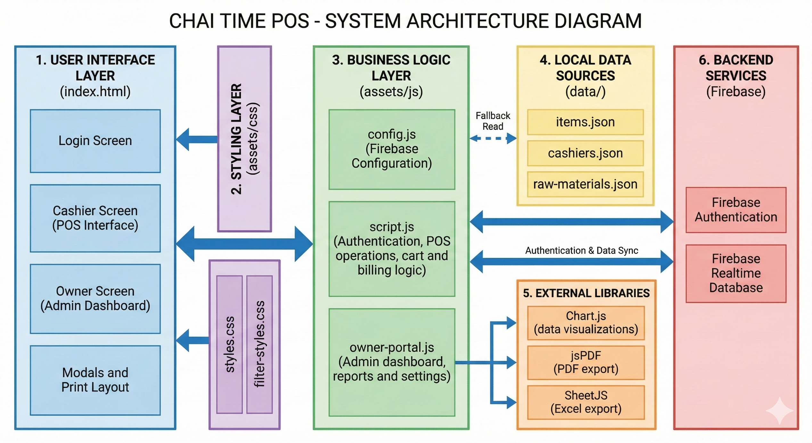
SYSTEM ARCHITECTURE DIAGRAM
11

Slide 12
Thank You
2026
+91 6379769351 | +91 9080854488 | +91 9345557536
thechaitime2026@gmail.com
https://chai-time.netlify.app/
12

