Slide 1

CHAI-TIME
POS System
Second Review Presentation · 2026
A web-based Point of Sale system to digitize café operations — billing, order management, real-time analytics, UPI payment integration, and shift-based cashier management powered by Firebase.
Firebase
Chart.js
jsPDF
Guided By
SheetJS
UPI Pay
HTML/CSS/JS
Mrs. V. Devi Nandhini AP/AI&DS
https://chai-time.netlify.app/
Dept. of Artificial Intelligence & Data Science
01

Slide 2
INTRODUCTION
Introduction
Problem Statement
Our Solution — Chai Time POS
Cafés depend on manual paper billing — prone to errors, delays, and revenue leakage.
No centralized system to track daily sales, cashier performance, or raw material costs in real time.
Owners have zero visibility into business metrics without manually counting receipts.
Cash-only acceptance limits customer convenience and slows billing queues.
Manual shift handovers result in unaccounted transactions and cash discrepancies.
No export mechanism — generating reports for review requires hours of manual work.
Cloud-based web POS using Firebase Realtime Database for instant, accurate billing.
Dual-role system: Cashier Interface for orders and Owner Portal for analytics.
Live Chart.js dashboard — daily/monthly sales, top items, cashier performance.
Cash and UPI payment with dynamic QR code scanning for fast checkout.
Shift management with open/close summaries and per-cashier transaction tracking.
PDF (jsPDF) and Excel (SheetJS) report export with date-range filtering.
02

Slide 3
LITERATURE SURVEY · PAPER 01 / 03
Transforming SME Operations with Real-time Mobile POS and Firebase Integration
Azhari & Sutarman · IJSTEM Vol. 4(4), pp. 108–135 · 2024 · CC BY 4.0 · DOI: 10.53378/ijstem.353134
What the Paper Studies
Connection to Chai Time POS
Citation Info [1]
Develops a mobile POS for SMEs using React Native + Firebase Realtime Database.
Role-based access: staff (cashier) & admin (owner) — same dual-role model as Chai Time.
Includes inventory sync, low-stock alerts, and real-time sales for café businesses.
SUS usability score >80 — validated high satisfaction from actual users.
Firebase Realtime DB used as backend — identical to Chai Time's architecture.
Dual-role login (Cashier/Owner) mirrors the role system proved in this paper.
Raw materials module parallels their SME inventory tracking sub-system.
Validates Firebase as proven choice for SME café POS environments.
[1] F. N. Azhari and Sutarman,
"Transforming SME operations...,"
IJSTEM, vol. 4, no. 4,
pp. 108–135, 2024.
DOI: 10.53378/ijstem.353134
Use: Intro + Lit Review + Tech Stack
03

Slide 4
LITERATURE SURVEY · PAPER 02 / 03
Seiton: A Mobile Inventory Management System for Micro, Small and Medium-sized Enterprise
Margate, Ravina, Pido & Young · IEEE ICETAS 2020 · IEEE Xplore · DOI: 10.1109/ICETAS51660.2020.9484183
What the Paper Studies
Connection to Chai Time POS
Citation Info [2]
Builds a mobile inventory app for 'Family Milk Tea' café SME in Philippines.
Solves stockout, overstocking, and manual Excel-based sales recording problems.
Handles stock tracking, purchase orders, and sales reporting for owner.
Validated with real café users — measurable improvement in inventory accuracy.
Same business type: milk tea/café — directly comparable context to Chai Time.
Raw Materials module in Chai Time solves the exact same stockout/tracking problem.
Owner Dashboard provides equivalent business insights as their system.
Strongest IEEE citation — use in Introduction for academic domain credibility.
[2] A. M. N. Margate et al.,
"Seiton: A Mobile Inventory...,"
in Proc. IEEE ICETAS 2020,
pp. 1–5.
DOI: 10.1109/ICETAS51660.2020.9484183
Use: Introduction + Related Work
04

Slide 5
LITERATURE SURVEY · PAPER 03 / 03
A Web-based Point of Sales for Automotive Component Industry using Rapid Application Development
Melvin, Wiratama, Sutomo & Sanjaya · JOINS Journal Vol. 8(2), pp. 167–176 · Nov. 2023 · Open Access · DOI: 10.33633/joins.v8i2.9383
What the Paper Studies
Connection to Chai Time POS
Citation Info [3]
Designs a web-based POS for an MSME using the RAD methodology.
Integrates inventory monitoring and sales transactions in one web platform.
SUS usability score: 86.6 — rated 'Very Good' by real business users.
Deployed and tested in an actual small business environment with real transactions.
Closest architectural match — both are single-platform web POS for MSMEs.
Chai Time adds UPI payment, shift management, and profit analytics beyond this.
Their SUS testing methodology can be adopted for Chai Time's evaluation section.
Cite when comparing system architecture in the Related Work section.
[3] M. Melvin et al.,
"A Web-based Point of Sales...,"
JOINS, vol. 8, no. 2,
pp. 167–176, Nov. 2023.
DOI: 10.33633/joins.v8i2.9383
Use: Related Work + Architecture
05

Slide 6
SUMMARY
KEY FINDINGS FROM LITERATURE
of Literature Survey
POS digitization reduces billing errors & time
01
All three papers confirm digital/web POS systems significantly reduce transaction errors and billing time vs. manual methods — the primary problem Chai Time solves.
[1]
Azhari & Sutarman, 2024
Mobile POS + Firebase for SMEs
Firebase proven for real-time SME applications
02
Azhari & Sutarman (2024) validate Firebase Realtime DB as a scalable, reliable backend for SME POS — directly justifying Chai Time's complete Firebase architecture.
[2]
Margate et al., 2020 (IEEE)
Inventory Mgmt · Café SME
Café/tea shop context is an active research area
03
Margate et al. (2020) focused on a milk tea café SME — confirming academic validity of your domain and strengthening your project's research foundation.
[3]
Melvin et al., 2023
Web-based POS · RAD method
Chai Time introduces novel contributions
04
Chai Time uniquely adds UPI/QR payment, cashier shift management, raw material cost tracking, and profit analytics — features absent from all three surveyed papers.
06

Slide 7
EXISTING vs PROPOSED SYSTEM
AREA
EXISTING SYSTEM
PROPOSED — CHAI TIME POS
Billing
✗ Manual paper bills or basic cash machines — slow and error-prone.
✓ Instant web billing with item search, discount application & Cash/UPI payment.
[3]
Sales Records
✗ Manual Excel sheets — risk of data loss, no real-time access.
✓ Firebase Realtime DB — cloud-synced, auto-updated, accessible from any device.
[1]
User Roles
✗ Single access; no cashier vs. owner role separation.
✓ Dual-role: Cashier Interface + Owner Portal with fully separate permissions.
[1][2]
Analytics
✗ No dashboard; owner manually tallies receipts for totals.
✓ Live Chart.js dashboards — sales trend, top items, cashier performance, P&L.
[2]
Payments
✗ Cash only; no digital payment or UPI support.
✓ Cash + UPI with dynamic QR code — customer scans to pay instantly.
New
Inventory
✗ Raw material costs tracked manually or not tracked at all.
✓ Raw material purchase logger with profit calculation and monthly cost view.
[2]
07
Citations: [1] Azhari & Sutarman 2024 · [2] Margate et al. IEEE 2020 · [3] Melvin et al. 2023 · New = novel feature not in surveyed papers

Slide 8
System
Architecture
Block Diagram & Module Overview
08

Slide 9
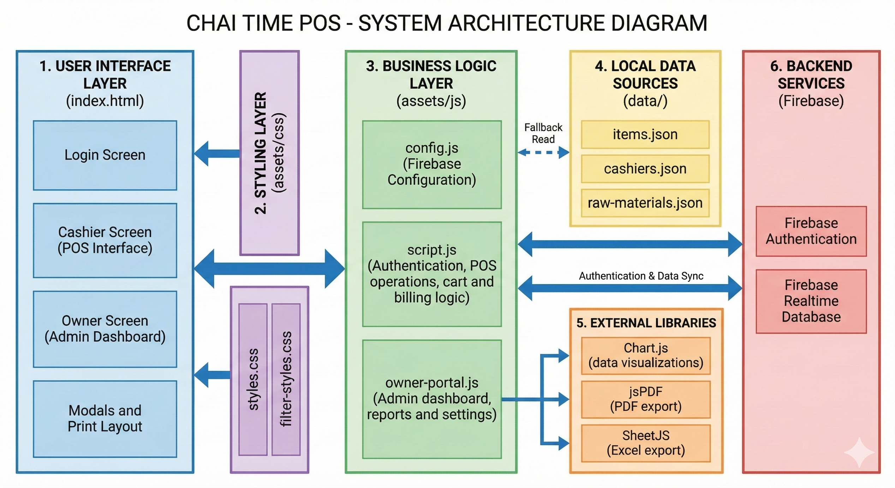
SYSTEM ARCHITECTURE DIAGRAM
09

Slide 10
MODULE DESCRIPTION
#
Module
Description
Key Features
01
Login &
Authentication
Firebase Authentication handles secure access. Cashiers select from a pre-approved name list; owners log in via email and password for the full admin portal.
Firebase Auth · Session persistence · Secure sign-out
02
Cashier POS
Interface
Displays a categorized menu with search and sort. Cashiers add items to cart, apply discounts, and confirm payment mode (Cash or UPI with QR scan).
Cart management · Discount % · 13+ categories · Real-time total
03
Bill Management
& Printing
Each transaction is stored in Firebase with a unique bill number. Bills can be reprinted, reviewed per cashier, and exported as PDF using jsPDF.
jsPDF print · Bill history · Per-cashier view · Reprint last bill
04
Shift
Management
Cashiers open and close shifts with a complete summary including total bills, cash collected, UPI received, and grand total for the session.
Open/close shift · Cash + UPI split · Session summary
05
Owner Analytics
Dashboard
Real-time Chart.js dashboards for daily/monthly sales, payment mode distribution (pie), top-selling items (bar), cashier performance, and items sold table.
Chart.js · Monthly trend · Top items · Cashier stats
06
Reports & Raw
Materials
Generates and exports itemwise, cashier-wise, P&L, and consolidated reports with date-range filtering. Raw material purchases tracked to calculate profit margin.
SheetJS Excel · jsPDF · Date-range filter · P&L calc
10

Slide 11
ALGORITHM
Billing & Payment Flow
Analytics & Report Algorithm
Step 1
Cashier logs in → Firebase Auth verifies identity and loads session.
Step 1
Owner logs in via email/password through Firebase Authentication.
Step 2
Menu items fetched from Firebase Realtime DB (fallback: local items.json).
Step 2
Firebase listener subscribes to all bills for selected date range.
Step 3
Cashier selects items → Cart accumulates line items with qty & price.
Step 3
Aggregation: total revenue, cash/UPI split, bill count, top items.
Step 4
Discount % applied → Subtotal and Grand Total computed dynamically.
Step 4
Chart.js renders: monthly bar, payment pie, top-items bar, cashier table.
Step 5
Payment mode selected:
• Cash: amount entered, change calculated.
• UPI: QR code displayed, cashier confirms receipt.
Step 5
Date-range filter applied → report type selected by owner.
Step 6
Bill written to Firebase: bill_no, date, cashier, items[], total, mode.
Step 6
Report computed:
• Item-wise: qty × price per item.
• Cashier-wise: bills and totals per cashier.
• P&L: total revenue − raw material costs.
Step 7
jsPDF generates printable bill; SheetJS logs entry to Excel export.
Step 7
Export triggered: jsPDF for PDF bills / SheetJS for Excel on demand.
Step 8
Cart cleared → Shift totals updated → Ready for next transaction.
Step 8
Raw material purchases logged separately to compute net profit margin.
11

Slide 12
CONCLUSION & FUTURE WORK
Conclusion
Future Work
Chai Time POS successfully digitizes café billing and business management, eliminating paper records and manual errors entirely.
Firebase Realtime Database provides reliable cloud sync validated by literature — supporting simultaneous cashier and owner sessions.
The dual-role system (Cashier + Owner Portal) significantly improves operational efficiency and provides real-time business visibility.
UPI QR payment integration adds a modern digital payment capability not found in any of the three surveyed reference systems.
Shift management with per-cashier tracking ensures full accountability and transparency in all daily café operations.
Chart.js dashboards and PDF/Excel report export empower owners with data-driven business decision support.
01
Mobile App (React Native)
Convert to Android/iOS app for fully offline billing during internet outages with local sync.
02
AI Demand Forecasting
ML models to predict peak hours, top-selling items, and optimal raw material stock levels.
03
Customer Loyalty Module
Loyalty points with customer profiles, redemption tracking, and personalised discount offers.
04
Multi-Branch Support
Extend Firebase to support multiple café branches with a single owner account and consolidated reports.
05
WhatsApp Bill Delivery
Auto-send digital bills to customers via WhatsApp Business API after each transaction.
12

Slide 13
Thank You
2026 · Second Review
+91 6379769351 | +91 9080854488 | +91 9345557536
thechaitime2026@gmail.com
https://chai-time.netlify.app/
Guided By: Mrs. V. Devi Nandhini AP/AI&DS
13

