Slide 1
Breach Analytics Platform
Design Gate Review — Week 3
DataFactZ AI Engineering Internship · Use Case 3 (Capstone) · <Your Name>

Slide 2
The Problem
After a breach, legal/compliance must know exactly who was exposed — across hundreds of documents, in inconsistent formats, before a regulatory deadline.
Manual triage doesn't scale
Hundreds of documents, 7+ formats, mixed digital/scanned
Both error directions are costly
Missing an exposed person = legal risk. Over-reporting = wasted trust
Evidence must be defensible
Every flag needs to trace to a specific source passage, not a black box
UC3 — Breach Analytics · Design Gate Review · 2

Slide 3
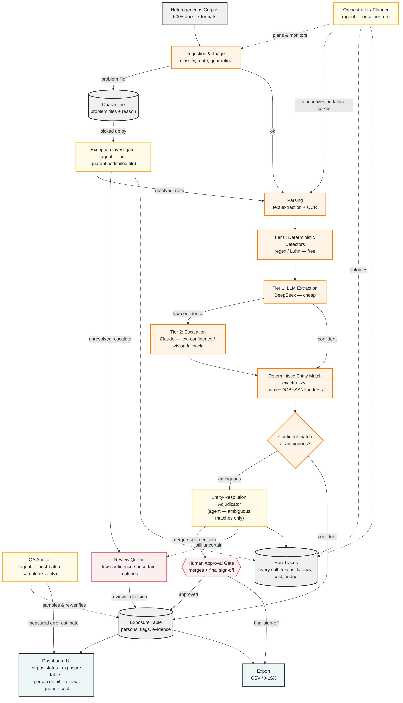
Architecture: Pipeline + Four Agents
Orange — deterministic pipeline
Gold — agents (judgment only)
Red — human review / approval
Gray — storage
Teal — dashboard / export
UC3 — Breach Analytics · Design Gate Review · 3

Slide 4
The Central Question: Pipeline vs. Agent
If there's a clear right answer or a fixed threshold → pipeline.
If it genuinely needs judgment, iteration, or an explained decision → agent.
Deterministic (pipeline)
Parsing, OCR, Tier 0/1/2 extraction, initial entity match — each has a clear pass/fail or fixed threshold
Entity-Resolution Adjudicator
Exists for the shared-name-vs-same-person case — a similarity score alone can't decide this
Exception Investigator
File-failure diagnosis benefits from trying alternate strategies in a loop, not a fixed retry-N rule
UC3 — Breach Analytics · Design Gate Review · 4

Slide 5
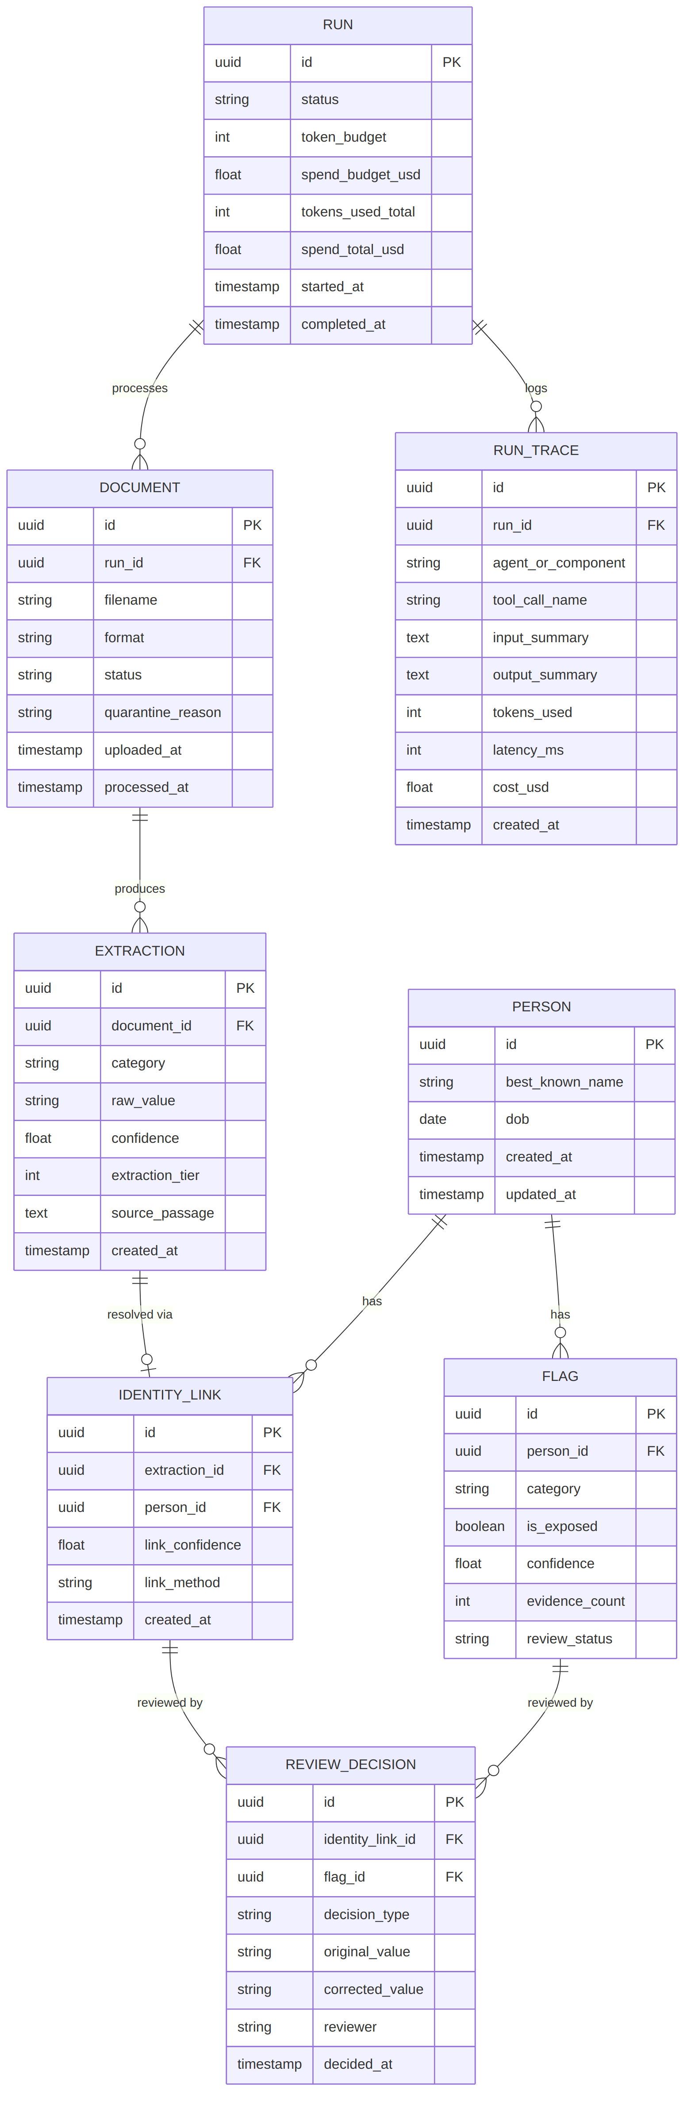
Database Design
EXTRACTION is generic (one row per element) — powers per-category accuracy AND per-tier cost from one table.
FLAG is the fast, UI-facing view; evidence traces through IDENTITY_LINK → EXTRACTION → DOCUMENT.
RUN / RUN_TRACE separated so budget checks stay a cheap single-row read.
UC3 — Breach Analytics · Design Gate Review · 5

Slide 6
Stack Justification
Decision | Chosen | Key rejected alternative
Orchestration | Hand-rolled agent layer | LangGraph — overkill for 4 fixed roles
Tool design | Single MCP tool surface | Per-agent schemas — 4 call shapes to support
Model tiering | Free → DeepSeek → Claude | One model for everything — fails cost/scale requirement
Infrastructure | Self-hosted (Postgres, FastAPI) | Full Azure — access still not provisioned
UC3 — Breach Analytics · Design Gate Review · 6

Slide 7
Corpus Generator — Verified, Not Just Planned
538
171
7
1,776
documents
synthetic people
formats
planted elements
✓ Digital/scanned detector: correct on every scanned file (0 extractable characters, verified)
✓ 8 shared-name collision pairs: verified distinct SSN/DOB per person, same display name
✓ 12 partial-identifier people: verified SSN and name genuinely land in separate documents
✓ 58 false-positive traps planted (order numbers, employee signatures, test records, placeholders) for precision scoring
✓ Both a flag/value bug and a misspelling-generator bug were found and fixed during verification
UC3 — Breach Analytics · Design Gate Review · 7

Slide 8
Accuracy & Cost — Measurement Plan
Status: methodology locked now, real numbers measured during the Week 4 build
Accuracy
Cost
• Person-level recall/precision vs. the 171-person manifest
• Per-category flag accuracy (SSN, DOB, financial, medical...)
• Name-variant linking + collision-separation success rate
• False-positive rejection rate, from negatives.csv
• Measured (not estimated) from real run traces
• Broken down by tier, extrapolated to 100K / 1M docs
• At least 2 configurations compared on a cost/accuracy curve
• One recommended configuration, defended
UC3 — Breach Analytics · Design Gate Review · 8

Slide 9
Top Risks
Risk | Likelihood | Mitigation
Cheap-tier model produces unreliable JSON (seen directly in Week 2) | High | Bracket-repair + non-anchoring retry, ported from Week 2
Entity resolution wrongly merges two people sharing a name | Medium | 8 deliberate collision pairs catch this before the demo
Cost report is estimated, not truly measured | Medium | Every call logged to RUN_TRACE with real tokens + pricing
Approval gates demoed but don't actually stop anything | Medium | Forced-failure demo exercises the budget-exceeded path live
UC3 — Breach Analytics · Design Gate Review · 9

Slide 10
Week 4 Build Plan
Mon
Feedback incorporated; scaffold + deterministic pipeline stages 1-4
Tue
Deterministic entity matching; Orchestrator + Exception Investigator online
Wed
Adjudicator + approval gates; review UI; QA Auditor; begin accuracy measurement
Thu
Cost measurement + tier analysis; export UI; feature freeze; status report 6pm
Fri
Deck, rehearsal, forced-failure dry run, capstone presentation + Q&A
UC3 — Breach Analytics · Design Gate Review · 10

Slide 11
Design locked. Corpus verified. Building starts Monday.
Questions?

