Slide 1


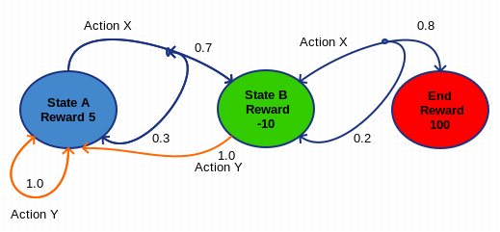
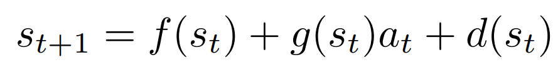
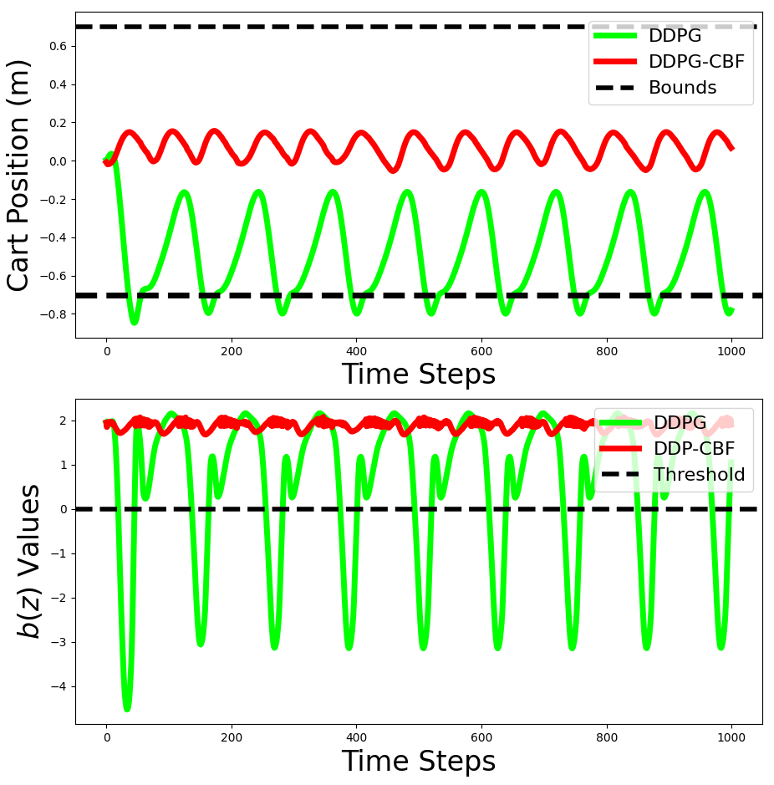
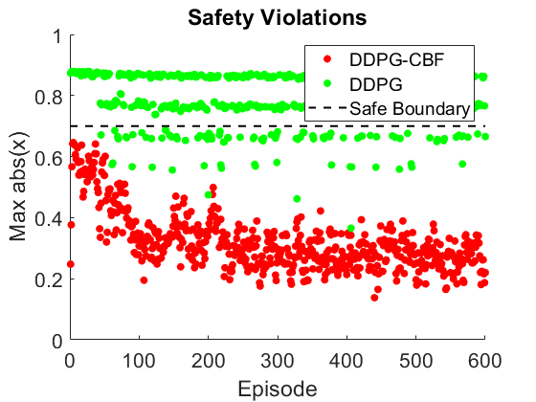

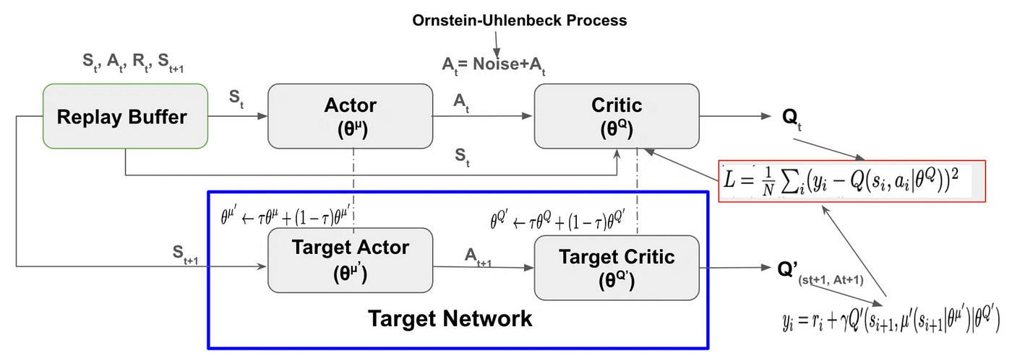
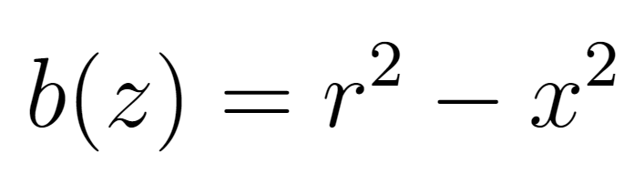
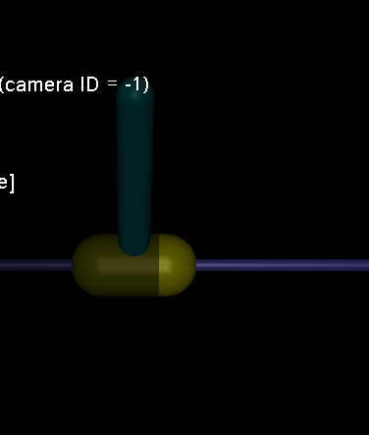
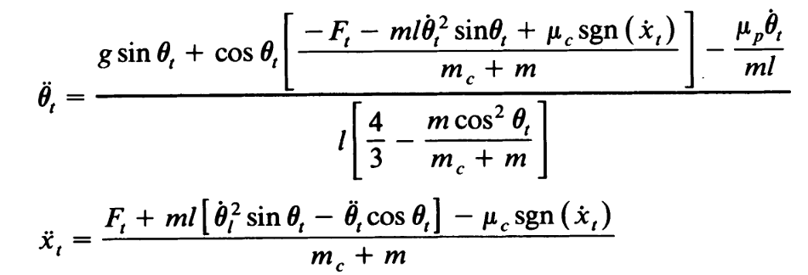
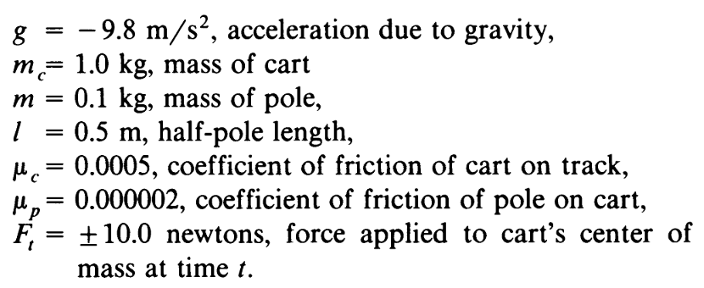
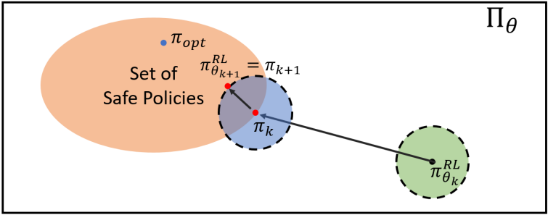
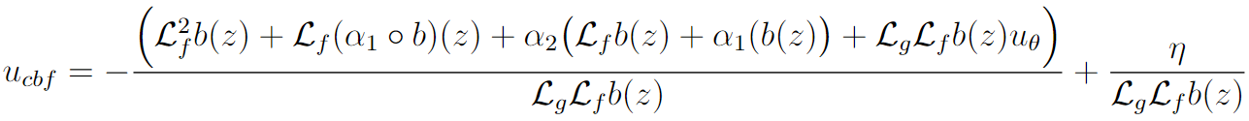
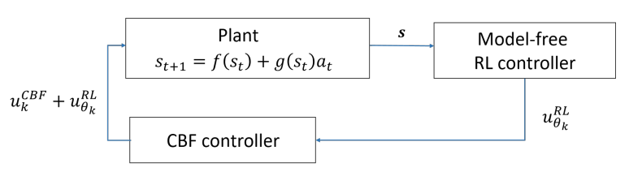
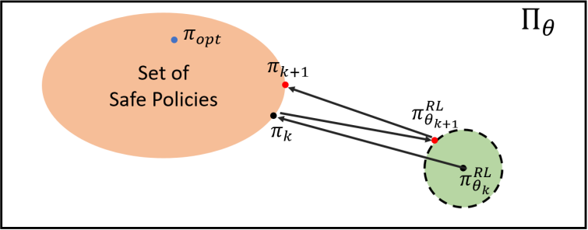
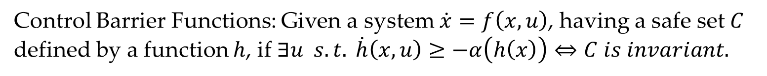
Safe Reinforcement Learning through Barrier Functions
Sriram Kodey, Department of Mechanical Engineering
Introduction
Background
Experimental results
Reinforcement Learning (RL) is quite successful at learning near optimal policies for continuous control tasks in simulation but faces challenges in real-world applications due to safety concerns. Systems will probably fail before learning an optimal policy.
Traditional model-based approaches like Lyapunov methods and model predictive control guarantee safety but are not exploratory algorithms.
Current safe RL techniques, such as reward-shaping and policy optimization, only approximate safety after initial learning, often violating safety early on.
This project explores using Control Barrier Functions (CBFs) as hard constraints to ensure safety throughout the learning process and investigates guiding policy exploration using CBFs.
System setup: a Markov Decision Process with control affine dynamics.
The RL-CBF controller was deployed and evaluated on the Inverted Pendulum environment in gym with the MuJoCo physics simulator.
Fig 2: Markov Decision Process
RL algorithm: learns a stochastic control policy $π\left(a | s\right)$ that maximizes the expected reward $J(π)$of the trajectory $τ\sim π, τ=\{s_{t}, a_{t}, …, s_{t+n},a_{t+n}\}$.
Control Barrier Functions: Given a system $\dot{x}=f\left(x, u\right)$, having a safe set $C$ defined by a function $h$, if $∃u s.t. \dot{h}\left(x, u\right)≥−α\left(h\left(x\right)\right)⇔C is invariant.$
Fig 5a: Safety violations during training. Fig 5b: Performance after training
Proposed Approach
Discussion:
The pure DDPG controller has clearly violated the safety boundary throughout the learning process.
The DDPG-CBF controller establishes hard safety constraints through the use of CBFs, thus no violations are observed during the entire training process.
DDPG-CBF requires more training time, since it has to check barrier constraint violations and compute the barrier compensator input for each batch during training.
CBF guided policy exploration can make training faster.
Barrier function doesn’t violate threshold with CBFs.
Barrier Function:
Problem Description
DDPG: is an actor-critic algorithm that combines the benefits of DQNs with capability of policy gradient methods.
RL's model-free nature allows it to generalize across various dynamic systems. This paper presents a framework that integrates any RL architecture with any Lyapunov-type Barrier Function, ensuring broad applicability and enhanced safety.
Inverted Pendulum cart pole system, with nonlinear dynamics and non-minimum phase characteristics.
Actor ~ Policy, Critic ~ Q Function
Used to train the Target Actor and Critic. Target networks are deployed.
HOCBF: Condition for control invariance
Conclusions
The results demonstrate the successful application of CBFs in RL architecture for safety guarantees during the training process.
DDPG-CBF: The model-free RL controller proposes a control based on the measurement (state estimate), which is fed to the CBF Controller. The CBF controller adds a signal to input that ensure control invariance of the system at all times.
Future work includes using CBFs to guide RL exploration for safe and efficient training.
Fig 1: Inverted Pendulum in MuJoCo
Fig 6: Barrier guided Policy optimization
The Barrier Function can be tailored to specific applications. In this project, the goal is to constrain the cart's position, ensuring it stays within the rail boundaries while learning a policy to keep the pole upright.
References: [1] R. Cheng, G. Orosz, R. Murray, and J. Burdick, "End-to-End Safe Reinforcement Learning through Barrier Functions for Safety-Critical Continuous Control Tasks," 2019 International Conference on Robotics and Automation (ICRA), 2019, pp. 4298-4305. [2] W. Xiao and C. Belta. High order control barrier functions. IEEE Transactions on Automatic Control, 67(7):3655–3662, 2021.
Fig 3: RL-CBF Controller architecture
Fig 4: Policy optimization with Barrier compensator
Notes:
We are living in very exciting times, we are witnessing how autonomous systems are revolutionizing the world we live in. As robots, or autonomous systems, become more pervasive in our everyday life, we find more and more sitations where, we as humans, must interact with them.

