Slide 1

STUDENT SERVANT
Prajwal Reddy 1602-19-737-086
L. Sriram 1602-19-737-114

Slide 2
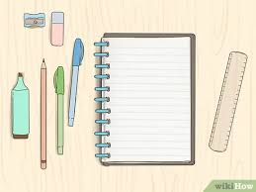

ABSTRACT PRESENTATION OF MINI PROJECT student servant
*In this day and age, from STUDIES to sales, everything is using online platforms. So, the time a student has to spend in front of a computer is increasing.
*OUR MAIN OBJECTIVE IS TO BUILD AN APPLICATION FOR MANAGING NOTES WHILE ONLINE CLASSES ARE ONGOING AND EVEN AFTER.
*THROUGH THIS APPLICATION, ONE HAS QUICK ACCESS TO write, edit and read the notes everyday FOR VARIOUS SUBJECTS.
FEATURES:
ADDING NOTES FOR SPECIFIC DATE ,SUBJECT AND TOPIC
EDITING AND DELETING ALREADY ADDED NOTES.
SEARCHING AND DISPLAYING NOTES WRITTEN ON A SPECIFIC DATE.
USER CAN BE SAFE WITH PASSWORD PROTECTION.

Slide 3
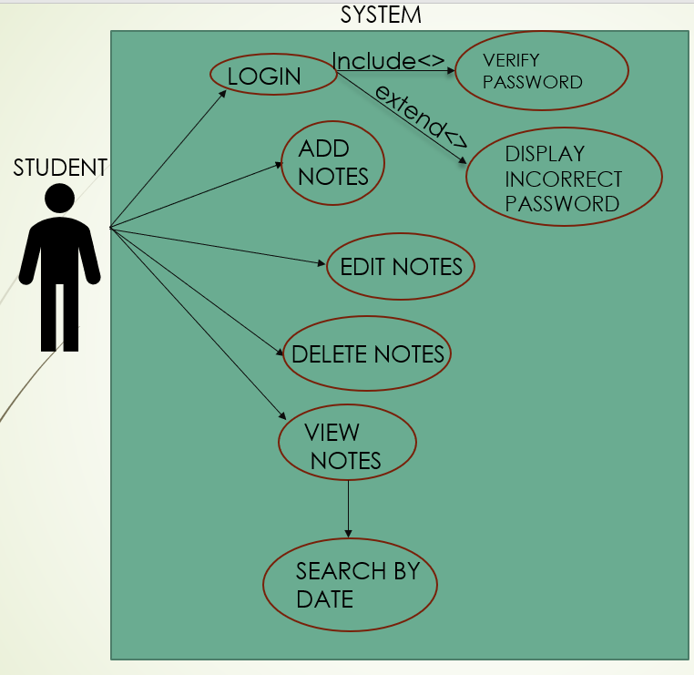
USER CASE DIAGRAM:

Slide 4
TECHNOLOGY USED:
SOFTWARE
HARDWARE
Software Requirements deal with defining the software resource requirements and prerequisites that need to be installed on a computer to provide optimal functioning of an application or the Mini Project we ideated and coded. These preconditions are generally not included in the software installation package and need to be installed separately.
In order to use CODIAC, one should have the following:
Operating System: Windows 7 or above
C Compiler: GNU Compiler Collection (GCC)
Editor: Any text editor ( Note Pad/ Note Pad++..) .
Hardware requirements refer to the common set requirements defined by any operating system or software application and are usually the physical computer resources. In this, we look into the architecture, processing power, memory, secondary memory, display adapter and peripherals.
In order to use this project, one should have the following:
Processor: Intel Pentium processor and above ( or equivalent..)
Memory: 2 GB RAM and above

Slide 5
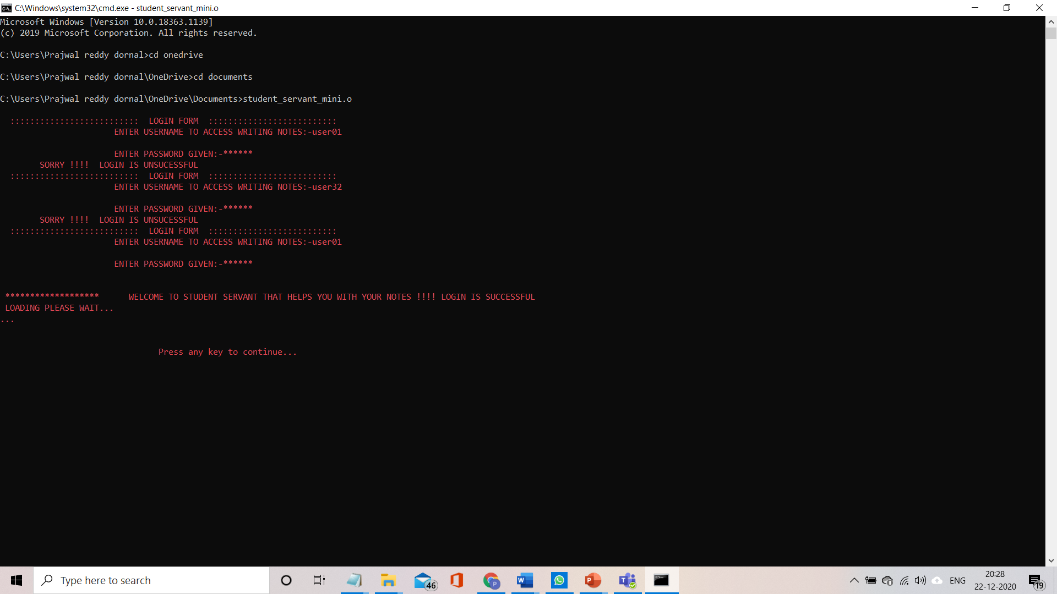
RESULTS:

Slide 6
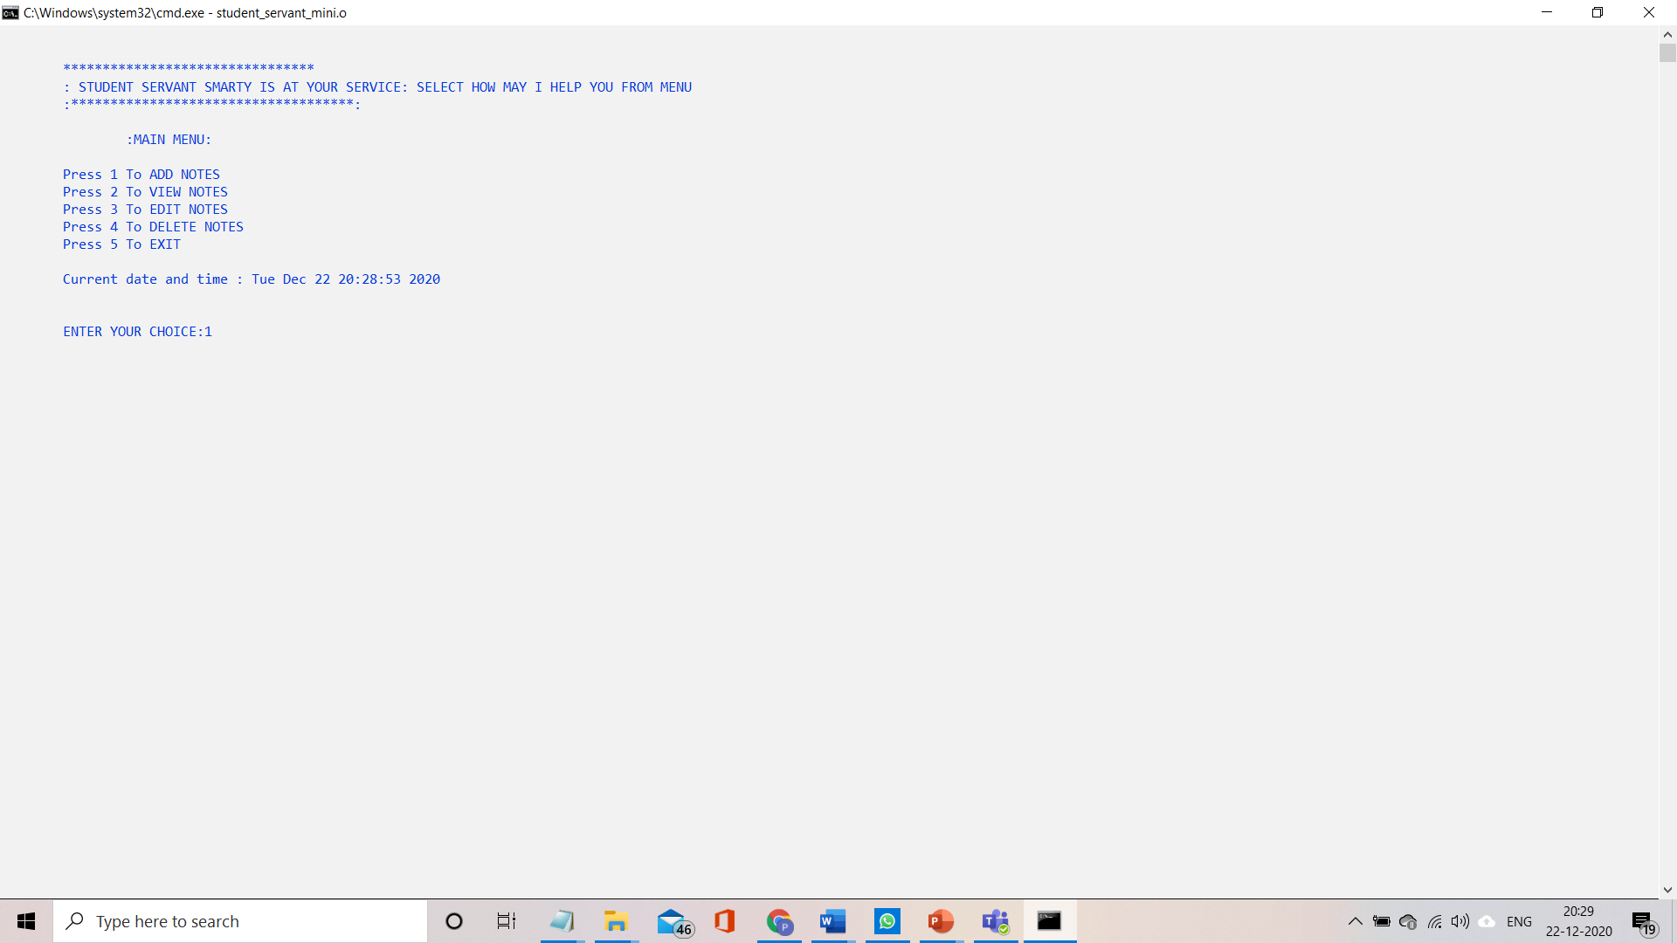

Slide 7
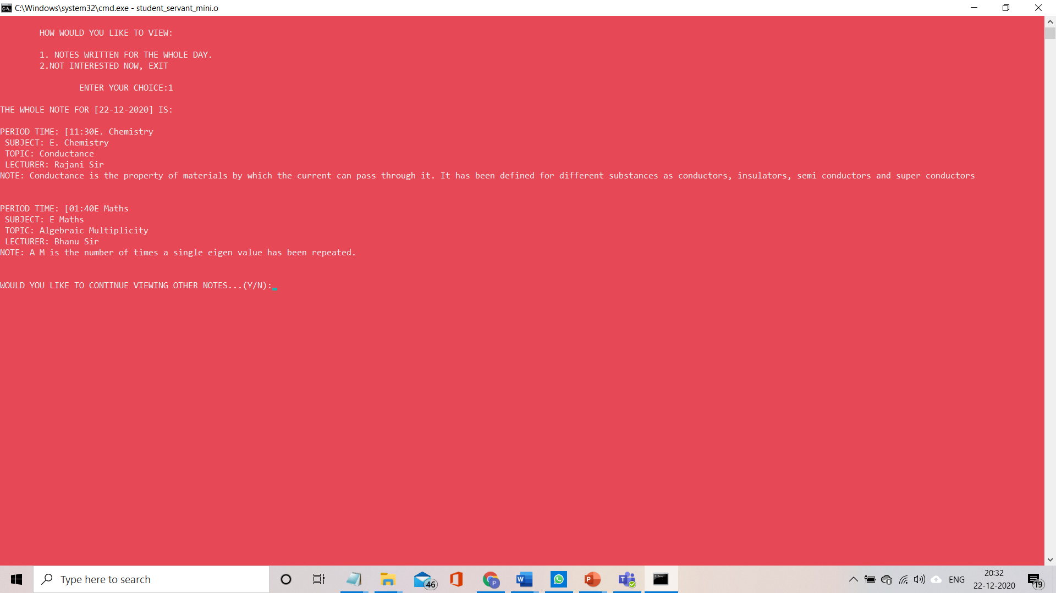

Slide 8
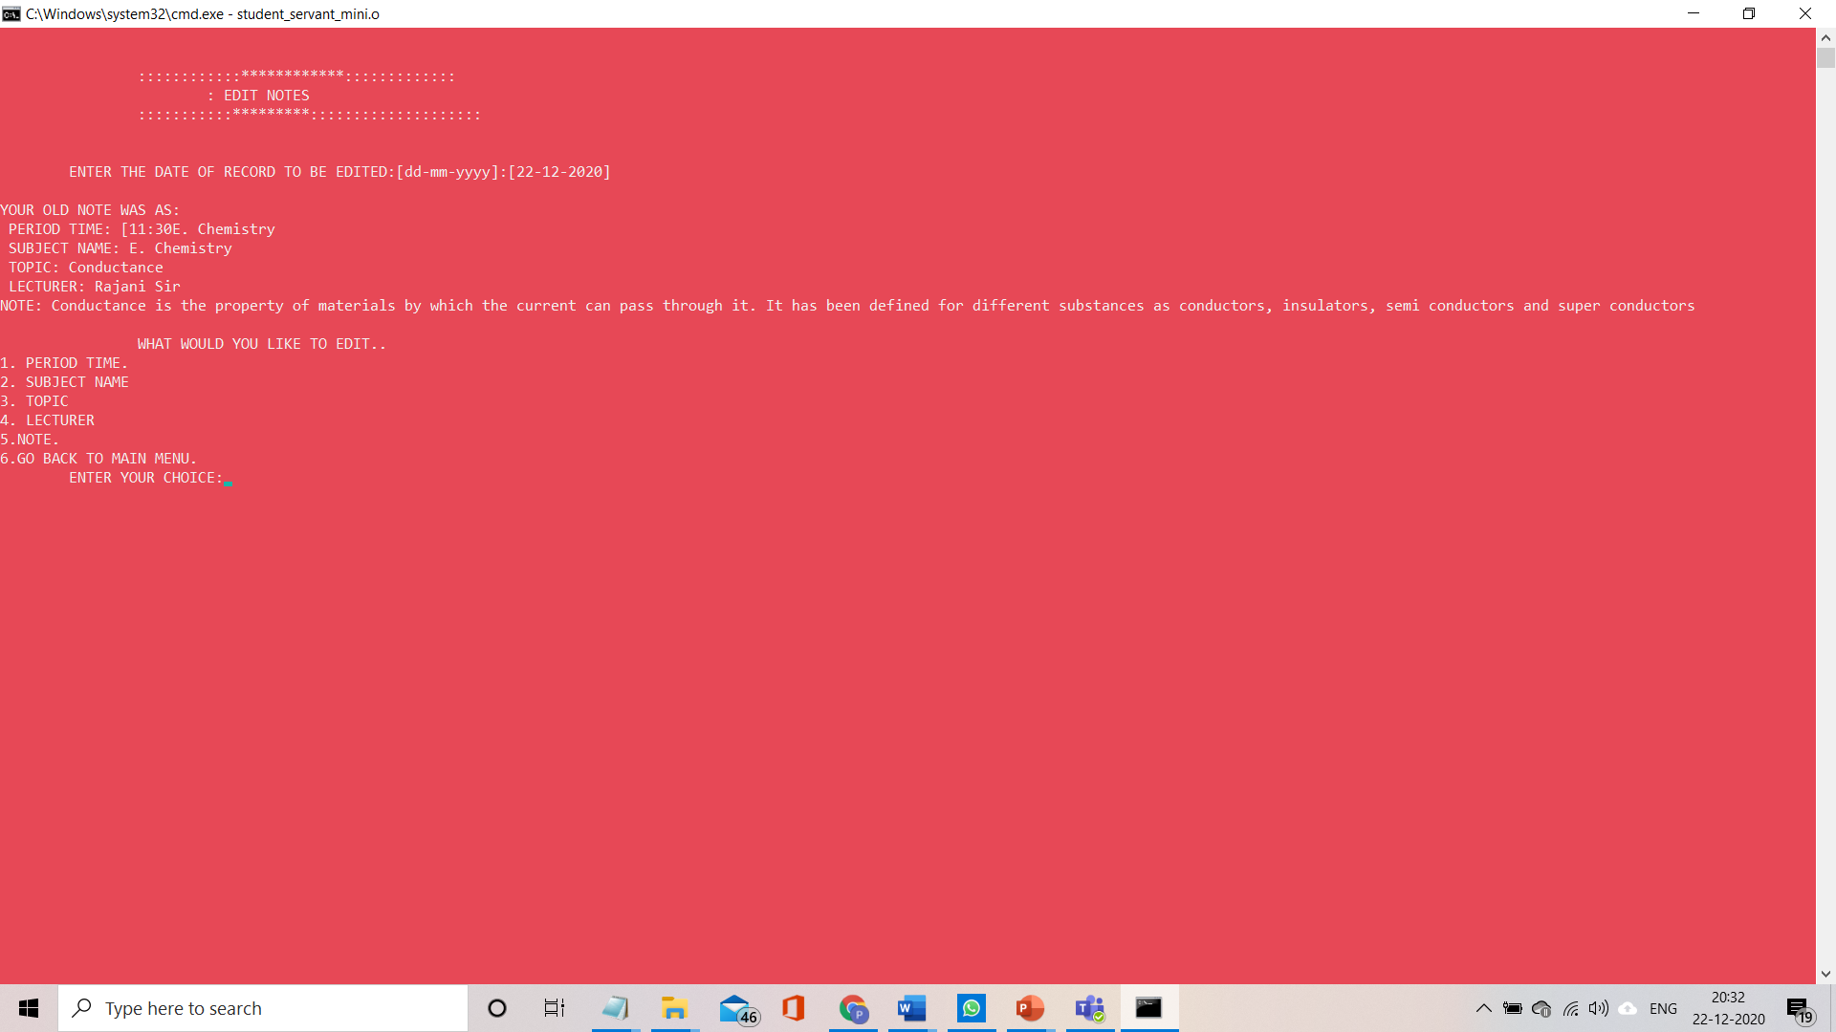

Slide 9
CONCLUSION AND FUTURE WORK:
To conclude, this application is prominently useful and can be handled easily by a 10 year old as well. This application introduces digital storing for a basic child and also gives immense support of portability of self written notes even for a 30 year old.
The Future work on this project is to lead to create an android application as well as an HTML web page. This Project can be further developed to give access to our teachers to look into our notes and correct them by sharing the HTML link.
THANK YOU

