Slide 1
Mini Project
QUICK FOODIE
ABUBAKAR – 084
L SRIRAM – 114
VIVEK RAJ -122

Slide 2
ABSTRACT:
The QUICKFOODIE described in this document has been designed to fill a specific niche in the market by providing small restaurants with the ability to offer their customers an online ordering option without having to invest large amounts of time and money in having custom software designed specifically for them. The system, which is highly customizable, allows the restaurant employees to easily manage the site content, most importantly the menu, themselves through a very intuitive graphical interface.
The website, which is the only component seen by the restaurant customers, is then built dynamically based on the current state of the system, so any changes made are reflected in real time. Visitors to the site, once registered, are then able to easily navigate this menu, add food items to their order, and specify delivery options with only a few clicks, greatly simplifying the ordering process. Back in the restaurant, placed orders are promptly retrieved and displayed in an easily readable format for efficient processing.

Slide 3
Hardware/Software
Software Requirements:
INTERPRETER:
Visual Studio Code
Text Editor
Hardware Requirements:
1 GB RAM
1GB CORE
Front End:
1)HTML
2)CSS
3)JAVA SCRIPT
BACK END:
PHP
MY SQL for connectivity

Slide 4
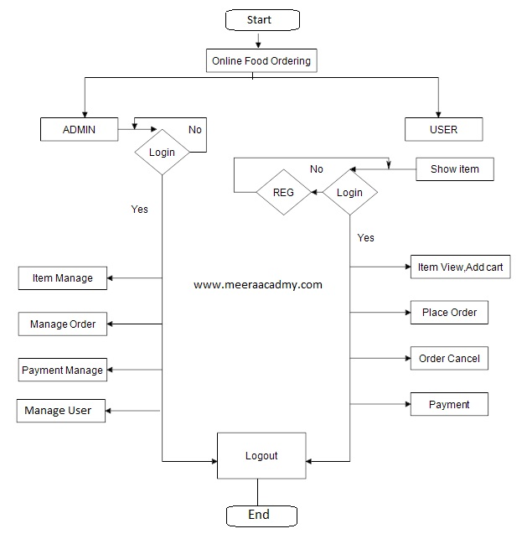

ARCHITECHTURE DESIGN:

Slide 5
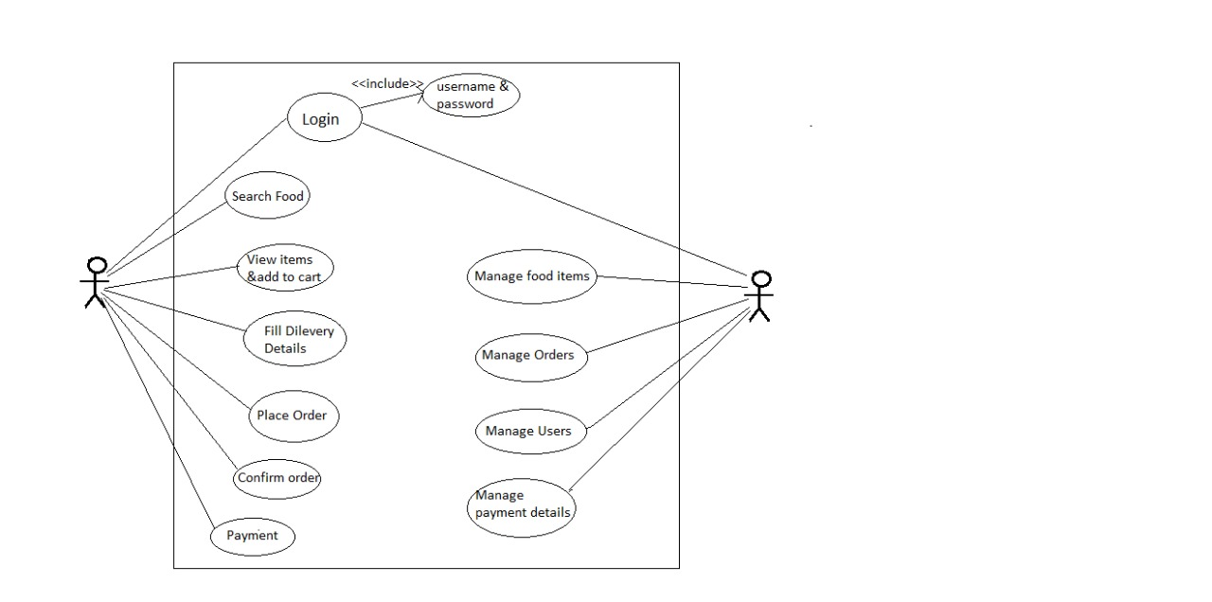

Slide 6

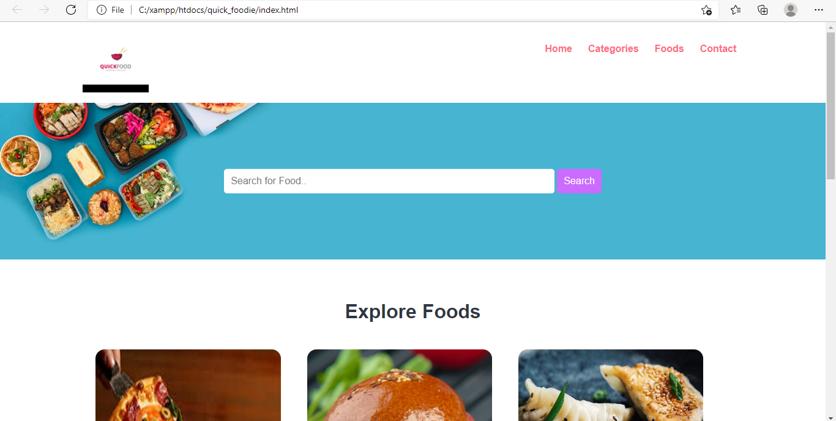

Slide 7
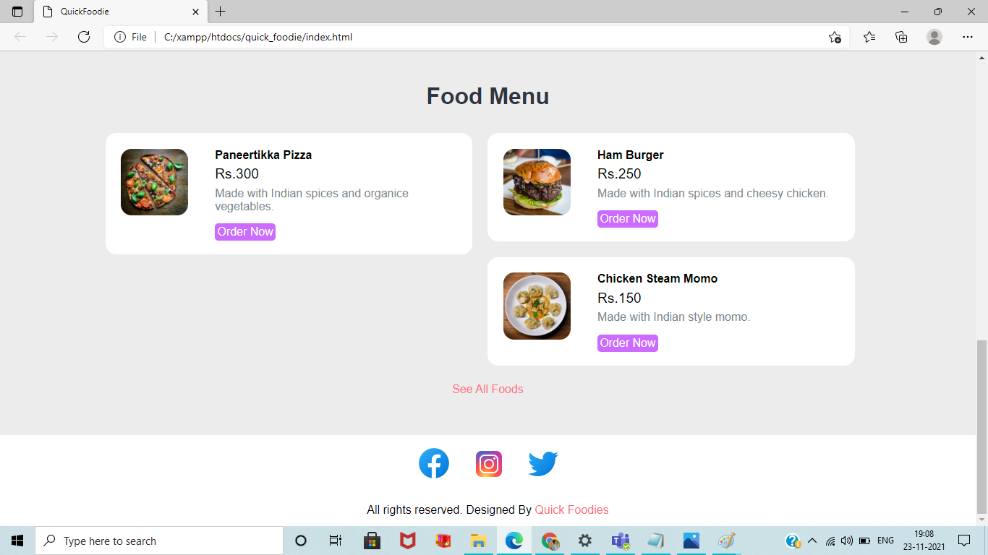

Slide 8
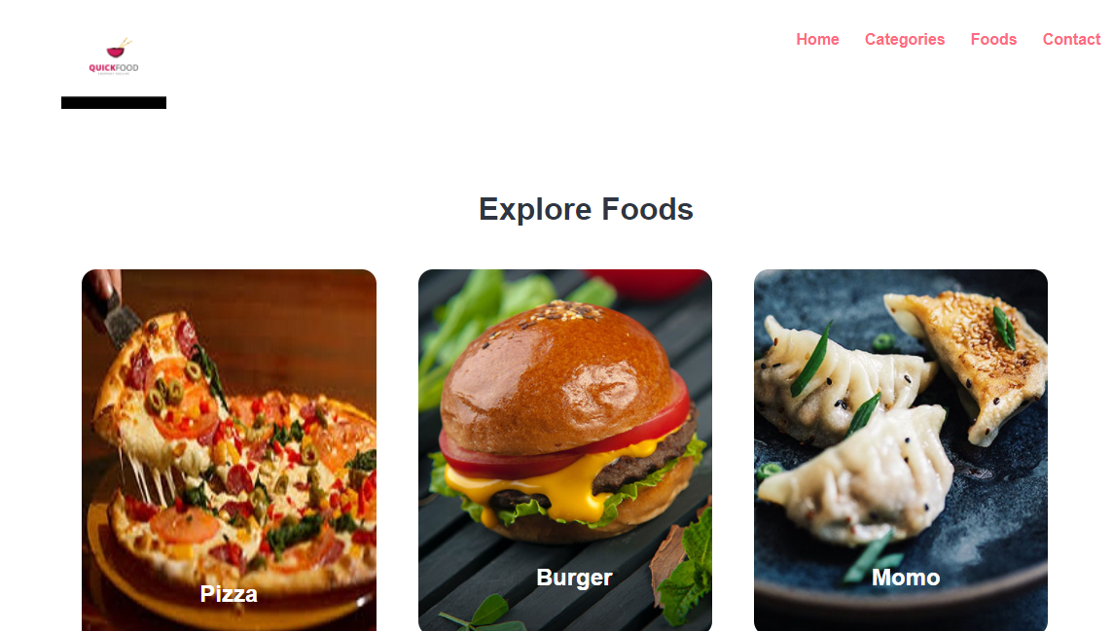

Slide 9
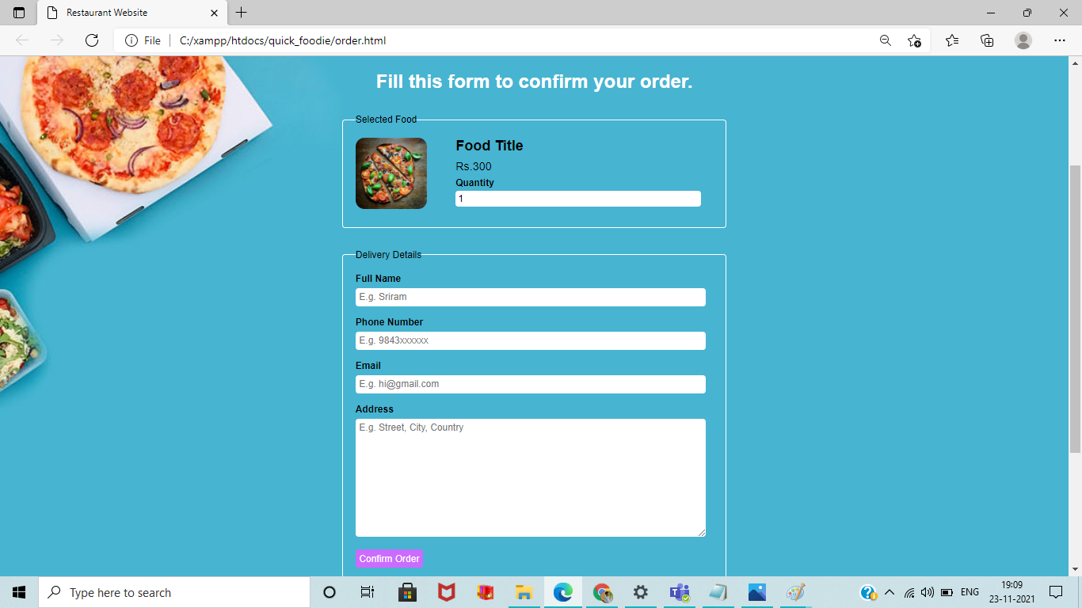

Slide 10
REFERENCES
http://ictactjournals.in/paper/IJMS_Vol_5_Iss_4_Paper_3_1089_1094.pdf
https://www.php.net/manual/en/langref.php
https://dev.mysql.com/doc/refman/8.0/en/

Slide 11
THANK YOU

