Slide 1
media streaming with ibm cloud video streaming

Slide 2
Introduction
Streaming media is video or audio content sent in compressed form over the internet and played immediately over a user's device, rather than being saved to the device hard drive or solid-state drive. During the streaming process, the media file that's played on the user's device is retrieved from a remote location and transmitted continuously over the internet using a wired or wireless connection.

Slide 3
Media streaming
Streaming media is multi media for playback using an offline or online media player. Technically, the stream is delivered and consumed in a continuous manner from a client, with little or no intermediate storage in network elements. Streaming refers to the delivery method of content, rather than the content itself.
Distinguishing delivery method from the media applies specifically to telecommunications networks as most of the traditional media delivery systems.There are challenges with streaming content on the Internet.

Slide 4
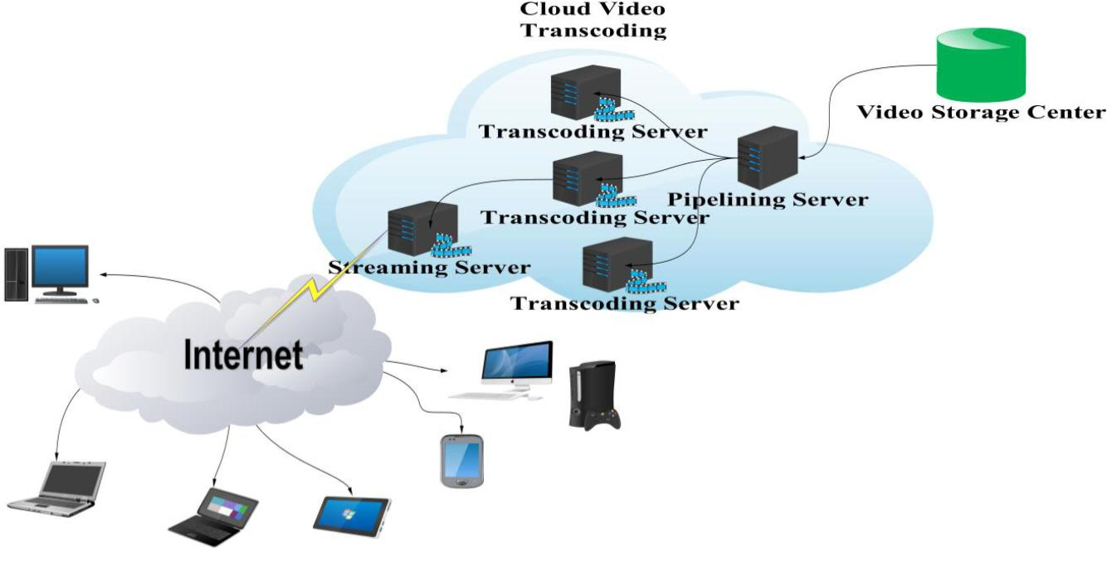
Diagrammatic representation

Slide 5
Video streaming
A cloud video streaming service streams and stores your video data (or someone else's video data) in the cloud. A good cloud video streaming service will host video, deliver it reliably whenever you want, be scalable and able to reach millions with its content. Some popular cloud video streaming services include Netflix and Hulu, but they can also include services like YouTube, Vimeo and api.video.

Slide 6
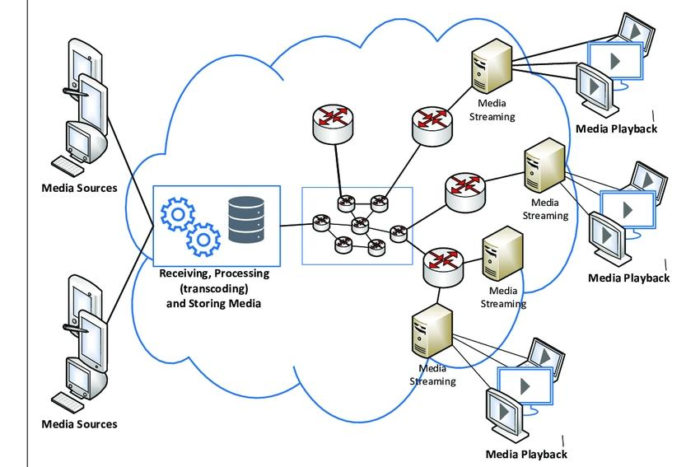
Diagrammatic representation

