Slide 1
TIME VALUE OF MONEY
PART-2

Slide 2
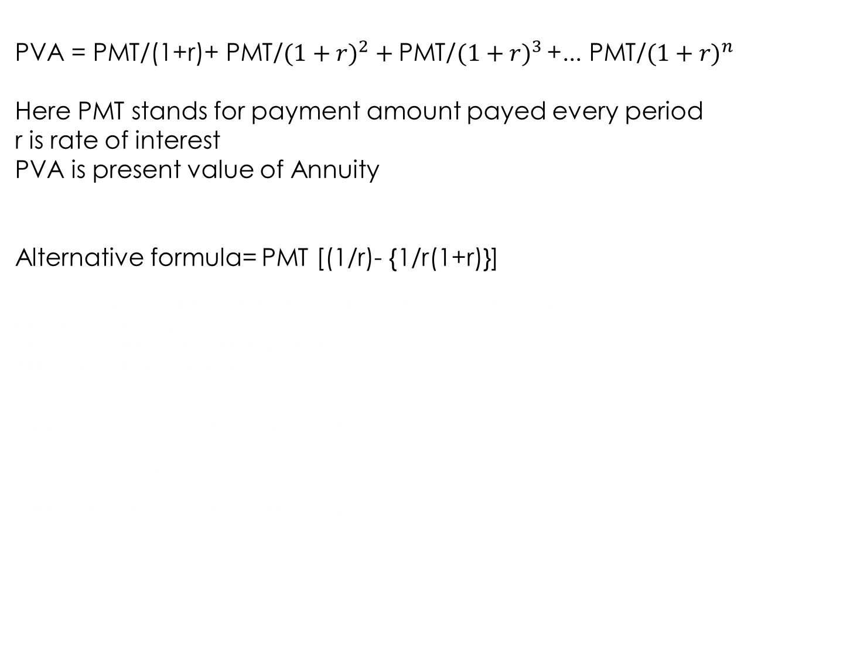
Present Value of Ordinary Annuity
Discounted Cash Flow analysis
PVA = PMT/(1+r)+ PMT/$(1+{r)}^{2}+\text{PMT}\text{/}(1+{r)}^{3 }$+... PMT/$(1+{r)}^{n}$
Here PMT stands for payment amount payed every period
r is rate of interest
PVA is present value of Annuity
Alternative formula= PMT [(1/r)- {1/r(1+r)}]
in hand today is worth more than one INR in future (say after one year) if
it is lent to somebody.
This is due to time value of money which is
equivalent to the notion of “interest rate”
Future Value= Today’s value (1+time value)
OR
Future Value= Today’s value (1+interst rate)

Slide 3
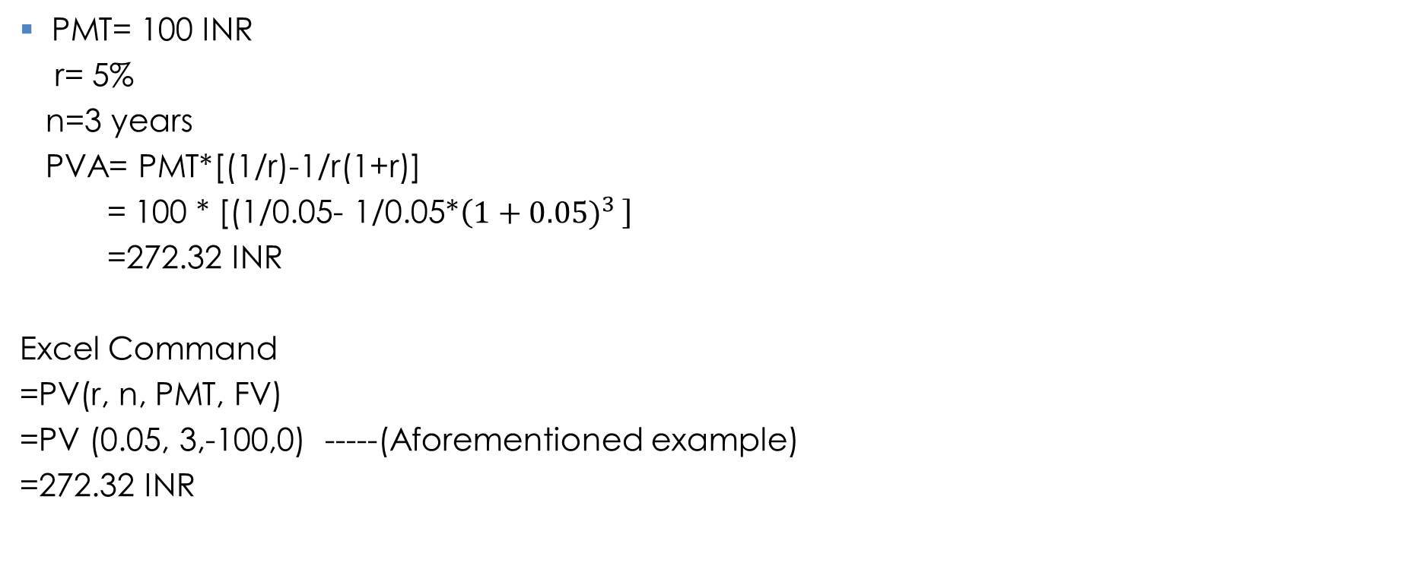
Example and Excel Command
PMT= 100 INR
r= 5%
n=3 years
PVA= PMT*[(1/r)-1/r(1+r)]
= 100 * [(1/0.05- 1/0.05*$\left(1+{0.05)}^{3 }\right]$
=272.32 INR
Excel Command
=PV(r, n, PMT, FV)
=PV (0.05, 3,-100,0) -----(Aforementioned example)
=272.32 INR

Slide 4
Present Value of Annuity Due
PVA of Annuity Due= PVA of Ordinary Annuity (1+r)
= 272.32 (1+0.05)
= 285.94 INR
Excel command
=PV (r, n, PMT, FV, Type)
= PV(0.05, 3, -100, 0,1)
=285.94 INR

Slide 5
Finding Annuity Payments, Periods and Interest Rates
Excel Commands to find Payment
= PMT(r, n, PV,FV)
= PMT(0.06 ,5, 0,1000)
=1773.96 INR
Excel Command to find Periods
= NPER(0.06,-1200, 0,10000)
= 6.96 (say 7 years)
Excel Command to find interest rate
= RATE( 3, -1200, 0, 10000)
= 25.78%

Slide 6
Semiannual and other compounding periods
Instead of once in a year compounding, if we compound twice a year (semiannually) then we can express the FV and PV relation in modified fashion-
$$FV=PV (1+{r/M)}^{Mn}$$
Where M=2 ( if semiannually compounded)
M=4 (if quarterly compounded)
and n= number of years
r= interest rate

Slide 7
Numerical Example
If one person borrows 100 INR for 2 years and if he has to pay 12% annual interest on a quarterly basis (compounding 4 times a year) then total payment (principle and interest) will be= 100$(1+{0.12/4)}^{4∗2}$
=126.68 INR
An interesting interpretation of ‘e’
$(1+{1/n)}^{n}$ and if n ∞
=e (approx. 2.718)

Slide 8

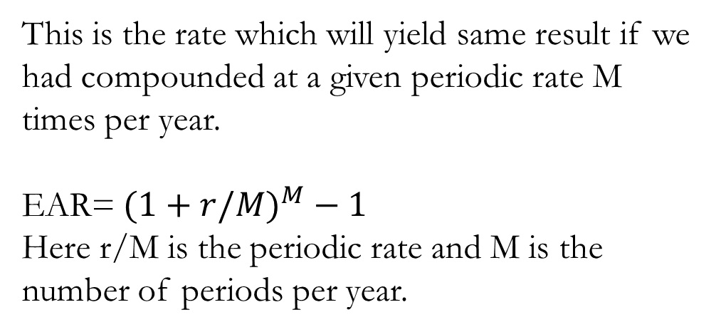
Effective Annual Rate
This is the rate which will yield same result if we had compounded at a given periodic rate M times per year.
EAR=$(1+{r/M)}^{M}−1$
Here r/M is the periodic rate and M is the number of periods per year.

Slide 9
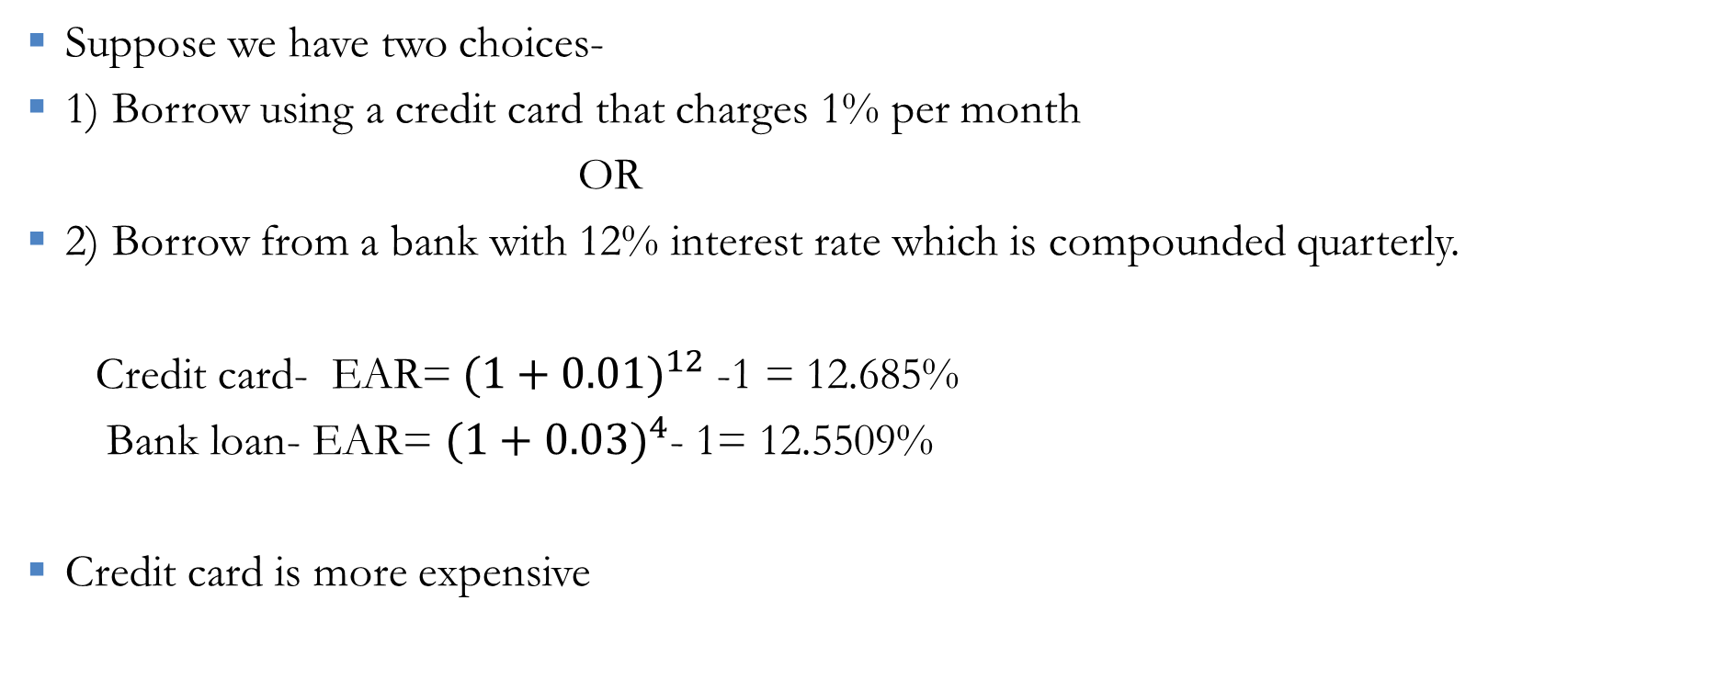
Numerical Example
Suppose we have two choices-
1) Borrow using a credit card that charges 1% per month
OR
2) Borrow from a bank with 12% interest rate which is compounded quarterly.
Credit card- EAR=$(1+{0.01)}^{12}$ -1 = 12.685%
Bank loan- EAR= $(1+{0.03)}^{4}$- 1= 12.5509%
Credit card is more expensive

Slide 10
Time value and Inflation
So far in our PV, FV analysis we did not incorporate the notion of inflation/deflation. However, in real life such factor plays important role
To determine the valuation of money over time we need to factor
inflation
Inflation is characterized as continuous increase in general price level.
If we assume the inflation (rate of change in price) as f, then price
worth 1 INR will become 1*(1+f) INR in future (say after 1 period)

Slide 11
Time value and Inflation
The rule is applicable for multiple years/periods and we may write the
value after n years will be
$(1+{f)}^{n }$
Hence what we can buy today for 1 INR, we need to pay $(1+{f)}^{n }$INR in future after n years.
So purchasing power will shrink by the factor $(1+{f)}^{n }$

Slide 12
Time value and Inflation
If a person has one rupee and if bank offers r% annual interest rate then after 1 year what will be the purchasing power of his money. Assume inflation rate is ‘f’.
After 1 year, bank will give back (1+r) rupee to that person.
However with this (1+r) he cannot buy the same thing what he used to buy earlier. Because of inflation his purchasing power will go down by the factor (1+f)
So, the money (1+r) can afford (1+f) fraction of old goods and services.
Hence real value in market of his money is (1+r)/(1+f)

Slide 13
Real and Nominal interest rate
From previous example how can we interpret the concept of real rate of interest and its distinction from nominal interest rate?
If we assume R is the real interest rate and r is the nominal interest rate the after 1 year real value of 1 INR becomes (1+r)/(1+f).
If we equate this value and assume real interest rate is inflation-adjusted rate then 1+R = (1+r)/(1+f)
or R= (1+r)/(1+f) – 1
= (1+r-1-f)/(1+f)
= (r-f)/(1+f)

Slide 14
Numerical example:
If nominal interest rate is 5% and inflation rate is 3% then what will
be the real interest rate?
R= (r-f)/(1+f) = (0.05-0.03)/(1+0.03)= 0.0194
R= 1.94%
Though nominal interest rate is as high as 5%, real value is only 1.94% due to inflation.

Slide 15
Numerical example
Suppose one wants to grow his money up to 100000 INR in 10 years. The person wants to make 10 deposits (each at the beginning of every year) in a bank which offers 6% interest rate and inflation rate in economy is 2%. How much you need to deposit initially to get 100000INR at the end of 10 years?
Real rate of interest R= (1+0.06)/(1+0.02)= 3.912%
In 10 years the target 100000INR will have purchasing power of 100000/(1+0.02)^10
= 82034.83INR
Hence to get FV=82034.83INR in 10 years with 6% interest rate we can calculate PMT value.
Excel Command = PMT(R,N,PV,FV)= -6598.87INR (Initial payment to be made)

Slide 16

Notion of IRR
IRR – Internal Rate of Return
An interest rate which yield a PV=0 for a cash flow over a period of time
Where r= IRR
Calculate the IRR

Slide 17
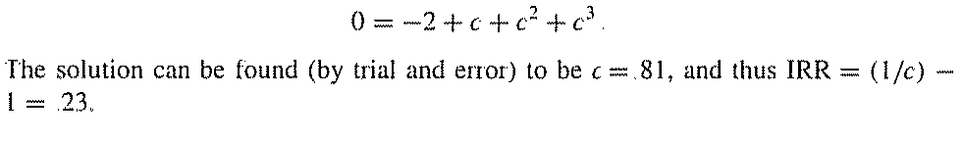
Solution

Slide 18


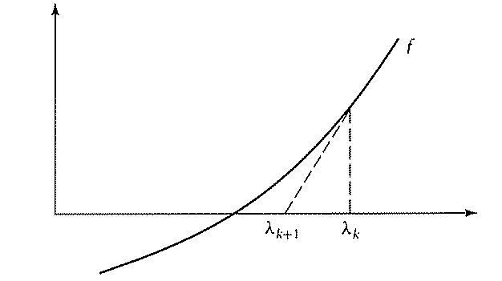
Newton Raphson Method

Slide 19
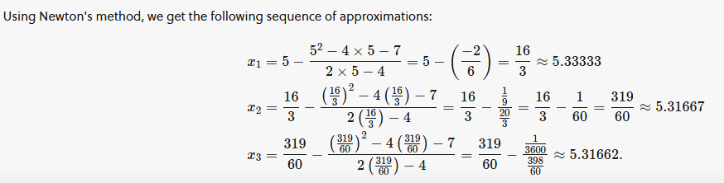
Numerical Example

Slide 20
Investment Decision (NPV vs IRR)
Suppose you have an opportunity to plant a tree which you can sell to lumber in future. You have two options. Grow the tree for one year and then sell for 2 INR or grow it for two years and then sell it for 3 INR. Initial cost to plant the tree is 1 INR.
What will you do?

Slide 21
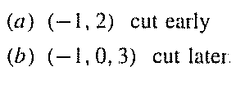

Assume r=10% (Let’s follow NPV concept)

Slide 22
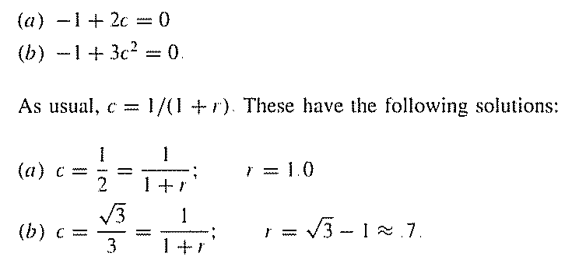
Let’s follow IRR Method

Slide 23
Cyclical Problem A 20000 INR car is expected to have low maintenance cost of 1000 INR per year and mileage up to 4 years. Second car costs 30000 INR and maintenance cost is 2000 INR per year with longevity of 6 years. Which car will you buy? (r=10%) Let’s assume 12 year long decision horizon for both cars
*

Slide 24
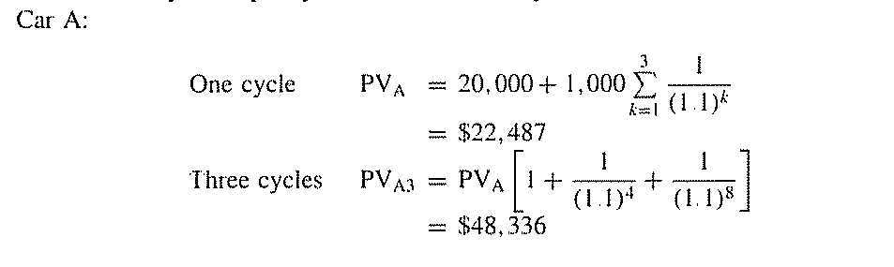
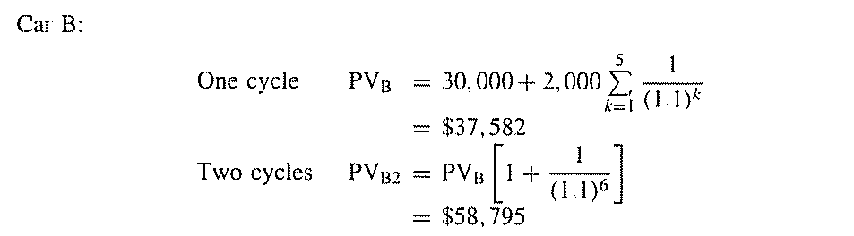

Slide 25
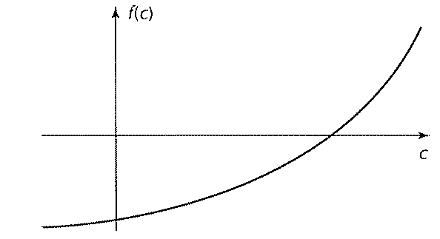




A simple proof of IRR>=0

Slide 26
MEAN VARAINCE ANALYSIS (Portfolio Analysis)

Slide 27
Random Variable
X be a random variable with X1, X2, X3, X4 values and p1, p2, p3, p4 probabilities (respectively)
E(X)= X1p1+X2p2+X3p3+X4p4
Var(X)= E(X^2)- [E(X)]^2
=(X1^2)p1+(X2^2)p2+……. - [E(X)]^2

Slide 28

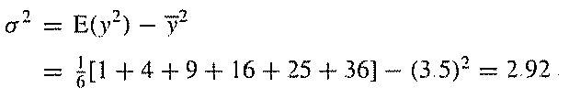
Numerical Example
Expected value of number of spots for a rolled die

Slide 29
Properties of Expectation

Slide 30


Covariance (Two random variables)

Slide 31

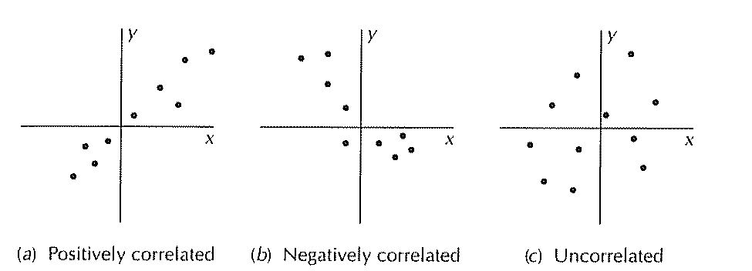
Correlation Coefficient

