Slide 1
Notion of Interest Rate
TIME VALUE OF MONEY

Slide 2
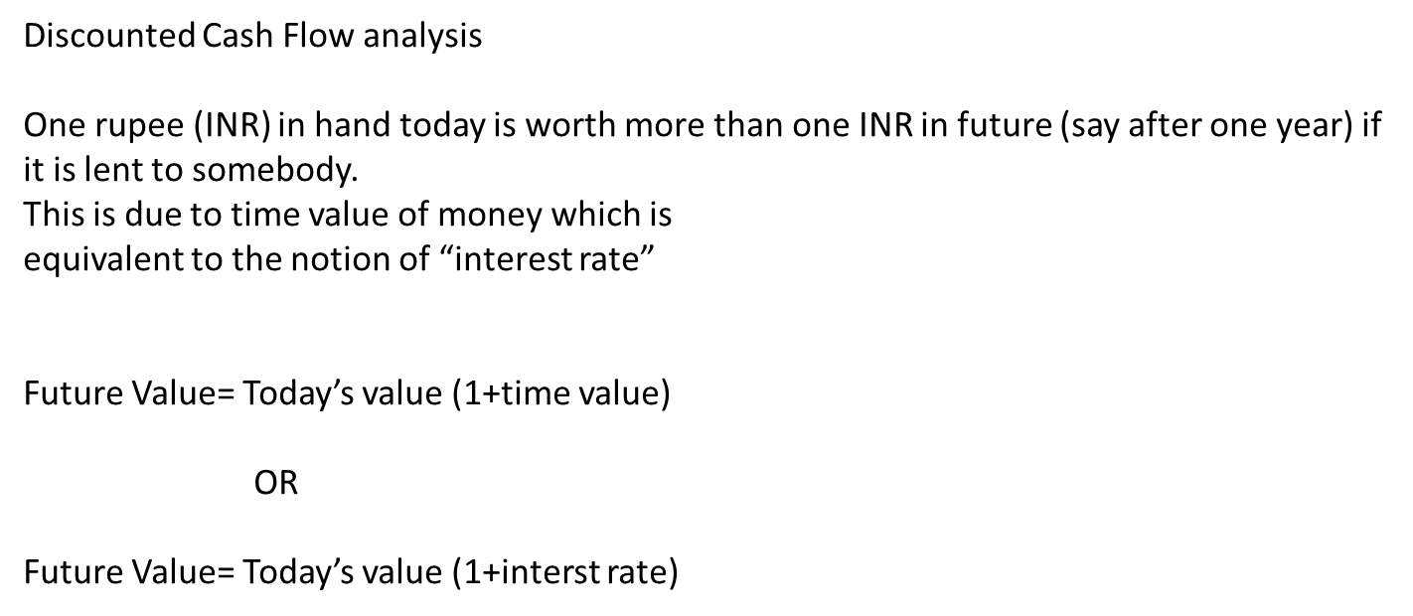
Introduction
Discounted Cash Flow analysis
One rupee (INR) in hand today is worth more than one INR in future (say after one year) if
it is lent to somebody.
This is due to time value of money which is
equivalent to the notion of “interest rate”
Future Value= Today’s value (1+time value)
OR
Future Value= Today’s value (1+interst rate)

Slide 3

Example
FV$=PV(1$
OR
PV$=FV/(1+{r)}^{n}$
100 INR
105 INR
110.25INR
Evolution of 100 INR with 5% interest rate (per annum)

Slide 4
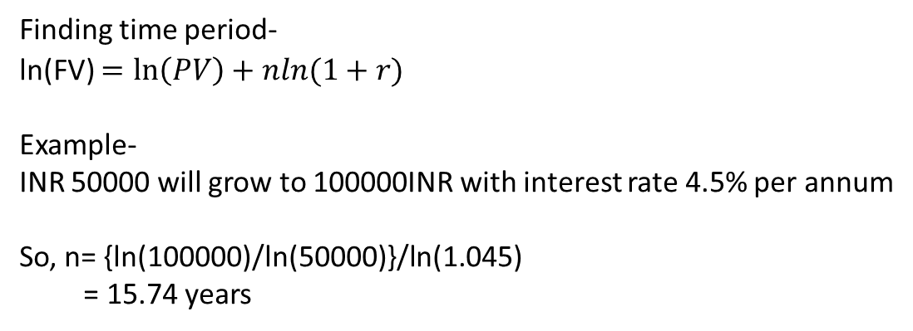

Numerical Example (find time period)

Slide 5
Notion of Annuities and Annuity due
Ordinary annuity (fixed amount of money at the end of the time period for certain number of years )
(Mortgages, car loan or student loan etc.)
However, if the payment is to be paid at the beginning of every time period (say a year)
then is refereed as annuity due.
(Rental payment, insurance premium etc.)

Slide 6
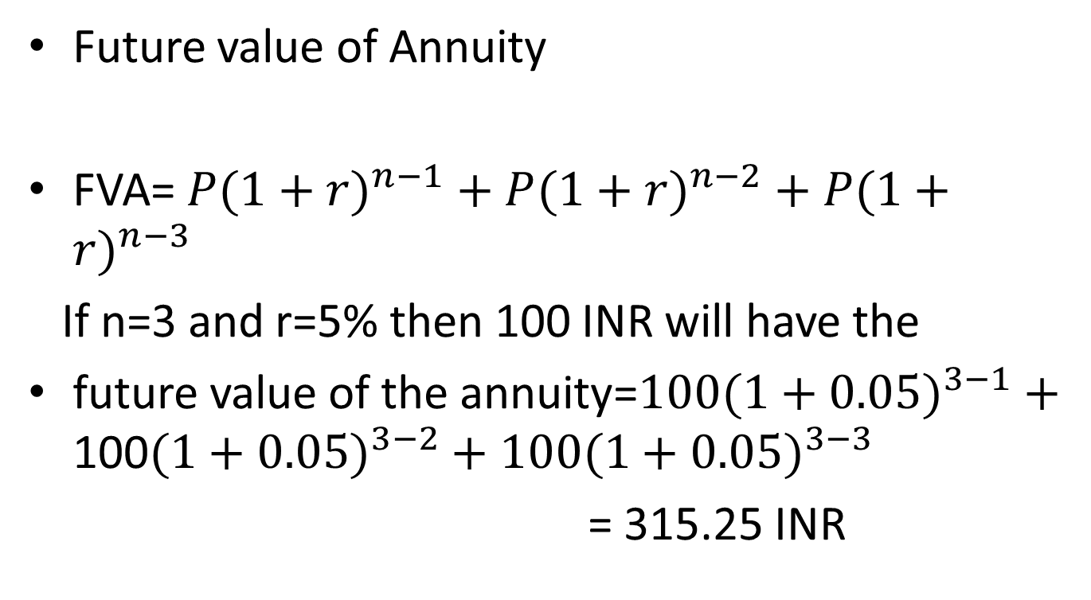
Numerical Example
Future value of Annuity
FVA= $P(1+{r)}^{n−1}+P(1+{r)}^{n−2}+P(1+{r)}^{n−3}$
If n=3 and r=5% then 100 INR will have the
future value of the annuity=$100(1+{0.05)}^{3−1}+$ 100$(1+{0.05)}^{3−2}+100(1+{0.05)}^{3−3}$
= 315.25 INR

Slide 7
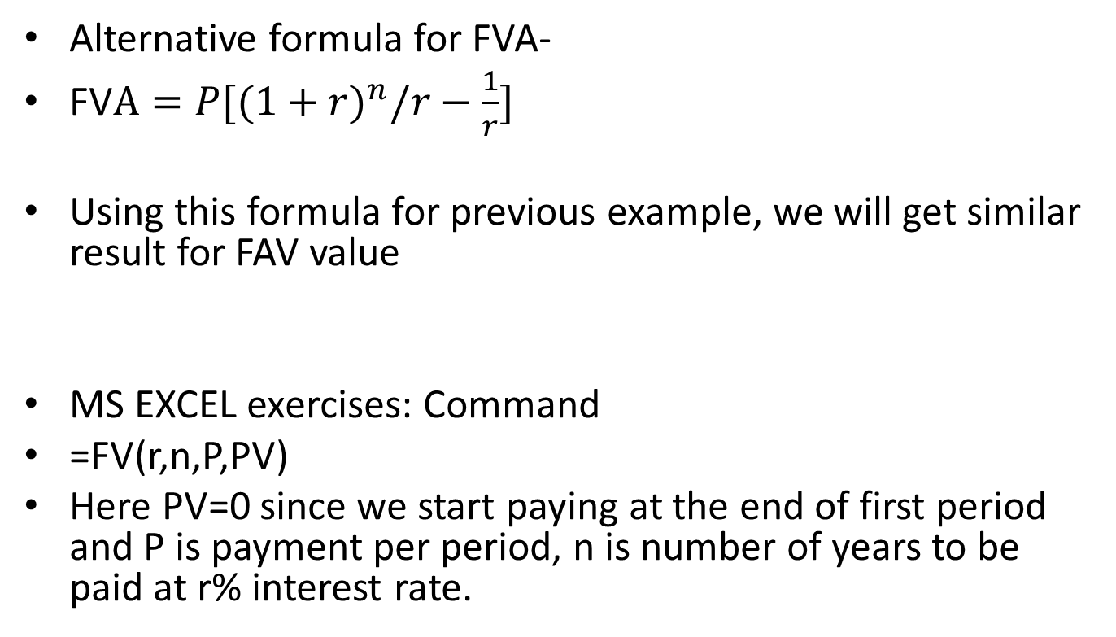
MS Excel command
Alternative formula for FVA-
FV$A=P[(1+{r)}^{n}/r−\frac{1}{r}]$
Using this formula for previous example, we will get similar result for FAV value
MS EXCEL exercises: Command
=FV(r,n,P,PV)
Here PV=0 since we start paying at the end of first period and P is payment per period, n is number of years to be paid at r% interest rate.

