Slide 1
MEAN VARIANCE ANALYSIS (Portfolio Analysis)

Slide 2
Random Variable
X be a random variable with X1, X2, X3, X4 values and p1, p2, p3, p4 probabilities (respectively)
E(X)= X1p1+X2p2+X3p3+X4p4
Var(X)= E(X^2)- [E(X)]^2
=(X1^2)p1+(X2^2)p2+……. - [E(X)]^2

Slide 3

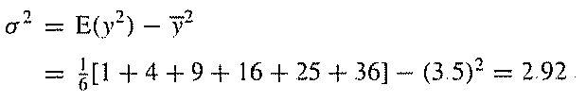
Numerical Example
Expected value of number of spots for a rolled die

Slide 4
Properties of Expectation

Slide 5


Covariance (Two random variables)

Slide 6

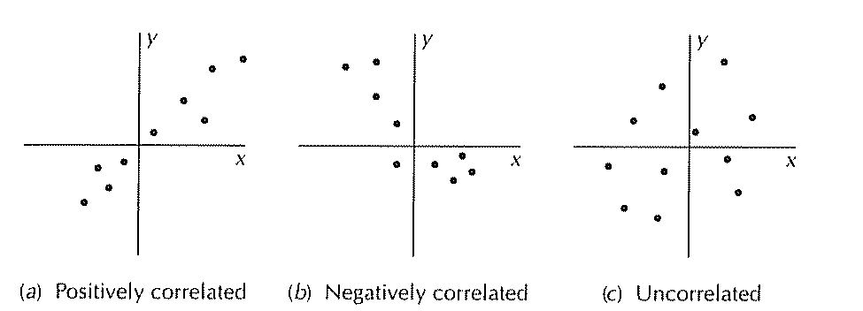
Correlation Coefficient

Slide 7
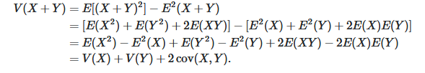
Sum of Two Variables Variances

Slide 8
What if two variables are statistically independent
V(X+Y)= V(X)+V(Y)+0
A die is rolled twice. Average of two numbers on surface is assumed to be a random variable Z.
Calculate the mean/expectation and variance of
Z.

Slide 9



Solution

Slide 10
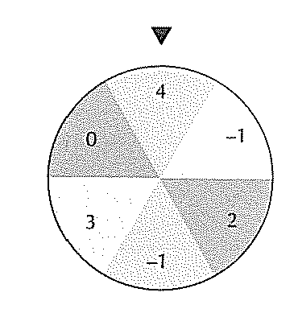
Example (Fortune Wheel)

Slide 11


Solution

Slide 12
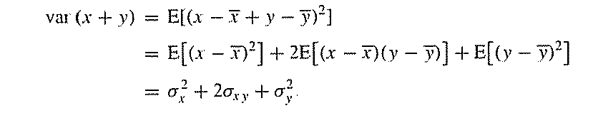
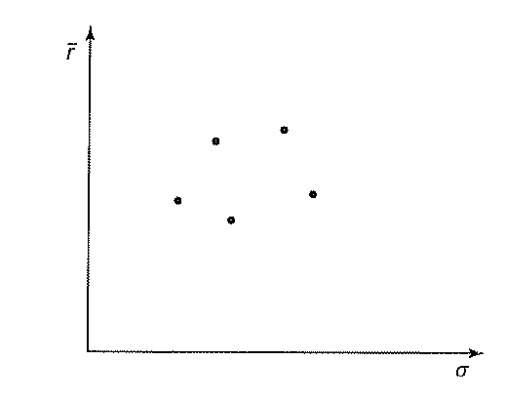

Slide 13

Expected value/mean return of a portfolio

Slide 14
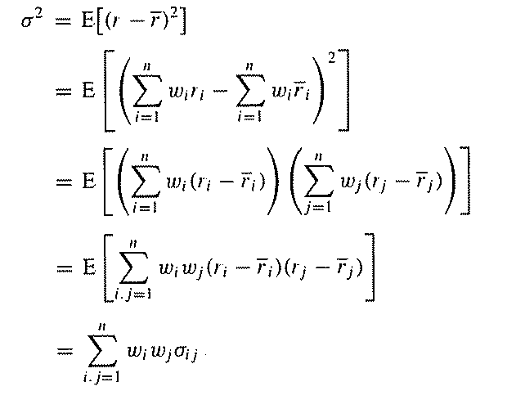
Variance of a portfolio

Slide 15
Calculate mean and variance of the portfolio (Assume w1=0.25)
If r1= 0.12, r2=0.15 and

Slide 16

Solution

Slide 17

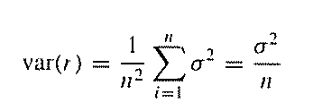
Notion of diversification

Slide 18
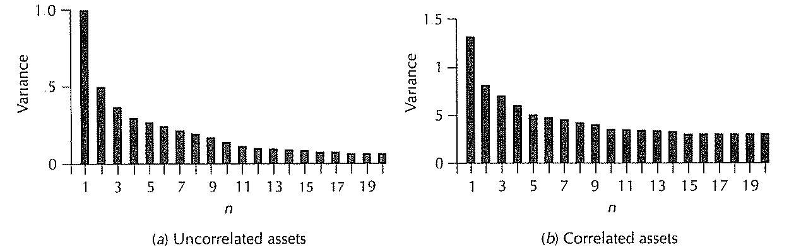
Diversification

Slide 19
Efficient Frontier
Return Stock
Government Bond
Standard Deviation (Risk)
Cash
Flipping a coin

Slide 20
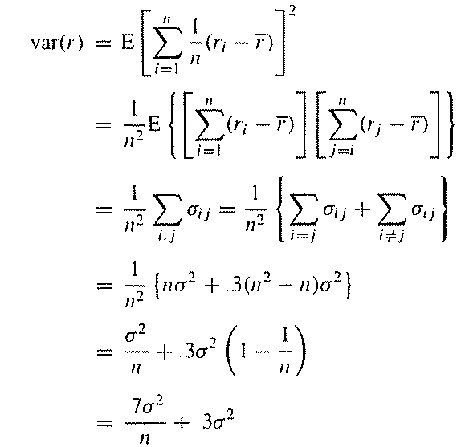
Suppose we have n stock in a portfolio with equal weightage and each with equal sd=σ. Further, covariance between each pair of stocks=0.3σ^2. What is variance of the portfolio

Slide 21



Two assets with different returns and risks (SD)

Slide 22
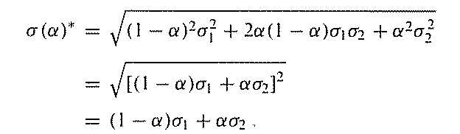
When ρ=+1 (upper bound)

Slide 23
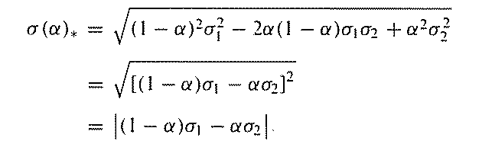
When ρ=-1 (lower bound)

Slide 24
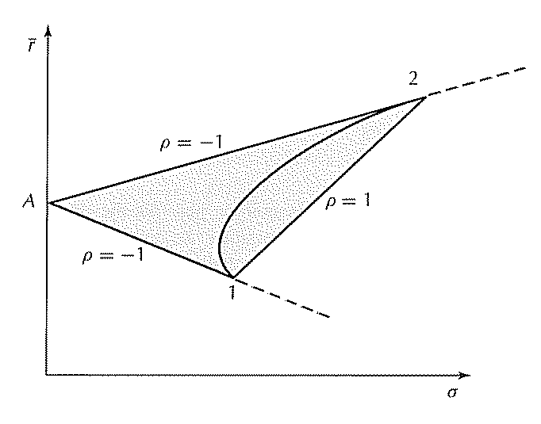

Efficient Frontier

Slide 25
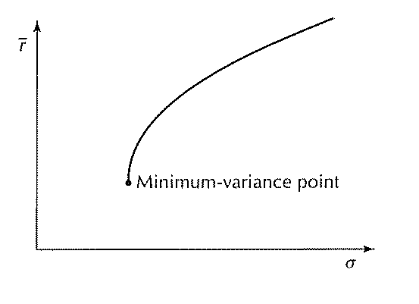
Efficient Frontier

Slide 26
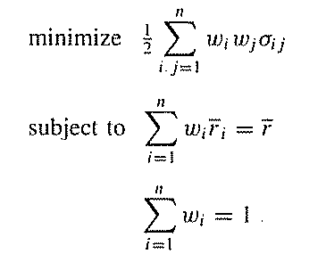
Markowitz Model

Slide 27
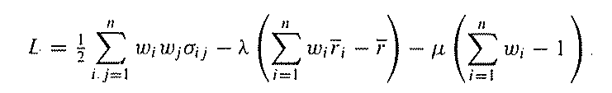
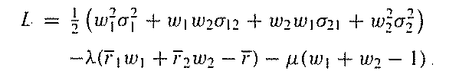
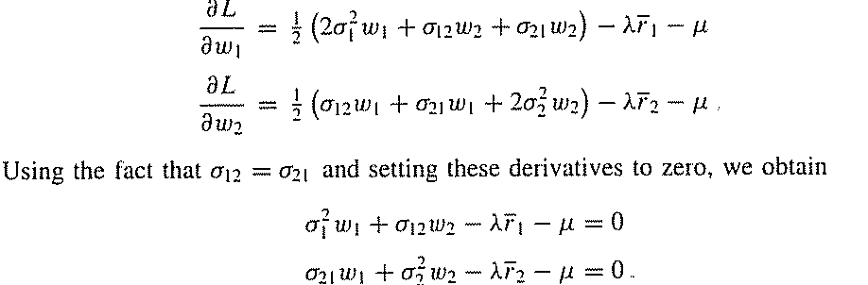
Solution (Lagrange Formula)- Constrained Optimization

