Slide 1
How to Formulate a Successful Start-up in the Midwest
O'Brien Chin
Nandini Meeraa Jayachandran
Kelleyanne Jensen
Sriram Srinivasan

Slide 2
Problem Opportunity
Problem Statement: How to Formulate a Successful Start-up in the Midwest
The rate of new entrepreneurs is 0.31 which means there are more than 500,000 people starting a business each month in United States.
According to many sources, more than 90% of all Internet business start-ups end in failure within the first 120 days.
Ref:https://www.kauffman.org/kauffman-index/reporting/~/media/c9831094536646528ab012dcbd1f83be.ashx
Ref: https://www.chrisducker.com/internet-business-failures/

Slide 3
Methodology
Step 1: Open-ended approach to collect data from startups owners and other experts in the field through interviews and survey to find the success factors.
Step 2: We plan to analyse the responses and sort them into a class of elements and generate a schema to recommend the real ingredients for startup success.
Steps 3: Our result will be more comprehensive to figure out if our findings support the previous research from our literature reviews and text book.
What is a startup? Is it merely a young business. A newly established business. (Young Entrepreneur Council, 2015)
Successful Startup: We consider the startup who cross the 3 year threshold and still is business making money to be successful.

Slide 4

Interview with Ken Moreano
Know your customer (DO THE RESEARCH)
All decisions must be based on findings in the data
Listen to the data and pivot when the data demands it
Forget your emotional attachment to your idea
Make alliances

Slide 5
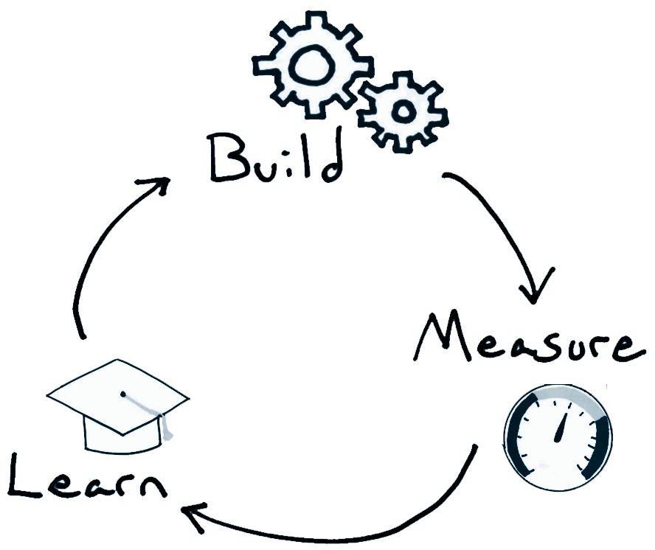
Interview with Traci Williams Hancock
Director, Maverick Innovations
Worked with 300+ technology start-ups
Recommends the Lean Start-up Methodology
Business Model Canvas
Get Customer feedback
Agile Development
Be coachable
Fill in your gaps
It’s really hard work
Source: https://hbr.org/2013/05/why-the-lean-start-up-changes-everything

Slide 6

Startup Survey
10 questions
Focusing on factors of success
Business Model
Revenue Model
Funding
Validating the Idea
Competitive Advantage
Customer Analysis
Management Team
Luck

Slide 7

Auction Software
Completed 3 years
Started generating profits has well established clients such as GE
Software as Service
75 Employees
Offshore Model
Stable business model
Agile

Slide 8

Flywheel
Offers WordPress hosting service
3 Founders
Founded in 2012
Depends on WordPress product
Failures of existing startups by Rick
Survived 3 year Threshold

Slide 9
Sources
https://www.kauffman.org/kauffman-index/reporting/~/media/c9831094536646528ab012dcbd1f83be.ashx
https://www.chrisducker.com/internet-business-failures/
https://hbr.org/2013/05/why-the-lean-start-up-changes-everything

Slide 10
Successful Startups in the Midwest
Proxibid
FlyWheel
Hudl
Spreetail
Auction Software

