Slide 1
Powertrain modelling of Electric Vehicle
Sriram.T,
170921136
4th Year B. Tech Student,
Dept. of ICE,
MIT, MANIPAL-576104
Guide’s Name : Mr. Suraj
Founder and CEO
Decibels lab
Bangalore

Slide 2
Content
Introduction
Objectives & Timeline
Training highlights
Conclusion
References

Slide 3
Introduction
The electric vehicle (EV) is propelled by an electric motor, powered by rechargeable battery packs, rather than a gasoline engine.
From the outside, the vehicle does not appear to be electric.
Under the hood, the electric car has:
• An electric motor.
• A controller.
• A rechargeable battery.

Slide 4
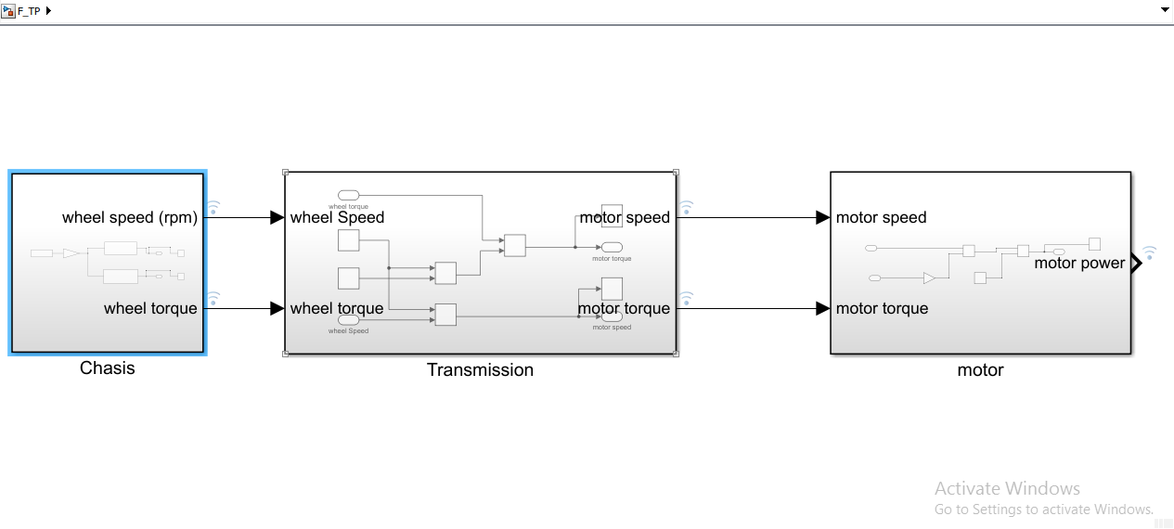
Fig.1 Overall view of the model

Slide 5
Objectives
To model the powertrain components of an Electric vehicle.
To compare effect of different drivecycles on electric powertrain.

Slide 6
Timeline
Period(months) | May | June
Literature review and feasibility study | Yes
Understanding the components of Electric vehicle | Yes
Modelling in Matlab/Simulink |  | Yes
Documentation and final report |  | Yes

Slide 7
Training Highlights
Importance of modelling Electric Powertrain
One of the key parameters for every EV manufactures are striving is Energy consumed/Km (Wh/Km) (Tesla overbeats all the other auto manufactures in this).
If you have got the right component sizing, done the best optimization studies, made every possible influencing parameter considered for studies & have performed 10000+ hours of simulations to understand how the system would behave in the real world.
This is the fortray of the Simulation engineering team (MBD), system architecture team & component design team. MBD being the core competency of Decibels

Slide 8
Program Introduction
The program stated with basic introduction to Electric vehicle ecosystem. This included understanding of various subsystems in an electric vehicle and also the list of component manufactures of the various parts in the subsystem.
The electric vehicle ecosystem consists of battery packs, chassis, transmission , motor controller , embedded electronics and charging ports.
Internship Timeline
The internship program was scheduled was 6 weeks.
The first week consisted about the basic knowledge of electric vehicle.
The second week was followed with understanding a chassis configuration in an EV, followed by mathematical modelling of chassis.
The third week was followed by modelling of transmission of EV and analysing the outputs of various drive cycles. The final week of training, introduced the modelling aspect of motor drives in EV and introduction of battery packs.
For the next two weeks, the interns were assigned a project to develop an entire powertrain of an electric vehicle and perform simulation on Matlab/Simulink software.

Slide 9
Workload and Project details
The workload consisted of contributing minimum of 35 to maximum of 50 hours in a week. Small assignments and tests were given during the week to gauge the students understanding.
At the end of every week, all the interns must present a topic about the recent developments in the EV sector. The presentation should last for atleast 10 minutes.
The project consisted of obtaining different values for wheel speed and torque ; motor speed and torque and motor power for different drive cycles.
The different plots were plotted in Matlab environment and found the performance for each configuration of powertrain.

Slide 10
Conclusion
Conclusion
The obtained plots concluded the performance of an electric powertrain for FTP-75 drive-cycle. Using the motor power plot we can find the possible amount of emission that can be produced from the vehicle.

Slide 11
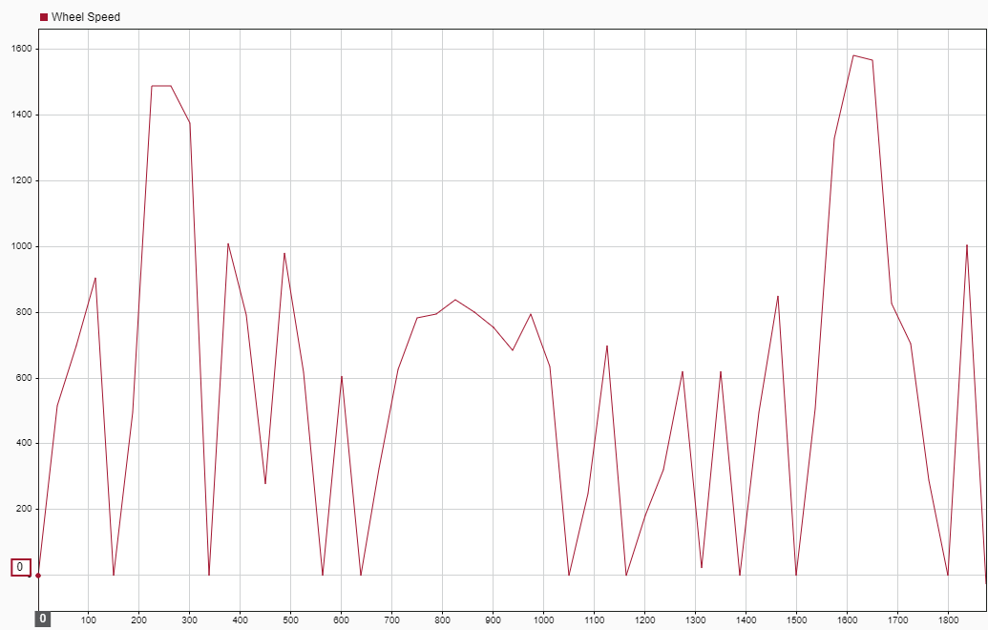
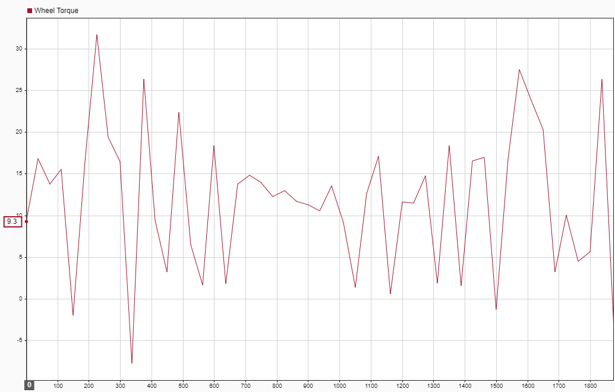
Fig.2 Wheel Speed Plot
Fig.3 Wheel torque Plot

Slide 12
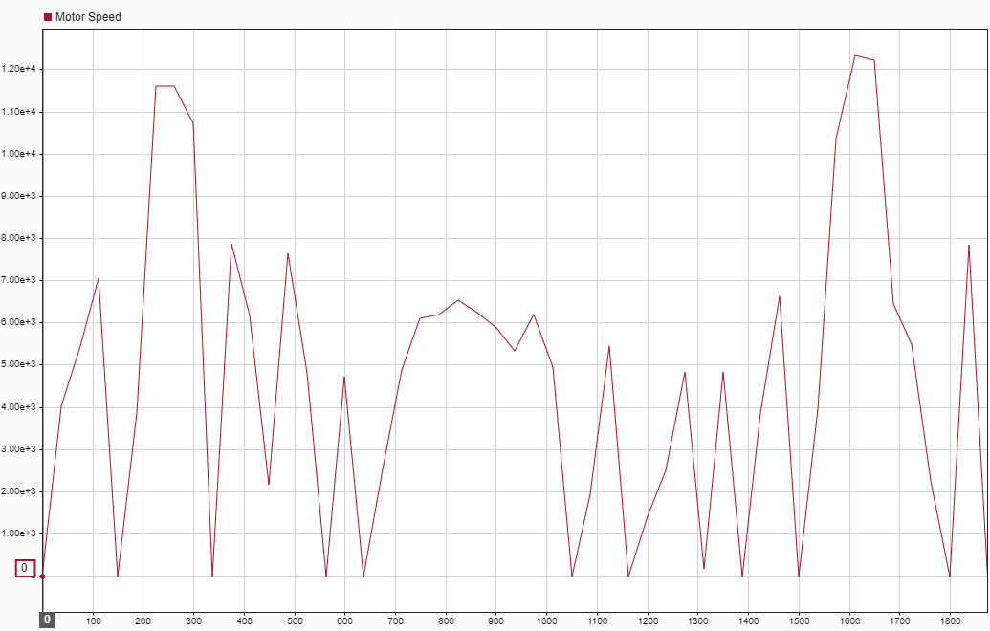
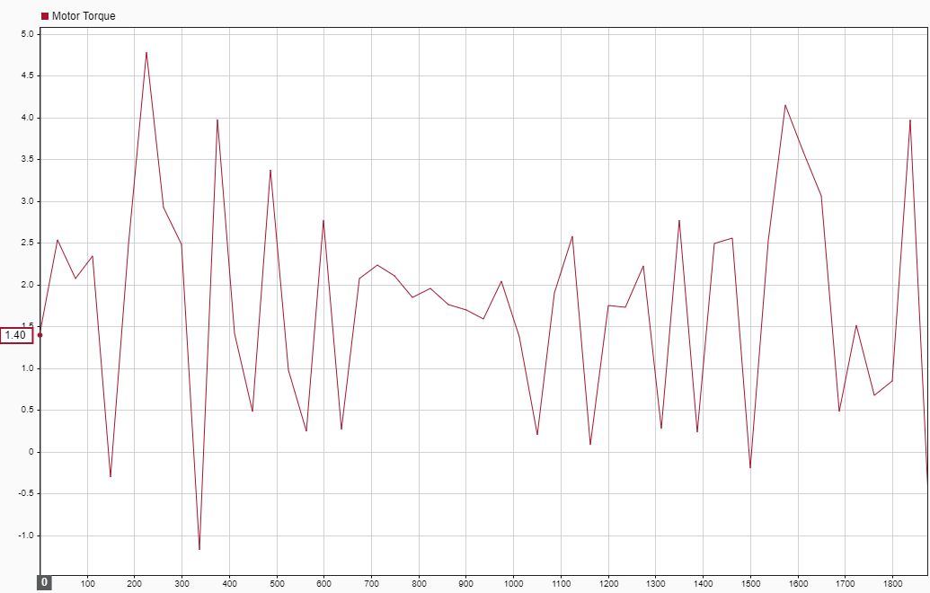
Fig.4 Motor Speed Plot
Fig.5 Motor torque Plot

Slide 13
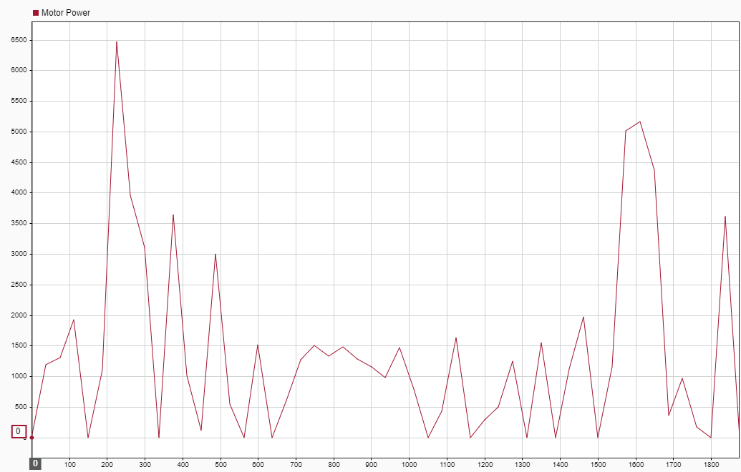
Fig.6 Motor power Plot

Slide 14
References
[1] Chen Lin, Li Zhao,"A DCT-Based Driv ng Cycle Generation Method and Its Application for Electric Vehicles," in Mathematical Problems in Engineering, 2015, Vol 2015.
[2] Zhincheng SW!, "Real - World Driving Cycles Adaptability of Electric Vehicles," in World Electric Vehicle Joumal,11,19, March 2020.
Other references:
Retrieved from: Car Engineer, https://www.car-engineer.com/the-different-driving-cycles/

Slide 15
Thank You

