Slide 1




🧠SmartBuddy
Your AI Learning Companion
SRI KIRUPA P (220701286) SRIRAMAN K (220701288)

Slide 2







Let’s get started
SmartBuddy: Your AI Learning Companion
Learn Smarter, Not Harder
Imagine having a learning companion that understands your needs.
That is SmartBuddy for you, an AI assistant that helps you learn through engaging tools like flashcards, quizzes, keypoints and voice notes.

Slide 3










01 Problem Statement
🎓 The Problem – A Familiar Student Struggle
It’s just two days before the final exam.
Arjun, a college student, sits at his desk surrounded by messy notebooks, screenshots, PDFs, and bookmarked web pages. He’s collected so much study material over the semester — but now he’s overwhelmed.
He thinks, “If only someone could help me revise all this… like a personal tutor who just gets what I need.”
In desperation, he turns to ChatGPT — but alas, it says:
⚠ "You’ve reached your usage limit." Frustrated, Arjun wishes for something smarter.
Something that doesn’t just answer one question at a time — but understands his context, remembers what he’s studying, and gives him flashcards, quizzes, and summaries built from his own notes.

Slide 4
01 Problem Statement
✨ That’s where SmartBuddy steps in.
A personalized AI learning companion that:
🗣 Talks with you like a real tutor
🧠 Remembers your study context using vector memory
🃏 Auto-generates flashcards and quizzes from your notes
🎤 Lets you record voice notes and turn them into key points
Now, Arjun doesn’t feel alone. He’s got SmartBuddy — a study partner who’s always ready, never forgets, and adapts to his needs.

Slide 5
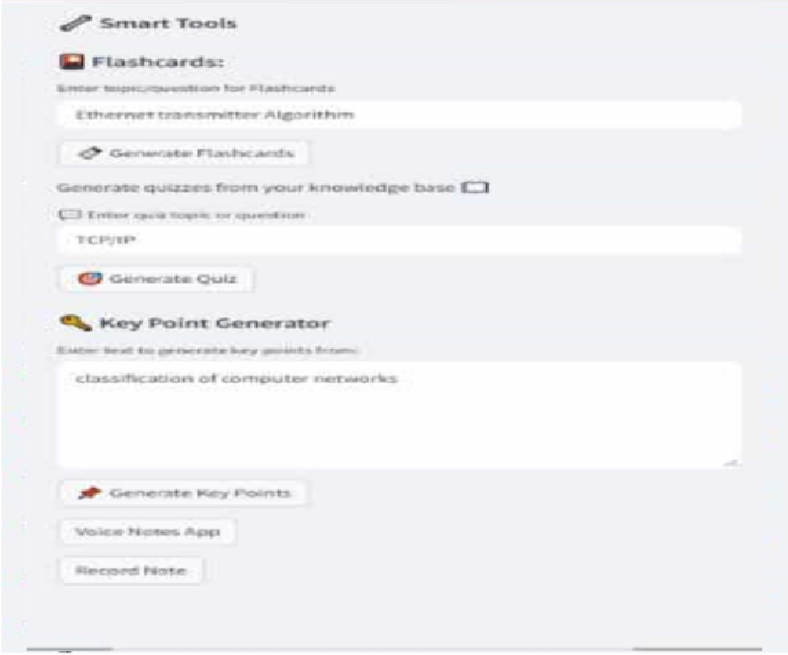
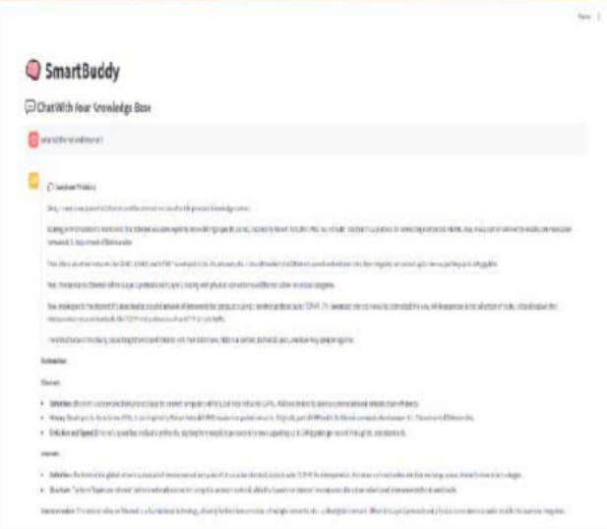
FEASIBILITY AND VIABILITY
02
💡 Viability
✅ Market Demand:
500M+ global students actively use EdTech
Rise of AI companions in learning (e.g., ChatGPT, Duolingo Max)
✅ User Retention Potential:
Contextual memory encourages long-term use
Daily revision helpers like flashcards & voice notes
✅ Monetization Pathways:
Freemium model (basic vs. Pro features)
Institutional licensing to colleges/schools
✅ Low Infrastructure Cost:
Uses lightweight vector DB and local caching
Can scale gradually based on adoption
Can we build it ? YES ✅
✅ Tech Stack Readily Available:
Python, Streamlit, FAISS, DeepSeek, Sentence Transformers
✅ Small Dev Team :
MVP achievable with 1–2 developers in weeks
✅ Voice + Text Integration:
Already supported via SpeechRecognition, PyAudio

Slide 6



What makes SmartBuddy Novel
03
Context-Aware Intelligence
Multimodal Learning Experience
Modular + Scalable AI
Student-Centric Not AI-Centric
✅ A friend who remembers what you said last night.
🎤 Voice Notes + 🗂 Flashcards
+ □ Quizzes It becomes your personal learning tutor
o Customizable to subjects, learners, and even school syllabi.

Slide 7




Existing Solution
04
🚀 SmartBuddy (The Evolution)
💡 Combines best of both: Conversational like ChatGPT Personalized like NotebookLM
🧠 Memory + 🃏 Flashcard/Quiz Generator + 🎤 Voice notes
💬 ChatGPT
o Strengths:
Excellent conversational AI
Can answer and explain almost anything Can generate quizzes & flashcards with right prompts
⚠ Limitations:
❌ “Limit reached” issues during peak study hours
❌ Doesn’t remember session context unless premium
❌ No native support for voice notes, auto tools, or learning flow
🧠 “SmartBuddy is built with learners in mind.”
📘 NotebookLLM (Google)
o Strengths:
Connects to docs (Google Docs integration)
Extracts summaries and key points Research-style assistant
⚠ Limitations:
❌ No persistent memory across sessions
❌ Can’t convert chats to study tools like flashcards/quizzes
❌ Limited customization of knowledge base
o Key Edge:
Persistent memory using FAISS Vector search = smarter, faster recall DeepSeek-based generation = open- source, adaptable
All-in-one study tools platform
🧠 “Inspired us to build SmartBuddy with memory + interactivity.”

Slide 8

05 Proposed Solution
🚀 Built for students who want results, not just answers.

Slide 9
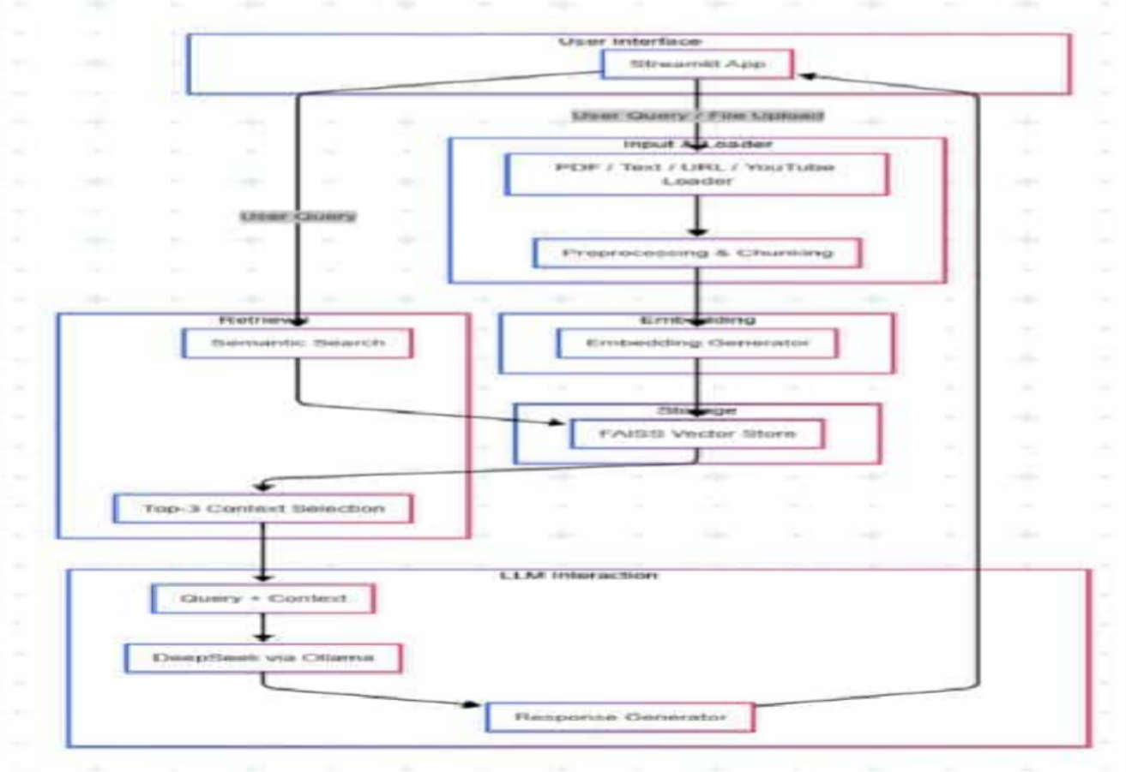
SYSTEM ARCHITECTURE
05

Slide 10
05
LIST OF MODULES
🎯User Interface
Input & Loader
⚙ Preprocessing & Chunking
🎯 Built using Streamlit
PDF/Text/URL/YouTube Loader
⚙ LLMs work best when data is split into manageable piece
🔗 Embedding Generator
🧠 FAISS Vector Store
Q Semantic Search
🎯 Avoid overloading and making results fast & accurate
🧠 DeepSeek via Ollama
📝 Clean, user-friendly answer — which could be text, quiz, flashcard, or summary
🔗 Embedding
🧠 Storage
Q Retrieval
🎯 Top-3 Context Selection
🧠 LLM Interaction
📝 Response Generator

Slide 11
06
WHAT’S NEXT FOR SMART BUDDY?
🚀 1. Personalized AI Experience
🔹 User profiles with session memory
🔹 Chat history & long-term context retention
🔹 Smarter, adaptive responses based on user behaviour
🧠 2. Multi-Modal Intelligence
🔹 Upload & process images, scanned notes, diagrams, and more
🔹 Extract knowledge beyond plain text (OCR + AI vision models)
🤝 3. Collaborative Learning
🔹 Shared workspaces for group study/projects
🔹 Multi-user chat with role-based access
🔹 Teacher-student interactive spaces

Slide 12

Conclusions
SmartBuddy stands out as an innovative educational assistant that addresses significant challenges faced by students today. By providing personalized learning experiences through AI- driven memory, interactive features like flashcards and quizzes, and the ability to engage via voice notes, SmartBuddy enhances the overall learning process, making studying more effective, organized, and enjoyable.
Imagine if every student had a personal AI mentor 24/7
— how far could learning go then?

Slide 13
Thank you!
Do you have any questions?
SmartBuddy @Github

