Slide 1
AUCTION BASED INTERNET ADVERTISING PLATFORM
SRIRAM CHANDRAMOULI

Slide 2
PROBLEM DESCRIPTION
To make all the products available at one place, so that the customers can be linked to different categories of a product.
To dynamically select the advertisement at the moment of a click.
Assign the ad space to the highest bidder.
To determine the product and its advertising rate based on view history.

Slide 3
ACTORS
ADMIN:
SYSTEM ADMIN:
Manages the user account of Enterprise Admin.
Manages customers and their user account.
ENTERPRISE ADMIN:
Manages the user account of customer.
PUBLISHER:
Manages the ads pace,
approves the advertiser’s bid for a workspace.

Slide 4
ACTORS CONTD…
ADVERTISER
Creates advertisement,
Places bid for a particular ad space.
CONSUMERS:
Logs in and view supplier product
Buys the product
Views his favorite advertisement and purchases the product if interested.
SUPPLIER:
Manages product.

Slide 5
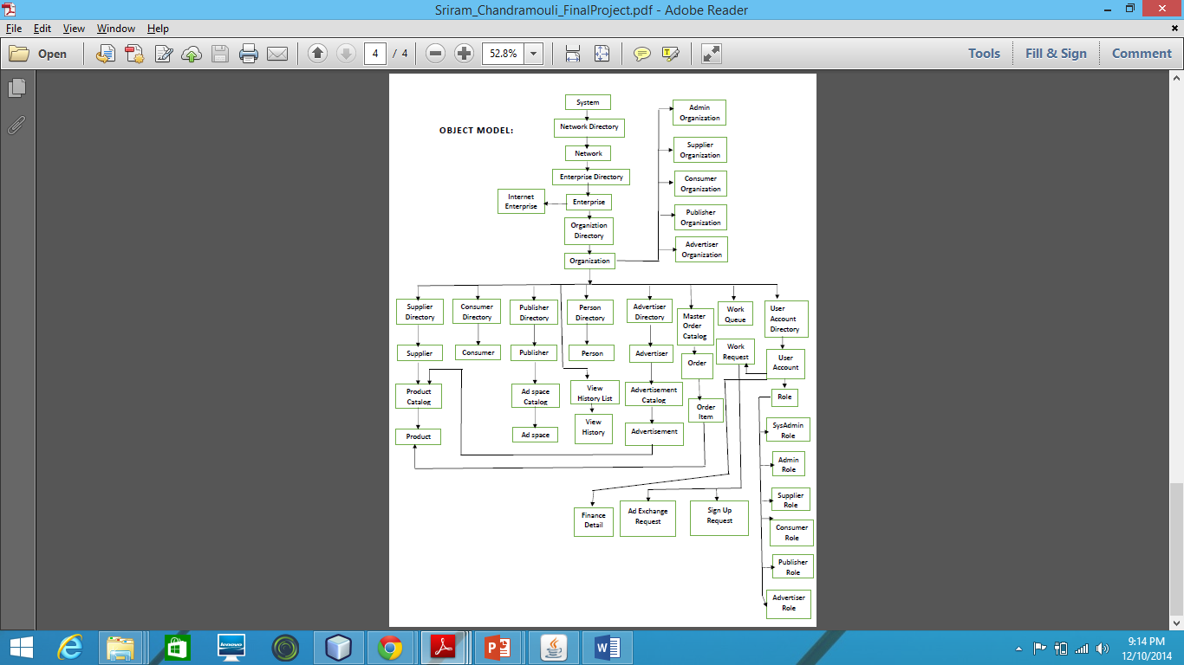
OBJECT MODEL

Slide 6
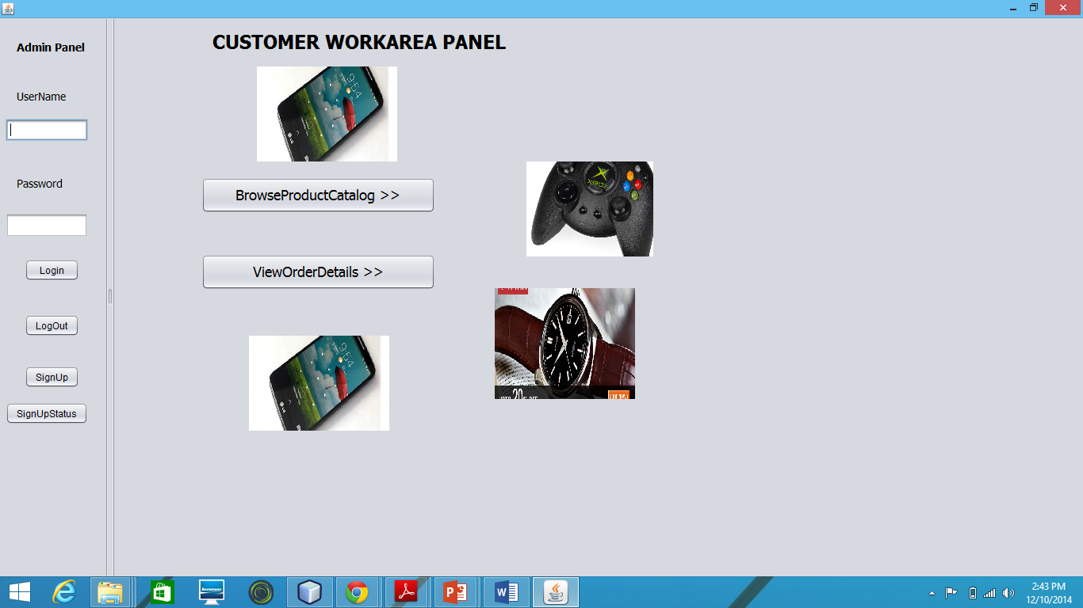
FEATURES
Ads are selected at the moment of click.
Ad space is assigned to the highest bidder.

Slide 7
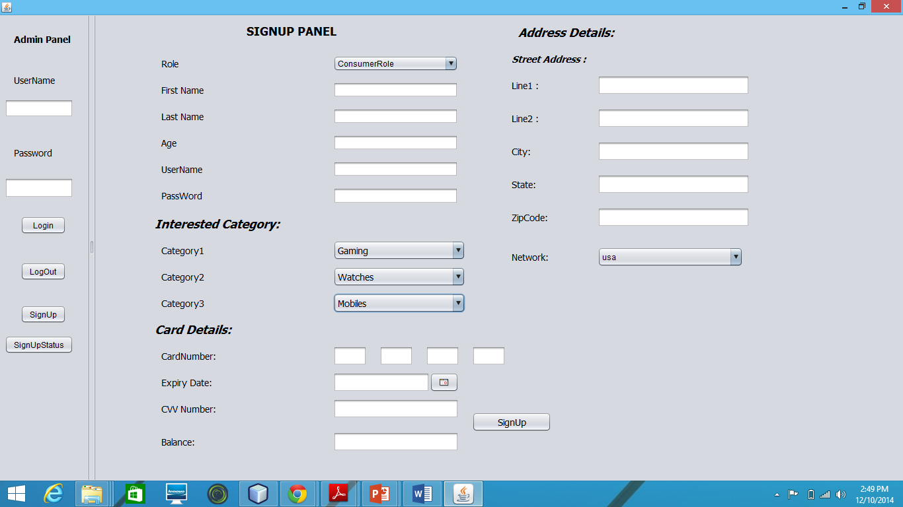
FEATURES CONTD…
Market definition and classification of users based on certain characteristics.
System has favorite category option in sign up panel for consumers, so that they can select top 3 favorite categories. This might lead to the probability that they might buy the product.

Slide 8
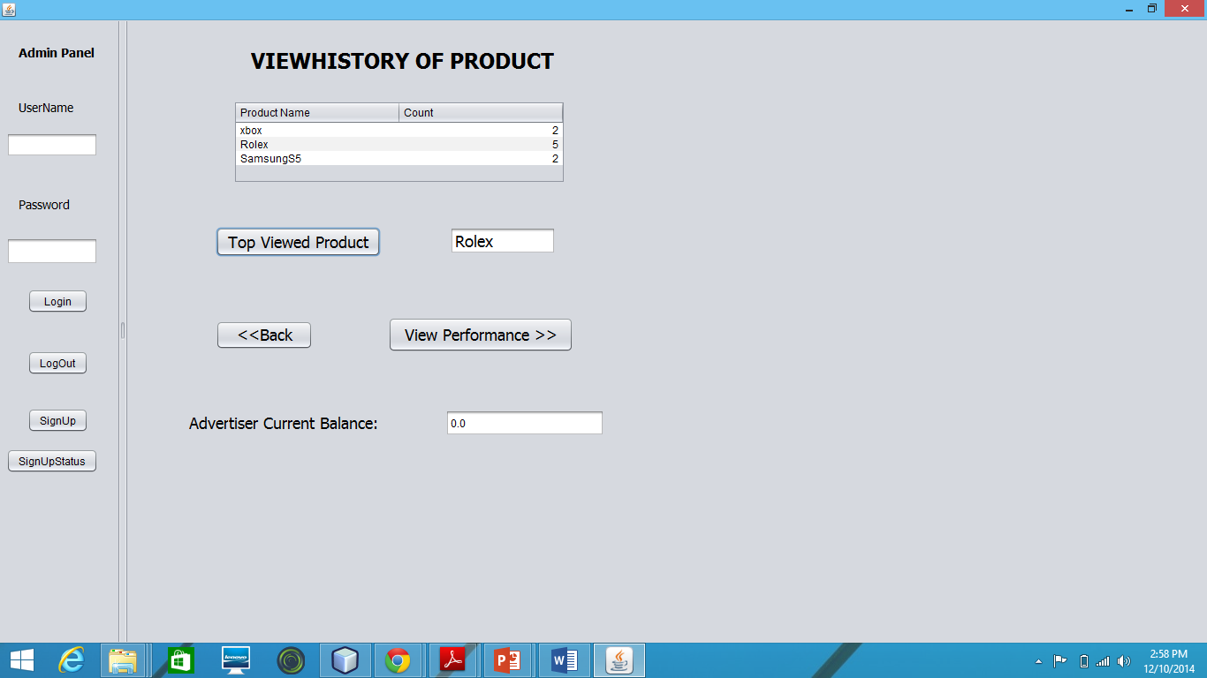
FEATURES CONTD…
Auction like model where user profiles and habits are offered to potential advertisers.

Slide 9
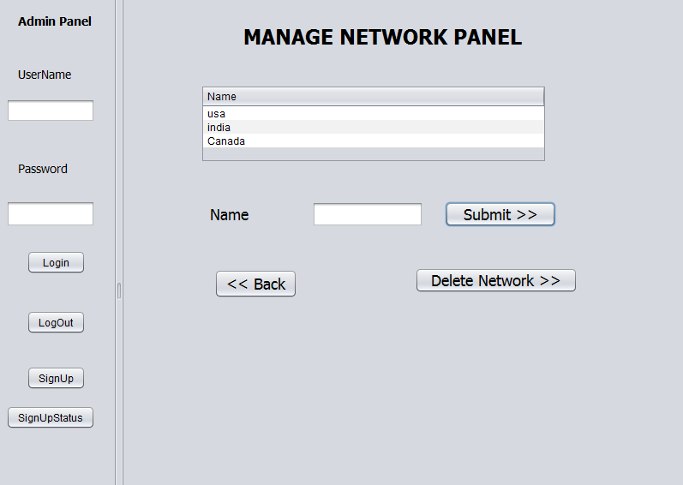
FEATURES CONTD…
The system is global in nature and geography aware.

Slide 10
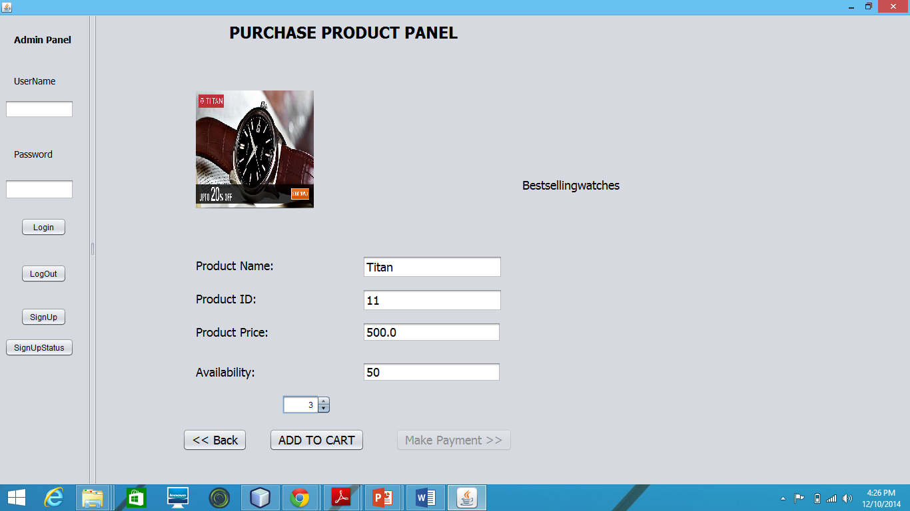
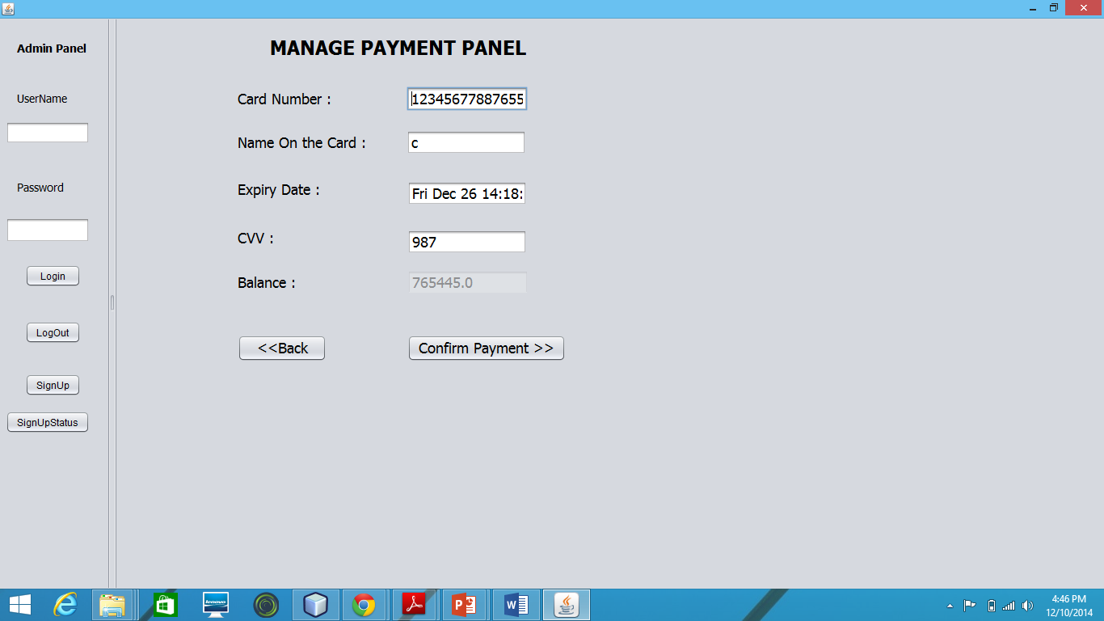
FEATURES CONTD…
Invoicing and payment are supported.

Slide 11
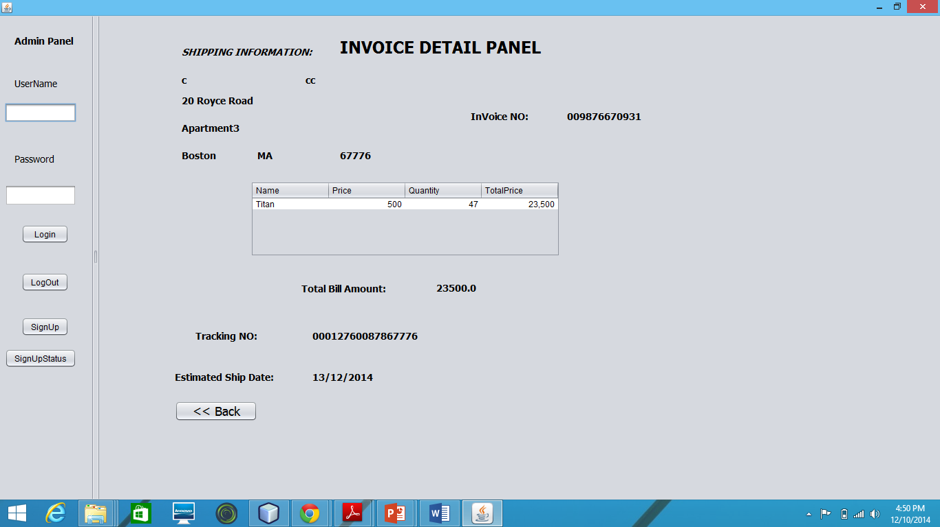
FEATURES CONTD…
Invoicing and payment are supported.

Slide 12
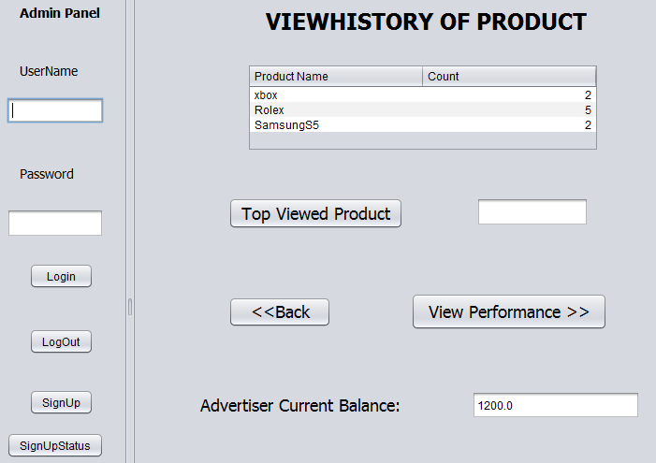
FEATURES CONTD…
Advertisers maintain financial accounts and Publishers are compensated accordingly.

Slide 13
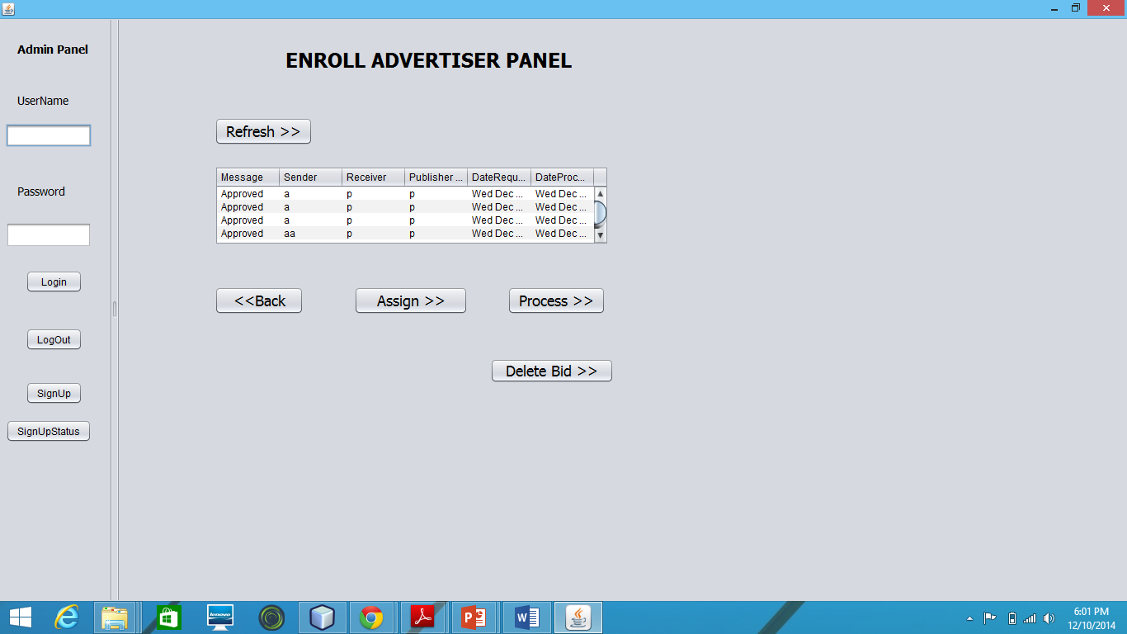
FEATURES CONTD…
The system includes companies who wish to advertise as well as advertising and marketing agencies.

Slide 14
CONCLUSION
Ads are dynamically selected at the moment of click.
The ad space is assigned to the highest bidder.
A swing model supporting advertising platform.

