Slide 1
NEU JOB PORTAL

Slide 2
CURRENT DAY PROBLEMS
Resumes are not collected at one place
No automated tracker to track the hiring process
Job traffic
Fake job posts
Complex job searches

Slide 3
OBJECTIVE
Easy access to jobs
Search optimization
Application status check
Secured login
H1B data for international students
Provide live support
One-click apply

Slide 4
TECHNOLOGIES USED
HTML5
CSS3
BOOTSRAP
ANGULAR JS
D3 JS
REACT JS
PHP
MYSQL
JAVASCRIPT
JQUERY
AJAX
Google APIs and Analytics
Python

Slide 5
FEATURES
Unique credentials
User flows – Employer and Candidate
Fixed header and footer
Responsive web design
User Sessions
H1B data graphs
Secured through Recaptcha
Search optimization
Bread crumbs
Sliders
Online chat
Timeline
Accordion View
Update Profile
Check status of application
Upload Resume

Slide 6
PRINCIPLES OF WEBDESIGN
Visual Hierarchy
Divine proportions
Hick’s law
Fitt’s law
Rule of Thirds
Navigation
“F” pattern design
Load Time
Mobile friendly

Slide 7
FIXED HEADER AND FOOTER
According to the Web Design study:
STICKY MENUS ARE 22% QUICKER TO NAVIGATE: The data from the study indicated that participants were able to find what they were looking for quicker when they didn’t have to scroll back to the top of the page. 22% might not seem like a big number, but it can have a big impact on visitors.
100% PREFERRED STICKY MENUS WITHOUT KNOWING WHY: ... Participants were then asked whether one of the websites felt easier to use. Six of the 40 participants had no preference, but of the 34 that did have a preference, 100% of them indicated that the website with the sticky navigation was easier or faster to use. Many comments along this line were made, such as “I don’t know how the websites were different, but I felt like I was spending a lot less time clicking with the first one.

Slide 8
SEO
Search engine optimization is a methodology of strategies, techniques and tactics used to increase the amount of visitors to a website by obtaining a high-ranking placement in the search results page of a search engine (SERP) -- including Google, Bing, Yahoo and other search engines.
It is common practice for Internet users to not click through pages and pages of search results, so where a site ranks in a search is essential for directing more traffic toward the site. The higher a website naturally ranks inorganic results of a search, the greater the chance that that site will be visited by a user.

Slide 9
BREADCRUMBS
There are various pro-breadcrumb arguments by Nielsen and other usability experts such as the fact that breadcrumbs:
Help users visualize their current location in relation to the rest of the web site
Enable one-click access to higher site levels and thus help users who enter a site through search or deep links
Never cause problems in user testing. Although some users may overlook them, those who use them never have problems with doing so
Take up very little space on the page
Reduce the bounce rate. In fact, breadcrumbs can be an excellent way to entice first-time visitors to continue browsing through a web site after having viewed the landing page
Enable users to reach pages and complete tasks faster
Are easily understood by users
Notes:
Breadcrumb navigation is often overlooked in the design and development process. Some people may see it as unnecessary while others may feel it is too big of a hassle for what its worth. Fact of the matter is, breadcrumb navigation will greatly increase the usability of a website. Breadcrumbs give users an alternative method of navigation, allow them to see where they stand in the hierarchy of a website, and will reduce the number of steps needed to navigate to a higher-level within a website.

Slide 10
BENEFITS OF SITEMAPS
A website's ranking with the search engines is one of the most important elements of business success. It is important to get your pages indexed so that you can show up in the results of searches done using the search engines.
Indexing is a process by which search engines, such as Google, send their robots to process and categorize the pages on your website. Some search engines might find it difficult to find all of your pages, especially the pages that are deeply buried.
There are some things you can do to help the search engines find all of your pages. These techniques will also help the people who visit your site to find the pages and move through your website with ease. These tips are primarily for Google, because of Google's present dominance over the Internet search industry. Google has the potential to bring more visitors to your site than all of the other popular directories and search engines, such as Yahoo and MSN, put together.

Slide 11
Web PAGES1
About Us
Contact Us
Site map
Blog
Live chat
H1B data
FAQ
User Profile
Feedback
Privacy Policy

Slide 12
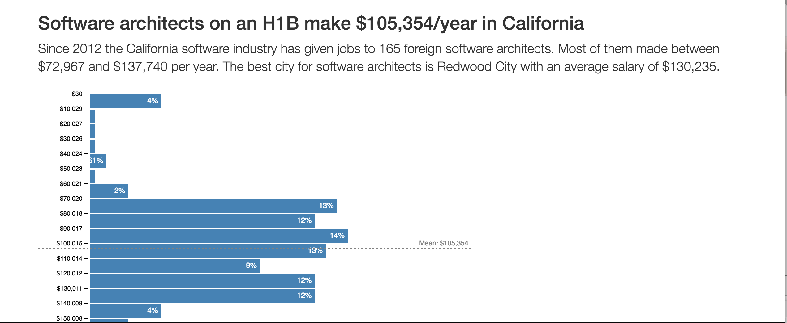
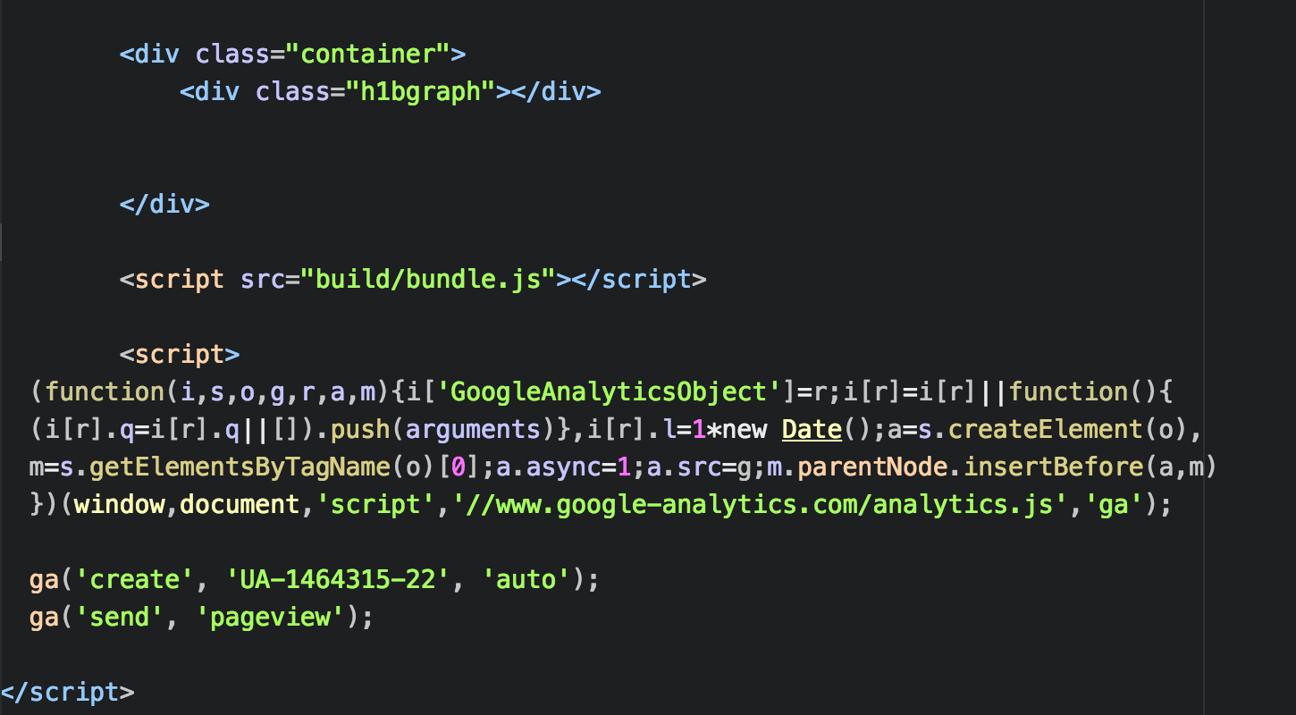
H1B Data Code snippets

Slide 13
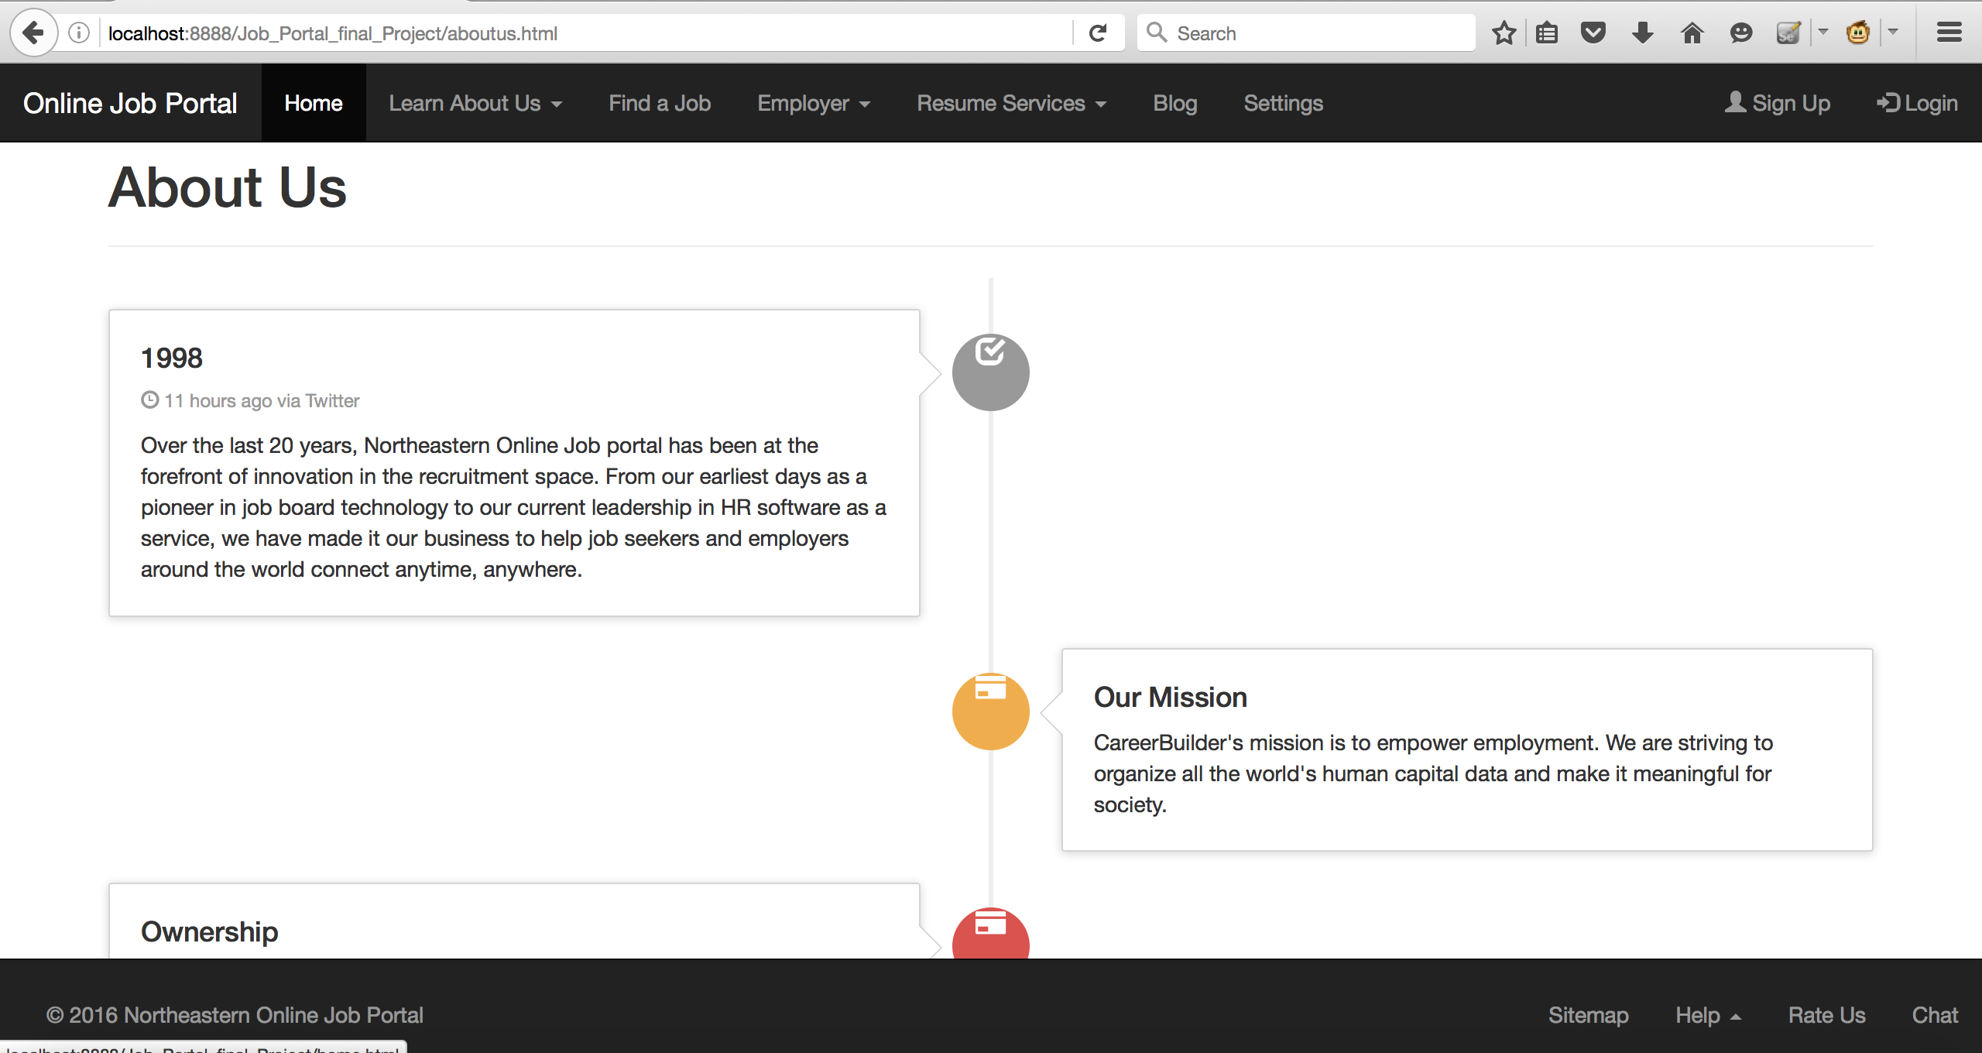
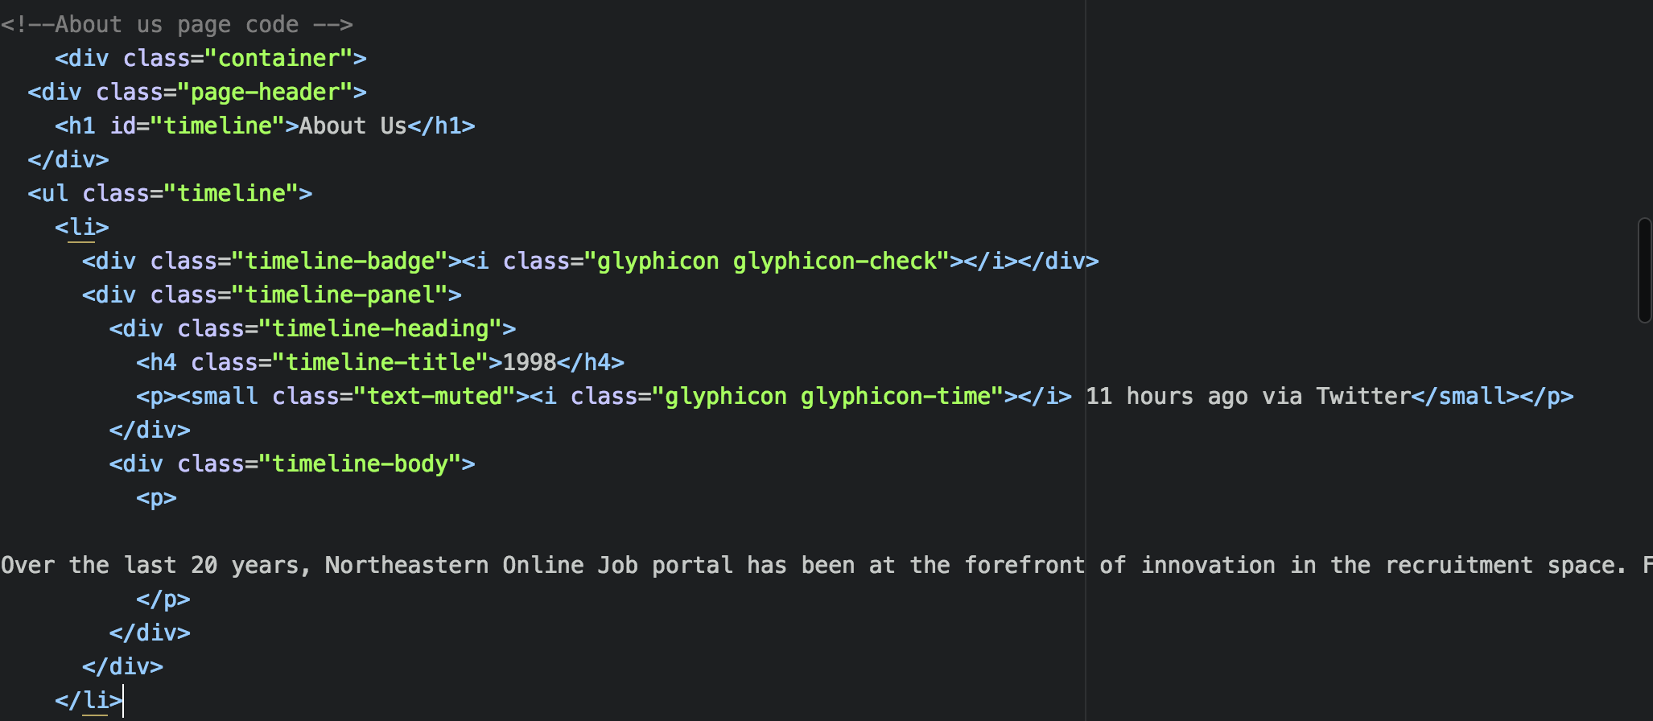
- Timeline Code snippets

Slide 14
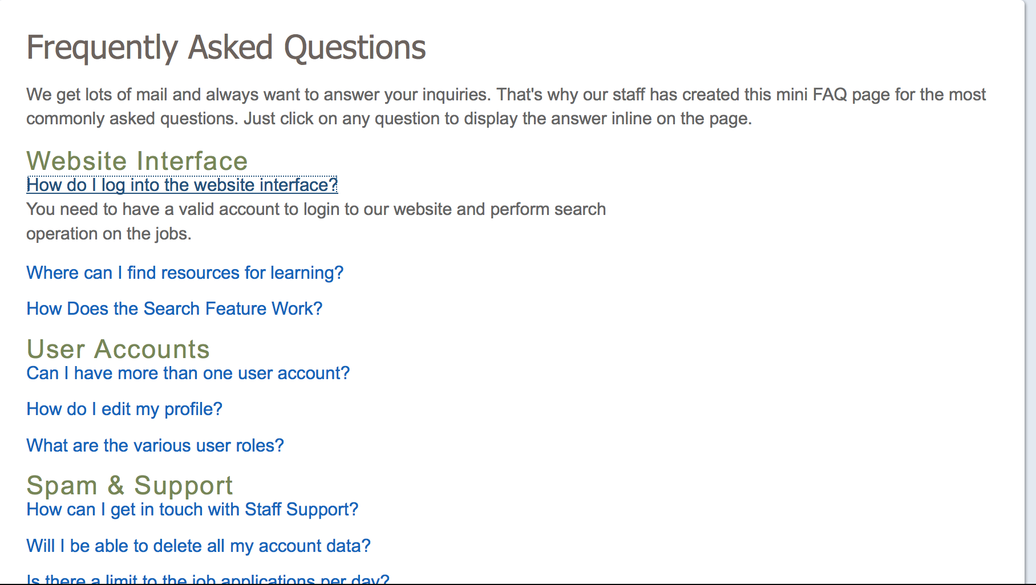
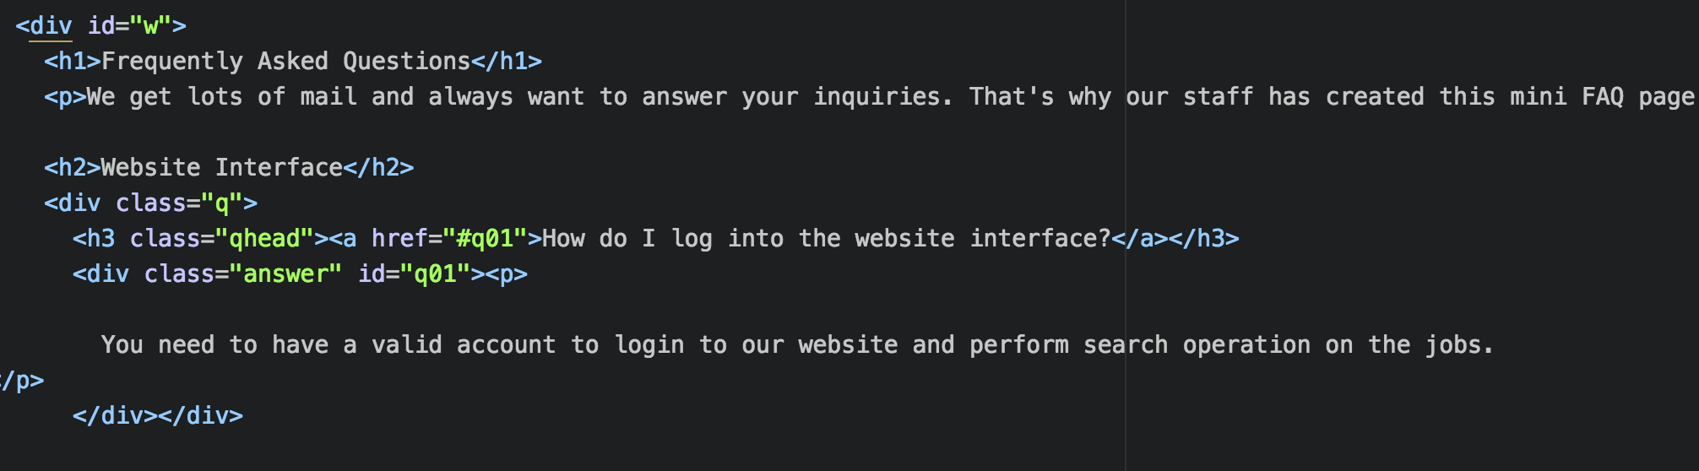
- Slider Code snippets

Slide 15
- Slider Code snippets

Slide 16
Web PAGES2
Login
Sign Up
Find job
Post Job
View Job Search results

Slide 17
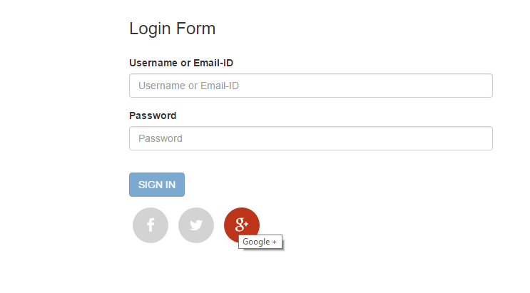
Log in page with various validations – Both Frontend and backend using php

Slide 18

Log in based on different roles – employers have home page

Slide 19
Log in based on different roles – employers have home page

Slide 20

Log in based on different roles – JOBSEEKER have home page

Slide 21

Search job based on keywords and location for job seekers

Slide 22
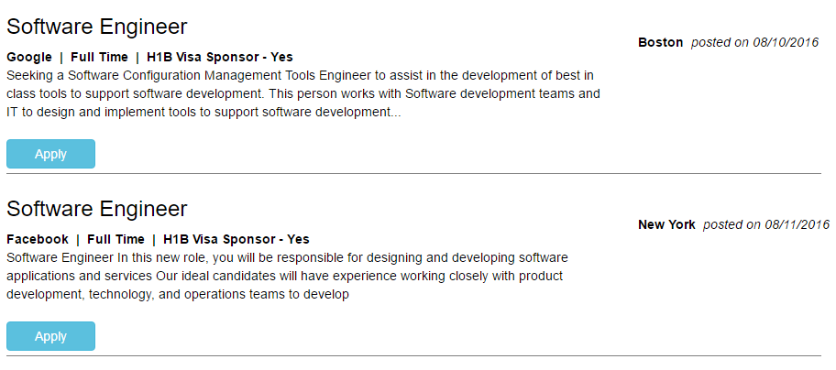
Search RESults based on job search for job seekers

Slide 23
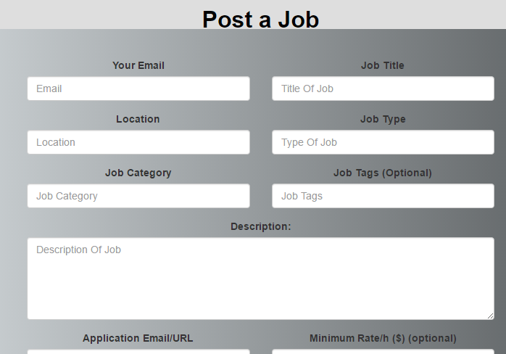
Post a job for employers

Slide 24
Web PAGES3
Home
Upload Resume
Apply job
Terms and Conditions
View Applications
View Submitted Jobs

