Slide 1
Experiential Learning Phase -II:
CS235AI
Implementing Custom System Calls
SRIRAM DS
1RV22CS203
VIBHAV SIMHA
1RV22CS230

Slide 2
Kernel and System calls
The kernel is the core code of the operating system. Usually when the computer starts the bootloader and the kernel are the first pieces of code to be loaded into the machine.
The kernel has control over the entire system, its memory, peripheral devices, processor and so on. User programs and applications can utilize the resources that the operating system makes available through system calls.
System calls are listed in the system call table and are executed in the privileged space of the kernel mode.
Some C libraries require interaction with the kernel, thus making use of the kernel's system calls.
While existing system calls provide a wide range of functionality, there are cases where developers may require specialized operations that are not covered by standard system calls. Custom system calls allow developers to extend the functionality of the operating system kernel to meet specific application requirements or address unique use cases.

Slide 3
Kernel and System calls
Kernels: The kernel is the core component of an operating system. It manages system resources, such as memory, CPU, devices, and filesystems, and provides a layer of abstraction for applications to interact with hardware. It also ensures that different processes running on the system are isolated and protected from each other.
System Calls: System calls are the interface between user-level processes and the kernel. They allow user-level programs to request services from the kernel, such as reading/writing files, creating processes, networking operations, and more. When a user-level program wants to perform privileged operations or access system resources, it invokes a system call. System calls provide a safe and controlled way for user-level programs to interact with the underlying hardware and kernel functionality.
System Call Table: The system call table is a data structure maintained by the kernel that maps system call numbers to their corresponding kernel functions. When a user-level program invokes a system call, the kernel looks up the system call number in the table to determine which kernel function to execute.

Slide 4
Kernel and System calls
Custom System Calls: While standard system calls cover a wide range of functionality, there are cases where developers may require specialized operations that are not provided by existing system calls. Custom system calls allow developers to extend the functionality of the kernel to meet specific application requirements or address unique use cases.
Use Cases: Custom system calls can be used for a variety of purposes, such as implementing specialized algorithms, accessing hardware features not exposed by standard system calls, optimizing performance-critical operations, or integrating with external libraries or systems.
Implementation: Implementing a custom system call typically involves defining a new system call number, writing the corresponding kernel function to handle the request, updating the system call table to include the new entry, and recompiling the kernel. Custom system calls are written in kernel-space code and execute with the same privileges as built-in system calls.
Benefits: Custom system calls provide a way to tailor the operating system to specific application requirements without modifying or extending user-level programs. They allow for efficient and controlled access to kernel functionality, enabling developers to leverage the full power of the underlying hardware and software platform.
Considerations: Developing and deploying custom system calls requires careful consideration of security, stability, and compatibility implications. Improperly designed or implemented custom system calls can introduce vulnerabilities, destabilize the system, or break compatibility with existing software.

Slide 5
Overview of adding custom system calls on a Linux device
Set your virtual machine
Get the kernel source code
Config the kernel
Compile & install the kernel
Reboot machine with custom kernel
Test the custom system call

Slide 6
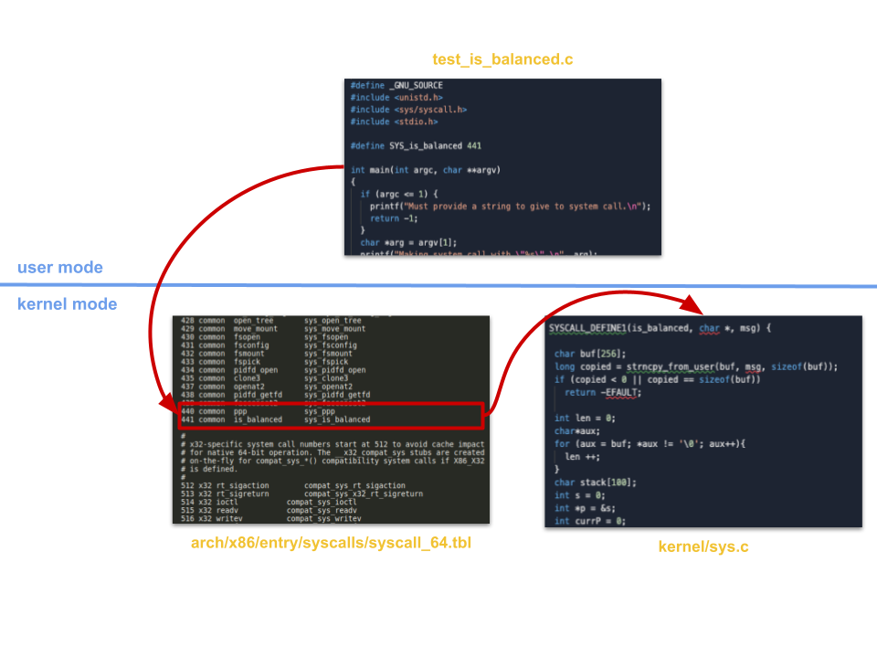
Overview

Slide 7
Hashing
Hashing is a fundamental concept in computer science and cryptography. It involves taking an input (or 'message') and applying a mathematical function to generate a fixed-size string of bytes, typically of a fixed length. This output is often referred to as the 'hash value' or 'hash code'. Hashing is widely used in various applications, including data storage, security, and digital signatures, among others. Here are some key aspects of hashing:
Deterministic: A hash function always produces the same output for the same input. This property is crucial for consistency and predictability.
Fixed Output Size: Regardless of the size of the input, the output of a hash function has a fixed size. For example, the output of the SHA-256 hash function is always 256 bits long.
Irreversibility: It should be computationally infeasible to reverse-engineer the original input from its hash value. This property is essential for security applications such as password storage.
Avalanche Effect: A small change in the input should result in a significantly different hash value. This property ensures that similar inputs produce drastically different outputs, enhancing the security and reliability of hash functions.

Slide 8
Hashing
Collision Resistance: It should be computationally difficult to find two different inputs that produce the same hash value. Collisions weaken the security of hash functions and can lead to vulnerabilities in various applications.
Hash Functions: There are various hash functions available, each with its own characteristics and use cases. Commonly used hash functions include MD5, SHA-1, SHA-256, and SHA-512. The choice of hash function depends on factors such as security requirements, performance considerations, and compatibility with existing systems.
Applications:
Data Integrity: Hashing is used to verify the integrity of data by comparing hash values before and after transmission or storage. If the hash values match, it indicates that the data has not been tampered with.
Digital Signatures: Hash functions are used in digital signatures to generate unique identifiers for documents or messages. These hash values are then encrypted with a private key to create a digital signature, which can be verified using the corresponding public key.
Password Storage: Hashing is commonly used to securely store passwords in databases. Instead of storing plaintext passwords, systems store the hash values of passwords. During authentication, the input password is hashed, and the resulting hash value is compared with the stored hash value.
Cryptographic Applications: Hash functions are integral to various cryptographic protocols, including cryptographic checksums, key derivation functions, and message authentication codes (MACs).

Slide 9
Why implement Hashing as a separate System Call?
Implementing hashing algorithms within the kernel itself as a separate system call can offer several advantages:
Efficiency: Performing hashing operations within the kernel can be more efficient than doing so in user space. Kernel code runs in privileged mode with direct access to hardware resources, which can lead to better performance, especially for large datasets.
Security: Keeping hashing operations within the kernel can enhance security by minimizing exposure to user space and potential vulnerabilities in user-level code. It reduces the attack surface and helps protect sensitive data during hashing operations.
Simplified Usage: Providing a dedicated system call for hashing operations can simplify the interface for applications and libraries that need to perform hashing. Developers can invoke the system call directly, without needing to implement hashing algorithms themselves or rely on external libraries.
Integration with Kernel Services: Hashing functionality implemented as a system call can leverage other kernel services and features, such as cryptographic accelerators, hardware-assisted hashing, or kernel-level optimizations. This integration can further enhance performance and security.

Slide 10
5.Kernel-Level Access: Some hashing use cases may require access to kernel-specific resources or data structures that are not readily available in user space. By implementing hashing within the kernel, applications can access these resources more easily and efficiently.
6.Privileged Operations: Certain hashing operations may require elevated privileges or access to protected system resources. By encapsulating hashing functionality within a system call, the kernel can enforce appropriate security policies and access controls.
Overall, while it's possible to implement hashing algorithms entirely in user space using libraries like OpenSSL or cryptographic APIs provided by the operating system, having a separate system call for hashing in the kernel can offer benefits in terms of performance, security, and ease of use, particularly for applications with stringent requirements or specialized use cases.

Slide 11
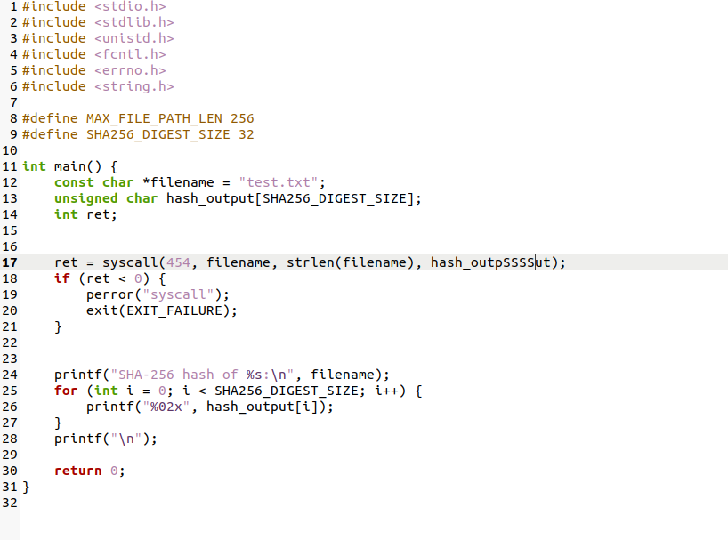
User Space Program snippets

Slide 12
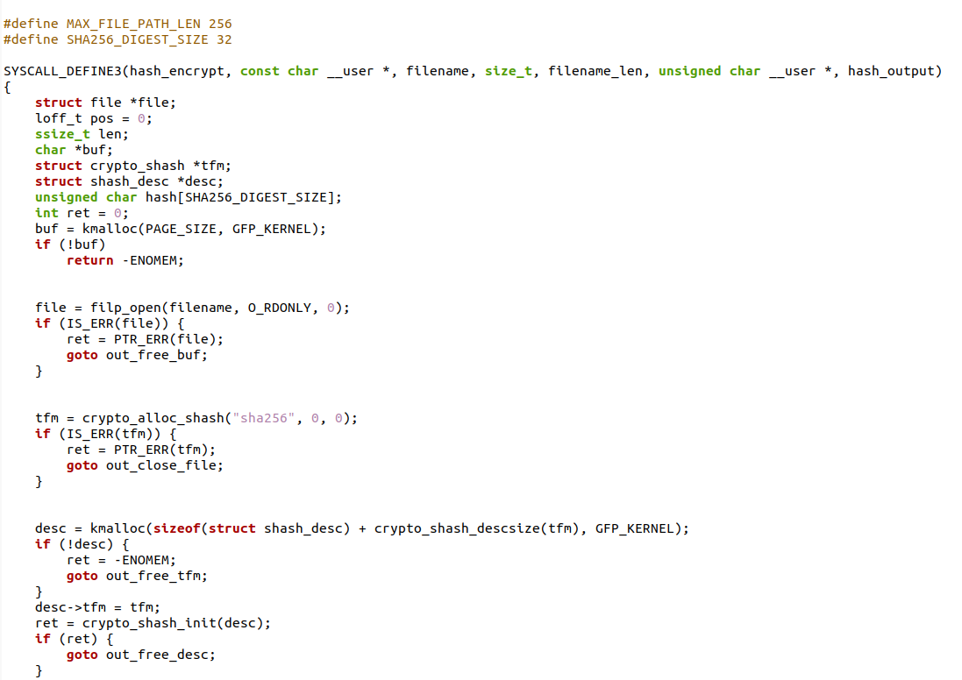
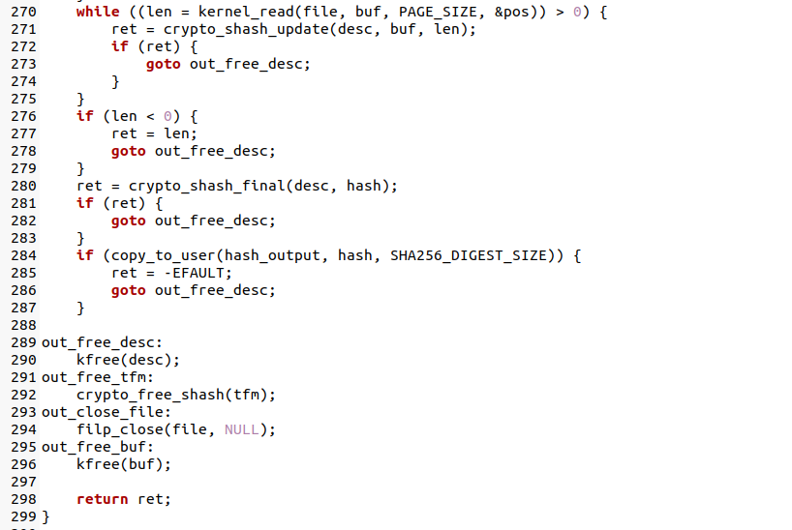
Kernel Space System Call Implementation snippets

Slide 13
REFERENCES (As per IEEE format and must be Numbered
consecutively in order of first mention) & Annexures / Appendix
Very enriching and a complete tutorial (uses Arch VM instead of Ubuntu), delves into the conceptual foundations behind each step. Write a System Call, by Stephen Brennan (2016). https://brennan.io/2016/11/14/kernel-dev-ep3/
2. Adding A System Call To The Linux Kernel (5.8.1) In Ubuntu (20.04 LTS), by Jihan Jasper Al-Rashid (2020). https://dev.to/jasper/adding-a-system-call-to-the-linux-kernel-5-8-1-in-ubuntu-20-04-lts-2ga8
3. Analyzing a Decade of Linux System Calls, highly informative article on system calls history by Mojtaba Bagherzadeh, Cor-Paul Bezemer.
https://www.researchgate.net/publication/319687129_Analyzing_a_Decade_of_Linux_System_Calls
4.Custom system calls – IEEE research paper by Sagar Maliye, Sandeep Krishnaswamy, Harish Gajula. https://ieeexplore.ieee.org/document/7522511.

