Slide 1
Data Visualization of the FED FUNDS RATE
Timothy Pillow

Slide 2

What is the fed funds rate ?

Slide 3
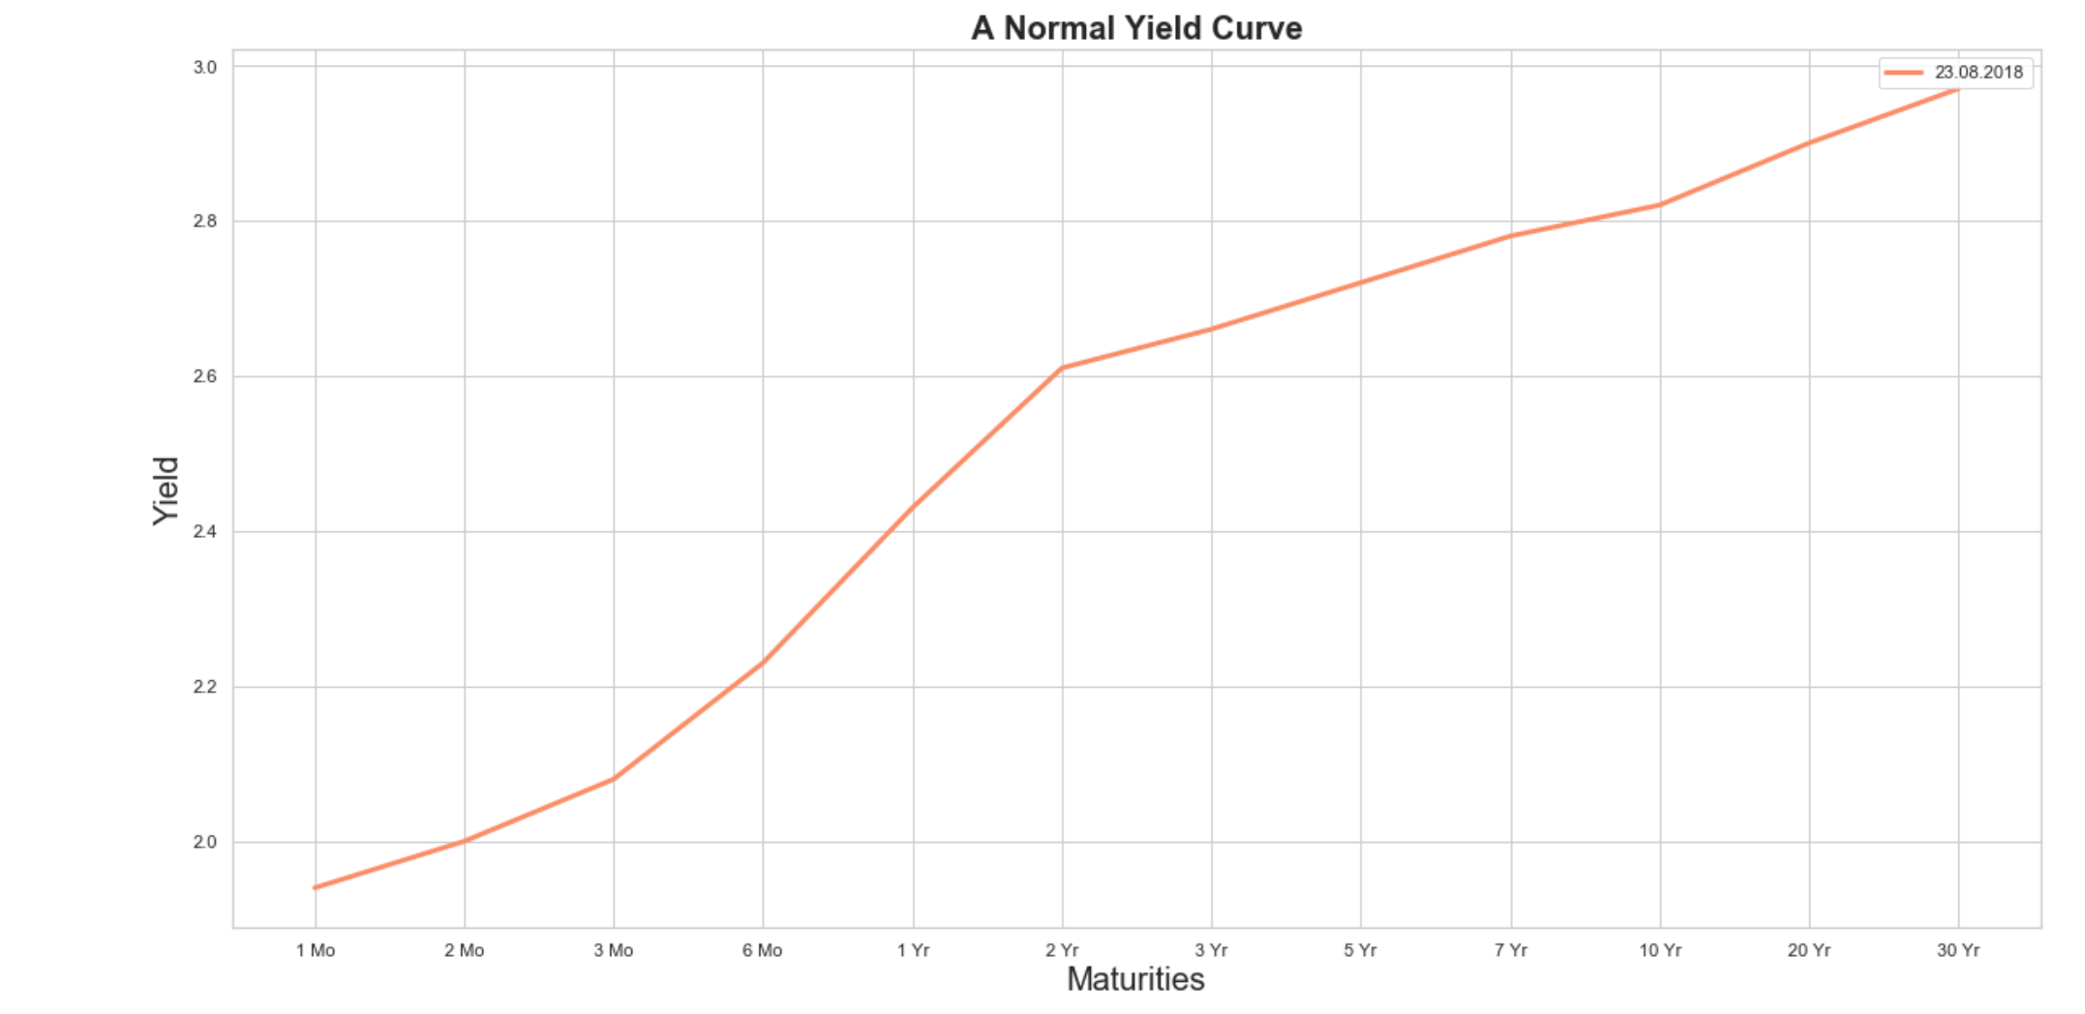
What is a yield Curve ?

Slide 4
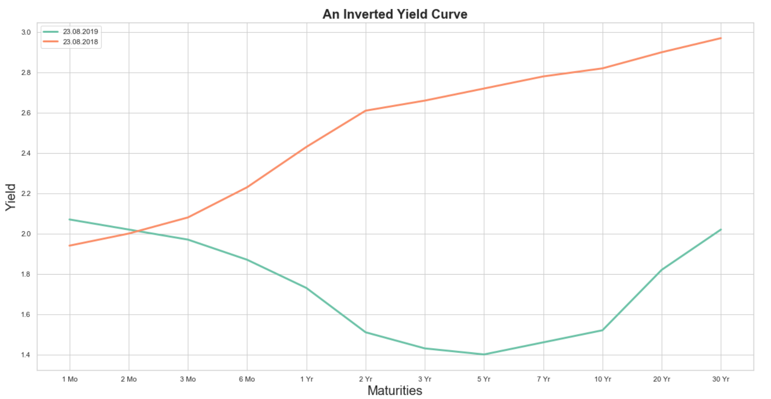
Can yield curves predict a recession ?

Slide 5
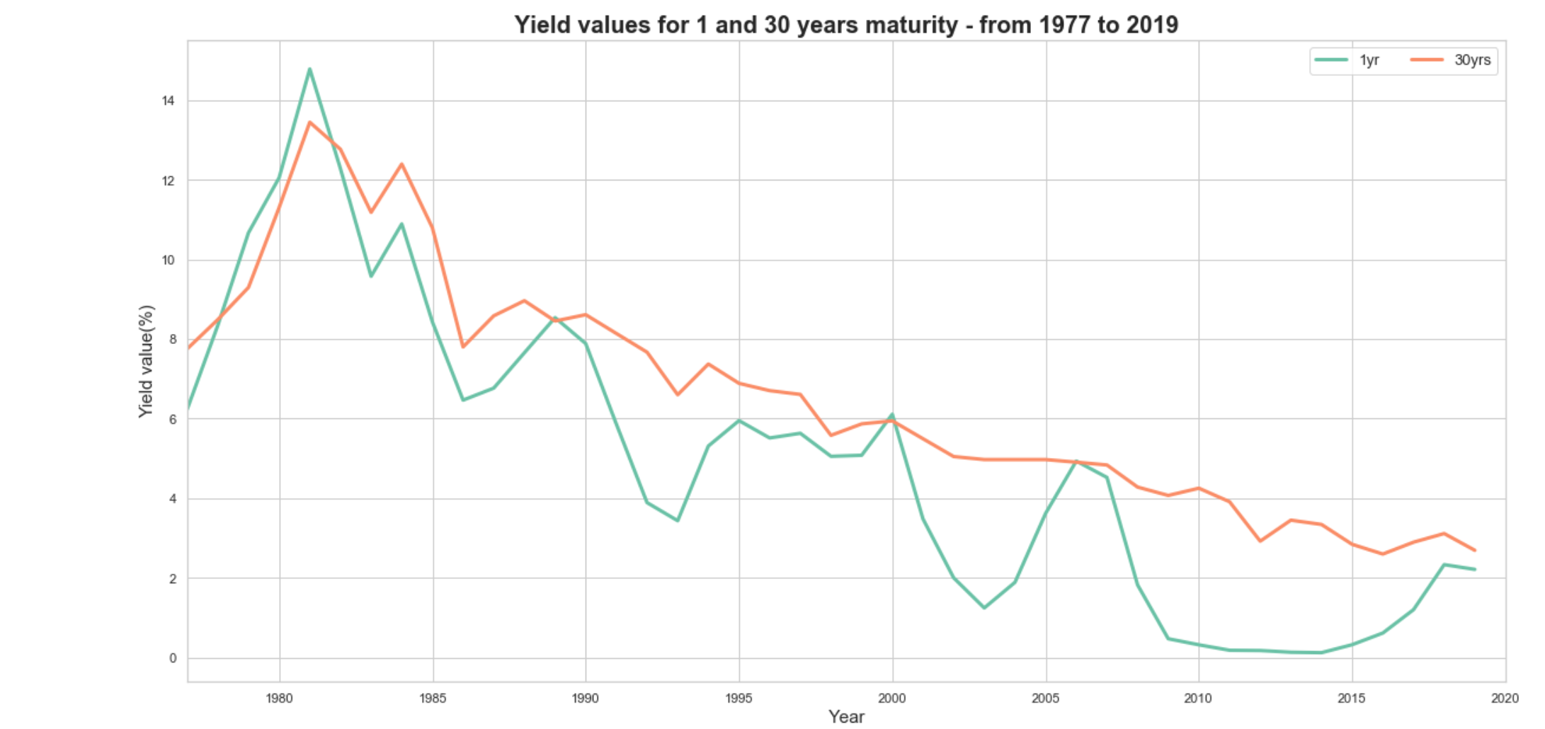
Short versus long term bonds

Slide 6
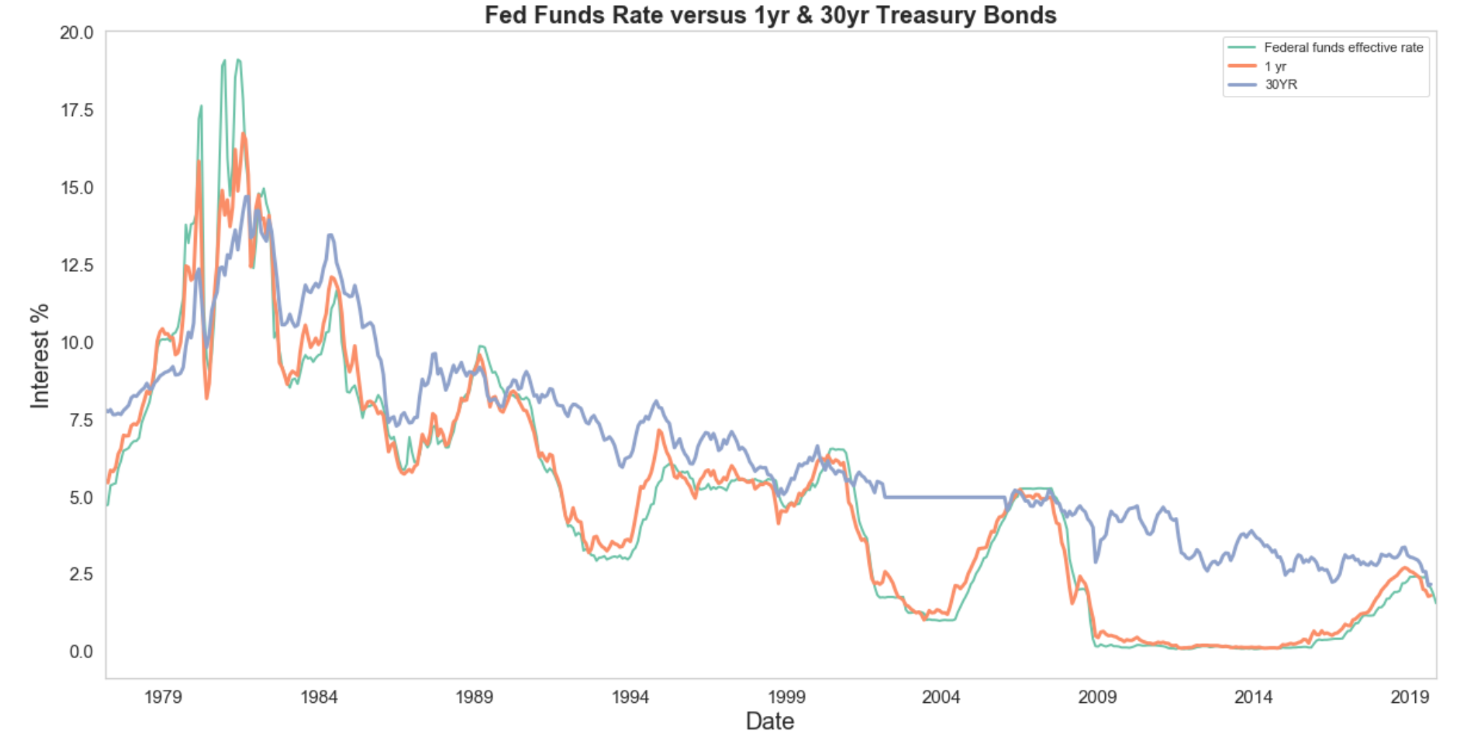

Slide 7
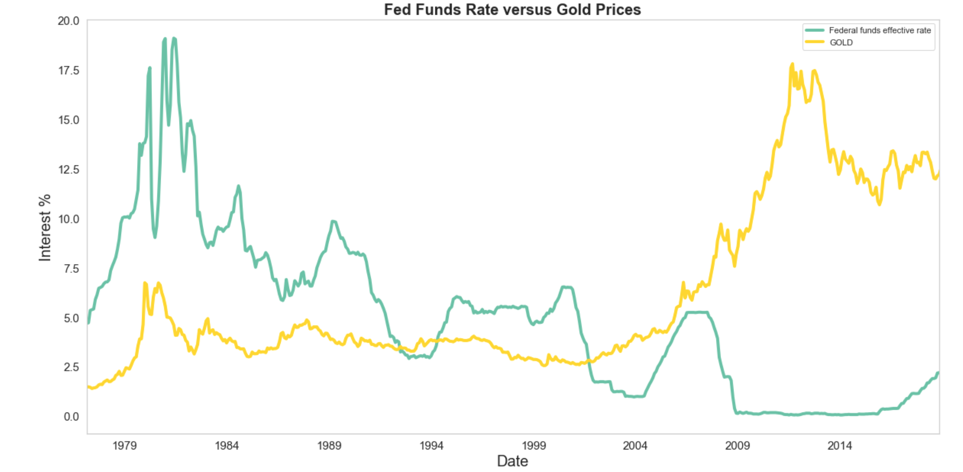

Slide 8
Sources:
https://www.kaggle.com/andradaolteanu/is-a-recession-coming-us-yield-curves-can-tell-us/data - Used original source code as a template and modified for own needs. Used yield curve data
https://www.federalreserve.gov/datadownload/Choose.aspx?rel=Z.1 – used Federal Reserve Downloads program to obtain fed funds data
Interesting links:
https://www.stlouisfed.org/on-the-economy/2017/october/increases-fed-funds-rate-impact-other-interest-rates
https://www.investopedia.com/terms/f/federalfundsrate.asp
https://www.investopedia.com/terms/i/invertedyieldcurve.asp

