Slide 1


CMR TECHNICAL CAMPUS
UGC(Autonomous)
Kandlakoya,Medchal Road,Hyd-501 401 Department of Computer Science Engineering
Mini Project On
Machine Learning Assessment for Severity of Liver Fibrosis for Chronic HBV Based on Physical Layer With Serum Markers
BATCH NO : 12
Project Guide: BATCH MEMBERS:
Ms.D.Sandhya Rani 217R1A0568 A.SRI RAM REDDY
Assistant Professor, CSE Department 217R1A05A8 M.REDDY KUMAR REDDY
217R1A0565 A.KASI VISWANATH NARASIMHA
Project Coordinator:
Dr. J. Narasimharao
Associate Professor, CSE Department

Slide 2
CONTENTS
Abstract
Existing System
Disadvantages of Existing System
Proposed System
Advantages of Proposed System
System Requirements
Novelty
System Architecture
Modules
UML Diagrams
Sample Code
Results
Conclusion
Future Scope
References
Github Link

Slide 3
ABSTRACT
Liver fibrosis, a common consequence of chronic Hepatitis B Virus (HBV) infection, is a critical factor in assessing disease progression and determining appropriate treatment strategies
Traditional methods for evaluating liver fibrosis, such as liver biopsy, are invasive and have limitations in accuracy and patient comfort
advanced machine learning algorithms to create predictive models for fibrosis severity. The study involves the collection of comprehensive patient data, including physical layer imaging results and serum marker levels, followed by the application of various machine learning techniques such as Random Forests, Support Vector Machines (SVM), and Neural Networks

Slide 4
EXISTING SYSTEM
Current methods for assessing liver fibrosis in chronic HBV patients include liver biopsy, elastography, and the use of serum markers. Liver biopsy, the gold standard, is invasive and carries risks. Elastography provides a non-invasive assessment of liver stiffness, but its accuracy can vary based on factors such as operator experience and patient conditions. Serum biomarkers like APRI and FIB-4 are less invasive but can lack specificity and sensitivity. Combining these methods has shown promise but often requires complex integration and may still fall short of providing comprehensive and accurate assessments.

Slide 5
DISADVANTAGES OF EXISTING SYSTEM
Invasive Procedure
Variable Accuracy
Limited Biomarker Sensitivity
Complex Integration

Slide 6
PROPOSED SYSTEM
The proposed system aims to enhance the assessment of liver fibrosis severity in chronic HBV patients by integrating data from physical layer imaging techniques and serum markers through advanced machine learning algorithms. The system involves:
Data Collection
Feature Extraction
Model Training
Integration and Prediction
Validation

Slide 7
ADVANTAGES OF PROPOSED SYSTEM
Non-Invasive Assessment
Enhanced Accuracy
Comprehensive Analysis
Reduced Diagnostic Costs
Early Detection and Monitoring
Personalized Treatment
Scalability and Efficiency
Integration of Modern Techniques
Improved Patient Experience
Adaptability
Comprehensive Decision Support

Slide 8
SYSTEM REQUIRMENTS
HARDWARE REQUIRMENTS
• System Processor : Intel core i3 or above
Ram : Minimum of 4GB and above
Hard Disk : Maximum of 20GB

Slide 9
SOFTWARE REQUIRMENTS
Operating Systems : Window 8 or above
Coding Languages : Python
Front-End : Python
Back-End : Tkinter Framework

Slide 10
NOVELTY OF PROJECT
The novelty of our project lies in employing advanced machine learning algorithms, the project aims to enhance predictive accuracy beyond traditional methods that typically rely on single data sources. This innovative approach not only supports a personalized medicine strategy, allowing for tailored assessments and treatment plans, but also emphasizes non-invasive methodologies that align with contemporary healthcare practices

Slide 11
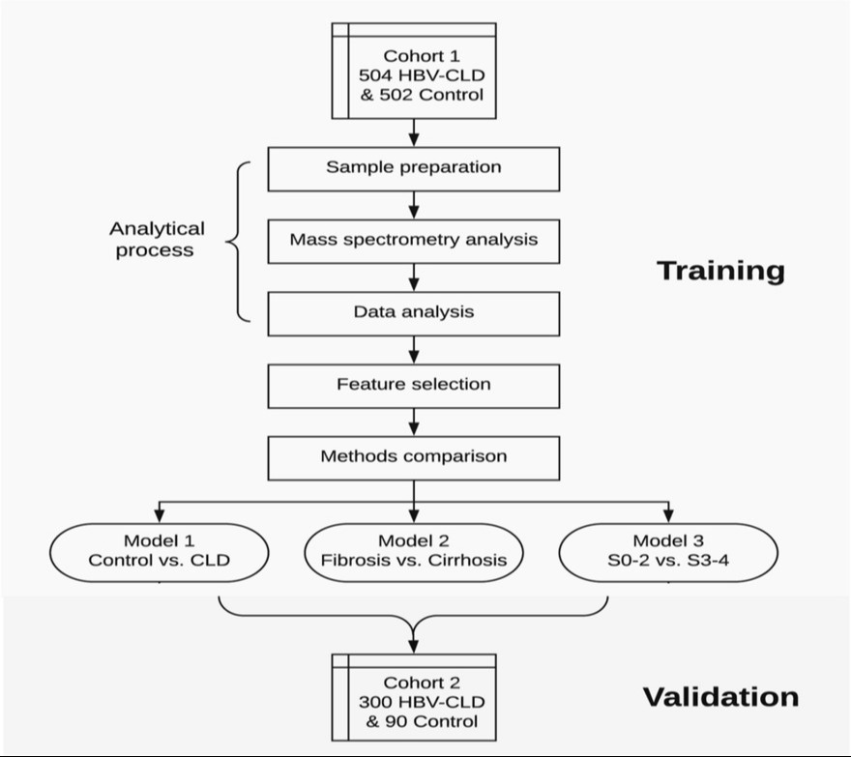
ARCHITECTURE

Slide 12
MODULES
User Module
System Module
Python Modules
Pandas
Tkinter

Slide 13
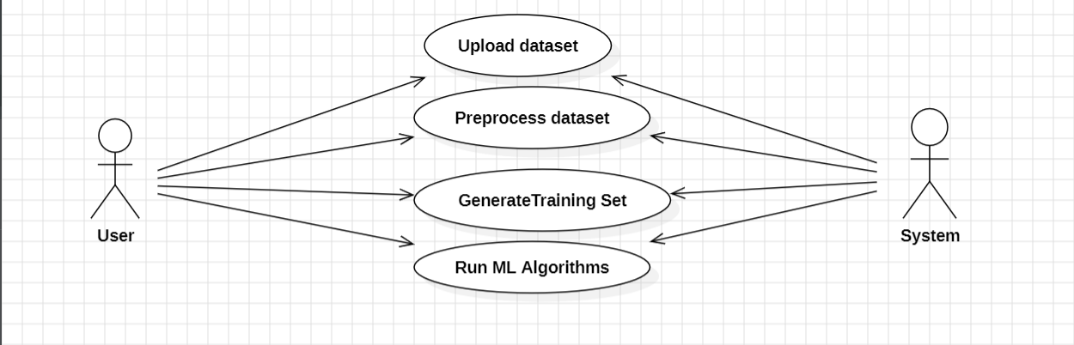










UML DIAGRAMS
USECASE DIAGRAM

Slide 14
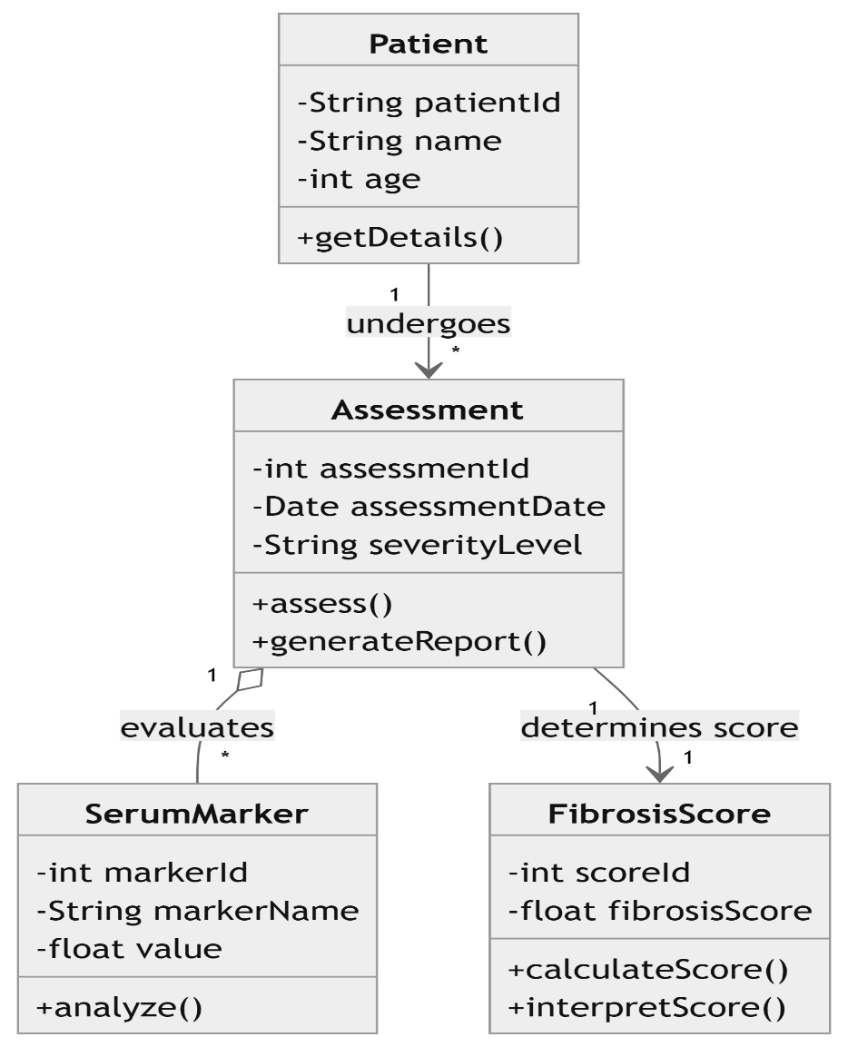
CLASS DIAGRAM

Slide 15
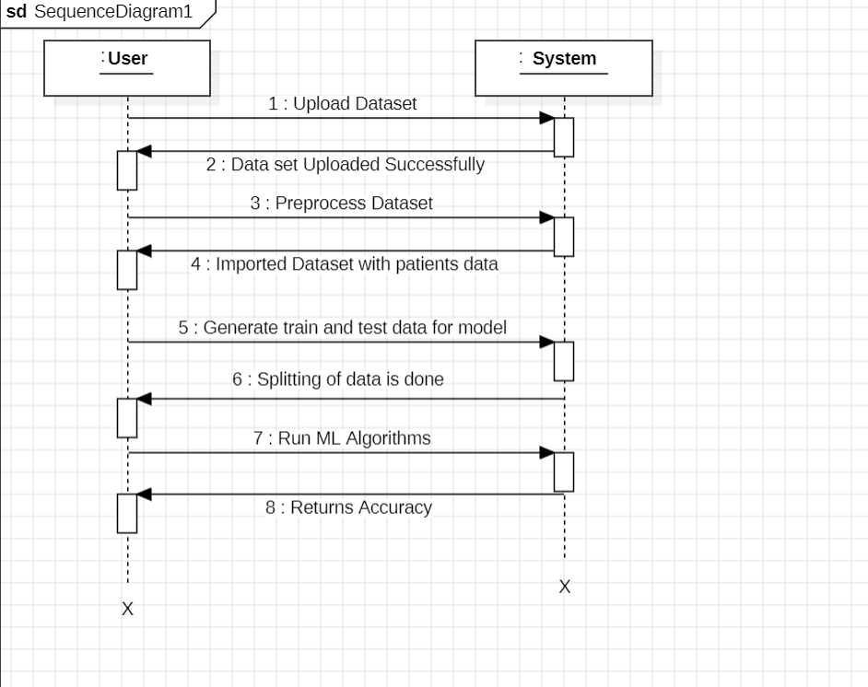
SEQUENCE DIAGRAM

Slide 16
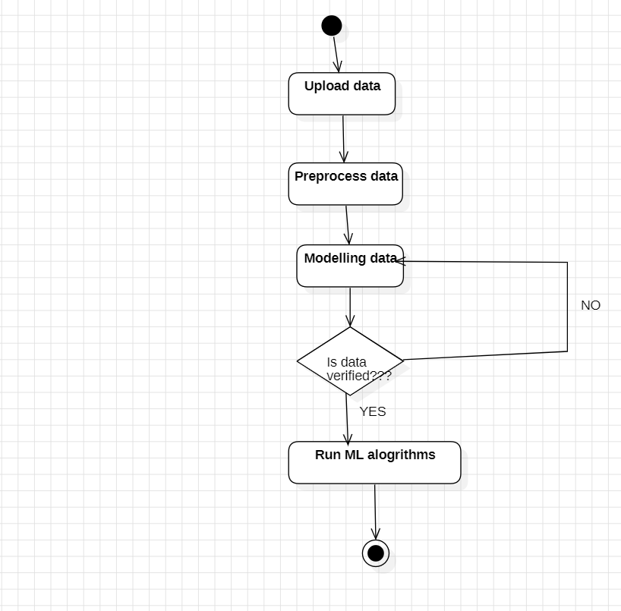
ACTIVITY DIAGRAM

Slide 17
SAMPLE CODE
import tkinter as tk
from tkinter import filedialog, scrolledtext, messagebox
import pandas as pd
from sklearn.model_selection import train_test_split
from sklearn.linear_model import LogisticRegression
from sklearn.metrics import classification_report, confusion_matrix
# Global variables
filename, raw_data, X, y = None, None, None, None
X_train, X_test, y_train, y_test = None, None, None, None
# Main window setup
main = tk.Tk()
main.title("Liver Fibrosis Detection")
main.geometry("800x600")

Slide 18
def upload():
"""Select and load the dataset."""
# File dialog to select a CSV.
# Display the selected filename.
def preprocess():
"""Preprocess the data (cleaning, feature extraction)."""
# Load the CSV, drop NaNs, split into features (X) and labels (y).
def dataSplit():
"""Split data into train/test sets."""
# Use train_test_split to divide X and y.
def logit():
"""Train Logistic Regression and display metrics."""
# Train Logistic Regression, predict, and show metrics.

Slide 19
def logit():
"""Train Logistic Regression model and display metrics."""
# Train, predict, and show accuracy/confusion matrix.
def knn():
"""Train KNN with multiple 'K' values and display metrics."""
# Loop over several 'K' values and show best result.
def rf():
"""Train Random Forest model and display metrics."""
# Train and display classification report.
def dt():
"""Train Decision Tree model and display metrics."""
# Train Decision Tree and show metrics.
def svc():
"""Train Support Vector Classifier and display metrics."""
# Train SVC and output accuracy/confusion matrix.
def adc():
"""Train AdaBoost with various base models and display metrics."""
# Experiment with different base models.

Slide 20
def xgb():
"""Train XGBoost and display metrics."""
# Train XGB model and output classification metrics.
def hgb():
"""Train Histogram-based Gradient Boosting and display metrics."""
# Train HGB and show performance metrics.
def stackclassify():
"""Create and train a stacking classifier."""
# Combine multiple models and display metrics.
def mlp():
"""Train and evaluate MLP classifier."""
# Train MLP and show metrics.
def ann():
"""Train or load an Artificial Neural Network (ANN)."""
# Check if model exists, else train a new one

Slide 21
# UI setup
font = ('times', 16, 'bold')
title = tk.Label(main, text='Liver Fibrosis Detection Using Machine Learning Models',
bg='PaleGreen2', fg='Khaki4', font=font)
title.place(x=0, y=5)
font1 = ('times', 14, 'bold')
btns = [
("Upload Dataset", upload), ("Preprocess Dataset", preprocess),
("Split Data", dataSplit), ("Logistic Regression", logit),
("KNN", knn), ("Random Forest", rf),
("Decision Tree", dt), ("SVC", svc),
("AdaBoost", adc), ("XGBoost", xgb),
("HGB", hgb), ("MLP", mlp),
("ANN", ann), ("Stacking Classifier", stackclassify)
]

Slide 22
for i, (text, cmd) in enumerate(btns):
tk.Button(main, text=text, command=cmd, font=font1).place(x=700, y=100 + i * 50)
pathlabel = tk.Label(main, bg='DarkOrange1', fg='white', font=font1)
pathlabel.place(x=700, y=150)
text = scrolledtext.ScrolledText(main, height=30, width=80, font=('times', 12, 'bold'))
text.place(x=10, y=100)
main.config(bg='PeachPuff2')
main.mainloop()

Slide 23
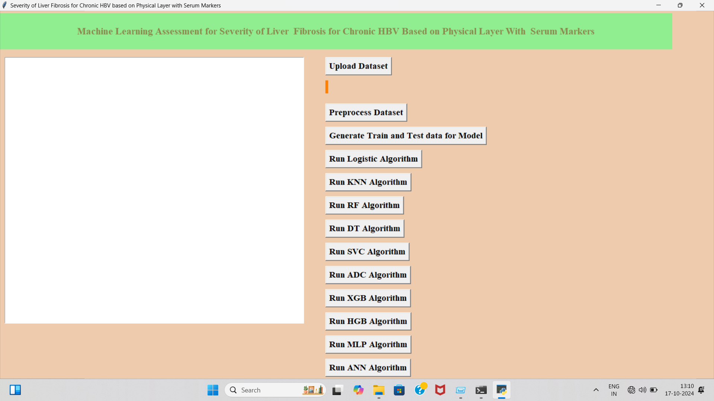
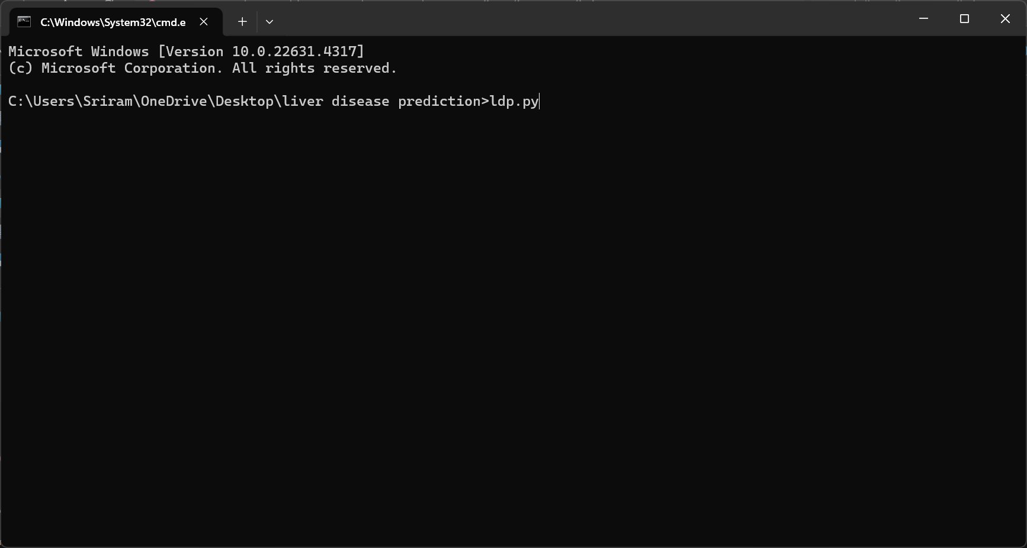
RESULTS
Run Ldp.py file
click “upload dataset”

Slide 24
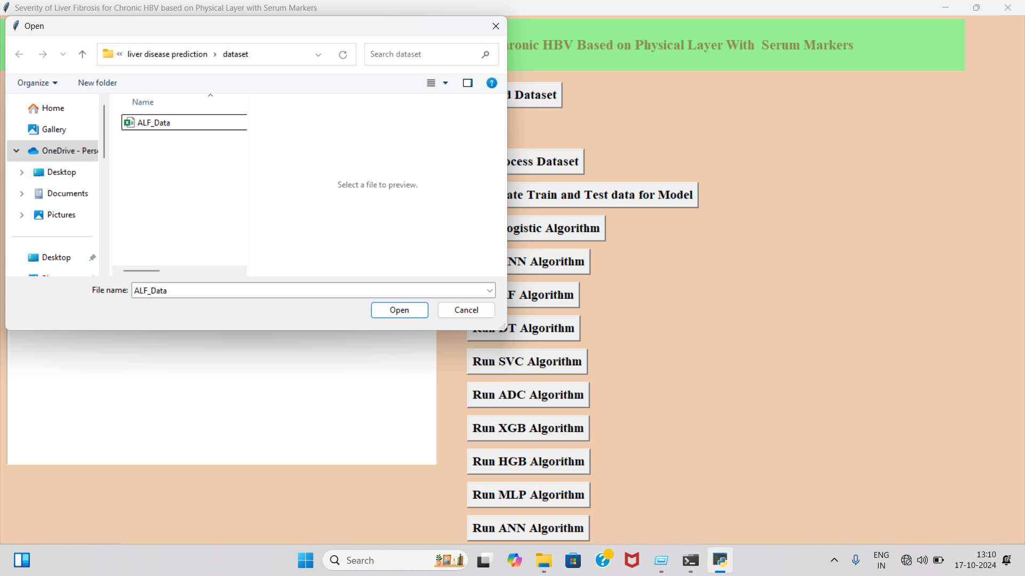
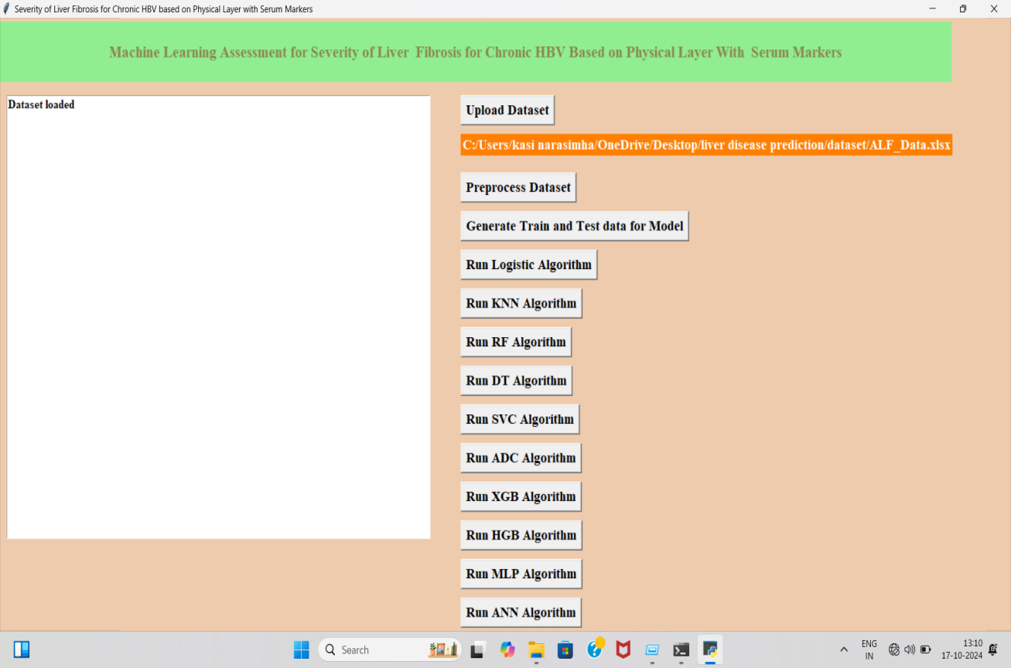
Select Dataset
Dataset uploaded sccesfully

Slide 25
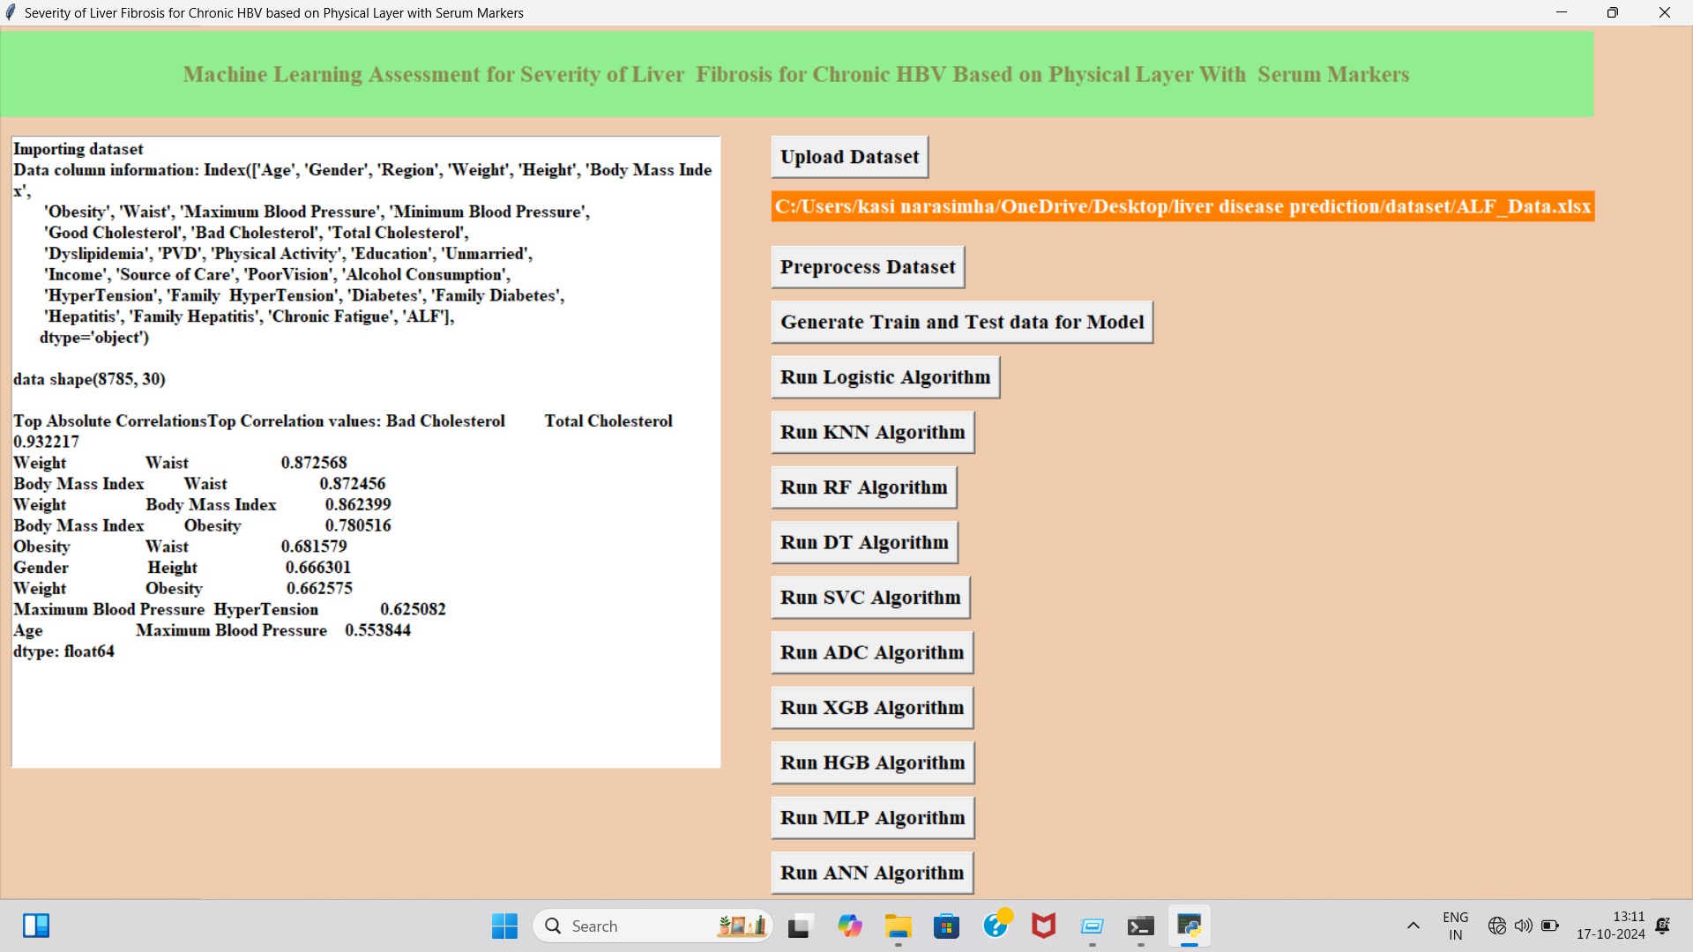
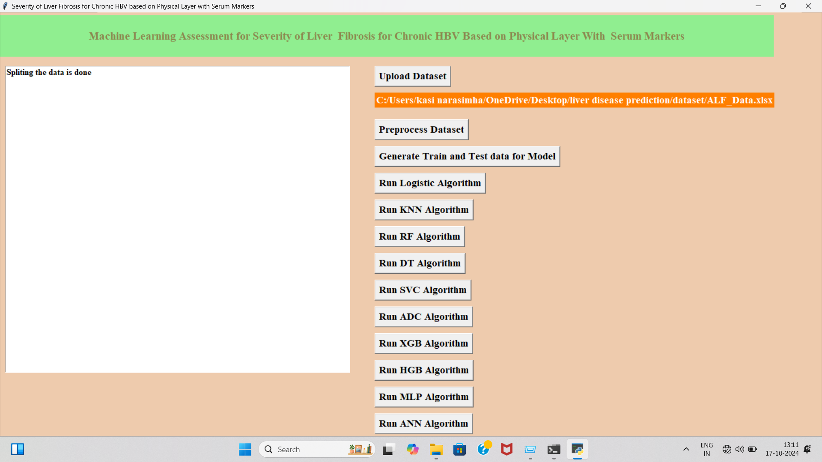
Generate Train and test data for model
Preprocess dataset

Slide 26
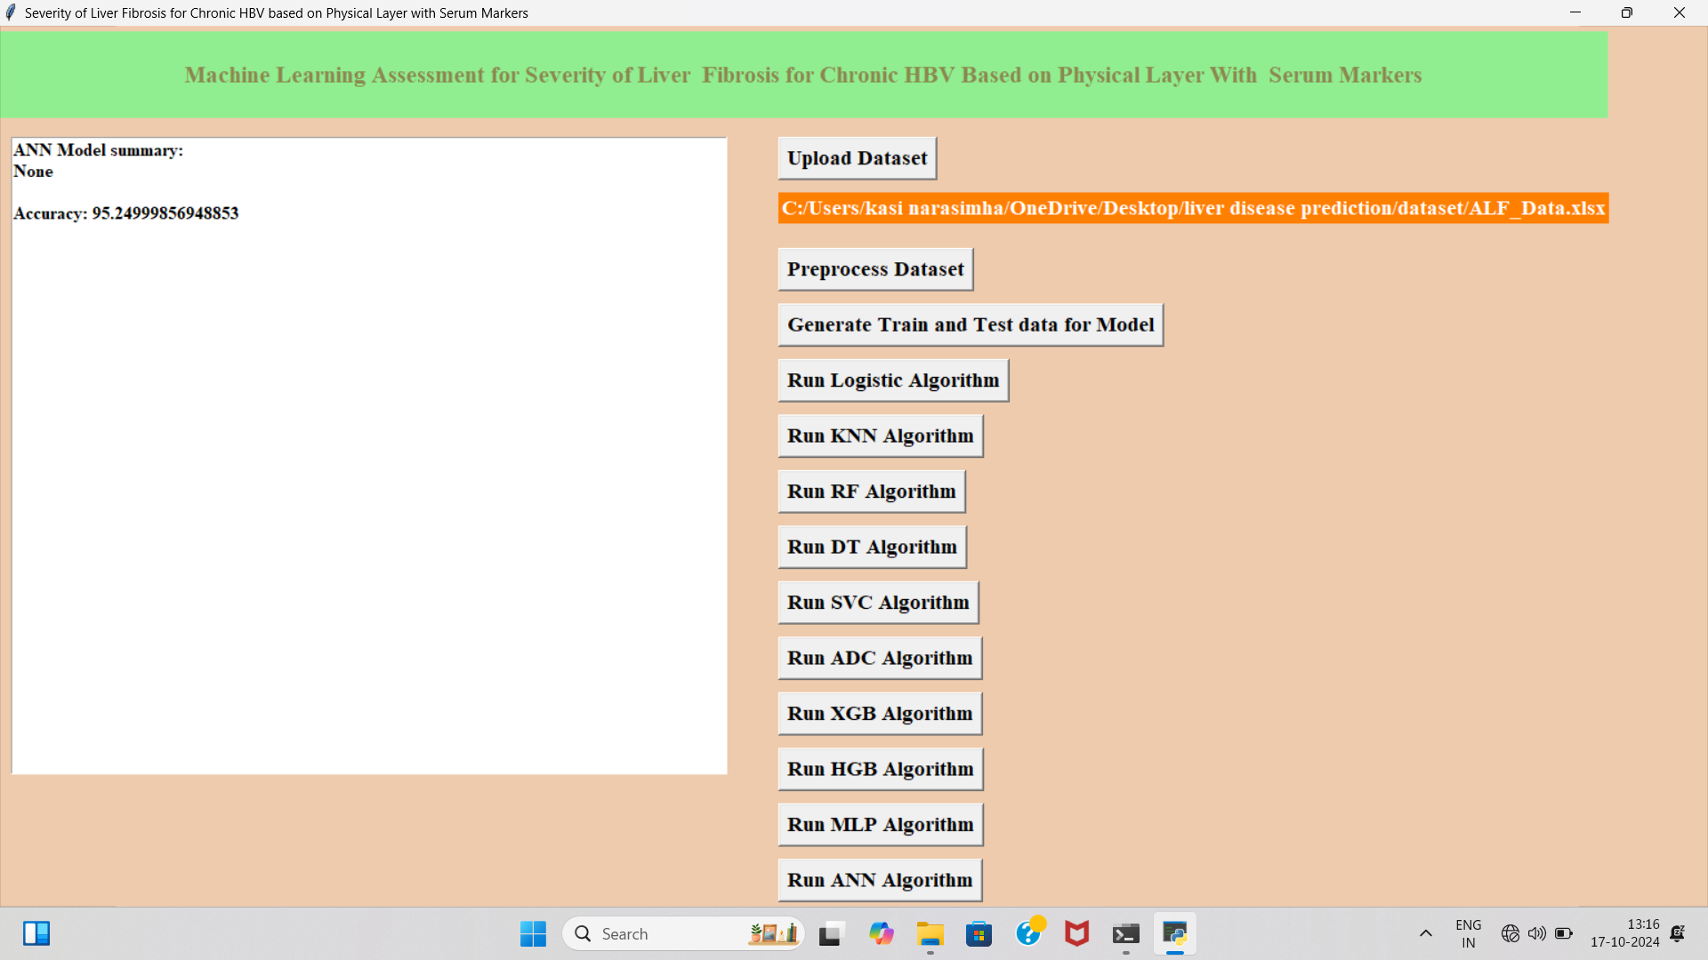
Run all alogirthms for eg i have executed ANN as it has higher accuracy

Slide 27
CONCLUSION
In conclusion, the proposed machine learning-based system for
assessing the severity of liver fibrosis in patients with chronic HBVrepresents a significant advancement in non-invasive diagnostic methodologies. By integrating data from physical layer imaging techniques, such as elastography, and serum biomarkers, the system leverages the strengths of diverse diagnostic modalities to provide a more accurate and comprehensive evaluation of liver fibrosis.
This approach not only improves the accuracy of fibrosis staging but also reduces patient discomfort and procedural risks associated with Invasive diagnostics.

Slide 28
FUTURE SCOPE
The future scope for this project involves further advancements in fraud detection by exploring novel feature selection techniques tailored to the nuances of credit card transaction data.
Continuously refining deep learning architectures, including convolutional neural networks (CNNs), by experimenting with diverse layers and configurations, can unlock even greater predictive power. Additionally, future endeavors could delve into ensemble methods to combine the strengths of multiple models for more robust and accurate fraud detection systems. Further research may also focus on enhancing interpretability and explainability of these models, ensuring transparency and trustworthiness in decision-making processes.

Slide 29
REFERENCES
1. Y. Abakarim, M. Lahby, and A. Attioui, ‘‘An efficient real time model for credit card fraud detection
based on deep learning,’’ in Proc. 12th Int. Conf. Intell. Systems: Theories Appl., Oct. 2018, pp. 1–7, doi:
10.1145/3289402.3289530.
2. H. Abdi and L. J. Williams, ‘‘Principal component analysis,’’ Wiley Interdiscipl. Rev., Comput. Statist.,
vol. 2, no. 4, pp. 433–459, Jul. 2010, doi: 10.1002/wics.101.
3. V. Arora, R. S. Leekha, K. Lee, and A. Kataria, ‘‘Facilitating user authorization from imbalanced data
logs of credit cards using artificial intelligence,’’ Mobile Inf. Syst., vol. 2020, pp. 1–13, Oct. 2020, doi:
10.1155/2020/8885269.
4. A. O. Balogun, S. Basri, S. J. Abdulkadir, and A. S. Hashim, ‘‘Performance analysis of feature selection
methods in software defect prediction: A search method approach,’’ Appl. Sci., vol. 9, no. 13, p. 2764,
Jul. 2019, doi: 10.3390/app9132764.

Slide 30
GITHUB LINK

Slide 31
THANK YOU

