Slide 1

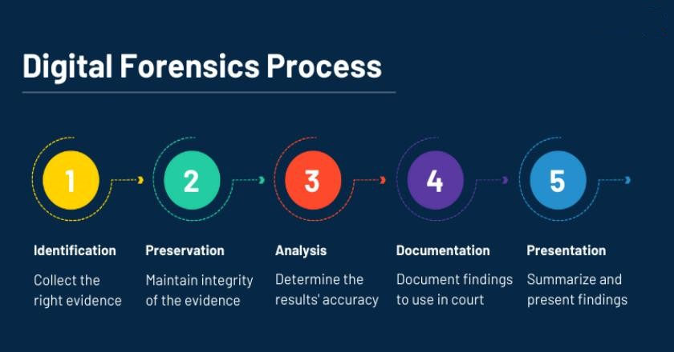
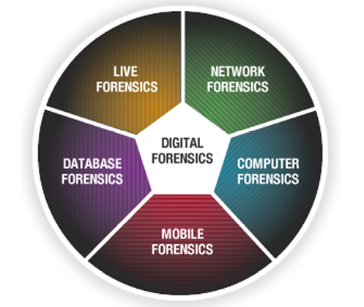


Basics of Cyber Forensics
E.R. Ramesh, M.C.A., M.Sc., M.B.A.,

Slide 2

Basics of
Cyber Forensics
Unit - 2
Understanding information
Methods of storing data:
number systems, character codes, record structures, file formats and file signatures
Word processing and graphic file formats
Structure and Analysis of Optical Media Disk Formats - Recognition of file formats and internal buffers - Extraction of forensic artifacts –
understanding the dimensions of other latest storage devices – SSD Devices

Slide 3
Methods of storing data
Basics of
Cyber Forensics
Primary Storage
Main Memory (or) Internal Memory
Directly accessible to the CPU through Memory Bus (Address Bus and Data bus)
Memory Management Unit acts as interface between CPU and RAM
(recalculates actual memory address and provides abstraction of virtual memory)

Slide 4
Methods of storing data
Basics of
Cyber Forensics
Volatile Primary Storage: RAM
Non-Volatile Primary Storage: ROM, BIOS
Data accessed in nanoseconds

Slide 5
Secondary Storage
Basics of
Cyber Forensics
External Storage (or) Auxiliary Storage
Not directly accessible to CPU
Non-Volatile
CPU uses Input/output channels to access data
Data accessed in milliseconds
Hard Disk, CD/DVD, Flash memory (e.g. USB flash drives or keys), floppy disks,magnetic tape, paper tape, punched cards, standalone RAM disks, and IomegaZip drives.

Slide 6
Tertiary Storage
Basics of
Cyber Forensics
Tertiary storage involves Robotic mechanism which will mount and dismount removable mass storage device according to system’s demand near line.
Storage Data is not immediately available, but can be made online quickly without human intervention.

Slide 7
Storage Media
Basics of
Cyber Forensics
Paper
In form of Paper tape (or) Punch Cards.
Information was recorded by punching holes into the paper or cardboard medium and was read mechanically to determine whether a particular location on the medium was solid or contained a hole.

Slide 8
Storage Media
Basics of
Cyber Forensics
Semiconductor
Uses semiconductor based Integrated Circuits to store information
Contains millions of tiny transistors and capacitors
Primary Storage typically consists of volatile semiconductor memory (DRAM)
Offline Storage typically consists of non-volatile semiconductor memory (Flash Drives, SSD)

Slide 9
Storage Media
Basics of
Cyber Forensics
Magnetic
Uses different patterns of magnetization on a magnetically coated surface to store information
Non-volatile, accessed using one or more read/write heads which has one or more recording transducers
Head, Medium (or) both must move relative to other to access data
Magnetic Disk (Floppy, HDD), Magnetic Tape
Carousel memory (magnetic rolls)

Slide 10
Storage Media
Basics of
Cyber Forensics
Optical
Stores information in deformities on the surface of a circular disc and reads this information by illuminating the surface with a laser diode and observing the reflection.
Non-volatile
Deformities may be permanent (read only), formed once (write once), reversible (read/ write) CD, DVD, BD, UDO

Slide 11
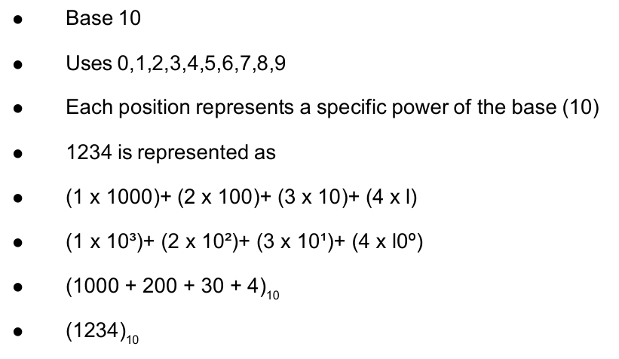
Number systems
Basics of
Cyber Forensics
Decimal

Slide 12
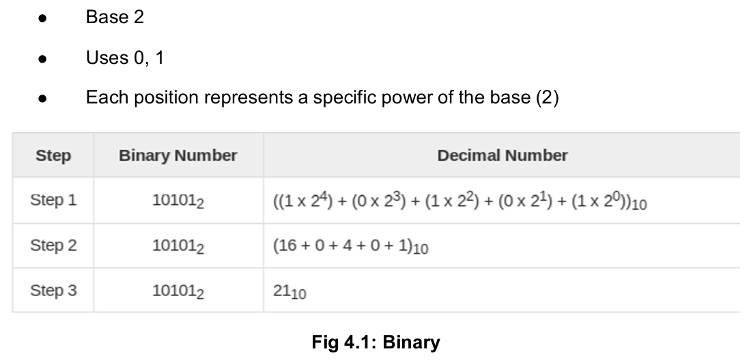
Number systems
Basics of
Cyber Forensics
Binary

Slide 13
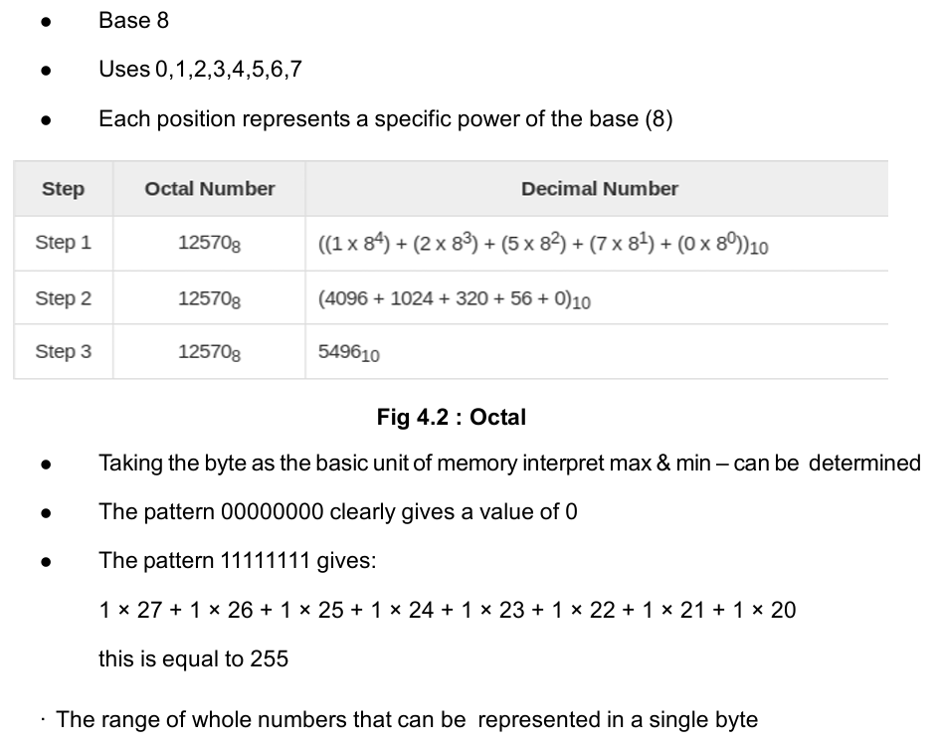
Number systems
Basics of
Cyber Forensics
Octal

Slide 14
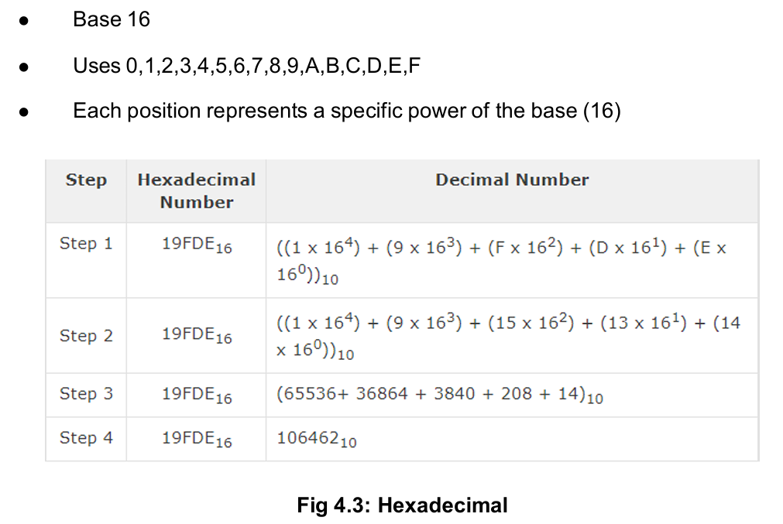
Number systems
Basics of
Cyber Forensics
Hexadecimal

Slide 15
Character codes
Basics of
Cyber Forensics
Character encoding is used to represent a repertoire of characters by some kind of encoding system.
Depending on the abstraction level and context, corresponding code points and the resulting code space may be regarded as bit patterns, octets, natural numbers, electrical pulses, etc.
Character encoding using internationally accepted standards permits worldwide interchange of text in electronic form.

Slide 16
Record structures
Basics of
Cyber Forensics
Unordered
Stores the records in the order they are inserted
Offers good insertion efficiency, but inefficient retrieval times
Ordered
Stores the records in order
May have to rearrange or increase the file size when a new record is inserted, hence low insertion efficiency
Provides more efficient retrieval as the records are pre-sorted

Slide 17
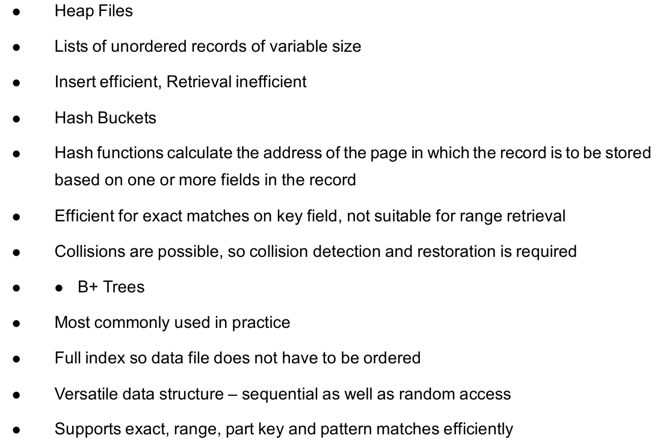
Structured
Basics of
Cyber Forensics

Slide 18
File formats and file signatures
Basics of
Cyber Forensics
A file format is a standard way that information is encoded for storage in a computer file. It specifies how bits are used to encode information in a digital storage medium.
File formats may be either proprietary or free and may be either unpublished or open
Filename Extension
A filename extension is an identifier specified as a suffix to the name of a computer file. The extension indicates a characteristic of the file contents or its intended use.

Slide 19
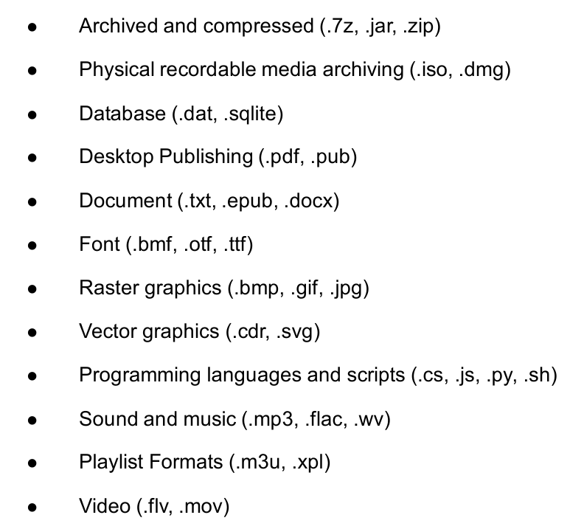
File formats and file signatures
Basics of
Cyber Forensics

Slide 20
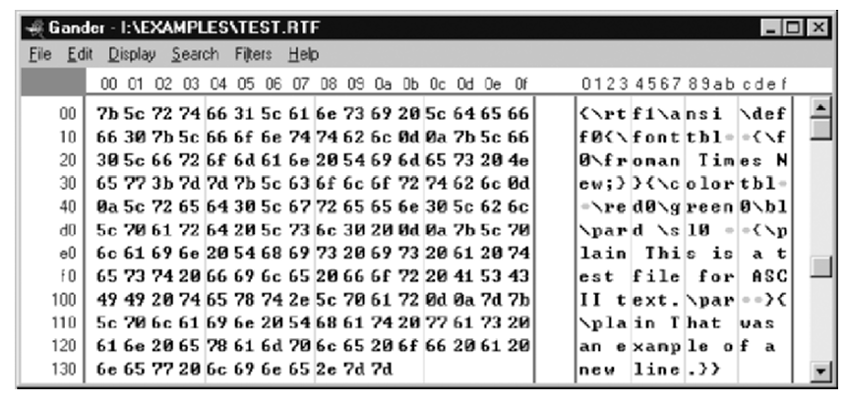
RTF file format
Basics of
Cyber Forensics

Slide 21
Magic Numbers
Basics of
Cyber Forensics
In the Unix community, in particular, the first few bytes of a binary file are often used to indicate type
This is generally referred to as its “magic number” and is defined as:
“Special data located at the beginning of a binary data file to indicate its type to a utility... once upon a time, these magic numbers were PDP-11 branch instructions that skipped over header data to the start of executable code” “it is very desirable that files should generally present themselves as self-describing objects from which an application launcher or navigation tool can readily deduce both their uses and at least some of the semantics of their contents”

Slide 22
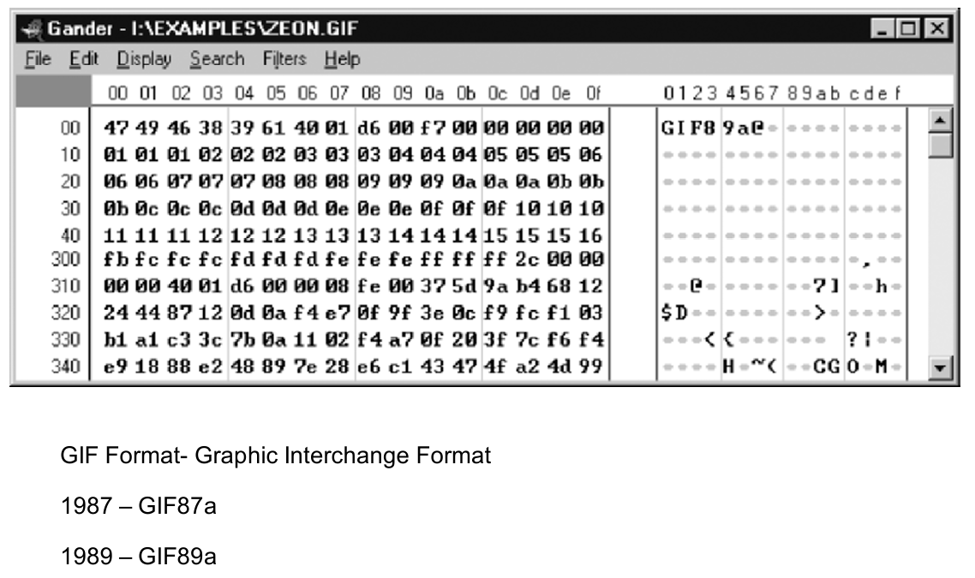
Graphic Formats
Basics of
Cyber Forensics

Slide 23
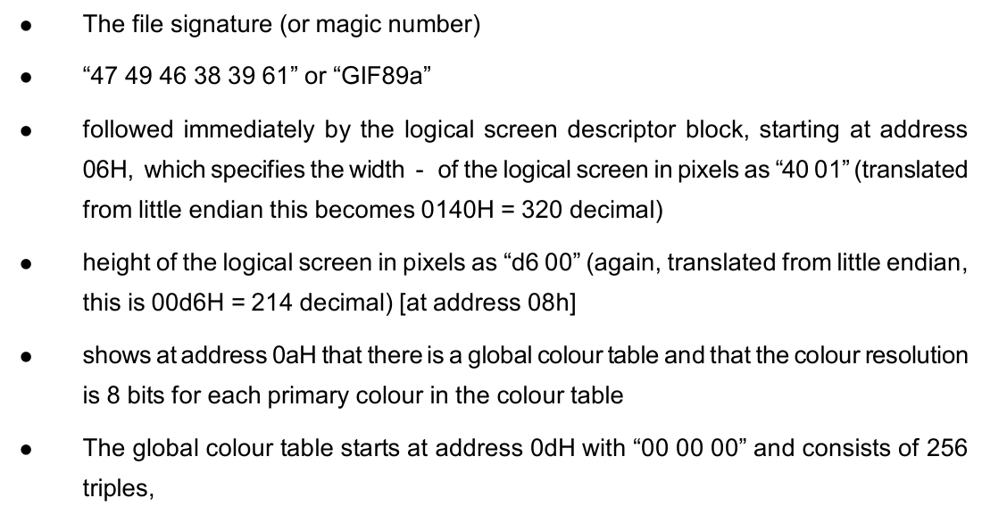
Graphic Formats
Basics of
Cyber Forensics

Slide 24
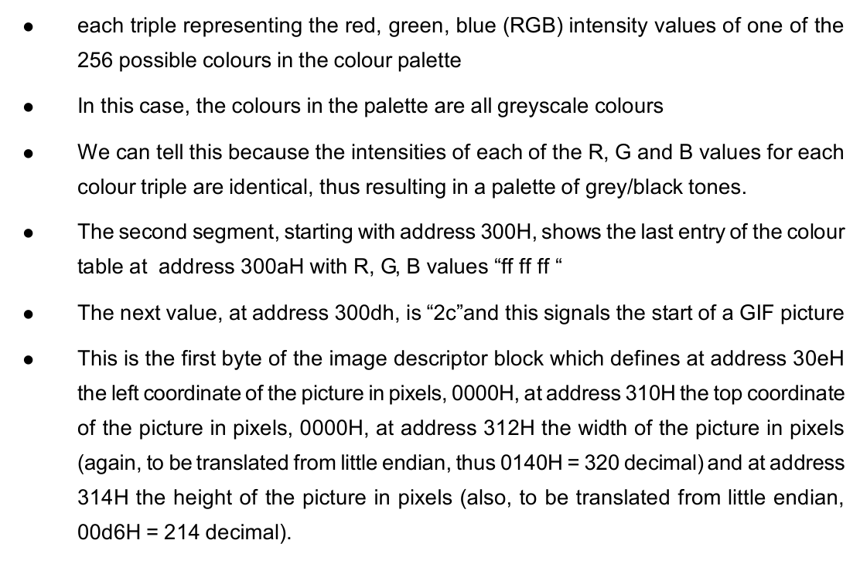
Graphic Formats
Basics of
Cyber Forensics

Slide 25
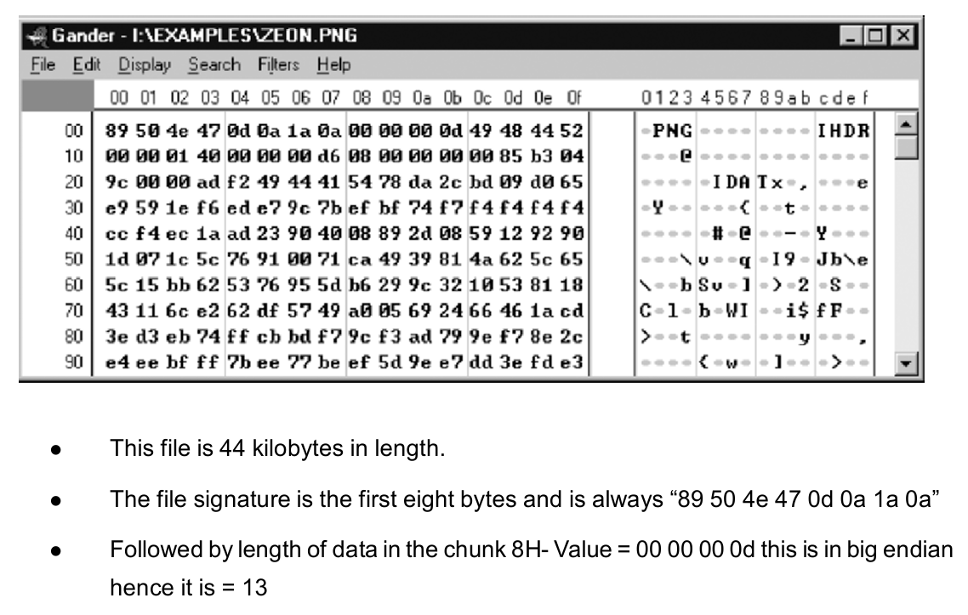
Portable Network Graphic
Basics of
Cyber Forensics

Slide 26
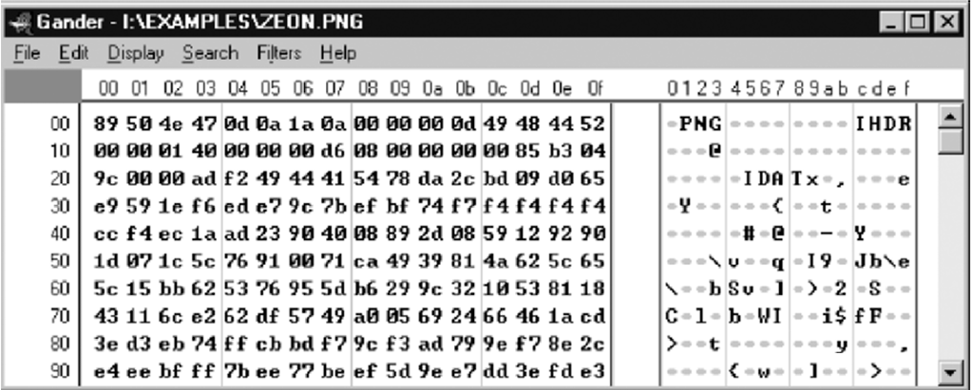
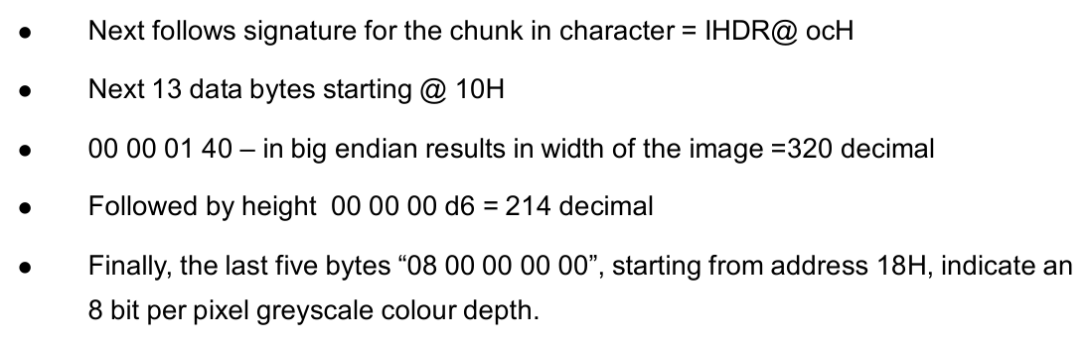
Portable Network Graphic
Basics of
Cyber Forensics

Slide 27
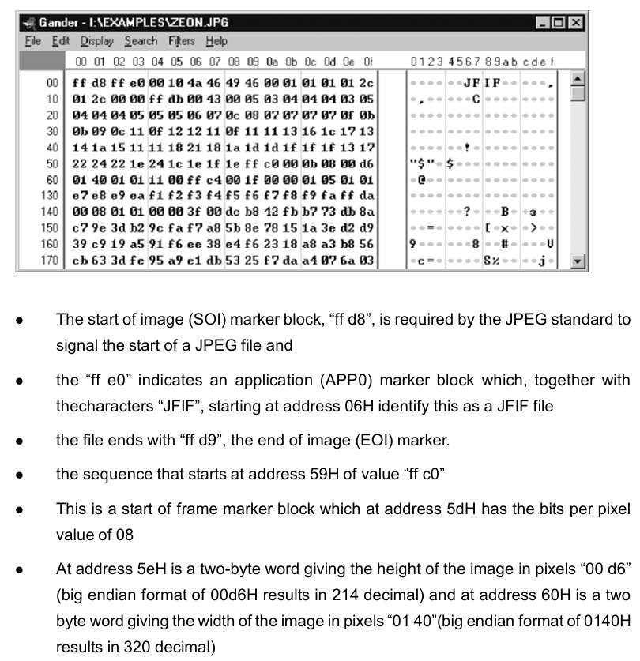
JPEG Compression
Basics of
Cyber Forensics

Slide 28
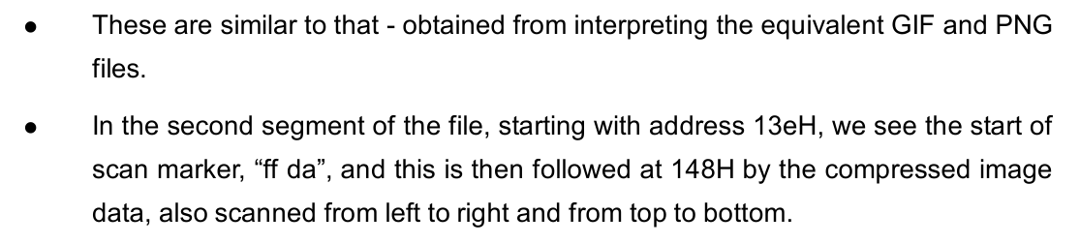
JPEG Compression
Basics of
Cyber Forensics

Slide 29
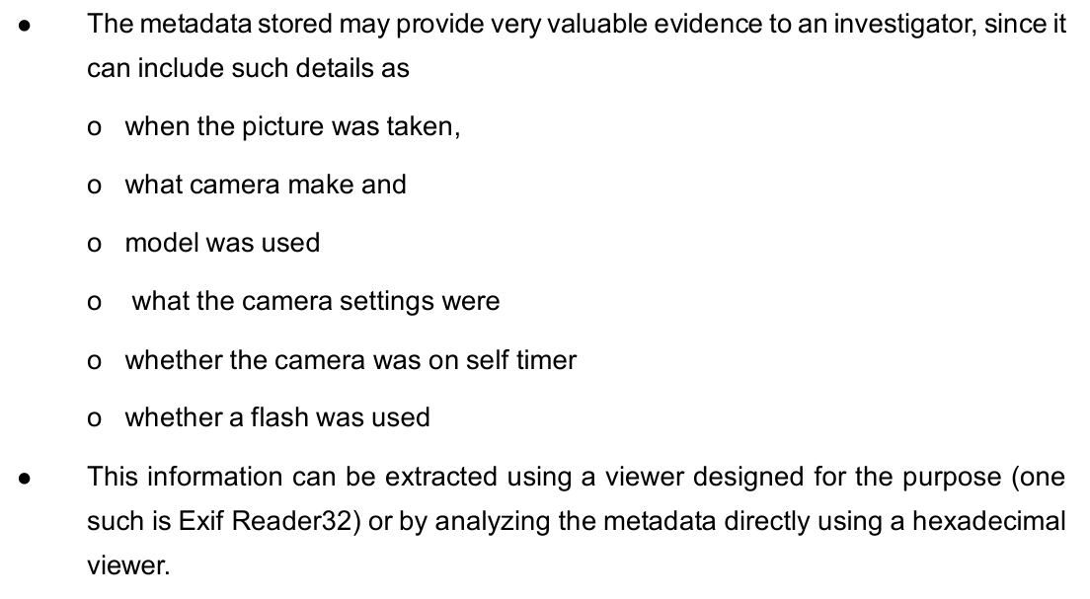
Exchangeable Image file Format
(ExIF)
Basics of
Cyber Forensics

Slide 30
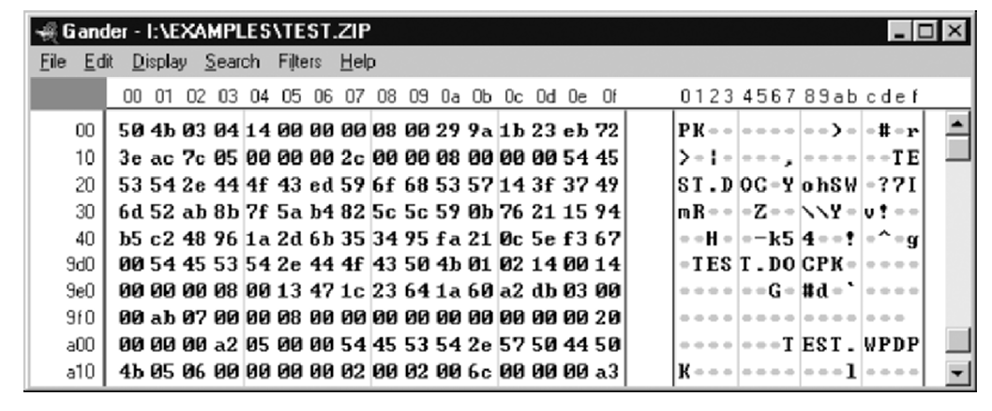
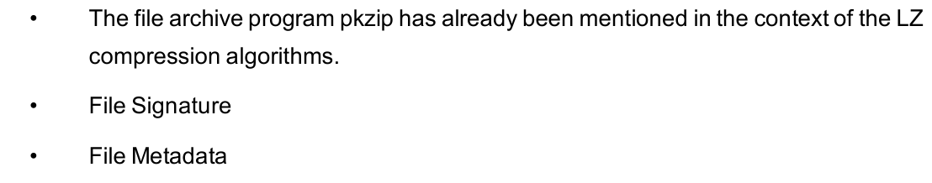
Archive Formats
Basics of
Cyber Forensics

Slide 31
File Header
Basics of
Cyber Forensics
The metadata contained in a file header are usually stored at the start of the file, but might be present in other areas too
Character-based files usually have character-based headers, whereas binary formats usually have binary headers
Used by software for reading or interpreting the file during the loading process and afterwards
Used by an operating system to quickly gather information about a file without loading it all into memory

Slide 32
File Magic Number
Basics of
Cyber Forensics
A short sequence of bytes (most are 2-4 bytes long) placed at the beginning of the file, used to identify the format of the file
Well-designed magic number test is a pretty sure sign that the file is either corrupt or of the wrong type
A valid magic number does not guarantee that the file is not corrupt or is of a correct type

Slide 33
File Checksum
Basics of
Cyber Forensics
The result of a hash function over the file contents
To verify the integrity of the file contents against transmission errors or malicious attacks
Included at the end of the file or in a separate file

Slide 34
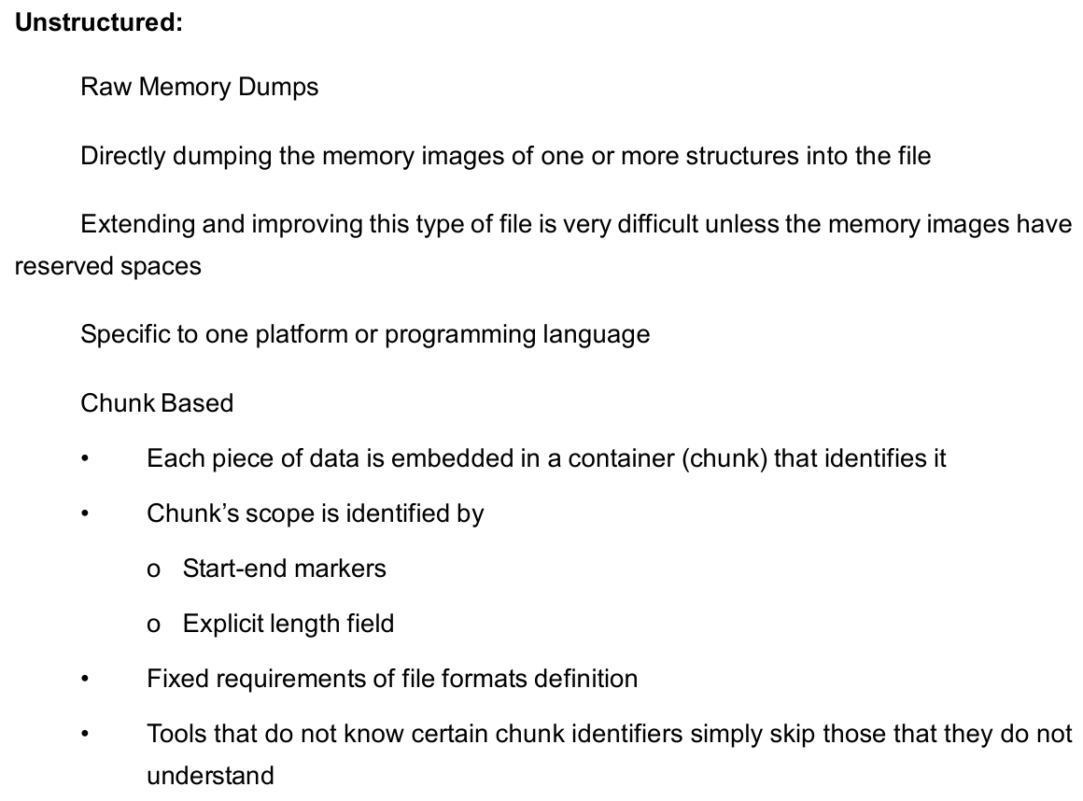
File Structure
Basics of
Cyber Forensics

Slide 35
Directory Based
Basics of
Cyber Forensics
Extensible format, that closely resembles a file system
File is composed of ‘directory entries’ that contain the location of the data within the file itself as well as its signatures
Example – Disk Images (.iso, .dmg)

Slide 36
Structure and Analysis of
Optical Media Disk Formats
Basics of
Cyber Forensics
Optical Media
An optical disc is designed to support one of three recording types: read-only (e.g.:CD and CD-ROM), recordable (write-once, e.g. CD-R), or re-recordable (rewritable, e.g. CD-RW).
Write-once optical discs commonly have an organic dye recording layer between the substrate and the reflective layer.
Rewritable discs typically contain an alloy recording layer composed of a phase change material, most often AgInSbTe, an alloy of silver, indium, antimony, and tellurium.

Slide 37
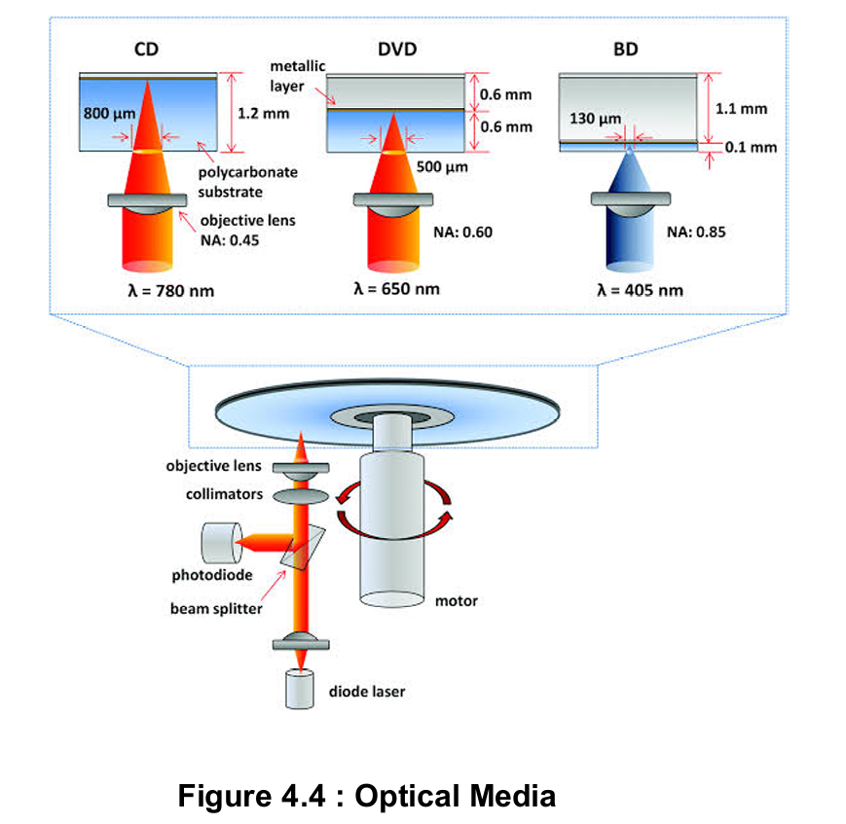
Structure and Analysis of
Optical Media Disk Formats
Basics of
Cyber Forensics
Optical discs are most commonly used for storing music (e.g. for use in a CD player), video (e.g. for use in a Blu-ray player), or data and programs for personal computers (PC)

Slide 38
Extraction of forensic artifacts
Basics of
Cyber Forensics
Recorder Identification of CD-R(W)
In 1995, the company Philips gave under the pressure of the music industry, represented by IFPI”, RIAA† and the RIAJ‡, in their”Orange Book” standard for recordable CDs a possible identification for the tracking of pirated content.
This Recorder Identification Code (RID) can be written in the Q-sectors of the individual songs or/and in the roll-in/out-blocks of the disc.
The RID code consists in 3 groups, including the following information: the manufacturer’s code, followed by the device type and unique serial number.

Slide 39
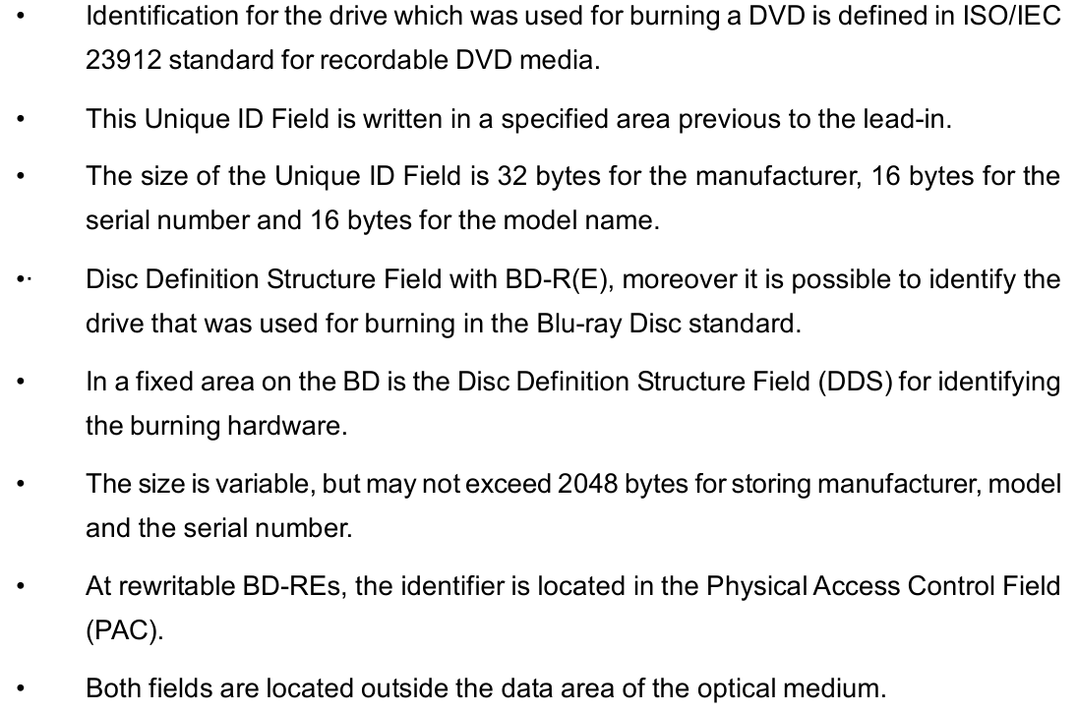
Unique ID Field of DVD-R(W)
Basics of
Cyber Forensics

Slide 40
File and MAC time analysis
Basics of
Cyber Forensics
The programs X-Ways Forensics, EnCase and FTK are very comprehensive tools for inspecting the file contents of the medium.
All these programs use file carving technologies, have filters for different file types and have possibilities for generating hash values. Interesting for a forensic investigation are the MAC times of the files.
X-Ways, EnCase and FTK provide this information in tabular form to the individual files.

Slide 41
The imaging process
Basics of
Cyber Forensics
The creation of forensic duplicates is a standard procedure in investigations of computer crime.
It was found that in opposite to the imaging process on hard drives, where the data of the unpartitioned space is taken up in the duplicate, only the data that containing between the border areas is copied in the duplicate.
The reason can be found in the fact that optical drives will be mounted just as logical drives in the system, however, as physical drives. The choice of the operating system was not relevant in this case.

Slide 42
The imaging process
Basics of
Cyber Forensics
The image generation under the operating systems Windows XP, Windows 7 and Linux (with the programs dump device (dd), Nero Burning Rom, FTK Imager, IsoBuster PRO, X-Ways and EnCase) took place and showed identical results.

Slide 43
Deleted media
Basics of
Cyber Forensics
This section examines the possibilities to reconstruct the contents of a deleted CD-RW, DVD-RW or BD-RE. Numerous tests were performed on this. Erased discs were checked for access under Mac OS, Linux and Windows 7.
None of the operating systems allowed direct access to the blank disc. The imaging process by using Windows and Linux broke with an error message.
The programs X-Ways, EnCase, FTK, IsoBuster PRO and CD/DVD Diagnostic found no data on the disk.

Slide 44
RID (CD)
Basics of
Cyber Forensics
Information can be examined about the used burning hardware on a CD.
To determine the Recorder Identification Code the open-source tool
The manufacturer’s code, the device type and the serial number could be found.
Often the serial number is 012345(hex). So only manufacturer and type are clearly ascertainable.

Slide 45
Understanding SSD Devices
Basics of
Cyber Forensics
A solid-state drive (SSD) is a solid-state storage device that uses integrated circuit assemblies as memory to store data persistently.
It is also sometimes called a solid-state device or a solid-state disk,although SSDs do not have physical disks.
SSDs can use traditional hard disk drive (HDD) interfaces and form factors, or newer form factors and interfaces that have been developed to address specific advantages of the flash memory technology used in SSDs.

Slide 46
Understanding SSD Devices
Basics of
Cyber Forensics
Traditional interfaces (e.g., SATA and SAS), and standard HDD form factors allow such SSDs to be used as drop-in replacements for HDDs in computers and other devices.
Working of SSD
An SSD is a larger, more complex device that aggregates pools of NAND flash storage, the type of storage also found in MP3 players and digital cameras. Unlike RAM, which doesn’t retain data when the machine shuts off, SSD flash memory is non-volatile, which means data is retained whether the device is powered on or not.

Slide 47
Understanding SSD Devices
Basics of
Cyber Forensics
With SSDs, every block of data is accessible at the same speed as every other block, no matter the location. This makes SSDs inherently faster than hard drives, where platters are spinning and drive heads are moving to the right location.
With HDDs, large files can be broken up and tucked into unused nooks and crannies of the drive, and data can be easily updated in place. This allows for efficient use of the total drive capacity.
On the other hand, scattered data obviously takes longer to locate, which is why defragmenting a hard drive has become a standard part of device maintenance.

Slide 48
Understanding SSD Devices
Basics of
Cyber Forensics
SDDs have a different and bigger problem – SSDs can only write to empty blocks. That’s okay when the SSD is new and all the blocks are empty.
But over time, as blocks get filled up, overwriting data becomes an issue, because the only way an SSD can update an existing page is to copy the contents of the entire block into memory, erase the block and then write the contents of the old block in addition to the new data.
If there are no empty blocks available, the SSD must scan for blocks marked for deletion, but not yet deleted, erase them, and then write the data to the now-erased page.

Slide 49
Understanding SSD Devices
Basics of
Cyber Forensics
Over time, as the SSD fills up, writing to the drive becomes more complicated and slower.
SSDs use a combination of methods to overcome this problem, including overprovisioning; wear leveling, a type of load balancing for flash cells; and garbage collection, a process that works in the background to delete stale files and optimize the available space, similar to the defrag function in HDDs.

Slide 50

Q & A
Basics of
Cyber Forensics
E.R. Ramesh, M.C.A., M.Sc., M.B.A.,
98410 59353, 98403 50547
rameshvani@gmail.com

