Slide 1


BFSI FRAUDS & COUNTERMEASURES
Sudhan Venu

Slide 2

Unit - IV
BFSI
Vulnerable areas in CBS and their exploitation
Core Banking System
Banking Overview
Conventional Bank Branch- setup – Traditional
Computerisation and Indian Banks
Drivers and options
TBA architecture computerisation and Indian Banks – options
Physical design CBS-Ovarian
General Ledger
CBS architecture Variations

Slide 3
Banking Overview
BFSI
Basic Banking - Accepting Deposits, Lending to Borrowers
Remittance Services - Draft (DD), Mail Transfer (MT) Telegraphic Transfer (TT)
Trade Finance
Bills – Collection, Purchase, Discount
Letter of Credit
Bank Guarantee
Safe Deposits and Lockers
Foreign Exchange Services
Investments and Treasury Operations
MIS And Statutory Reporting
Risk Management
Consultancy Services
Loan Syndication
Mergers And Acquisitions and Portfolio Management

Slide 4
Conventional Bank Branch - Set up - Traditional
BFSI
Multiple Counters – Dedicated Tasks
Strong Visual Monitoring
Each Staff Handles Only His/ Her Books
Easy to See Who is Accessing/ Doing What
Absent/ Former Staff Can Not Enter Transactions
Transactions go Through Multiple Hands
Easy Error Trapping

Slide 5
Computerisation & Indian Banks
BFSI
Reconciliation Applications
Rangarajan Committee Reports
First Report - ALPMs And Back Office Systems
Second Report - Branch Level LAN and Administrative Office – Data Processing Centres
MIS Applications
Consolidation of Branch Returns
Business Performance Tracking
Payroll Application
Personnel Inventory
Industrial Relations Issues - Slow Computerisation
Changes Started With
Railway Reservation – Customer Need
Liberalisation in Early 1990s
New Private Sector Banks

Slide 6
TBA Architecture Computerisation & Indian Banks - Options
BFSI
Typical Approach Adopted by Banks
Core Banking Solutions (CBS)
Centralised Database
Branches Linked to Central Data Centre (CDC)
Smaller Banks - Link All Branches
Larger Banks - CBS Co-Exists With Other Approaches
Single Vendor And Solution
Mandatory Modules
Customer Maintenance
Deposit Accounts
Loans and Trade Finance
Clearing, Collections, Remittances
General Ledger, Reports, Queries
Maintenance of Interest Rates, Charges

Slide 7
TBA Architecture Computerisation & Indian Banks - Options
BFSI
Additional Modules
Safe Deposits, Lockers, Inventory
Treasury Operations
Additional Features – Support For
Telebanking, Internet Banking, Mobile Banking
ATM Network
Customer Relationship Management
Client
Teller : browser or client/server
Customer : branch, ATM, POS, telephone, Internet; TV browser, PDA, mobile phone etc.

Slide 8
Physical Design CBS – Overview
BFSI
CBS Revolves Around Parameterisation
General Ledger
Products
Interest Calculation Methods
Service Charges
User Rights Management
Transaction Level Features
Interfaces to SWIFT, ATM, RTGS and so on

Slide 9
CBS Architecture Variations
BFSI
Single Central Database Approach - Finacle
Branch Server + Central Database - Flexcube, Bancs24
Cluster Approach
Branches Grouped Into Clusters
Clusters Connected to Central Server
CBS Variation – Cluster Approach
Branches Grouped into Geographic Clusters
Cluster Server at Hub Location (Mini-CBS)
Cluster Hubs Linked to Central Site
Central Server Maintains Aggregate Data
Transactions Across Branches Routed to Appropriate Cluster Server

Slide 10
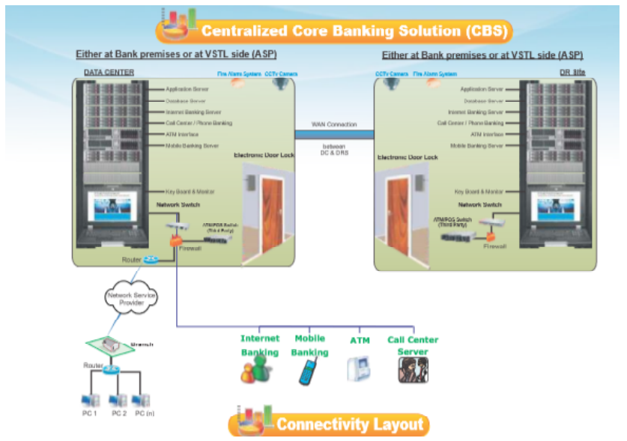
CBS Architecture
BFSI

Slide 11
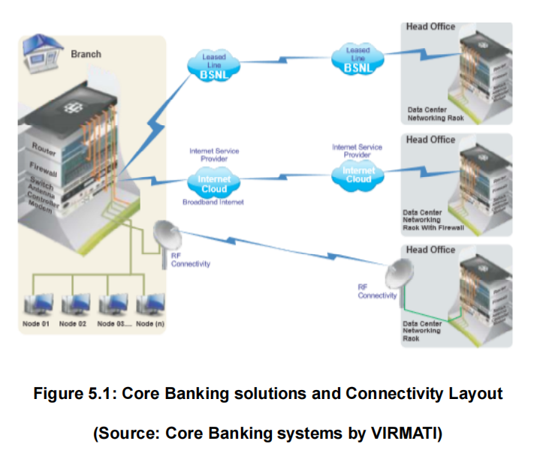
CBS Architecture
BFSI

Slide 12
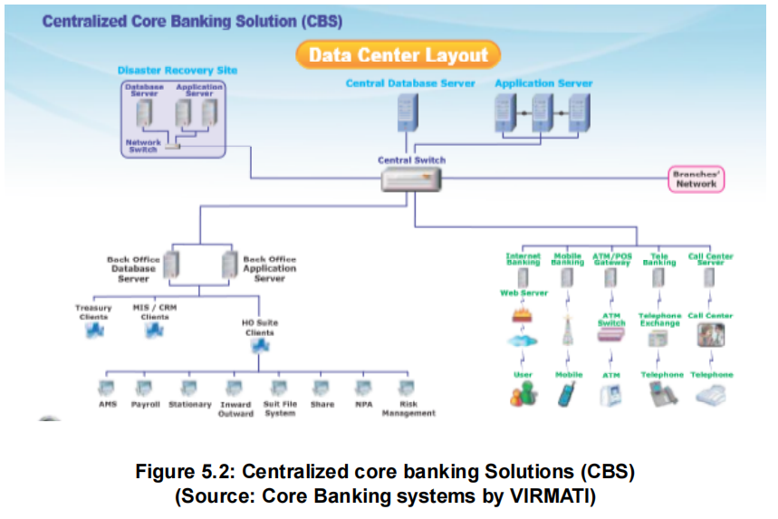
CBS Architecture
BFSI
The data centre Layout of centralized core Banking Solution (CBS) is illustrated in the following figure

Slide 13
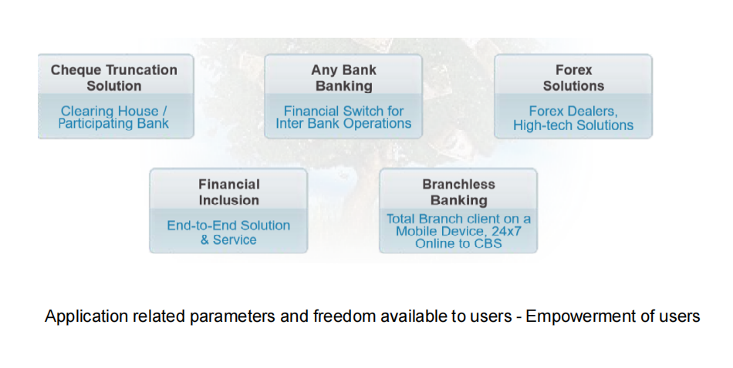
CBS Architecture
BFSI

Slide 14
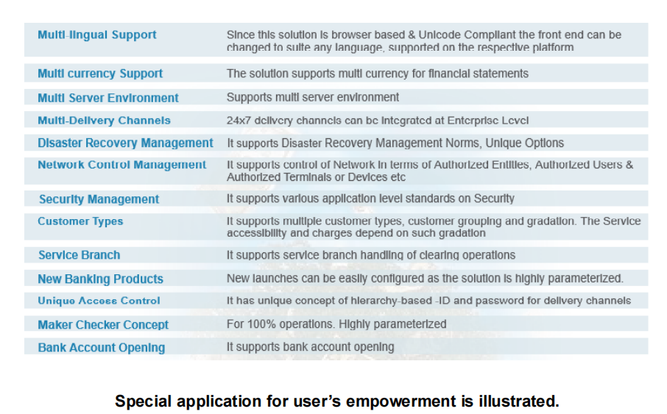
CBS Architecture
BFSI

Slide 15
Database Management
BFSI
Realtime update at both, primary and secondary database servers, using SQL mirroring/Oracle Guard
Support Storage area networks (SAN)
History of database for MIS
Platforms
CBS solutions is built on 3 tier architecture
It is browser based and compatible with IE, Netscape Navigator, Mozilla Firefox and so on.
Development tools are Microsoft ASPNET 2005, JavaScript and Business Object 11.5
The Application Server is IIS web Server on MS windows 2008
It is ODBC compliant and it can work with oracle or MS SQL

Slide 16
Unit - V
BFSI
Money Laundering and Anti Money Laundering
Stages of Money Laundering - Brief
Legal Acts Enacted
Cash Transactions in Money Laundering
Money Laundering Reporting Officers [MLRO]
Laundering Process
Money Laundering Process – Detailed
Banks Role in Laundering
Anti-Money Laundering Legal frameworks

Slide 17
What is Money Laundering
BFSI
Money laundering is the process of transforming the profits of crime and corruption into ostensibly “legitimate” assets
Money laundering is the process by which large amounts of illegally received money is given the appearance of having originated from a legitimate source.
money laundering has criminal dimensions related to black
It is the way to convert the black money into white money.
Money laundering must involve a predicate crime such as the violation of Indian Penal Code, IPC, Narcotics, Prevention of Corruption Act and Human Trafficking.
In India, stashing Black money a civil crime, while money laundering has criminal
dimensions related to black money.

Slide 18
Techniques of Money Laundering
BFSI
Hawala: Hawala is an alternative or parallel remittance system. It exists and operates outside of, or parallel to ‘traditional’ banking or financial channels.
Structuring deposits: Also known as smurfing, this method entails breaking up large amounts of money into smaller, less-suspicious amounts.
Third party cheques: Utilizing counter cheques or banker’s drafts drawn on different institutions and clearing them via various third-party accounts. Third party cheques and traveler’s cheques are often purchased using proceeds of crime.
Credit Cards – Clearing credit and charge card balances at the counters of different banks. Such cards have a number of uses and can be used across international borders.

Slide 19
Causes of Money Laundering
BFSI
No deals for sharing tax information with other countries
Availability of instant corporations
Corporate Secrecy Laws – as the corporate law of certain countries enables launderers to hide behind shell companies.
Excellent Electronic Communication
Tight Bank Secrecy Laws
A Government that is Relatively Invulnerable to Outside Pressures
A high degree of Economic Dependence on the Financial Services Sector
A Geographical Location that Facilitates Business Travel to and from rich neighbors.

Slide 20
Harmful effects of Money Laundering
BFSI
Terrorism:
Money Laundering serves as an important mode of terrorism financing. Terrorists have shown adaptability and opportunism in meeting their funding requirements.
Threat to banking system:
Across the globe, banks have become a major target of Money Laundering operations and financial crime because they provide a variety of services and instruments that can be used
to conceal the source of money.

Slide 21
Harmful effects of Money Laundering
BFSI
Threat to economic and political stability:
The infiltration and sometimes saturation of dirty money into legitimate financial sectors and national accounts can threaten economic and political stability.
Thus money laundering is an activity which is capable of corrupting a chain of financial institution.
money laundering is an activity which is capable of corrupting a chain of financial institution

Slide 22
Regulation of Money Laundering in India
BFSI
Threat to economic and political stability:
With its growing financial strength, India is vulnerable to money laundering activities even though the country’s strict foreign exchange laws make it difficult for criminals to launder money.
International Narcotics Control Strategy Report by Bureau for International Narcotics and Law Enforcement Affair emphasizes India’s Vulnerability to money-laundering activities.

Slide 23
Regulation of Money Laundering in India
BFSI
Threat to economic and political stability:
The report highlighted India’s emerging status as a regional financial center, its large system of informal cross-border money flows, and its widely perceived tax avoidance roblems all contribute to the country’s vulnerability to money laundering activities.
Some common sources of illegal proceeds in India are narcotics trafficking, illegal trade in endangered wildlife, trade in illegal gems (particularly diamonds), smuggling, trafficking in persons, corruption, and income tax evasion. Because of India’s geographical location between the heroin-producing countries of the Golden Triangle and Golden Crescent, India continues to be a drug-transit country

Slide 24
Regulation of Money Laundering in India
BFSI
Solutions:
More strict laws related Anti-money laundering is necessary because money laundering tends to corrupt even the most professional players in the market.
There is a need to sensitize the Private Sector about their role in anti-money laundering activities
Continuous up-gradation and dissemination of information is necessary
There is a need to build a balance between financial confidentiality and this confidentiality turning to a money-laundering haven.

Slide 25
Global steps to counter money laundering problem
BFSI
International efforts to combat money laundering: International regimes attempt to monitor or regulate international relations and activities. By establishing norms, rules, and procedures agreed to in order to regulate money laundering, international regime reduce the disparities between divergent legal systems.
United Nations Convention against illicit traffic in Narcotic Drugs and psychotropic substances:
India’s urgent need to control drug trafficking reflects growing awareness within the international community that drug trafficking and money laundering must be suppressed. The United has played an integral role in the global community’s fight against illicit drug trafficking and money laundering.

Slide 26
Global steps to counter money laundering problem
BFSI
Financial Action Task force on money laundering: Intergovernmental groups have also taken action against the rising levels of global money laundering. The task force was
created by G-7 countries to curb the occurrence of money laundering.
Basel Committee Minimum standards: The Basle committee on Banking regulations and supervisory practices consists of officials from the central banks and supervisory authorities
of eleven major industrialized nations and Luxembourg. In 1998, the committee adopted a statement of principles that targeted money laundering.

Slide 27
Laws related to money laundering
BFSI
The Prevention of money Laundering Act 2002(PMLA):
It comes into force in 2005.
It defines money laundering offence and provides for the freezing, seizures and confiscation of the proceeds of crime.
The provisions of this act are applicable to all financial institutions like banks, mutual funds, insurance companies, and their financial intermediaries.
The agency monitoring the anti-Money laundering activities in India is the Financial Intelligence Unit (FIU-IND). The agency is responsible for coordinating and strengthening efforts of national and international intelligence, investigation and enforcement agencies in pursuing the global efforts against money laundering and related crimes.
According to the act, there can be punishment of imprisonment upto 3-7 years with fine upto 5 lakh rupees. But in case of offences done under Narcotic Drugs and Psychotropic Substance Act 1985, maximum punishment is extent to 10 years rather than 7 years.

Slide 28
Laws related to money laundering
BFSI
The Prevention of money Laundering Act 2002(PMLA):
Section 3 of the Prevention of Money Laundering Act, 2002 (PMLA) has defined the“offence of money laundering”as under:
“Whosoever directly or indirectly attempts to indulge or knowingly
Assists or knowingly is party or is actually involved in any proces
Or activity connected with the proceeds of crime (including its Concealment, possession, acquisition or use ) and projecting or Claiming it as untainted property shall be guilty of offense of Money laundering”.
Money launders use the banking system for cleansing ‘dirty money’ obtained from criminal activities with the objective of hiding/disguising its source. The process of money laundering usually creating a web of financial transactions so as to hide the origin and true nature of these funds.

Slide 29
Laws related to money laundering
BFSI
The Prevention of Money Laundering (Amendment) Act 2012:
The act was enacted in 2002, but was amended thrice, first in 2005, then in 2009 and then 2012.
PMLA (Amendment) Act, 2012 has enlarged the definition of money laundering by including activities such as concealment, acquisition, possession and use of proceeds of crime as criminal activities.
The amendment has introduced the concept of Corresponding law to link the provisions of Indian law with the laws of foreign countries and to provide for transfer of the proceeds of foreign predicate offence committed in any manner in India.
It also introduced the concept of ‘reporting entity’ which would include a banking company, financial institution, intermediary or a person carrying on a designated business or profession.

Slide 30
Laws related to money laundering
BFSI
The Prevention of Money Laundering (Amendment) Act 2012:
The amendment act has removed this upper limit of fine which was levied by 2002 act
The act has provided for provisional attachment and confiscation of property of any person (for a period not exceeding 180 days).
The act has delegated the powers upon the Director to call for records of transactions or any additional information that may be required for the purposes of investigation.
The government needs to step in to expedite a probe into what could be a massive money laundering exercise. This will help in better results than waiting for millions of missing investors to turn up.

Slide 31
Stages of Money layndering in Brief
BFSI
PLACEMENT: This is first stage of money laundering. In this stage the cash, generated in stages the cash, generated in small unrecognizable quantity, through illegal or money laundering activities is place into the financial system.
LAYERING: while transferring funds, instead of ‘straight’ transfers from one point to another, a complex series of transfers are made. Layering ultimately conceals or obliterates the source of funds, the nature of funds and/or their ownership
Benami – Syndicate etc

Slide 32
Stages of Money layndering in Brief
BFSI
STRUCTURING: keeping the amounts lower than that fixed for reporting and building up similar transactions till the amount placed to be laundered. For example transaction in cash below Rs.10.00 lakh (to avoid CTR), making Demand Draft below Rs.50,000 /- (to avoid giving PAN no), planning maturity value of TDR below Rs.20,000 /- to have payment only in cash
INTEGRATING: This is the stage where tainted money eventually merges, quietly, into the legitimate economic and financial systems as ‘clean’ money. The tainted money assumes a legitimate look at this stage.

Slide 33
Legal Acts Enacted
BFSI
Government of India along with Reserve Bank of India are the central agencies monitoring and issuing guidelines, instructions to counter money laundering activities.
PMLA:
The prevention of Money laundering Act, 2002 (PMLA) enacted to combat money laundering and financing of terrorism.
Enacted on 17th Jan, 2003
Brought into force from 1st July, 2005
Administered by:
Financial intelligence unit (FIU) for verification of identity of client, maintenance of records and reporting
Enforcement Directorate (ED) for investigation of and prosecution for money laundering offenses.
Finance Action Task Force Inter-governmental body having 36 Member countries.

Slide 34
Legal Acts Enacted
BFSI
Financial action Task Force (FATF)
FATF has classified countries into High, Medium & Low Risk based on deficiencies in AML/CFT guidelines.
A few examples of High Risk countries: - Iran, North Korea, Indonesia, Myanmar, Algeria, Pakistan, Iraq, Afghanistan, Argentina etc.
Medium Risk countries – India, United Kingdom, Japan, Germany, France.
Low Risk countries – Norway, Finland, Sweden, New Zealand, Denmark

Slide 35
Cash/Transactions in Money Laundering
BFSI
Nobody knows the ownership of cash. Source of cash not known – Anonymity; cash changed hands is not known; changing form of cash (gold, etc.). Counterfeit currency notes are in circulation.
Transactions in accounts of customer and non-customers are another case for money laundering.
Large and multiple transactions and frequency of such transactions between accounts and multiple accounts are other forms of money laundering.
To counter such nefarious actions, Banks have to maintain records, furnish information, and verify identity of customers and report of financial intelligence unit – India (FIU-IND) besides their own Head Office through a specially appointed top management official designated as “Principal Officer”

Slide 36
Money laundering reporting officers (MLRO)
BFSI
This term (usually abbreviated to MLRO) is used to describe the nominated officer appointed under Regulation 20(2)(d) of the 2007 Regulations and as referred to in Section 331 Proceeds of Crime Act 2002(POCA).
Why have an MLRO?
Regulation 20(2)(d)(i) requires that all businesses within the regulated sector must have a nominated officer to receive Disclosures under Part 7 of POCA and the Terrorism Act, and to make disclosures to the Serious Organised Crime Agency (SOCA)
Regulation 20(3) provides that there is no requirement to have a nominated officer in the regulated sector if you are an individual who provides regulated services but do not employ any people or act in association with anyone else.

Slide 37
Money laundering reporting officers (MLRO)
BFSI
Who should be an MLRO?
The role of the MLRO carries significant responsibility and should be undertaken by an appropriately experienced individual.
An MLRO should be of sufficient seniority to make decisions on reporting which can impact a business’s relations with its clients and its exposure to criminal, civil, regulatory and disciplinary sanctions. They should also be in a position of sufficient responsibility to enable them to have access to all of the business’s client files and business information to enable them to make the required decisions on the basis of all information held by the business.
Businesses authorised by the Financial Conduct Authority (FCA) (one of the successors to the Financial Services Authority) will need to obtain the FCA’s approval to the appointment of the MLRO as this is a controlled function under section 59 of the Financial Services and Markets Act 2000.

Slide 38
Money laundering reporting officers (MLRO)
BFSI
Role of the MLRO?
An MLRO is responsible for ensuring that, when appropriate, the information or othe matter leading to knowledge or suspicion, or reasonable grounds for knowledge or suspicion of money laundering is properly disclosed to the relevant authority. The decision to report, or not to report, must not be subject to the consent of anyone else. The MLRO will also liaise with SOCA or law enforcement on the issue of whether to proceed with a transaction or what information may be disclosed to clients or third parties.
The size and nature of some businesses may lead to the MLRO delegating certain duties regarding the business’s anti-money laundering/counter terrorist financing obligations. Delegation does not relieve the MLRO of responsibility. In some large businesses, one or more permanent deputies of suitable seniority may be appointed. The reporting channels should be well known to all relevant employees.

Slide 39
Money laundering reporting officers (MLRO)
BFSI
All businesses will need to consider arrangements for temporary cover when the nominated officer is absent.
MLRO’s may also take responsibility for:
Training within the business
Advising on how to proceed with work once an internal report and/or SAR has been made in order to guard against risks of tipping off or prejudicing an investigation
The design and implementation of internal anti-money laundering systems and procedures
If this role is not undertaken by the MLRO, these responsibilities should be taken on by another sufficiently senior and skilled person within the business. This person should work closely with the MLRO.

Slide 40
Money laundering reporting officers (MLRO)
BFSI
Money Laundering Reporting Officer MLRO Every practice should have a ‘nominated officer” officer or a Money Laundering Reporting Officer (MLRO) as provided for by Part 7 of the Proceeds of Crime Act 2002 or Part 3 of the Terrorism Act 2000.
Regulation 20 of the 2007 Regulations require this person to be appointed, to have procedures where staff make internal suspicious activity disclosures to the MLRO and a defined policy for the MLRO to consider any such internal reports to determine if a SAR should be made. A breach of regulation 20 can result in an offence (regulation 45).
The presence of an appointed MLRO ensures that the direction of AML/CTF policy is centralised and that submissions to NCA or the relevant Financial Intelligence Unit (FIU) are consistent.

Slide 41
Money laundering reporting officers (MLRO)
BFSI
Internal systems and policies:
The MLRO should have a degree of seniority and authority within the business to drive policy decisions and actions. He/she should have undergone sufficient level of training and hold suitable qualifications and experience. Arrangements should be in place for when the MLRO is absent.
In conjunction with the senior management if applicable, the MLRO should oversee the implementation and adherence to risk based policies and processes on: a) customer due diligence and ongoing monitoring, b) reporting processes, c) keeping of records, d) internal controls, e) practice AML/CTF risk assessment, f) training of staff, g) communication of ML/TF policy and issues within the business.

Slide 42
Money laundering reporting officers (MLRO)
BFSI
The MLRO’s duties include establishing an internal AML/CTF policy which will set out on record how all risks considered in the practice AML/CTF risk assessment, surrounding clients, services, locations served and delivery channels, are managed. (See CCAB Guidance, para.
The MLRO should ensure that the practice AML policies are recorded and monitored for effectiveness. The risk assessment of the business should be conducted by the MLRO and they have responsibility for monitoring internal compliance and effectiveness of controls.
The MLRO should work with management to ensure that the training provided to staff is suitable for the practice on a risksensitive basis.

Slide 43
Money laundering reporting officers (MLRO)
BFSI
Evaluation of internal reports
Sections 327-329 of POCA 2002 outline the MLRO’s responsibilities surrounding disclosures where there are suspicions or knowledge of specific offences around ML/TF.
A decision by the MLRO not to report externally must be documented and have sufficient reason and detail outlined describing how the decision was made. The details of this should be filed separately from the actual client file to ensure the client is not tipped-off accidentally.
If the practice has already carried out an act for a client without realising that the act could amount to a money laundering offence, the MLRO should immediately make an authorised disclosure under POCA.

Slide 44
Money laundering reporting officers (MLRO)
BFSI
Evaluation of internal reports
The MLRO should ensure that once a SAR is submitted with a request for consent that the practice does not do the act in question until the notice period has elapsed (i.e. 7 working days from day after SAR is made).
If consent to act is refused by the NCA or relevant FIU, the MLRO must wait until the ‘moratorium period’ has elapsed which is a period of 31 days starting with the day on which the person receives notice that consent to the doing of the act is refused.
Where consent is received or refused the NCA or relevant FIU will communicate this to the MLRO and it is the duty of the MLRO to ensure that the staff or officers act accordingly.

Slide 45
Money laundering reporting officers (MLRO)
BFSI
Case Scenario:
The Sahara Group’s case calls for a thorough probe to reveal all its money laundering dimensions.
It has been about five years since the Supreme Court ordered the Sahara Group, led by Subrata Roy, to refund money that it borrowed investors without sufficient regulatory clearance.
The Securities and Exchange Board of India, was tasked by the apex court to oversee the actual transfer of money from the Sahara Group to investors.
The total amount, including interest on the initial principal, that need to be refunded to investor has bulged to about Rs 40,000 crore.

Slide 46
Money laundering reporting officers (MLRO)
BFSI
Of this, SEBI has received an aggregate amount, including interest earned on deposits, of about Rs 14,487 crore from the Sahara Group.
As per the SEBI’s latest annual report, on March 31, 2017 only about Rs 85.02 crore,
including interest of about Rs 38.05 crore, of this amount has actually been returned to investors.
The Group failed to satisfy the apex court’s request to provide evidence of the source of funds used to make the claimed return payments.
The Enforcement Director began proceeding in 2014 against the Sahara Group under the prevention of money laundering act.

Slide 47

Q & A
BFSI
Sudhan Venu
9176332725 sudhanvenu@gmail.com

