Slide 1
M.Sc. - Cyber Forensics & Information Security
SESSION ON
BFSI FRAUDS & COUNTERMEASURES

Slide 2
INSURANCE
INSURANCE
What for Insurance?
An arrangement by which a Company undertake to provide a guarantee of compensation for specified loss, damage, illness, or death in return for payment of a specified premium.
The Concept is mainly on Uberrima fides (sometimes seen in its genitive form uberrimae fidei) is a Latin phrase meaning "utmost good faith" (literally, "most abundant faith"). It is the name of a legal doctrine which governs insurance contracts.
Parties to the Insurance
Insurer (Insurance Company)
Insured (Policy Holder)

Slide 3
INSURANCE
TYPES OF INSURANCE
Life Insurance
Life (Whole Life) and Endowment or various types with various options introduced. Financial related
General Insurance or Non-Life Insurance
Insurance for Vehicle, Automobile, Machineries, Buildings and Property etc.
Health Insurance – Individual Policies & Group Policies (Apart from Insurer and Insured one more intermediary is there i.e., TPA – Third Party Administrator
General Insurance is for Loss suffered - Indemnity & Third Party Coverage, Accident Self, Vehicle and other additional features

Slide 4
INSURANCE
Types of Insurance Fraud
Life Insurance Fraud
Life insurance fraud may involve faking death to claim life insurance. Fraudsters may sometimes turn up a few years after disappearing, claiming a loss of memory.
Health Insurance Fraud
Health insurance fraud is described as an intentional act of deceiving, concealing, or misrepresenting information that results in health care benefits being paid to an individual or group. Fraud can be committed either by an insured person or by a provider. Member fraud consists of claims on behalf of ineligible members and/or dependents, alterations on enrollment forms, concealing pre-existing conditions, failure to report other coverage, prescription drug fraud, and failure to disclose claims that were a result of a work-related injury.

Slide 5
INSURANCE
Types of Insurance Fraud
Automobile Insurance Fraud
Fraud rings or groups may fake traffic deaths or stage collisions to make false insurance or exaggerated claims and collect insurance money. The ring may involve insurance claims adjusters and other people who create phony police reports to process claims.
Property Insurance Fraud
Possible motivations for this can include obtaining payment that is worth more than the value of the property destroyed, or to destory and subsequently receive payment for goods that could not be otherwise sold.

Slide 6
FRAUDS
Fraud
Fraud means action or lack of action to gain benefit through intentional deception, cheating and stealing. Fraud occurs under two major categories. They include:
Transaction Frauds
This happens through fraudulent claim or conversion of an underwriting of company’s assets to ones personal use such as assets misappropriation.
Statement Frauds
This involves intentional misstatement of some financial values to affect the appearance of books, profits/result or value of asset/ liability to deceive shareholders, lenders etc.

Slide 7
FRAUDS
Fraud
White collar crime
When a person, employed by an undertaking in a position of trust, breaches such trust, beyond delegated powers with intention to cheat it is known as white collar crime.
(Please refer the figure 7.1 represents various factors causing the frauds & why do frauds occur are explained in figure 7.2) (Page 195 of the Booklet)

Slide 8
FRAUDS
7.2 Methods of computer related frauds
Manipulation of computer inner working by modification of programs
Offline changing in the back office of computer output
LAN system operated as stand alone
Theft of business secrets from computer files
Alteration of data already entered in the computers
Systems have fudge facility that allows errors to be corrected
Entering of false data into computers which would give false outputs
Data espionage through remote access
Theft of intellectual property rights stored in computer systems

Slide 9
FRAUDS
7.3 Scope of computer related Frauds
Variety of software/frequent upgradation
Lack of checks on veracity of programs
Absence of technical knowledge/understanding on computer system working
Non-use of analysis, statistics, ratio compatibility provided by the software
Non-compliance of systems instructions
Non-monitoring of audit trails

Slide 10
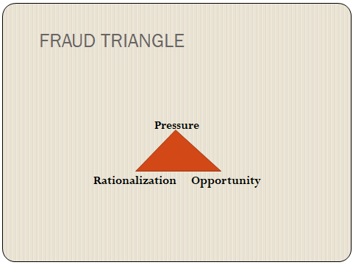
FRAUDS
FRAUD TRIANGLE

Slide 11
FRAUDS
The three factors that make up the fraud triangle are:
Pressure: Most individuals require some form of pressure to commit a criminal act.
Rationalization: The mind-set of a person about to commit an unethical act is one of rationalization.
Opportunity: An opportunity to commit the act must be present.

Slide 12
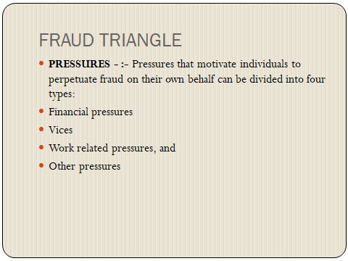
FRAUDS

Slide 13
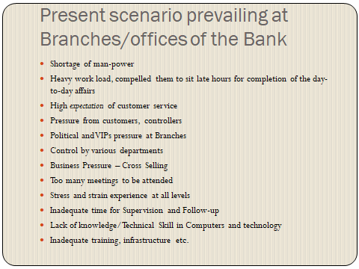
FRAUDS
Present Scenario at Financial Institution

Slide 14
FRAUDS
Rationalization
But rationalization is a psychological state that is very difficult to see. Further, it can be very common - we all rationalize from time to time. Professor Pamela Murphy has studied this mental component of fraud and concluded that many of us - may be most of us - are capable of rationalizing fraud under the right circumstances.
Just as a fraud is committed in secrecy, so the “reason” for it is kept secret. Sharing it with others would risk exposing the perceptions underlying the rationalization and make it impossible to keep them. By the same token, the rationalization side of fraud is very difficult to detect and prevent.
The internal dialogue that comforts perpetrators and lets them know it is OK to do this for whatever reason.
This kind of rationalization, particularly on something small, is just the sort of thing that can get the snowball of inappropriate behaviour rolling. This is a case of a non-financial fraud – misuse of property and equipment – but most financial frauds start out with something small like this too.
Often they start out with the perpetrator observing what their boss is doing and then patterning that behaviour.

Slide 15
FRAUDS
What are some common factors that provide opportunities for fraud?
Many factors provide opportunities for fraud including the inability to judge the quality of performance; failure to discipline fraud perpetrators; lack of access to information; ignorance, apathy, and incapacity; and lack of an audit trail.
Things that one can avoid fraud – not giving opportunity to the fraudsters from the point of view of individuals
Spot imposters
Do online searches
Don't believe your caller ID
Don't pay upfront for a promise
Consider how you pay
Talk to someone
Hang up on robocalls
Be skeptical about free trial offers
The above points to be given due consideration when forensic audit is undertaken.

Slide 16
FRAUDS
What is the difference between Forensic Auditing and Internal Auditing?
A Forensic Audit/examination is designed to focus on reconstructing past financial transactions for a specific purpose, such as concerns of fraud, whereas an internal audit is typically focused more on compliance and/or the performance of the organization.
On the other hand, an Organization may need a forensic Audit/examination if:
Suspicions of fraud or theft arise.
Turnover has occurred and account balances are not what they should be (positively or negatively).
Accounts that were thought to be in your entity’s name are not really owned by your entity.
Reconciliation procedures result in timing differences or unidentified differences, or they don’t reconcile at all.
Vendors that should have been paid have not been paid, and/or customers that should have paid have not.
Theft of personally identifiable information has occurred or business systems have been hacked.

Slide 17
FRAUDS
What is the difference between Forensic Auditing and Internal Auditing? contd….
Labour and materials have resulted in poor quality products that are not selling (or worse, are out of compliance with laws and regulations).
A whistle-blower hotline identified issues such as assets stolen or other defalcations (theft, misappropriation, plunderage, thievery, peculation, thieving, larceny, stealing, raid, embezzlement, misapplication).
While some matters require both a forensic audit/examination and an internal audit, the key to determining which service to use is to determine the time and objectives of the project(s). A forensic audit/examination is designed to focus on reconstructing past financial transactions for a specific purpose, such as concerns of fraud, whereas an internal audit is typically focused more on compliance and/or the performance of the organization.

Slide 18
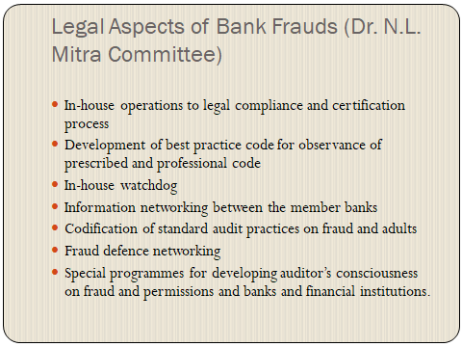
FRAUDS
Forensic Auditors to go through whether the following aspects are observed by the Organisation:

Slide 19
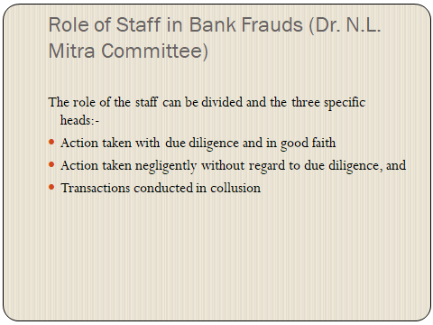
FRAUDS
Forensic Auditors to go through whether the following aspects are observed by the Organisation:

Slide 20
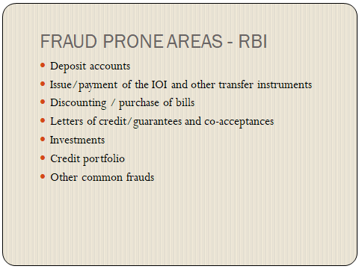
FRAUDS
Fraud Prone Areas as stated by the Regulator:

Slide 21
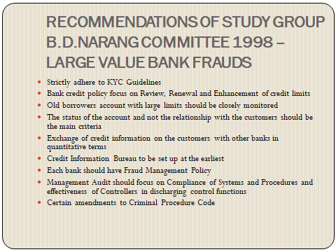
FRAUDS
Fraud Prone Areas as stated by the Study Group on Large Value Bank Frauds:

Slide 22
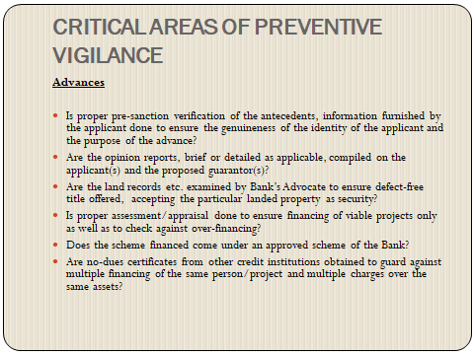
FRAUDS
CRITICAL AREAS – ADVANCES RELATED

Slide 23
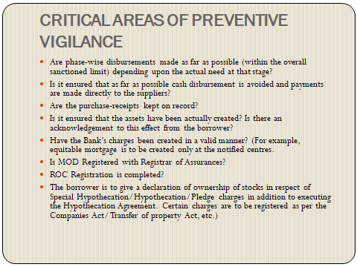
FRAUDS
CRITICAL AREAS – ADVANCES RELATED

Slide 24
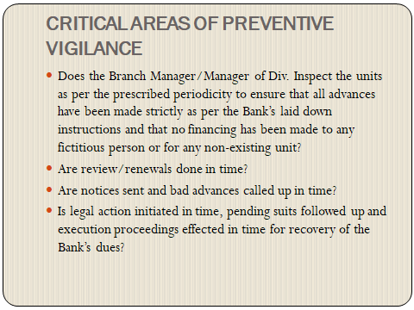
FRAUDS
CRITICAL AREAS – ADVANCES RELATED

Slide 25
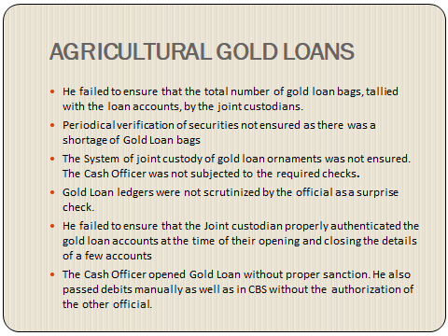
FRAUDS
CRITICAL AREAS – ADVANCES RELATED

Slide 26
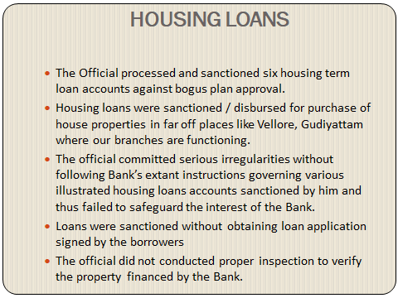
FRAUDS
CRITICAL AREAS – ADVANCES RELATED

Slide 27
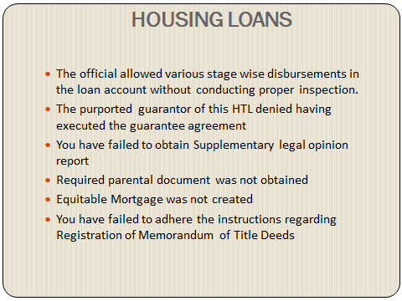
FRAUDS
CRITICAL AREAS – ADVANCES RELATED

Slide 28
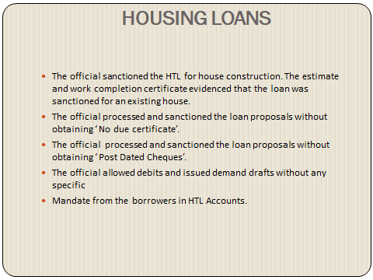
FRAUDS
CRITICAL AREAS – ADVANCES RELATED

Slide 29
FRAUDS
LATEST ONLINE FRAUDS
Greeting card scams
Lottery scam
Hitman scam
West African Scam or Nigerian Scam
Sweepstakes Scam
Bank loan or Credit Card Fraud
Auction Fraud
Investment Fraud
Work-at-Home Scam

Slide 30
FRAUDS
LATEST ONLINE FRAUDS
Online Dating Scam or ‘Catfishing’ Scam
Identity Theft - Using malware or computer intrusion techniques, cybercriminals steal personally identifiable information to assume someone else's identity.
Fake antivirus software
Phishing email scam

Slide 31
FRAUDS
FRAUDS AT VARIOUS PLACES
At Branches: Customer, Non Customer, Insider, Collusion with an outsider or gang – Various areas may be covered
At ATM: Customer, Non Customer, Insider, Tech Experts
At POS: Debit Card, Credit Card, Merchant Establishments, Fradulant staff at the Establishments, Outsider
Net Banking: Worms, unwarranted links, online purchases, OTP related, cypher cafes, Open Source wifi
Pishing, Smear Pishing, Vishing, Telecom Frauds etc.
At Organisation level

Slide 32
THANK YOU ALL
BY
SUDHAN VENU

