Slide 1
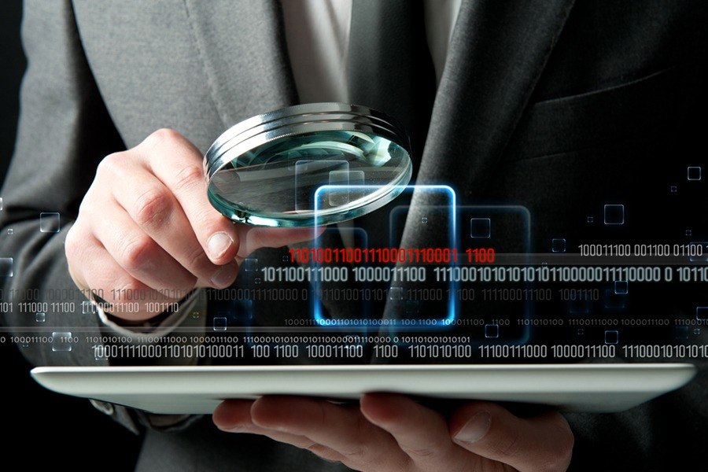
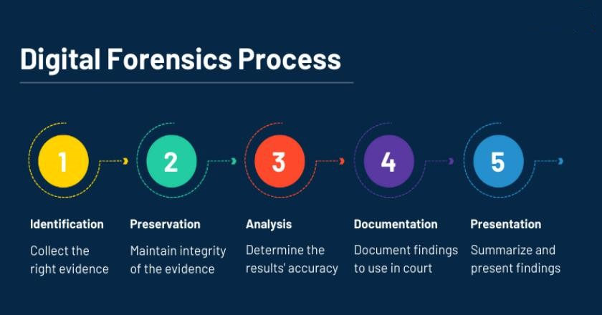
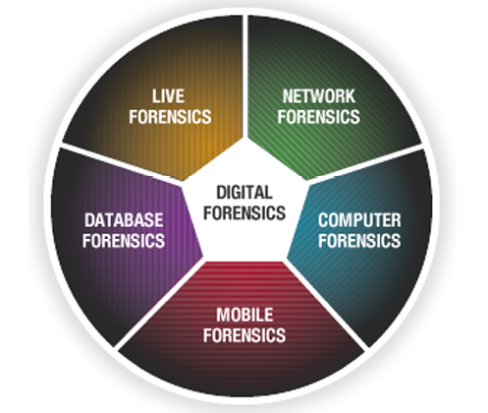


Basics of Cyber Forensics
E.R. Ramesh, M.C.A., M.Sc., M.B.A.,

Slide 2

Basics of
Cyber Forensics
Unit - 1
Digital Investigation
Digital Evidence and Computer Crime
History & Terminology of Computer Crime Investigation
Technology and Law
The Investigative Process
Investigative Reconstruction
Modus Operandi
Motive and Technology
Digital Evidence in the Courtroom

Slide 3
Digital Evidence and Computer Crime
Basics of
Cyber Forensics
Crime is as old as mankind. Crime is as old as humankind. Most crimes leave behind traces of “silent evidence”.
The traces of materials, known as physical evidence, are found at the scene of crime and acts as potent clues that become the most eloquent witness subsequently.
Evidence that is conspicuously found in the crime scene be it dust, pollens, bloodstain, bullet, glass, paint, hair, ash and the like serves as silent speakers of truth.
These materials as such can become valuable pieces of evidence in the hands of forensic scientists who seek truth and nothing but truth.

Slide 4
Digital Evidence and Computer Crime
Basics of
Cyber Forensics
The term forensics roots from the Latin word, “forensics” which generally means forum for discussion. In modern days Forensic investigation uses various facets of Science coupled with Technology in the process of establishing facts in criminal or civil courts of law.
Forensic science is a multidisciplinary subject, drawing principally from chemistry, biology, physics, geology, psychology, social science and the like.
Forensic Science is the science that deals with analysis of physical evidence collected from all possible sources in which criminal and victim are associated with. The latest entrant in this field is cyber forensics.

Slide 5
Digital Evidence and Computer Crime
Basics of
Cyber Forensics
It is digital and it includes advanced computer science technology and its main goal is submission of the proven claims of scientific methods and strategies to recover any significant digital traces.
Cyber crimes are staggering. As computers become more advanced, so do criminal activities. Therefore, computer forensics niche is in constant progression along with the technological advancements of computers.

Slide 6
Digital Evidence and Computer Crime
Basics of
Cyber Forensics
Although technology in general and computers specifically, since their introduction and dissemination into mainstream society, have benefited society, there is also a sinister, dark side to this technology when it is abused.
In recent years, society has seen the rise in abuse of:
Fraud audits Identity theft Hacking
Embezzlement Instances of homicide Drug and embezzlement record keeping Child pornography
Civil litigation in cases of divorce,
age or race discrimination
sexual harassment, wrongful dismissal, termination. Compromise customer privacy data stored electronically

Slide 7
Digital Evidence and Computer Crime
Basics of
Cyber Forensics
Peer-to-peer file sharing Leak or unauthorized disclosure of internal and confidential information
Theft of trade secrets, intellectual property
Unlawful access to company computers
Use of company computers or technology for personal gain (running auction sites, shopping, E-bay, fantasy sports leagues, etc.)
Violation of company acceptable use policies (downloading music and movies, accessing adult Web site, etc.)
Launching denial of service attacks against a competitor

Slide 8
Crime and the Internet
Basics of
Cyber Forensics
Internet, has gone beyond imagination since its inception in 1989, the most significant technological advancement conceived by TIM Berner Lee “The world wide web” has now caused the world into a global village.
Digital communication and interaction has grown to nearly two thirds of the world population. This has contributed to a change in society, significant impact on business and critical infrastructure, and fundamental aspects of modern society.
Cyber space has transformed the global economy in a phenomenal way.

Slide 9
Crime and the Internet
Basics of
Cyber Forensics
The scale of cyber space usage and its magnitude and increased acquiescence of internet demonstrates a global obsession which leads internet to an intrinsic and compelling part of society’s day to day activities.
Increased number of communications via email, chat, social networking, huge volume of online shopping, internet banking, gaming, purchase of online gifts, travel tickets, online purchase of property and so on only reflects that the society has a paradigm shift from citizens to netizens.
A recent survey was conducted to find out the dependence of youth on the internet.

Slide 10
Crime and the Internet
Basics of
Cyber Forensics
The outcome of the survey was that 75% of the youth could not survive without the internet and they belong to the age group between 16 to 24 years.
Despite its useful advancement of technology, internet provides ample opportunity for unscrupulous individuals performing undesirable activities caused by the ease of access, open nature, and increased anonymity facilitated in the virtual world.
E governance is becoming more and more pervasive and this has begun to touch the citizens life in many ways.

Slide 11
Crime and the Internet
Basics of
Cyber Forensics
Driving license, Vehicle registration certificate, Filing of income tax returns, Land records, Banking transactions, Credit Cards, Railway reservation, Passport issuance, Immigration control and many more have become the way of life and many of these could be categorized as mission critical rolled out on all these projects.
The nature of risks and vulnerabilities are becoming more and more transformational today and there is a need to create new knowledge and understanding new risks, interactions and probabilities and costs.
Citizens are gradually becoming dependent on computers, networks and the like and transforming into Netizens.

Slide 12
Crime and the Internet
Basics of
Cyber Forensics
Any deviant behavior, with malicious intent leads to crime in the cyber space. Studying cyber crime from e governance perspective is the need of the hour. Cyber spans not only State but National boundaries as well. Cyber crime is going to be a major problem to any country’s law enforcement.
These crimes have no geographic boundaries that are clearly definable, transcends the border of States and Nations’ physical area that is accessible over computer and Telecommunication networks across the globe with a time frame of milliseconds. It is difficult to implement regulations because laws are different in different countries.

Slide 13
Crime and the Internet
Basics of
Cyber Forensics
The growth of Internet and its proliferation worldwide now increased the need for conducting cyber crime investigations through efficient and meticulous Cyber Forensics.
Extensive knowledge and skill in computer technology is required for Police, Judiciary, Lawyers, Forensic experts, Private Investigators and Network Administrators to counter this fraud/menace through effective training, creation of specialized units, necessary legislations, and international co operation.
Those are some of the steps that require immediate attention of all Governments in the world.

Slide 14
Crime and the Internet
Basics of
Cyber Forensics
Computers can be used to commit crimes, and crimes can be recorded on computers, including violation of company policies, records of embezzlement, email harassment, leaks of proprietary information, murder and even terrorism.
The global internet usage has risen over 2 billion people over a span of ten years. Unclassified and classified networks and foreign intelligence organization are working to acquire the capacity to disrupt elements of critical information infrastructure. The tools and techniques used by cyber criminals are increasing in sophistication at an incredible rate.

Slide 15
Crime and the Internet
Basics of
Cyber Forensics
Beyond government activities, cyber criminals can control botnets with millions of infected hosts, whether the goal is monetary, access to intellectual property, or disruption of critical infrastructure systems.
The pursuit of cyber crime detection has two main objectives. One to prevent the occurrence cyber crime in vulnerable institutions requiring security from loss, pilferage and mishandling by accidental or intentional manipulations and the other detection and documenting cyber crimes through a disciplined methodology. With advancement of technology, computer is both the instrument of crime, as well as the location of evidence.

Slide 16
Crime and the Internet
Basics of
Cyber Forensics
Forensic Science in its broadest definition is the application of science to Law, especially to those of criminal and civil laws that are enforced by Police agencies in Criminal justice system.
Cyber Forensics presents the investigation and analysis techniques on computers to obtain potential legal evidence. It involves the preservation, identification, extraction and documentation of computer evidence stored as data or magnetically encoded information.
The computer operating system invariably leaves behind the computer evidences transparently without the knowledge of computer user which may be hidden from view.

Slide 17
Crime and the Internet
Basics of
Cyber Forensics
Special Forensic software tools and techniques are required in order to recognize and retrieve such evidences. Computer Forensics involves obtaining and analyzing such digital information for use in civil / criminal or administrative cases. Digital evidence was not considered as tangible evidence in courts until recently but now they are gaining importance.

Slide 18
Cyber Forensics / Digital Forensics
Basics of
Cyber Forensics
Cyber Forensics is simply application of computer investigation and analysis techniques in the interest of determining potential legal evidence.
Forensic computing is the process of identifying preserving, analyzing and presenting the digital evidence in a manner that is legally acceptable.
It is the study of evidence from attacks on computer system in order to learn what has occurred, how to prevent it from recurring and the extent of the damage Cyber Forensics is one of the emerging professions of 21st century.

Slide 19
Cyber Forensics / Digital Forensics
Basics of
Cyber Forensics
It can be thought of as an investigation of computer based evidence of criminal activity, using scientifically developed methods that attempts to discover and reconstruct event sequences from such activity.
The fascinating part of the science is that the computer operating system invariably leaves behind the computer evidences transparently without the knowledge of computer operator. The information may actually be hidden from view.
Any enterprise that uses computer networks should have concern for both security and forensic capabilities (Yasinsac and Manzano, 2001).

Slide 20
Cyber Forensics / Digital Forensics
Basics of
Cyber Forensics
They suggest that forensic tools should be developed to scan continually computers and networks within an enterprise for illegal activities.
When misuse is detected these tools should record sequence of events and store relevant data for further investigation. Special Forensic software tools and techniques are required in order to recognize and retrieve such evidences.
Cyber Forensics involves obtaining and analyzing such digital information for use in civil/criminal or administrative cases. Digital evidence was not considered as tangible evidence in courts until recently but now they are gaining importance.

Slide 21
Definition of Cyber Forensics
Basics of
Cyber Forensics
In a Computer Crime, the process of identifying, preserving, analyzing and presenting digital evidence to prove the crime in a way that is legally acceptable in the court of law.
According to A.Lunn, cyber forensics is employment of a set of predefined procedures to examine a Computer system using software or hardware tools to extract and preserve the evidence of criminal activity.

Slide 22
A Military Cyber Forensics Definition
Basics of
Cyber Forensics
The exploration and application of scientifically proven methods to gather, process, interpret, and utilize digital evidence in order to:
  Provide a conclusive description of all cyber-attack activities for the purpose of complete post-attack enterprise and critical infrastructure information restoration
  Correlate, interpret, and predict adversarial actions and their impact on planned military operations
  Make digital data suitable and persuasive for introduction into a criminal investigative process

Slide 23
A Military Cyber Forensics Definition
Basics of
Cyber Forensics
While the last goal of the definition directly addresses law enforcement needs in cyber forensics, it is also required for the military commander who will be making decisions on how to engage aggressors in cyberspace, who may be civilian enemy combatants rather than state sponsored attackers.
The commander will need to know for sure who is attacking prior to taking any action that would be viewed as a violation of a Treaty or other international agreement.
Forensic results that meet criminal investigative criteria can help justify a commander’s actions in retaliation.

Slide 24
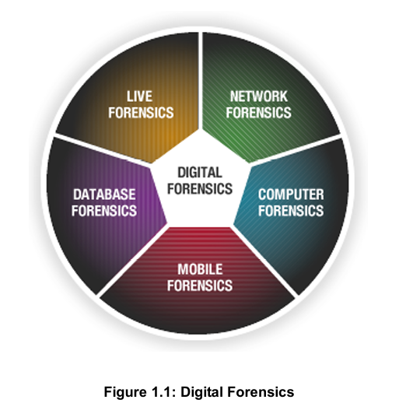
Terminologies
Basics of
Cyber Forensics

Slide 25
Terminologies
Basics of
Cyber Forensics
Disk Forensics: deals with extracting data/information from storage media by searching active, deleted files and also from unallocated and slack space.
Network Forensics: It is a sub branch of digital forensics relating to monitoring and analysis of computer network traffic for the purpose of information gathering, legal evidence or intrusion detection.
Unlike other areas of digital forensics, network investigation deal with volatile and dynamic information. It is also called Pro-active forensics.

Slide 26
Terminologies
Basics of
Cyber Forensics
Wireless Forensics: It is a sub part of network forensics. The main goal of wireless forensics is to provide the tools required to collect and analyze the data from ireless network traffic. The data collected can correspond to plain data or with the broad usage of Voice over Internet Protocol (VoIP) technologies especially over wireless technology.
Database Forensics: is a branch of digital forensics relating to study and examine databases and their related metadata. A forensic examination of a database may relate to the timestamps that apply to the row (update time) in a relational table being inspected and tested for validity in order to verify the actions of a database user.

Slide 27
Terminologies
Basics of
Cyber Forensics
Malware Forensics: deals with analysis and identification of a malicious code, to study their payload, viruses, worms, Trojans, Keyloggers etc.
Mobile Phone Forensics: deals with examination and analysis of mobile devices, to retrieve phone and SIM contacts, call logs(Dialled, Missed & Received), incoming and outgoing SMS/MMS, Audio, videos, paired device history and in some smart phones, geolocation and calendar information etc.
GPS Forensics is also called SatNav Forensics, is a relatively new discipline with the fast paced world of Mobile Device Forensics.

Slide 28
Terminologies
Basics of
Cyber Forensics
It is used for examining and analysing GPS devices to retrieve information such as TrackLogs, TrackPoints, WayPoints, Routes, Photos, audio etc.
Email Forensics: Deals with recovery and analysis of emails including deleted emails, calendars and contacts.
Memory Forensics deals with collecting data from system memory (system registers, ache, RAM) in raw form and then carving the data from Raw dump.

Slide 29
Terminologies
Basics of
Cyber Forensics
E-Discovery: E-Discovery is the process of evaluating solutions for organization. A defensible e-Discovery process is repeatable, systemized and meets legal requirements for proper handling and admissibility of computer evidence.
Email archiving can be a useful complement e-Discovery. A defensible e-discovery process is repeatable, systematized and meets legal requirements for proper handling and admissibility ofcomputer evidence.
An ideal e-discovery process identifies, collects, preserves, processes, reviews and produces relevant electronically stored information.

Slide 30
Terminologies
Basics of
Cyber Forensics
Relevant information may be found in unmanaged, unstructured, semi structured or structured data sources dispersed across networks on desktops, laptops, servers, share drives, removable storage media and other devices.
As the name implies, email archiving is limited to the contents of email system since they work only with the set of emails and do not extend to data on the network. An effective repeatable and defendable eDiscovery response plan requires an organization to proactively anticipate the type of discovery that could be initiated and develop an offensive strategy that employs both technology and human resources (Scott Carlson, 2009). The same is illustrated in the figure 1.1

Slide 31
Digital Spectrum
Basics of
Cyber Forensics
With the advent of new forms of criminality associated with growth of digital technologies, numbers of terms are used within the forensic community. These include cyber crime, high tech crime, e-crime, new technology crime to indicate new and digitized versions of existing crime.
Some crimes can be placed on the spectrum depending upon the extent of digital environment. Consider a street thief who first observes an unwary user input the PIN in an ATM and then steals the card and later withdraws cash; this is not a crime that appears to be particularly digital and it is therefore placed at the less digital end of the spectrum.

Slide 32
Digital Spectrum
Basics of
Cyber Forensics
On the other hand, skimming the magnetic strip, cloning a card and then using it to make transactions is clearly a crime unique to digital era and would appear to be placed at the more digital end of the spectrum.
Similarly, some crimes are more likely to have a digital aspect rather than uniquely exploit digital technologies.
For example, a fraud enacted via an e-bay, a fraudster may have had planning for the fraud in the internet, setting up temporary and difficult to trace email accounts, surfing the internet for images, descriptions and prices.

Slide 33
Digital Spectrum
Basics of
Cyber Forensics
These are activities which exploit the advantages of digital technologies but nonetheless arise from a conventional and classic form of crime. This is illustrated in Figure 1.2

Slide 34
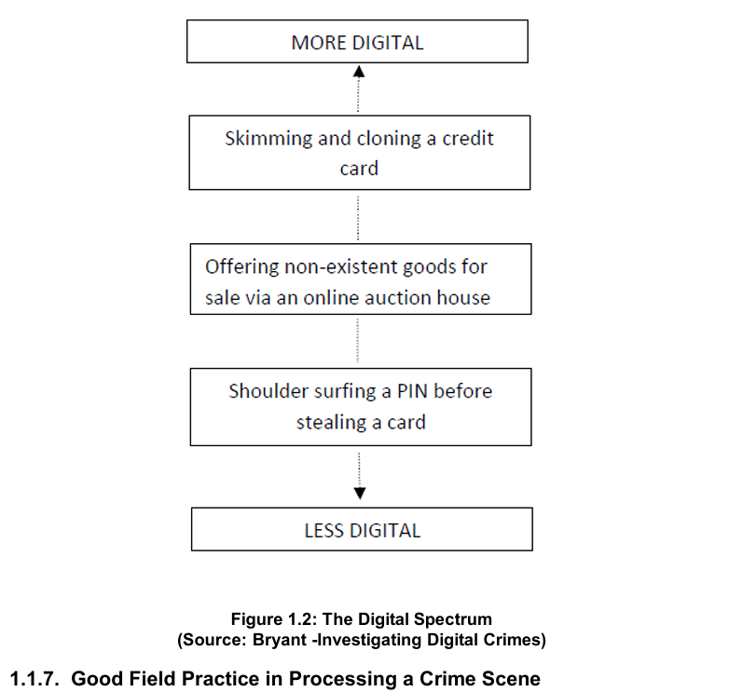
Digital Spectrum
Basics of
Cyber Forensics

Slide 35
Good Field Practice in Processing a
Crime Scene
Basics of
Cyber Forensics
Crime Scene: It is crucial to understand the definition of crime scene. For practical purpose, a Crime scene is the aftermath of an event that is considered, by law, to be illegal.
For basic understanding the crime scene can be considered the apex of an Inverted pyramid that expands to encompass the five phases
  Investigation of crime,
  the recognition,
  analysis,
  interpretation of evidence, and
  finally court trial.

Slide 36
Good Field Practice in Processing a
Crime Scene
Basics of
Cyber Forensics
Crime scene should be processed with due diligence, utmost care and by the application of technology because any mistake made in processing the crime scene are impossible to rectify.
Both errors of omission and commission made in processing a crime scene can confound the final resolution in two ways to make thing worse.
The investigators use general guidelines for processing crime scene and exercise the use of check sheets, forms lists as templates for search and examination to be counterproductive.

Slide 37
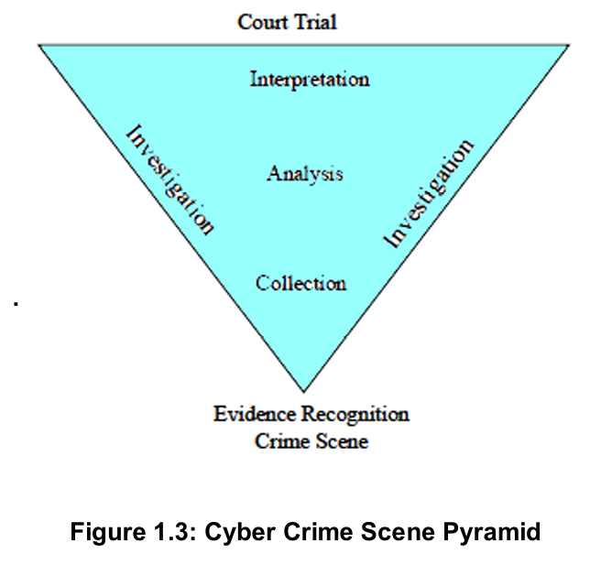
Good Field Practice in Processing a
Crime Scene
Basics of
Cyber Forensics
Each crime scene is unique and must be approached with knowledge, education and experience of the investigator. Crime scene is the apex of an inverted pyramid. This is illustrated in the Figure.1.3.

Slide 38
Digital Event and Case Relevance
Basics of
Cyber Forensics
Digital Event is an occurrence that changes the state of one or more objects. If the state of an object changes as a result of an event, then it is an effect of the event. Some types of objects have the ability to cause the events and these called causes (Carrier and Spafford, 2004).
The property of any piece of information, which is used to measure its ability to answer the investigative “who, what, where, when, why and how” questions in criminal investigation (Rubin and Garrtner, 2005).

Slide 39
Digital Event and Case Relevance
Basics of
Cyber Forensics
The ultimate purpose of crime scene investigation is to seek to solve the commission of crime inevitably that fall under the umbrella of the six “W” questions:
    What happened?
    2. When did it happen?
    3. Where did it happen?
    4. Who was involved?
    5. How was it done?
    6. Why was it done?

Slide 40
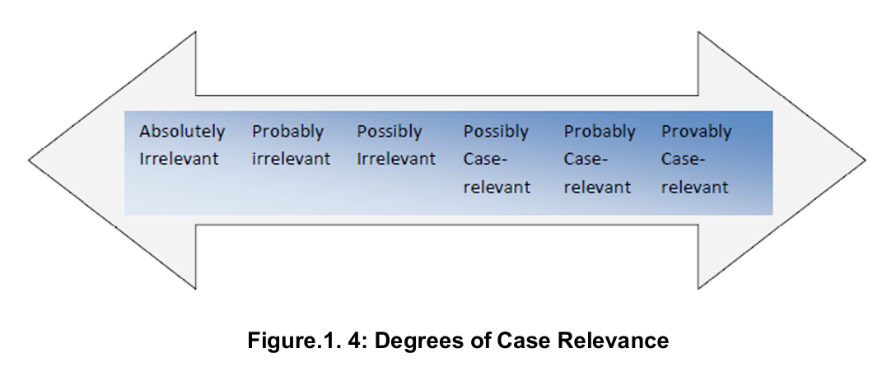
Digital Event and Case Relevance
Basics of
Cyber Forensics
In the examination of physical evidence the first five questions are relevant. The question “Why” is irrelevant for laboratory analysis and it is left for the establishment of motive by” “Profilers, “Criminologist” and “Courts”. Degrees of case relevance is illustrated in Figure 1.4.

Slide 41
Locard’s Principle:
Traditional Forensics Vs. Cyber Forensics
Basics of
Cyber Forensics
Locard’s Exchange Principle is often cited in forensics publications, “Every contact leaves a trace.” Essentially Locard’s Exchange Principle is applied to crime scenes in which the perpetrator(s) of a crime comes into contact with the scene.
The perpetrator(s) will both bring something into the scene, and leave with something from the scene. In the cyber world, the perpetrator may or may not come in physical contact with the crime scene, thus, this brings a new facet to crime scene analysis.

Slide 42
Locard’s Principle:
Traditional Forensics Vs. Cyber Forensics
Basics of
Cyber Forensics
According to the World of Forensic Science, Locard’s publications make no mention of an “exchange principle,” although he did make the observation “Il est impossible au malfaiteur d’agir avec l’intensité que suppose l’action criminelle sans laisser des traces de son passage.” (It is impossible for a criminal to act, especially considering the intensity of a crime, without leaving traces of this presence).

Slide 43
Cyber Exchange Principle
Basics of
Cyber Forensics
“Artifacts of electronic activity in digital devices are detectable through forensic examination, although such examination might require access to computer and network resources involving expanded scope that may involve more than one venue and geolocation.” (Zatyko and Bay, 2012).
Locard’s Exchange Principle does apply to cyber crimes involving computer networks, such as identity theft, electronic bank fraud, or denial of service attacks, even if the perpetrator does not physically come in contact with the crime scene.

Slide 44
Cyber Exchange Principle
Basics of
Cyber Forensics
Although the perpetrator may make virtual contact with the crime scene through the use of a proxy machine, we believe he will still “leave a trace” and digital evidence will exist.
Breaking apart the principle into its parts and analyzing the application of Locard’s Exchange Principle, one has to determine whether or not the following occurs:
  Are there two items?
  Is there contact?
  Is there an exchange of material?

Slide 45
Cyber Exchange Principle
Basics of
Cyber Forensics
To illustrate the application of Locard’s Exchange Principle to a cyber crime, we take the example of identity theft where someone’s identity is stolen and the perpetrator intends to use the stolen information for criminal gain.
Let us further suppose the perpetrator steals the identity through the use of a Trojan horse and keyboard logger on the victim’s computer. One could contend that during this type of cyber crime Locard’s Exchange Principle does not apply.

Slide 46
Cyber Exchange Principle
Basics of
Cyber Forensics
The rationale is that because a human is not at the crime scene there is no trace evidence from the human on the computer or digital media at the scene. However, in actuality there may be lots of digital evidence such as the Trojan horse itself, changed passwords, digital logs, and so on.
Thus, in this example, there is a trace at and from the scene. It may involve finding the trace evidence at other physical locations than just the one scene of the crime. The key logger could be added software or hardware or both, but in both cases it remains behind for an investigator to discover. This examination typically involves bits and bytes of information.

Slide 47
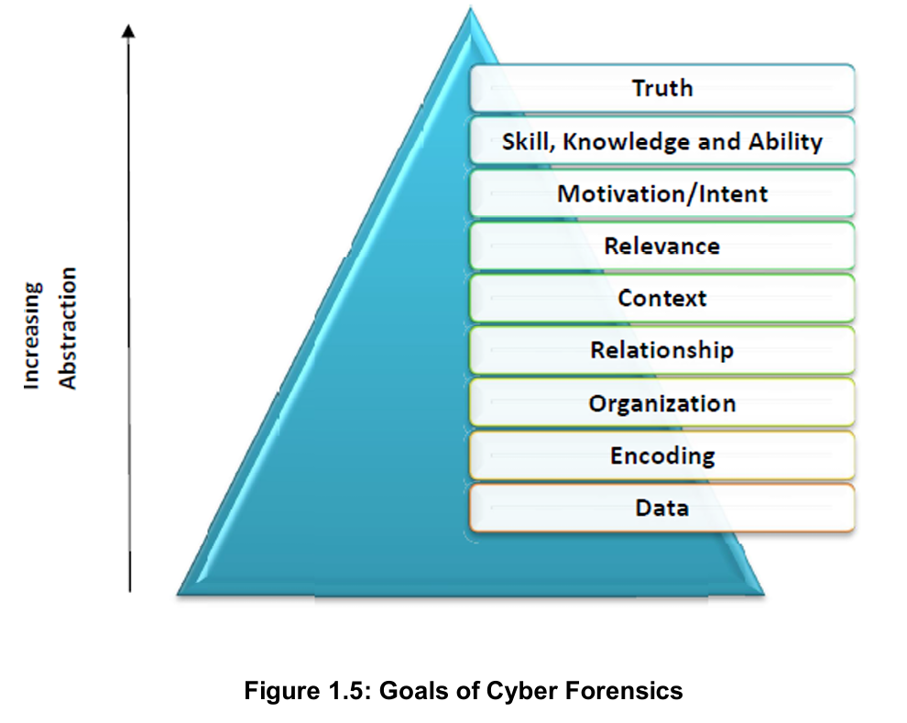
Goals of Cyber Forensics
Basics of
Cyber Forensics

Slide 48
Goals of Cyber Forensics
Basics of
Cyber Forensics
In pursuit of finding the truth, the goal of digital forensics moves from specific to abstract. This can be from acquiring the evidence from the storage media in the form of data or information. This information could be represented inside the media as an encoding (i.e) ASCII or binary.
The encoded data in the form of information may be involving incidents that transpired in an organization and event reconstruction needs to be made on timeline basis.
The correlation or the relationship between events must be established specific to the context for e.g.: an unauthorized exploit.

Slide 49
Goals of Cyber Forensics
Basics of
Cyber Forensics
After acquiring the data must be relevant or coincidental to the questioned occurrence. This incident may involve the motivation or the malicious intent of the attacker. The intent may be information component or human component.
It requires the skill, knowledge and ability of the investigator in the process of unraveling the truth. Incident and response time have inverse relationship. Severity and number of attacks/penetrations are high when compared to earlier years as against the time to respond is very low.
A graphical representation of the goal from specific to abstract is represented in the Figure 1.5.

Slide 50
Digital Evidence
Basics of
Cyber Forensics
Digital evidence or electronic evidence is any probative information stored or transmitted in digital form that a party to a court case may use at trial.
Before accepting digital evidence a court will determine if the evidence is relevant, whether it is authentic, if it is hearsay and whether a copy is acceptable or the original is required.
Any data stored or transmitted using a computer that support or refute a theory of how an offense occurred or that address critical elements of the offense such as intent or alibi Chisum(1988).

Slide 51
Digital Evidence
Basics of
Cyber Forensics
Digital evidence is defines as any data that can establish that a crime has been committed or can provide a link between crime and its perpetrator (Casey, 2000)
Definition provided by Scientific Working Group on Digital Evidence (SWGDE) – any information o probative value that is either stored or transmitted in digital form.
International Organization on Computer Evidence (IOCE) defines DE as information stored or transmitted in binary form that may be relied in court.

Slide 52
Digital Evidence
Basics of
Cyber Forensics
The term digital evidence and electronic evidence are sometimes used interchangeably. However, an effort should be made to distinguish between electronic devices such as mobile phones and the digital data it can contain.
When considering the many sources of digital evidence it is useful to categorize the computer systems into three groups. (Henseler, 2000).

Slide 53
Digital Evidence
Basics of
Cyber Forensics
Open computer systems: Open computer systems are what most people think of as computers-systems comprised of hard drives, keyboards, monitors – devices such as laptop, desktop and servers that obey the standards.
These systems with their ever in creating amounts of storage space can be rich sources of digital evidence. A simple like can contain incriminating information and can have associated properties that are useful in an investigation.
For example, details such as when a file was created, who created, or that it was created on another computer can all be important.

Slide 54
Digital Evidence
Basics of
Cyber Forensics
Communication systems – Tradition telephone system, wireless telecommunication systems, the internet and networks in general can be a source of digital evidence.
For instance, the internet carries email messages around the world. The time a message was sent, who sent it, or what the message contained can all be important in an investigation.
To verify when a message was sent, it may be necessary to examine the log files from intermediate servers and routers that handled a given message. To verify the contents of a message, it may be necessary to eavesdrop on the communications as it occurs.

Slide 55
Digital Evidence
Basics of
Cyber Forensics
Embedded systems - Mobile phones, PDA, smart cards and many other systems with embedded computers may contain digital evidence.
For example, navigation system can be used to determine where a vehicle has been and sensing and diagnostic modules in many vehicles hold data that can be useful for understanding vehicle accidents, including the vehicle speed, brake status, throttle position during the last five seconds before impact.

Slide 56
Digital Evidence
Basics of
Cyber Forensics
The use of digital evidence has increased in the past few decades as courts have allowed the use of e-mails, digital photographs, ATM transaction logs, word processing documents, instant message histories, files saved from accounting programs, spreadsheets, internet browser histories, databases, the contents of computer memory, computer backups, computer printouts, Global Positioning System tracks, logs from a hotel’s electronic door locks, and digital video or audio files.
The same is illustrated in Table 1.1

Slide 57
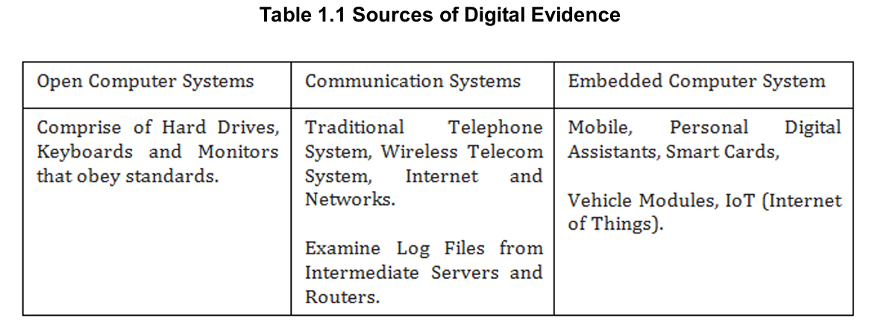
Digital Evidence
Basics of
Cyber Forensics

Slide 58
History and Terminology of
Computer Crime Investigation
Basics of
Cyber Forensics
The field of computer forensics began in the 1980s, shortly after personal computers became a viable option for consumers. In 1984, an FBI program was created.
Known for a time as the Magnetic Media Program, it is now known as the Computer Analysis and Response Team (CART). Shortly thereafter, the man who is credited with being “the father of computer forensics” began work in this field. His name was Michael Anderson, and he was a special agent with the criminal investigation division.
Anderson worked for the American government until the mid 1990s, after which he founded New Technologies, Inc., a leading computer forensics firm.

Slide 59
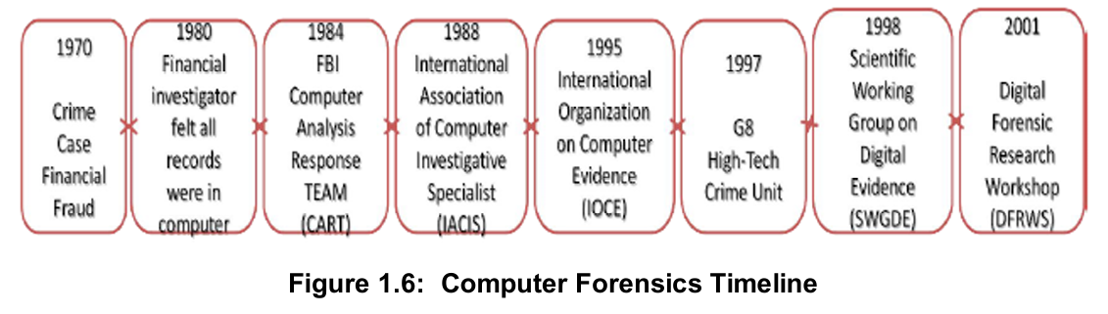
Emergence of Cyber Forensic Investigating Agencies
Basics of
Cyber Forensics
A meeting held in 1988 in Oregon led to the formation of the International Association of Computer Investigative Specialists (IACIS). Shortly after that, the first classes were held to train SCERS (Seized Computer Evidence Recovery Specialists). Computer Forensic Timeline is illustrated in Figure.1.6 and it represents the evolution of digital forensics domain as such.

Slide 60
Phases of Cyber Forensics
Basics of
Cyber Forensics
Different Phases of Cyber Forensics are:
1. Ad-hoc phase which was characterized by lack of structure, lack of clear goals, lack of adequate tools, processes and procedures. Further huge legal issues on how to proceed with digital evidence were seen.
2. Structured Phase is complex solution for computer forensic from accepted procedures, special tools developed and what is more important enabling criminal legislation to wide use of digital evidences.
3. Enterprise phase –Three areas of this phase are real-time collection of evidence, developing field collection tools and forensic becoming a service in companies.

Slide 61
Development of Cyber Forensics
Basics of
Cyber Forensics
Computer forensics is the study of extracting, analyzing and documenting evidence from a computer system or network. It is often used by law enforcement officials to seek out evidence for a criminal trial.
Government officials and business professionals may also have need of a specialist familiar with computer forensic techniques.
The discipline of computers forensics is relatively new, having been founded in the 1980s.

Slide 62
Development of Cyber Forensics
Basics of
Cyber Forensics
This digital evidence consists of data from storage media like hard disk, floppy disks, zip disks, Compact discs, DVDs, emails, data transmitted over communication links (wired and wireless), log files generated by the operating system, logs from perimeter devices like router and switch, PDA, Mobile Phones, MP3 players, USB devices, and even plethora of devices which do not fit into the original concept of computers like the washing machines, engine management system in cars, GPS devices.
In order for evaluation and acceptance of Digital evidence – a new type of evidence, previously not considered by courts, certain basic principles are suggested by research scholars and these are given below

Slide 63
Development of Cyber Forensics
Basics of
Cyber Forensics
Authenticity – the evidence should be authentic that is “it should specifically linked to the circumstances and persons alleged – and produced by someone who can answer questions about such links”
Accuracy – the evidence should be free from any reasonable doubt about the quality of procedures used to collect the material, analyze the material if that is appropriate and necessary and finally to introduce it into court and produced by someone who can explain what has been done.

Slide 64
Development of Cyber Forensics
Basics of
Cyber Forensics
In the case of exhibits which themselves contain statements – a letter of other document, for example – ‘accuracy’ must also encompass accuracy of content and that normally requires the document’s originator to make a witness statement and be available for cross examination”.
Accuracy – when presented evidence contains statements created in a computer “accuracy must encompass the accuracy of the process which produced the statement as well as the accuracy of the contents”
Completeness - “tells within Its own terms a complete story of a particular set of circumstances or events”

Slide 65
Development of Cyber Forensics
Basics of
Cyber Forensics
Chain of custody, transparency and explainable are the other basic principles the needs to be followed among the other principles. Unlike the physical evidence, the digital evidence, by itself has no informational value.
It requires skill and talent in interpreting the latent information which is dependent on the process by which it is unraveled and the process in turn depends on the basic principles of computer science.
In order to be legally acceptable in the court of law, it requires a motivated skilled expert who will apply appropriate tools to achieve, efficiency and reliability.

Slide 66
Digital Data
Basics of
Cyber Forensics
Digital data are all around us and should be collected in any investigation routinely. More likely than not someone involved in the crime used a computer, personal digital assistant, mobile phone or accessed the internet.
Therefore every corporate investigation should consider relevant information stored on the computer systems by their employees both at work and at home.
Every search warrant should include digital evidence to avoid the need for the second warrant and the associated time lost.

Slide 67
Digital Data
Basics of
Cyber Forensics
Even if digital data do not provide a link between a crime and its victim or a crime and its perpetrator they can be useful in a investigation, digital evidence can reveal how a crime was committed, provide investigative leads, disprove or support witness statements and identify likely suspects.
Cyber Forensics focuses on three kinds of data namely active data, latent data and archival data.

Slide 68
Digital Data
Basics of
Cyber Forensics
Active Data
An active data is one that is currently available, visible and that which can be understood using an application within a computer.
Active data might also be protected using passwords or some means of encryption.
Some of the active data are: word processor files, spread sheets, files and directories, email content, database programs, system files, history files, temporary internet files, cookies, recycle bin and the like.

Slide 69
Digital Data
Basics of
Cyber Forensics
Latent Data
Latent data also called as ambient data, volatile data may be in the form of deleted files, memory dumps and similar data which reside in swap files, temporary files, printer spool files, metadata, shadow file and so on.
It requires an expert talent to bring to light the latent data using specialized tools and techniques.

Slide 70
Digital Data
Basics of
Cyber Forensics
Archival data
Data that has been stored or backed up to external storage media such as tapes, CDs, DVDs, external hard disks, pen drive, zip disks, network servers or the internet is archival data.
Necessary precautions have to be taken while performing forensic examination since the backup peripheral devices do not have all the information.
Hence, it is always better to perform forensic examination on original source media because backups do not store latent data.

Slide 71
Cardinal Rules in Cyber Forensics
Basics of
Cyber Forensics
The cardinal rules of computer forensics can be expressed as the five ‘A’s
Admissibility must guide actions: document everything that is done
Acquire the evidence without altering or damaging the original
Authenticate your copy to be certain it is identical to the source data
Analyze the data while retaining its integrity and
Anticipate the unexpected.

Slide 72
Cardinal Rules in Cyber Forensics
Basics of
Cyber Forensics
The cardinal rules are designed to facilitate a forensically sound examination of computer media and enable a forensic examiner to testify in court as to their handling of a particular piece of evidence.
A forensically sound examination is conducted under controlled conditions, such that it is fully documented, replicable, and verifiable.
A forensically sound methodology changes no data on the original evidence, preserving it in pristine condition. The results must be replicable such that any qualified expert who completes and examination of the media employing the same tools and methods employed will secure the same results.

Slide 73
Cyber Forensic Lab
Basics of
Cyber Forensics
The role of cyber forensics will be increasing importance to the legal system as information continues to evolve into purely a digital form and the systems on which such digital information is stored becomes more technologically advanced.
Strategic planning for setting a laboratory involves in developing a forensic practice: Operational Perspective, Technological perspective/ venue, Scientific Perspectives and an artistic perspective. Other areas of significance are Core Mission and Services, Budget and Standard operating procedures.
Cyber Forensics Lab requires adequate infrastructure for examination and analysis of Digital Evidence.

Slide 74
Cyber Forensic Lab
Basics of
Cyber Forensics
Adequate Infrastructure not only includes technical infrastructure but also assets such as workspace, dedicated communication lines, 24/7 internet connection among others which should be made available to the cyber forensic experts.
Operational Perspective
All business venue must have sound business management, financial profitability, core service etc. a police cyber forensics lab may not have profit per se, but the lab has to demonstrate value of service and return of Investment in order to acquire annual budget allocations and training in new technologies to continue fighting crime.

Slide 75
Cyber Forensic Lab
Basics of
Cyber Forensics
Technological Perspective
Technological advancement calls for sophisticated knowledge in data and data storage technologies. More complex techniques are used by criminals to hide their criminal activity.
The commercial market is rolling out a new wave of newest and shiniest technologies available to upkeep the demand for progress; again forensics community is at the front of the line, dismantling and investigating every new gadget that hits the shelves in order to reveal its secrets.

Slide 76
Cyber Forensic Lab
Basics of
Cyber Forensics
Scientific Perspective
In order reveal facts objectively through empirical observation, deductive reasoning and conversion of hypothesis to demonstrable proof of the fact, examiners have to perform their duties according to reliable, repeatable, valid, objective, consistent and accurate methodologies, thereby enabling the presentation of the findings as acceptable in court of law.

Slide 77
Cyber Forensic Lab
Basics of
Cyber Forensics
An Artistic Perspective
A great degree of technological prowess or expertise and competency is required in fact finding. Although the investigative process involves a rigid set of procedures, intuitive and creative skills of the forensic examiner is also required.
Raw technological skill does not empower an examiner to understand the man and the machine. More artistry and creativity is required to enable a better understanding of how the tools of technology and human nature and thought process interact.

Slide 78
Cyber Forensic Lab
Basics of
Cyber Forensics
Budget
Every forensic facility be it business organization or government, require funds to function. It has to spend on building, staff, and stock. It has to operate, maintain and grow a facility.
Every operation needs to demonstrate return of investment in order to prove viability of the venture.

Slide 79
Core Missions and Services
Basics of
Cyber Forensics
Primary consideration of forensics facility is the design plan and what services are to be rendered and the scope at which it is to be provided. A firm grasps of a prospective lab core mission and range of service will provide guidance on every aspect of building, functional forensic facility, touching on everything from annual budget to furniture ergonomics.
The technical aspects would include the requisite hardware and software tools for examination and analysis. The cyber lab should possess robust operating system software such as Microsoft Windows, MAC OS, Linux, SOLARIS. It must also have powerful computer workstation with standard peripherals.

Slide 80
Core Missions and Services
Basics of
Cyber Forensics
Another vital requisite would be Uninterruptible Power management software is also required for extensive control and monitoring capabilities. In general, the infrastructure is layered and it should be built, frequently updated as per the requirements and needs and the same is illustrated in Figure.1.7.

Slide 81
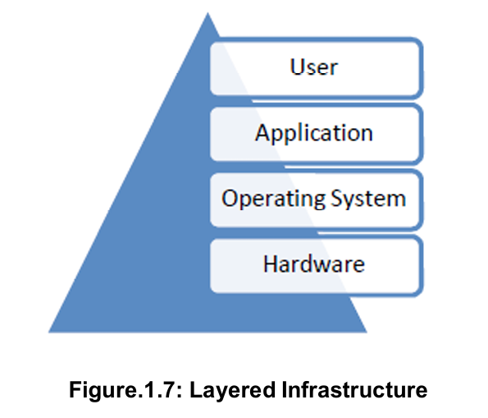
Core Missions and Services
Basics of
Cyber Forensics

Slide 82
Increasing awareness of Digital Evidence
Basics of
Cyber Forensics
In the recent years, judiciary and law enforcement are encountering progressively more digital evidence in their work. Less obviously, cyber security professionals and military decision makers are concerned with digital evidence.
An increasing number of organizations are faced with necessity of collecting evidence on their networks in response to incidents such as computer intrusions, fraud, intellectual property theft, child pornography, stalking, sexual exploitation and harassment, and more violent crimes. Organizations are forced to consider legal remedies when criminals target them.

Slide 83
Increasing awareness of Digital Evidence
Basics of
Cyber Forensics
The need is that the organizations giving more attention to handling digital evidence in a way that it will hold up in court. In addition to collection of evidence, organization by processing digital evidence properly is protecting their organizations liabilities such as invasion of privacy and unfair dismissal claims.
As a result, there is an increasing training and knowledge in digital evidence handling. Organization must also respond to such incidents and recover from such incidents in a rapid manner in order to minimize the loss/ damage to the organization.

Slide 84
Increasing awareness of Digital Evidence
Basics of
Cyber Forensics
Hence, cyber security professionals hundreds of security incidents on a daily basis as a result there is no enough time to open an investigation for each incident. There are three significant drawbacks to this. They are:
Each unreported incident deprives defense council an opportunity to learn basics about computer related crimes. They are only involved only when the stakes are high and cases are complicated.
Due to poor evidence collections policies, lawyers and law enforcement officers job difficult to prosecute an perpetrator.

Slide 85
Increasing awareness of Digital Evidence
Basics of
Cyber Forensics
This approach results in under reporting of criminal activity, deflating the statistics that are used to allocate the corporate and government spending on computer related crimes.
Government agencies are also interested in using digital evidence to detect terrorist activities and prevent future attack. As a result data mining techniques are used to detect and investigate criminal activity. Understandably the possibility of the government freely sifting through every citizens personal data for anything that looks suspicious is privacy advocate’s worst nightmare.

Slide 86
Increasing awareness of Digital Evidence
Basics of
Cyber Forensics
In certainty the risk associated with these pre-crime systems will do more harm that the problems they aim to address. The reason for this is
  Inadequate training data sets
  Inaccurate data
  High number of false positives and
  Information overloaded

Slide 87
Challenging aspects of Digital Evidence
Basics of
Cyber Forensics
Digital evidence is a form of physical evidence creates several challenges for digital forensicators.
Slippery from of evidence makes it difficult to handle – Example: Hard Disk platter contains amalgam of data – pieces of information scattered across the disk and are layered on top of each other over a period of time. Only a small portion of this may be relevant to a case, making it necessary to extract useful pieces and translate them to meaningful form that can be interpreted.
Radio waves and microwaves travelling through the air contain a tangle of data making it necessary to find the desired signal amongst the noise and translate it into the data that can be understood.

Slide 88
Challenging aspects of Digital Evidence
Basics of
Cyber Forensics
Volatile nature of the evidence – transient nature of data and packets makes it difficult to collection of evidence a difficult task
Digital evidence is generally an abstraction of some event or digital object. When a person instructs a computer to perform a task such as composing a email and sending it, the activities generate data remnants that give only a partial view of what occurred. Unless some surveillance equipments are installed – individual mouse clicks, keystrokes, internal system commands, and minutiae are not recorded or retained.

Slide 89
Challenging aspects of Digital Evidence
Basics of
Cyber Forensics
Only certain results of the activity such as email message and server logs remain to give a partial view of what transpired. Email message and server logs are several layers of abstraction to magnetic fields on the disk to letters and numbers seen on the screen. Each layer can introduce error
Digital evidence can be manipulated – it can be altered either maliciously by perpetrators or accidentally during collection
Fortunately there are several features that can be used to mitigate this problem

Slide 90
Challenging aspects of Digital Evidence
Basics of
Cyber Forensics
Digital evidence can be duplicated exactly and a forensic copy can be examined as it is original. It is a common practice when dealing with digital evidence to examine a copy, thus allowing the risk of damaging the original.
With right tools it is very easy to determine if digital evidence has been modified or tampered with, by comparing it with an original copy.
Digital evidence is difficult to destroy. Even when a file is deleted or a hard disk is formatted, still the digital evidence can be retrieved.

Slide 91
Challenging aspects of Digital Evidence
Basics of
Cyber Forensics
When criminals attempt to destroy the evidence – copies and associated remnants can remain in places that they were not aware of.
Digital evidence is circumstantial making it difficult to attribute computer activity to an individual. Therefore digital evidence can be only one component of a solid investigation.
If a case hinges upon a single form of digital evidence such as a timestamp on computer files, then the case is unacceptably weak.

Slide 92
Challenging aspects of Digital Evidence
Basics of
Cyber Forensics
Without additional information it could be argued that someone else used the computer at that time. If the defendant argues that some exonerating digital evidence was not collected from one system, this would impact a weak case that does not have supporting evidence of guilt from other sources.

Slide 93
Following the cyber trail
Basics of
Cyber Forensics
It is a common belief that cyber space is separate from the physical space.
This is simply not the case – crime on cyber space mirrors crime in physical space. There are several reasons to this:
Crime on internet reflects crime in physical space with human perpetrators, victims and should be treated with same gravity.

Slide 94
Following the cyber trail
Basics of
Cyber Forensics
To neglect the very real and direct link between people and the online activities that involve them limits one’s capability to investigate and understand crimes with an online component – example – auction fraud provides a simple demonstration of how a combination from the virtual world to physical world is used to apprehend a criminal
Criminals feel that they are safe in the internet but they don’t realize the fact that they are observable, and hence vulnerable.

Slide 95
Following the cyber trail
Basics of
Cyber Forensics
This opportunity can be utilized to uncover the crimes in physical world that would have been possible without investigation in the cyber space
Some of the cases that have been solve by observing the criminals include:
  Murder
  Child pornography
  Child abusers
  Drug dealers
  Weapon traffickers
  Human traffickers

Slide 96
Following the cyber trail
Basics of
Cyber Forensics
When a crime is committed in physical world, the cyber space has related digital evidence and should be considered as an extension of crime scene.
The crimes of today and future requires the digital forensicators to become skilled at finding connections between the cyber criminal and the cyber crime which can be extended to the physical world by following the cyber trail.
The cyber trail should be considered even when there is no sufficient internet activity. Criminals are learning to conceal their internet activities. With the rise of wireless the difficulty rises.

Slide 97
Following the cyber trail
Basics of
Cyber Forensics
There are growing numbers of sensors on the internet such as cameras showing highway traffic on the web.
These cameras may inadvertently capture evidence relating to crime.
In addition to the internet, the cyber trail can be found on commercial systems.(e.g: ATMs, credit cards, debit cards) and on privately owned networks.
The rich source of digital evidence on privately owned networks include:

Slide 98
Following the cyber trail
Basics of
Cyber Forensics
Internal emails
Chats
News groups
Web servers
Databases
Document management systems
Time clock systems
Individuals information

Slide 99
Challenging aspects of the cyber trail
Basics of
Cyber Forensics
The challenging aspects of the cyber trail include:
The dynamic and distributed nature of networks makes it difficult to collect digital evidence
Data can be spread over beyond geographic boundaries
It is not feasible to take a snapshot of a given network at a given instant
Network traffic is transient and must be captured while it is in transit. Once a network traffic is captured – only copies remain and the original data is unavailable

Slide 100
Challenging aspects of the cyber trail
Basics of
Cyber Forensics
The amount of data lost during evidence collection process can be documented but the lost evidence cannot be retrieved
Huge volume of data travels across the network and it is difficult to sniff – useful information can be like a needle in a haystack
Even when the digital evidence is obtained from the network, a great deal of anonymity makes it difficult for attributing to a criminal

Slide 101
Technology and Law
Basics of
Cyber Forensics
Need for Law human beings are vulnerable to unlawful acts which are crimes, and therefore, rules of law are required to protect them against such acts. Computer systems are vulnerable.
This technological progress can easily dupe, exploit a person by illegal or unauthorized access. The result is damage to the computer system.
With the help of networks the cyber criminals indulge in criminal activity without any fear of being apprehended and tried for the offences committed by them.

Slide 102
Technology and Law
Basics of
Cyber Forensics
The reasons for committing cybercrimes by criminal may briefly be stated as;
  1. Wider accesses to information.
  2. Complexity of computer system.
  3. Negligence of network users.
  4. Non- availability or loss of evidence.
  5. Lack of Jurisdiction leading to fearless crimes.
Cybercrime Evolution or Neo-criminology: Computer Technology and Internet with its advancements has bought about new variety of crimes thereby providing ever increasing opportunities for the criminals to indulge in illegal activities unabated.

Slide 103
Technology and Law
Basics of
Cyber Forensics
The last quarter of twentieth century witnessed several sophisticated ways through which the perpetrators of cybercrime found it easy to penetrate into the system of software and internet to commit cybercrime which may be characterized as the new species of white collar crime.
These crimes have global ramifications sabotaging the national economy and business ventures. They are not restricted to any geographical area or territory and may be committed within a fraction of a second affecting victim who may be thousands of miles away.

Slide 104
Technology and Law
Basics of
Cyber Forensics
These new variety of crime have thrown a big challenge before the law enforcement agencies and they are required to evolve a neo criminological approach to handle these internet crimes.
Here the risk in such crimes is that the victims are totally unaware of the crime committed on their property or on person.

Slide 105
Groups of Cyber Criminals
Basics of
Cyber Forensics
  1. Children and Adolescent age between 8-18 years
  2. Professional Hackers / Crackers
  3. Disgruntled Employees or vengeful persons
  4. Cyber abuser.
By the use of internet the incidences of cybercrime have increased, therefore the need for such crimes to be channelized and regulated by effective cyber laws. Cyber laws are that branch of law which deals with the newly emerging issues out of the development of the internet and other communication mediums functioning over the cyberspace. These laws need to regulate all aspects of transactions of the internet and the cyberspace.

Slide 106
Groups of Cyber Criminals
Basics of
Cyber Forensics
There are many issues faced by the development of the internet and the corresponding crimes arising there from
  1.Domain name
  2. Intellectual Property Rights
  3. E-commerce
  4. Encryption
  5. Electronic contracts
  6. On-line banking
Cyber law may be defined as the law governing cyberspace which is a non-physical terrain created with two or more computers networked together .Online system create a cyber space.

Slide 107
Groups of Cyber Criminals
Basics of
Cyber Forensics
Cyberspace is not restricted to internet alone, but has computers, its networks and software. Therefore cyber law refers to the law relating to computer, computer networks and includes all activities that take place in relation to information stored, exchanged or retrieved using the computer system.

Slide 108
Reasons to Pass Cyber Laws
Basics of
Cyber Forensics
1. To prevent computer abusers to carry on their illegal activities for personal gains.
2. To prevent political rivalry so that innocent people do not become a victim of their criminal act. (e.g.) A person staying in one country can easily dupe a person having a bank account in any other nation, by transferring millions in the bank of a third nation, within no time with the help of lap-top and cell phone.
Like many other countries India to has developed independent laws, to tackle cybercrime. But still in some countries there exists traditional laws to deal with such offences.

Slide 109
Importance of Cyber Laws
Basics of
Cyber Forensics
To regulate all the features of contacts and actions with respect to the internet.
To tackle issues on e-commerce, encryption, electronic contracts, on-line banking.
To tackle multidimensional crimes.
To have laws as cybercrime recognizes no territorial boundaries.

Slide 110
Provisions of the I.T. Act
Basics of
Cyber Forensics
Jurisdiction, Extent and Scope of the IT Act 2000
Short title, extent and applicability
The Act is called The Information Technology Act 2000 and is applicable to entire India; it is applicable to all the crimes which is committed in and abroad.

Slide 111
Statement of Object of Reasons of The Information Technology Act,2000
Basics of
Cyber Forensics
Objects of the Act of 2000: The progress in communication and technology led to the need to have a law governing transaction in business.
Todays’ business world is internet savvy and conducts most of their business transactions in electronic form instead of traditional papers. It was observed then that information stored in electronic form was much easier, cheaper, and retrieve and speedier to communicate.
Despite the very many plus point of internet businessmen are reluctant to settle any transaction in electronic form as there is no proper framework of law.

Slide 112
Statement of Object of Reasons of The Information Technology Act,2000
Basics of
Cyber Forensics
Objects
To provide for legal outline.
Legal Sacrosanctity to all e-records.
To make in its ambit all business transaction legal and transfer of information from one computer to another.

Slide 113
…..
Basics of
Cyber Forensics
……

Slide 114
…..
Basics of
Cyber Forensics
……

Slide 115

Q & A
Basics of
Cyber Forensics
E.R. Ramesh, M.C.A., M.Sc., M.B.A.,
98410 59353, 98403 50547
rameshvani@gmail.com

