Slide 1
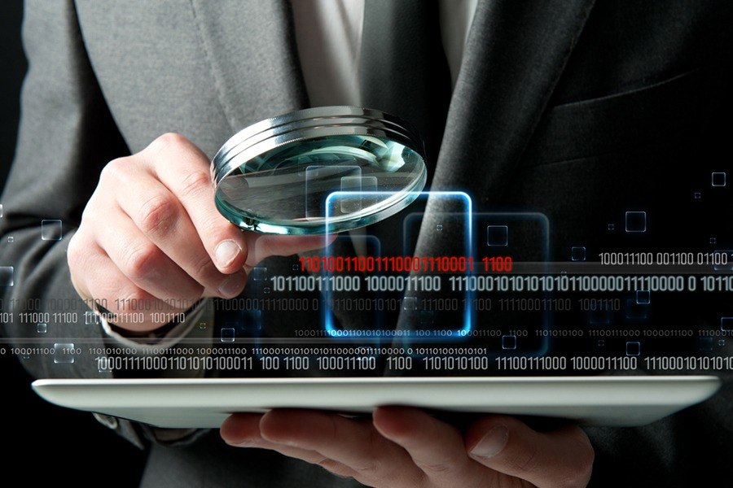
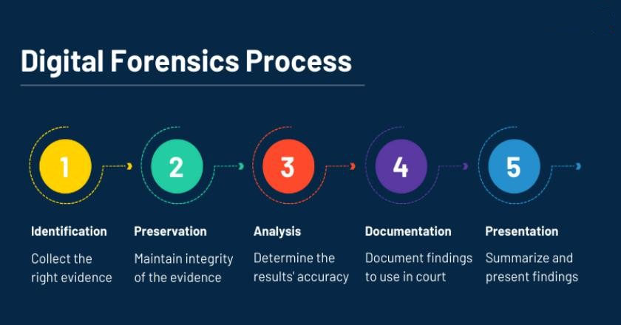
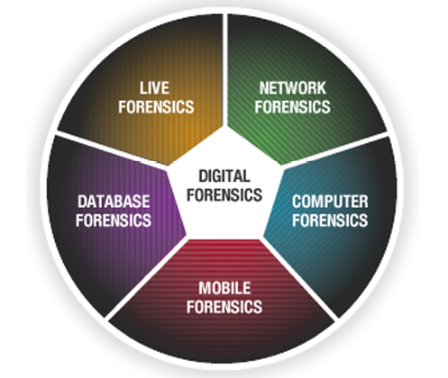
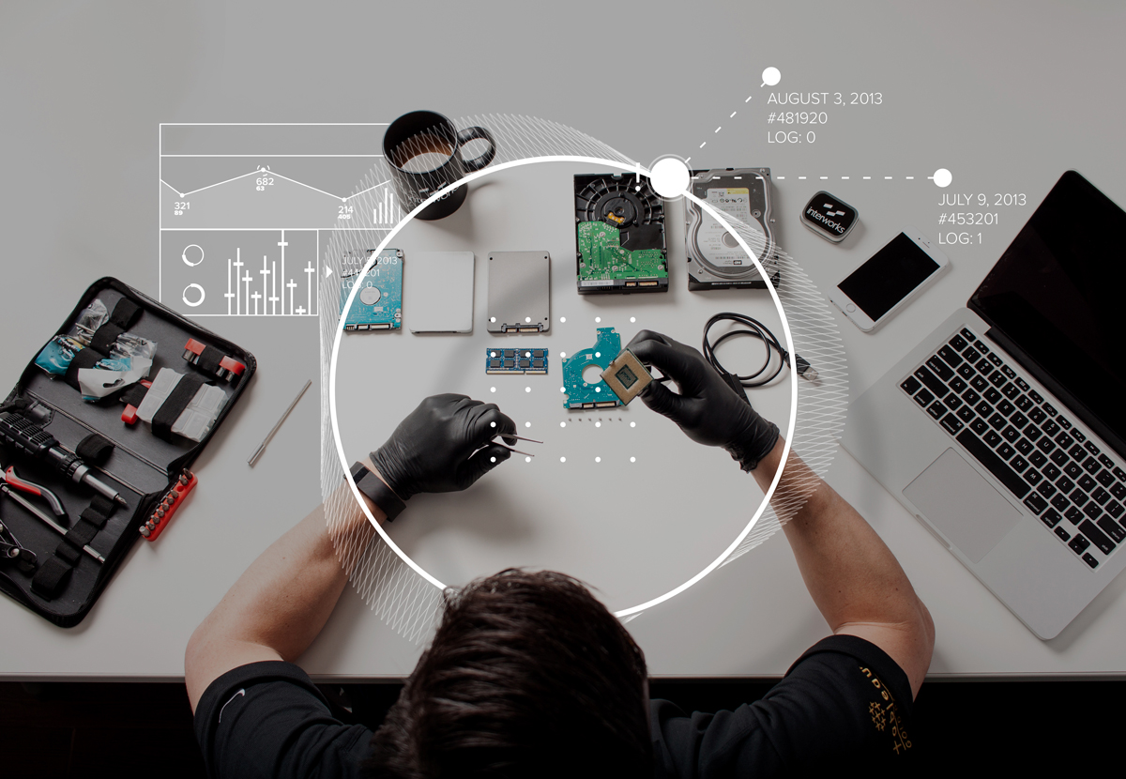

Basics of Cyber Forensics
E.R. Ramesh, M.C.A., M.Sc., M.B.A.,

Slide 2

Basics of
Cyber Forensics
Unit - 3
Computer Basics for Digital Investigators –
Computer Forensic Fundamentals-
Applying Forensic Science to computers –
Computer Forensic Services –
Benefits of Professional Forensic Methodology –
Steps taken by computer forensic specialists.

Slide 3
Computer Forensic Fundamentals
Basics of
Cyber Forensics
What is Computer Forensics?
Computer forensics is the process of methodically examining computer media (hard disk, diskettes, taps, etc) for evidence. In other words computer forensics is the collection, preservation, analysis, and presentation of computer related evidence.
Computer forensics also referred to as computer forensic analysis, electronic discovery, electronic evidence discovery, digital discovery, data recovery, data discovery, and computer analysis and computer examination.

Slide 4
Computer Forensic Fundamentals
Basics of
Cyber Forensics
Computer evidence can be useful in criminal cases, civil disputes and human resource employment proceeding.
Use of Computer Forensics in Law Enforcement
Computer forensics assists in Law Enforcement. This can include:
Recovery deleted files such as documents, graphics and photos.
Searching unallocated space on the hard drive places where an abundance of data often resides.

Slide 5
Computer Forensic Fundamentals
Basics of
Cyber Forensics
Tracing artefacts, those tidbits of data left behind by the operating system. Our experts know how to find these artifacts and more importantly they know how to evaluate the value of the information they find.
Processing hidden files that are not visible or accessible to the user that contain past usage information. Often this process requires reconstructing and analyzing the date codes for each file and determining when each file was created, last modified, last accessed and when deleted.
Running a straight search for email when no email client is obvious.

Slide 6
Choosing a Computer Forensics Specialist for a Criminal Case
Basics of
Cyber Forensics
When the services of a computer forensics specialist are required, look very carefully at the level of experience of the individuals involved.
There is far more to proper computer forensic analysis than the ability to retrieve data, especially when a criminal case is involved.
The services of person who will be called to testify in court, who will be able to explain what was done to computer Services and its data. The court will want to know that individual’s own level of training and experience, not the experience of his or her employer.

Slide 7
Choosing a Computer Forensics Specialist for a Criminal Case
Basics of
Cyber Forensics
Make sure you find someone who not only has the expertise and experience, but also the ability to stand up to the scrutiny and pressure of cross-examination.

Slide 8
Computer Forensic Services
Basics of
Cyber Forensics
No matter how careful they are, when people attempt to steal electronic information (everything from customer databases to blueprints), they leave behind traces of their activities.
Likewise, when people try to destroy incriminating evidence contained on a computer (from harassing memos to stolen technology), they leave behind vital clues. In both cases, those traces can prove to be the smoking gun that successfully wins a court case.
Thus, computer data evidence is quickly becoming a reliable and essential form of evidence that should not be overlooked.

Slide 9
Computer Forensic Services
Basics of
Cyber Forensics
A computer forensics professional does more than turn on a computer, make a directory listing, and search through files.
Forensics professionals should be able to successfully perform complex evidence recovery procedures with the skill and expertise that lends credibility to your case.

Slide 10
Computer Forensic Services
Basics of
Cyber Forensics
For example, they should be able to perform the following services:
Data seizure
Data duplication and preservation
Data recovery
Document searches
Media conversion
Expert witness services
Computer evidence service options
Other miscellaneous services

Slide 11
Data Seizure
Basics of
Cyber Forensics
Federal rules of civil procedure let a party or their representative inspect and copy designated documents or data compilations that may contain evidence.
Computer forensics experts, following federal guidelines, should act as this representative, using their knowledge of data storage technologies to track down evidence & experts should also be able to assist officials during the equipment seizure process.

Slide 12
Data Duplication and Preservation
Basics of
Cyber Forensics
When one party must seize data from another, two concerns must be addressed:
(1) the data must not be altered in any way,
(2) and the seizure must not put an undue burden on the responding party. Computer forensics experts should acknowledge both of these concerns by making an exact duplicate of the needed data. Because duplication is fast, the responding party can quickly resume its normal business functions, and, because experts work on the duplicated data, the integrity of the original data is maintained.

Slide 13
Data Recovery
Basics of
Cyber Forensics
Using proprietary tools, computer forensics experts should be able to safely recover and analyze otherwise inaccessible evidence.
The ability to recover lost evidence is made possible by the expert’s advanced understanding of storage technologies.
For example, when a user deletes an email, traces of that message may still exist on the storage device. Although the message is inaccessible to the user, experts should be able to recover it and locate relevant evidence.

Slide 14
…..
Basics of
Cyber Forensics
……

Slide 15
…..
Basics of
Cyber Forensics
……

Slide 16

Q & A
Basics of
Cyber Forensics
E.R. Ramesh, M.C.A., M.Sc., M.B.A.,
98410 59353, 98403 50547
rameshvani@gmail.com

