Slide 1
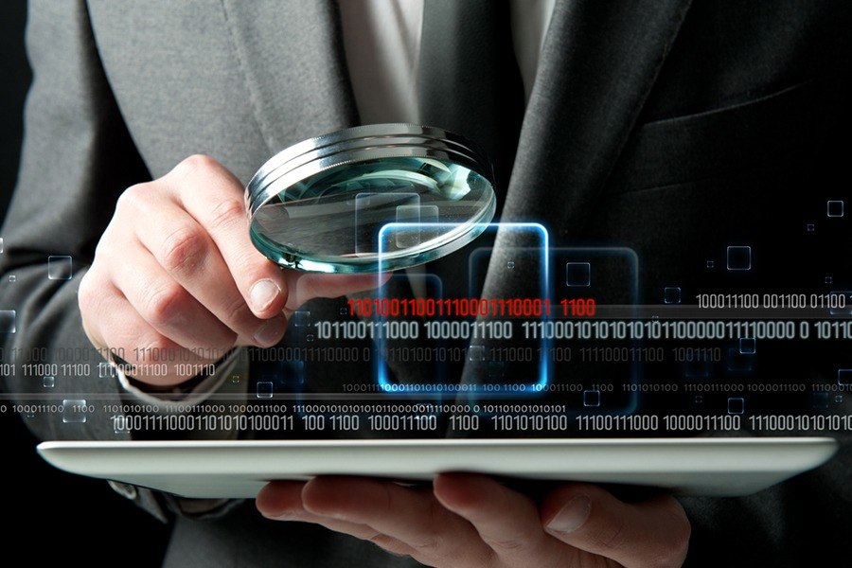
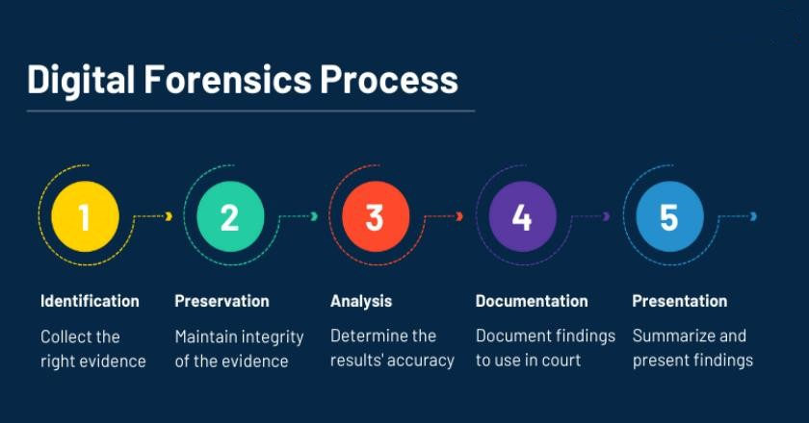
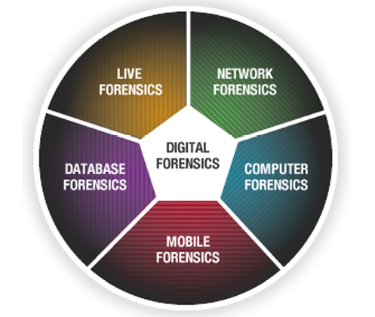
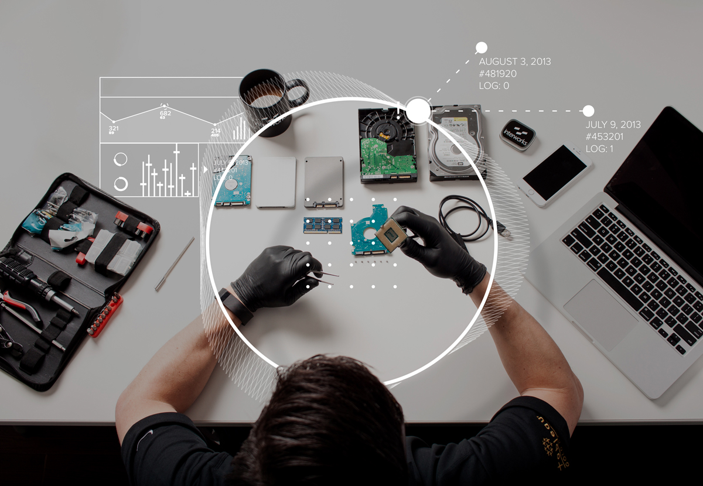

Basics of Cyber Forensics
E.R. Ramesh, M.C.A., M.Sc., M.B.A.,

Slide 2

Basics of
Cyber Forensics
Unit - 4
Standards, Guidelines and Best Practices
Handling the Digital Crime Scene
Digital Evidence Examination Guidelines
  ACPO
  IOCE
  SWGDE
  DFRWS
  IACIS HTCIA
  ISO 27037

Slide 3
Standards, Guidelines and
Best Practices
Basics of
Cyber Forensics
The standard concerns the principles behind, and the forensic processes involved in investigating incidents.
The standards
Provides guidelines that encapsulate idealized models, for common incident investigation processes across various incident investigation scenarios involving digital evidence.
This includes processes from pre-incident preparation up to and including returning evidence for storage or dissemination as well as any general advice and caveats on such processes.

Slide 4
Standards, Guidelines and
Best Practices
Basics of
Cyber Forensics
Guidelines
The guidelines describe processes and principles applicable to various kinds of investigations. An organization’s forensics guidelines should include general methodologies for investigating an incident using forensic techniques, since it is not feasible to develop comprehensive procedures tailored to every possible situation.
The goal for the guidelines and procedures is to facilitate consistent, effective, and accurate forensic actions, which is particularly important for incidents that may lead to prosecution or internal disciplinary actions.

Slide 5
Standards, Guidelines and
Best Practices
Basics of
Cyber Forensics
Because electronic logs and other records can be altered or otherwise manipulated, organizations should be prepared, through their policies, guidelines, and procedures, to demonstrate the integrity of such records.
The International Organization for Standardization (ISO), an international non-governmental organization, and the International Electrotechnical Commission (IEC), an international not-for profit organization, develop and publish international standards to harmonize practices between countries.

Slide 6
Standards, Guidelines and
Best Practices
Basics of
Cyber Forensics
In 2012, the International Organization for Standardization (ISO) and the International Electrotechnical Commission (IEC) published international standards for digital evidence handling (ISO/IEC 27037 Guidelines for Identification, Collection, Acquisition, and Preservation of Digital Evidence).
These guidelines included only the initial handling of digital evidence.
In summary, this International Standard provides a general overview of all incident investigation principles and processes without prescribing particular details.

Slide 7
Standards, Guidelines and
Best Practices
Basics of
Cyber Forensics
Best Practices
Best practice guides are available to identify and promote valid and reliable digital forensics processes and outcomes.
Best practices also serve to encourage professionals to adopt a consistent methodology to facilitate the interchange of data.
The importance of the best practices or guidelines set by the renowned organizations is to make the investigation procedure universal, a synchronization for carrying out investigation where ever it is carried out in the world.

Slide 8
Standards, Guidelines and
Best Practices
Basics of
Cyber Forensics
Best practices guide also help to carry out the investigation fulfilling the Legal criteria. The best practices guide helps in
  Maintaining the professional ethics,
  Ways of handling the evidences,
  Following the principles of forensic examination,
  Proper facilities,
  Discusses about the duties of the investigating personnel,
  Designing a Quality process manual,
  Use of recommended tools and related Equipment,
  Computer forensics examination environment,
  Ways of storing and
  Maintaining chain of custody

Slide 9
Standards, Guidelines and
Best Practices
Basics of
Cyber Forensics
Cases in point are the U.S. Scientific Working Group on Digital Evidence’s best practices for compuer forensic examination, digital evidence collection, and computer forensic acquisitions, and the European Network of Forensic Science Institutes’ best practice manual for the forensic examination of digital technology.

Slide 10
Maintaining Professional Ethics
Basics of
Cyber Forensics
Computer Forensics specialist or any other person involved in a forensics examination has to play an important role by maintaining strict ethical standards.
The basic objective in his/ her role as forensic expert is to ensure that the evidence gathered and analyzed meets the highest quality standards possible.
The investigation he/she has carried out must be complete based on proper guidelines and procedures followed along with the Integrity and Authenticity. The proper handling of evidence and following forensic examination principles is must.

Slide 11
Maintaining Professional Ethics
Basics of
Cyber Forensics
Professional ethics are very important for a Computer Forensics specialist in his job, his / her prime objective in carrying professional duties is to collect evidence, preserve evidence and must ensure that the evidence is properly handled and kept secured. The mindset of a professional must be carried by the forensic experts while:
Going for the identification of the possible evidences at the crime scene.
While performing seizure of computer or computing related device(s).

Slide 12
Maintaining Professional Ethics
Basics of
Cyber Forensics
Acquisition of relevant data
Protecting the system(s) during the forensic examination from any possible alteration.
Proper care while handling of devices to prevent damage, corruption of data.
Analyze all possibly relevant data found and also look into inaccessible areas of a disk like unallocated spaces, Slack spaces, and Hidden file/drives/volume.
Relate the events transpired

Slide 13
Maintaining Professional Ethics
Basics of
Cyber Forensics
Expert witness adds value to your investigation.
Document every action taken and present very concise and reliable report of the investigation

Slide 14
Handling the Digital Evidence
Basics of
Cyber Forensics
Any procedures, processes or practices framed in digital evidence recovery falls within a defined and accepted framework for Computer Forensics investigation and we must comply with the principles stated earlier.
For example in identification and recovery of digital evidences, Computer Forensics specialists must go to the crime scene himself or any crime scene investigator with experience must go himself and recover the evidences. It is important that relevant legal guidelines or constraints are known to the investigator.
In the entire phase of digital forensic process the handling of evidence is very important.

Slide 15
Handling the Digital Evidence
Basics of
Cyber Forensics
While collecting the digital evidences there needs to be an extra care taken. The transportation cannot be neglected.
While collecting digital storage medium such as HDD, Mobile Phones, and Computers care should be taken to prevent exposure to high temperature, water, magnetic field.
For Example: Mobile phones should be collected in Faraday bags as Radio Frequency shield which prevents incoming calls and messages.

Slide 16
Handling the Digital Evidence
Basics of
Cyber Forensics
Since mobile phones have small memory compared to Hard Disk, the oldest message which might be crucial may get deleted when new incoming messages are received.
Also, Mobile phones if the mobile in ON state it shouldn’t be switched off and if the battery is low then, keep it charged till it reaches the forensic workstation, and anti-static bags will prevent any signals and communication of the mobile phone with the surrounding.
Also the phone can be put on an airplane mode. In order to understand some basic steps to be kept in mind.

Slide 17
Digital Evidence Examination Guidelines
Basics of
Cyber Forensics
A single neglectful act can result in the loss of information (digital). An investigator must have a thorough understanding of what is to be recovered from crime scene or in other words what possible evidences can be gathered.
For the process of collecting the evidences few steps are to be kept in mind:
  Preparation
  Searching the scene
  Prioritization
  Evidence collection

Slide 18
Digital Evidence Examination Guidelines
Basics of
Cyber Forensics
Preparation
Prior to any investigation, the Computer Forensics specialist must ensure that he/she has the proper tools including forensically sterile media.
All equipment, sampling materials, storage and transportation containers should be new, preferably disposable, or cleaned thoroughly before and after use.
Extra care and precautionary measures should be taken so that the digital evidence is preserved.

Slide 19
Digital Evidence Examination Guidelines
Basics of
Cyber Forensics
Following steps may be useful in preparation phase:
Follow the Legal procedures and make sure you have a search warrant.
Discuss about the search with involved personnel.
Make sure there is someone as in-charge at the crime scene.
Consider the safety and comfort of search personnel - do not be caught unprepared when encountering a potentially dangerous scene or inclement weather- examples are:
    o Clothing
    o Communication
    o Lighting assistance

Slide 20
Digital Evidence Examination Guidelines
Basics of
Cyber Forensics
    o Shelter
    o Transportation
    o Food
    o Medical assistance
    o Scene security
    o Equipment
  5. Organize communication with services of an ancillary nature (e.g., medical examiner, prosecute attorney) in order that questions which surface during crime scene search may be resolved.

Slide 21
Digital Evidence Examination Guidelines
Basics of
Cyber Forensics
  Also remember to reduce the risk of loss or damage to digital evidence, all areas: indoor, outdoor or while transporting should be protected using procedures that are recommended to be followed to ensure digital evidence remains valid as per the Legal system.

Slide 22
Searching the Crime Scene
Basics of
Cyber Forensics
The search at a crime scene is a very first step an investigator or first responder takes towards a progressive forensic investigation.
Areas should be searched systematically and thoroughly for digital evidences and related material.
To increase investigative efficiency, areas should be targeted and prioritized according to how likely digital evidence may be found and the amount of digital data that may be recovered.

Slide 23
Searching the Crime Scene
Basics of
Cyber Forensics
The followingthings must be kept in mind while doing an investigation are:
Approach scene and first Secure it so that nobody comes near to the scene of crime
Initiate preliminary survey
Evaluate physical evidence that could be possible and primary source of evidence
Prepare narrative description
Photography of a crime scene is very important
Prepare a scene of crime
Always conduct detailed search
Record everything about the evidences and investigators
Conduct final survey

Slide 24
Securing the Crime Scene
Basics of
Cyber Forensics
Securing the crime is most important within the premises where crime occurred. Check for the extent to which scene has been protected.
Gather information from personnel who have entered scene and have knowledge about it. Keep on making the notes.
Keep out unauthorized personnel from accessing the crime scene.

Slide 25
Detailed Search and Collection of Physical Evidence
Basics of
Cyber Forensics
Perform search for all the evidences that possibly should be there. Look in every corner for evidence.
The digital evidence can be very fragile which means volatile data. The most volatile must be preserved first. Also,
Photograph all items before collection
Record everything in evidence form.
Ensure that evidence or the container of evidence is initialed by investigator collecting the evidence.
Do not handle evidence excessively after recovery.
Seal all evidence containers at the crime scene.
Different types of evidence require different media to preserve.

Slide 26
Detailed Search and Collection of Physical Evidence
Basics of
Cyber Forensics
Cross check everything time and again before leaving the crime scene.
Maintain chain of custody of that evidence.
Physical evidence could be various storage media that contains digital evidence. The sources of evidence could be the following: Common Exhibits (Physical Evidence) to be seized:
Memory storage media like HD / FD / CD / DVD / Flash cards / Thumb Drive / Pen Drive / ZIP Drive…
CPU / Laptop
SIM cards / Mobile Phones (GSM / CDMA)
Proper packing is important

Slide 27
Detailed Search and Collection of Physical Evidence
Basics of
Cyber Forensics
Antistatic covers to be used to insulate media from the electromagnetic fields
Thermocole or Bubble covers may be used to ensure shock proof Mobile Phones (GSM / CDMA)
Verify, whether the SIM card is inserted in the phone
Collect the data cables and charger unit if feasible
Check the mobile phone has got extendable memory slot and look for the memory card and seize it If a standalone SIM card presents, it is also to be seized
Proper packing is important
Antistatic covers to be used to insulate media from the electromagnetic fields
Thermocole or Bubble covers may be used to ensure shock proof
If there is a SIM card only, it should be packed properly

Slide 28
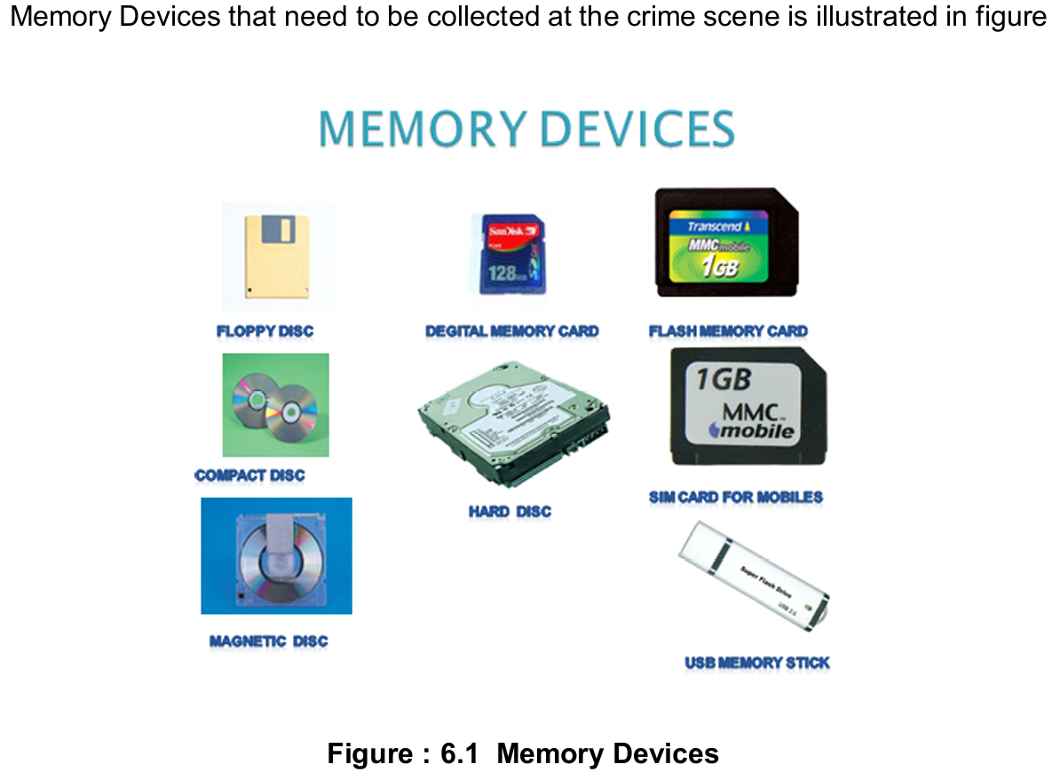
Detailed Search and Collection of Physical Evidence
Basics of
Cyber Forensics

Slide 29
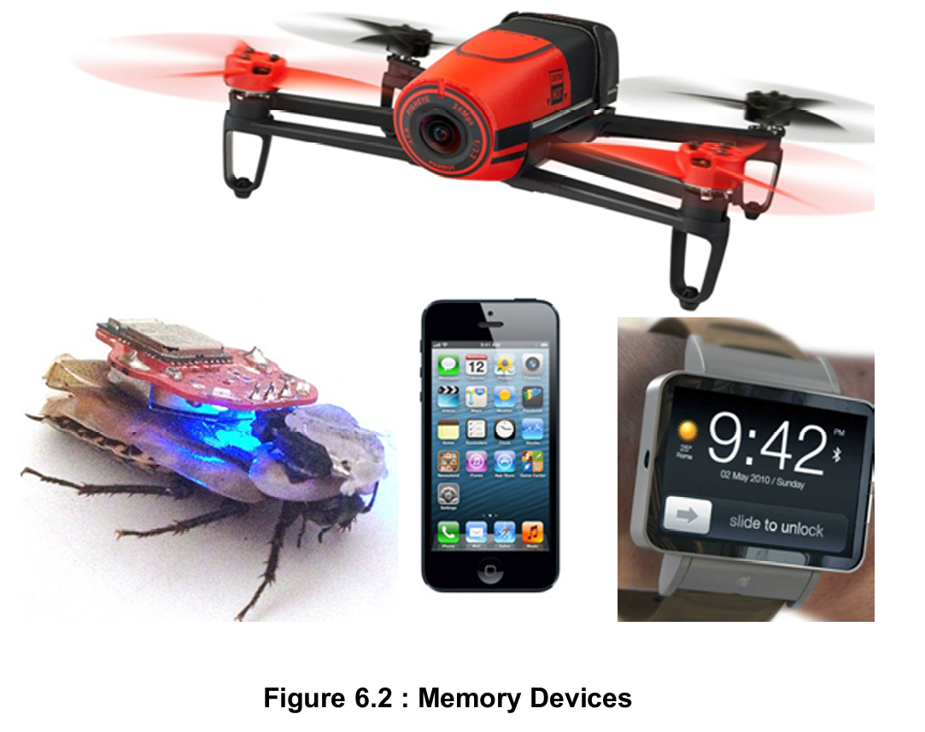
Detailed Search and Collection of Physical Evidence
Basics of
Cyber Forensics

Slide 30
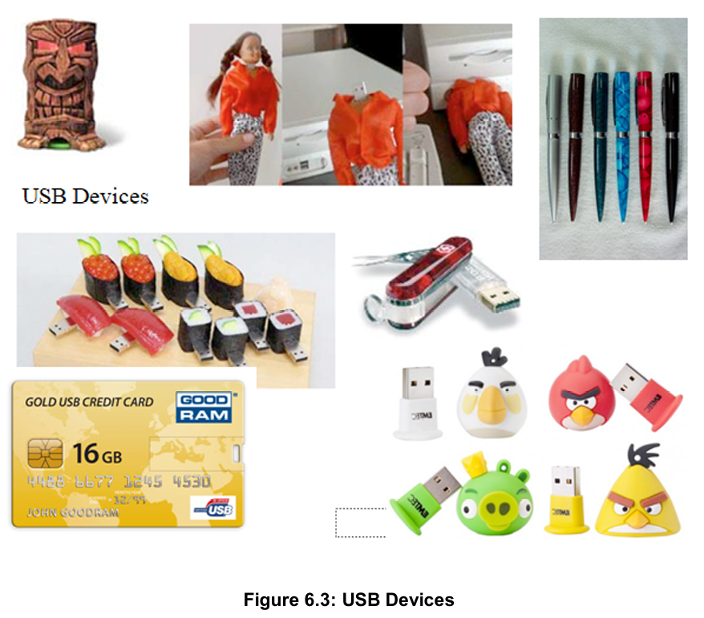
Detailed Search and Collection of Physical Evidence
Basics of
Cyber Forensics

Slide 31
Final Survey
Basics of
Cyber Forensics
Final survey is more often done to attain assurance that the search or the crime scene investigation is done perfectly and nothing is left behind.
What we do is:
Discuss all aspects of the search.
Double check everything.
Ensure all evidence is accounted.
Make sure possible hiding places of difficult access areas have not been overlooked in detailed search.
Critical issues: have you gone far enough in the search for evidence, documented all essential things, and made no assumptions which may prove to be incorrect in the future?

Slide 32
Sizing Evidence
Basics of
Cyber Forensics
General Guidelines concerning the seizing of evidence are provided as follows:
Consult with the investigating officer to determine the necessary equipment to take to the scene.
Review the legal authority to seize the evidence, ensuring any restrictions are noted. If necessary during the execution of the seizure, obtain additional authority for evidence outside the scope of the search.
When it is impractical to remove the evidence from the scene, the evidence items should be copied or imaged according to local procedures.
All suspects, witnesses, and by-standers should be removed from the proximity of digital evidence, ensuring that the above individuals are not in possession of potential evidence.

Slide 33
Sizing Evidence
Basics of
Cyber Forensics
Solicit information from potential suspects, witnesses, LAN administrators, etc. to ascertain knowledge of the system to be seized (e.g., password(s), operating system(s), screen name, email ddress.
Scene should be searched systematically and thoroughly for evidence.
Searchers should be able to recognize the different types of evidence.

Slide 34
Prioritization
Basics of
Cyber Forensics
In general, a Computer Forensics specialist conducting an investigation, must do his work effectively and as quickly as possible.
Because if a case arises where live forensic investigation is needed, the digital evidence is volatile and we must respond very quickly to take dump of the machine.
Another thing is digital evidence from huge stores of data – that may be terabytes in size that definitely can be time consuming, disruptive, and costly. Extracting data from computers can be tampered easily by our slightest of mistake.

Slide 35
Prioritization
Basics of
Cyber Forensics
So let us try to understand what to do, and what to prioritize? The ISIF (Information Security and Forensic Society) of Hong Kong describes:
In conducting an examination for digital evidence, prioritizing the deployment of resources is critical. Yet prioritization of activities is not easy, as the following must be considered before any activities are initiated:
The urgencies and priorities
The nature of the case
Time constraints

Slide 36
Prioritization
Basics of
Cyber Forensics
The other types of forensic examination that may have to be carried out on the same items (E.g. fingerprint analysis).
The items that have the potential to provide the most information in response to the various propositions.
The items offering the best choice of target data, in terms of evidential value.
After an assessment of the relevant requirements, examination activities should be assigned to the appropriate qualified individual(s).

Slide 37
Prioritization
Basics of
Cyber Forensics
The investigator(s) in charge and the investigation team should prioritize evidence collection to prevent loss, destruction or contamination. Team members should:
Conduct a careful and methodical evaluation that considers all physical evidence possibilities (e.g., biological fluids, latent prints and trace evidence.
Focus first on the easily accessible areas in open view and then proceed to out-of view locations.
Select a systematic search pattern for evidence collection based on the size and location of the scene(s).

Slide 38
Prioritization
Basics of
Cyber Forensics
Select a progression of processing and collection methods so that initial techniques do not compromise subsequent methods.
Concentrate on the most transient evidence and work to the least transient forms of physical evidence.
Move from least intrusive to most intrusive processing and collection methods.
Regularly assess environmental and other factors that may affect the evidence.

Slide 39
Prioritization
Basics of
Cyber Forensics
Remain aware of multiple scenes (e.g., victims, suspects, vehicles and locations).
Recognize other methods that are available to locate, document, and collect evidence (e.g., alternate light sources, and blood pattern documentation).
Team members should carefully collect, preserve, package and transport evidence.
Maintain scene security throughout processing and until the scene is released.
Document evidence collection by recording its location at the scene, the date of collection and who collected it.

Slide 40
Prioritization
Basics of
Cyber Forensics
Collect each item identified as evidence. Establish a chain of custody.
Obtain standard and reference samples from the scene.
Obtain control samples.
Consider obtaining elimination samples. Immediately secure electronically recorded evidence (e.g., answering machine tapes, surveillance camera videotapes and computers) from the vicinity. Identify and secure evidence in containers (e.g., label, date and initial container) at the crime scene.

Slide 41
Prioritization
Basics of
Cyber Forensics
Different types of evidence require different containers (e.g., porous/ nonporous and crushproof).
Package items to avoid contamination and cross-contamination.
Document the condition of firearms/weapons prior to rendering them safe for transportation and submission.
Avoid excessively handling the evidence after it has been collected.
Maintain the evidence at the scene in a manner designed to diminish degradation or loss.

Slide 42
Prioritization
Basics of
Cyber Forensics
Transport and submit evidence items for secure storage.

Slide 43
The principles of forensic examination
Basics of
Cyber Forensics
There are Cardinal Rules of Evidence which must be followed by the experts as a part of best practice and these principles include:
Never mishandle evidence
Never work on original evidence
Use proper software utilities
Never trust the suspect operating system
Document everything

Slide 44
The principles of forensic examination
Basics of
Cyber Forensics
The reason behind following these principles are:
Maintenance of data integrity as well as data authenticity without which the evidence is not admissible in court
Prevention of contamination of data
Proper and comprehensive documentation, along with chain of custody etc.
Following proper Digital Forensic Scientific Methodology

Slide 45
Proper facilities
Basics of
Cyber Forensics
The creation of a digital forensic laboratory is not a trivial issue and will be dependent upon a number of factors and be constrained by number of regulations and rules. It involves the provisioning of proper facilities. Facilities Include working space, trained personnel, Hardware, software and so on. In a typical laboratory space required for following functions include:
Reception area with storage
Waiting area/Meeting area
Storage for personal possessions and equipment
Viewing room
Dismantling area
Secure Storage
Sensitive investigation area

Slide 46
Proper facilities
Basics of
Cyber Forensics
Imaging area
Analysis area
Management Office
A significant number of power points will be required in each area.
A number of network ports will also be needed for the laboratory network, but these should be carefully considered and controlled.
The laboratory facilities should have adequate security.

Slide 47
Proper facilities
Basics of
Cyber Forensics
Depending on the configuration of the working areas within the laboratory, consideration should be given to the separation of the workstations into cubicles separated by privacy screens to prevent inadvertent visibility of material on the screen of workstation by anyone using the other workstation.
Three distinct types of storage are required. A significant volume of storage is needed for the evidence and there is also a need for storage of images created and any product of investigation, both images, products for onsite storage, and a backup system of offsite storage should also be facilitated.

Slide 48
Proper facilities
Basics of
Cyber Forensics
Also there needs to be a space to store all of the cables, connectors, attachments and tools required in the process of digital forensics investigations.
The laboratory will also require a storage area for documents, sterile disks, and other disposable items as well as an area or the short term storage of equipment.
The laboratory will need to have facilities such as intrusion detection, fire detection and motion sensor alarm system installed.

Slide 49
The duties of the investigating personnel
Basics of
Cyber Forensics
Investigating Personnel: Computer Forensics examination cannot be possible without trained personnel. A computer forensic investigation cannot be complete without having the required set of:
Skilled personnel: who are very well trained to either conduct or assist in an examination.
Quality Assurance: An important element is a computer forensics Quality Process Manual that will help to ensure consistency of process and provide a valuable reference resource for persons who may be involved in an investigation.
Proper tools and facilities: without the use of proper standard, forensic tools we cannot simply carry away the investigation.

Slide 50
The duties of the investigating personnel
Basics of
Cyber Forensics
These tools or facilities help to keep the evidence secure and safe. Also, helps to save our time during investigation and definitely is very handy.
The person who has an expertise in the subject of computer forensics is usually called as Computer Forensics Examiner/Specialist etc. In simple words he is an expert in this area.
The Computer Forensics Examiner/Specialist cannot be a person who is not well trained in technical stuff. He/she must understand the various technologies and techniques used by the criminals universally.

Slide 51
The duties of the investigating personnel
Basics of
Cyber Forensics
The Computer Forensics Examiner/Specialist must also have an idea of Legal system, jurisdiction and IT related Laws. He/she must have a deep knowledge about the subject and thorough understanding of what transpires so that He/she can interpret rightly what exactly has happened. Few points regarding the areas He/she must be familiar with:
Understanding about the Hardware of the devices
Software and tools being used in Digital Forensics Investigation like EnCase, FTK etc.
Knowledge of different Operating Systems (MOBILE/COMPUTERS)
Knowledge of Internet/web technology
Understanding of Networks and Databases

Slide 52
The duties of the investigating personnel
Basics of
Cyber Forensics
Business, conceptual and/or operational knowledge
Well versed in Programming Languages
Familiar with latest Gadgets (functionality)
Knowledge of Procedures for gathering and preserving digital evidences
Knows the professional or ethical standards.

Slide 53
Designing a Quality process manual
Basics of
Cyber Forensics
The Digital forensic methodology is to be followed with accuracy and once the procedures followed and the quality of the work done, there should be a documented computer forensics Quality Process Manual covering all systems, processes and methods used in the examination and reporting of forensic digital evidence.
The Information Security and Forensics Society, Hong Kong (ISFS) describes the process documentation and use of Quality Process Manual.
It provides detailed steps and procedures to be followed during an examination.

Slide 54
Designing a Quality process manual
Basics of
Cyber Forensics
Such a Quality Process Manual would not only help ensure consistency of process, it could additionally serve as an important reference resource for personnel who may find themselves in a first responder situation.
This information can be particularly critical as first responders who are unaware of proper forensics procedures may inadvertently destroy valuable evidence.

Slide 55
Process Documentation
Basics of
Cyber Forensics
Process Documentation includes the following:
Standard operating procedures
Contacts
Evidence handling and tracking
Corrective action policy/procedures
Complaint and conflict resolution
Among other things, this Quality Process Manual should document organizational policy outlining the following:
Steps to be taken in the event a forensic examination is necessary Procedures to follow Persons to contact Whenever appropriate the Quality Process Manual should provide standardized form templates.

Slide 56
Process Documentation
Basics of
Cyber Forensics
It should be organized in an easily accessible, reference able and comprehensive format, be regularly reviewed and updated if necessary.
Readers should be aware that such standards documentation is common among firms that value quality, for instance organizations that are ISO 9000 certified.
A Quality Process Manual also a good indicator to staff, investors and others of the importance of quality to the organization.

Slide 57
For organizations conducting investigations
Basics of
Cyber Forensics
For organizations that are conducting forensics examinations, their Quality Process Manual should also include procedures and information on:
Standard Operating Procedures
Complaints and conflict resolution
Corrective Action Policy/Procedures

Slide 58
Standard Operating Procedures
Basics of
Cyber Forensics
The Standard Operating Procedures should define everything starting from:
Incident identification– Where an event is recognized as an incident it should be classified into a type of incident.
Preparation – Detailed procedures for the proper preparation of tools, techniques, monitoring authorizations and management support.
Approach strategy – Provide details about the best practices and guidelines on how approach for search and seizure of evidences so that positive result is guaranteed.

Slide 59
Standard Operating Procedures
Basics of
Cyber Forensics
The Standard Operating Procedures should define everything starting from:
Incident identification– Where an event is recognized as an incident it should be classified into a type of incident.
Preparation – Detailed procedures for the proper preparation of tools, techniques, monitoring authorizations and management support.
Approach strategy – Provide details about the best practices and guidelines on how approach for search and seizure of evidences so that positive result is guaranteed.

Slide 60
Standard Operating Procedures
Basics of
Cyber Forensics
Preservation – Isolating, securing and preserving the state of physical and digital evidence.
Collection – Procedures and processes for recording the physical scene and duplication of digital evidence using standardized and accepted practices.
Documentation - Maintaining record of actions taken during an investigation.
Analysis – Look for evidences and draw conclusions based on evidence found.

Slide 61
Standard Operating Procedures
Basics of
Cyber Forensics
Presentation – Provide a structured and clear report which explains the conclusions reached.
It shouldn’t be more technical, non-technical person should be able to understand easily.

Slide 62
Use of recommended tools and related Equipment
Basics of
Cyber Forensics
Forensic Hardware: Forensic hardware includes workstation, write blockers, and forensic devices. (a)
Forensic Workstations Forensic Recovery of Evidence Device (FRED, Digital Intelligence) family of workstations consists of integrated forensic processing platforms capable of handling the most challenging computer case.
FRED is available in Mobile, Stationary and laboratory configurations.

Slide 63
Use of recommended tools and related Equipment
Basics of
Cyber Forensics
These systems are designed for both the acquisition and examination of Digital evidence. FRED professional forensic systems and the Digital Intelligence Ultrabay universal write protected, imaging bay, deliver the ability to easily duplicate evidence directly fromIDE/SCSI/SATA hard drives, USB Devices, Firewire devices, floppies, CDs,DVDs, ZIP cartridges, DLT-V4 tapes and PC Card/smart card/SD –MMC/Memory stick/Compact Flash Media in a forensically sound environment.Various categories of FRED workstations are:
FRED – Forensic Recovery of Evidence Device an ideal tool forlaboratory for imaging and processing

Slide 64
Use of recommended tools and related Equipment
Basics of
Cyber Forensics
FREDDIE – a highly portable solution which meets both imaging andprocessing requirements FRED interrogation Equipment.
FRED- L – The Laptop of FRED family of tools
FRED- microFRED the smallest, full powered Forensic Workstation
FRED Systems: is the complete forensic hardware and hardwaresolution. The 19" LCD monitor is included. The available OSs on thissystem is MS 6.22, Wins 98, Wins XP Pro, and Linux 9.1 Pro. Somesoftware such as Norton GHOST 10.0 & 2003, Nero DVD/CD

Slide 65
Use of recommended tools and related Equipment
Basics of
Cyber Forensics
Authoring Software, DriveSpy, Image, PDWipe, PDBlock, and PARTare included.
Other open source forensic workstation with pre-installed software with collection of tools includes:
SIFT Workstation – Ubuntu flavor with collection of forensic tools pre-installed
Kali Linux- Linux based workstation with collection of forensic tools

Slide 66
Forensic Network
Basics of
Cyber Forensics
Forensic Network is a series of processing and imaging computers connected and integrated directly with a high speed, high capacity server to share resources.
The file server operates as the core of the Forensic Network and can be used as a central storage facility for Forensic Images as well as the applications software for use by the client processing and imaging stations.

Slide 67
Forensic Write Blockers
Basics of
Cyber Forensics
Forensic write blockers are Write blockers are devices that allow acquisition of information on a drive without creating the possibility of accidentally damaging the drive contents.
They do this by allowing read commands to pass but by blocking write commands, hence their name.

Slide 68
…..
Basics of
Cyber Forensics
……

Slide 69
…..
Basics of
Cyber Forensics
……

Slide 70

Q & A
Basics of
Cyber Forensics
E.R. Ramesh, M.C.A., M.Sc., M.B.A.,
98410 59353, 98403 50547
rameshvani@gmail.com

