Slide 1
NETWORK SECURITY AND CRYPTOGRAPHY

Slide 2
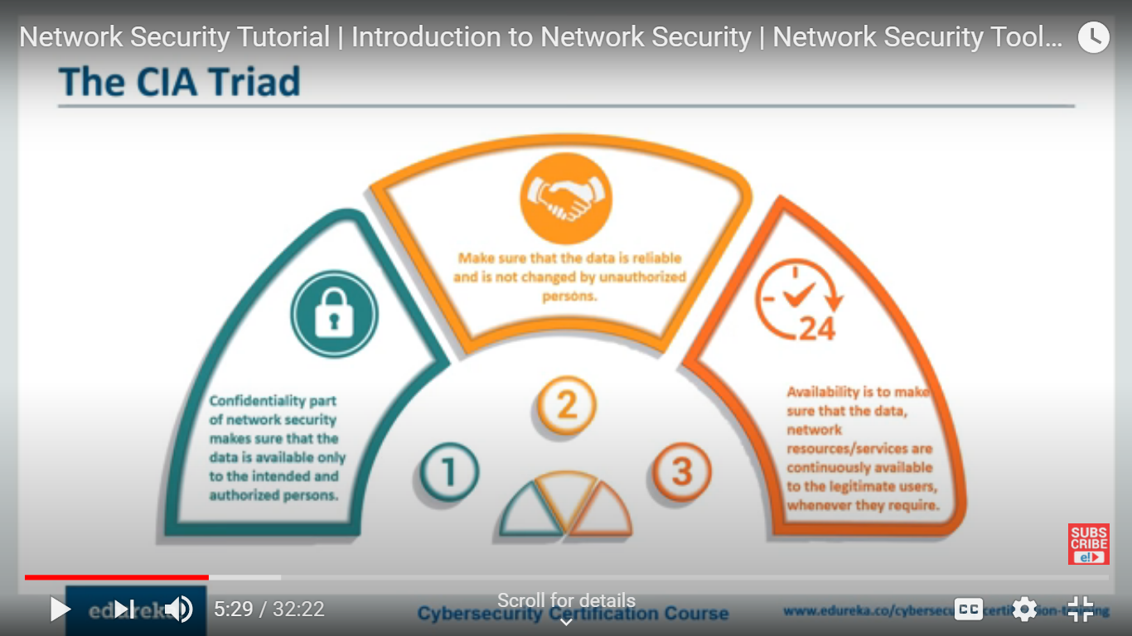
CIA Traid

Slide 3
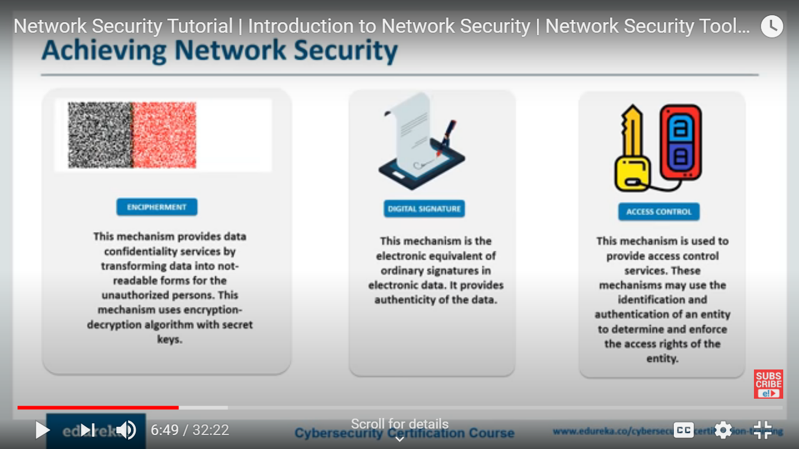

Slide 4
DAD Triad
Goals for defeating the security of an organization.
Disclosure:
Unauthorized individuals gain access to confidential information.
Alteration
Data is modified through some unauthorized mechanism
Denial
Authorized users cannot gain access to the system for legitimate purposes.
DAD activities may be malicious or accidental

Slide 5
PGP
Defacto standard for providing security in the E-mail communication
It uses public key cryptography, symmetric key cryptography, hash functions to provide privacy, sender authentication, integrity and non repudiation
It also provides data compression and key management support.
It uses RSA, MD5 and IDEA

Slide 6
S/MIME
S/MIME, or Secure/Multipurpose Internet Mail Extensions, is a technology that allows you to encrypt your emails.
S/MIME is based on asymmetric cryptography to protect your emails from unwanted access.
It also allows you to digitally sign your emails to verify you as the legitimate sender of the message, making it an effective weapon against many phishing attacks out there.

Slide 7
SSL
Secure Socket Layer
In the year 1995 Netscape developed SSL version 2 and used in the Netscape navigator 1.1
Netscape developed SSL version 3 in 1999 by many security updates

Slide 8
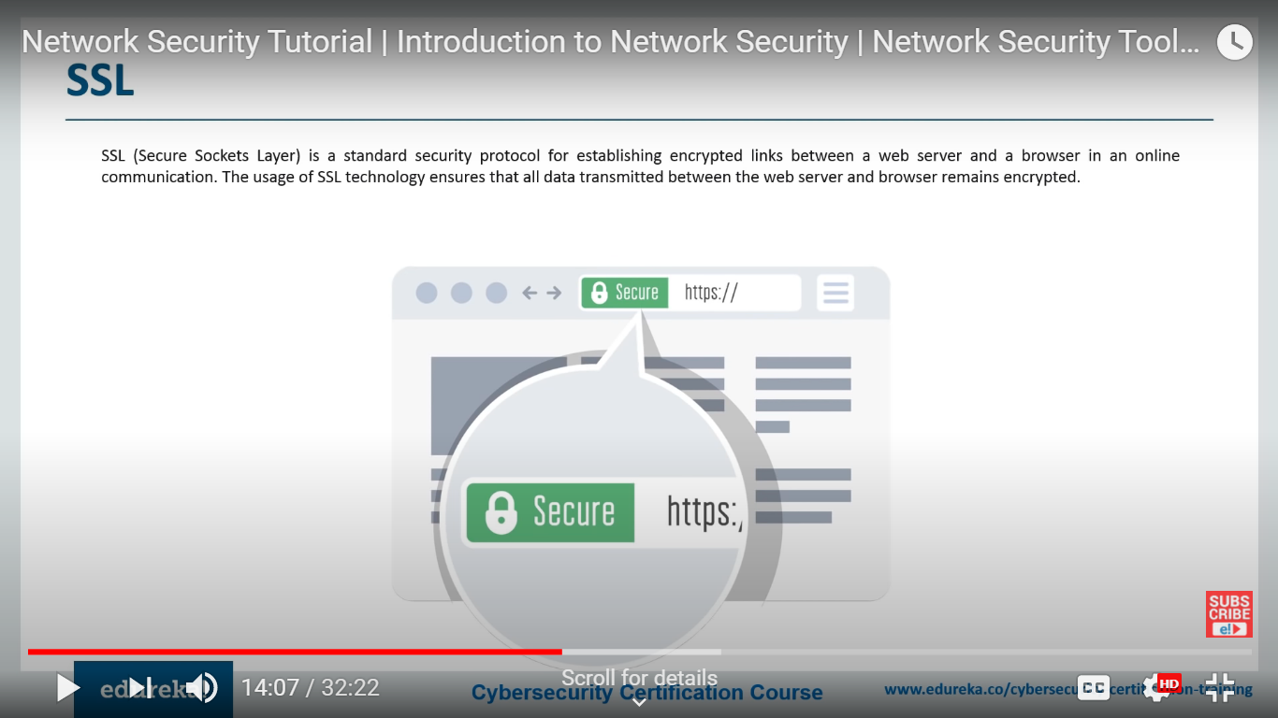
SSL

Slide 9
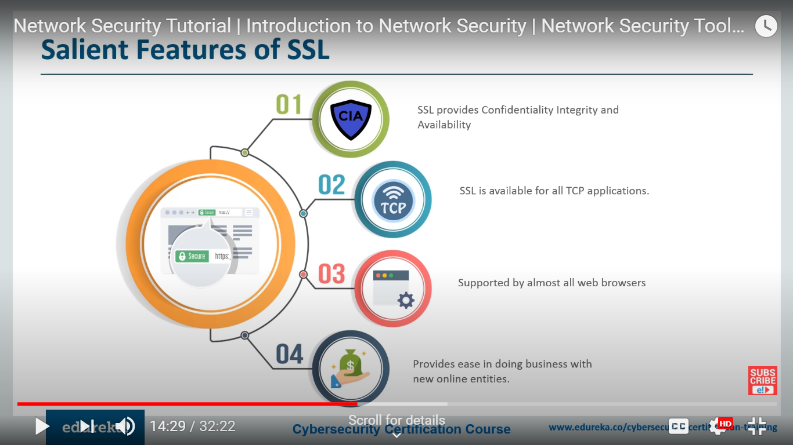
Salient Features

Slide 10
Confidentiality maintained by exchanging the information in the encrypted form.
Authenticated the communication entities by Server certificates

Slide 11
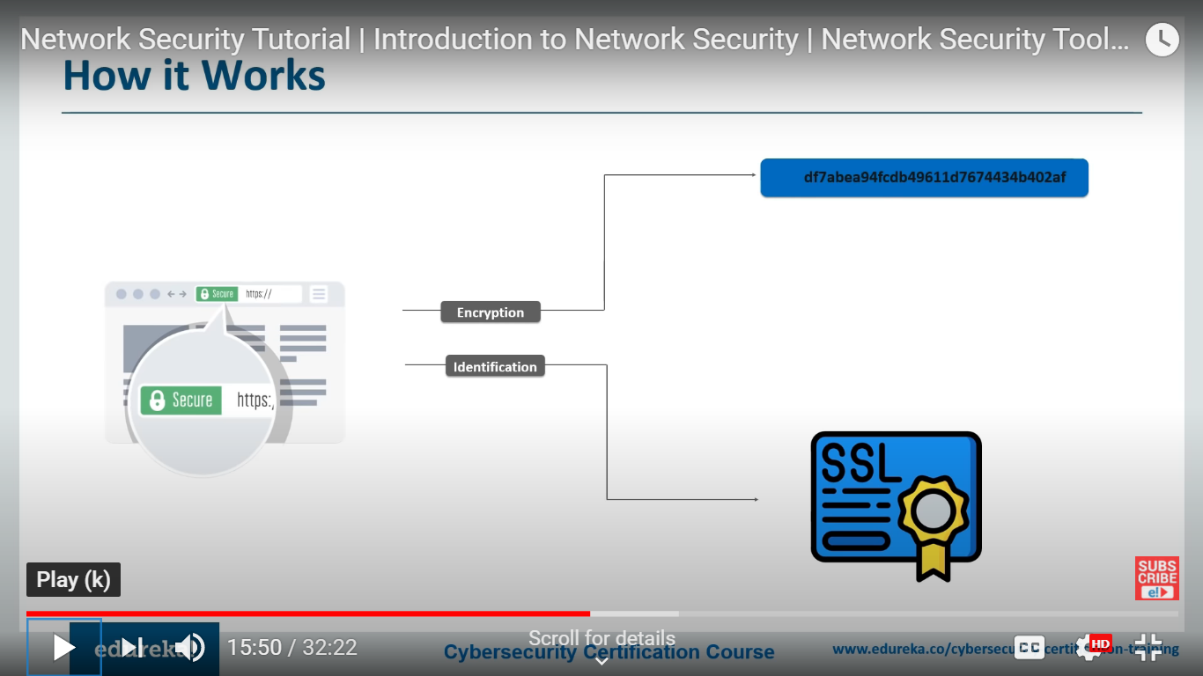
Working

Slide 12
TLS
Transport Layer Security (TLS) encrypts data sent over the Internet to ensure that eavesdroppers and hackers are unable to see what you transmit which is particularly useful for private and sensitive information such as passwords, credit card numbers, and personal correspondence.
TLS protocol aims primarily to provide cryptography, including privacy (confidentiality), integrity and authenticity through the use of certificates, between two or more communicating computer applications. It runs in the Application Layer.

Slide 13
With TLS it is also desirable that a client connecting to a server is able to validate ownership of the server’s public key.
This is normally undertaken using an X.509 digital certificate issued by a trusted third party known as a Certificate Authority (CA) which asserts the authenticity of the public key.
In some cases, a server may use a self-signed certificate which needs to be explicitly trusted by the client (browsers should display a warning when an untrusted certificate is encountered), but this may be acceptable in private networks and/or where secure certificate distribution is possible.
It is highly recommended though, to use certificates issued by publicly trusted CAs.

Slide 14
SET
Secure Electronic Transaction
It is an open encryption and security specification designed to protect credit card transactions on the internet.
It is in effect a set of protocols for ensuring security and confidentiality.
It is first used in February 1996 and was proposed by Visa and MasterCard

Slide 15
Wireless Authentication Protocols
These are a number of wireless authentication protocols including
EAP | Extensible Authentication Protocol
LEAP | Lightweight Extensible Authentication protocol
PEAP | Protected Extensible Authentication Protocol

Slide 16
Extensible authentication Protocol (EAP)
Extensible Authentication Protocol (EAP) is an authentication framework.
It is frequently used in wireless networks and point – to – point connections.
It provides some common functions and negotiation of authentication methods called EAP methods.
EAP authentication is generally initiated by the server. It is a protocol that basically supports a wide range of authentication protocols.

Slide 17
LEAP (Lightweight Extensible Authentication Protocol)
Proprietary protocol from Cisco Systems
To authenticate the client must provide username and password credentials, then both client and Access Point (AP) exchanges encrypted challenge phrase.
Access is provided to client if encrypted challenge phrase matches.
Later it was found vulnerable, so LEAP has since been deprecated.

Slide 18
Protected Extensible Authentication Protocol (PEAP)
PEAP was developed jointly by Cisco, Microsoft and RSA Security.
It uses the Digital Certificate. Authentication server present a Digital Certificate (DC) to clients in outer authentication, if clients are satisfied with DC, then a TLS tunnel is built for inner authentication.
The Digital Certificate consist of data in a standard form that identifies owner.

Slide 19
IPSEC
IPsec (Internet Protocol Security) is a framework that helps us to protect IP traffic on the network layer.
Reason:
Because the IP protocol itself doesn’t have any security features at all.

Slide 20
Security Associations (SA)
An association is a one-way relationship between a sender and a receiver that affords security services to the traffic carried on it.

Slide 21
IKE (Internet Key Exchange)
IKE (Internet Key Exchange) is one of the primary protocols for IPsec since it establishes the secure, authenticated communication channel between two parties.
IKE enables two parties on the internet to communicate securely. Specifically, it is a key management protocol used to set up a security association (SA) using IPSEC
IKE uses two phases:
IKE Phase 1
IKE Phase 2

Slide 22
IKE phase 1
In IKE phase 1, two peers will negotiate about the encryption, authentication, hashing and other protocols that they want to use and some other parameters that are required.
In this phase, an ISAKMP (Internet Security Association and Key Management Protocol) session is established.
This is also called the ISAKMP tunnel or IKE phase 1 tunnel.

Slide 23
IKE Phase 1
The main purpose of IKE phase 1 is to establish a secure tunnel that we can use for IKE phase 2.

Slide 24
Step 1 : Negotiation
Hashing: we use a hashing algorithm to verify the integrity, we use MD5 or SHA for this.
Authentication: each peer has to prove who he is. Two commonly used options are a pre-shared key or digital certificates.
DH (Diffie Hellman) group: the DH group determines the strength of the key that is used in the key exchange process. The higher group numbers are more secure but take longer to compute.
Lifetime: how long does the IKE phase 1 tunnel stand up? the shorter the lifetime, the more secure it is because rebuilding it means we will also use new keying material. Each vendor uses a different lifetime, a common default value is 86400 seconds (1 day).
Encryption: what algorithm do we use for encryption? For example, DES, 3DES or AES.

Slide 25
Step 2: DH Key Exchange
Once the negotiation has succeeded, the two peers will know what policy to use. They will now use the DH group that they negotiated to exchange keying material. The end result will be that both peers will have a shared key.

Slide 26
Step 3: Authentication
The last step is that the two peers will authenticate each other using the authentication method that they agreed upon on in the negotiation. When the authentication is successful, then IKE phase 1 completed.
The end result is a IKE phase 1 tunnel (aka ISAKMP tunnel) which is bidirectional.
This means that both peers can send and receive on this tunnel.

Slide 27
The three steps above can be completed using two different modes:
Main mode
Aggressive mode
Main mode uses six messages while aggressive mode only uses three messages. Main mode is considered more secure.

Slide 28
IKE-Phase 2
The IKE phase 2 tunnel (IPsec tunnel) will be actually used to protect user data. There is only one mode to build the IKE phase 2 tunnel which is called quick mode.

Slide 29
IPsec Protocol: do we use AH or ESP?
Encapsulation Mode: transport or tunnel mode?
Encryption: what encryption algorithm do we use? DES, 3DES or AES?
Authentication: what authentication algorithm do we use? MD5 or SHA?
Lifetime: how long is the IKE phase 2 tunnel valid? When the tunnel is about to expire, we will refresh the keying material.
(Optional) DH exchange: used for PFS (Perfect Forward Secrecy).

Slide 30
IPSec Protocol Mode: Tunnel, transport, or wildcard (required for all implementations).
Path MTU: Any observed path maximum transmission unit (maximum size of a packet that can be transmitted without fragmentation) and aging variables (required for all implementations).

Slide 31
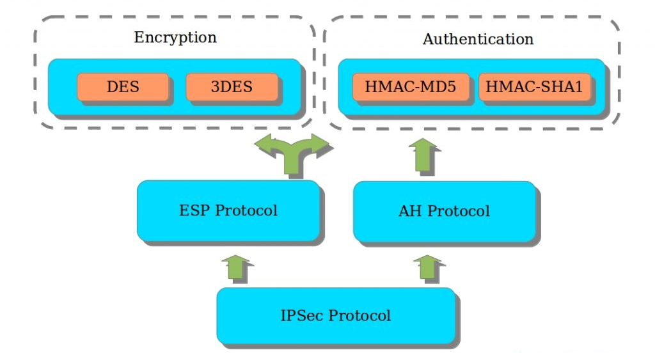
IPSEC Protocol

Slide 32
Both protocols support two different modes:
Transport mode
Tunnel mode
The main difference between the two is that with transport mode we will use the original IP header where only the packet payload is encrypted while in tunnel mode, we use a new IP header where the entire packet is encrypted.

Slide 33
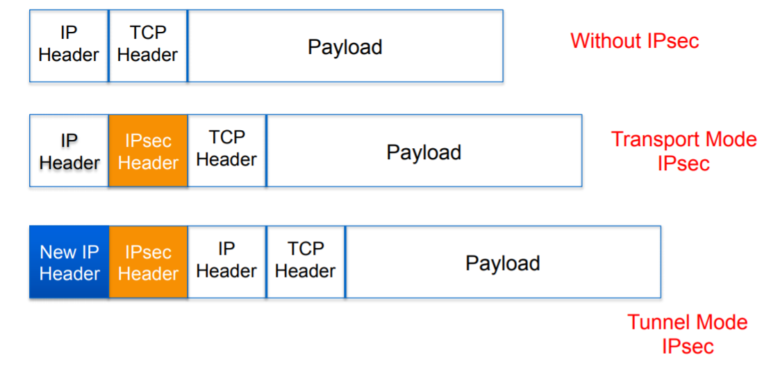
Transport and Tunnel Mode

Slide 34
AH (Authentication Header)
ESP (Encapsulating Security Payload)
AH and ESP both offer authentication and integrity but only ESP supports encryption. Because of this, ESP is the most popular choice nowadays.

Slide 35
Point to point protocol (ppp)
Point to point protocol is basically an asymmetrical protocol suite for different connections or links
PPP also wants other protocols to establish connection, authenticate users and to carry the network layer data.
PPP is not a single protocol but a protocol suite that includes protocols that simply address different aspects of point to point layer 2 communication
There are basically 2 routers in the PPP session i.e., initiator (mainly client) and Responder (mainly server).

Slide 36
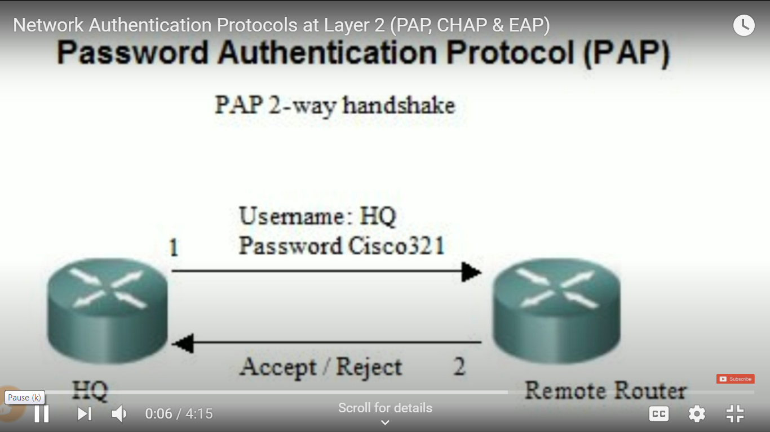
PAP

Slide 37
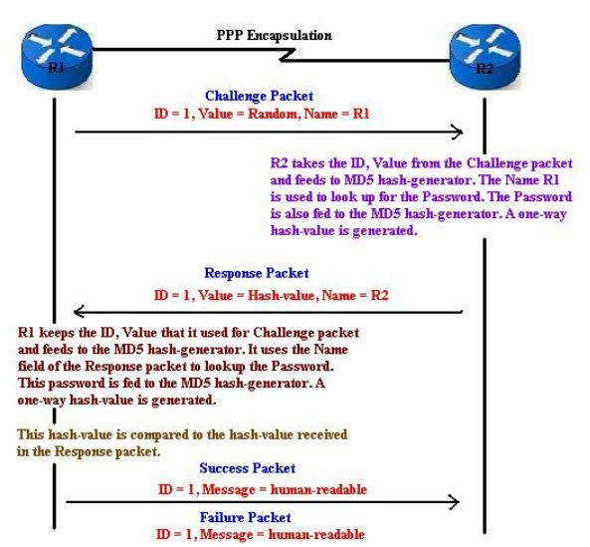
CHAP

Slide 38
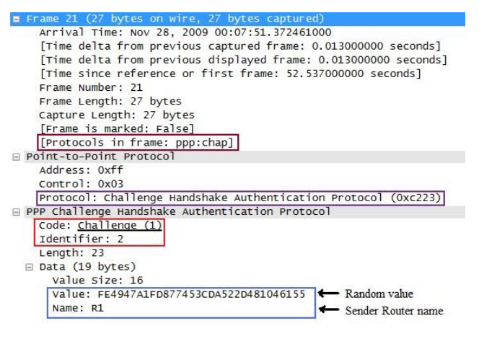
Challenge

Slide 39
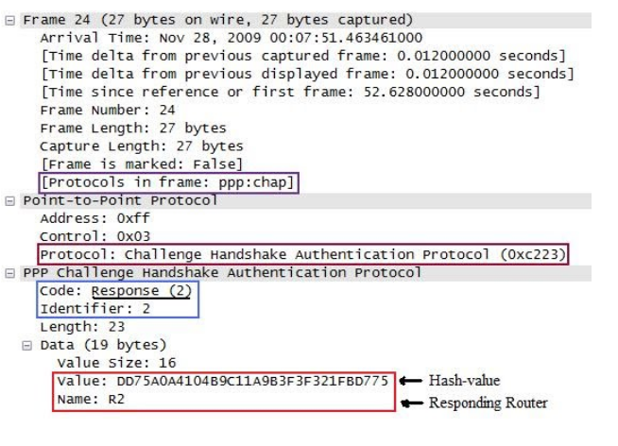
Response

Slide 40
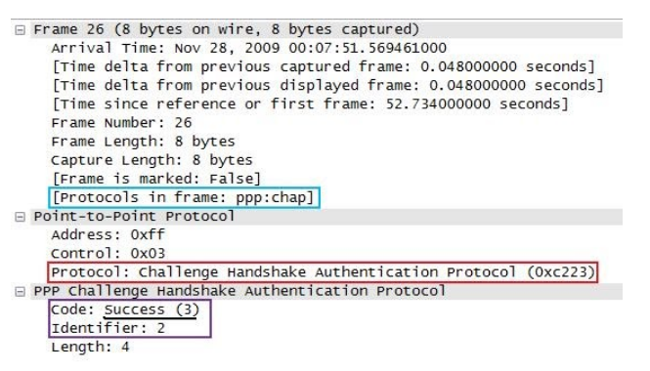
Success

Slide 41
AAA
Authentication, Authorization and Accounting (AAA).
Before allowing and entity to perform certain actions, you must ensure you know who that entity actually is (Authentication) and if the entity is authorized to perform that action (Authorization). Additionally, you need to ensure that accurate records are maintained showing that the action has occurred, so you keep a security log of the events (Accounting).

Slide 42
RADIUS and TACACS+
Remote Access Dial In User Service (RADIUS) and Terminal Access Controller Access-Control System Plus (TACACS+) are two common security protocols used to provide centralized access into networks.
RADIUS was designed to authenticate and log remote network users, while TACACS+ is most commonly used for administrator access to network devices like routers and switches. Both protocols provide centralized Authentication, Authorization, and Accounting (AAA) management for computers that connect and use a network service.

Slide 43
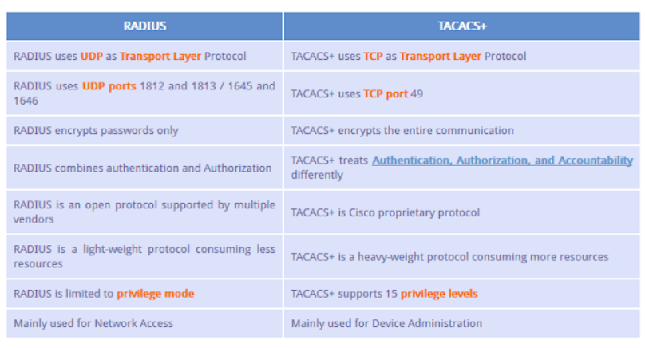

Slide 44
HDLC
High – Level Data Link Control (HDLC) is a group of communication protocols of the data link layer for transmitting data between network points or nodes.
Since it is a data link protocol, data is organized into frames.
A frame is transmitted via the network to the destination that verifies its successful arrival.
It is a bit – oriented protocol that is applicable for both point – to – point and multipoint communications.

Slide 45
HDLC
HDLC supports two types of transfer modes are
1. Normal Response mode (NRM)
2. Asynchronous Balanced Mode (ABM)

Slide 46
Normal Response Mode (NRM)
In this mode, the configuration of the station is unbalanced. There are one primary station and multiple secondary stations. Where the primary station can send the commands and the secondary station can only respond.
This mode is used for both point-to-point as well as multiple-point links.

Slide 47
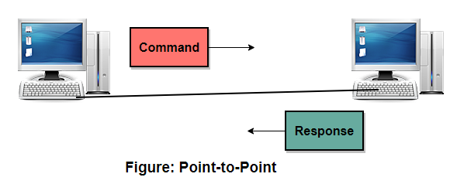
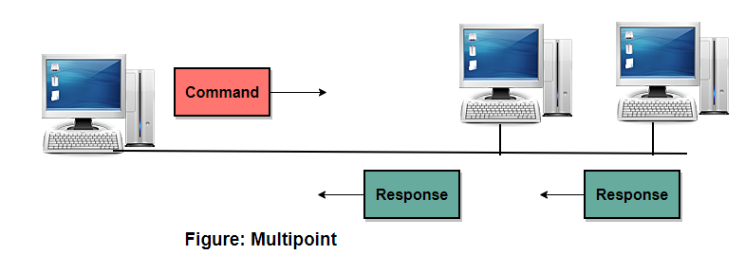

Slide 48
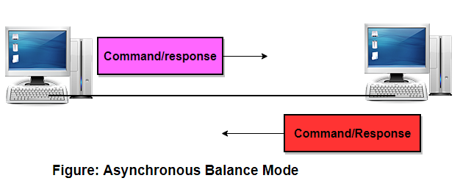
Asynchronous Balance Mode (ABM)
In this mode, the configuration of the station is balanced. In this mode, the link is point-to-point, and each station can function as a primary and as secondary.
Asynchronous Balance mode(ABM) is a commonly used mode today.

Slide 49
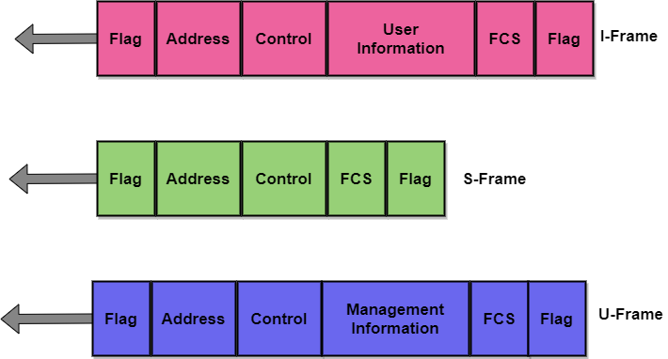
HDLC Frame

Slide 50
Layer 2 forwarding protocol (l2f)
L2F, or Layer 2 Forwarding, is a tunnelling protocol developed by Cisco systems to establish VPN connections over the Internet.
L2F does not provide encryption or confidentiality by itself.
L2F was specifically designed to tunnel point – to – point protocol traffic.
L2F has been superseded by L2TP, L2F uses port 1701/udp.

Slide 51
Point-to-Point Tunneling Protocol
PPTP stands for Point-to-Point Tunneling Protocol. PPTP, operating on TCP port 1723, is one of the oldest VPN protocols
PPTP was developed by a Microsoft
Out of all the VPN protocols, PPTP is one of the most common, easiest to set up, and computationally fastest.
However, PPTP is also subject to serious security vulnerabilities.
For this reason, PPTP is NOT recommended except in cases where security is absolutely non-essential

Slide 52
Layer 2 Tunneling Protocol (L2TP)
L2TP stands for Layer 2 Tunneling Protocol.
L2TP was first proposed in 1999 as an upgrade to both L2F (Layer 2 Forwarding Protocol) and PPTP (Point-to-Point Tunneling Protocol). Because L2TP does not provide strong encryption or authentication by itself, another protocol called IPsec is most often used in conjunction with L2TP.

Slide 53
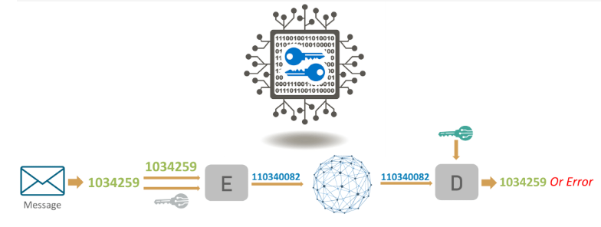
What Is Cryptography?
Cryptography is the practice and study of techniques for securing communication and data in the presence of adversaries.

Slide 54
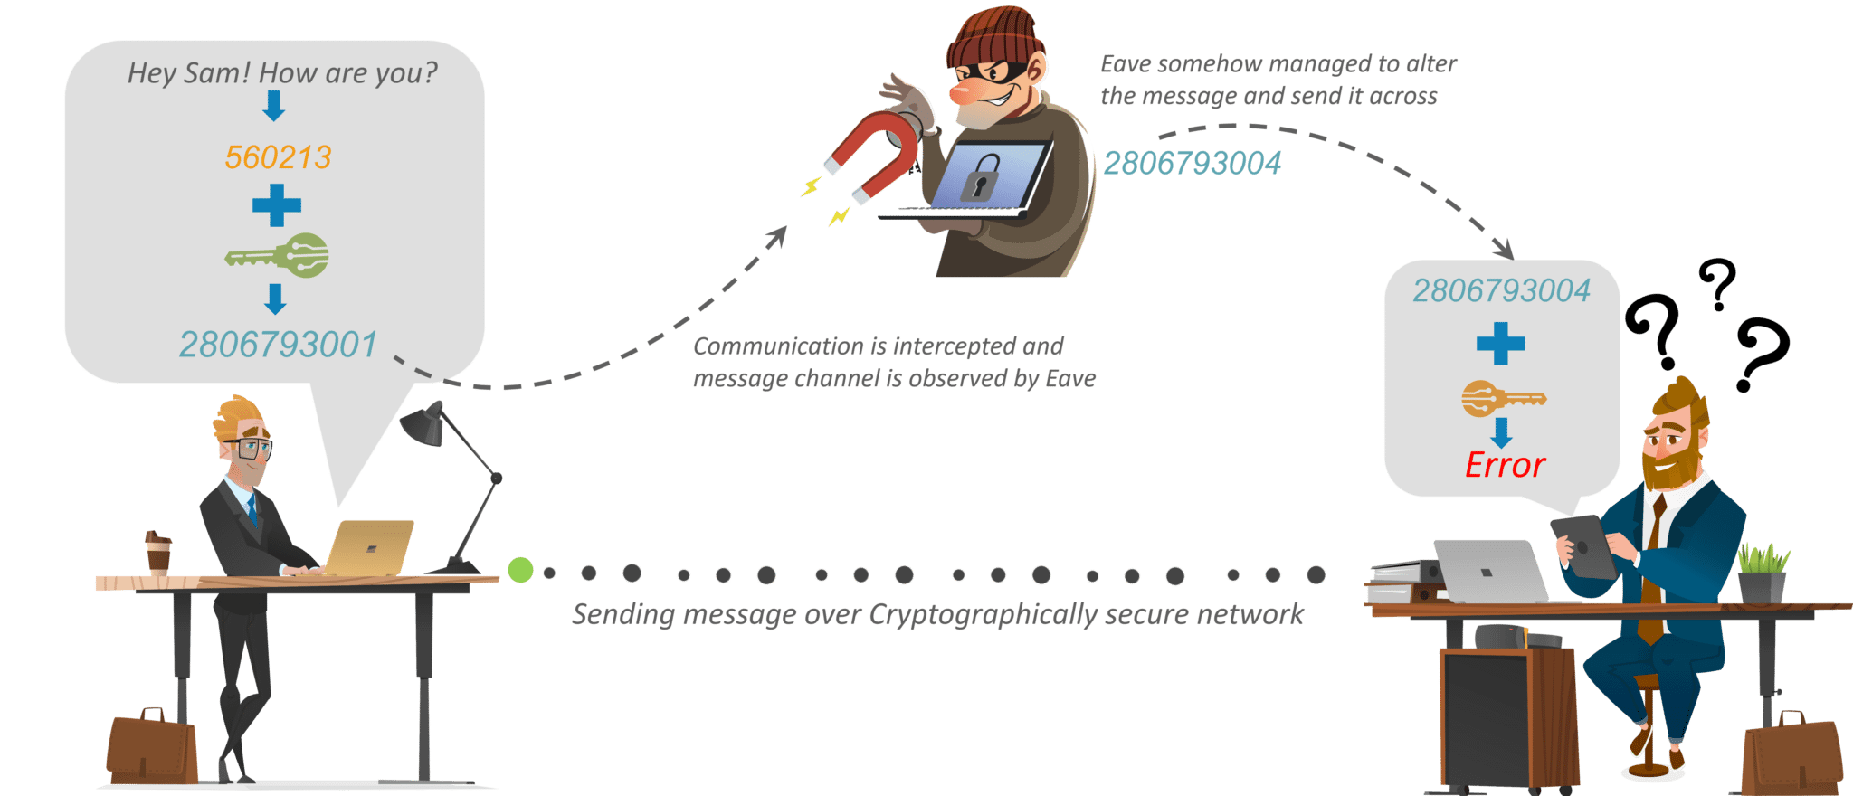

Slide 55
Basic Terminologies
Plaintext - original message
Ciphertext - coded message
Cipher - algorithm for transforming plaintext to ciphertext
Key - info used in cipher known only to sender/receiver
Encipher (encrypt) - converting plaintext to ciphertext
Decipher (decrypt) - recovering plaintext from ciphertext
Cryptography - study of encryption principles/methods
Cryptanalysis (codebreaking) - study of principles/ methods of deciphering ciphertext without knowing key
Cryptology - field of both cryptography and cryptanalysis

Slide 56
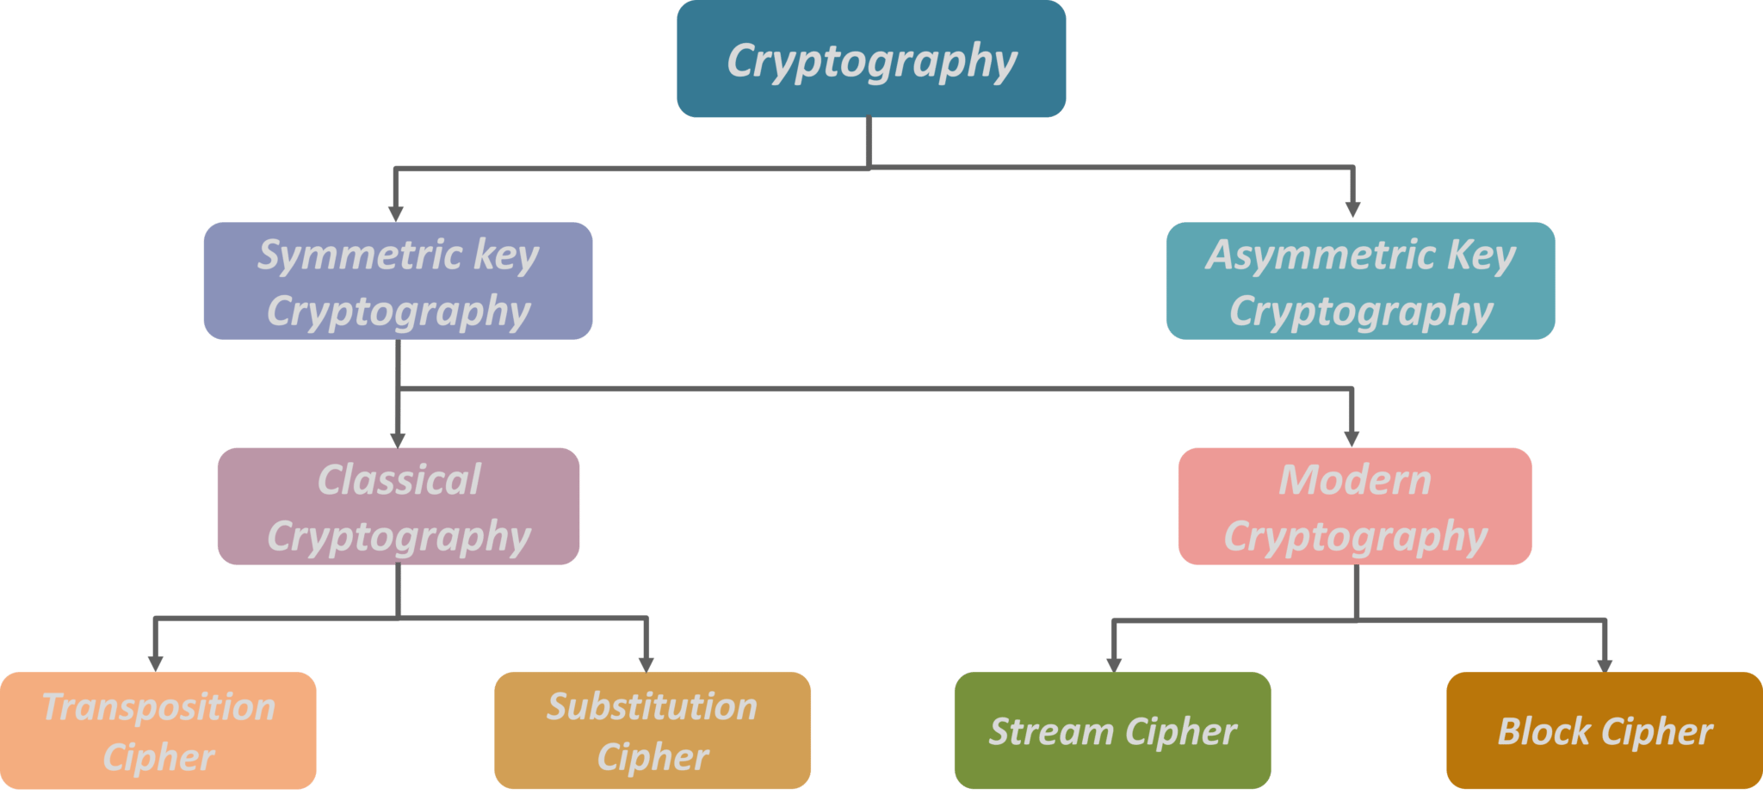

Slide 57
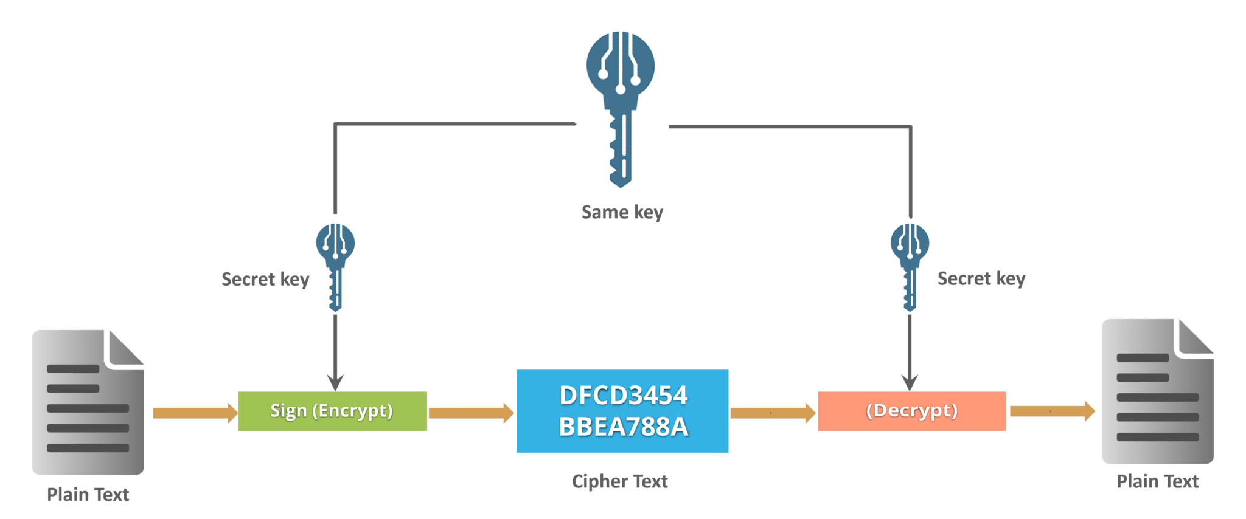
Symmetric Key Cryptography
An encryption system in which the sender and receiver of a message share a single, common key that is used to encrypt and decrypt the message. The most popular symmetric–key system is the Data Encryption Standard (DES)

Slide 58
Substitution Cipher
Method of encryption by which units of plaintext are replaced with ciphertext, according to a fixed system; the “units” may be single letters (the most common), pairs of letters, triplets of letters, mixtures of the above, and so forth.

Slide 59
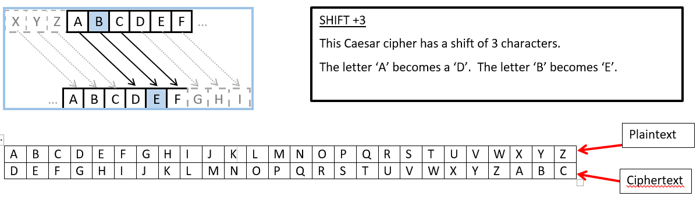
Caesar Cipher

Slide 60
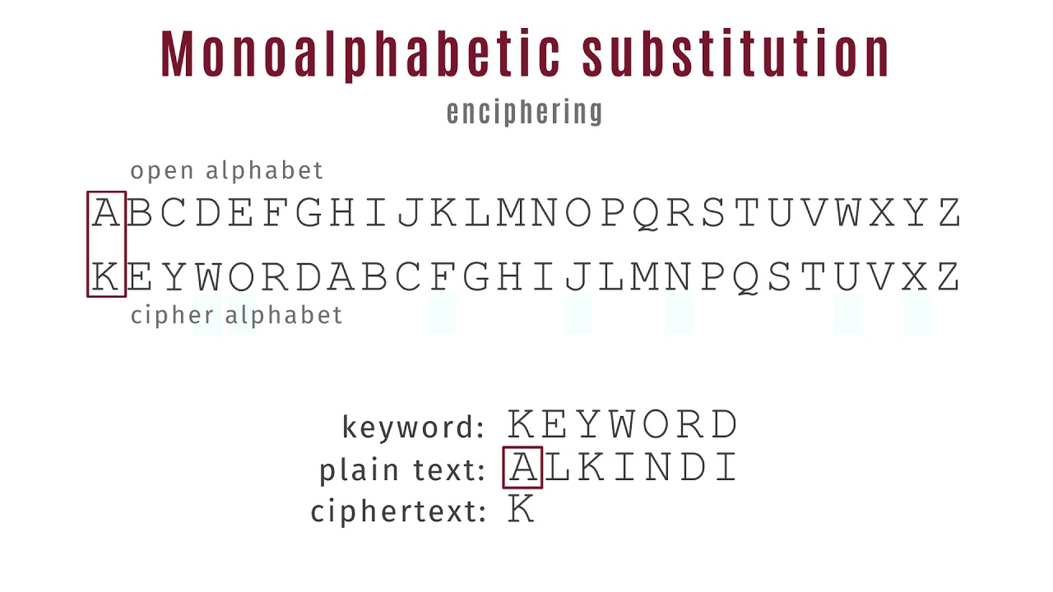
Monoalphabetic Substitution

Slide 61
One-Time Pad
If a truly random key as long as the message is used, the cipher will be secure
Is unbreakable since ciphertext bears no statistical relationship to the plaintext
Since for any plaintext & any ciphertext there exists a key mapping one to other
Can only use the key once though
Problems in generation & safe distribution of key

Slide 62
Transposition Ciphers
In Cryptography, a transposition cipher is a method of encryption by which the positions held by units of plaintext (which are commonly characters or groups of characters) are shifted according to a regular system, so that the ciphertext constitutes a permutation of the plaintext.

Slide 63
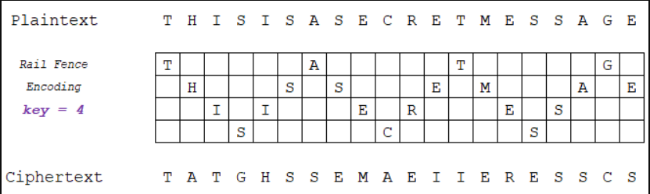
Rail Fence Cipher

Slide 64
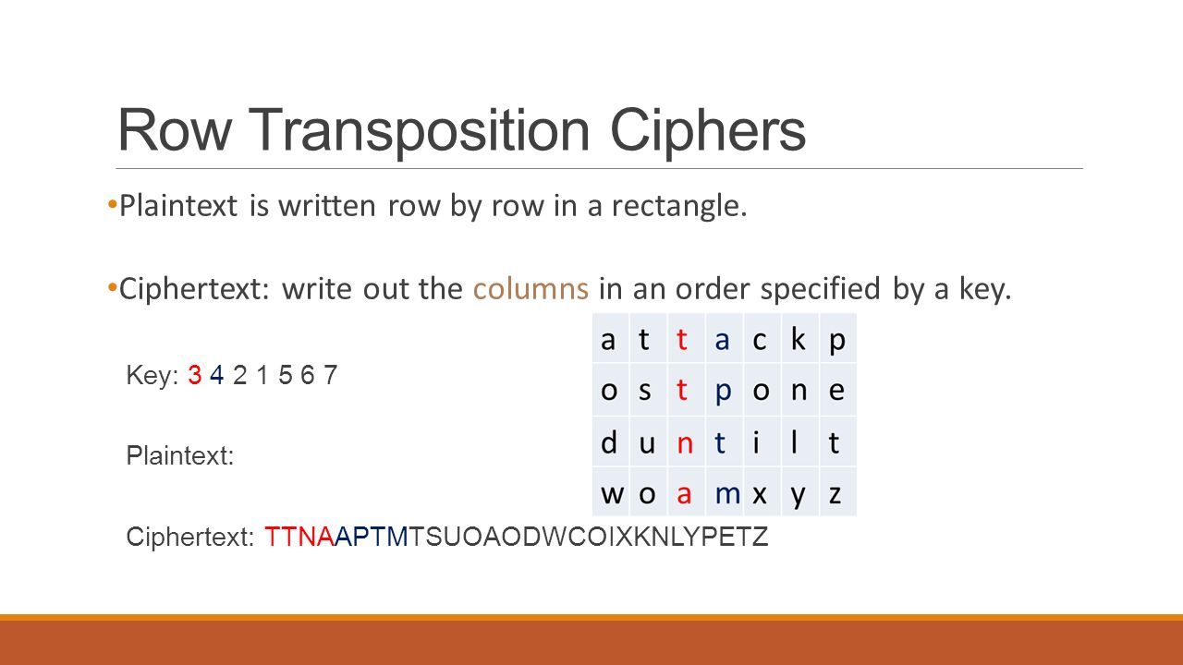
Row Transposition Cipher

Slide 65
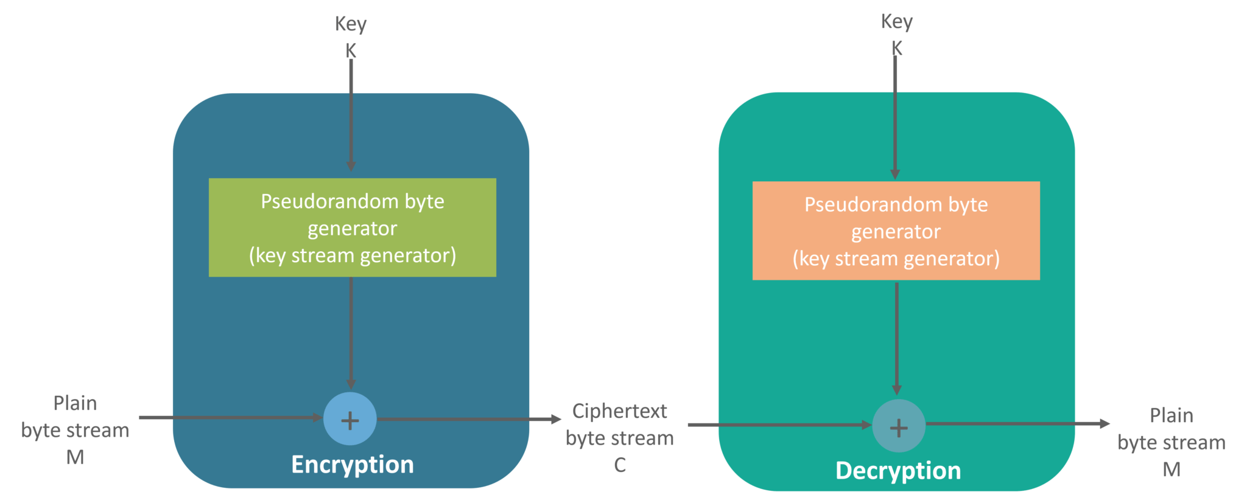
Stream Cipher
Symmetric or secret-key encryption algorithm that encrypts a single bit at a time. With a Stream Cipher, the same plaintext bit or byte will encrypt to a different bit or byte every time it is encrypted.

Slide 66
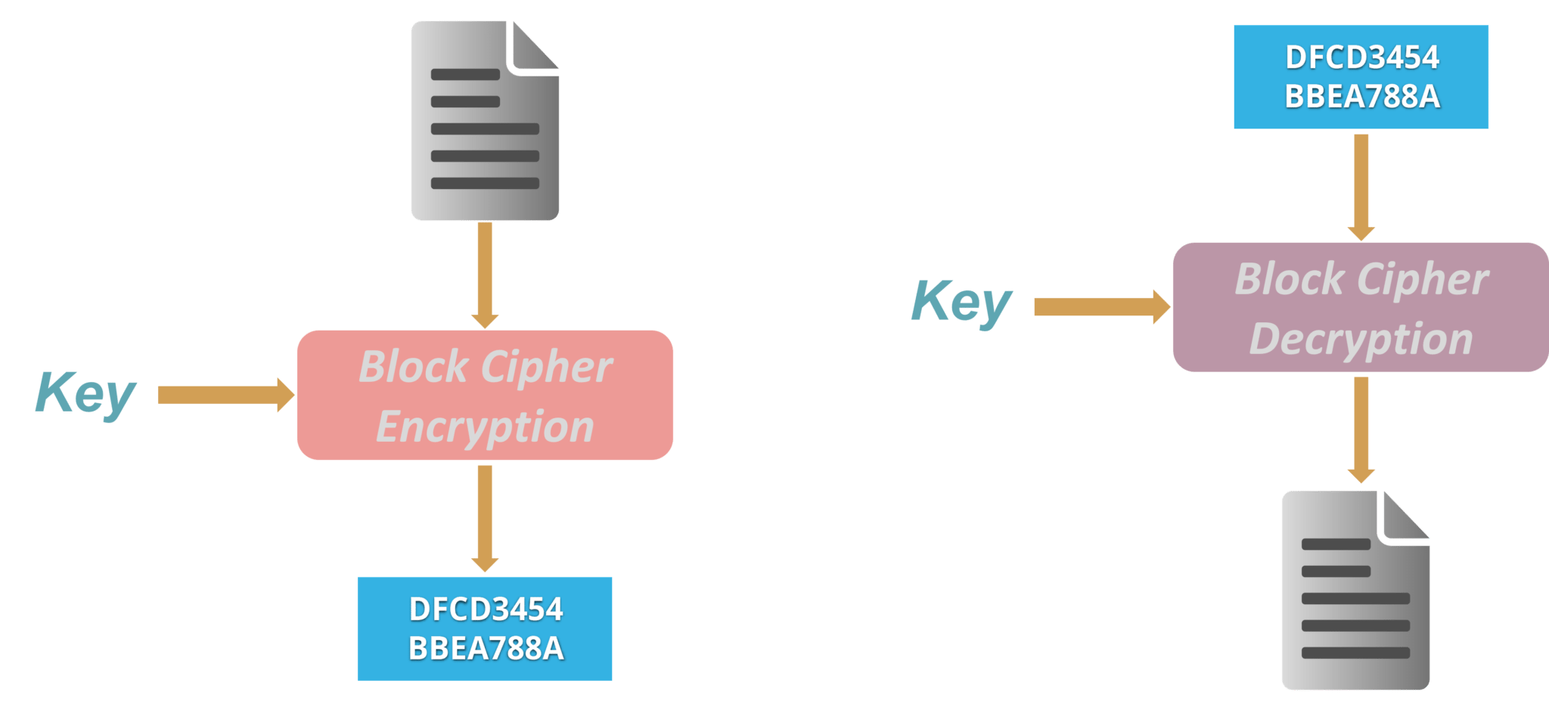
Block Cipher
An encryption method that applies a deterministic algorithm along with a symmetric key to encrypt a block of text, rather than encrypting one bit at a time as in stream ciphers

Slide 67
Asymmetric Key Encryption (or Public Key Cryptography)
The encryption process where different keys are used for encrypting and decrypting the information.
Keys are different but are mathematically related, such that retrieving the plain text by decrypting ciphertext is feasible.

Slide 68
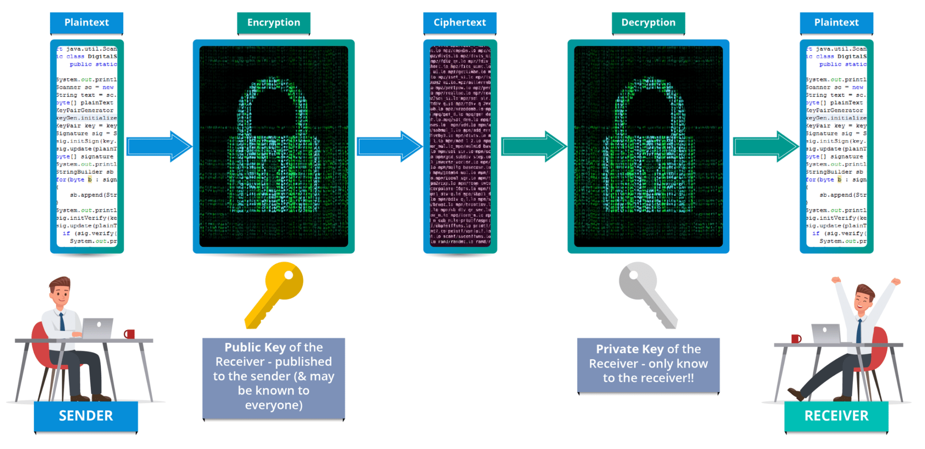
Asymmetric Key Encryption

Slide 69
RSA Algorithm
RSA stands for Rivest, Shamir, and Adelman, inventors of this technique
Both public and private key are interchangeable
Variable Key Size (512, 1024, or 2048 bits)

Slide 70
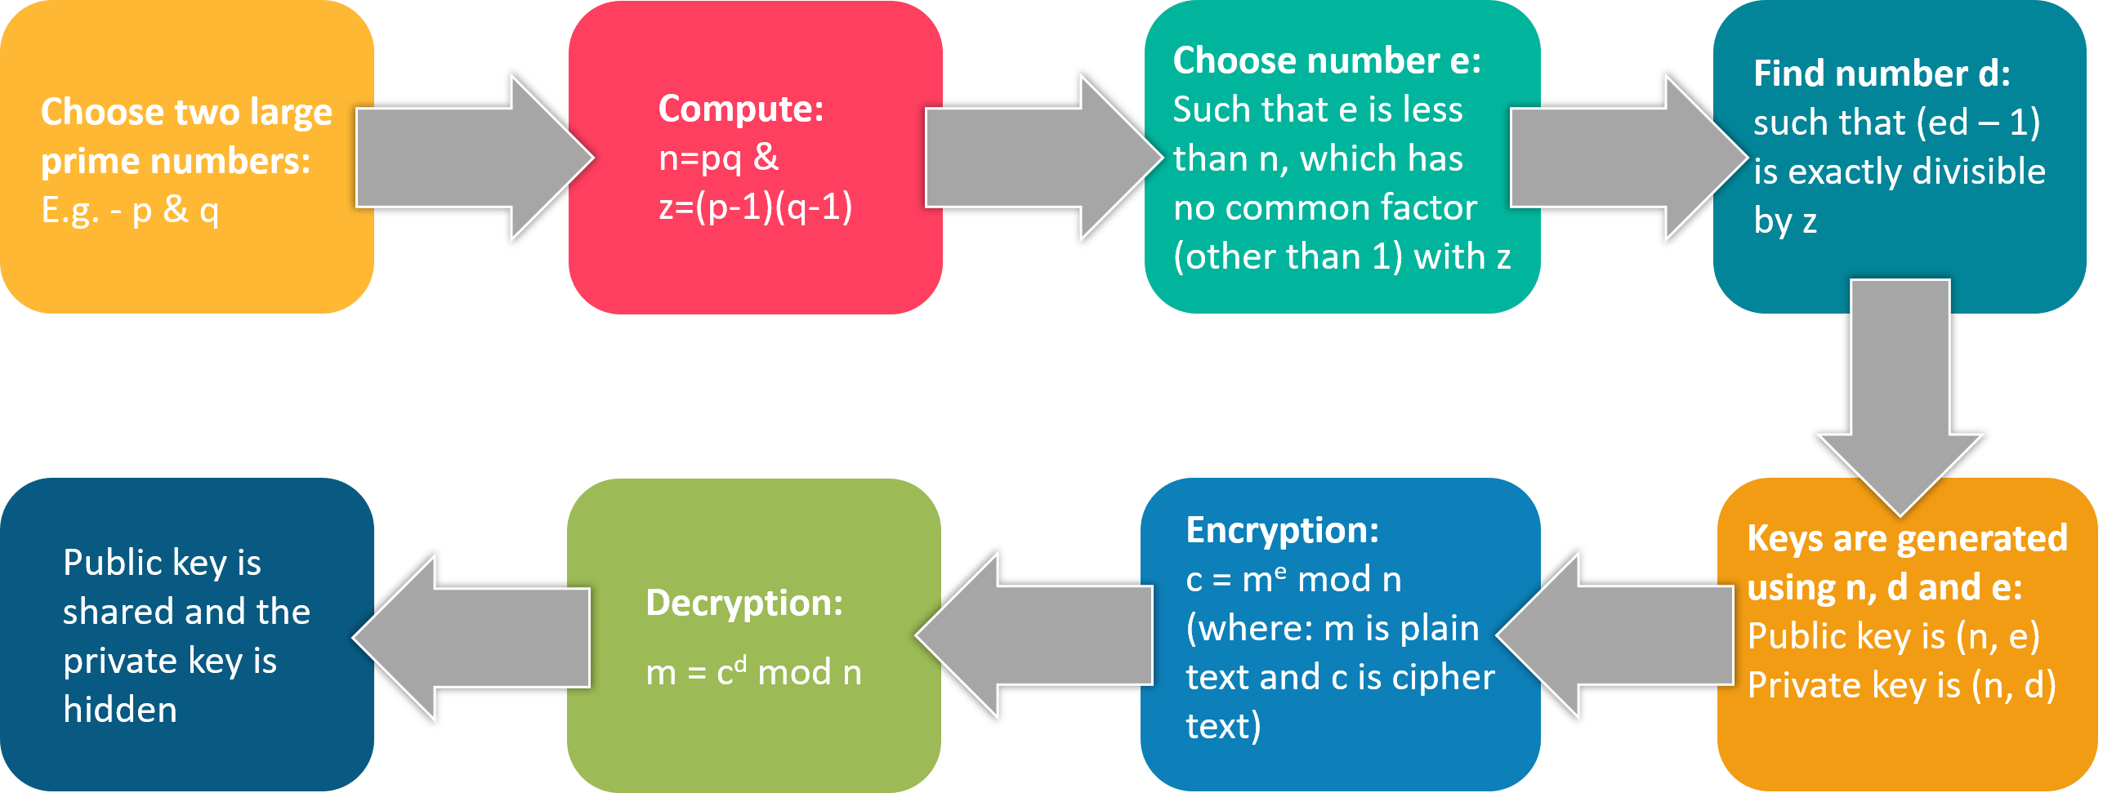
RSA

Slide 71
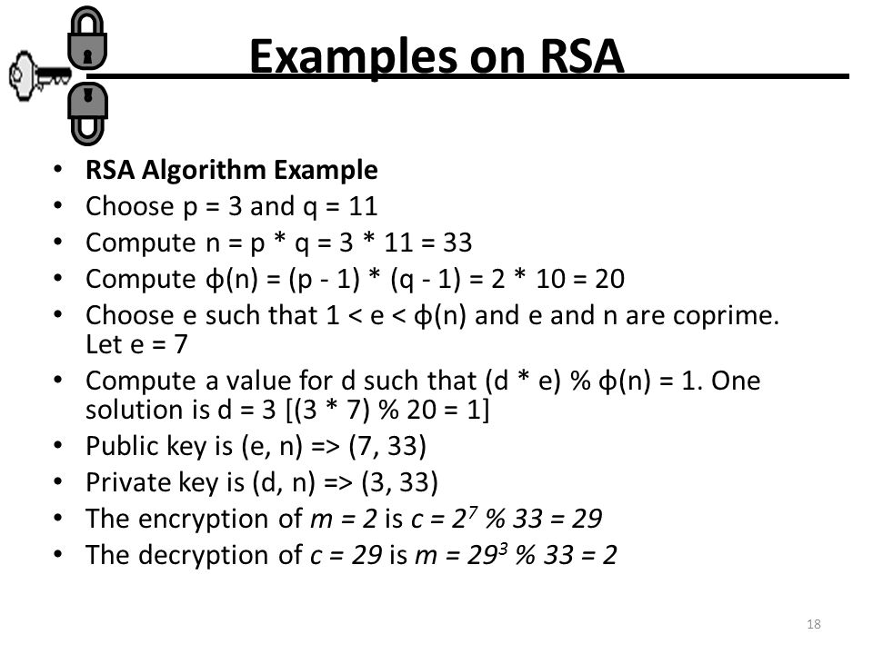

Slide 72
ELECTRONIC CODE BOOK
A block cipher takes a fixed-length block of text of length b bits and a key as input and produces a b bit block of ciphertext.
The ECB method is ideal for a short amount of data, such as an encryption key. Thus, if you want to transmit a DES or AES key securely, ECB is the appropriate mode to use.
The most significant characteristic of ECB is that if the same b-bit block of plaintext appears more than once in the message, it always produces the same ciphertext.
For lengthy messages, the ECB mode may not be secure.

Slide 73
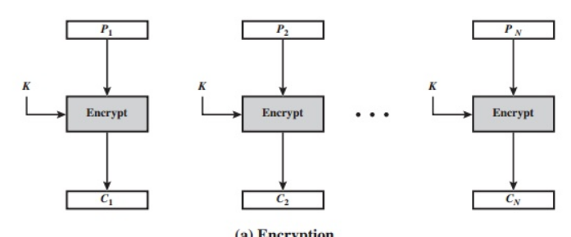
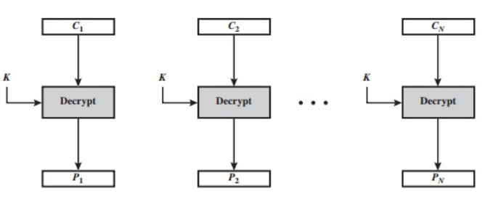
ECB
Encryption
Decryption

Slide 74
Cipher Block Chaining(CBC) Mode
In this scheme, the input to the encryption algorithm is the XOR of the current plain- text block and the preceding ciphertext block; the same key is used for each block. In effect, we have chained together the processing of the sequence of plaintext blocks.

Slide 75
For decryption, each cipher block is passed through the decryption algorithm. The result is XORed with the preceding ciphertext block to produce the plaintext block.
Because of the chaining mechanism of CBC, it is an appropriate mode for encrypting messages of length greater than b bits.
In addition to its use to achieve confidentiality, the CBC mode can be used for authentication.

Slide 76
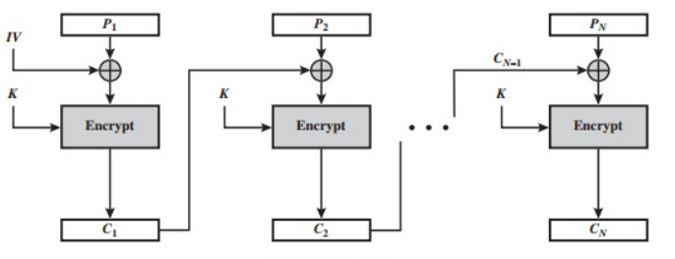
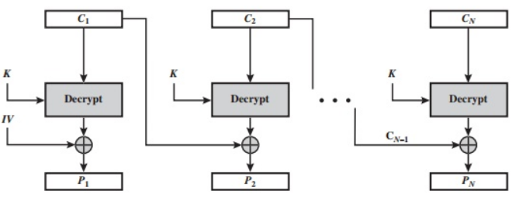
CBC Mode
Encryption
Decryption

Slide 77
For AES, DES, or any block cipher, encryption is performed on a block of b bits. Inthe case of DES, b = 64 and in the case of AES, b = 12
However, it is possible toconvert a block cipher into a stream cipher, using one of the three modes :
cipher feedback (CFB) mode, output feedback (OFB) mode, and counter (CTR) mode.

Slide 78
Cipher Feedback Mode
the input to the encryption function is a b-bit shift register that is initially set to some initialization vector (IV).
The leftmost (most significant) s bits of the output of the encryption function are XORed with the first segment of plaintext P1 to produce the first unit of ciphertext C1, which is then transmitted.

Slide 79
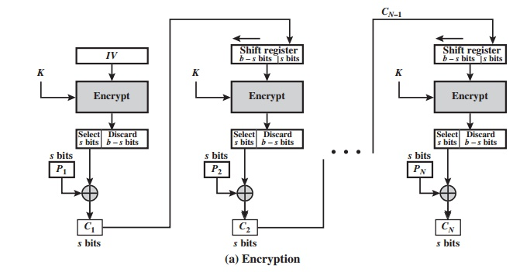
Encryption

Slide 80
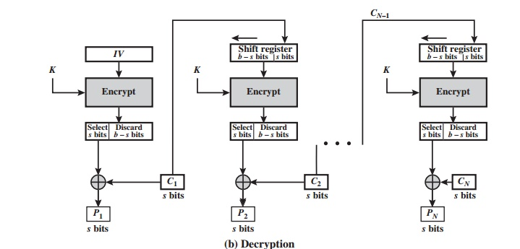
Decryption

Slide 81
OUTPUT FEEDBACK MODE
The output feedback (OFB) mode is similar in structure to that of CFB.
The output of the encryption function that is fed back to theshift register in OFB, whereas in CFB, the ciphertext unit is fed back to the shift register.
The other difference is that the OFB mode operates on full blocks of plaintext and ciphertext, not on an s-bit subset.

Slide 82
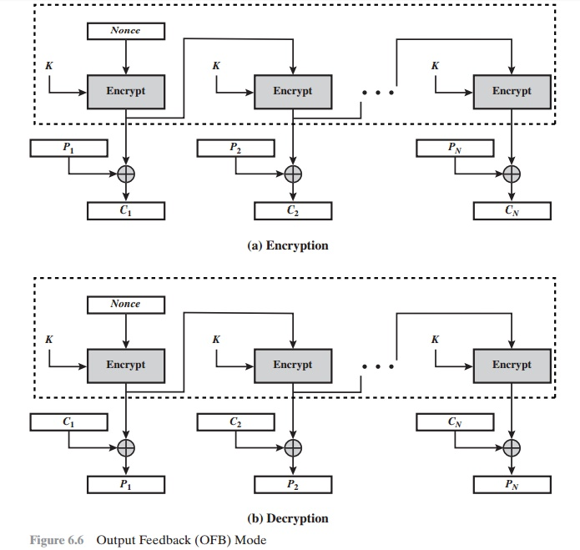
Encryption and Decryption

Slide 83
Counter Mode
Counter (CTR) mode has increased recently with applications to ATM (asynchronous transfer mode) network security and IP sec (IP security)
Typically, the counter is initialized to some value and then incremented by 1 for each subsequent block
For encryption, the counter is encrypted and then XORed with the plaintext block to produce the ciphertext block; there is no chaining.
For decryption, the same sequence of counter values is used, with each encrypted counter XORed with a ciphertext block to recover the corresponding plaintext block.

Slide 84
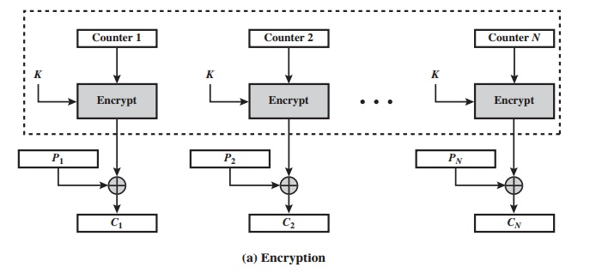
Encryption

Slide 85
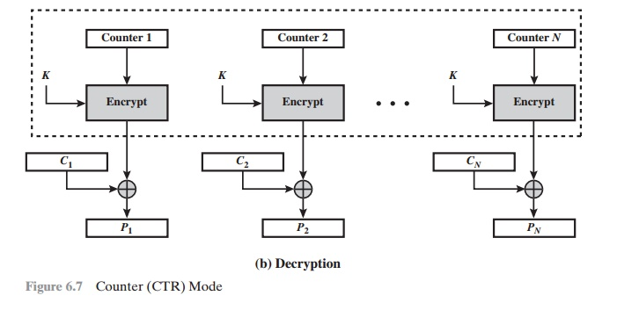
Decryption

Slide 86
DES
The most widely used encryption scheme is based on the Data Encryption Standard (DES) adopted in 1977 by the National Bureau of Standards, now the National Institute of Standards and Technology (NIST), as Federal Information Processing Standard 46 (FIPS PUB 46).
The algorithm itself is referred to as the Data Encryption Algorithm (DEA).
For DES, data are encrypted in 64-bit blocks using a 56-bit key. The algorithm transforms 64-bit input in a series of steps into a 64-bit output.
The same steps, with the same key, are used to reverse the encryption.

Slide 87
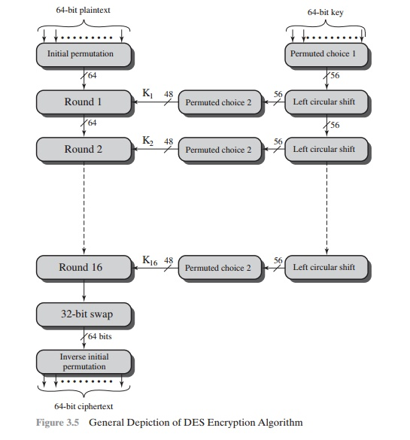
General DES algorithm

Slide 88
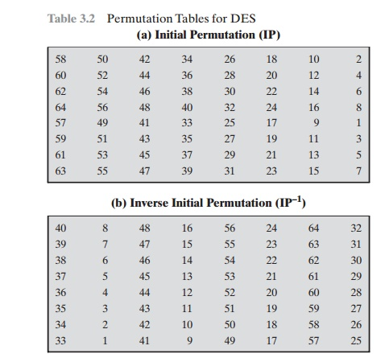
Permutation Table

Slide 89
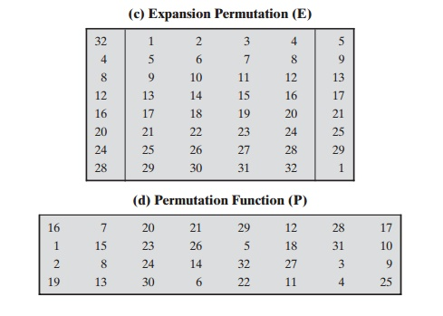
Permutation Table

Slide 90
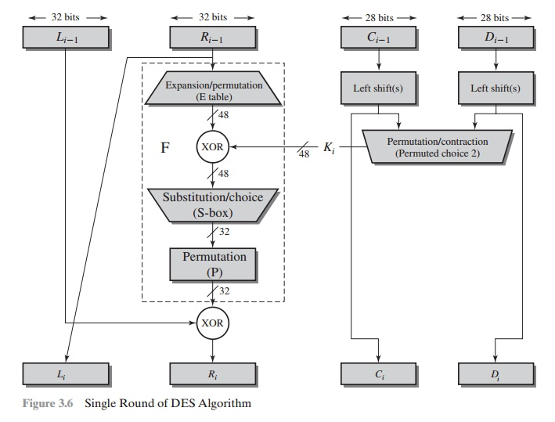
Single Round of DES

Slide 91
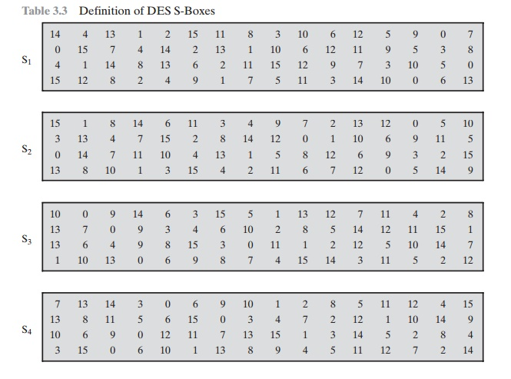
DES S-Boxes

Slide 92
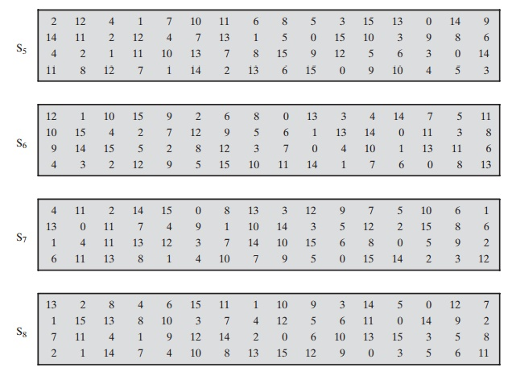
DES S-Boxes

Slide 93
AES STRUCTURE
The cipher takes a plaintext block size of 128 bits, or 16 bytes. The key length can be 16, 24, or 32 bytes (128, 192, or 256 bits). The algorithm is referred to as AES-128, AES-192, or AES-256, depending on the key length.
The cipher consists of N rounds, where the number of rounds depends on the key length: 10 rounds for a 16-byte key, 12 rounds for a 24-byte key, and 14 rounds for a 32-byte key

Slide 94
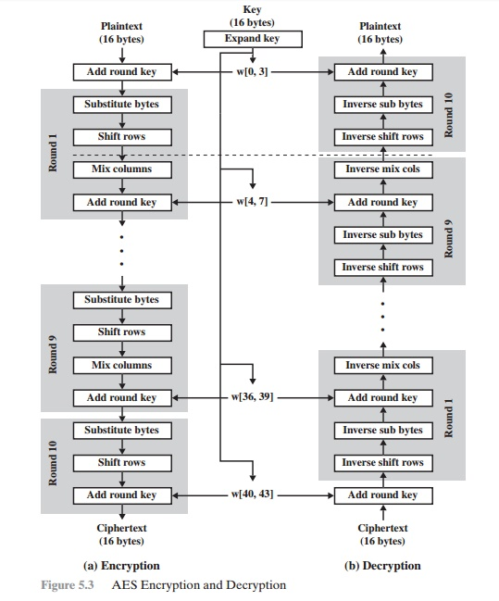
AES Encryption and Decryption

Slide 95

S-Box Substitution

Slide 96
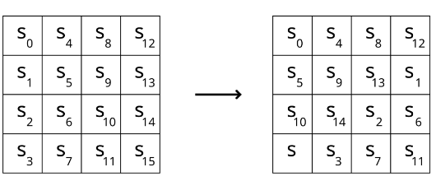
Shift Rows

Slide 97
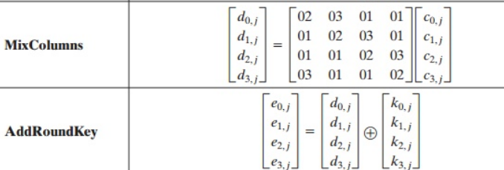
Mix Columns and Add Round Key

Slide 98
Triple DES or 3DES
3DES uses 48 rounds in its computation, which makes it highly resistant to differential cryptanalysis. However, because of the extra work 3DES performs, there is a heavy performance hit. It can take up to three times longer than DES to perform encryption and decryption.

Slide 99
Modes of 3DES
DES-EEE3 Uses three different keys for encryption, and the data are encrypted, encrypted, encrypted.
DES-EDE3 Uses three different keys for encryption, and the data are encrypted, decrypted, and encrypted.
DES-EEE2 The same as DES-EEE3 but uses only two keys, and the first and third encryption processes use the same key.
DES-EDE2 The same as DES-EDE3 but uses only two keys, and the first and third encryption processes use the same key.

Slide 100
EDE
How much protection could be provided by encrypting something, decrypting it, and encrypting it again?
The decrypting portion here is decrypted with a different key. When data are encrypted with one symmetric key and decrypted with a different symmetric key, it is jumbled even more. So the data are not actually decrypted in the middle function, they are just run through a decryption process with a different key.

Slide 101
PKI
PKI (or Public Key Infrastructure) is the framework of encryption and cyber security that protects communications between the server (your website) and the client (the users).
It works by using two different cryptographic keys: a public key and a private key.
When communicating, the client uses the public key to encrypt and decrypt, and the server uses the private key. This protects the user’s information from theft or tampering.

Slide 102
Elements of PKI
A certificate authority (CA) that stores, issues and signs the digital certificates;
A registration authority (RA) which verifies the identity of entities requesting their digital certificates to be stored at the CA;
A central directory—i.e., a secure location in which keys are stored and indexed;

Slide 103
Digital Certificate
A digital certificate is like a drivers license—it’s a form of electronic identification for websites and organizations. Secure connections between two communicating machines are made available through PKI because the identities of the two parties can be verified by way of certificates.

Slide 104
SSL and PKI
SSL (Secure Sockets Layer) Cryptography relies heavily on PKI security to encrypt and decrypt a public key exchange using both symmetric and asymmetric encryption.

Slide 105
Working of PKI with SSL
First, the web server sends a copy of its unique asymmetric public key to the web browser.
The browser responds by generating a symmetric session key and encrypting it with the asymmetric public key that was received by the server.
In order to decrypt and utilize the session key, the web server uses the original unique asymmetric private key.

Slide 106
Certificate Revocation List
A certificate revocation list, or CRL for short, is a list of certificates that have been revoked before their expiration date by certificate authorities.
the main idea here is to provide a central location for web clients such as browsers to check whether or not a site's SSL/TLS certificate is trustworthy.

Slide 107
Some Reasons
The private key has been lost or compromised, therefore it can no longer be trusted
The previous owner of a domain no longer owns that domain or ceases operations entirely
The certificate was discovered to be counterfeit

Slide 108
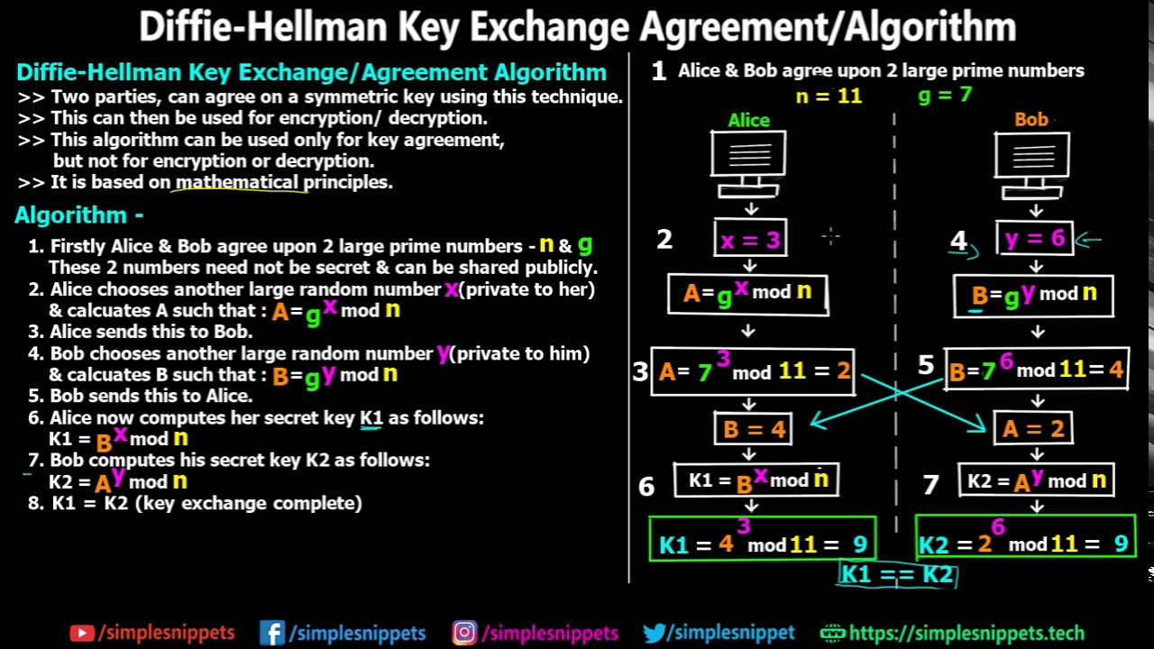

Slide 109
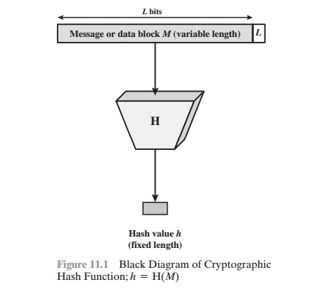
Hash function
A hash function H accepts a variable-length block of data M as input and produces a fixed-size hash value h = H(M).
Some of the hashing algorithms are SHA, MD5

Slide 110
Digital Signature
A digital signature is an authentication mechanism that enables the creator of a message to attach a code that acts as a signature. Typically the signature is formed by taking the hash of the message and encrypting the message with the creator’s private key. The signature guarantees the source and integrity of the message.

Slide 111

Process

Slide 112

Salting

Slide 113
A cryptographic salt is made up of random bits added to each password instance before its hashing.
Salts create unique passwords even in the instance of two users choosing the same passwords.
Salts help us mitigate rainbow table attacks by forcing attackers to re-compute them using the salts.
Creating cryptographically strong random data to use as salts is very complex and it's a job better left to leading security solutions and providers

Slide 114
IDEA
IDEA (International Data Encryption Algorithm) is an encryption algorithm. It is a symmetric block cipher which takes 64 bit as a input, 128-bit key and performs 8 identical rounds for encryption in which 6 different subkeys are used and four keys are used for output transformation.

Slide 115

IDEA

Slide 116

Steps in one Round

Slide 117

Output Transformation

Slide 118
Security threats and vulnerabilities

Slide 119
Network Vulnerability
A network vulnerability is a weakness or flaw in software, hardware, or organizational processes, which when compromised by a threat, can result in a security breach.

Slide 120
Malware (Malicious Software)
Malware is a malicious software that is unknowingly purchased, downloaded, or installed. The use of malware to exploit network vulnerabilities continue to rise hitting an all time high of 812.67 million infected devices in 2018.

Slide 121
Viruses
A virus is the most common type of malware attack. In order for a virus to infect a system it requires a user to click or copy it to media or a host.
Most viruses self-replicate without the knowledge of the user. These viruses can be spread from one system to another via email, instant messaging, website downloads, removable media (USB), and network connections.

Slide 122
Worms
Similar to a virus, a worm can also self-replicate and spread full copies and segments of itself via network connections, email attachments, and instant messages.
Unlike viruses, however, a worm does not require a host program in order to run, self-replicate, and propagate. Worms are commonly used against email servers, web servers, and database servers.
Once infected, worms spread quickly over the internet and computer networks.

Slide 123
Trojan Horses
Trojan horse programs are malware that is disguised as legitimate software.
A Trojan horse program will hide on your computer until it’s called upon. When activated, Trojans can allow threat actors to spy on you, steal your sensitive data, and gain backdoor access to your system.
Trojans are commonly downloaded through email attachments, website downloads, and instant messages.
Unlike computer viruses and worms, Trojans are not able to self-replicate.

Slide 124

Man in the middle attack
A man in the middle (MITM) attack is a general term for when a perpetrator positions himself in a conversation between a user and an application—either to eavesdrop or to impersonate one of the parties, making it appear as if a normal exchange of information is underway.

Slide 125
Spoofing
IP spoofing involves an attacker disguising himself as an application by altering packet headers in an IP address. As a result, users attempting to access a URL connected to the application are sent to the attacker’s website.
ARP spoofing is the process of linking an attacker’s MAC address with the IP address of a legitimate user on a local area network using fake ARP messages. As a result, data sent by the user to the host IP address is instead transmitted to the attacker.
DNS spoofing, also known as DNS cache poisoning, involves infiltrating a DNS server and altering a website’s address record. As a result, users attempting to access the site are sent by the altered DNS record to the attacker’s site.

Slide 126
Bots/Botnets
Botnet, short for roBOT NETwork, is a group of bots, which are any type of computer system attached to a network whose security has been compromised. They are typically controlled remotely.
The Mirai botnet was able to gain control of internet of things (IoT) connected devices like your DVR, home printer as well as smart appliances by entering the default username and password that the devices shipped with.
The threat actors deployed a DDoS (distributed denial of service) attack by sending large amounts of data at a website hosting company, causing many popular websites to be taken offline.

Slide 127
Rootkit
A rootkit allows someone to maintain command and control over a computer without the computer user/owner knowing about it.
Once a rootkit has been installed, the controller of the rootkit has the ability to remotely execute files and change system configurations on the host machine. A rootkit on an infected computer can also access log files and spy on the legitimate computer owner’s usage.

Slide 128

Stuxnet - the first known rootkit for industrial control systems

Slide 129
DDoS attacks: Rootkits allow the compromised computer to be used as a bot for distributed-denial-of-service attacks. The attack would now be traced to the compromised computer and not to the attacker's system. These bots are also called as zombie computers and are used as part of bot networks to launch the DDoS attacks, and other malicious activities such as click fraud and spam email distribution.

Slide 130

DDOS attack

Slide 131
Brute force attack
A brute force attack, also known as an exhaustive search, is a cryptographic hack that relies on guessing possible combinations of a targeted password until the correct password is discovered. The longer the password, the more combinations that will need to be tested.

Slide 132
Dictionary attack
A dictionary attack is a systematic method of guessing a password by trying many common words and their simple variations. Attackers use extensive lists of the most commonly used passwords, popular pet names, fictional characters, or literally just words from a dictionary – hence the name of the attack. They also change some letters to numbers or special characters, like “p@ssw0rd”.

Slide 133
HONEYPOT
A honeypot is a computer or computer system intended to mimic likely targets of cyberattacks. It can be used to detect attacks or deflect them from a legitimate target. It can also be used to gain information about how cybercriminals operate.

