Slide 1
Consumer Attention Mapping System
AI-powered retail attention intelligence platform

Slide 2


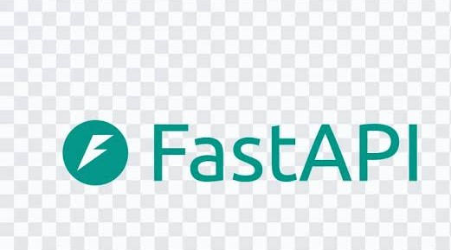
Technology Stack
Python is a high-level, interpreted programming language known for its simple and readable syntax.
It is widely used for web development, automation, data analysis, artificial intelligence, and machine learning.
React.js is a JavaScript library used for building interactive and dynamic user interfaces.
It helps developers create reusable UI components and efficiently build modern web applications.
FastAPI is a modern, high-performance Python framework used for building APIs and backend applications.
It provides fast API development with automatic documentation, data validation,

Slide 3
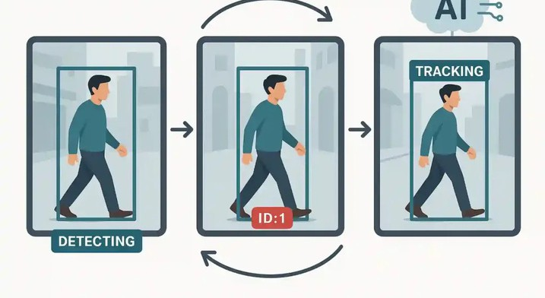

Core Features
Shopper Detection & Tracking – multi-person, path, zone analysis
Product Interaction – pickup, return, purchase detection

Slide 4
Challenges in Retail Analytics
Limited Insights:
retailers lack real-time attention data Most retailers rely on sales numbers or basic footfall counts, which fail to capture why customers engage with certain products. Without visibility into attention patterns, they miss opportunities to optimize shelf placement and promotions.
Manual Observation – inefficient, error-prone, low accuracy: Traditional methods like staff observation or surveys are slow, subjective, and prone to human error. They cannot scale across multiple stores or provide consistent, actionable insights in real time.
Poor Shelf Placement :
reduces visibility and conversions Products often go unnoticed due to suboptimal shelf positioning. This leads to wasted marketing spend and lower conversion rates, as retailers cannot identify which placements truly drive customer engagement.
Solution:
AI-powered platform for automated, real-time consumer analytics By leveraging cameras, computer vision, and AI models, the system delivers objective, scalable, and real-time insights. Retailers gain actionable intelligence to improve product visibility, optimize layouts, and boost conversions.

Slide 5
System Architecture
The architecture of the Consumer Attention Mapping System is designed for robustness, scalability, and security. At the foundation, data sources such as in-store cameras, POS systems, CRM platforms, and cloud storage feed information into the system. This data is processed through a microservices layer that handles shopper detection, tracking, attention analysis, and product interaction, ensuring each function operates independently for easy updates and scalability. The processed information flows into the analytics layer, where heatmaps, attractiveness scoring, and optimization recommendations are generated to provide actionable insights. Finally, these insights are delivered through intuitive dashboards tailored for different roles — Store Managers, Retail Analysts, Marketing Managers, and Administrators — enabling each stakeholder to monitor performance, understand consumer behavior, and make data-driven decisions in real time.

Slide 6
Challenges & Solutions
Scalability:
Modular microservices → seamless growth
Security:
JWT, OAuth2, encryption → safe data handling
Engagement:
Real-time dashboards → actionable insights
Integration:
APIs for POS, CRM, marketing platforms → smooth interoperability

Slide 7
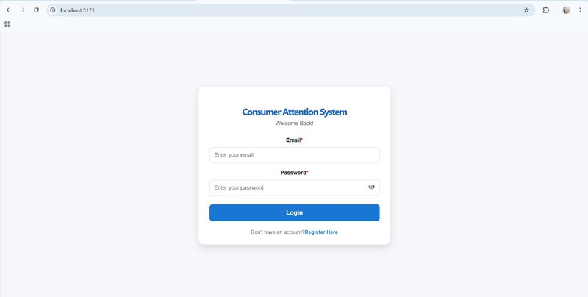
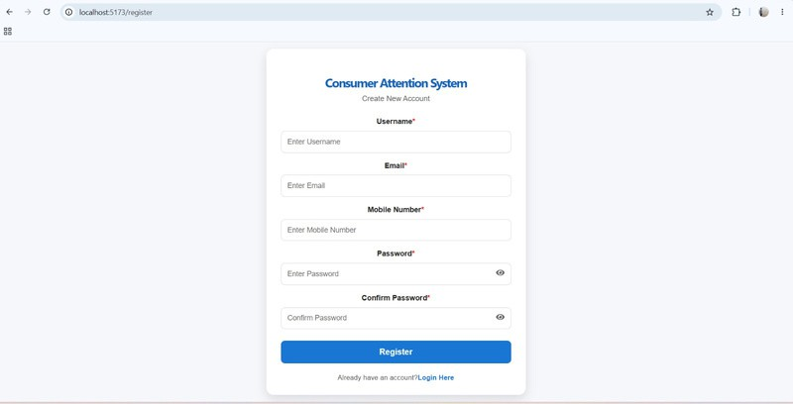
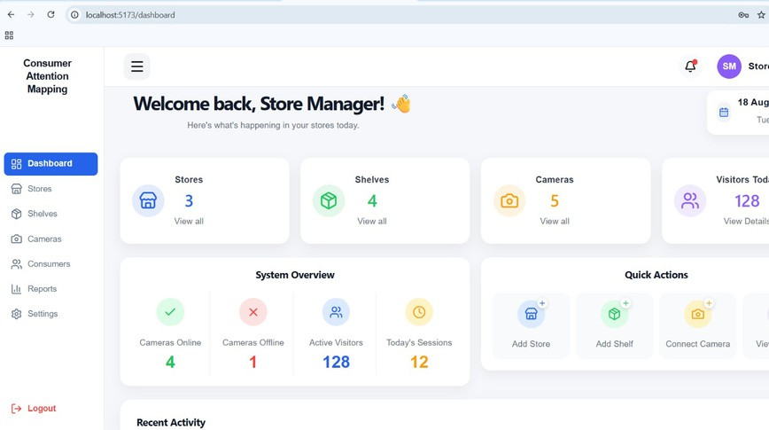
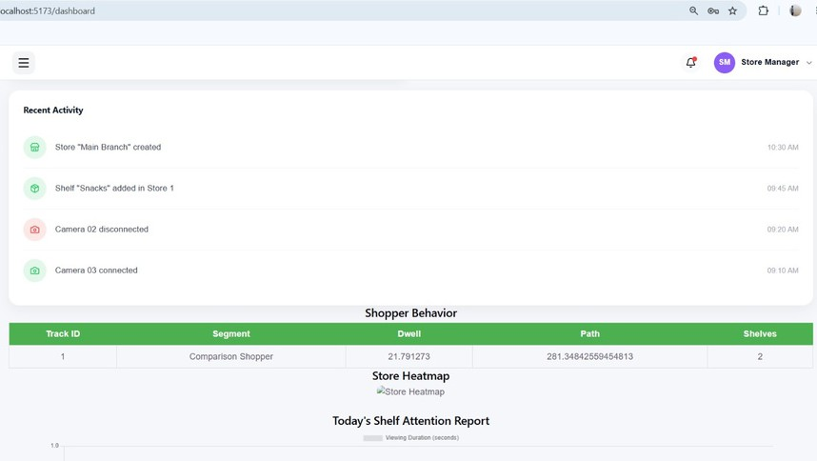
Frontend Outputs

Slide 8
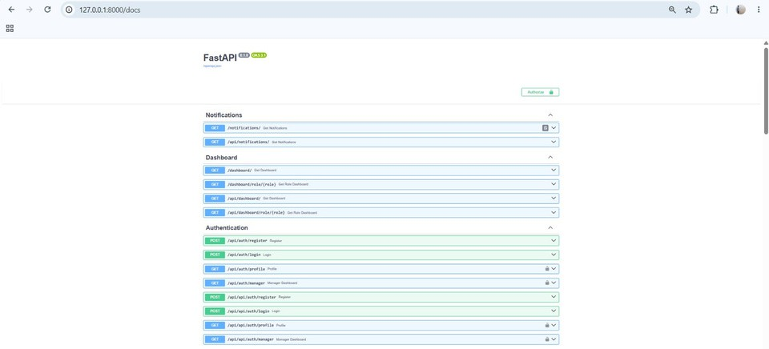
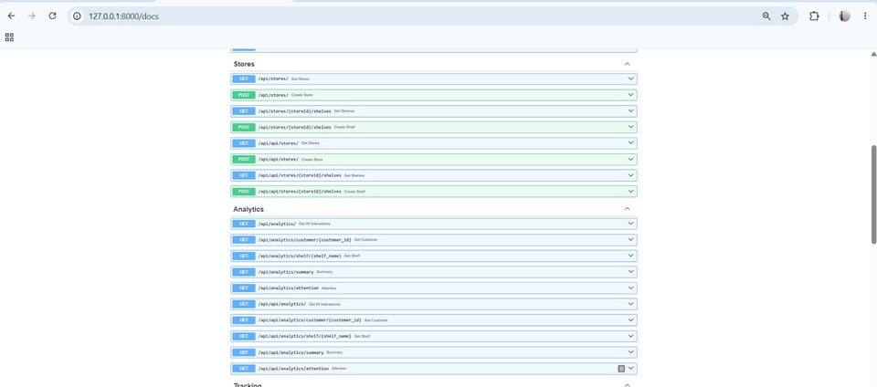
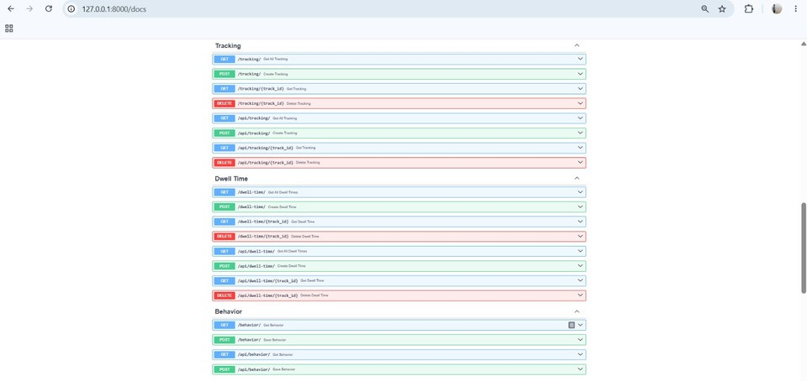
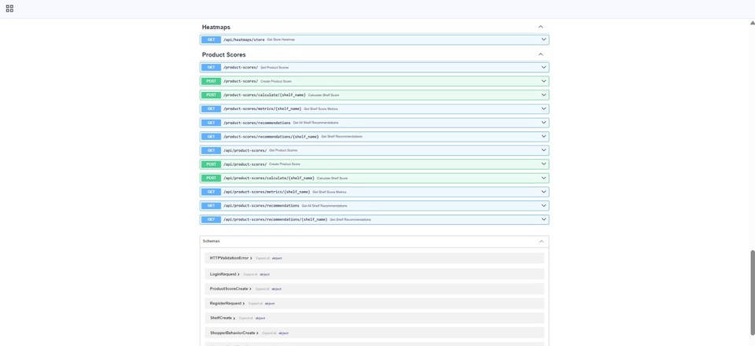
Backend Outputs

Slide 9
Future Enhancements
AI Recommendations: Personalized promotions & smart reminders
Predictive Analytics: Forecast conversions & turnout Advanced Visualization: Comparative analysis across stores/events
Expansion: Shopping malls, FMCG, supermarkets

Slide 10
CONCLUSION
Consumer Attention Mapping System enables retailers to optimize shelf placement, impr^{Car}o^{do} ve product visibility, and enhance cust^{C}o^{ardo}mer experience.

Slide 11
THANK
YOU

