Slide 1
MARIO
Mobile Recharge System

Slide 2
PROBLEM STATEMENT :
The online mobile recharge web application is an innovative solution catering to the growing needs of users seeking a convenient and secure method to recharge their mobile services. With a user-friendly interface, the application allows seamless registration and authentication, enabling users to create accounts and log in securely. Providing a dashboard that acts as a control center, the application presents a spectrum of mobile recharge options, from selecting service providers to customizing plans and recharge amounts.
-> Authenticated Login.
-> Responsive Plans.
-> Good Payment.
-> Strong Data Backup.

Slide 3
PROPOSED SOLUTION :
-> Web application with a streamlined registration and login process.
-> Develop a dashboard for users to easily access recharge options, history, and support.
-> Implement a secure payment gateway for safe transactions.
-> Provide admins with a robust dashboard for managing plans, add-ons.
-> Ensure high security, scalability, usability, and availability.

Slide 4
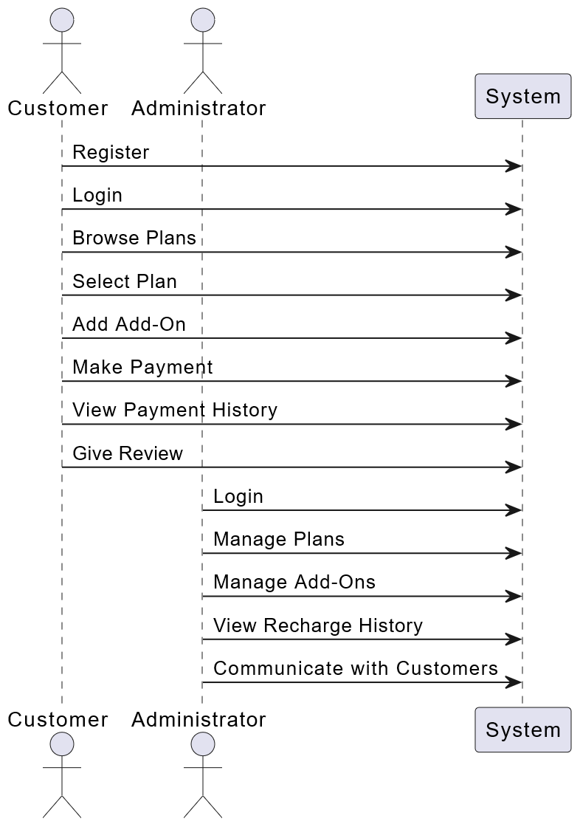
ACTIVITY Diagram :

Slide 5
SEQUENCE Diagram :

Slide 6
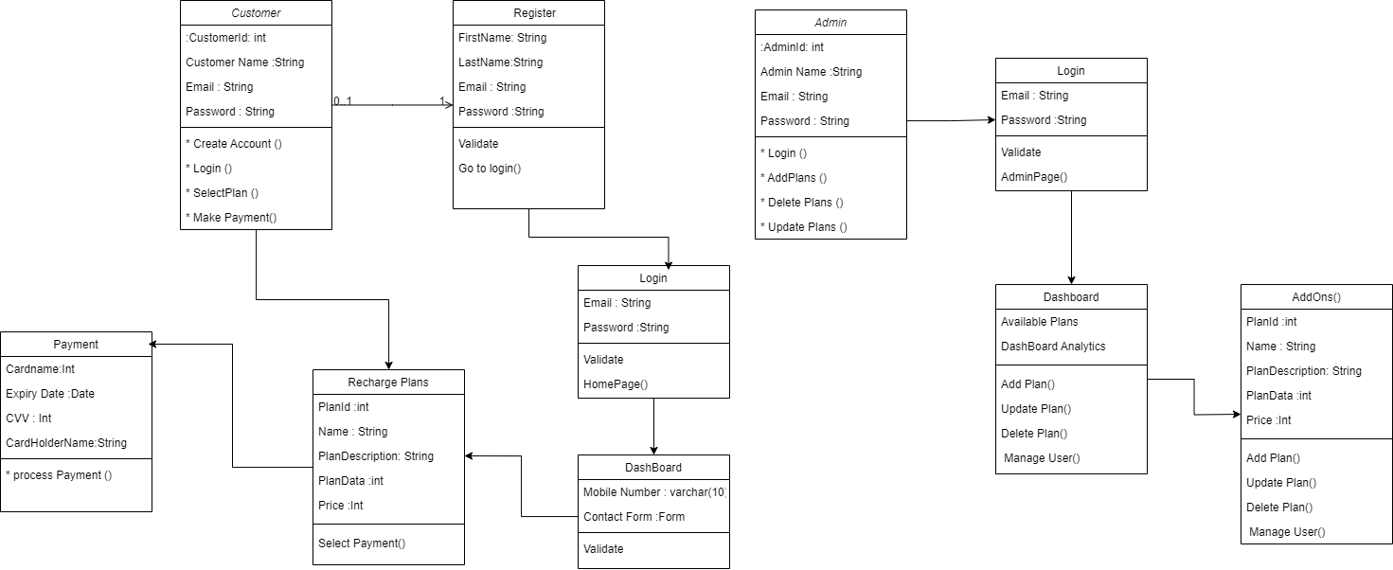
UML CLASS Diagram :

Slide 7
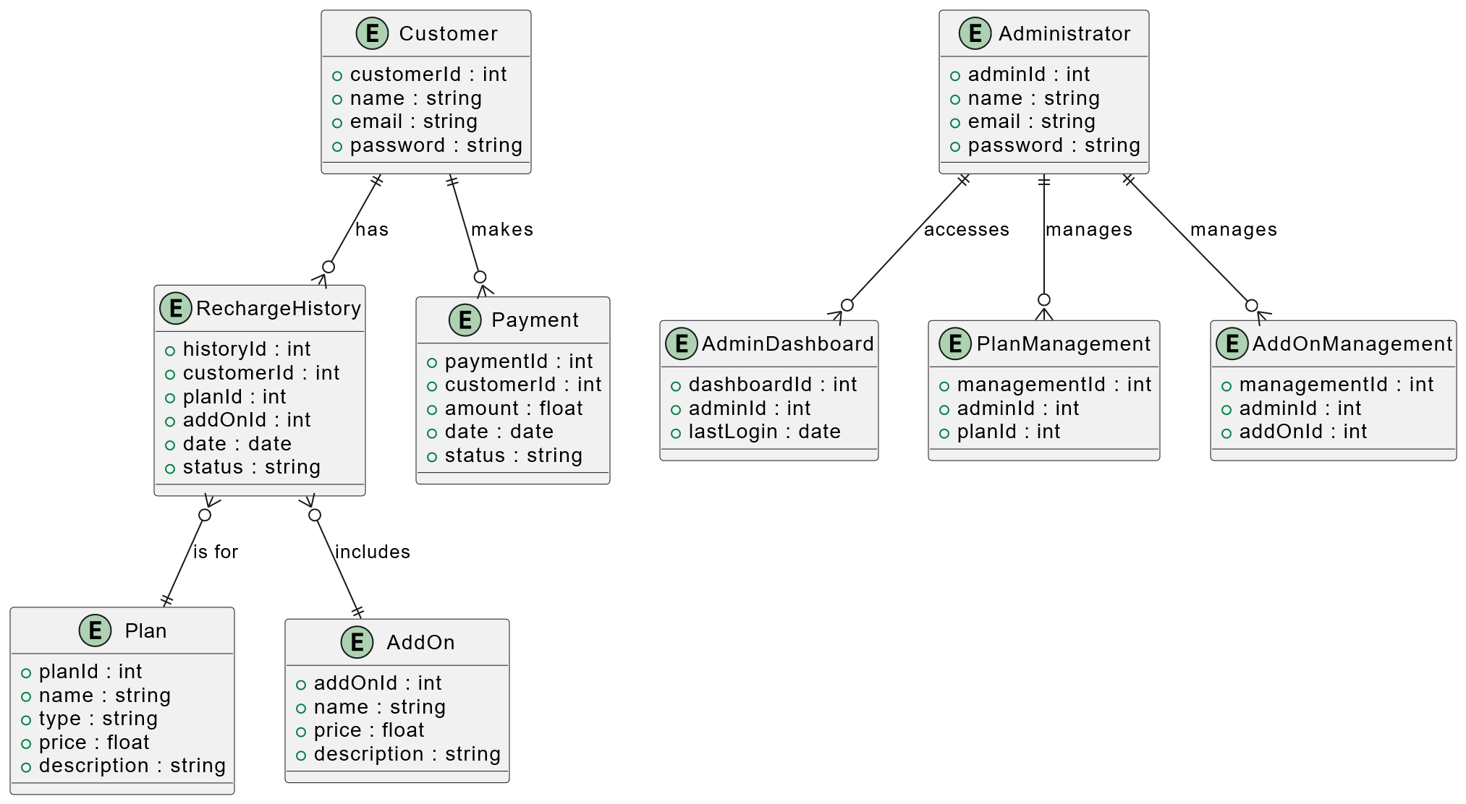
ER CLASS Diagram :

Slide 8
THANK YOU

