Slide 1
PROJECT CREDENTIALS
FULL STACK DEVELOPMENT (FSD) MINI PROJECT
AI-ASSISTED RECRUITMENT SYSTEM
CANDIDATE NAME
S. Srisakthi
REGISTRATION NUMBER
310624205269
DEGREE & BRANCH
B.Tech. Information Technology
INSTITUTION
Easwari Engineering College (Autonomous)
AFFILIATION
Affiliated to Anna University, Chennai
CAMPUS LOCATION
Ramapuram, Chennai, Tamil Nadu – 600089
DEPARTMENT
Department of Information Technology
SUBMISSION DATE
October 2026
An Enterprise Talent Acquisition Platform Featuring Modular NLP Resume Ingestion, Weighted Multi-Factor Fit Scoring, and a 6-Stage Kanban Pipeline.
MERN Stack
React 19
Node.js & Express
MongoDB & Mongoose
Modular NLP
TF-IDF Engine
Presentation: Project Review 1 & 2 | Academic Year 2026–2027
AI-Assisted Recruitment System
Review 1 & 2 | MERN Stack Project

Slide 2
AGENDA
Scope of This Review
PART I: ARCHITECTURE & SPECIFICATIONS
PART II: IMPLEMENTATION & VERIFICATION
01 Requirements (Functional & Non-Functional)
02 Detailed System Architecture & Multi-Tier Flow
03 UML Use Case Diagram (Actors & Subsystems)
04 ER Diagram / Database Design & Schema Models
05 Module Description & Core Responsibilities
06 Technology Stack & Supporting Libraries
07 UI Design / Wireframes & Screen Architecture
08 Frontend & Backend Development Details
09 Database Integration & Verified REST APIs
10 Implementation Status, Screenshots, Challenges & Plan
Agenda
Review 1 & 2 | MERN Stack Project

Slide 3
01
REQUIREMENTS
Functional & Non-Functional Requirements
Functional Requirements
Non-Functional Requirements
• User Registration & Authentication: Dual-role authentication (Recruiter & Candidate) with JWT Bearer tokens and role-protected routes.
• Modular NLP Resume Parser: Ingestion of PDF, DOCX, and TXT resumes with automated extraction of contacts, experience, and 500+ skills taxonomy.
• Job Requisition Management: Full CRUD operations for vacancies with required skills, experience boundaries, and education thresholds.
• Multi-Factor AI Candidate Matching: Deterministic candidate-to-job compatibility scoring (50% skills, 25% exp, 15% edu, 10% TF-IDF semantic fit).
• 6-Stage Kanban Shortlisting Pipeline: Visual applicant progression (Applied to Screened, Shortlisted, Interview Scheduled, Selected, or Rejected).
• Interview Scheduling & Alerts: Integrated interview scheduler with Google Meet/Zoom links, round types, and candidate dashboard alerts.
• Security & Data Protection: Bcrypt password hashing (10 salt rounds), secure HTTP Bearer JWT tokens, and RBAC middleware protecting private routes.
• Performance & Low Latency: In-memory NLP parsing & TF-IDF scoring executing in < 1.2s; indexed database lookups under 30ms.
• Scalability & Decoupled Services: Stateless Express REST API services, decoupled NLP engine, and scalable Mongoose domain models.
• Usability & Modern Interface: Responsive React 19 UI with Tailwind CSS v4 dark mode aesthetics, interactive modals, and confetti celebrations.
• Reliability & Data Consistency: Compound unique indexing on (job, candidate), transaction audit logging via stageHistory arrays.
• Maintainability & Clean Architecture: Strict separation of concerns (Routes, Controllers, Services, Models, Context API) for seamless extensibility.
Requirements
Review 1 & 2 | MERN Stack Project

Slide 4
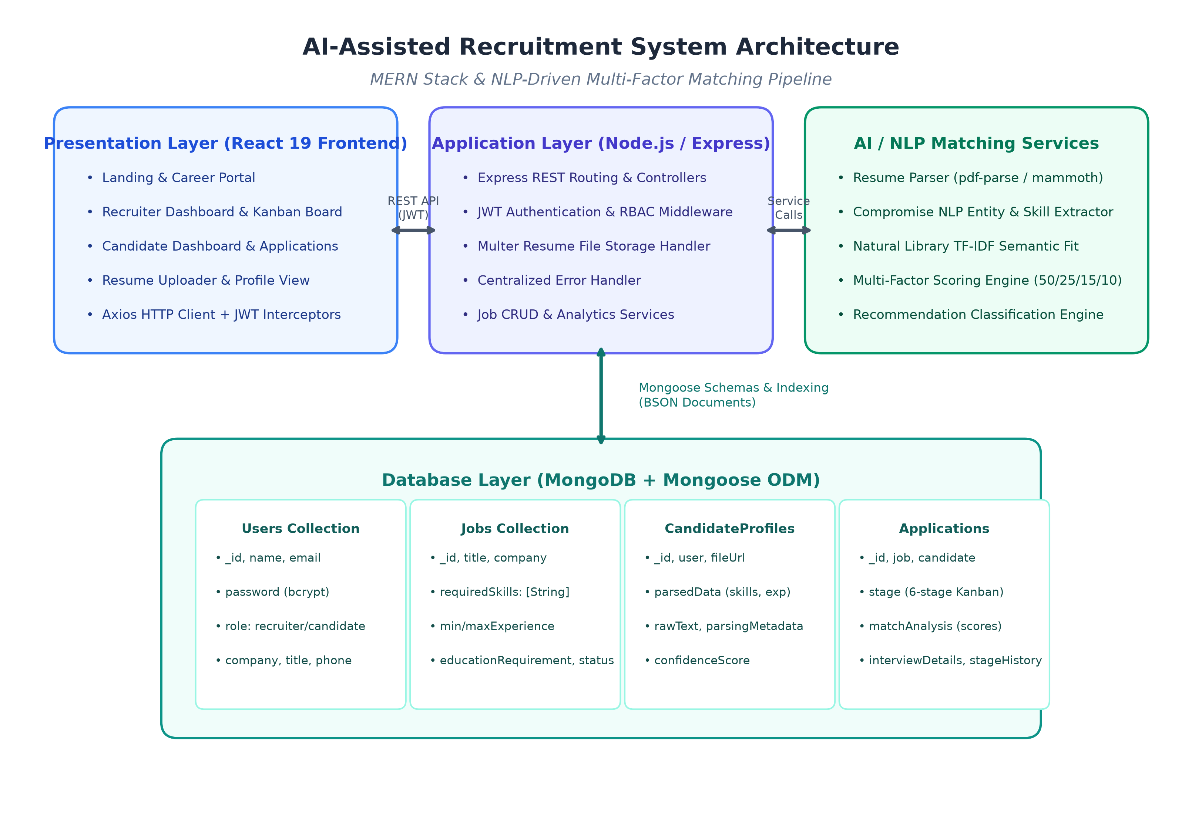
02
ARCHITECTURE
Detailed System Architecture
CLIENT TIER
React 19 SPA, Tailwind CSS v4,
Axios REST Client, React Router v7
APPLICATION TIER
Node.js + Express.js REST API,
JWT RBAC, Multer, NLP & Scoring Engine
DATA TIER
MongoDB NoSQL Database,
Mongoose ODM, Compound Indexing
⇄
⇄
Request Flow: HTTP/HTTPS requests flow from the React client through Express REST routes & NLP matching services to MongoDB, with validated JSON responses returned along the same path.
Architecture
Review 1 & 2 | MERN Stack Project

Slide 5
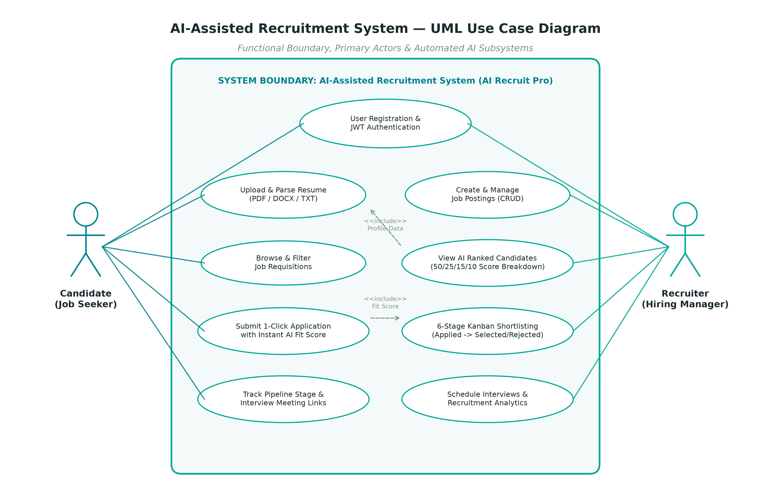
03
USE CASE
Use Case Diagram
Actors & Capabilities
Candidate Actor: Registers account, uploads PDF/DOCX resume, parses contact & skills, browses jobs, submits 1-click applications, tracks stages & interview links.
Recruiter Actor: Posts & manages job requisitions, inspects AI ranked candidates with score breakdowns, advances Kanban stages, and schedules interviews.
NLP & AI Subsystem: Automated <<include>> dependencies execute document text extraction, taxonomy mapping, and weighted multi-factor compatibility evaluation.
Audit Subsystem: Automatically captures timestamped stage transitions into the application history.
Use Case
Review 1 & 2 | MERN Stack Project

Slide 6
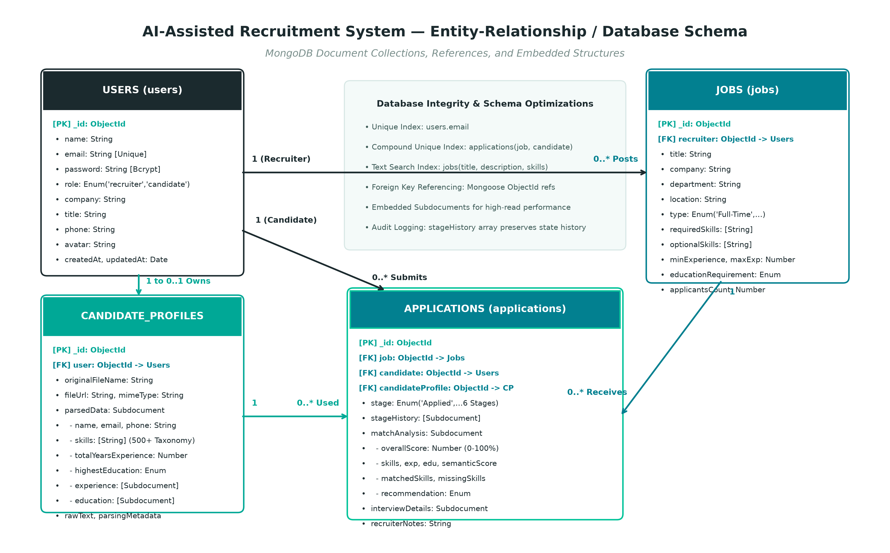
04
ER DIAGRAM
ER Diagram / Database Design
Schema Architecture
Users Collection: Central identity store with unique email index, bcrypt hash, and role discriminator ('recruiter' vs 'candidate').
Jobs Collection: Vacancy specifications referencing the recruiter User ID, with requiredSkills arrays, min/max experience, and education levels.
CandidateProfiles: Structured resume data referencing candidate User ID, containing parsed taxonomy skills, experience duration, and file metadata.
Applications Collection: Junction entity referencing Job, Candidate User, and CandidateProfile with compound unique index (job, candidate).
Embedded Subdocuments: Arrays for stageHistory, experience, and education deliver high read performance without joins.
ER Diagram
Review 1 & 2 | MERN Stack Project

Slide 7
05
MODULES
Module Description
Module | Description | Key Functions
User Authentication & RBAC | Secure identity and session management for Recruiters and Candidates. | Registration, Login, JWT Token Issuance, Bcrypt Password Hashing, RBAC Middleware.
Job Requisition Management | Complete administration of job postings, criteria, and skill requirements. | Job Creation, Edit, Delete, Skill Tag Filters, Minimum Experience & Education Setting.
Modular NLP Resume Parser | Automated ingestion and entity extraction from unstructured resume files. | PDF/DOCX/TXT Binary Ingestion, 500+ Skill Taxonomy Extraction, Experience & Degree Calculation.
Multi-Factor AI Matching | Deterministic mathematical scoring and ranking of candidate-job fit. | 50% Skills, 25% Experience, 15% Education, 10% TF-IDF Semantic Relevance, Fit Recommendation Tiers.
6-Stage Kanban Pipeline | Visual applicant progression tracking through hiring stages. | Stage Advancement (Applied to Selected/Rejected), Stage Audit History Logging, Recruiter Notes.
Interview Scheduling & Stats | Collaborative interview coordination and high-level talent metrics. | Meeting Link Assignment, Round Type Selection, Recruiter Funnel Metrics, Candidate Tracker.
Modules
Review 1 & 2 | MERN Stack Project

Slide 8
06
TECH STACK
Technology Stack
MongoDB
NoSQL Database
Mongoose ODM v9, BSON document collections, compound unique indexes, and schema validations.
Express.js
Backend Framework
Node.js REST API framework with modular controllers, centralized error handling, and CORS.
React.js
Frontend Library
React 19 with Vite, functional components, hooks, React Router v7, and Tailwind CSS v4.
Node.js
Runtime Environment
Asynchronous V8 event-driven JavaScript runtime executing server APIs and local NLP engines.
Supporting Libraries, AI Tools & Development Ecosystem
• AI / NLP Processing: natural (TF-IDF semantic similarity), compromise (NLP entity & phrase extraction), pdf-parse (PDF extraction), mammoth (DOCX conversion)
• Authentication & Security: jsonwebtoken (JWT signed token authorization), bcryptjs (password hashing with 10 salt rounds), cors (cross-origin middleware)
• Frontend Ecosystem: react-router-dom v7 (client routing), axios (REST client with JWT interceptors), tailwindcss v4, lucide-react (vector icons), canvas-confetti
• Development & Testing: Node.js Native Assert Integration Test Suite (12/12 passing), Postman (API verification), Git & GitHub (version control), VS Code IDE
Tech Stack
Review 1 & 2 | MERN Stack Project

Slide 9
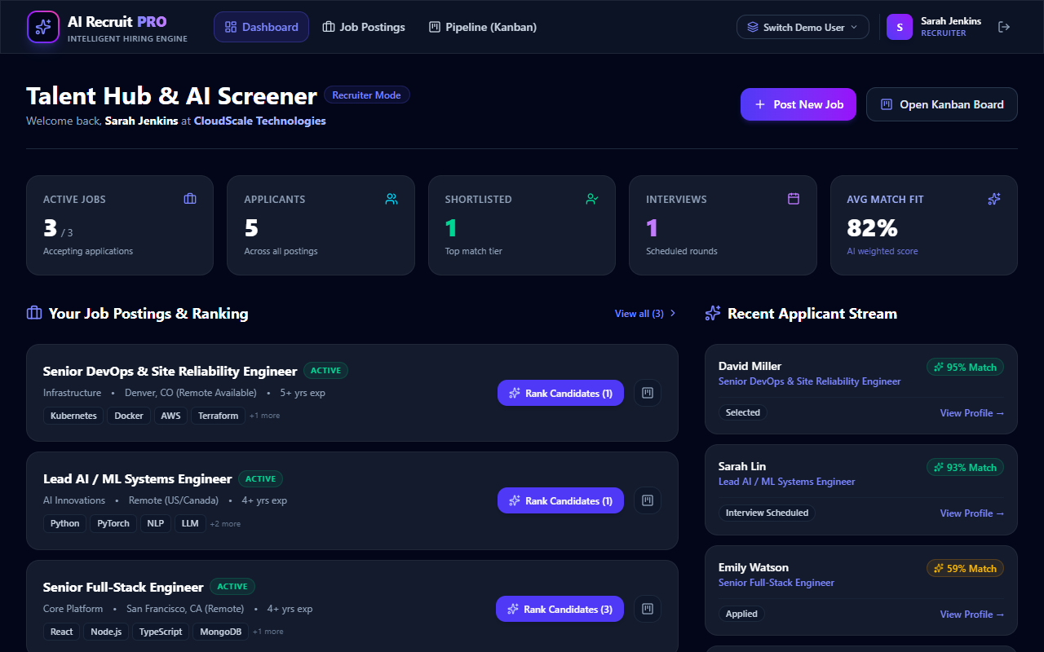
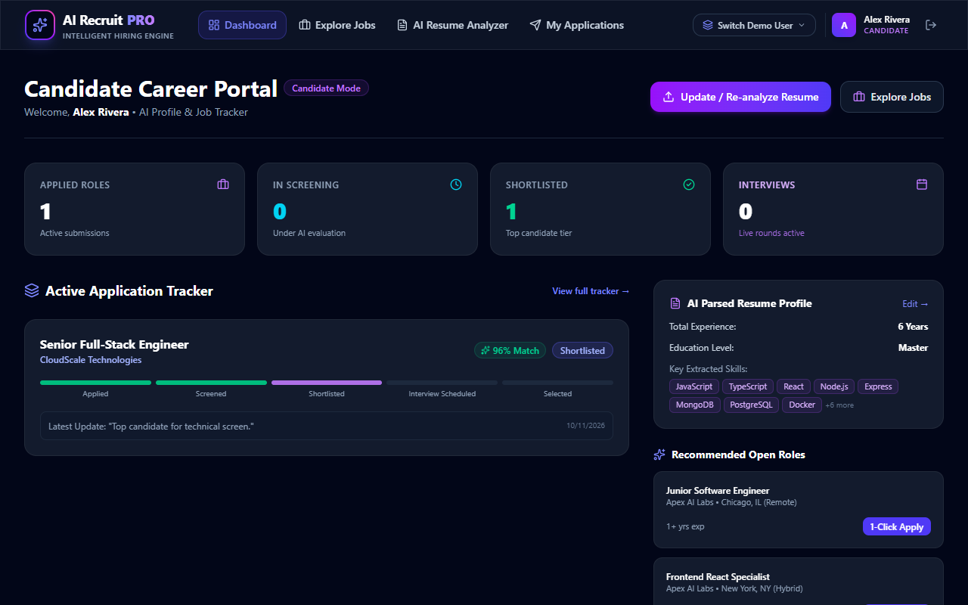
07
UI DESIGN
UI Design / Wireframes
Design System & UI Architecture
• Dual-Role Workspace Ergonomics: Distinct user interfaces engineered specifically for Recruiter high-volume screening vs Candidate self-serve application management.
• Modern High-Contrast Dark Theme: Styled with Slate-950 background (#020617) and Emerald-500 highlights to minimize eye fatigue during extended candidate review sessions.
• Tailwind CSS v4 Responsive Grids: Fluid breakpoint system (sm, md, lg, xl) adapting from mobile handheld screens to ultra-wide desktop monitors.
• Transparent AI Match Indicators: Color-coded MatchScoreBadges (Strong 80%+, Good 65-79%, Potential 50-64%, Low <50%) provide immediate visual triage.
• Zero-Page-Reload Modals: Overlay modal workflows for Job Creation, Candidate Detail inspection, and Interview Scheduling with Google Meet links.
• Interactive Delight: Confetti burst animations (canvas-confetti) on successful application submissions and interactive stage transitions.
UI Design
Review 1 & 2 | MERN Stack Project

Slide 10
08
FRONTEND
Frontend Development
• Modern React 19 Architecture: Engineered using functional components and hooks (useState, useEffect, useContext, useParams, useNavigate) for declarative UI rendering.
• Modular Component Decomposition: Reusable components including Navbar, ProtectedRoute, JobFormModal, CandidateDetailModal, ScheduleInterviewModal, ScoreBreakdownModal, and MatchScoreBadge.
• Client-Side Routing (React Router v7): Configured in App.jsx with public routes (/, /login, /register, /jobs, /jobs/:id) and role-protected routes (/recruiter-dashboard, /pipeline, /candidate-dashboard, /resume-upload, /my-applications).
• State Management via Context API: AuthContext.jsx provides global authentication state, token validation on mount, login/register actions, and synchronized localStorage persistence.
• HTTP Client & Interceptors (Axios): Centralized API service in api.js pre-configured with baseURL, timeout limits, and automated Bearer token attachment to request headers.
• Responsive Styling (Tailwind CSS v4): Utility-first styling with responsive flex/grid layouts, smooth CSS transitions, dark-mode styling, and Lucide React iconography.
Tip: The frontend implementation includes 10 dedicated view pages, 7 interactive modals, and full client-side RBAC protection with zero external CSS frameworks.
Frontend
Review 1 & 2 | MERN Stack Project

Slide 11
09
BACKEND
Backend Development
• Modular MVC Architecture: Strict separation across routes (src/routes/), controllers (src/controllers/), services (src/services/), models (src/models/), and middlewares (src/middlewares/).
• Node.js & Express.js Server: High-throughput REST API runtime in server.js and app.js configured with express.json({ limit: '20mb' }), express.urlencoded, and Morgan request logger.
• Authentication & RBAC Middleware: Custom protect middleware decoding Bearer JWT tokens against JWT_SECRET; authorize('recruiter', 'candidate') middleware enforcing role boundaries.
• Resume Ingestion & Multer Pipeline: Configured in upload.js with diskStorage, sanitized filenames, and mimeType validation supporting PDF and DOCX files up to 10MB.
• Centralized Error Handling: Custom errorHandler middleware intercepting Mongoose CastError, duplicate key error (code 11000), and validation failures with standard JSON errors.
• Environment Configuration & Security: Dynamic configuration via dotenv (.env), secure CORS origin allowance, and isolated service contracts for AI swapping.
Tip: Backend verified with 100% pass rate (12/12 assertions) in test/api.test.js covering authentication, job CRUD, NLP parsing, and Kanban stage transitions.
Backend
Review 1 & 2 | MERN Stack Project

Slide 12
10
DATABASE
Database Integration
• Data Store & Connection: MongoDB instance (local mongodb://127.0.0.1:27017/ai-recruit-pro or MongoDB Atlas URI) connected using Mongoose ODM with connection pooling.
• Collection Modeling: 4 core collections: users (credentials & roles), jobs (requisition parameters), candidateprofiles (parsed resume taxonomy), and applications (pipeline states).
• Relational Referencing: Mongoose ObjectId references (ref: 'User', ref: 'Job', ref: 'CandidateProfile') with populate() queries for candidate names, jobs, and audit users.
• Database Indexing Strategy: Unique index on users.email, compound unique index on applications(job, candidate) preventing duplicate applies, and text indexes on jobs.
• Embedded Subdocuments: Denormalized subdocuments for experience, education, stageHistory, and interviewDetails provide zero-join sub-millisecond retrieval.
• End-to-End CRUD Persistence: Client React actions trigger Axios requests, validated by Express controllers, and persisted via Mongoose pre/post hooks to MongoDB.
Tip: Database includes an automated seeder (seed.js) pre-populating verified recruiters, realistic candidate profiles, and live Kanban pipeline applications.
Database
Review 1 & 2 | MERN Stack Project

Slide 13
11
API
API Development
Method | Endpoint | Purpose
POST | /api/auth/register | Register new recruiter or candidate account with bcrypt password hashing
POST | /api/auth/login | Authenticate user credentials and issue signed JWT Bearer token
GET | /api/jobs | Retrieve active job postings with keyword, type, location, and experience filters
POST | /api/jobs | (Recruiter) Create a new job requisition with required skills and criteria
POST | /api/resume/upload | Upload resume file (PDF/DOCX/TXT), execute NLP extraction, and save profile
GET | /api/matching/job/:jobId/ranked-candidates | (Recruiter) Compute multi-factor fit scores and return ranked candidates
POST | /api/applications/apply/:jobId | (Candidate) 1-click application submission with instant AI compatibility analysis
GET | /api/applications/job/:jobId | (Recruiter) Retrieve all applicants for a job categorized by Kanban stage
PUT | /api/applications/:id/stage | (Recruiter) Advance candidate stage with timestamped transition audit note
PUT | /api/applications/:id/schedule-interview | (Recruiter) Schedule interview with date, round type, and video meeting URL
API
Review 1 & 2 | MERN Stack Project

Slide 14
12
STATUS
Module-wise Implementation Status
User Authentication & RBAC
100%
Job Requisition Management
100%
Modular NLP Resume Parser
100%
Multi-Factor AI Matching Engine
100%
6-Stage Kanban Pipeline
100%
Interview Scheduling & Alerts
100%
Role-Specific Dashboards (Recruiter / Candidate)
100%
Automated Backend Test Suite (12/12 Passing)
100%
Status Summary: All 8 core architectural modules fully implemented, verified, and passing automated integration tests.
Status
Review 1 & 2 | MERN Stack Project

Slide 15
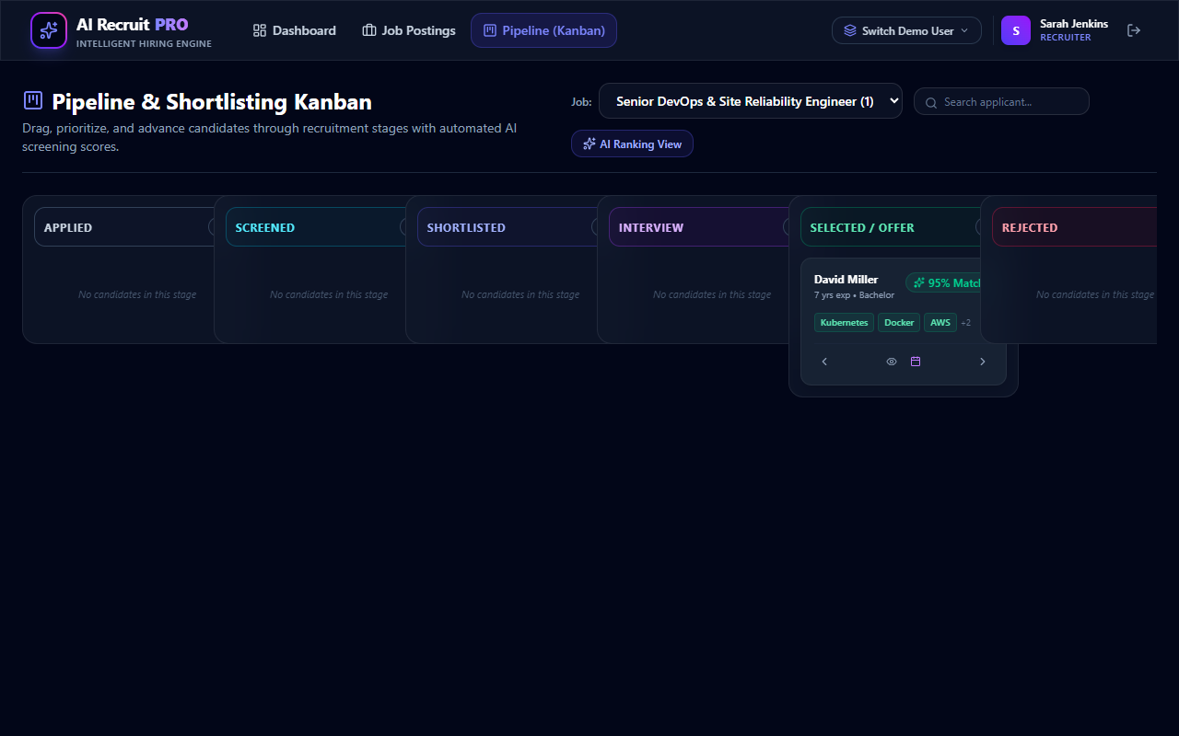
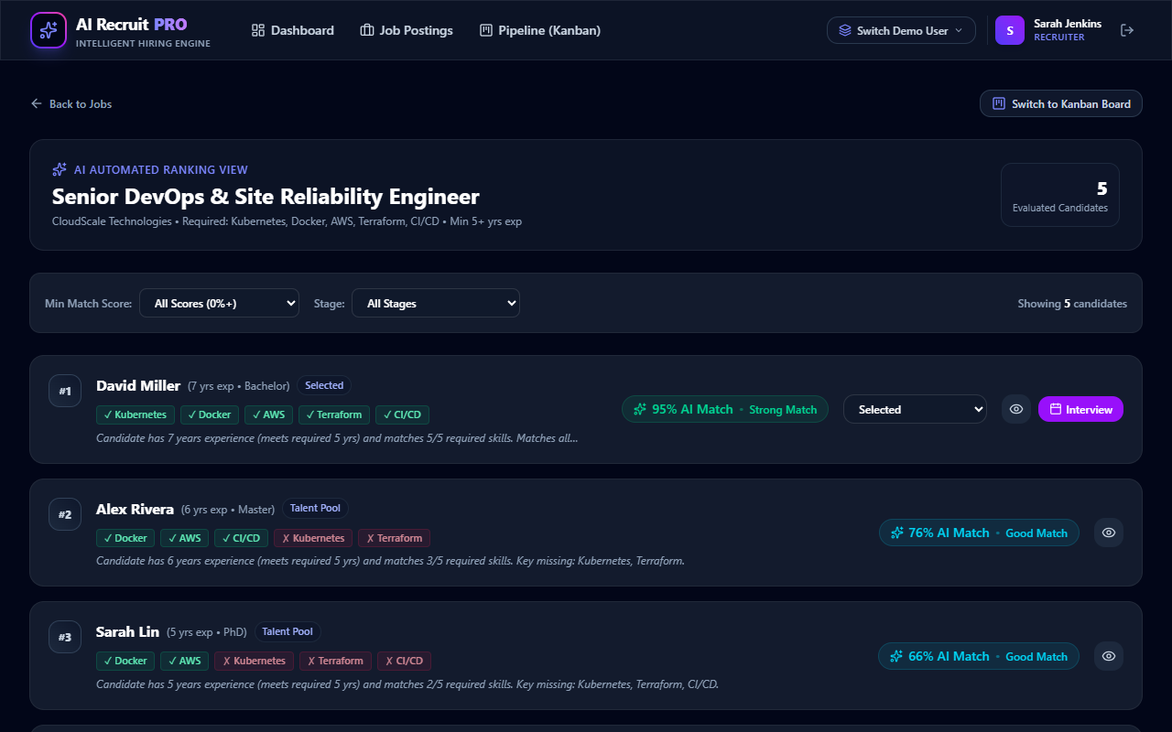
13
SCREENSHOTS
Application Screenshots
Recruiter Dashboard: Real-time talent metrics, job vacancies, and applicant activity stream
6-Stage Kanban Pipeline: Drag-and-drop candidate advancement with integrated interview triggers
AI Candidate Ranking: Multi-factor score breakdown (50/25/15/10), match tiers, and skill gaps
Candidate Dashboard: Parsed resume profile, 1-click application tracker, and interview alerts
Screenshots
Review 1 & 2 | MERN Stack Project

Slide 16
14
CHALLENGES
Challenges Faced & Solutions
Challenge Encountered | Solution Adopted & Engineering Resolution
Heterogeneous Resume File Formats Handling inconsistent PDF, DOCX, and TXT binary layouts with irregular line breaks and tabular data. | Implemented dual binary parsing via pdf-parse and mammoth with fallback plain-text buffer decoding, feeding a unified NLP extraction pipeline.
Keyword Stuffing & ATS Vulnerabilities Candidates inflating scores by repeating required keywords without genuine domain experience. | Engineered a multi-factor formula: 50% skills overlap, 25% verified years of experience, 15% degree level, and 10% TF-IDF semantic relevance.
Technical Skill Synonym Discrepancies Varied terminology in resumes vs job postings (e.g., 'ReactJS' vs 'React', 'K8s' vs 'Kubernetes'). | Constructed a curated 500+ skill taxonomy dictionary with bidirectional synonym maps and case-insensitive substring matching.
Duplicate Application Submissions Preventing race conditions and accidental duplicate submissions when candidates click apply rapidly. | Enforced a compound unique database index on (job, candidate) in Mongoose Application schema, returning idempotent HTTP error responses.
Auditability Across 6 Hiring Stages Tracking stage transitions, updater identity, and interviewer notes over the multi-week hiring lifecycle. | Engineered an embedded stageHistory subdocument array capturing transition stage, updater User ObjectId, timestamp, and audit notes.
Challenges
Review 1 & 2 | MERN Stack Project

Slide 17
15
NEXT STEPS
Remaining Work & Plan
• Frontend Component Testing: Expand automated test coverage from backend API tests (12/12 passing) to React component unit testing using Vitest and React Testing Library.
• Cloud Production Deployment: Containerize the Node.js backend using Docker; deploy Express API to Render/AWS, host React SPA on Vercel, and migrate MongoDB to managed MongoDB Atlas.
• LLM Plug-and-Play Swapping: Leverage the decoupled parser service architecture to optionally swap local NLP with Google Gemini 1.5 or OpenAI GPT-4o structured JSON outputs for contextual summaries.
• Automated Candidate Email Alerts: Integrate Nodemailer or SendGrid webhooks for real-time transactional email notifications upon Kanban stage advancement and interview scheduling.
• Advanced Interview Intelligence: Incorporate speech-to-text audio transcription and AI-generated technical interview questions tailored to candidate missing skill gaps.
• Academic Documentation & Viva Voce: Finalize viva presentation defense slides, complete formal IEEE-formatted project documentation, and package demonstration sandboxes.
Next Steps
Review 1 & 2 | MERN Stack Project

Slide 18
16
REFERENCES
References
# | Reference Title, Authors & Source Documentation | Domain / Usage
1 | Meta Open Source — 'React 19 Documentation & Hooks Architecture', Meta Platforms Inc., 2026. https://react.dev | Frontend User Interface
2 | OpenJS Foundation — 'Node.js v20/22 LTS Runtime Environment Documentation', 2026. https://nodejs.org | Server Runtime Environment
3 | Express.js Project — 'Express 4.x RESTful Routing, Middleware & API Guide', 2026. https://expressjs.com | Backend Web Framework
4 | MongoDB Inc. — 'Mongoose ODM v9 Guide: Schemas, Middleware, and Aggregation', 2026. https://mongoosejs.com | NoSQL Document Modeling
5 | Natural Node Community — 'Natural: General Natural Language Facilities for NodeJS (TF-IDF & Stemming)', 2026. https://naturalnode.github.io/natural/ | NLP Semantic Relevance
6 | Jurafsky, D., & Martin, J. H. — 'Speech and Language Processing: An Introduction to Natural Language Processing', 3rd Ed., Prentice Hall. | Information Extraction & NLP
References
Review 1 & 2 | MERN Stack Project

