Slide 1
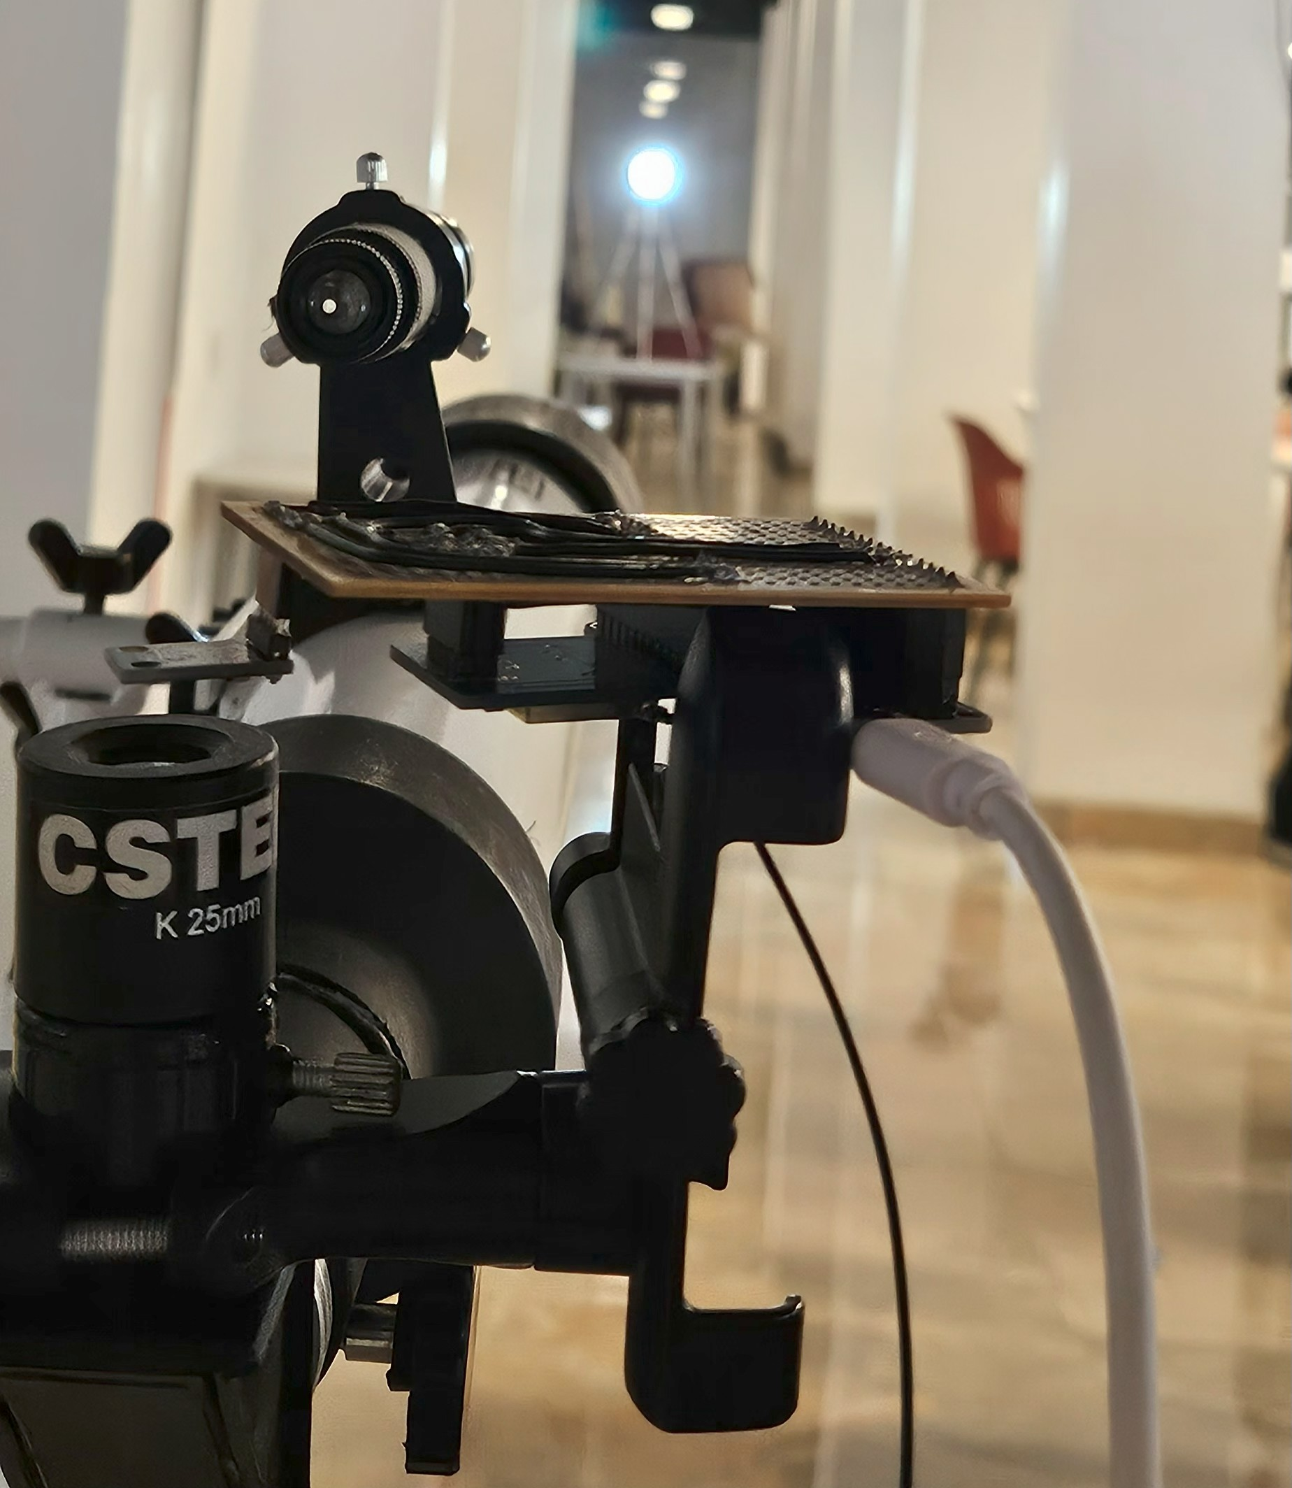
HUNTING FOR EXOPLANETS WITH AI AND ML: EXPLORING NEW WORLDS
BY TEAM ARCNAVE
GOVERNMENT POLYTECHNIC COLLEGE – COIMBATORE 641014
Notes:
AI-generated content may be incorrect. --- This presentation introduces how artificial intelligence and machine learning are revolutionizing the search for exoplanets, focusing on the ARCNAVE project. We will explore traditional discovery methods, the role of AI/ML, and the exciting future of exoplanet research.

Slide 2
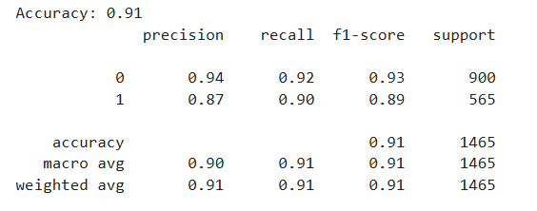
OVERVIEW & RESULTS:
To build an AI model capable of classifying exoplanet candidates as Confirmed or False Positive.
Use NASA’s Cumulative Kepler Dataset to analyze transit-based planetary data.
Identified high-impact parameters influencing planet confirmation. Columns used: koi_disposition, koi_period, koi_time0bk, koi_duration, koi_depth, koi_prad, koi_model_snr, koi_steff, koi_srad koi_smass, koi_kepmag
ML model used to train : Random Forest Classifier
Total model Accuracy: 0.91 = 91%
.
Notes:
We will begin by understanding what exoplanets are and the challenges in discovering them. Next, we'll discuss the role of AI and ML in astronomy, followed by an overview of the ARCNAVE project. We will then compare ARCNAVE with other approaches and conclude with future prospects and impacts.

Slide 3
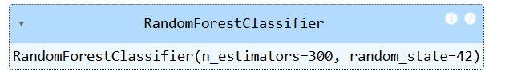
METHODOLOGY
Preprocessed the dataset: normalized nulls(some columns have null fields normalized with mean values), normalized numerical values
Applied Random Forest Classifier to identify important predictive features.
Tuned hyperparameters to optimize model performance.
NASA Cumulative Dataset → Feature Selection → Model Training → Candidate Testing
Notes:
We will begin by understanding what exoplanets are and the challenges in discovering them. Next, we'll discuss the role of AI and ML in astronomy, followed by an overview of the ARCNAVE project. We will then compare ARCNAVE with other approaches and conclude with future prospects and impacts.

Slide 4
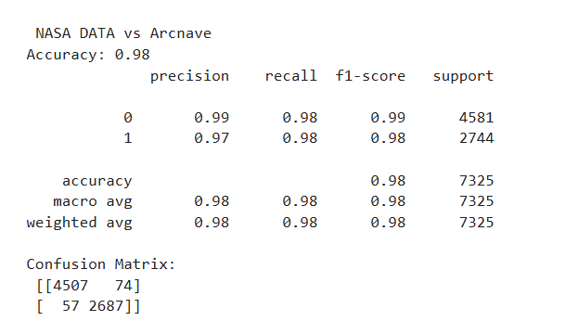
VALIDATION ON NASA DATA
Dataset Used for validation: “only tested on candidates”
Source: NASA Exoplanet Archive – Cumulative Kepler Dataset
Dataset includes KOI (Kepler Object of Interest) entries.
Validated the model against NASA previously marked as “CANDIDATE” and later marked as “CONFIRMED” and “FALSE POSITIVE”, obtaining an
prediction result of 98%. COLUMNS used: koi_disposition & koi_pdisposition
Previously marked as CANDIDATE: 4717
Now CONFIRMED:2737(our AI predicted 2687 correctly)
Now FALSE POSITIVE: 1 (our AI predicted 1 correctly)
Still marked as CANDIDATE: 1979 (NASA still not
Confirmed ) this data will be used to prediction
Notes:
We will begin by understanding what exoplanets are and the challenges in discovering them. Next, we'll discuss the role of AI and ML in astronomy, followed by an overview of the ARCNAVE project. We will then compare ARCNAVE with other approaches and conclude with future prospects and impacts.

Slide 5
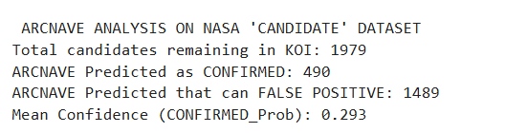
AI PREDICTION RESULTS
Total candidates remaining in KOI dataset for prediction is 1979 so we predicted its future possibilities with our trained AI
RESULT shows that out of 1979 candidates 490 can be a confirmed as “EXOPLANET”
Notes:
We will begin by understanding what exoplanets are and the challenges in discovering them. Next, we'll discuss the role of AI and ML in astronomy, followed by an overview of the ARCNAVE project. We will then compare ARCNAVE with other approaches and conclude with future prospects and impacts.

Slide 6
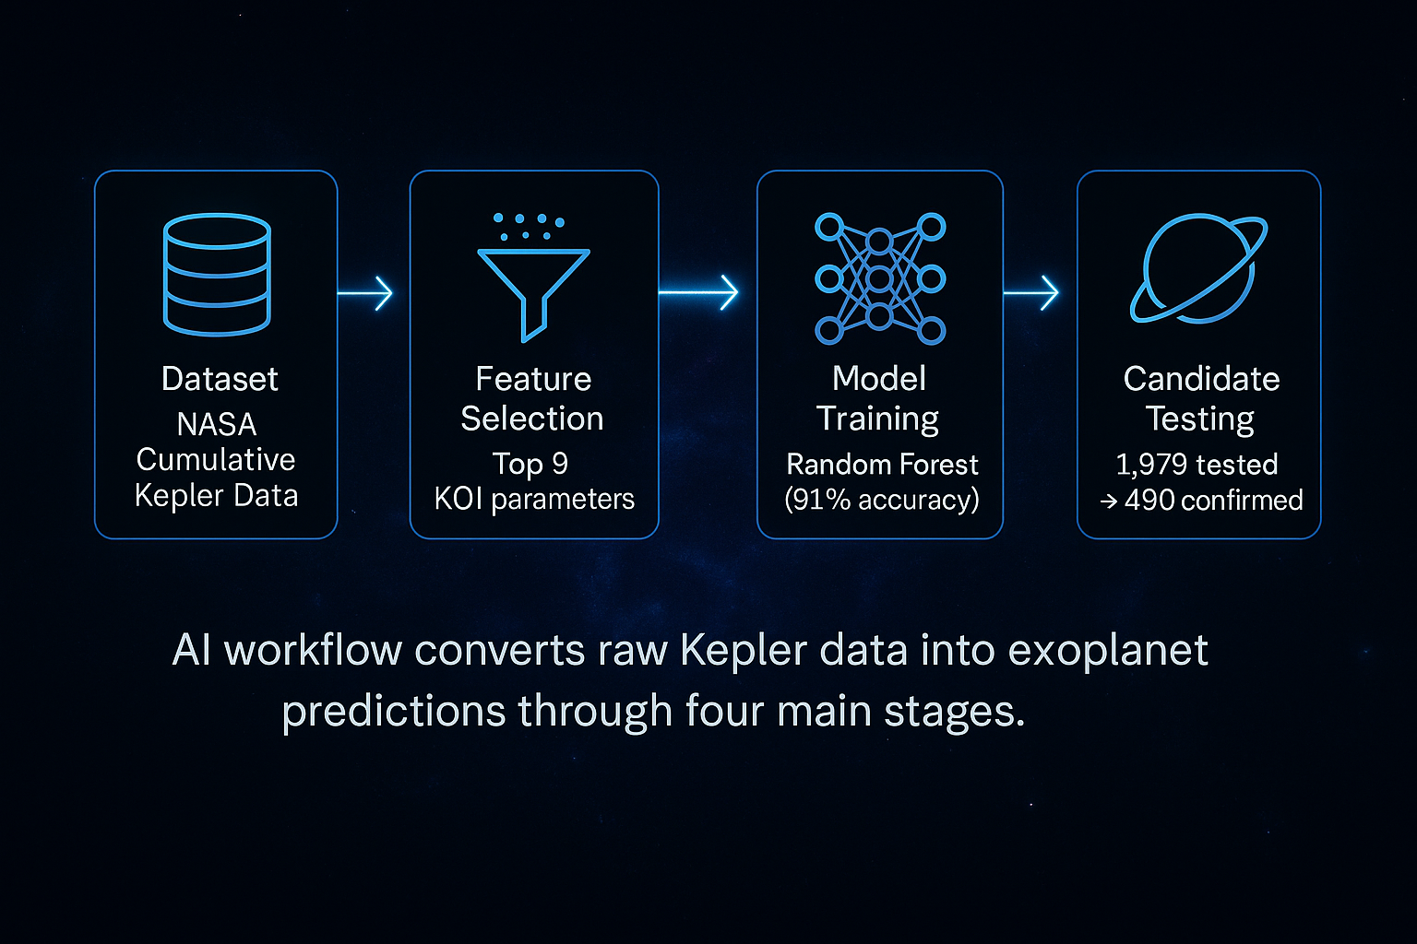
SUMMARY
Notes:
We will begin by understanding what exoplanets are and the challenges in discovering them. Next, we'll discuss the role of AI and ML in astronomy, followed by an overview of the ARCNAVE project. We will then compare ARCNAVE with other approaches and conclude with future prospects and impacts.

Slide 7
FUTURE SCOPE & TEAM
Exploring onboard ML with CubeSat for autonomous sky observation.
Plan to extend to TESS and MAST datasets for broader planetary analysis.
Team ARCNAVE Government Polytechnic College Coimbatore 641014 , Tamil Nadu
“We train machines to find new worlds — a world away, yet within data.”
Notes:
We will begin by understanding what exoplanets are and the challenges in discovering them. Next, we'll discuss the role of AI and ML in astronomy, followed by an overview of the ARCNAVE project. We will then compare ARCNAVE with other approaches and conclude with future prospects and impacts.

