Slide 1
How Docker Works?

Slide 2
Is Docker a VM?

Slide 3
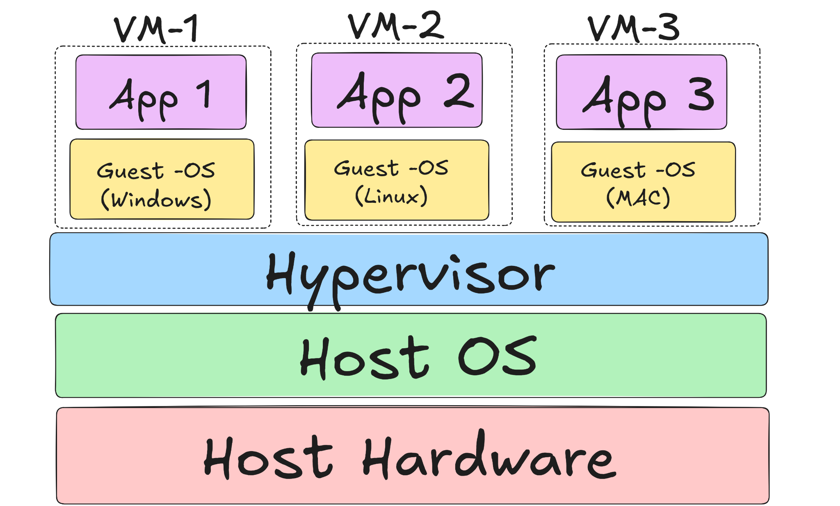
What is a VM?
We can think VM as a computer running on top of another computer.
Notes:
Hypervisor - A software that create and manages the VMs
VMs have their own separate kernel and OS.

Slide 4

What is Docker?
Docker is a platform that bundle your code, libraries and dependencies in a container which can run on any environment.
No more ‘ It works on my machine’.

Slide 5
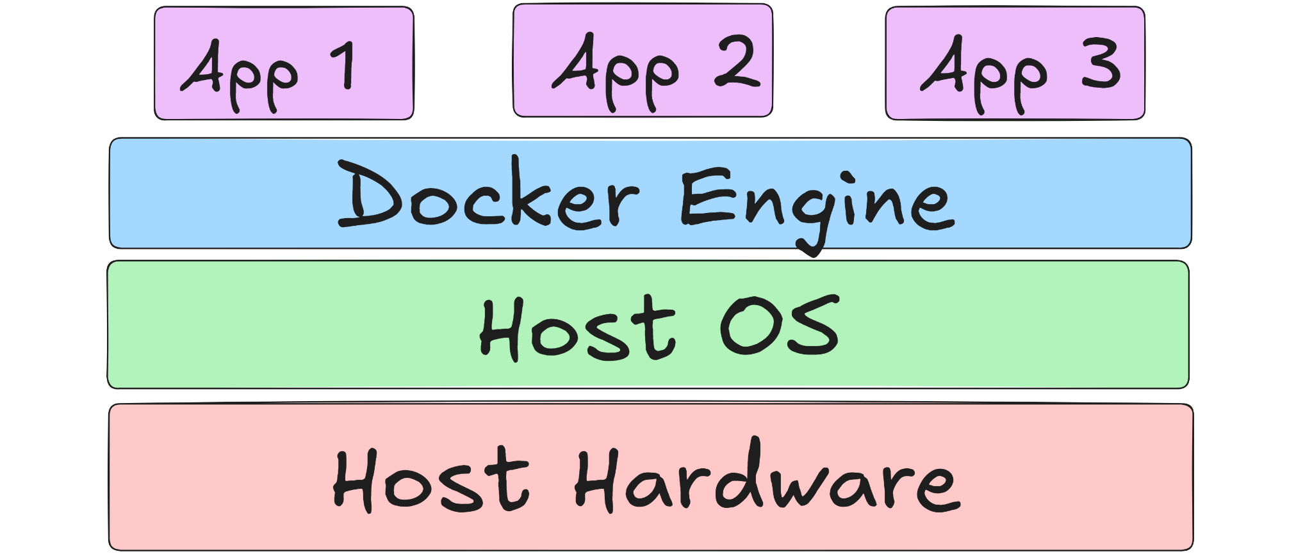
Docker Structure

Slide 6
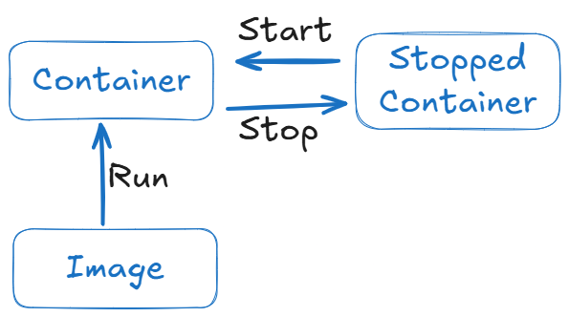
Container Life Cycle

Slide 7
Is Docker a VM ?
First of all unlike VMs docker don’t have separate OS and a kernel.
Docker use host’s OS and kernel.

Slide 8
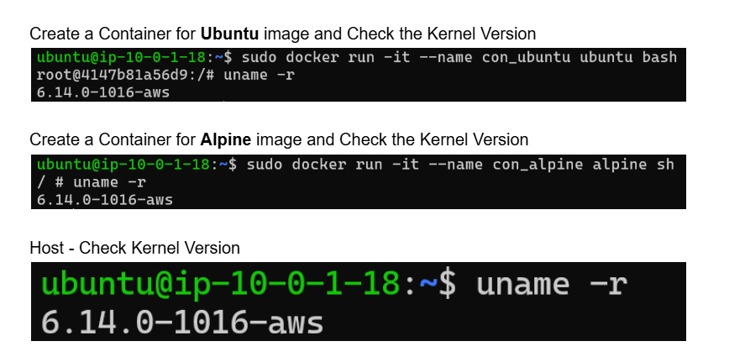
Practical To Visualize Container don’t have separate kernel

Slide 9
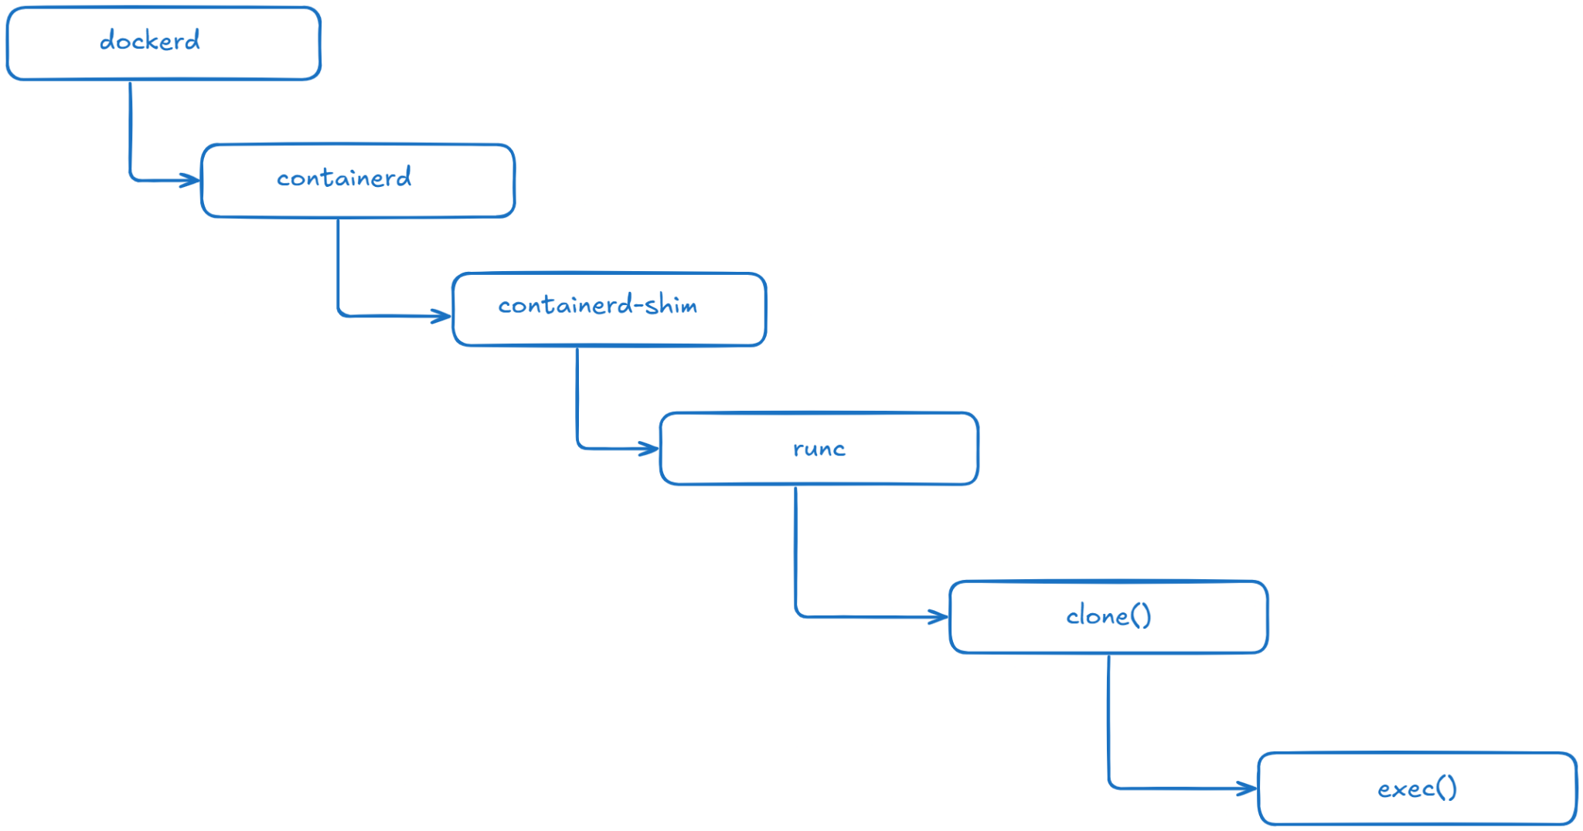
Docker container creation process

Slide 10
Fork() vs Clone()
Fork() and Clone() are the system call methods.
Fork used to create a new process with new resources.
Clone used to create a new process but, with the help of flags we can share resources with the parent resources.

Slide 11
setns()
setns() is a system call that used to join with an existing resources.

Slide 12
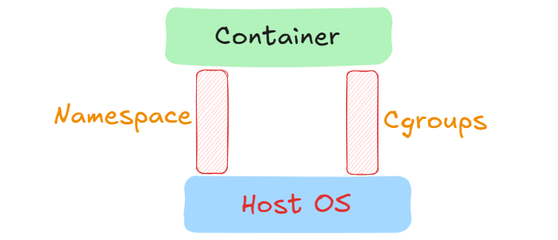
How containers achieve isolation like VM ?
In Docker isolation achieved by the help of namespace and cgroups.
Namespace and Cgroups are features of the Linux Kernel.

Slide 13
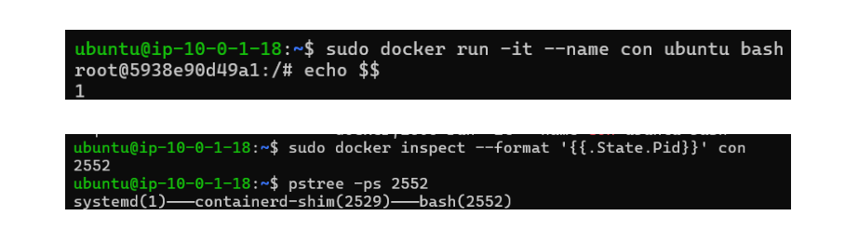
Namespace
Namespace define what a process can see.
Some of the namespaces : PID, NET, USER, MNT, UTS, IPC
Namespaces can be shared.

Slide 14
Cgroups (Control Groups)
Cgroups control, limit, and monitor how much of the system’s resources a process can use.
We can simply put ‘ How much a process can use? ’
Cgroup includes CPU, Memory limit and Number of processes.

Slide 15
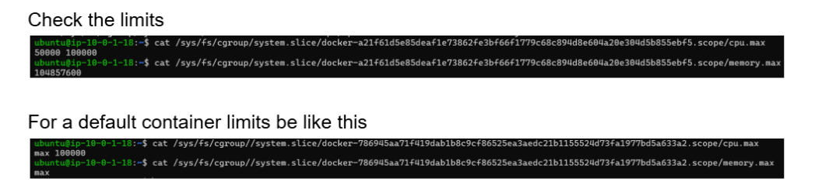
When we check the limits of two different containers

Slide 16
Overlay File System
It’s a Linux kernel file system that combines multiple layers into one unified view.
It have 4 layers
Lower Layer ( Read) : For storing base image
Upper Layer (Write) : Where our changes are made
Merged Layer : Combination of Lower + Upper; which we witness as output
Work Layer : Docker store meta data and internal usage.

Slide 17
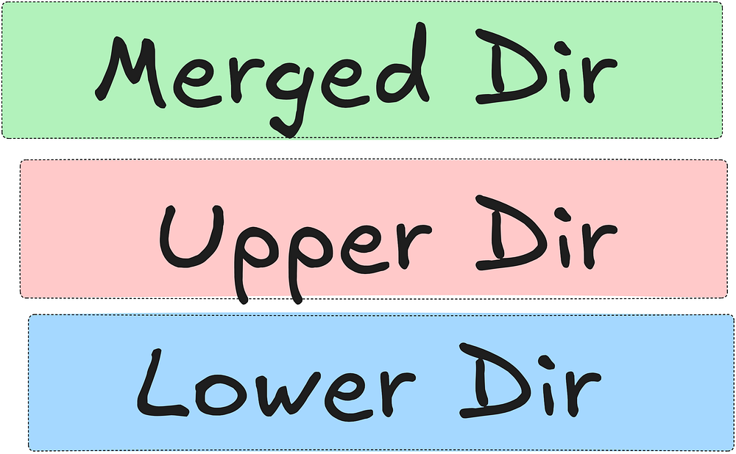
Copy On Write
CoW is a technique used by docker when data copies only on modification, otherwise files stays in the lower / read layer.
Because of it many containers can share same base images.

Slide 18
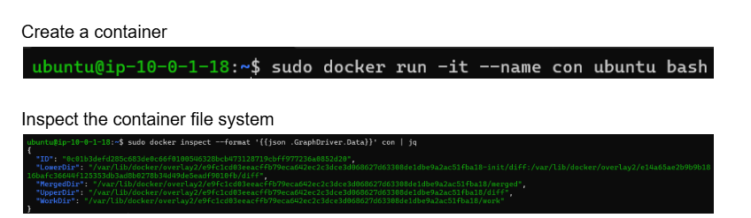
Practical way to see the Overlay FS of a container

Slide 19
Writeable layer existence with container life cycle
When the container stops the writable layer won’t be affected.
When the container deleted then the writable layer is removed from the hard disk. (Only Lower / Read layer won’t be removed unless image deleted from the disk)

Slide 20
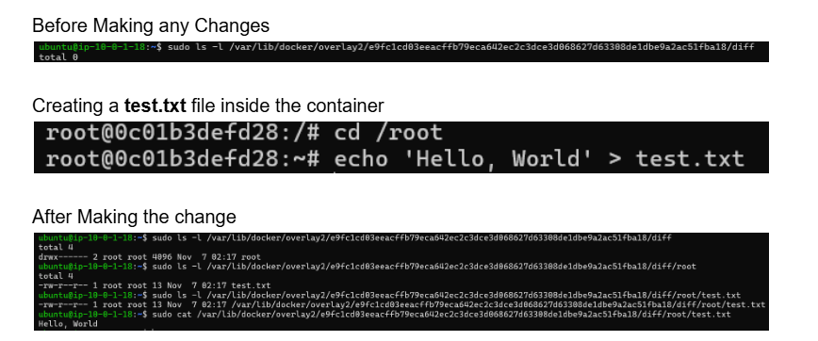
Practical to see changes applied on Upper Dir

Slide 21
Thank You

