Slide 1

N-Body Simulations of Globular Clusters Using Monte Carlo-Method
EE 336 – Modeling and Simulation of Stochastic Processes – Course Project
Srishti Goel (200108053)

Slide 2
What Are Globular Clusters?
Spherical clusters of stars, all born from the same parent gas cloud.
They are astronomically important as they allow us to study properties and statistics of stellar evolution and dynamics with fewer variable parameters.
Here, we study the dynamics of such a system

Slide 3
Monte Carlo Simulations
A Monte Carlo simulation is essentially a model to predict the probabilities of experiments when various random variables are present.
An example of Monte-Carlo simulations being used in N-body systems in Physics is in Ising Models to study the ferromagnetic behavior of materials. By assuming random spins in an NXN matrix in the beginning, we flip them till a thermal equilibrium is attained.

Slide 4

Initialization
Radius was initialized as a random variable from the Plummer distribution: which was generated by taking the inverse CDF of the same on a uniformly random variable
The velocities were taken as uniform random variables in the polar coordinates
Mass was also a uniform random variable [0 – 5 MASS_SCALE]
Angular momentum and energy were calculated using NLM.

Slide 5
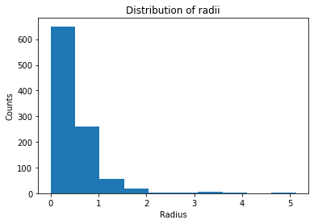
Distribution of radii achieved

Slide 6
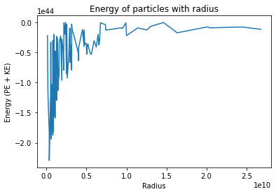
Initial energy distribution as a function of radial distance

Slide 7
Algorithm Flow
Time Step Calculation : O(N)
Collision Dynamics : O(N)
Stellar Evolution : O(N)
New Orbit Calculation : O(NlogN)
Potential Calculation and Sorting : O(NlogN)

Slide 8



Time Step Calculation
Since there are many processes involved (collision relaxation, collision of stars, and stellar evolution, we choose the minimum value among these to use

Slide 9
Collision Dynamics
Star collisions here means that they start orbiting the common center of mass, after exchanging matter, etc. In the relaxation time before stabilizing
This process happens with a probability of collision proportional to the time-step, and the relative velocities of the colliding particles
No loss of energy, linear momentum or angular momentum is seen

Slide 10
Stellar Evolution
Stars continuously lose matter to the nuclear fusion processes inside their cores.
Assuming the luminosity of the stars remains constant and proportional to their mass^3.5, we make all of them lose mass: Mass lost = const x mass^3.5 x time_step

Slide 11
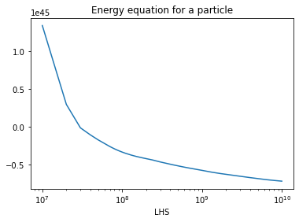
New Orbit Calculation
The new orbit is calculated as solution of the equation lying in the desired range: This was solved using Bisection method

Slide 12
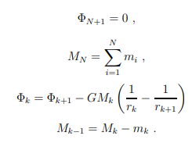


Potential Calculation
To calculate the energy of the particle, we use a loop of O(N) complexity, taking help of the spherical symmetry, and the fact that we have a sorted array of radii. It uses the following equations:

Slide 13
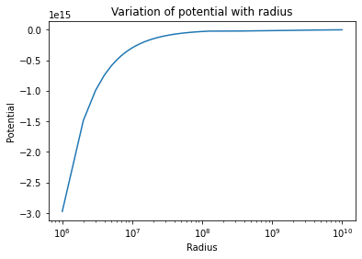
Using this in the Code

Slide 14
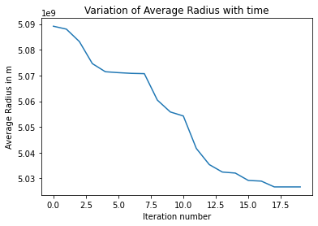
Observed Results - Collisionless
We see that the radius slowly decreases over time till it eventually stabilizes to a value around 0.5 * LENGTH_SCALE

Slide 15
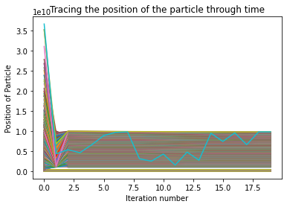
Tracing the position of particles through time

Slide 16
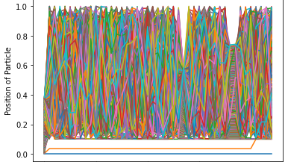
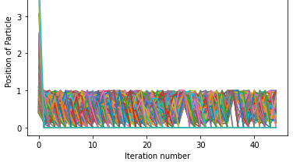
Observed Result – With Collision
We see that the initially inner particles collide more initially, and spread outwards
Initially outer particles collide and fall inwards, till the average radius stabilizes around 1-1.5 LENGTH_SCALE

Slide 17
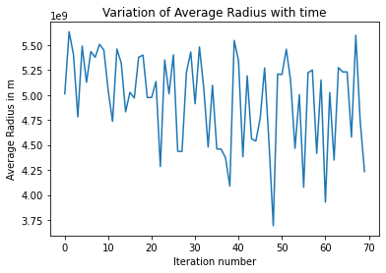
Average radius of the system – With Collision

