Slide 1

National Institute of Technology Karnataka,Surathkal
By :
Aman sirohi 204ca005
Atanu Pradhan 204ca007
Srishti 204ca050
Yogita sharma 204ca056
SUBMITTED TO:
MS. DEEPTHI L.
1

Slide 2
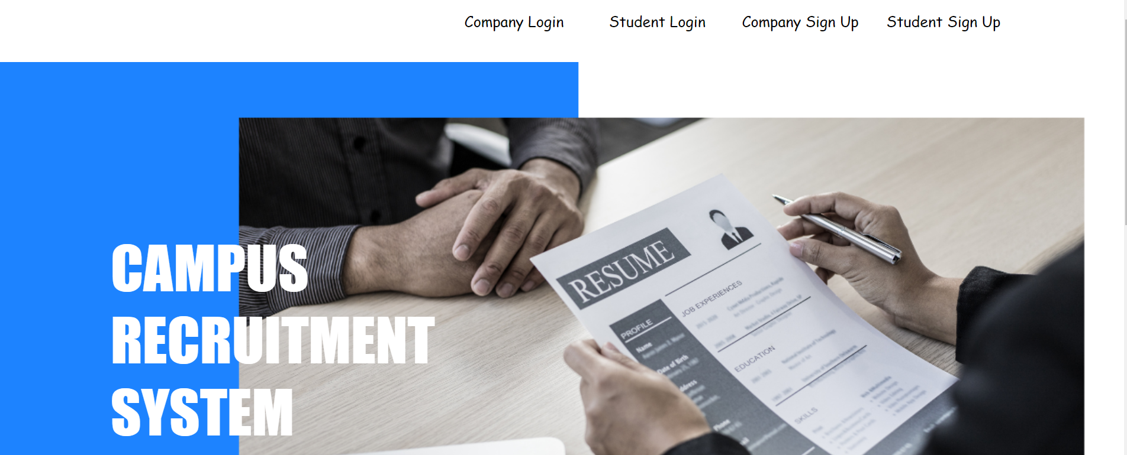
CAMPUS RECRUITMENT MANAGEMENT SYSTEM

Slide 3
Objective:
allows the job seekers to apply for the job opportunity
01
Provide a communication platform between the Applicant and the Organization.
02
To make the task of the recruiter and job seeker easier rather than waiting in queue for enrollment.
03

Slide 4
Features:
1. Student Signup
2. Company Signup
3. Student Login
4. Company Login
5. Vacancy Generation
Student Application in Vacancy
Student Selection by Company

Slide 5
ENTITIES AND PRIMARY KEYS :
students
sid
company
id
jobs
job_id
application
app_id

Slide 6
Student portal
Registration
Login
Dashboard
Apply in Vacancy
Logout

Slide 7
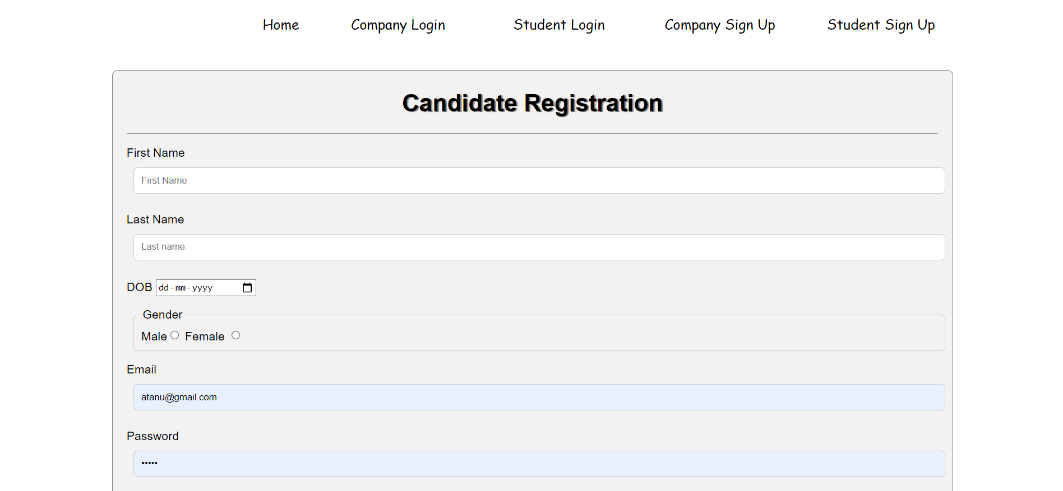
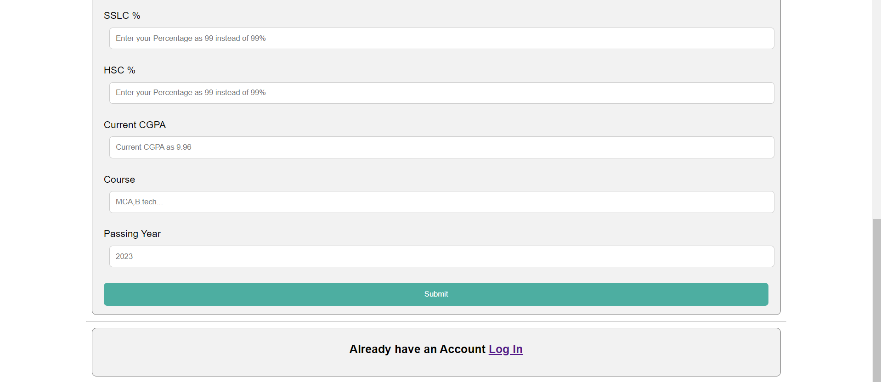
Student Signup
A form to get the details of student registering in the portal.

Slide 8
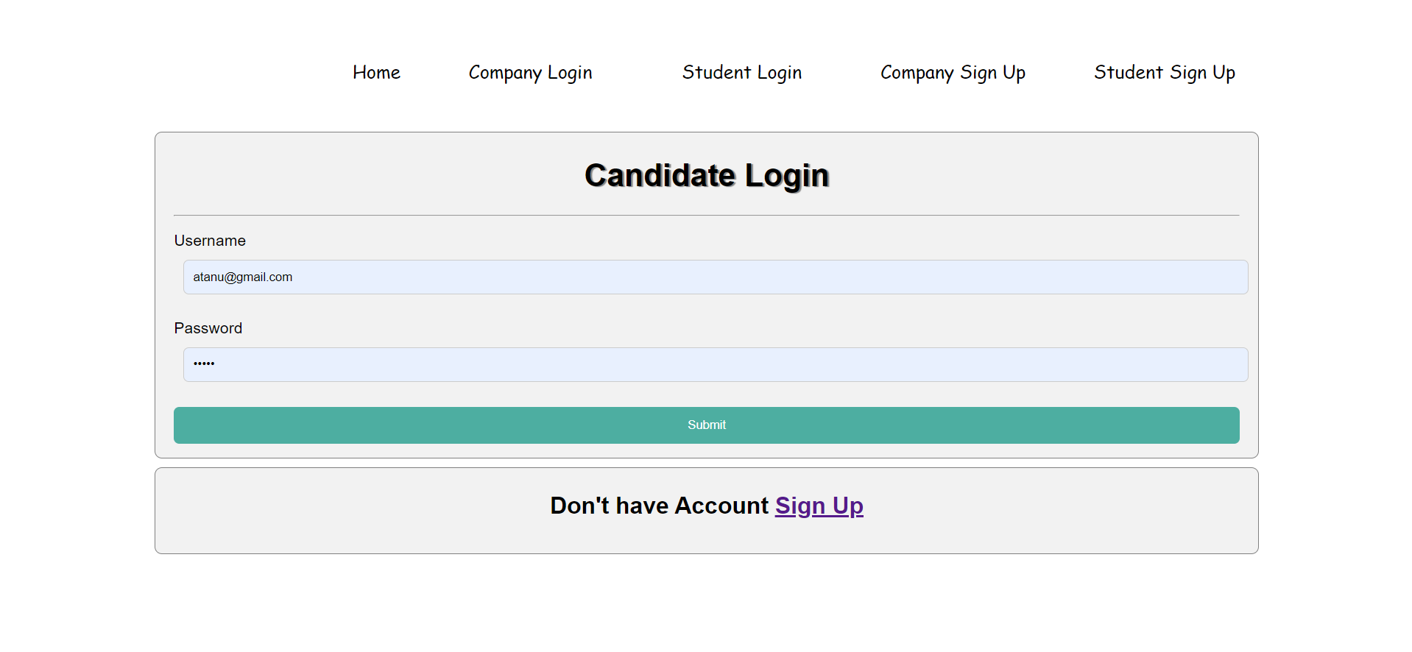
Student login
Authentication of the student.

Slide 9
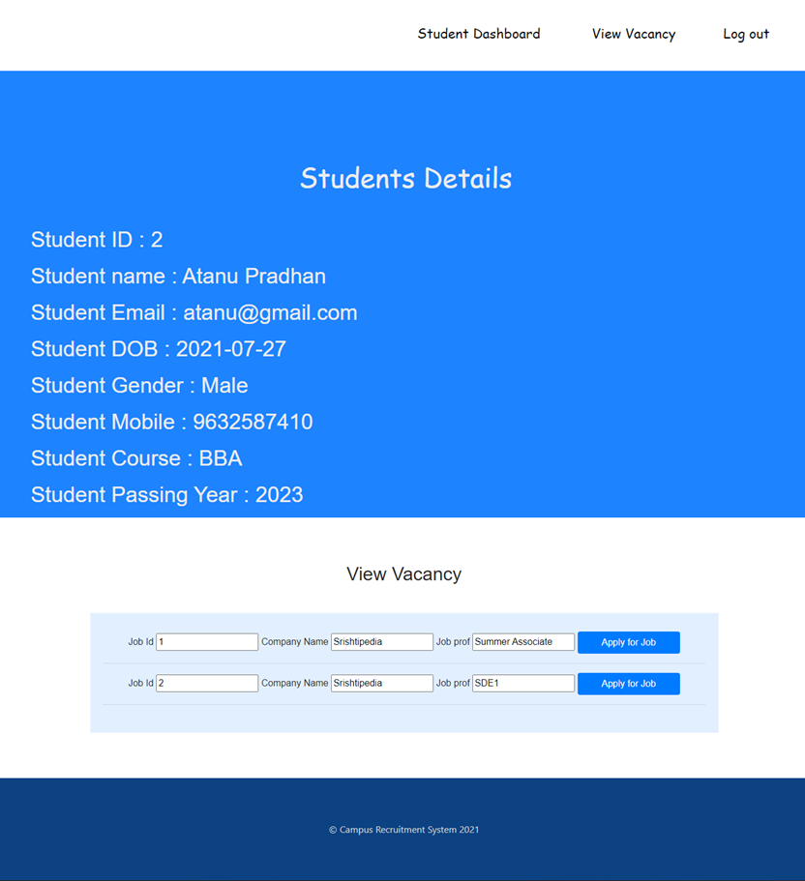
Student dashboard
Features:
Shows the details of student
Shows the vacancy information so that student can apply
Apply in the vacancy shown.

Slide 10
Company portal
Registration
Login
Dashboard
Create job
Students applied
Select Student
Logout

Slide 11
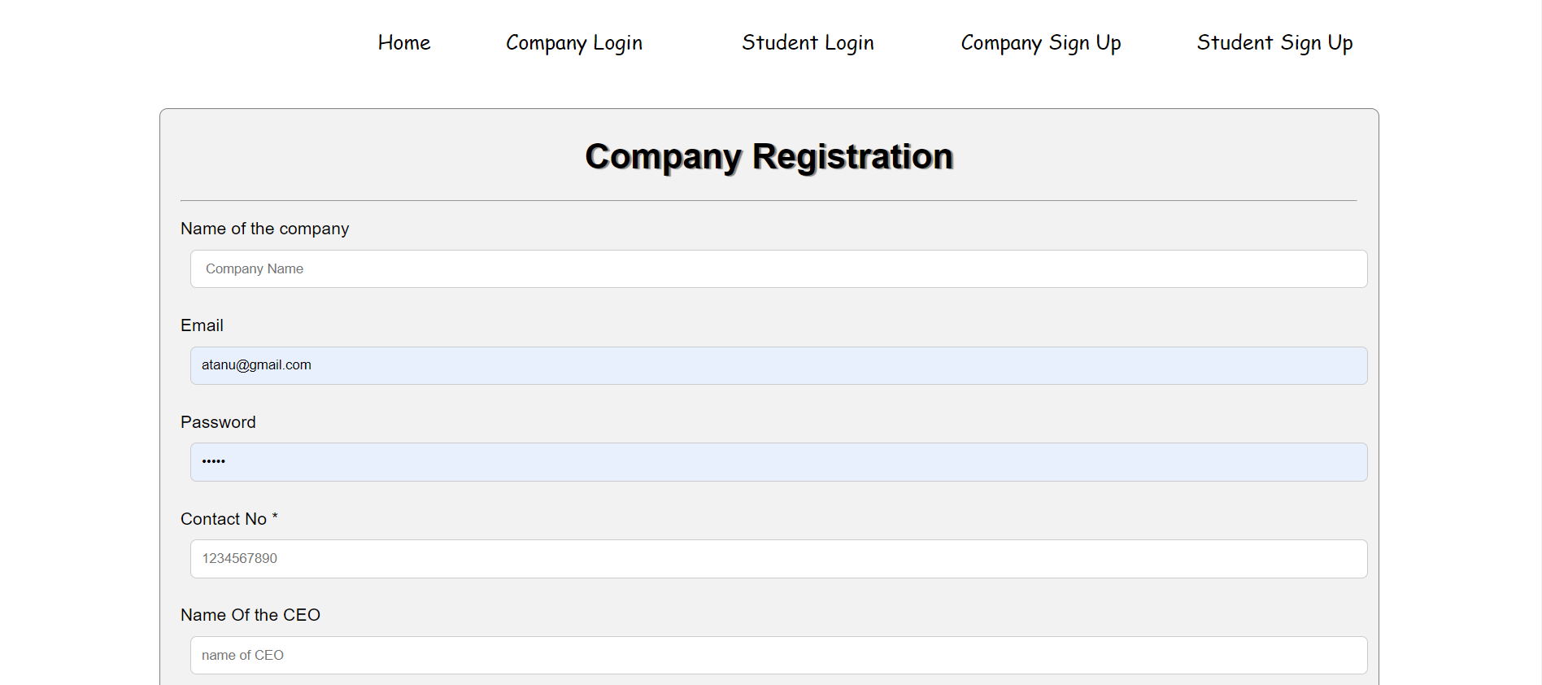
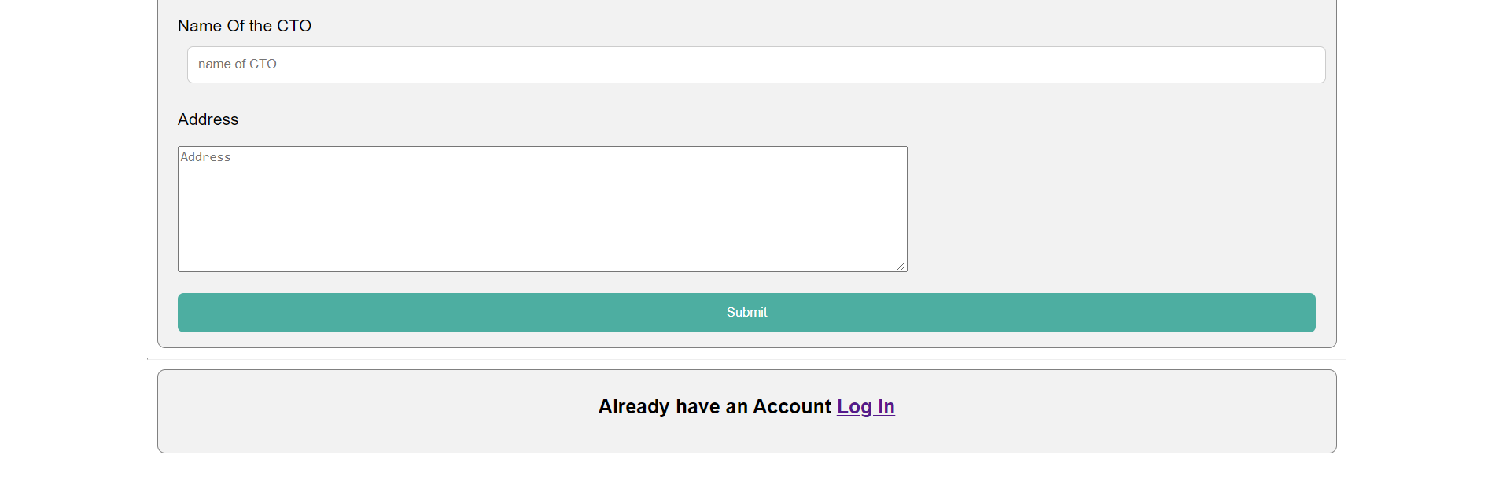
Company Signup
A form asking for all the necessary details of the company.

Slide 12
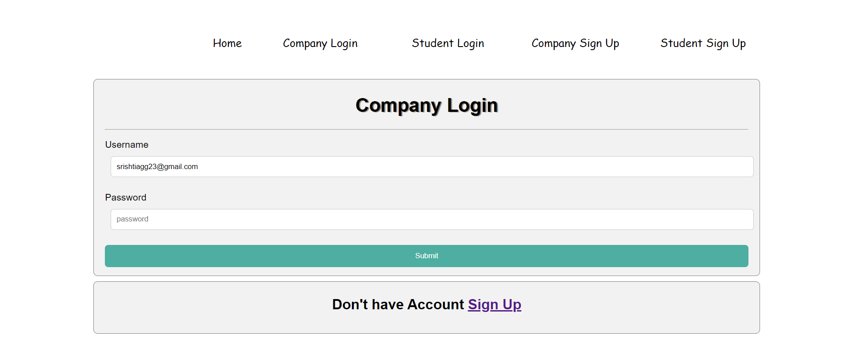
Company login
Authentication of the company.

Slide 13
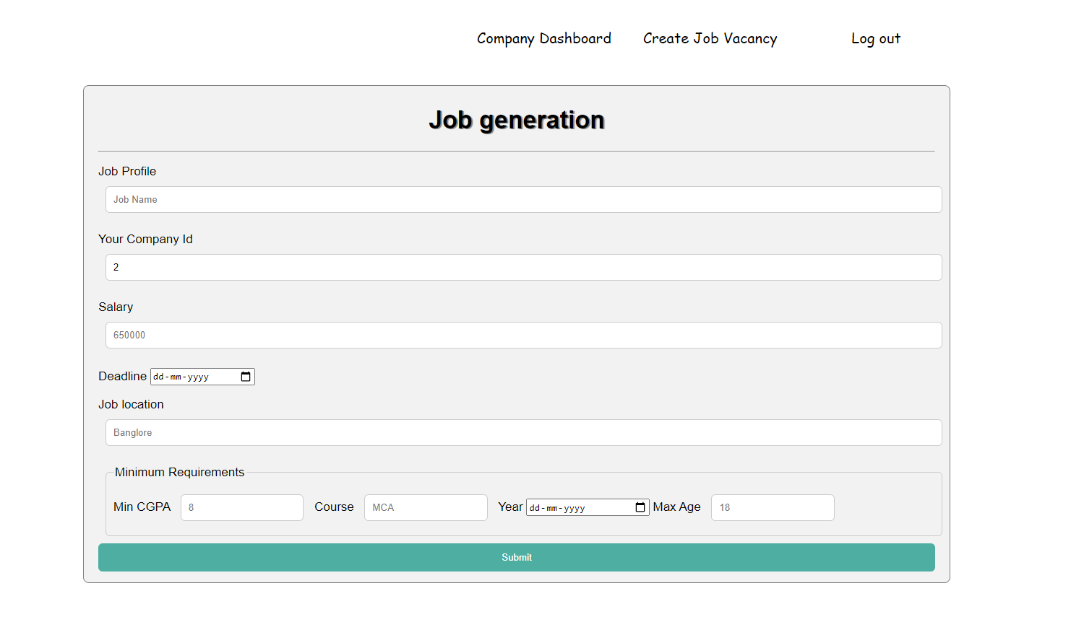
Vacancy Generation
A form shown on company portal that asks for the details of job and gives an id to every job for better identification.

Slide 14
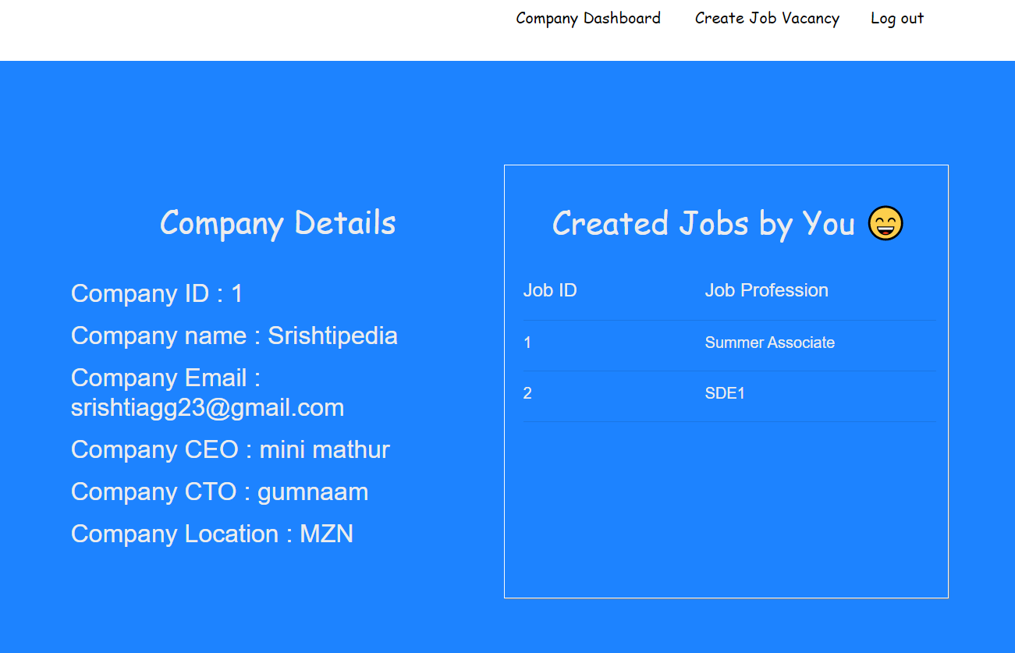
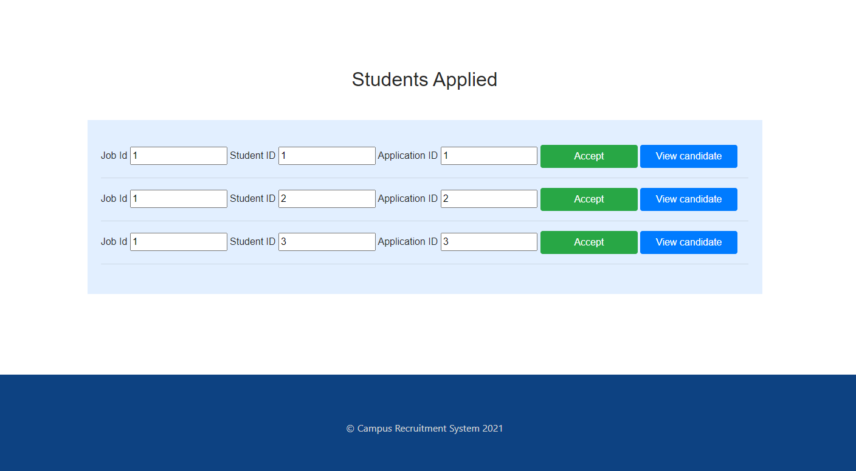
Company Dashboard
Shows the company details.
Shows the jobs created by the company.
Gives a list of students applying in the jobs made by the company.
Company can also view the details of the student who has applied.
Selection of student for a particular job.

Slide 15
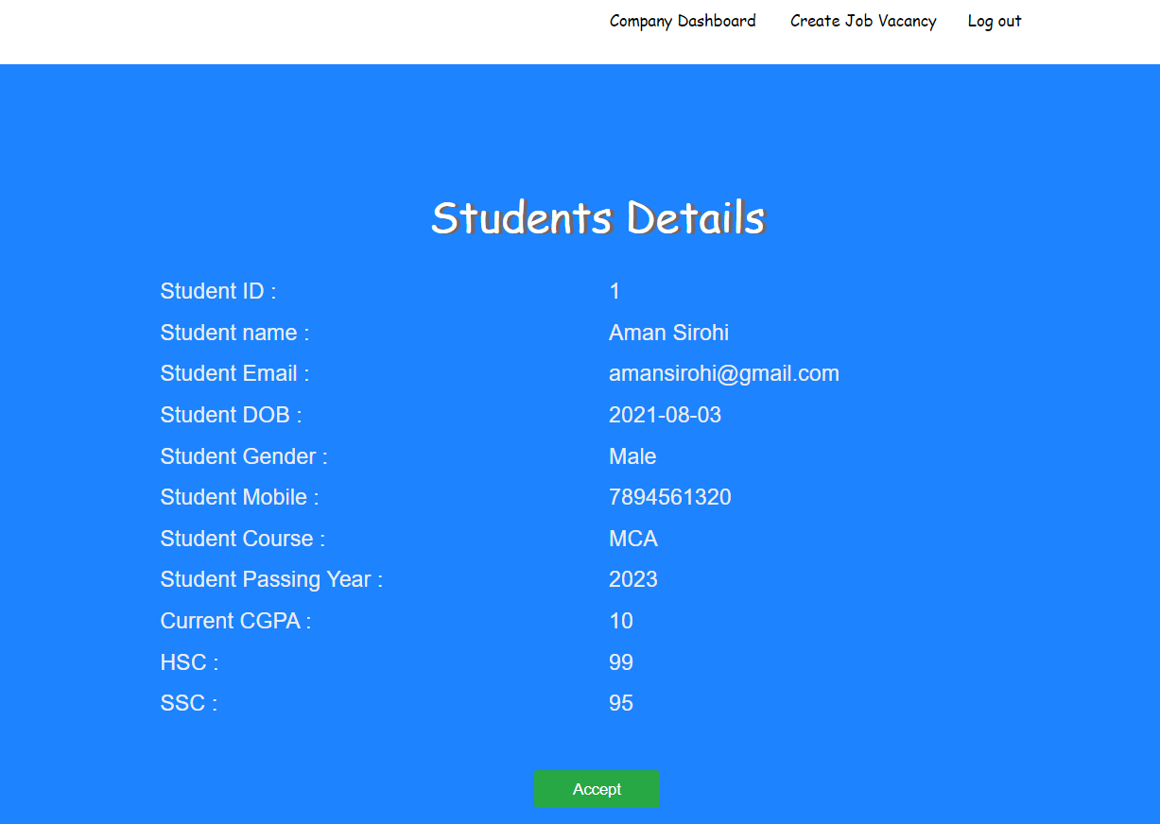
View And select Student

Slide 16
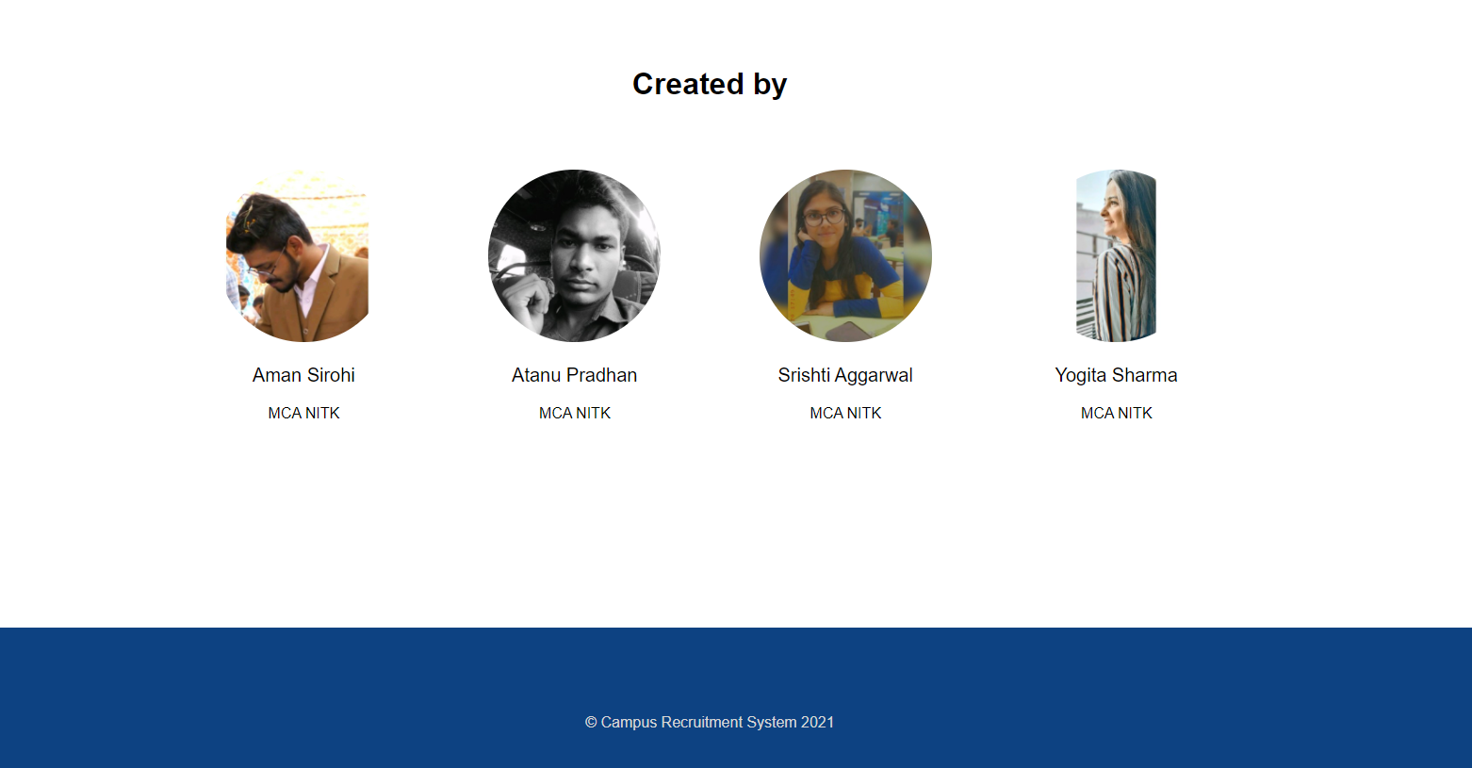

Thank you!

